Slide 1
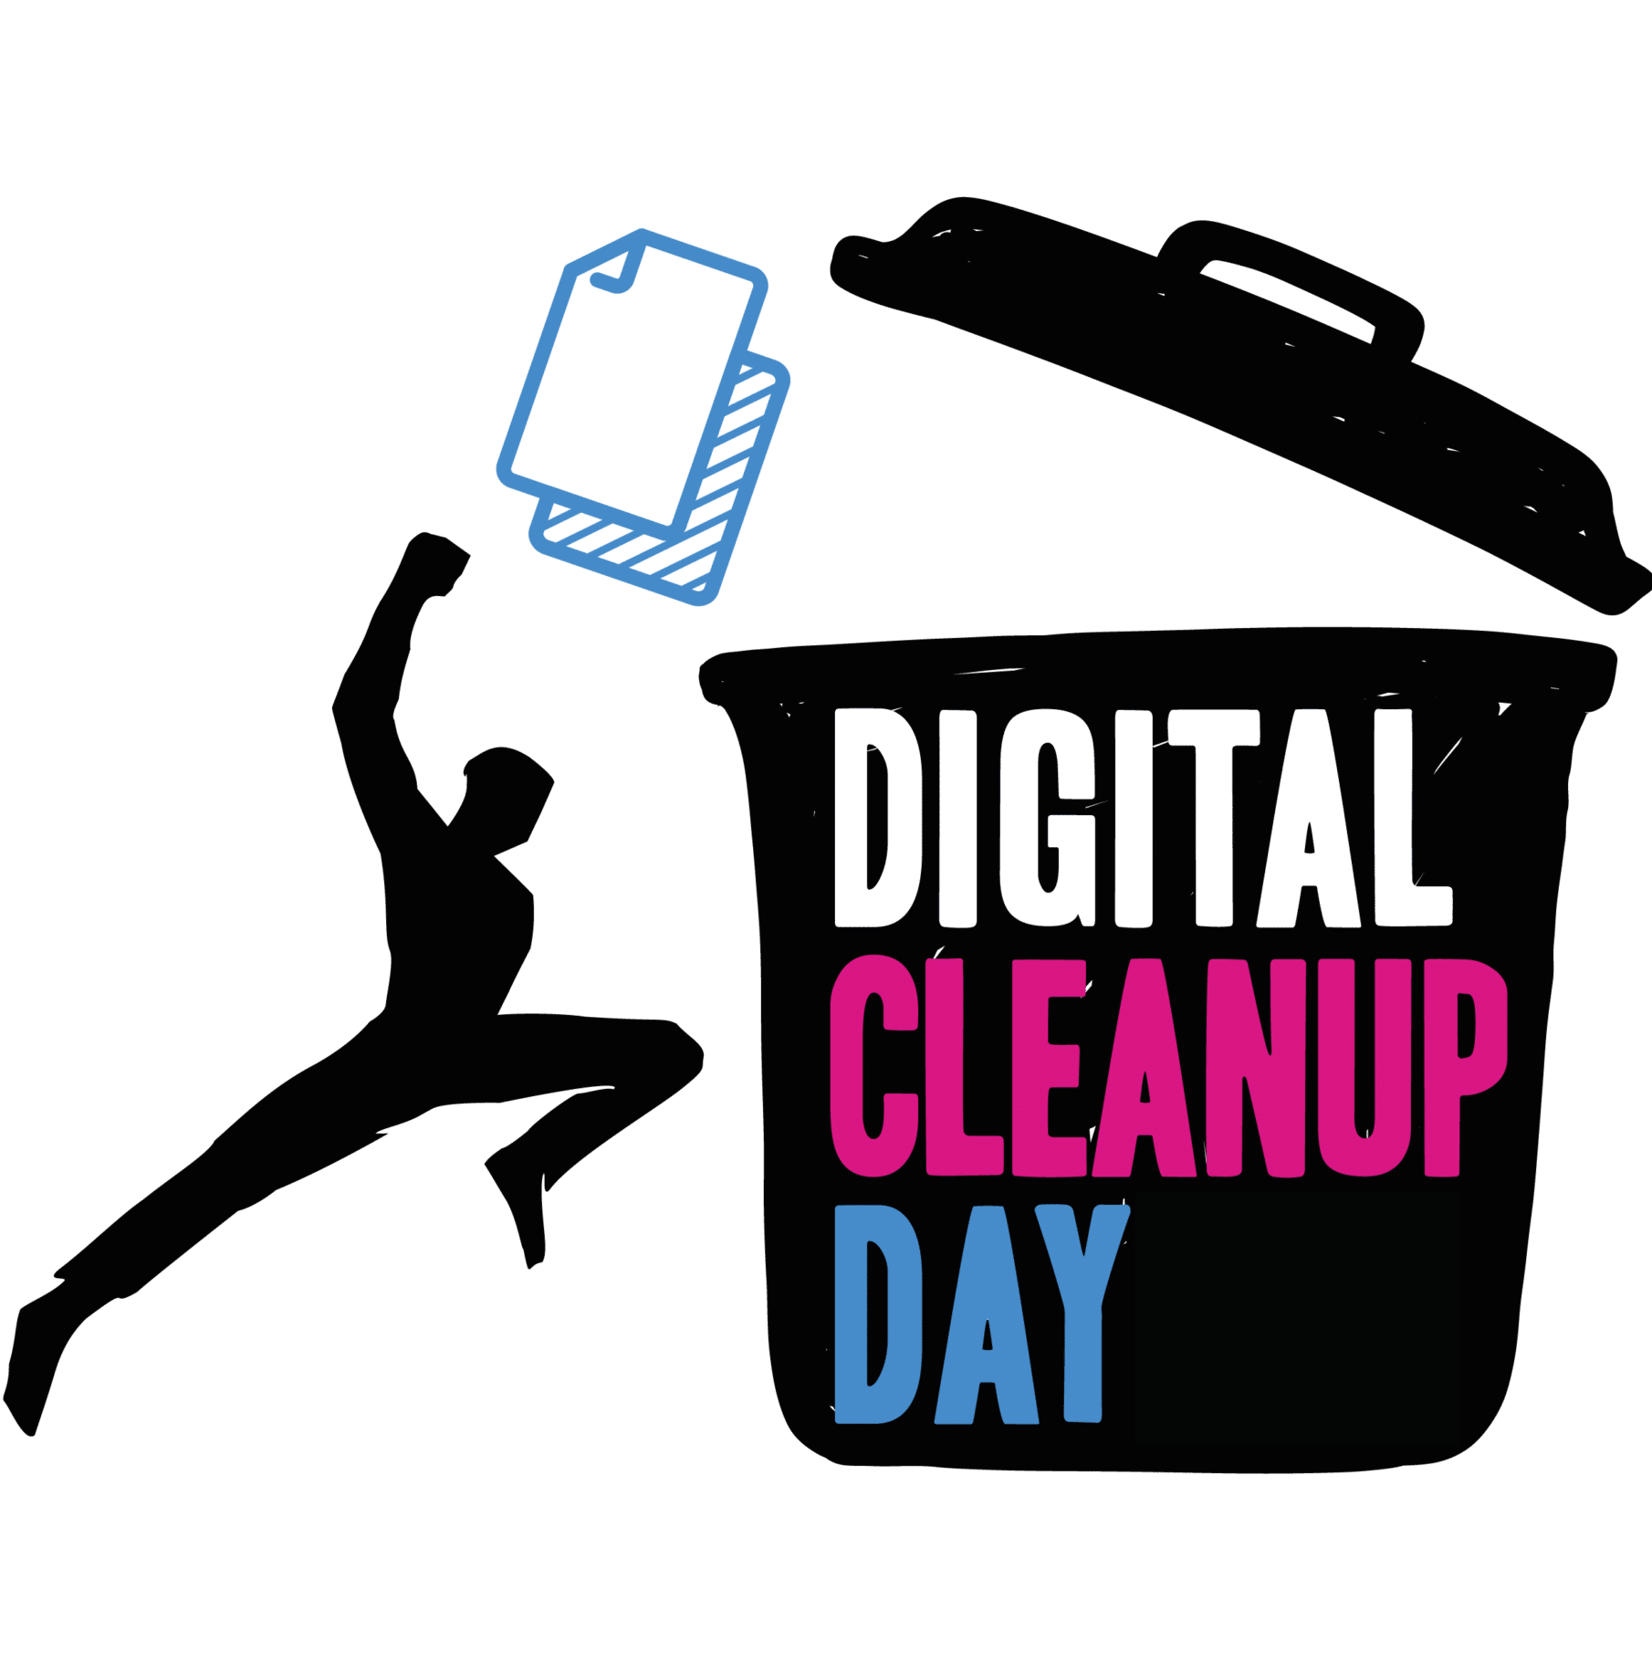
Digital Cleanup
A workshop for students and staff
Mélanie Maillot
Melanie Sengupta
Aurélie Kitzinger

Slide 2
Program
Short quiz to test your prior knowledge
What you need to know about digital waste and why it matters
Live demo by SIU
Staff member contest
Q&A

Slide 3
1
Warm up quiz

Slide 4
Q1
xxx

Slide 5
Q2
xxx

Slide 6
Q3
xxx

Slide 7
3
What is digital waste?
Why does it matter?

Slide 8

Digital carbon footprint
= the environmental impact of digital technologies and activities, including the energy use and greenhouse gas emissions.​
​
The carbon footprint of 1 email 4g – 50g (with attachments).​

Slide 9
Digital waste
= Unused, redundant, or obsolete digital data and resources that consume energy, storage, and infrastructure without providing value, often contributing to environmental harm through inefficient tech usage​
Examples:​
Unused software & apps​
Unwanted emails​
Unoptimised / overwhelming websites​
Duplicate and obsolete files​
What is not digital waste:
Broken laptops
Old smartphones
Archived, findable data files

Slide 10

Not so immaterial ...!​
Digital services rely on a large physical infrastructure: ​
Devices (which produce electronic waste) ​
Networks​
Data centres (built from mined minerals and metals and powered by significant energy and water use)​
Water usage for cooling​
​ Keeping an email on a local server could generate up to 100 kg of CO2 per user
per year​
It will become impossible to fulfil the demand of electric energy used by storage of
unwanted data with renewable energy​

Slide 11
How bad is it?
A 2024 study in Nature Communications* shows that:​
typical annual digital content use (web, social media, streaming, video conferencing, etc.) can represent about 40% of an individual’s carbon budget compatible with limiting global warming to 1.5 °C​
the impacts embodied in devices themselves (raw material extraction, manufacturing, distribution, and end‑of‑life) are often the largest contributor, accounting for around one‑third of climate impacts and the vast majority of mineral and metal resource use.
Additionally, the demand for digital data needs more energy than we can produce with renewable energy sources
*Istrate, R., Tulus, V., Grass, R. N., Vanbever, L., Stark, W. J., & Guillén-Gosálbez, G. (2024). The environmental sustainability of digital content consumption. Nature Communications, 15(1), Article 3724. https://doi.org/10.1038/s41467-024-47621-w; Read the study through a-z here

Slide 12
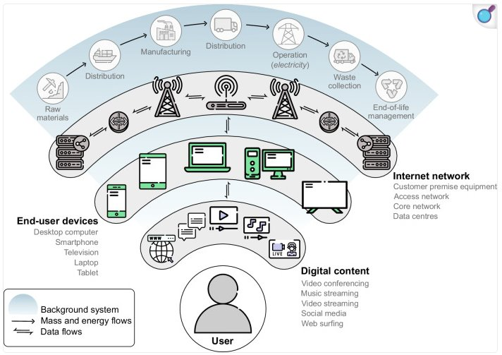
(unnecessary) data and processes → real-world resource and energy use​
Source:​ Istrate, R., Tulus, V., Grass, R. N., Vanbever, L., Stark, W. J., & Guillén-Gosálbez, G. (2024). The environmental sustainability of digital content consumption. Nature Communications, 15(1), Article 3724. https://doi.org/10.1038/s41467-024-47621-w
​

Slide 13
In short
Managing data more efficiently ​
= ​
reducing digital waste and the associated environmental footprint

Slide 14
Want to know more ?
Come to the LLC to check out our poster campaign and learn about the footprint of emails, smartphones, cloud environments, and the Internet
Read and share the informative posters about digital environmental footprint via OrbiLu : [link]

Slide 15
2
Live Demo & Practice

Slide 16
What we‘ll cover
Understanding the impact of files: with Uni data​
Measure your own impact ​
        Mail​
        Clouds​
        Computer​
        Phone/Tablets
Clean your files ​
        Mail​
        Clouds​
        Computer​
        Phone/Tablets

Slide 17
4
Contest for staff members

Slide 18
Contest for staff members
xxx

Slide 19
5
Q&A

Slide 20
Thank you and
HAPPY CLEANING!

