Slide 1
Grade Retention in
Primary Education in Luxembourg
  Effectiveness regarding
  academic achievement + noncognitive outcomes
  Martha Ottenbacher, Rachel Wollschläger, Ulrich Keller, Sonja Ugen

Slide 2




The setting Luxembourg
Languages in school
Pre school
(4-5 years)
Primary
(6-11 years)
Secondary
(>= 12 years)
RETENTION by age 15 (PISA, 2018)
Belgium | 31%
Germany | 20%
France | 17%
Netherlands | 17%
Scandinavia | < 5%
Luxemb. | 32%

Slide 3

Grade retention – Theory + Empirics
Pro
Retention
Contra
Retention
Time to learn (AA)
Social comparison theory + reference group (AA)
Social comparison theory + reference group (PS)
Attitutes towards self (PS)
Unpleasant emotions (PS)
Age-appropriateness of curriculum (PS)
School identification (PS)
Labled Stigma/Labeling theory (PS)
Inconsistent / non-significant effects
Hwang/Cappella (2019), Wu et al. (2010)
Meta studies: average zero effects / favoring promotion
Goos et al. (2021), Jimerson (2001)

Slide 4
Large Scale Assessment in Luxembourg: EpStan
Years: 2010 – 2024
Panel: grades 1, 3, 5, 7, 9
Participation is mandatory → nearly full sample
Size in 2024: 26,600 students
Assessment of core competences: based on national curriculum, but independent of teacher
Academic achievement + psychosocial outcomes
Student perspective + parent perspective
Data matching for research is possible

Slide 5
EpStan Data – Present Study
Grade 3
(2017 | 2018)
Retention yes/no
Grade 5
(2019 | 2020)
academic achievement
psychosocial outcome
Grade 1
(2015)
Baseline covariates
Demographics, Academic achievement, Psychosocial outcomes
Academic achievement:
Math, German reading, French reading
Psychosocial outcome:
anxiety, interest, self-concept
LU / DE
Final sample after restrictions: | 3,801 students (545 were retained)

Slide 6
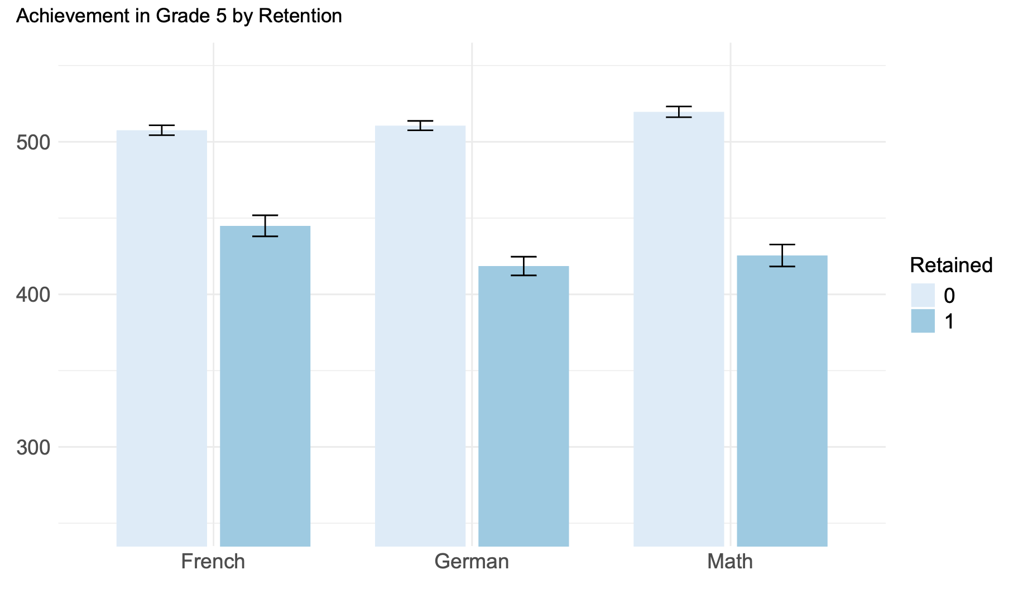
Descriptives
Descriptives on achievement (2019|2020)

Slide 7
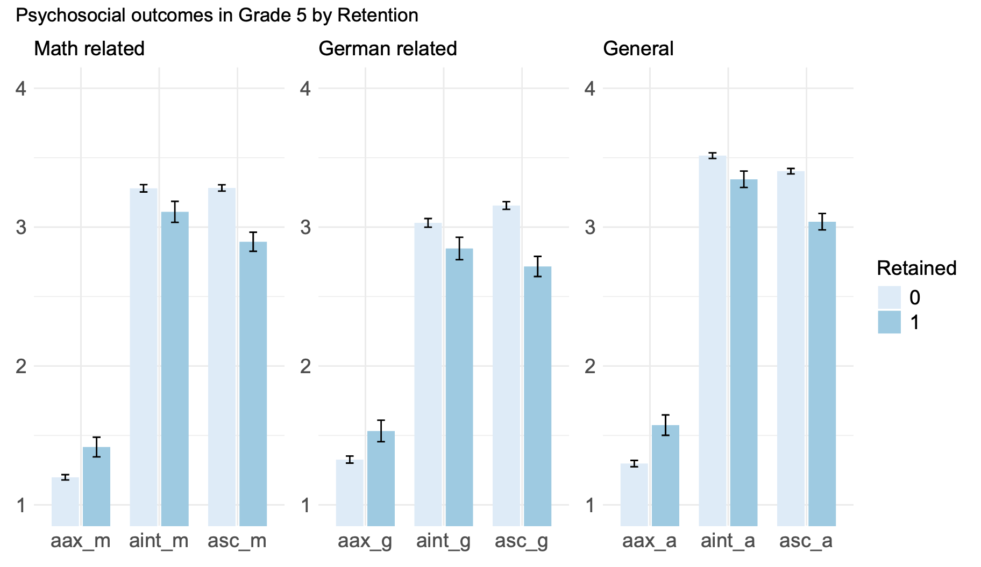




Descriptives
Descriptives on noncognitive outcomes (2019|2020)

Slide 8
Method
Steps to prepare analysis
Missings
Imputation: nonparametric missing value imputation using Random Forest
Student grade 1 baseline characteristics
Multiple gradient boosted logistic regressions and diagnoses
→ best balance between retained and promoted → propensity scores
Weight the whole sample
Establish Compara-bility

Slide 9
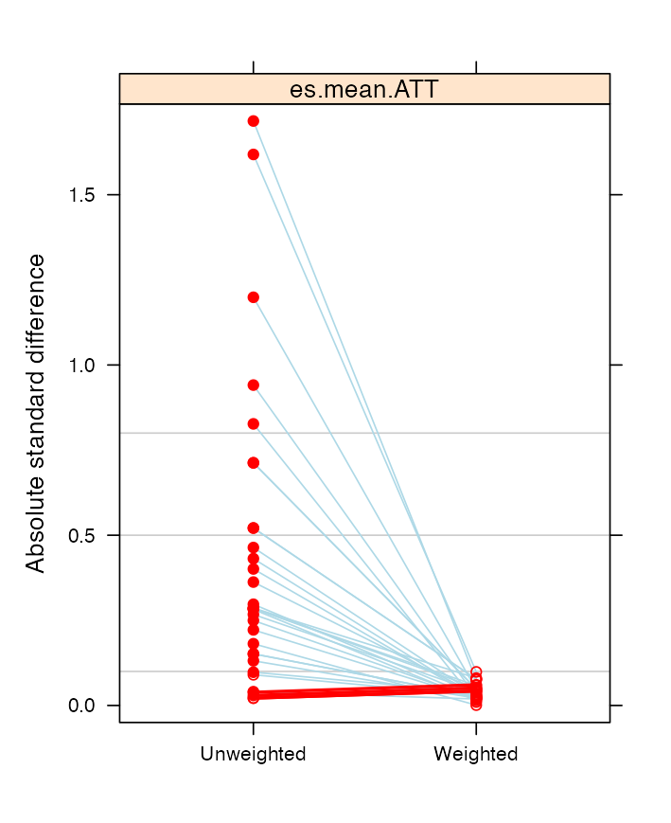
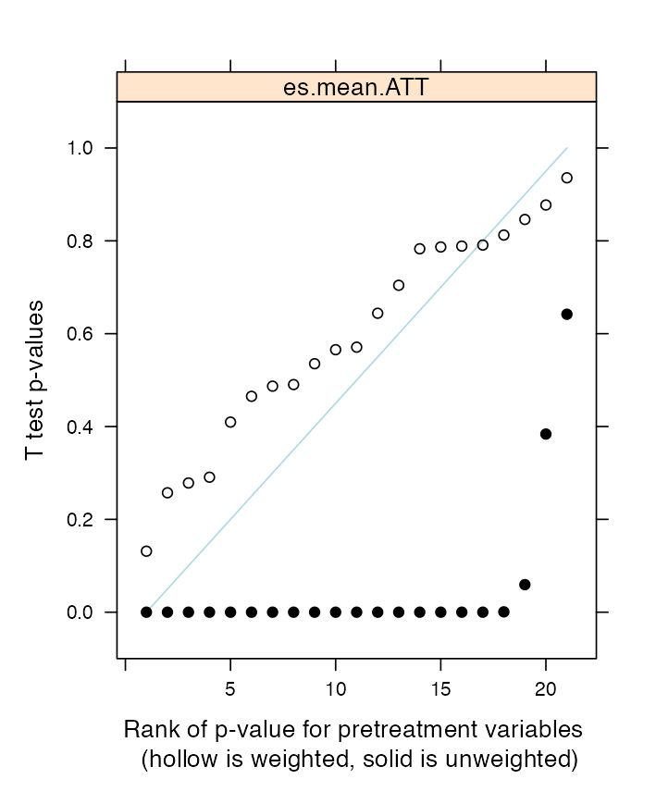
Results
Establishing Comparability
  twang: control group matches characteristics of unweighted treatment group
Standardized effect size of pretreatment variables
t-test p-values for weighted pretreatment variables

Slide 10
Method
Steps to prepare analysis
Missings
Imputation: nonparametric missing value imputation using Random Forest
Student grade 1 baseline characteristics
Multiple gradient boosted logistic regressions and diagnoses
→ best balance between retained and promoted → propensity scores
Weight the whole sample
Establish Compara-bility
Causal effect
ATT via survey-weighted generalised linear models

Slide 11
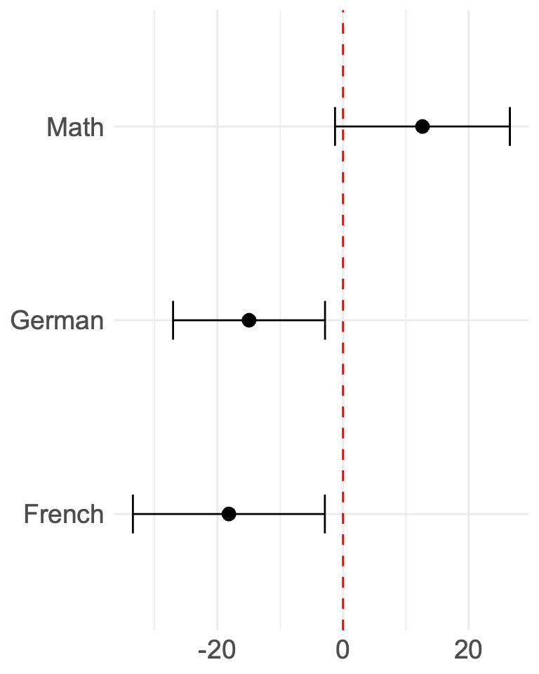
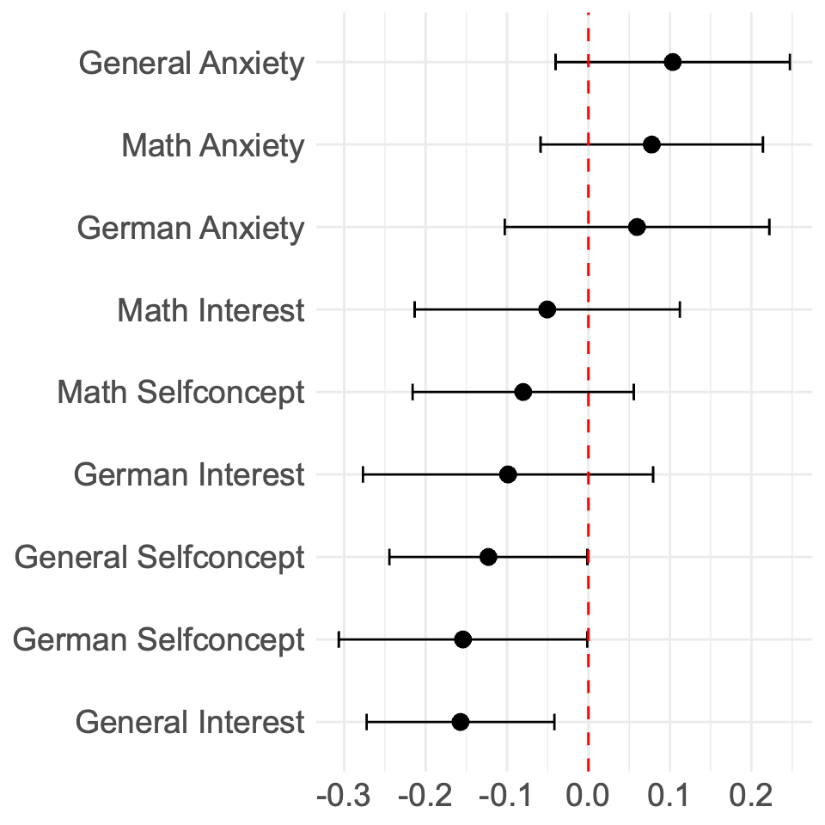
Results
Differences in predicted outcomes: Retained – Promoted students
(beta / confidence interval *p<0.05; ** p<0.01; *** p<0.001 / cohen’s d)
13 / * / -2.52
-15 /***/ 3.43
-0.12 / ** / 2.80
-18 / *** / 3.30
-0.15 / ** / 2.80
-0.16 / *** / 3.78

Slide 12
Results + Limitations
What is the causal effect?
Limitations
  Missings
  Grade retention dummy (no information if retention in grade 1, grade 2 or grade 3)
  Year of birth (not month of birth)
German reading
French reading
Math
School interest in general
Self-concept in general
Self-concept in German

Slide 13
Conclusions for Luxembourg
EpStan data:
  Assess core competences in primary
  Causal effect can be estimated
Retention effect in our study:
  Predominatly non-significant or significant negative
Conclusions for Luxembourg:
  No general recommendation for retention
  Increasing diversity among students in terms of migration/home language
  But hints that tailored support helps
    Broader implications for countries with increasing immigration

Slide 14


Questions or data request?
data@epstan.lu

Slide 15
Appendix

Slide 16
Grade retention – Background discussion
Cost-benefit perspective
  economically relevant
  negative spillover on classmates of receiving class: first time course takers have lower achievements (Hill 2014)
  increased dropout rates from school: school content doesn’t match interests of older retained students? (Jimerson/Ferguson 2007, Hughes et al. 2017, Jimerson et al. 2002, Andrew 2014)
  labour market outcomes decreased : repetition records in CV decrease likelihood for positive call-back (Baert/Picchio 2021)
Causal effects remain unclear
  educational setting: pedagogic measures accompanying retention or mere repetition
  grade: positive in Kindergarten (Vandecandelaere et al. 2016a), detrimental in primary (Ikeda/García 2021), positive in high school + beyond (Kinder/Knecht 2011, Tafreschi/Thiemann 2016)
  time perspective: short term effects are higher or positive; long term effects are lower/negative (e.g. Wu et al. 2008, Allen et al. 2009, Wu et al. 2010)
  quality of the study: correlational studies present larger (negative) effects

Slide 17
Theory
Potential effects of grade retention
 | Pro | Contra
Academic achievement
Psychosocial wellbeing
Time to learn (Caroll 1963, Bloom 1976): Consolidate knowledge before stepping on.
Social comparison theory (Festinger 1954): We compare upwards. Lower performing students achieve better results in group with slightly higher performing mates. Via increased motivation, goal settings, information on task completion.
Social comparison theory (Festinger 1954): We compare upwards. Lower performing students have higher self-concept if retained and surrounded by equally/lower performing mates.
Attitutes towards self (Festinger 1954): Retainees have advantage over classmates (age, experience from previous curriculum).
Triggers dismissal by children: curriculum for retainees is no longer age-appropriate which lowers interest.
Anxiety: Being retained and need to integrate into new group is associated with unpleasant emotions like fear, threat, anxiety.
Labled Stigma/Labeling theory (Becker 1963): Retention is visible. Association with failure. Others perceive retainees negatively. Retainees may internalize the belief of weak performer. Self-fulfilling prophecy.
Notes:
Wu et al. 2010: “Grade retention brings about such a change in reference”

Slide 18
Grade retention – Empirics
Pro
Retention
Contra
Retention
Math Klapproth et al. (2016)
Languages Gómez Soler et al. (2021), Hwang/Cappella (2019) , Klapproth et al. (2016), Vandecandelare et al. (2016)
Self-concept (general + in German)
Klapproth et al. (2016), Martin (2011)
Inconsistent/non-significant effects
Hwang/Cappella (2019), Wu et al. (2010)
Meta studies: average zero effects or favoring promotion
Goos et al. (2021), Jimerson (2001)

Slide 19
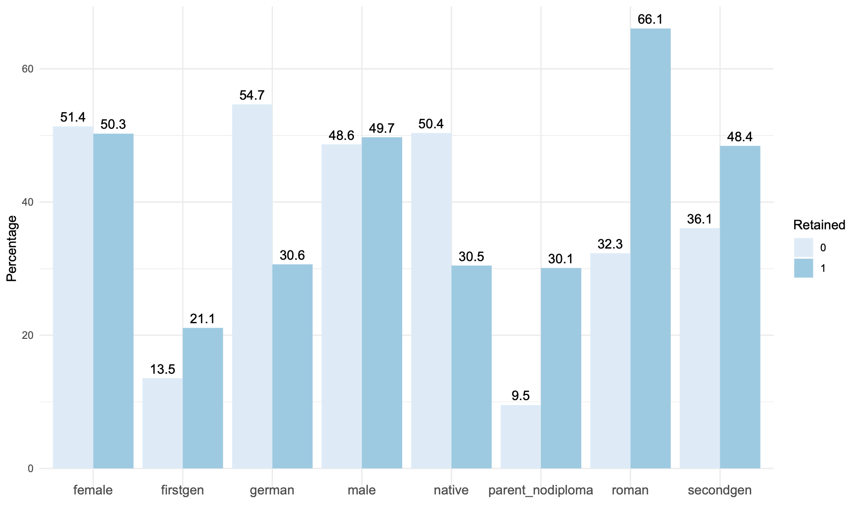
Descriptives
Descriptives on some baseline characteristics (2015)
Notes:
Parent perspective schon früher teasern und einleiten, hier zu spät

Slide 20
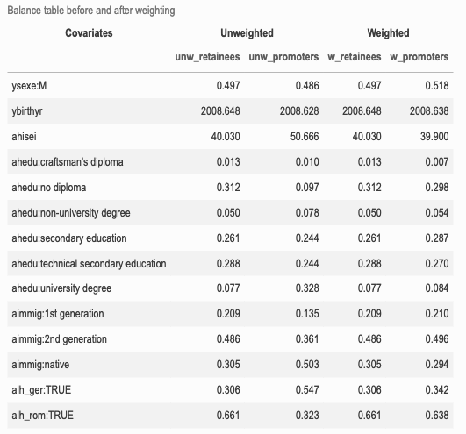
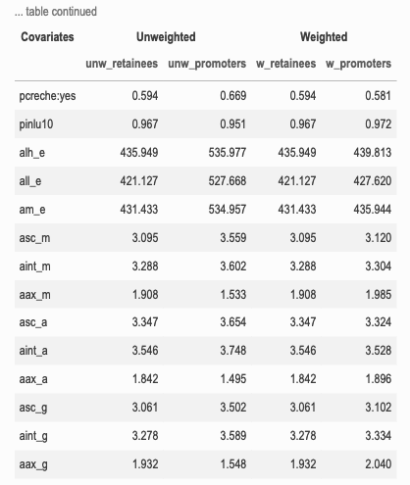
Results
Establishing Comparability

Slide 21
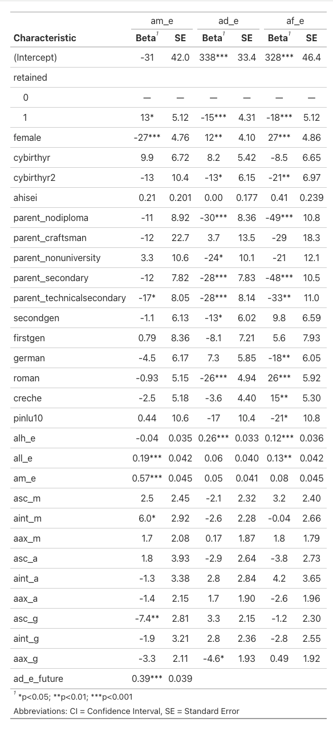
Results (Detailed)

Slide 22
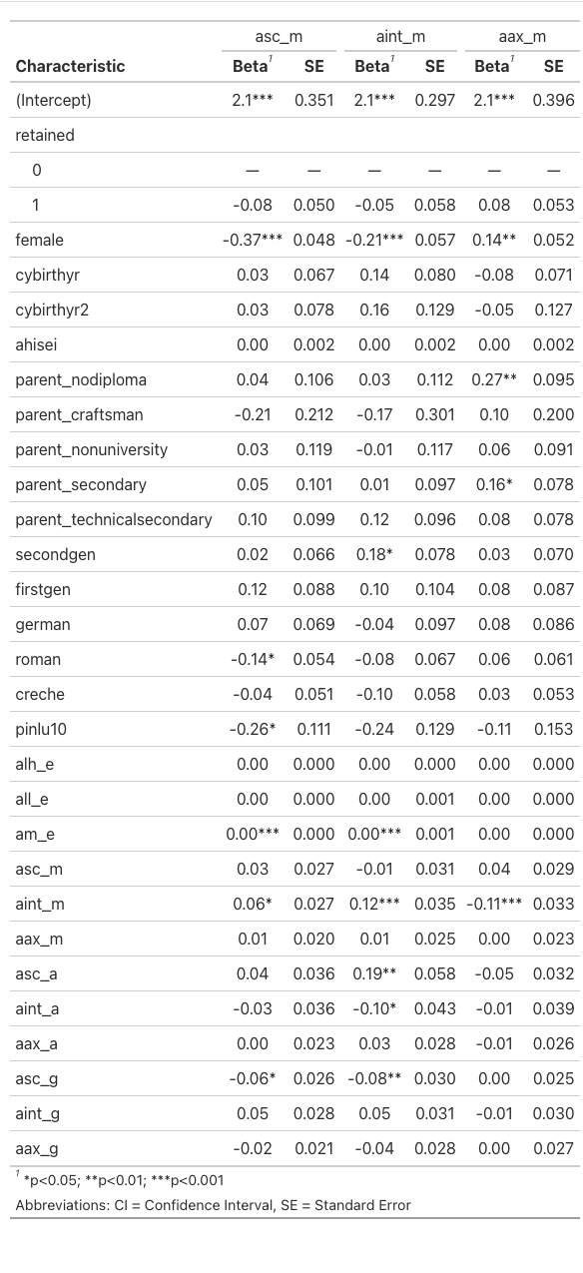
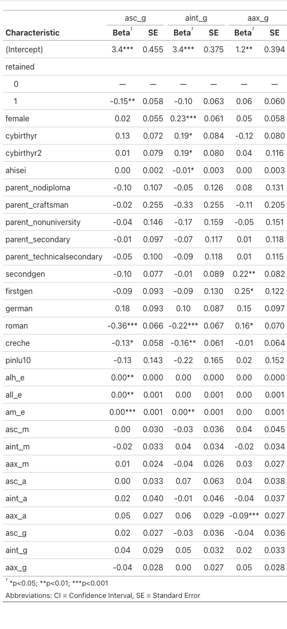
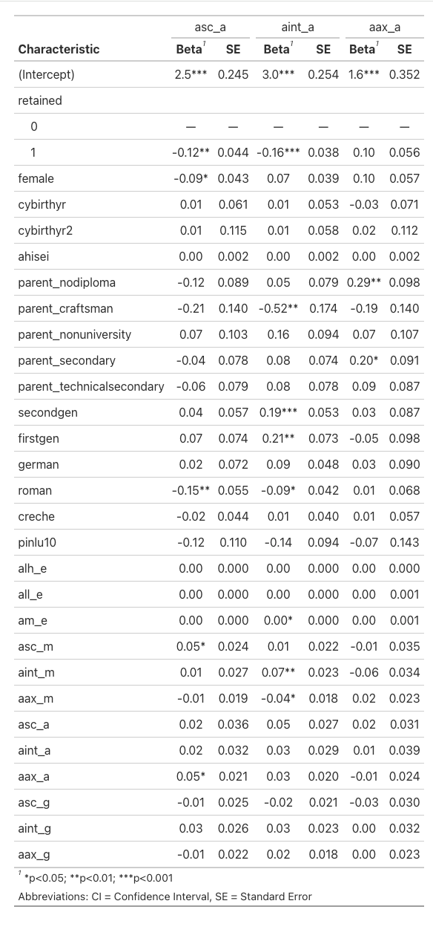
Results (Detailed)

Slide 23
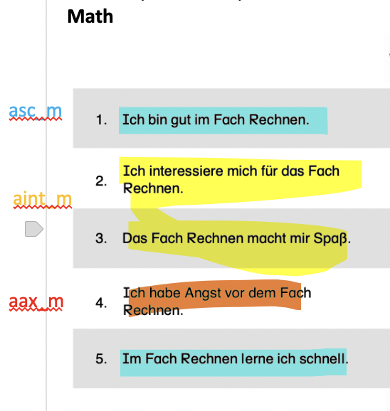
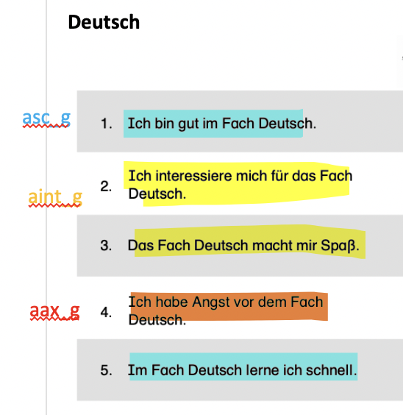
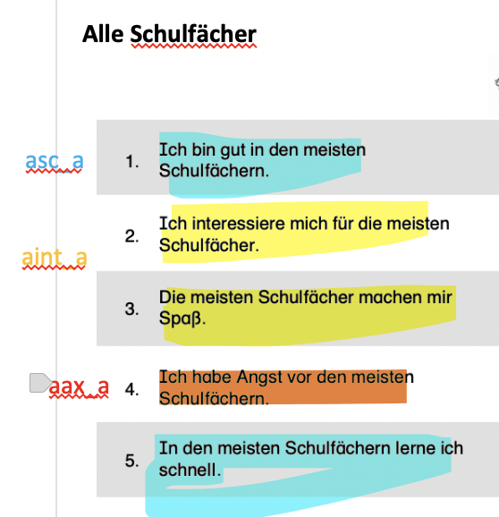
Data
Scales construction noncognitive outcomes

Slide 24
Method
Estimating ATE: controls in other studies
Back to 3. Today
 | 1 |  | 2-3 | 4-6 | 7-9 | 10-12
Dep Var grade 5 | Math |  | Language | Math related psychosocial | Language related psychosocial | General psychosocial
Age | Wu et al.2008, Ikede/Garcia 2013, Hu/Hannum 2019, Schwerdt et al. 2015 |  | Wu et al.2008, Ikede/Garcia 2013, Hu/Hannum 2019, Schwerdt et al. 2015 |  |  | Ikede/Garcia 2013, Hu/Hannum 2019, Wu et al. 2010
Age, Age² |  |  |  |  |  | Nagin et al. 2003
Age cohort | Peixoto et al. 2025 (subsamples)
Month of birth | Vandecandelaere 2016c, Vandecandelaere 2016b, Goos et al. 2013, Hwang/Capella 2019 |  | Hwang/Capella 2019 | Hwang/Capella 2019 | Hwang/Capella 2019 | Vandecandelaere 2016a, Hwang/Capella 2019
Age no | Winter/Green2012, Nuñes et al. 2015, Klapproth/Schaltz 2015, McCombs et al. 2009, Lorence/Dwerkin 2006 |  | Nuñes et al. 2015, Lorence 2014, Roderick/Nagaoka 2005, Moser et al 2012, McCombs et al. 2009, Lorence/Dwerkin 2006 |  |  | Martorelli/Mariano 2018
AA grade 5 yes
AA grade 5 no |  |  |  | Goos et al. 2013 | Goos et al. 2013 | Vandecandelaere 2016a, Goos et al. 2013

