Slide 1
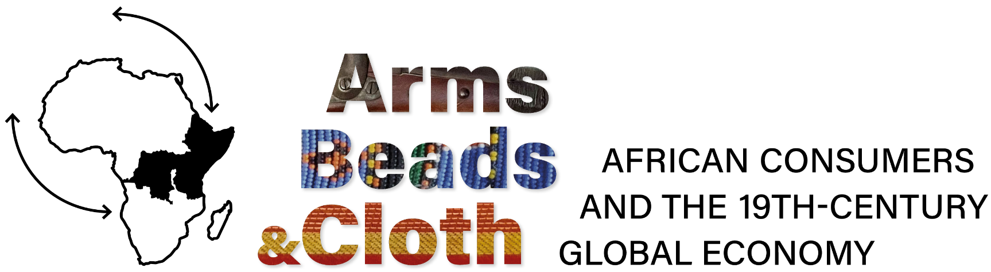


Currency areas in modern precolonial Africa:
New insights from traveller accounts
Lauren Coetzee¹ Karin Pallaver² Alessandro De Cola² Edward Kerby³ Alexander Moradi⁴
PhD Colloquium
18th October, 2024
¹ University of Luxembourg
² University of Bologna
³ Stellenbosch University
⁴ University of Bozen-Bolzano

Slide 2
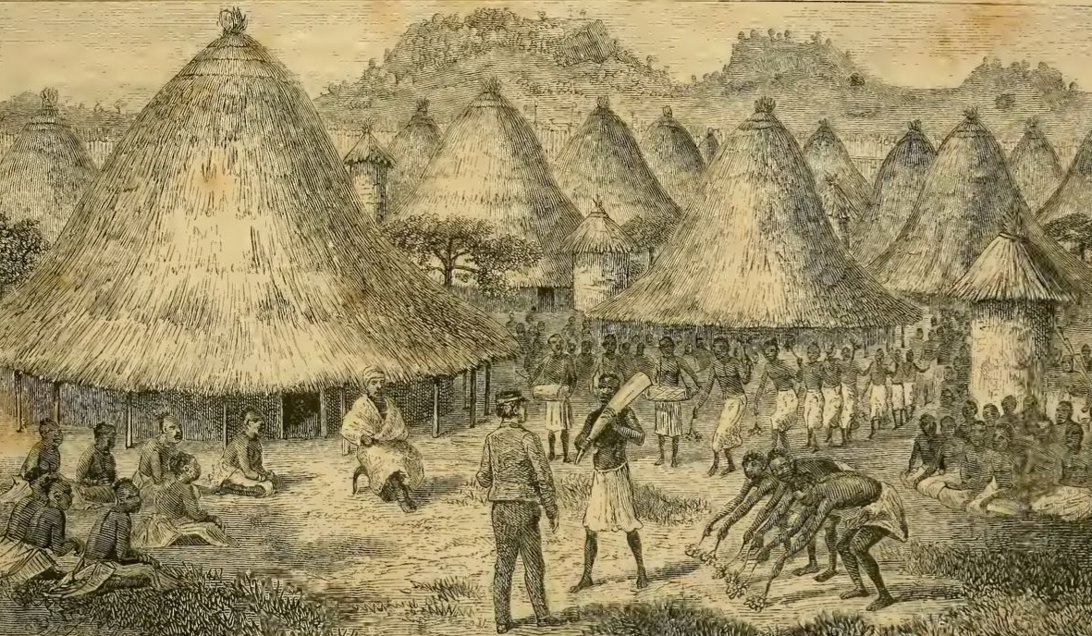
Motivation
Beads were used for exchange and trade in different epochs, and African regions.
Their circulation shows currency areas and trade connections within the continent.
Exchange is the basis of economic integration & development.
Beads are therefore our window into these processes.
“Chitapangwa receiving Dr. Livingstone”
Chuma, Susi & H. Waller. “The Last Journals of David Livingstone, in Central Africa, from 1865 to his Death,” Vol. I, 1874.
______________
Precolonial Currency Areas
Notes:
Lauren & Karin
Colours, beads ethnic groups = extension of Africa in relation to other goods used
Specialisation of beads (production)
Trade stats (exports)
Expansion in currency = econ. Dev
Amount of beads around and also how frequently they are exchanged (what they represent)
Estimate of wealth? Rough estimate of exchange rate (old GDP estimates?)
Leigh Gardner: Natural History Museum and Currency (how do these dynamics work?)
GDP estimates Broadberry & Gardner based on assumptions
Consumption opportunities increase with consumption of money
Connection between currency use and state development/ centralisation
West Africa = many centralised states (used cowries)
East Africa = less centralised states (mostly Ghana) and used cowries too
Used cowries, but smaller numbers than beads (less focused on shells, more focused on beads in Tanganyika area)
Glass beads always more frequent
Ideas of conspicuous consumption

Slide 3
Research Question
What was the regional distribution of beads across Africa over 500 years?
Hypothesis: The distribution of beads across Africa over 500 years shows how pre-colonial African regions were much more connected than previously assumed.
______________
Precolonial Currency Areas
Notes:
Lauren
CURRENCY = means of exchange, unit of account, store of VALUE, a system (think of money – coins and paper notes, but this is MODERN)
Pre-colonial connections within africa
Inter-ethnic trade
Role of european traders on the coast
See the routes in the maps
Trade connections between people and places

Slide 4
Literature
Beads as ornaments: “gewgaw myth” (Curtin 1975); “cursory list” (Richardson 1979); “ornament myth” (Pallaver 2019)
Regional focus (Ogundiran: 2002); (Wood 2012); (Koleini, Colomban, Pikirayi, Prinsloo 2019)
However - Little understanding of their economic role; little quantitative information
______________
Precolonial Currency Areas
Notes:
Karin
Diverse geographies of colonial currencies later (failures of colonial currency imposition – failure to realise greater circulation/ trade routes established?)
The vast majority of these goods were well made and durable:
- the ‘gewgaw myth’—the notion that Africans were gullible, indiscriminate trading partners, exchanging captives for trinkets, defective firearms, and cheap drink—has long since been debunked.
Paul Lovejoy points out that virtually all pre-colonial economies required the use of circulating mediums of exchange and units of account.
However, as David Richardson has pointed out, the discussion on these currency objects has been “usually restricted to a cursory listing of certain well-known trade goods without a serious analysis of what this means”

Slide 5
Project Relevance
Collaboration across disciplines and methods.
Synergetic combination of qualitative and quantitative approaches:
Enhanced magnitude and scope of the research;
Quantitative insights supported by qualitative regional expertise.
Beads previously seen only as ornaments, but when viewed as currency, then overlapping interests allows for more interdisciplinary collaboration.
______________
Precolonial Currency Areas
Notes:
Karin
Paul Lovejoy points out that virtually all pre-colonial economies required the use of circulating mediums of exchange and units of account. However, as David Richardson has pointed out, the discussion on these currency objects has been “usually restricted to a cursory listing of certain well-known trade goods without a serious analysis of what this means”
Keep it short. If you have 20 minutes, you don’t want to talk 10 minutes about the work of others.

Slide 6
Methodology (I)
A Directory of Travellers Never Existed - Time Traveller built one:
Searching three major online repositories:
(voyage* OR exploration* OR expedition* OR travel* OR survey* OR excursion*) AND LOCATION AND (date: 1200 TO 1900 OR NA) AND (mediatype = texts)
where LOCATION is defined from a compiled list of historical names of African regions and territories.
Manually searched several secondary sources to add travellers.
Corpus contains multiple languages which we translated to English.
Coded metadata about the traveller and journey.
State and non-state actors (scientists (16%), military men (15%), missionaries (11%), civil servants (9%), explorers (5%), ...from various nationalities.
______________
Precolonial Currency Areas
Notes:
Lauren
Percentages based on full corpus, but need to revise summary stats for the paper
Number of travellers added to the corpus at the beginning of the collaboration (?)

Slide 7
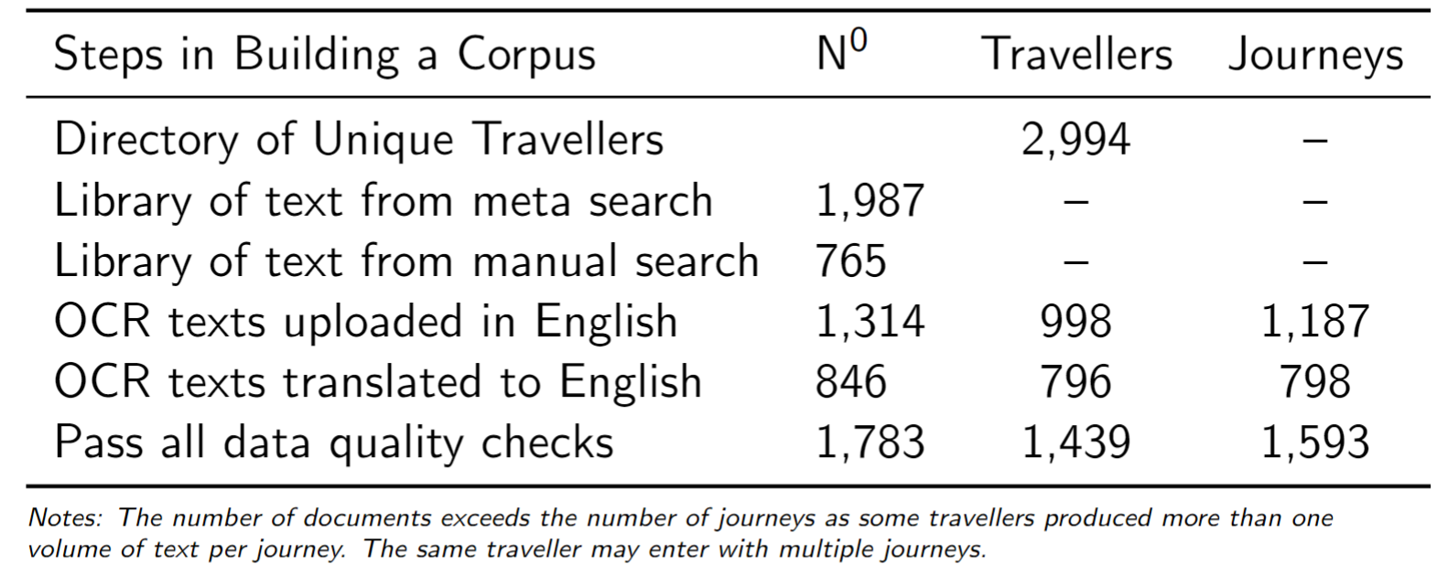
Methodology (II)
Dimensions of working corpus
Approximately 700,000 pages of text
Approximately 30,000,000 words/token
______________
Precolonial Currency Areas
Notes:
Lauren
Data quality = min. 150 words per page, use OCR to check for quality

Slide 8
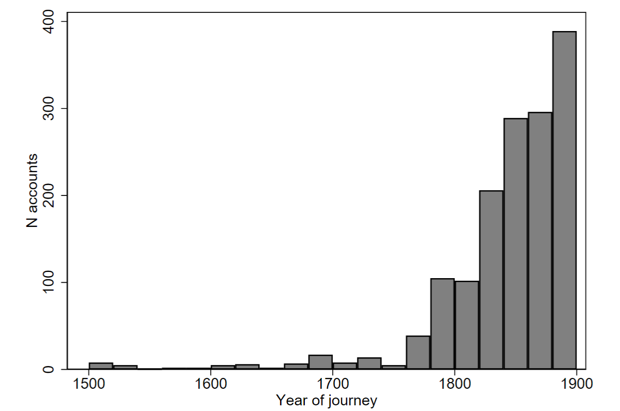
Methodology (III)
Temporal Coverage of Corpus
______________
Precolonial Currency Areas
Notes:
Lauren

Slide 9
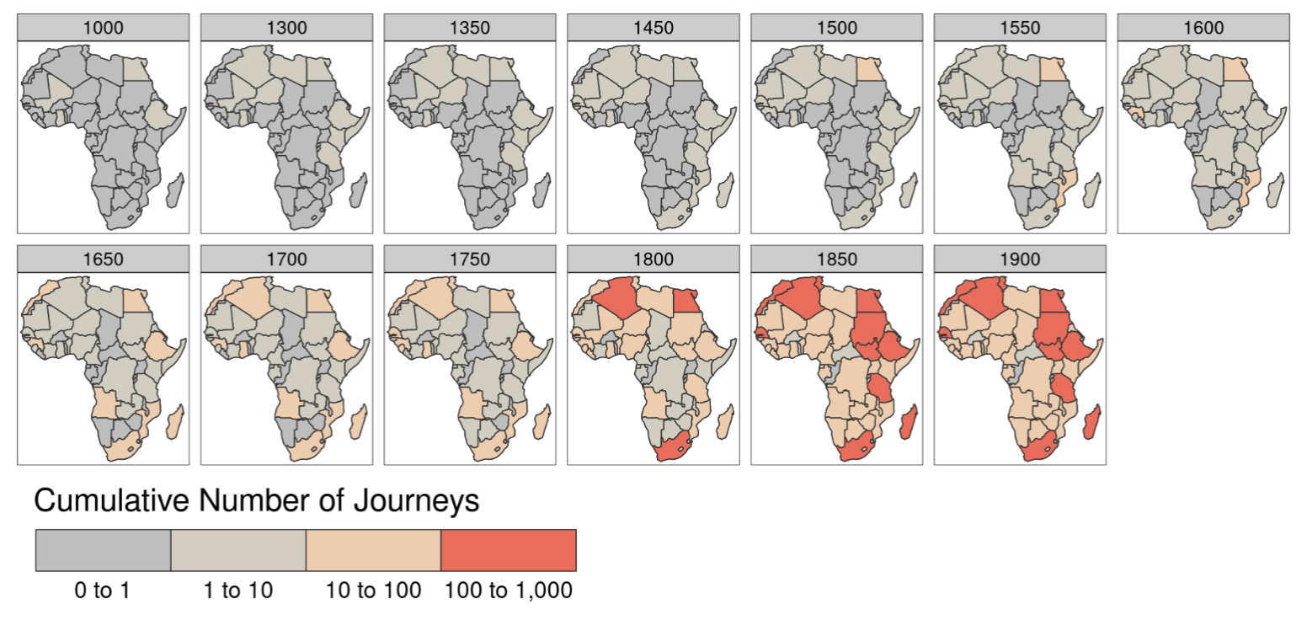
Methodology (IV)
Spatial Coverage of Corpus
______________
Precolonial Currency Areas
Notes:
Lauren

Slide 10
Methodology (V)
Beads Database
Searched the corpus for the word bead/s and a dictionary for African terms for beads.
Search returned ~10,000 observations.
Exported database of text `snippet’s, full pages - with pre and post ‘context’ pages,
for each observations - and associated metadata.
Hand coded 14 variables for each observation.
Price, Size, Colour, Location, Function
Origin, Shape, Type, Name, Relationship
Unit, Ethnic Group, Nature of Exchange, Interaction
Coded working sample currently contains ~2,000 observations
______________
Precolonial Currency Areas
Notes:
Lauren
Database built from elastic search (fuzzy search term picking up embedding of word “beads” and “native bead terms”
Returned 10 000 observations
Hand coded (close reading of these extracts) across 14 variables and observations (linked to additional meta data and maps, artefacts, images, etc.)
Variables in a table?
Relationship needs to be explained
Nature of exchange and international, intra and inter-ethnic interactions
Results in working sample

Slide 11
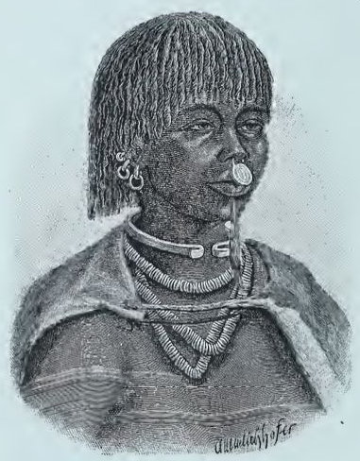
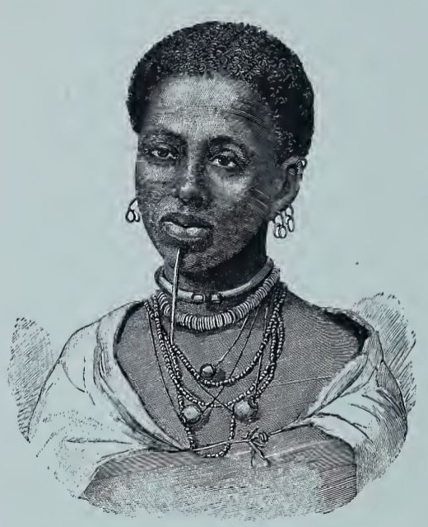
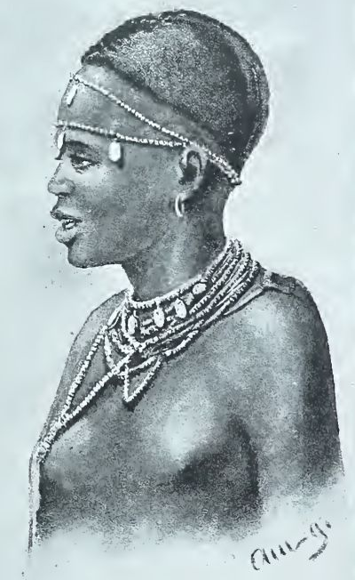
Function of Beads
“Turkana Woman”
“A Reshiat Woman”
“Ukambani Woman”
S. Teleki & L. von Höhnel. “Discovery of Lakes Rudolf and Stefanie,” Vol.II, 1887.
______________
Precolonial Currency Areas

Slide 12
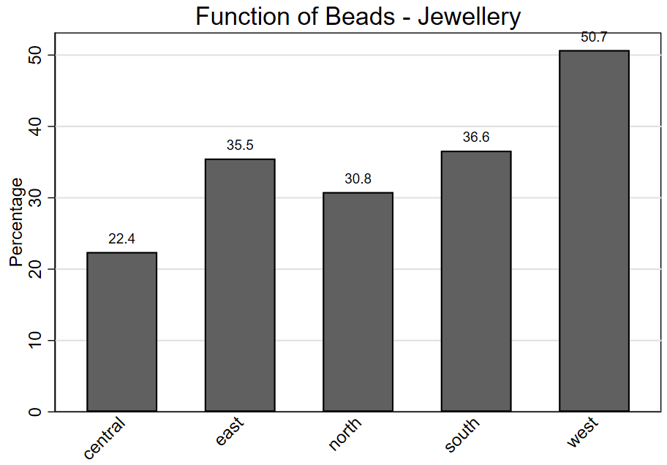
N=1,798
______________
Precolonial Currency Areas
Notes:
Karin

Slide 13
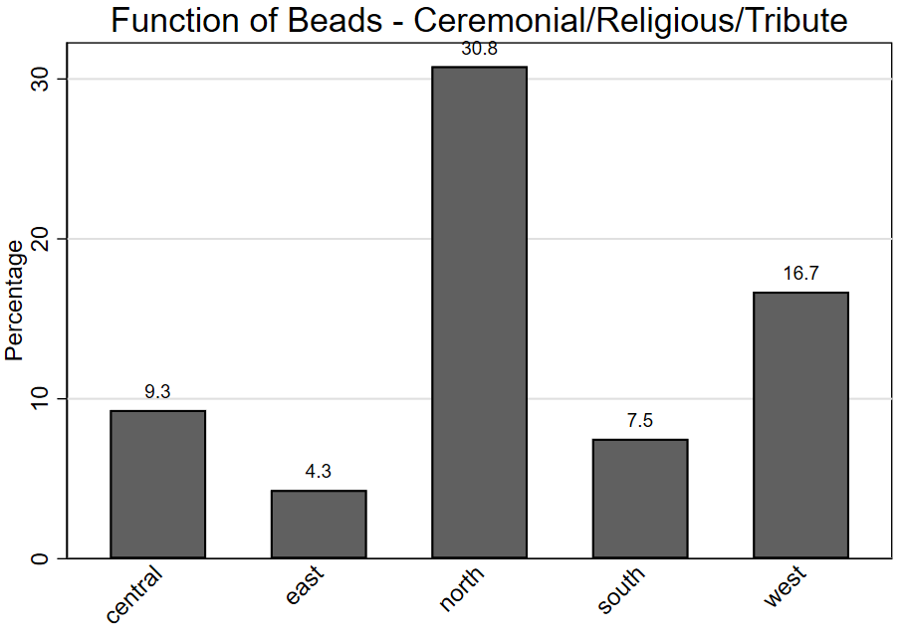
______________
Precolonial Currency Areas
Notes:
Karin

Slide 14
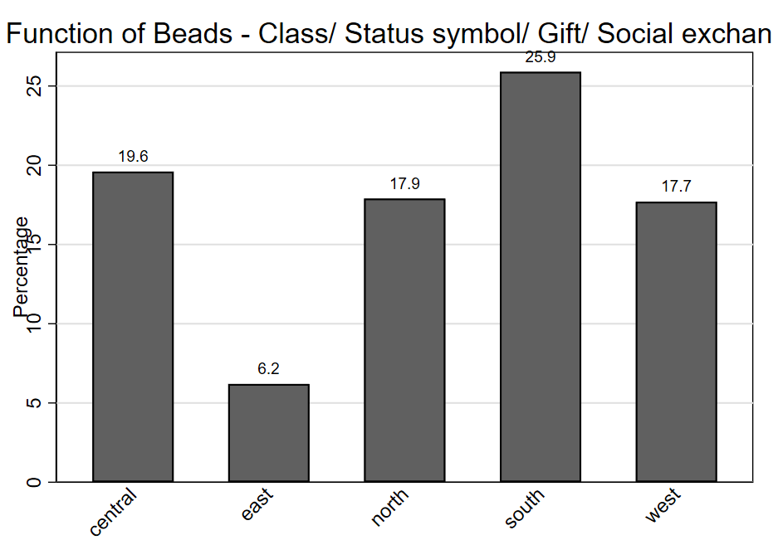
______________
Precolonial Currency Areas
Notes:
Karin

Slide 15
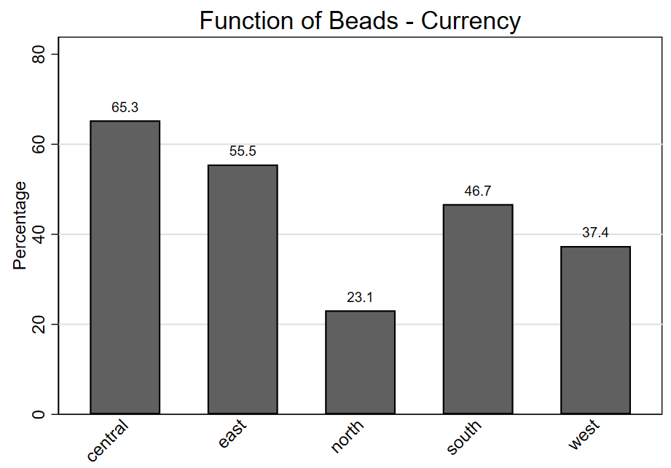
N=1,798
______________
Precolonial Currency Areas
Notes:
Literature on East Africa working with qualitative sources pointed at the use of beads as “currency”, but with TimeTraveller we have a strong quantitative evidence of this function for beads. Moreover, there is no reference in the literature on the monetary function of beads in Central Africa. LLM sheds some light on the monetary use of glass beads for this region as well.

Slide 16
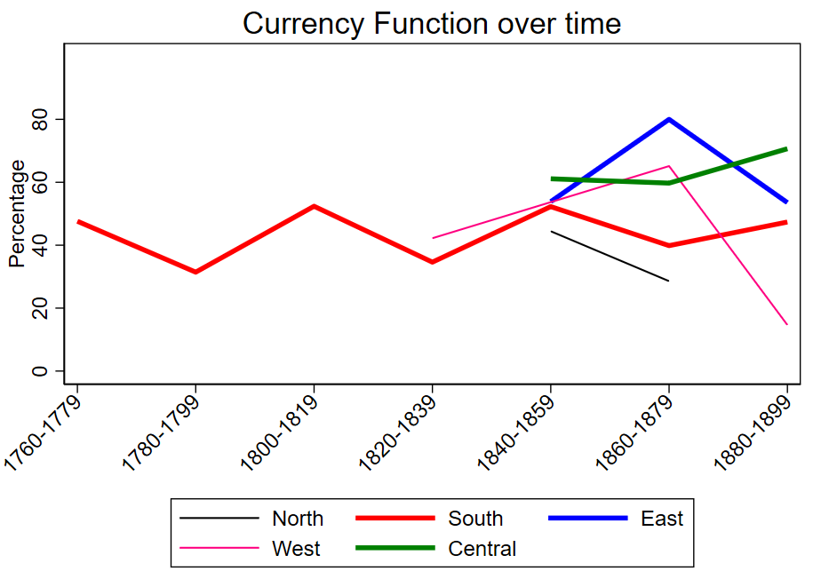
N=1,798
______________
Precolonial Currency Areas
Notes:
Lauren/ Karin to comment on intersection between Central and East
Sample also biased by data from SA
Difficult to explain west decline, but novel insights (maybe colonial rule)
Number of explorations? (more in West in early half, move to east and central towards end of 19th C)
We can see the growth in the observations of use of beads in Central Africa after 1880. This might be related to decline in number of elephants in the east (overexploitation) and expansion of the frontier of ivory inland.

Slide 17
Relationship with Goods

Slide 18
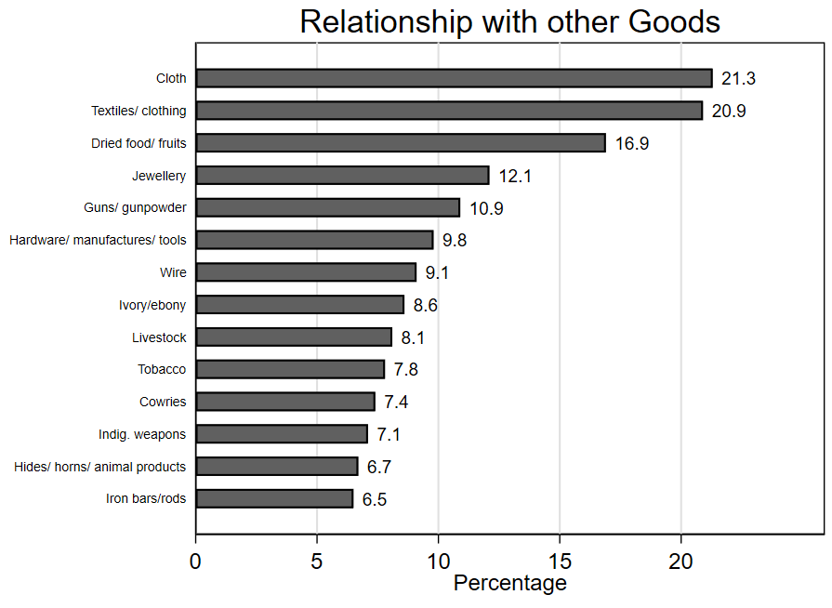
N=1,087
______________
Precolonial Currency Areas
Notes:
Lauren
Same as before but limited to categories with > 5%
Cloth and textiles so high together (could be combined?)
Shows all 33 categories,
Discuss a few that are interesting
Says something about trade items in Africa
Made a big effort to catch the small things too

Slide 19
Colour of Beads

Slide 20
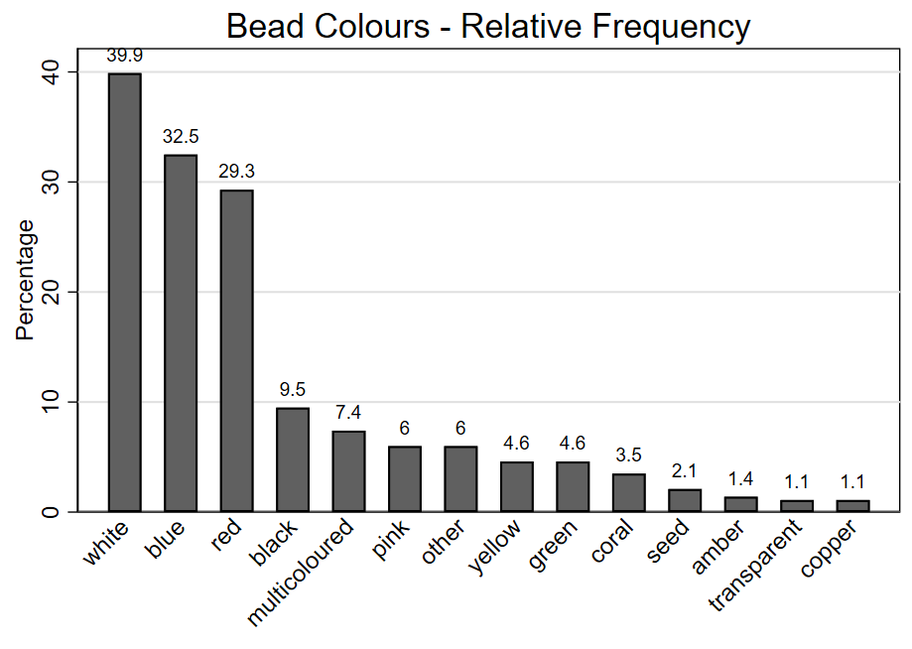
N=283
______________
Precolonial Currency Areas
Notes:
When a colour is mentioned, this is what is captured here
Explorers used by europeans usually glass or coral, but not explicitly stated
Local beads not glass generally (mentioned by explorers)
They were not explicitly stating that … glass beads were exchanged for … (what did they bring at the beginning of the expedition?)

Slide 21
Spatial Distribution of Colours

Slide 22
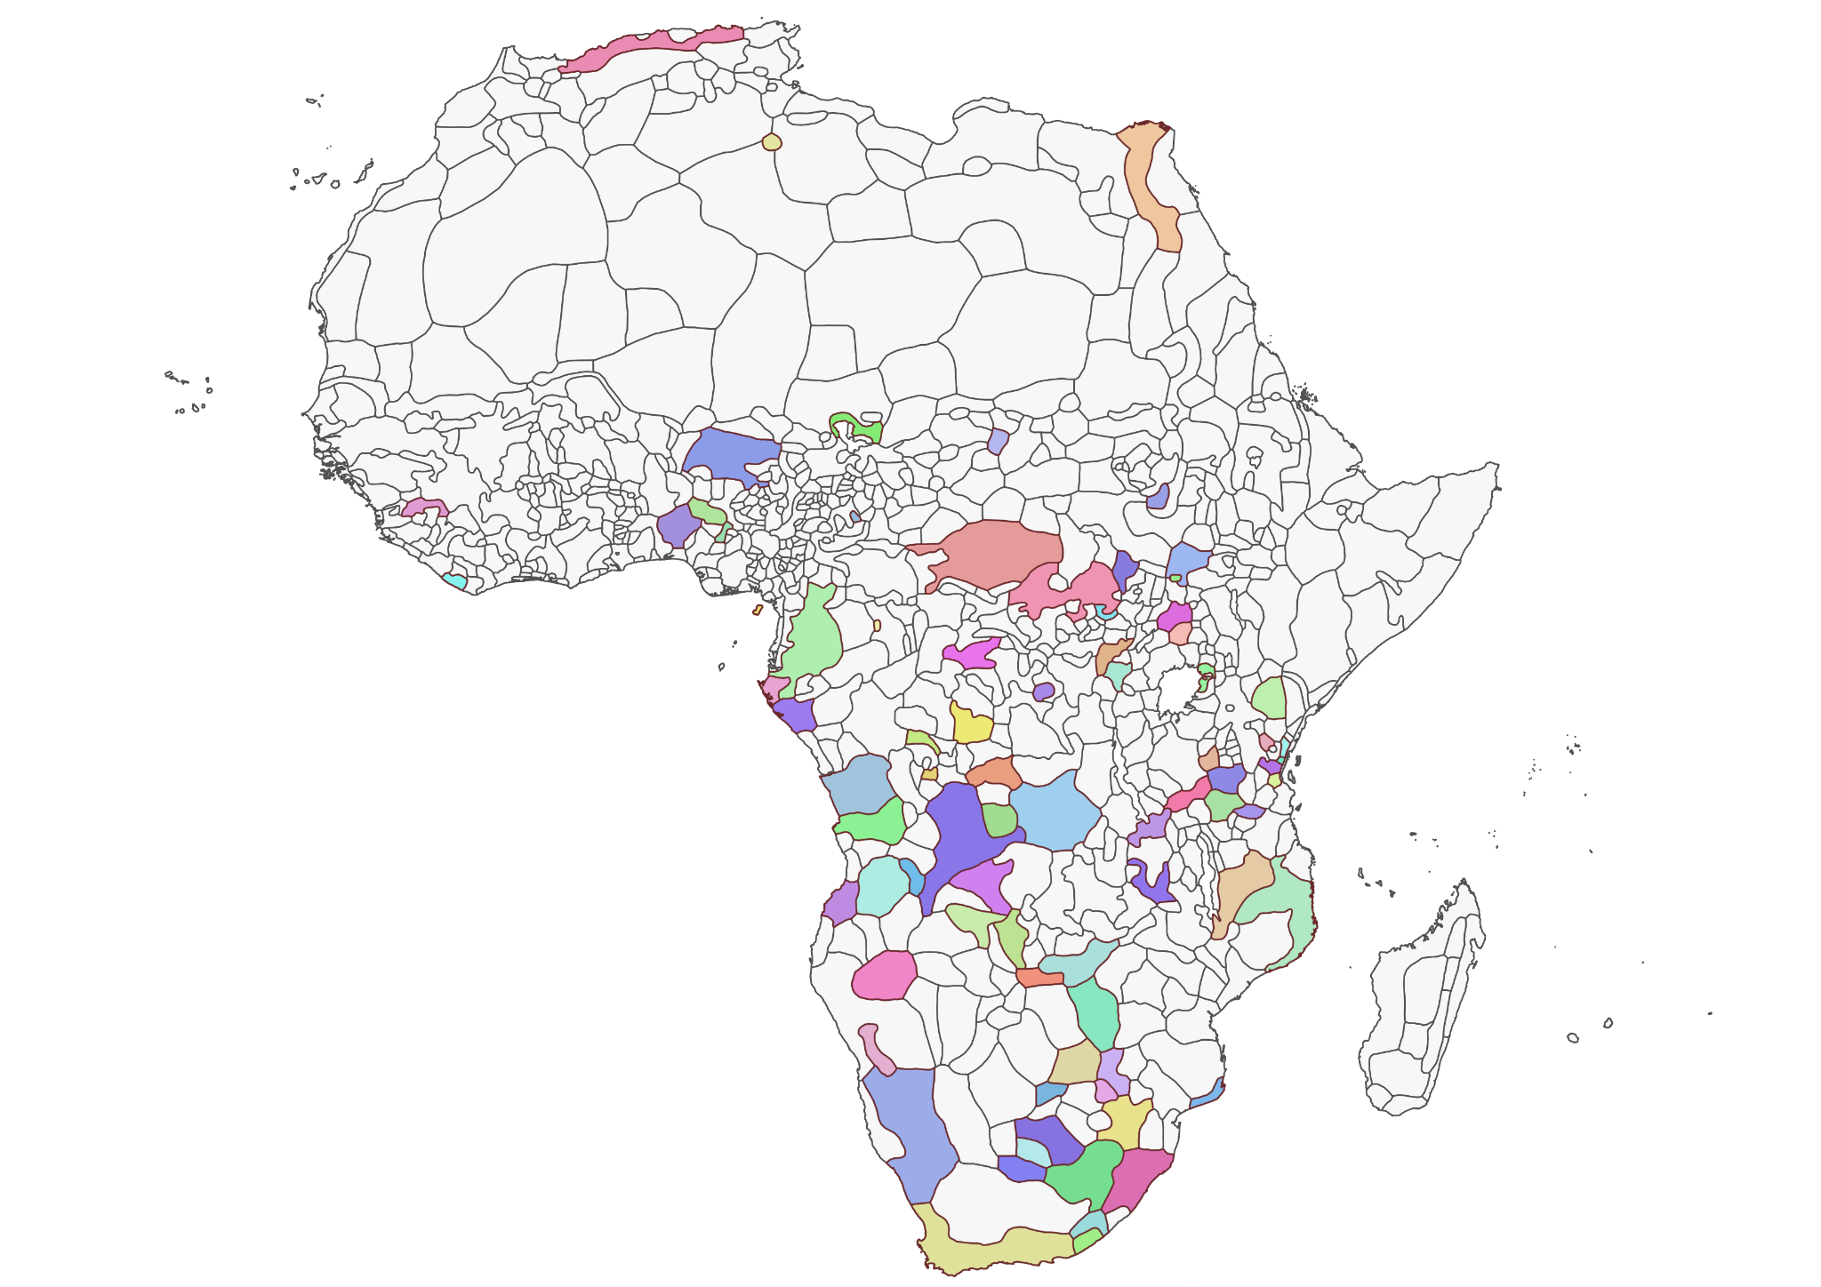
Trade Interactions per Ethnic Group
______________
Precolonial Currency Areas
Notes:
Lauren

Slide 23
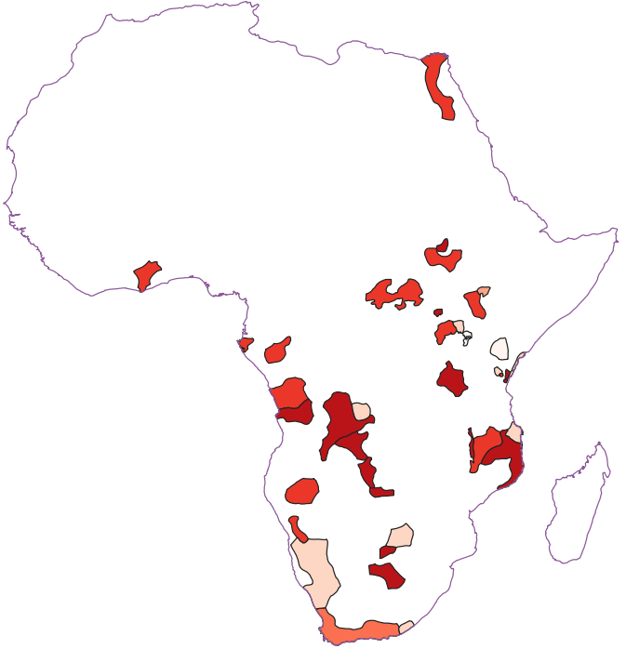
Red Beads
N(Colours)=283
N(Ethnic groups)= 390.
N(Colours & ethnic groups): 74.
______________
Precolonial Currency Areas

Slide 24
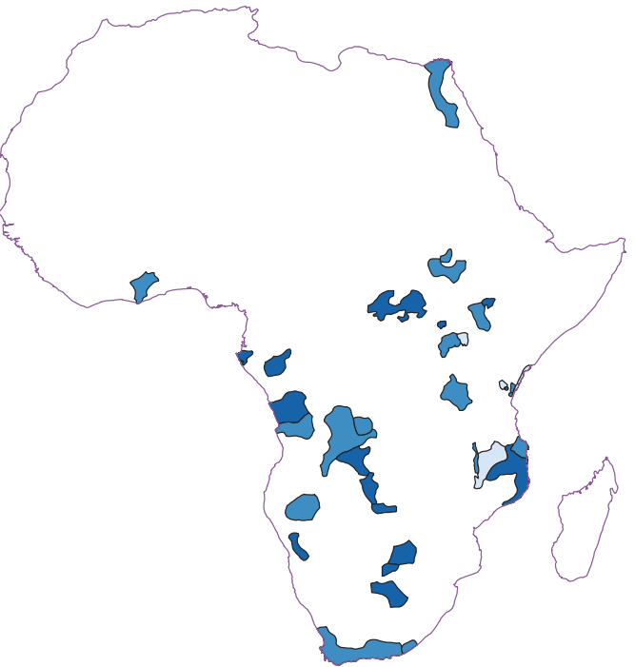
Blue Beads
N(Colours)=283
N(Ethnic groups)= 390.
N(Colours & ethnic groups): 74.
______________
Precolonial Currency Areas

Slide 25
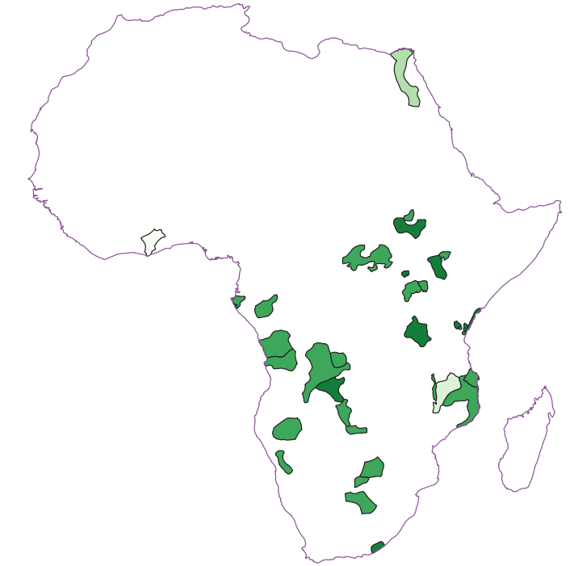
White Beads
N(Colours)=283
N(Ethnic groups)= 390.
N(Colours & ethnic groups): 74.
______________
Precolonial Currency Areas

Slide 26
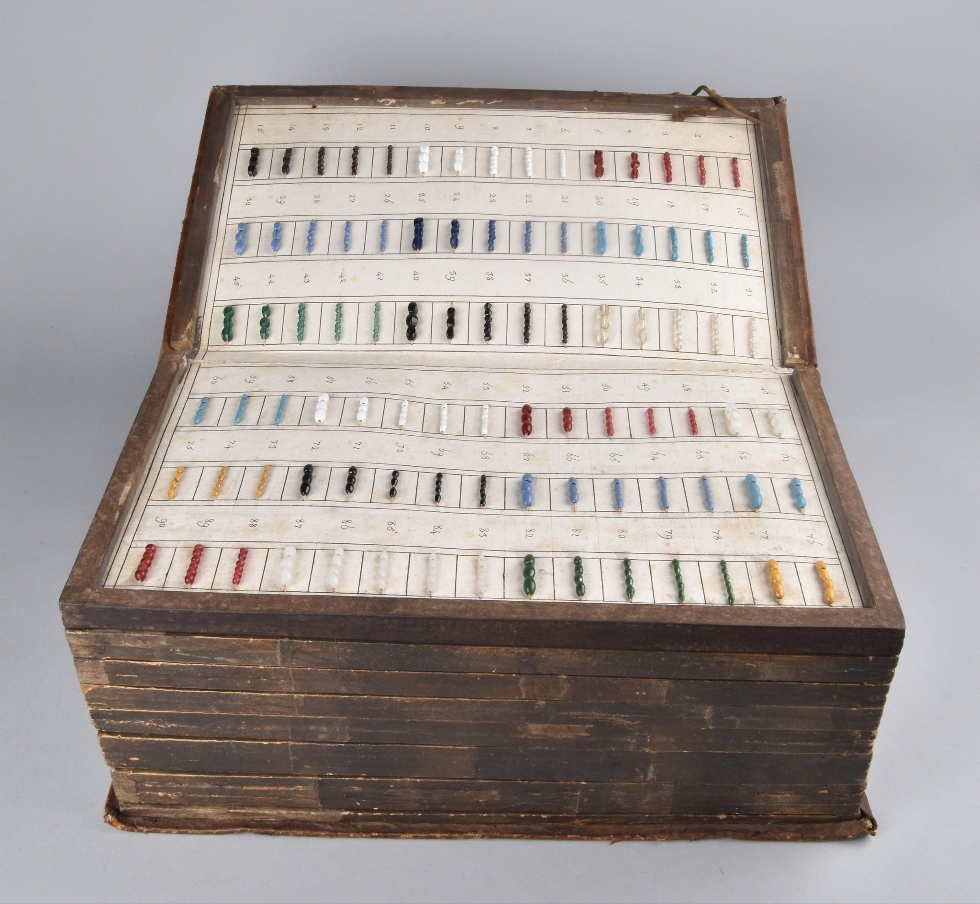
Case Study: 19th-century East Africa
What can we learn using the Time Traveller corpus?
Formation of currency areas: where beads are used as currency and where they are not used
Overlap of functions;
Relations of beads with other currencies and mediums of exchange;
Currency areas not only regional: continental connections;
Powerful narrative of the web of entanglements that was created by Africans as currency users
Bead Book, ©The Trustees of the British Museum
______________
Precolonial Currency Areas
Notes:
Karin
Visualization of beads areas: where they are not used: this contributes to locate “currency areas”.
This highlights trading connections within the continent (not only East Africa but across regions);
they entered interregional and intracontinental networks that connected African societies within Africa through a web of localities capable of passing material goods on in all directions. The study of the history of beads provides a powerful narrative of the web of entanglements that was created by Africans as currency users and consumers
EXAMPLE by Livingstone
The study of glass beads makes it possible to pursue what Patrick Manning has recently suggested is a way for African historians to contribute to global history while simultaneously strengthening their analyses: tracing links and parallels among African regions; unearthing connections in all directions, including the African diaspora and the societies in Asia and the Indian Ocean; more fully including the maritime dimension of Africa in the continent’s interactions; continuing to focus on history from below, by understanding the interaction among different levels of social organization (Manning 2013: 329).
Make it more applicable to the historians

Slide 27
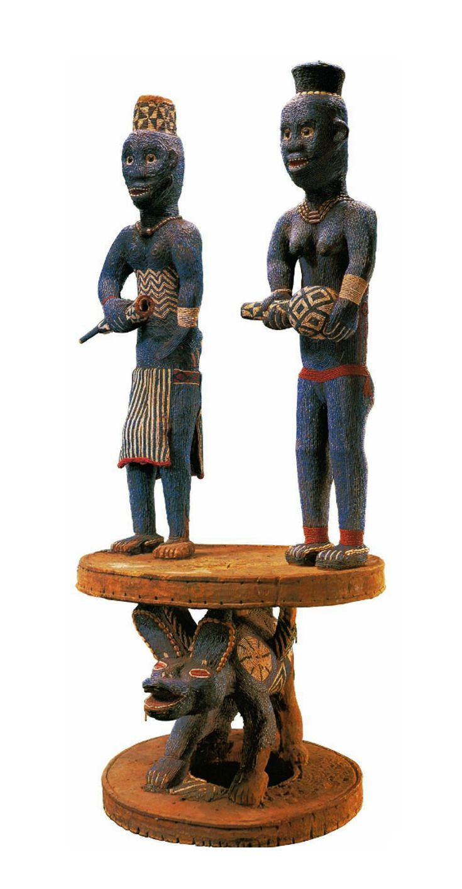
Discussion
Beads Database
This is Big Data in AEH.
Relevance of Central Africa
Colour specificities based on regions
Inflation/ Exchange rates
Changing patterns of consumption
______________
Precolonial Currency Areas
Throne of Njouteu: Royal Couple, late 19th–early 20th century. Cameroon
The Metropolitan Museum of Art
Notes:
Lauren
Database built from elastic search (fuzzy search term picking up embedding of word “beads” and “native bead terms”
Returned 10 000 observations
Hand coded (close reading of these extracts) across 14 variables and observations (linked to additional meta data and maps, artefacts, images, etc.)
Variables in a table?
Relationship needs to be explained
Nature of exchange and international, intra and inter-ethnic interactions
Results in working sample

Slide 28
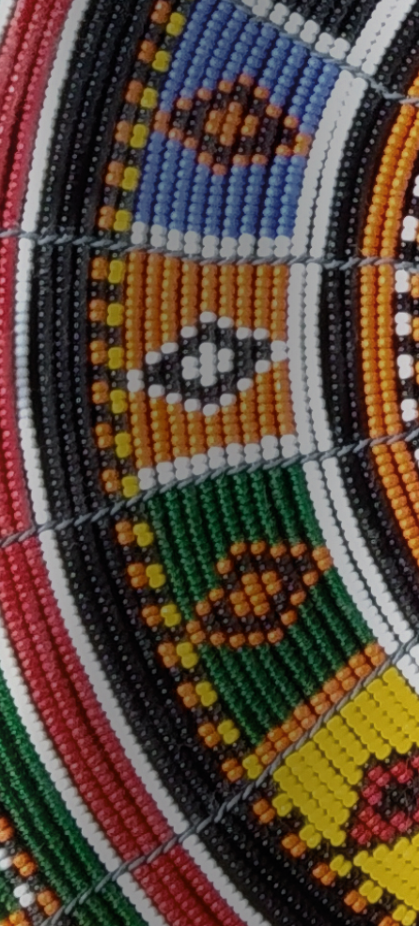
Road Ahead
Beads Database
Complete data set
Refine Code book
Can we estimate money supply and income?
Exchange rates? Trade routes?
State centralisation and the relationship with expansion of trade
______________
Precolonial Currency Areas
Notes:
Lauren
Lessons? Re-coding? Challenges?
Why not let ChatGPT do it? Have another go at this with another model/ type of GenAI

Slide 29
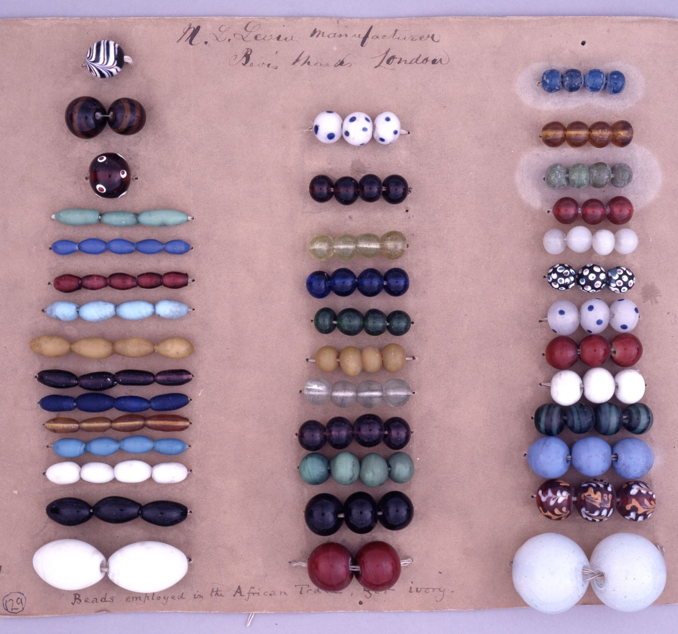
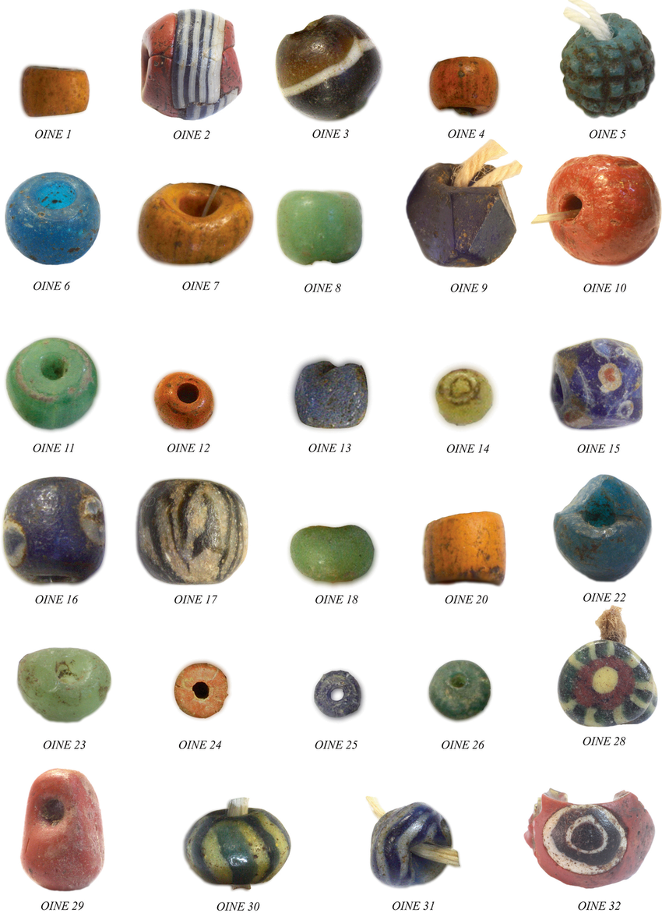
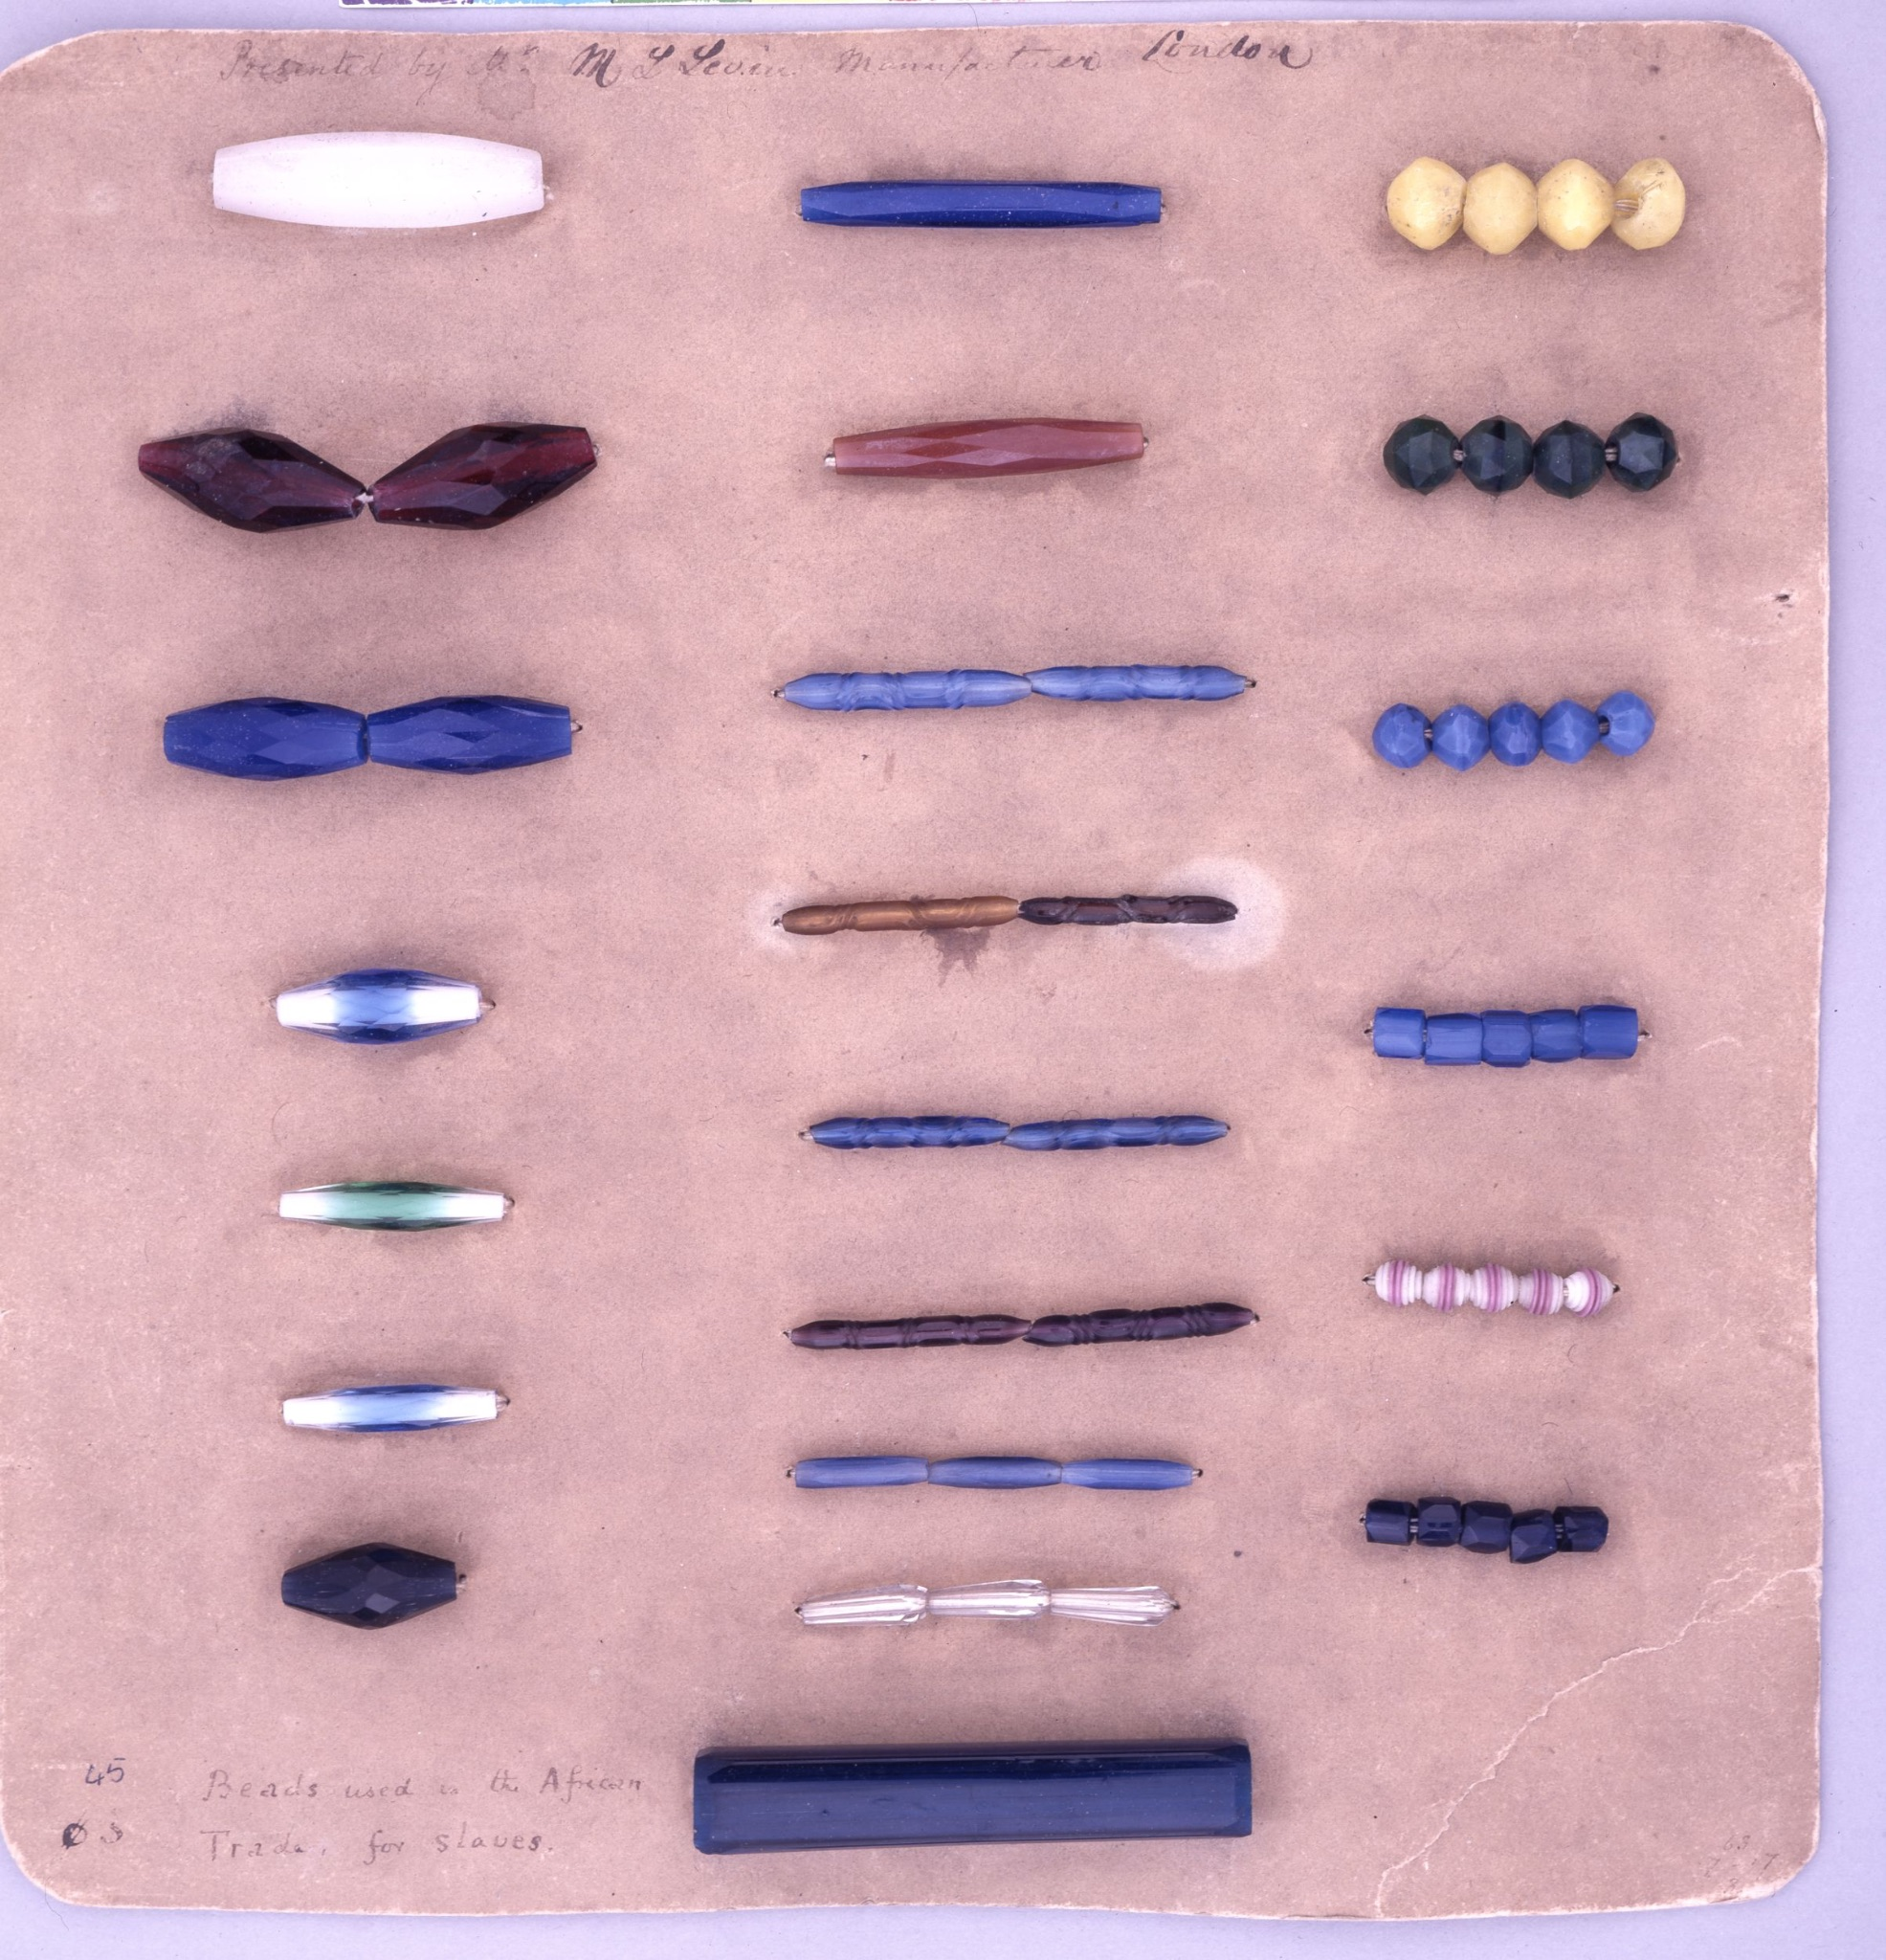
Thank You
Beads employed in African trade, M.L. Levin Manufacturer,
©The Trustees of the British Museum
Joanna Then-Obluska, “Beads and pendants from the Hellenistic to Early Byzantine Red Sea port of Berenike, Egypt, Season 2014-2015,” Polish Archaeology in the Mediterranean, 2018.
______________
Precolonial Currency Areas
Notes:
Database built from elastic search (fuzzy search term picking up embedding of word “beads” and “native bead terms”
Returned 10 000 observations
Hand coded (close reading of these extracts) across 14 variables and observations (linked to additional meta data and maps, artefacts, images, etc.)
Variables in a table?
Relationship needs to be explained
Nature of exchange and international, intra and inter-ethnic interactions
Results in working sample

Slide 30
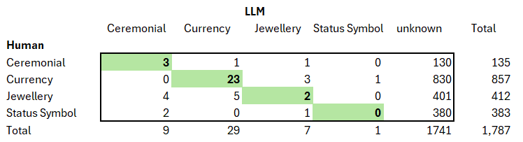
Human versus Generative AI - Function of Beads
______________
Precolonial Currency Areas
Notes:
Lauren
Lessons? Re-coding? Challenges?
Why not let ChatGPT do it? Have another go at this with another model/ type of GenAI
Cross tabulation which shows the categories humans chose vs. LLMs
Asked open ai what the function is
Gave it categories (followed similarly to humans)
In 3 cases, LLM agrees with humans (like 9 ceremonial functions)
Green blocks = where humans and LLMs agree
Currency- the LLM was quite good (23 were correctly identified)
All other cells = disagreement
Unknown = big category where LLM couldn’t identify and humans could
LLMs quickly coded as unknown, and in some things (ceremonial jewellery and status symbol) was quite bad (but currency is good)
Unknown category

Slide 31
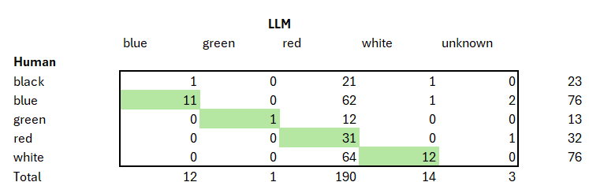
Human versus Generative AI - Color of Beads
______________
Precolonial Currency Areas
Notes:
Lauren
Lessons? Re-coding? Challenges?
Why not let ChatGPT do it? Have another go at this with another model/ type of GenAI
We added more colours than what the LLM got (like pink, multicoloured, etc.)
Blue colours (humans and LLM agree)
Few cases where LLM was wrong with blue
Unknown version in colours = red as default (64 cases where it was unsure and coded as red)
Fantasizing that these colours were red (how are colours constructed and where they come in a sentence)
Dont trust the red, but you can trust the other colours
Independent of which colours humans coded, LLMs coded as red
E.g. 23 black colours, but LLM says they’re red
76 blue beads and LLM says 62
Depends on the prompt and the text you are using (so LLM validation by humans remains essential)

