Slide 1

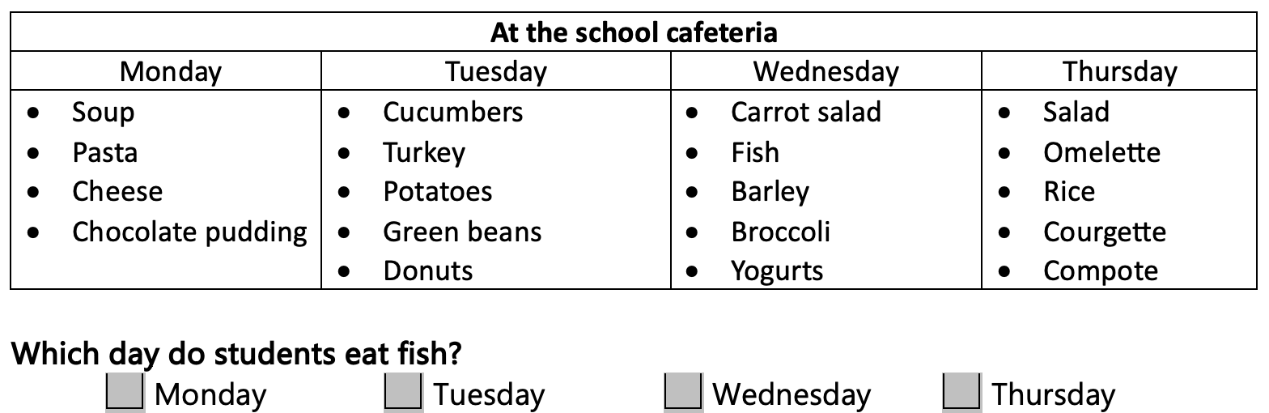
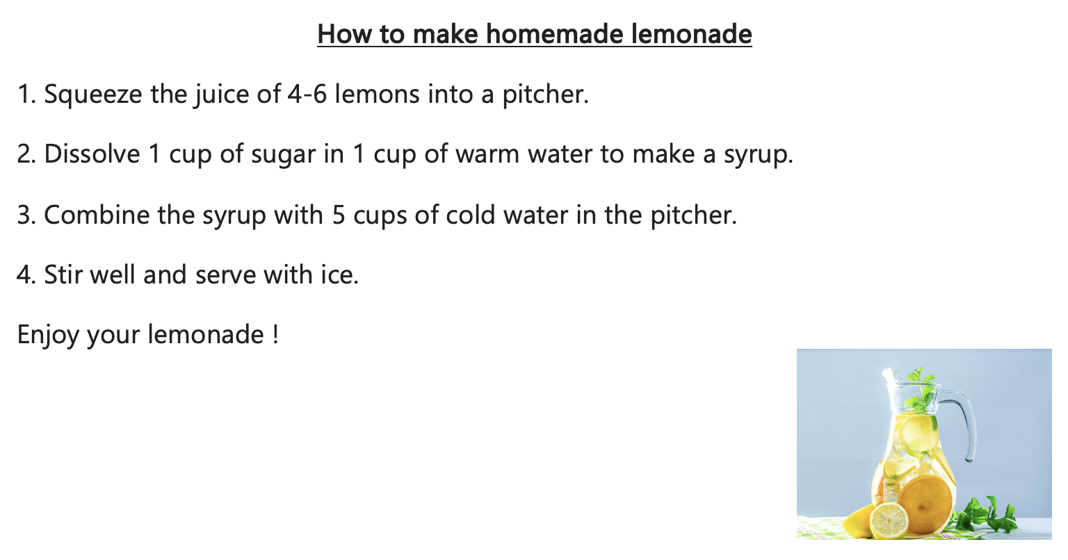
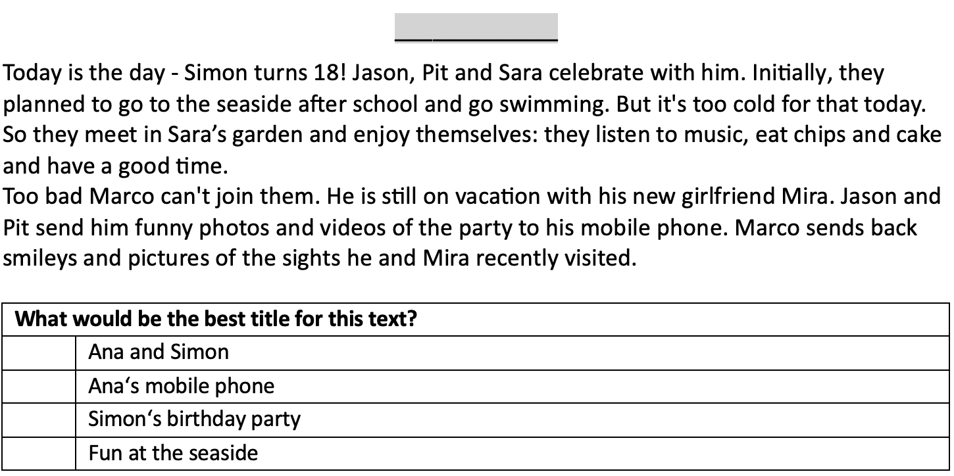
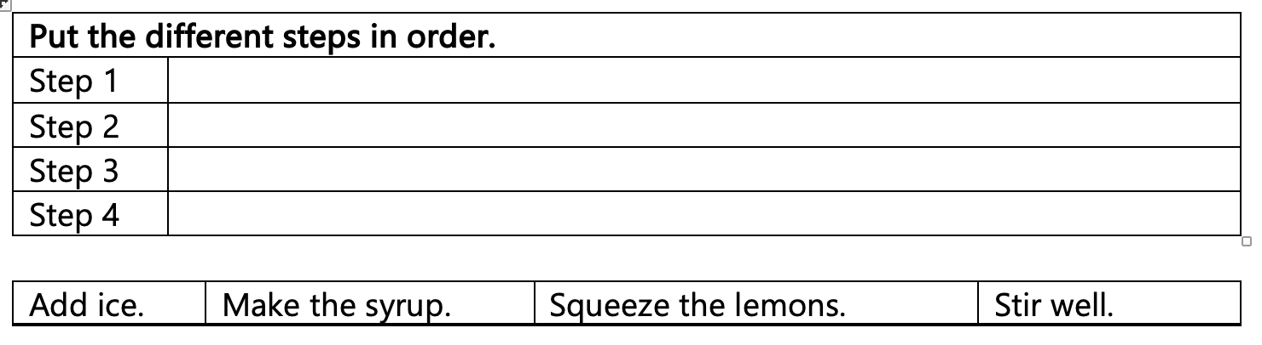
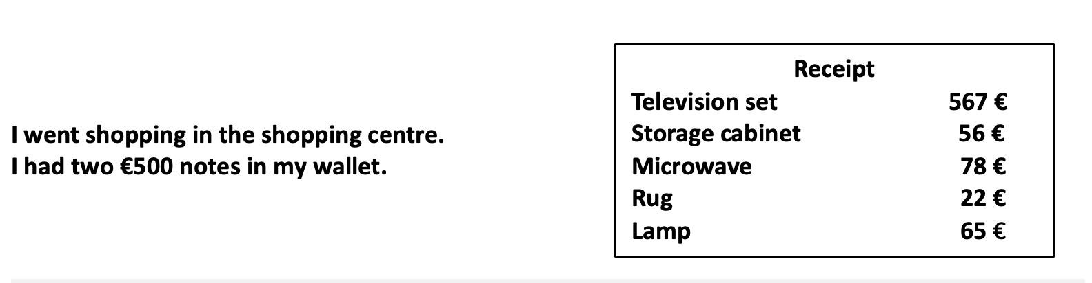
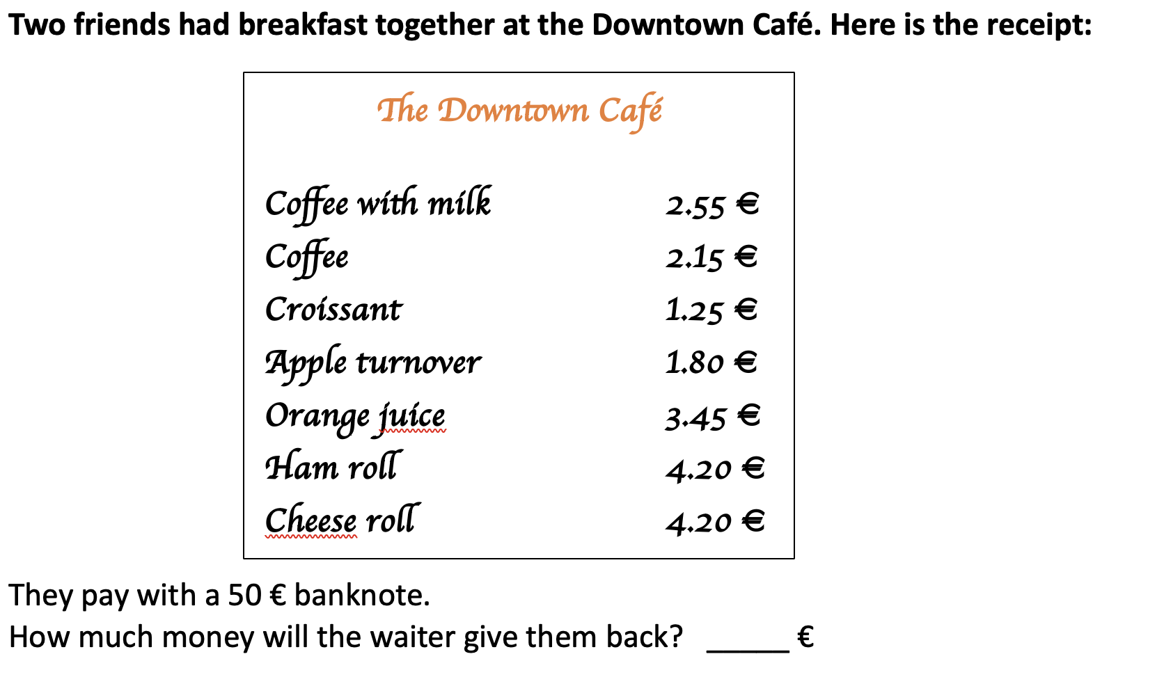
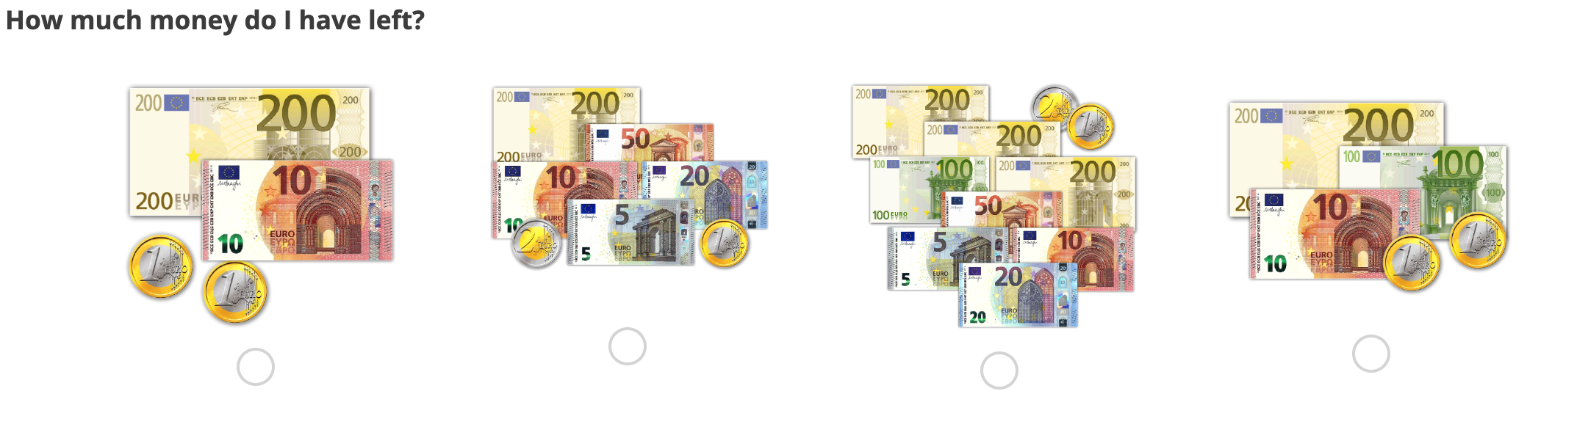
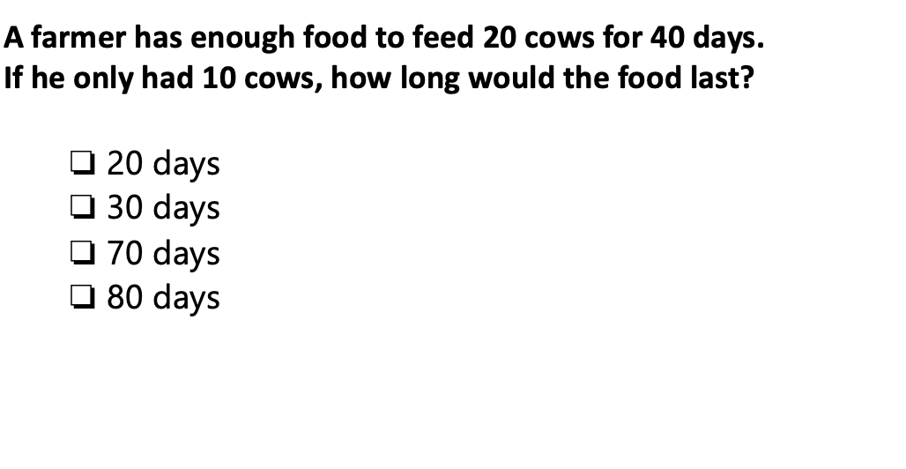

Spotlight on ESG-VP students - a new approach to testing
Dr. Charlotte Krämer, Dr. Sylvie Gamo, Cécile Braun, Pamela Inostroza Fernandez, Dr. Philipp Sonnleitner
LUCET – University of Luxembourg
1. Context of the study:
Main goal of ÉpStan in Grade 9: testing the competencies students are expected to have, in order to successfully complete their academic year.
E.g., ÉpStan level 2 for reading comprehension in French and German: “The student can read linguistically, thematically, and structurally simple factual, functional, and media texts from his/her everyday life as well as literary texts.” (MEN, 2008)
E.g., ÉpStan level 1 for math: “Students can solve math problems that require the application of only one procedure.” (Sonnleitner et al., 2018; MEN, 2019)
But the tests are highly challenging for the vast
majority of VP students: they stay below ÉpStan
Niveau 1, and we don’t know much about their
basic reading and math competencies.
Therefore, the present study puts these VP students
in the spotlight and reveals what they can do!
2. Objectives:
Fine-tuning of ÉpStan competency tests.
More concrete description of ESG-VP students’ reading and math abilities & better feedback (more tangible and positively stated).
Increased motivation and chance for students to show their proficiency level.
In the long run: better-tailored interventions for ESG-VP students.
3. Research question, study design & item examples (G/F/M):
Research question: How to design reading and math items that better reflect ESG-VP students’ math and reading competencies?
Study design for languages based on 1) German study on different levels of functional illiteracy amongst adults (Grotlüschen & Riekmann, 2011; id., 2012) and 2) on expert knowledge and experiences of teachers from Luxembourg:
Level 0.1: decoding of single words (VP modules 1-2)
Level 0.2: decoding of single sentences (VP modules 2-3)
Level 0.3: decoding of short texts (VP modules 3-4)
Study design for math: items reflecting the ESG-VP curriculum (Modules 1-5):
4. Methods and first results for German (2022):
Tasks were administered online using the web-based platform OASYS. Students responded on lap-top or desktop computers to 27 main test tasks and to up to 16 pretest tasks in a closed answer format. Test time was restricted to 45 minutes for the main test and to 25 minutes for the pretest. Task difficulties are based on ÉpStan main test 2022 (n = 6699) and ÉpStan pretest data (n = 242). Tasks were unidimensionally scaled using a 1-PL model within the R-package “TAM”, task difficulties range typically from -3 to 3 logits.
5. Outlook:
First results for French and math will be available in spring 2024 (drawn from ÉpStan pretest in autumn 2023), building the base for future research and test development in Grade 9.
6. Limitations:
Background variables (SES, gender, language spoken at home, migration background) have not yet been exploited. But we know from past studies, that ESG-VP students form a rather heterogeneous group whose weak academic performances are typically due to an interplay of several unfavourable factors.
Due to study design (online assessment), questions measuring reading skills on word level require reading skills beyond that level.
7. Literature (selection):
Grotlüschen, A.; Riekmann, W. (2011): leo. – Leve-One Studie, Literalität von Erwachsenen auf den unteren Kompetenz-niveaus. Presseheft, Universität Hamburg.
Grotlüschen, A.; Riekmann, W. (2012): Funktionaler Analphabetismus in Deutschland. Ergebnisse der ersten leo. – Level-One Studie. Münster: Waxmann.
MEN (2008). Bildungsstandards Sprachen. Leitfaden für den kompetenzorientierten Sprachenunterricht an Luxemburger Schulen. Luxemburg: MEN.
MEN (2019). Mathématiques, Référentiel de compétences pour la voie préparatoire.
MEN (2020). Dossier d'information. La voie de préparation de l'enseignement secondaire général.
Sonnleitner, P., Krämer, C., Gamo, S., Reichert, M., Muller, C., Keller, U. & Ugen, S. (2018).Schülerkompetenzen im Längsschnitt – Die Entwicklung von Deutsch-Leseverstehen und Mathematik in Luxemburg zwischen der 3. und 9. Klasse. In LUCET & SCRIPT, Nationaler Bildungsbericht Luxemburg 2018 (S. 39–58). Luxemburg: LUCET & MEN.
Key insights:
Different theoretical task levels show clearly distinguishable empirical difficulties.
Empirical pretest difficulties are on average 0.8 higher on ÉpStan scale than main test difficulties (pretest taken at the end of a long test morning: lower motivation; higher % of missing answers)!
Considering that, level 0.x tasks broaden the difficulty spectrum compared to regular ÉpStan main test tasks for ESG-VP students.
Rational-based task development allows for more fine-grained assessment of lower reading skills.
Source: https://dashboard.epstan.lu
Example: Level 0.1: decoding of single words
Example: Level 0.2: decoding of single sentences
Example: Level 0.3: decoding of short texts
For examples, see section 4!
Example: Math, module 1
Example: Math, module 3
Example: Math, module 5
contact: charlotte.kraemer@uni.lu

Slide 2

Spotlight on ESG-VP students - a new approach to testing
Dr. Charlotte Krämer, Dr. Sylvie Gamo, Cécile Braun, Pamela Inostroza Fernandez, Dr. Philipp Sonnleitner
LUCET – University of Luxembourg
1. Context of the study:
Main goal of ÉpStan in Grade 9: testing the competencies students are expected to have, in order to successfully complete their academic year.
E.g., ÉpStan level 2 for reading comprehension in French and German: “The student can read linguistically, thematically, and structurally simple factual, functional, and media texts from his/her everyday life as well as literary texts.” (MEN, 2008)
E.g., ÉpStan level 1 for math: “Students can solve math problems that require the application of only one procedure.” (Sonnleitner et al., 2018; MEN, 2019)
But the tests are highly challenging for the vast
majority of VP students: they stay below ÉpStan
Niveau 1, and we don’t know much about their
basic reading and math competencies.
Therefore, the present study puts these VP students
in the spotlight and reveals what they can do!
2. Objectives:
Fine-tuning of ÉpStan competency tests.
More concrete description of ESG-VP students’ reading and math abilities & better feedback (more tangible and positively stated).
Increased motivation and chance for students to show their proficiency level.
In the long run: better-tailored interventions for ESG-VP students.
3. Research question, study design & item examples (G/F/M):
Research question: How to design reading and math items that better reflect ESG-VP students’ math and reading competencies?
Study design for languages based on 1) German study on different levels of functional illiteracy amongst adults (Grotlüschen & Riekmann, 2011; id., 2012) and 2) on expert knowledge and experiences of teachers from Luxembourg:
Level 0.1: decoding of single words (VP modules 1-2)
Level 0.2: decoding of single sentences (VP modules 2-3)
Level 0.3: decoding of short texts (VP modules 3-4)
Study design for math: items reflecting the ESG-VP curriculum (Modules 1-5):
4. Methods and first results for German (2022):
Tasks were administered online using the web-based platform OASYS. Students responded on lap-top or desktop computers to 27 main test tasks and to up to 16 pretest tasks in a closed answer format. Test time was restricted to 45 minutes for the main test and to 25 minutes for the pretest. Task difficulties are based on ÉpStan main test 2022 (n = 6699) and ÉpStan pretest data (n = 242). Tasks were unidimensionally scaled using a 1-PL model within the R-package “TAM”, task difficulties range typically from -3 to 3 logits.
5. Outlook:
First results for French and math will be available in spring 2024 (drawn from ÉpStan pretest in autumn 2023), building the base for future research and test development in Grade 9.
6. Limitations:
Background variables (SES, gender, language spoken at home, migration background) have not yet been exploited. But we know from past studies, that ESG-VP students form a rather heterogeneous group whose weak academic performances are typically due to an interplay of several unfavourable factors.
Due to study design (online assessment), questions measuring reading skills on word level require reading skills beyond that level.
7. Literature (selection):
Grotlüschen, A.; Riekmann, W. (2011): leo. – Leve-One Studie, Literalität von Erwachsenen auf den unteren Kompetenz-niveaus. Presseheft, Universität Hamburg.
Grotlüschen, A.; Riekmann, W. (2012): Funktionaler Analphabetismus in Deutschland. Ergebnisse der ersten leo. – Level-One Studie. Münster: Waxmann.
MEN (2008). Bildungsstandards Sprachen. Leitfaden für den kompetenzorientierten Sprachenunterricht an Luxemburger Schulen. Luxemburg: MEN.
MEN (2019). Mathématiques, Référentiel de compétences pour la voie préparatoire.
MEN (2020). Dossier d'information. La voie de préparation de l'enseignement secondaire général.
Sonnleitner, P., Krämer, C., Gamo, S., Reichert, M., Muller, C., Keller, U. & Ugen, S. (2018).Schülerkompetenzen im Längsschnitt – Die Entwicklung von Deutsch-Leseverstehen und Mathematik in Luxemburg zwischen der 3. und 9. Klasse. In LUCET & SCRIPT, Nationaler Bildungsbericht Luxemburg 2018 (S. 39–58). Luxemburg: LUCET & MEN.
Key insights:
Different theoretical task levels show clearly distinguishable empirical difficulties.
Empirical pretest difficulties are on average 0.8 higher on ÉpStan scale than main test difficulties (pretest taken at the end of a long test morning: lower motivation; higher % of missing answers)!
Considering that, level 0.x tasks broaden the difficulty spectrum compared to regular ÉpStan main test tasks for ESG-VP students.
Rational-based task development allows for more fine-grained assessment of lower reading skills.
Source: https://dashboard.epstan.lu
Example: Level 0.1: decoding of single words
Example: Level 0.2: decoding of single sentences
Example: Level 0.3: decoding of short texts
For examples, see section 4!
Example: Math, module 1
Example: Math, module 3
Example: Math, module 5
contact: charlotte.kraemer@uni.lu

Slide 3
Left overs

