Slide 1

LuxPARK Metabolomics data analysis and modelling
Elisa Gómez de Lope
Biomedical Data Science Group
Notes:
Intro

Slide 2
LuxPARK metabolomics analysis and modelling
Goals: - Characterize blood metabolomics changes in PD vs. controls - Build prediction models for clinical outcomes & identify molecular network alterations
Data: LC-MS metabolomics (Metabolon) using 1500 LuxPARK blood plasma samples
Baseline analysis (1300 samples)
PD (593, including 56 de novo PD) and Controls (592)
all PD with dementia (PDD, 46)
3 forms of atypical parkinsonism (PSP: 46, MSA-P: 12, CBS: 11)
Longitudinal analysis (200 samples)
Annual follow-up visits 1 & 2 for 100 PD patients in the baseline analysis (4 timepoints of data overall)
Balanced genders (50/50)

Slide 3
Differential analysis and confounder adjustments
Goal: Identify PD-associated metabolite alterations, independent from common confounders
Method:
Statistic: empirical Bayes moderated t-statistic, comparing idiopathic PD vs. matched controls
Adjustments: Adjust for age, gender, BMI and L-Dopa treatment effects by using 3-O-Methyldopa (=3-Methoxytyrosine) levels + comparison de novo PD vs. controls
Test for other confounders: Principal variance component analysis (PVCA) does not suggest the presence of further confounders with major effects in our clinical data

Slide 4
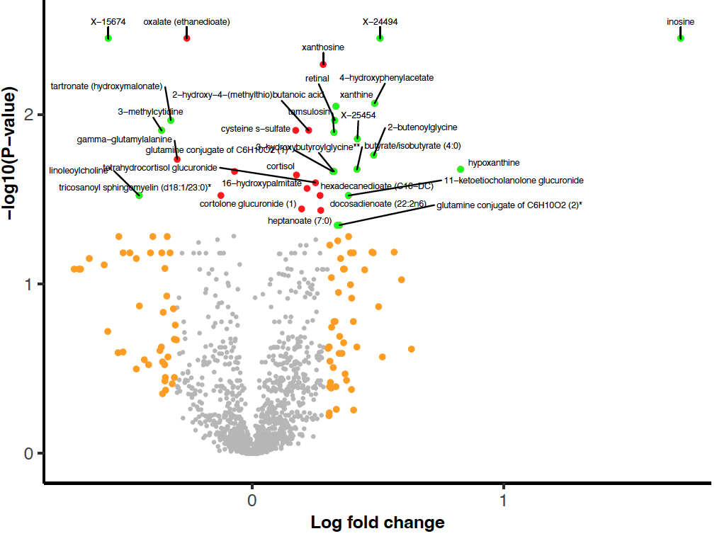
Metabolomics – Volcano plot (de novo PD vs. control)
Xanthine metabolism
FDR < 0.05
Abs(logFC) > 0.3
Abs(logFC) > 0.3 & FDR < 0.05

Slide 5
Shared significant metabolites – de novo PD & all-PD vs. Ctrl
 | De novo PD vs. Control |  |  | All PD vs. Control (adjusted)
Metabolite | logFC | P.Value | adj.P.Val | logFC | P.Value | adj.P.Val
inosine | 1.70 | 1.05E-05 | 3.56E-03 | 0.65 | 2.65E-03 | 3.04E-02
X-24494 | 0.51 | 1.19E-05 | 3.56E-03 | 0.26 | 4.34E-05 | 1.54E-03
tartronate (hydroxymalonate) | -0.32 | 6.77E-05 | 1.08E-02 | -0.17 | 6.18E-04 | 1.03E-02
retinal | 0.33 | 7.26E-05 | 1.08E-02 | 0.13 | 5.26E-03 | 4.77E-02
hypoxanthine | 0.83 | 2.70E-04 | 2.12E-02 | 0.47 | 1.24E-04 | 3.26E-03
16-hydroxypalmitate | 0.22 | 4.58E-04 | 2.73E-02 | 0.11 | 1.63E-03 | 2.13E-02
linoleoylcholine* | -0.45 | 5.86E-04 | 3.01E-02 | -0.31 | 2.11E-05 | 9.84E-04
Blue = xanthine metabolites

Slide 6
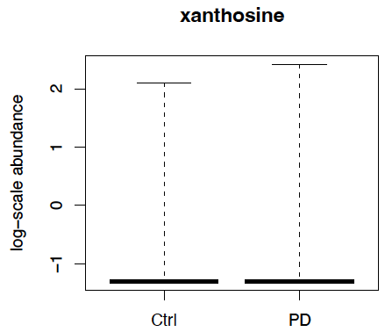
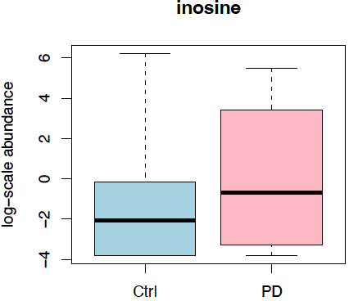
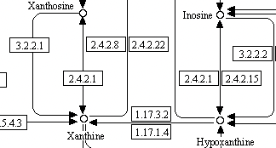
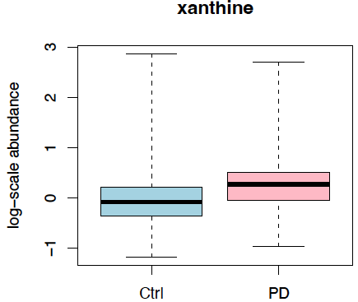
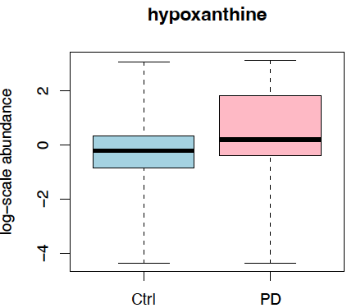
Purine/xanthine metabolism in de novo PD vs. controls
Core interactions in the KEGG Purine metabolism pathway

Slide 7
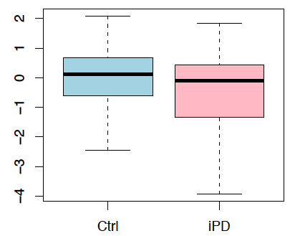
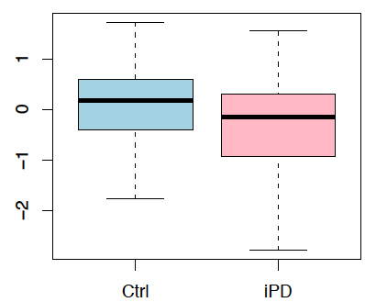
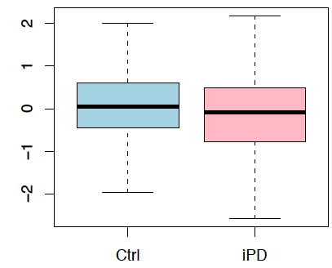
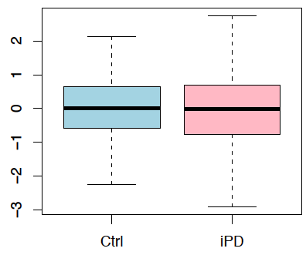
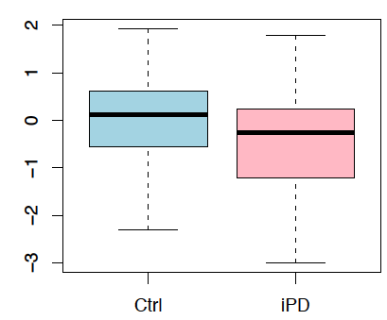
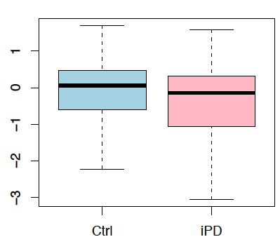
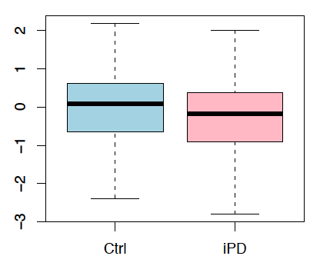
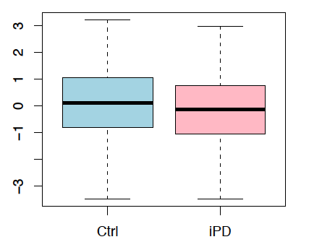
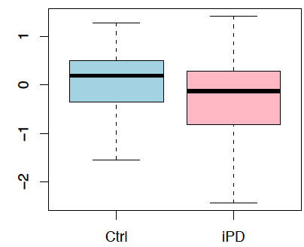
Caffeine/xanthine metabolism in PD vs. Control
caffeine
theophylline
3-methylxanthine
Consistent with previous results reported by Hattori et al. (2015)
theobromine
1,3-dimethylurate
paraxanthine
1-methyxanthine
1-methylurate
AAMU
1,7-dimethylurate
A significant correlation between coffee consumption and a decreased risk of PD has been reported in Hong et al. (2020): The effect of caffeine on the risk and progression of Parkinson’s Disease: A meta-analysis.

Slide 8
Prior research on xanthine/caffeine derivatives in PD
Xanthine and caffeine derivatives showed neuroprotective effects in multiple in vitro and in vivo PD models (Xu et al., 2010; Kasabova-Angelova et al., 2020) → proposed as potential drug candidates
The substituted xanthine molecule is used as a scaffold for the synthesis of new compounds
Proposed mechanisms of action: - Antagonism of adenosine A2A receptors (targeted by the drug Istradefylline) - Monoamine Oxidase type B (MAO-B) inhibition
xanthine
paraxanthine
caffeine
inosine
hypoxanthine

Slide 9
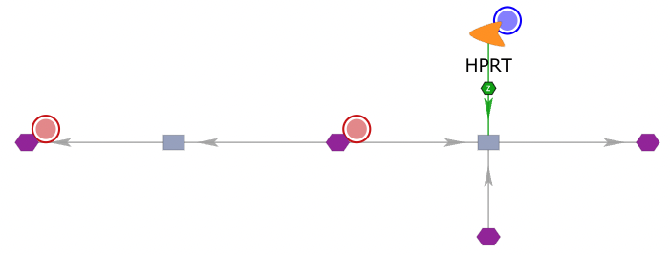


Joint metabolomics & transcriptomics network analysis
hypoxanthine phosphoribosyltransferase → Decreased in PD transcriptomics data: Brain (p < 2E-15, Meta-analysis) Blood (p = 0.03, Tübingen cohort)
XDH
1
xanthine
hypoxanthine
IMP
ATP
AMP
Increased in PD Decreased in PD
Pyrophosphate
cellular ATP deficiency in PD?
inosine
Phosphoribose diphosphate
・HPRT1 over-expression inhibits DA neuron loss in 6-OHDA mice by activating Wnt/ß-catenin signaling (Jiang et al., Aging, 2020)
・Open-label, single arm trial (26 PD patients): inosine + XDH inhibitor increased blood hypoxanthine and ATP, and decreased UPDRS III score (Watanabe et al., 2020)

Slide 10

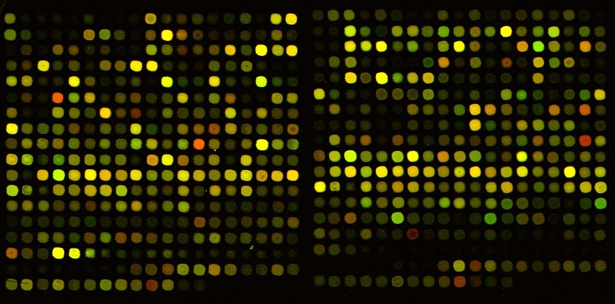
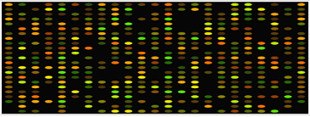

Generation of pathway-level features
Purine Metabolism, (Hypo)Xanthine/Inosine containing
Purine Metabolism, (Hypo)Xanthine/ Inosine containing
Hypoxanthine Inosine Allantoin Xanthine Urate Xanthosine N1-methylinosine …..
i₁ | Agg(P₁i₁)
i₂ | Agg(P₁i₂)
… | …
i_{n} | Agg(P₁i_{n})
i
P
1
i
1
1
i
P
2
i
1
2
…
…
i
P
n
i
1
n
Temporal metabolomics matrices (4xmxn)
Temporal aggregated matrices (4xmxp)
T3
Aggregation based on KEGG mappings
T2
T3
T1
T2
T0
T1
T0
Aggregation statistics + PCA, Pathifier’s dimension reduction-derived deregulation scores
KEGG
Database Mapping
KEGG

Slide 11
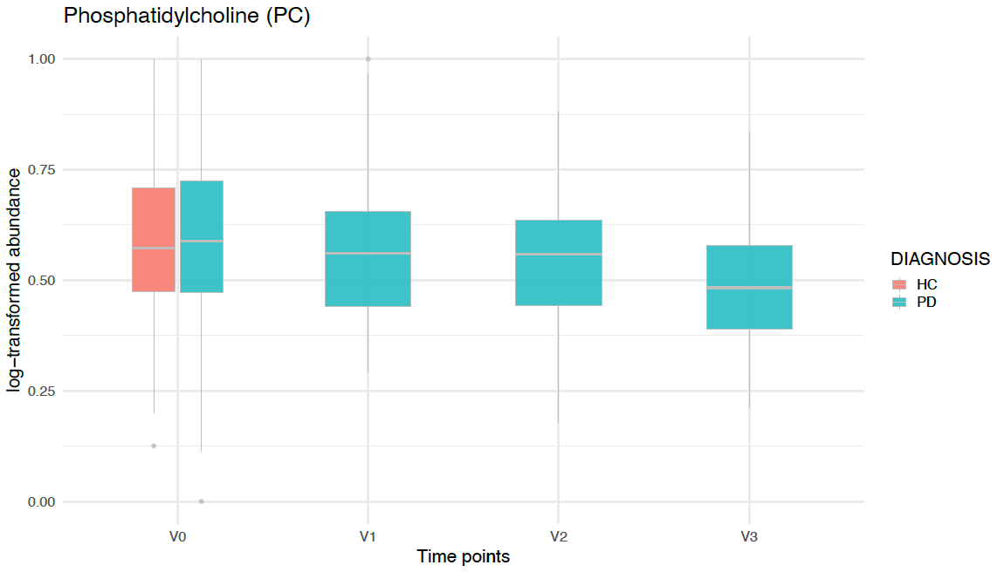
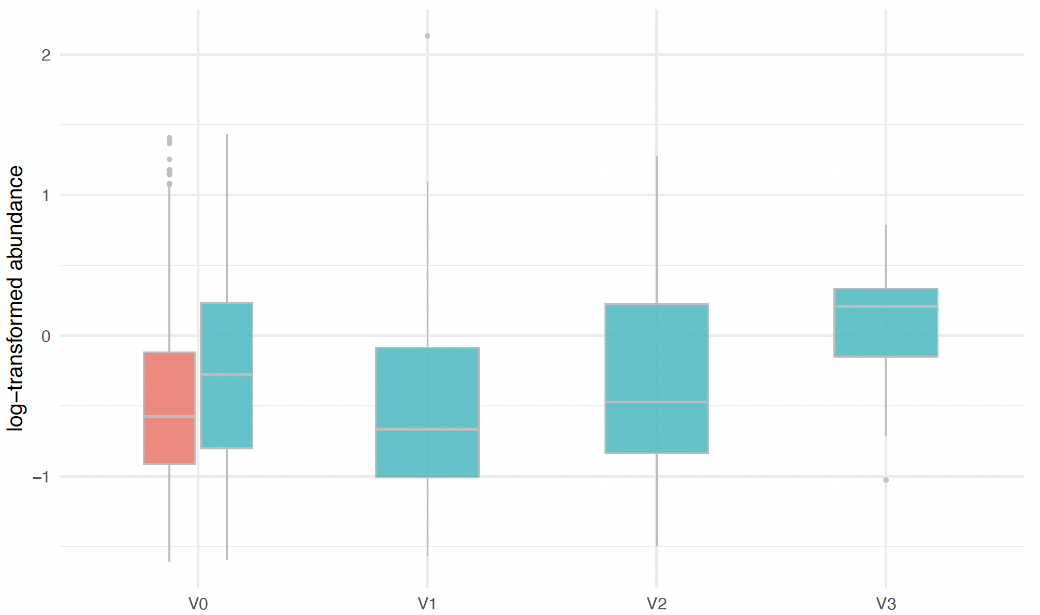
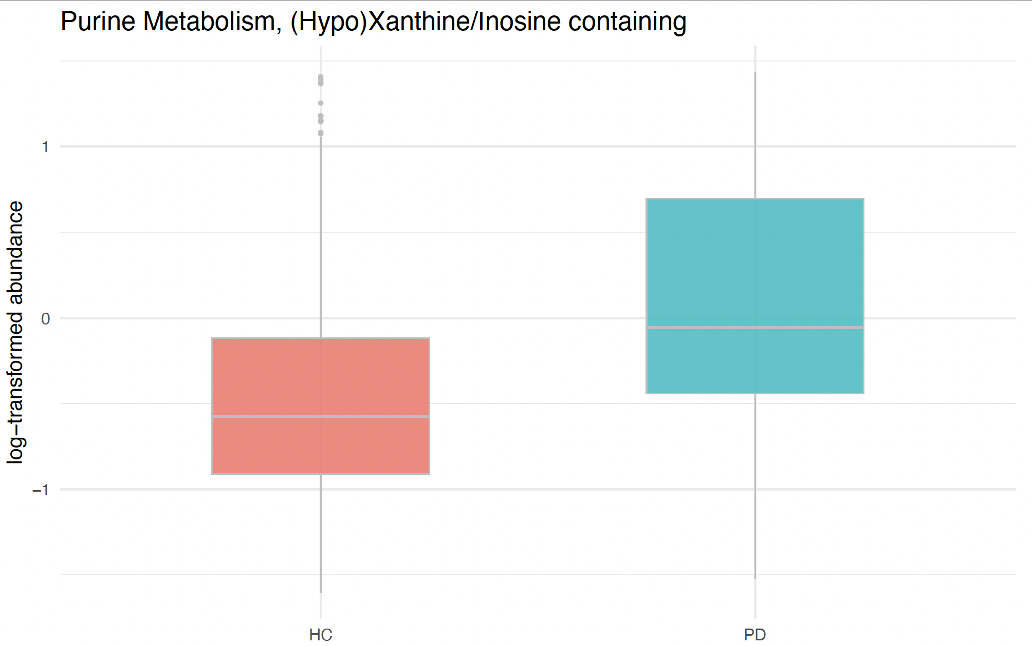
Purine Metabolism, (Hypo)Xanthine/Inosine containing pathway at baseline and over time
Positive association with time
Upregulated in de novo PD vs controls at baseline
Average log-transformed abundance
Average log-transformed abundance
HC
PD
T0
T1
T2
T3

Slide 12
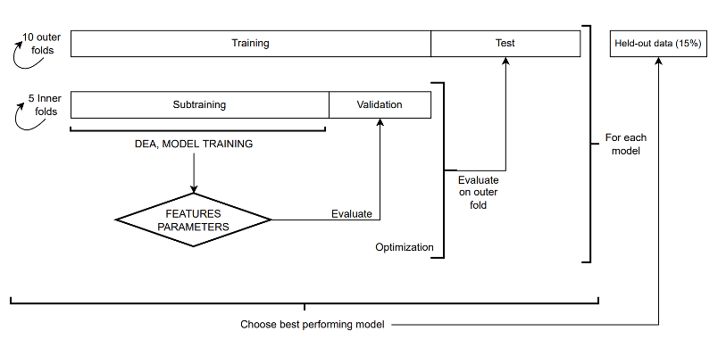
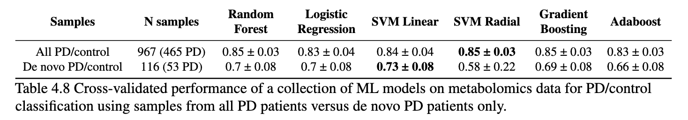

ML models on metabolomics data: predicing PD diagnosis
ML models were run in a nested cross-validation setting including feature selection and hyperparameter optimization
Lasso
Treatment effect addressed by filtering out metabolites:
- with Pearson correlation > 0.2 with 3-Methoxytyrosine levels
- Tyrosine and Tryptophan metabolism pathways

Slide 13
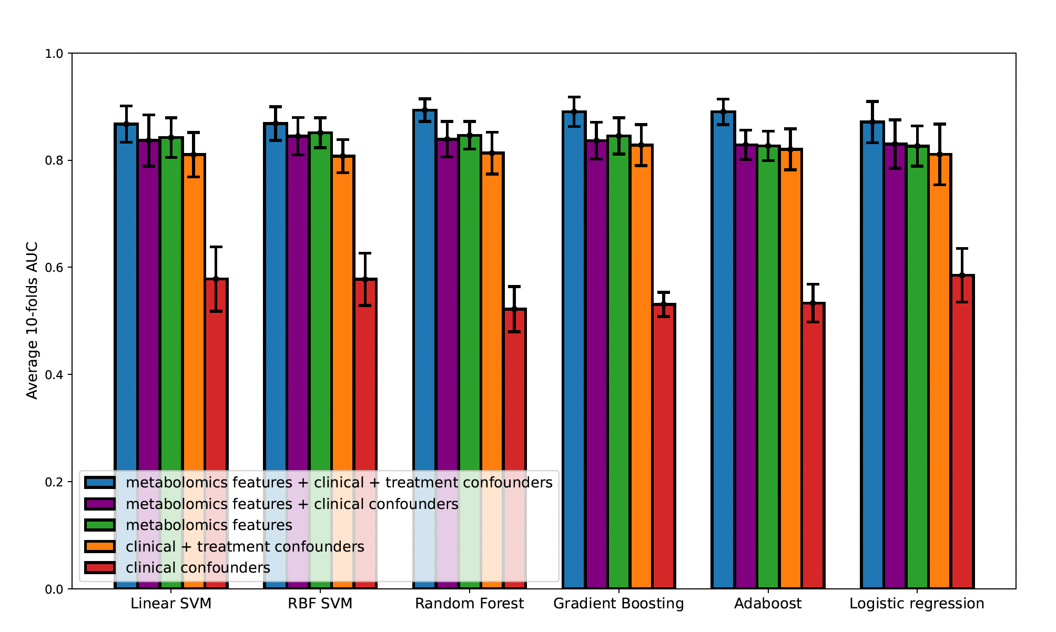
ML analyses on metabolomics data: Confounding effects
Confounding effect of medication >> clinical confounders (age, gender, BMI)

Slide 14
Xanthines as relevant features from predictive PD diagnosis
Shap values of (mean -aggregated) KEGG pathways on SVM model with radial kernel (all PD vs. controls)

Slide 15
Xanthines as relevant features from predictive UPDRS III (binarized)
Shap values of (mean -aggregated) KEGG pathways on Logistic regression model

Slide 16
Outlook
• Metabolic network analysis → Use further methods to exploit the graph structure of metabolite-metabolite interaction network
→ Score enzyme-metabolite subnetwork alterations (including single-cell transcriptomics data)
• Longitudinal machine learning analyses
→ Prediction of future motor and non-motor outcomes, using temporal differences between first visits as dynamic biomarkers

Slide 17
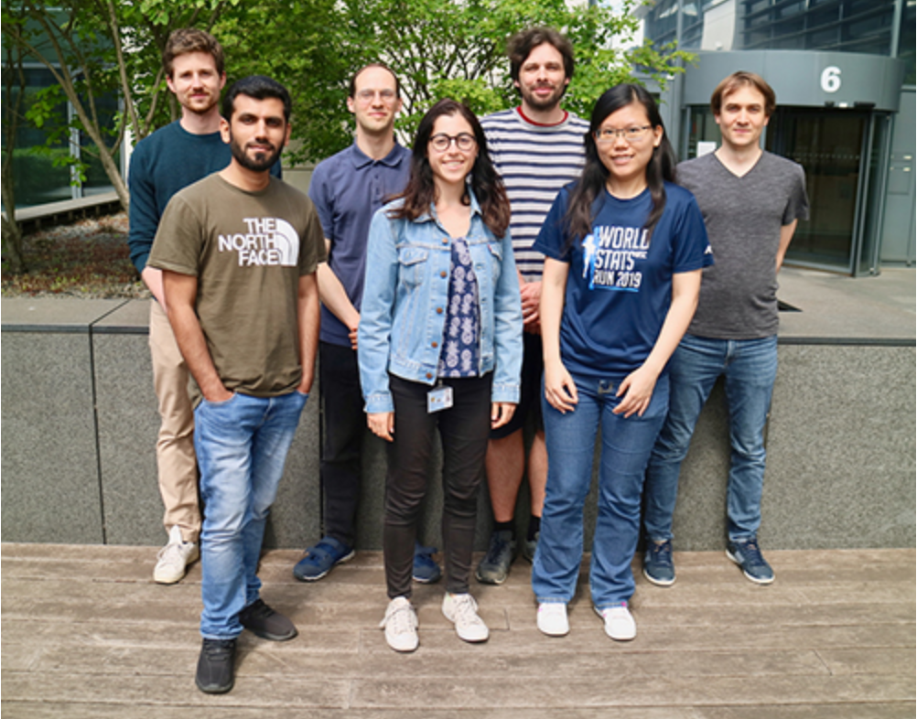
LuxPARK Metabolomics data analysis and modelling
Enrico Glaab
A. Rauschenberger
M. Ali
R. Loo
F. Nasta
S. Le Bars
C. Brzenczek
L.-C. Tranchevent
Q. Klopfenstein
M. Ledda
Elisa Gómez de Lope
Biomedical Data Science Group

Slide 18
Top-ranked metabolites - de novo PD vs. control
Metabolite | logFC | P.Value | adj.P.Val
oxazepam (sedative, medication effect) | 0.12 | 1.93E-07 | 2.87E-04
oxalate (ethanedioate) | -0.26 | 8.42E-06 | 3.56E-03
X-15674 | -0.57 | 9.45E-06 | 3.56E-03
inosine | 1.70 | 1.05E-05 | 3.56E-03
X-24494 | 0.51 | 1.19E-05 | 3.56E-03
xanthosine | 0.28 | 2.04E-05 | 5.06E-03
4-hydroxyphenylacetate | 0.49 | 4.04E-05 | 8.61E-03
xanthine | 0.33 | 4.83E-05 | 9.00E-03
tartronate (hydroxymalonate) | -0.32 | 6.77E-05 | 1.08E-02
retinal (matches with decreased ALDH1A1 levels) | 0.33 | 7.26E-05 | 1.08E-02
3-methylcytidine | -0.36 | 9.33E-05 | 1.25E-02
2-hydroxy-4-(methylthio)butanoic acid | 0.23 | 1.05E-04 | 1.25E-02
cysteine s-sulfate | 0.17 | 1.09E-04 | 1.25E-02
Tamsulosin (α1 adrenergic receptor antagonist) | 0.33 | 1.20E-04 | 1.27E-02
X-25454 | 0.42 | 1.40E-04 | 1.39E-02
2-butenoylglycine | 0.48 | 1.87E-04 | 1.75E-02
gamma-glutamylalanine | -0.30 | 2.10E-04 | 1.84E-02
butyrate/isobutyrate (4:0) | 0.42 | 2.65E-04 | 2.12E-02
hypoxanthine | 0.83 | 2.70E-04 | 2.12E-02
glutamine conjugate of C6H10O2 (1)* | 0.32 | 3.03E-04 | 2.17E-02
Xanthine
metabolism

Slide 19
Top-ranked metabolites - de novo PD vs. control
Metabolite | logFC | AveExpr | t | P.Value | adj.P.Val
oxazepam (sedative, medication effect) | 0.12 | -1.99 | 5.26 | 1.93E-07 | 2.87E-04
oxalate (ethanedioate) | -0.26 | 0.00 | -4.49 | 8.42E-06 | 3.56E-03
X-15674 | -0.57 | -0.35 | -4.47 | 9.45E-06 | 3.56E-03
inosine | 1.70 | -1.40 | 4.44 | 1.05E-05 | 3.56E-03
X-24494 | 0.51 | -0.40 | 4.41 | 1.19E-05 | 3.56E-03
xanthosine | 0.28 | -1.19 | 4.29 | 2.04E-05 | 5.06E-03
4-hydroxyphenylacetate | 0.49 | -0.50 | 4.13 | 4.04E-05 | 8.61E-03
xanthine | 0.33 | 0.01 | 4.09 | 4.83E-05 | 9.00E-03
tartronate (hydroxymalonate) | -0.32 | -0.03 | -4.01 | 6.77E-05 | 1.08E-02
retinal (matches with decreased ALDH1A1 levels) | 0.33 | -0.55 | 3.99 | 7.26E-05 | 1.08E-02
3-methylcytidine | -0.36 | -0.17 | -3.93 | 9.33E-05 | 1.25E-02
2-hydroxy-4-(methylthio)butanoic acid | 0.23 | -0.05 | 3.90 | 1.05E-04 | 1.25E-02
cysteine s-sulfate | 0.17 | -0.06 | 3.89 | 1.09E-04 | 1.25E-02
Tamsulosin (α1 adrenergic receptor antagonist) | 0.33 | -2.29 | 3.87 | 1.20E-04 | 1.27E-02
X-25454 | 0.42 | -0.43 | 3.83 | 1.40E-04 | 1.39E-02
2-butenoylglycine | 0.48 | -1.20 | 3.76 | 1.87E-04 | 1.75E-02
gamma-glutamylalanine | -0.30 | -0.02 | -3.73 | 2.10E-04 | 1.84E-02
butyrate/isobutyrate (4:0) | 0.42 | -0.48 | 3.67 | 2.65E-04 | 2.12E-02
hypoxanthine | 0.83 | -0.30 | 3.66 | 2.70E-04 | 2.12E-02
glutamine conjugate of C6H10O2 (1)* | 0.32 | 0.00 | 3.63 | 3.03E-04 | 2.17E-02
Xanthine
metabolism

