Slide 1
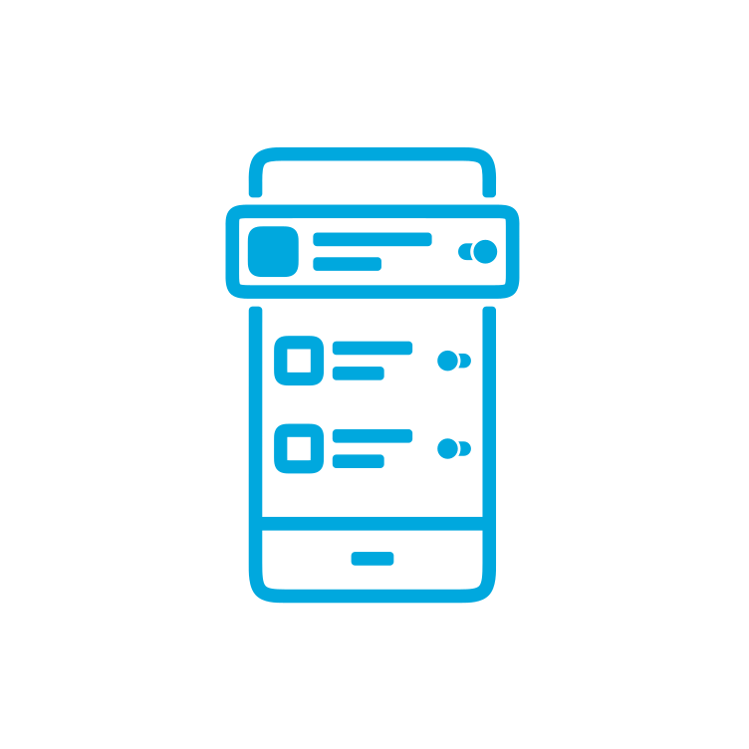
Analysing the Influence of Loss-Gain Framing on Data Disclosure Behaviour:
Euro USEC 2023 October 16 & 17, Copenhagen, Denmark
SUPPORTED BY THE LUXEMBOURG
NATIONAL RESEARCH FUND (FNR) IS/14717072
NextGenerationEU :“IR0000036” – CUP J13C2200040000
NextGenerationEU :Digitalization and Technology Research Center of the
A Study on the Use Case of App Permission Requests
KERSTIN BONGARD-BLANCHY, Luxembourg Media and Digital Design Center, Luxembourg
JEAN-LOUIS STERCKX, KU Leuven, Belgium
ARIANNA ROSSI, LIDER Lab, Dirpolis Institute, Scuola Superiore Sant’Anna, Italy
ANASTASIA SERGEEVA, University of Luxembourg, Luxembourg
VINCENT KOENIG, University of Luxembourg, Luxembourg
SALVADOR RIVAS, University of Luxembourg, Luxembourg
VERENA DISTLER, University of Luxembourg, Luxembourg, University of the Bundeswehr Munich, Germany

Slide 2
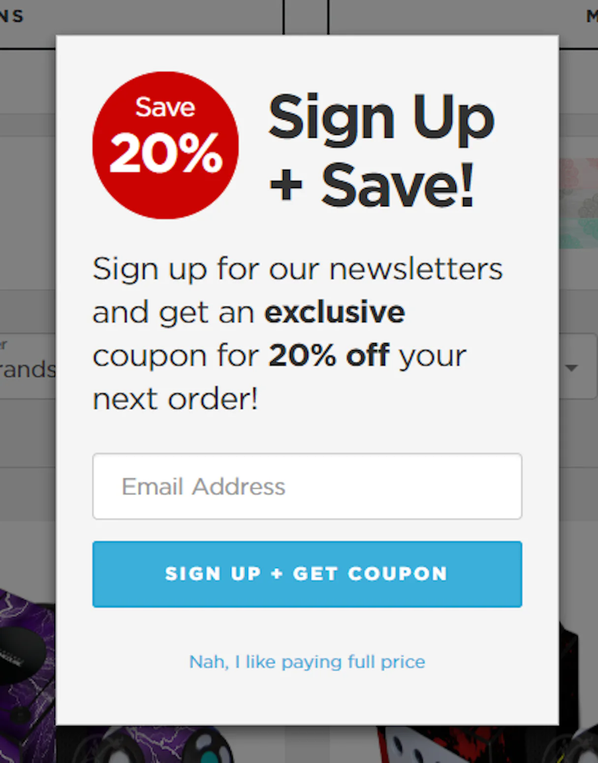
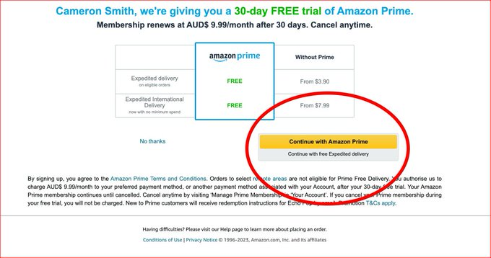
Deceptive design patterns
Deceptive patterns (also known as “dark patterns”) are tricks used in websites and apps that make you do things that you didn't mean to, like buying or signing up for something.
For example:
Trick wording
Sneaking
Obstruction
https://www.deceptive.design/
Notes:
Mostly visual techniques, but also text-based types, like “Confirmshaming”;

Slide 3
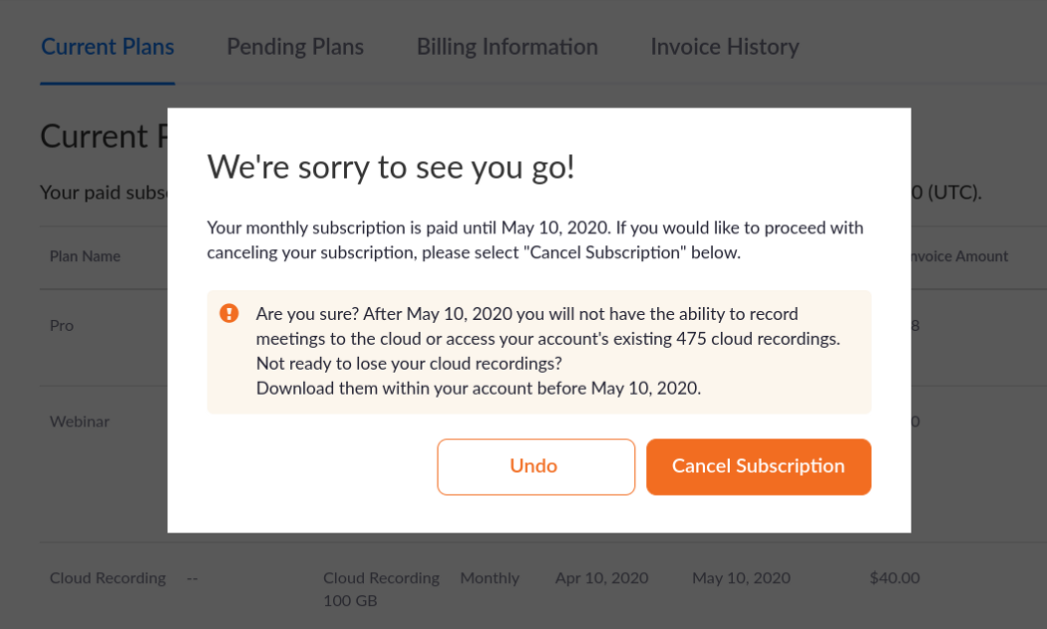
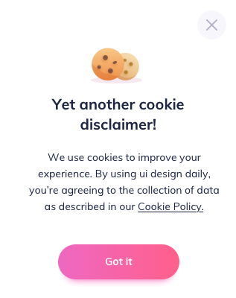
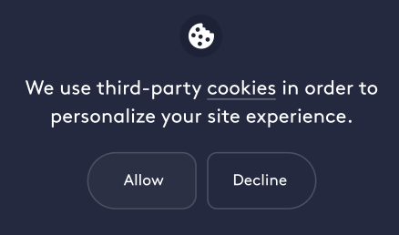
Loss-gain framing as deceptive
design patterns
EDPB condemns the implementation of “emotional steering”:
“using wording or visual elements [...] in a way that conveys information to users in either a highly positive outlook, making users feel good, safe or rewarded, or a highly negative one, making users feel anxious, guilty or punished”

Slide 4
Loss-gain framing as deceptive
design patterns
Does this really influence user choices?
The framing effect
Cognitive bias where people act differently based on how information is presented
(and not in the information itself).
Loss-gain framing
Presenting information in terms of potential losses or gains to influence decisions.

Slide 5
Our Research Questions
How does framing of app permission requests…
RQ1
…influence users’ disclosure behaviour?
Does this really influence user choices?
…influence people’s perception of being informed and their trust in the request?
RQ2
Notes:
What is the role of purpose uncertainty in the process?

Slide 6
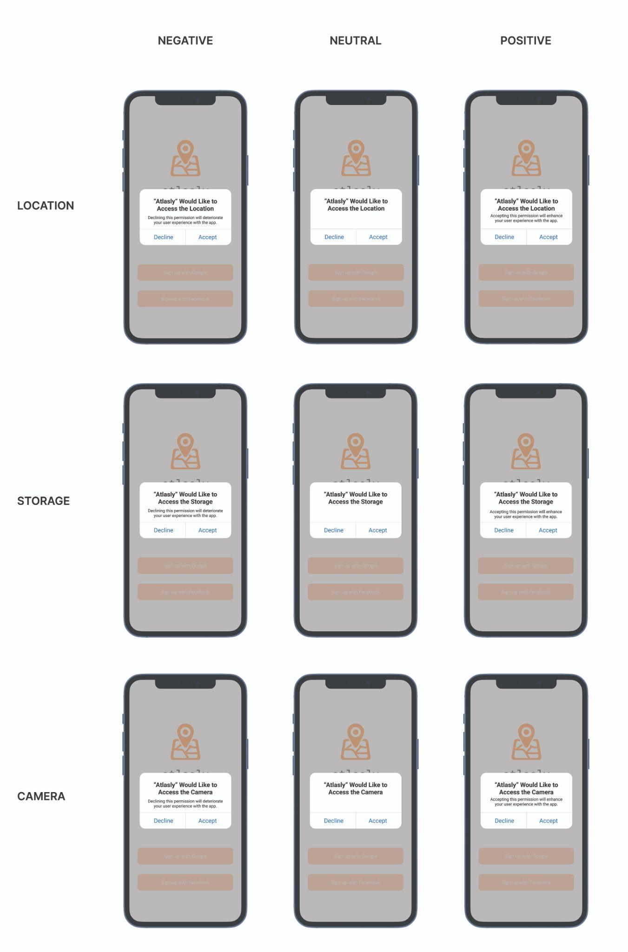
Study design
Use case:
App permission requests - privacy risk
9 variations of the same interface
Certainty as key factor
high certainty
Location
Certainty
Storage
Certainty
Use case selection via prestudy:
Bongard-Blanchy, K., Sterckx, J. L., Rossi, A., Distler, V., Rivas, S., & Koenig, V. (2022, June). An (Un) Necessary Evil-Users'(Un) Certainty about Smartphone App Permissions and Implications for Privacy Engineering. In 2022 IEEE European Symposium on Security and Privacy Workshops (EuroS&PW) (pp. 01-08). IEEE.
Camera
Certainty

Slide 7
Study design
Study design

Slide 8
Study scenario
Imagine…
you install a navigation app
you launch it for the first time
permission request
We would like to explore your interaction with our new navigation app
(no mention about disclosure)
We would like to explore your interaction with our new navigation app
(no mention about disclosure)

Slide 9
Study procedure
Demographics
Study scenario
Questions
5-point Likert scale:
People’s perception of being informed
Perceived trustworthiness
Sentence completion:
I decided to accept or decline this app permission request because…
Open question:
What are your thoughts and experiences regarding such requests from apps?
Accept/Decline
permission

Slide 10
Study sample
 | 96 | 100 | 81
 | 114 | 90 | 86
 | 84 | 94 | 103
Certainty
Certainty
Certainty
Prolific participants
Gender balance
UK residency
Fluent English
N=848
Distribution of participants across conditions

Slide 11
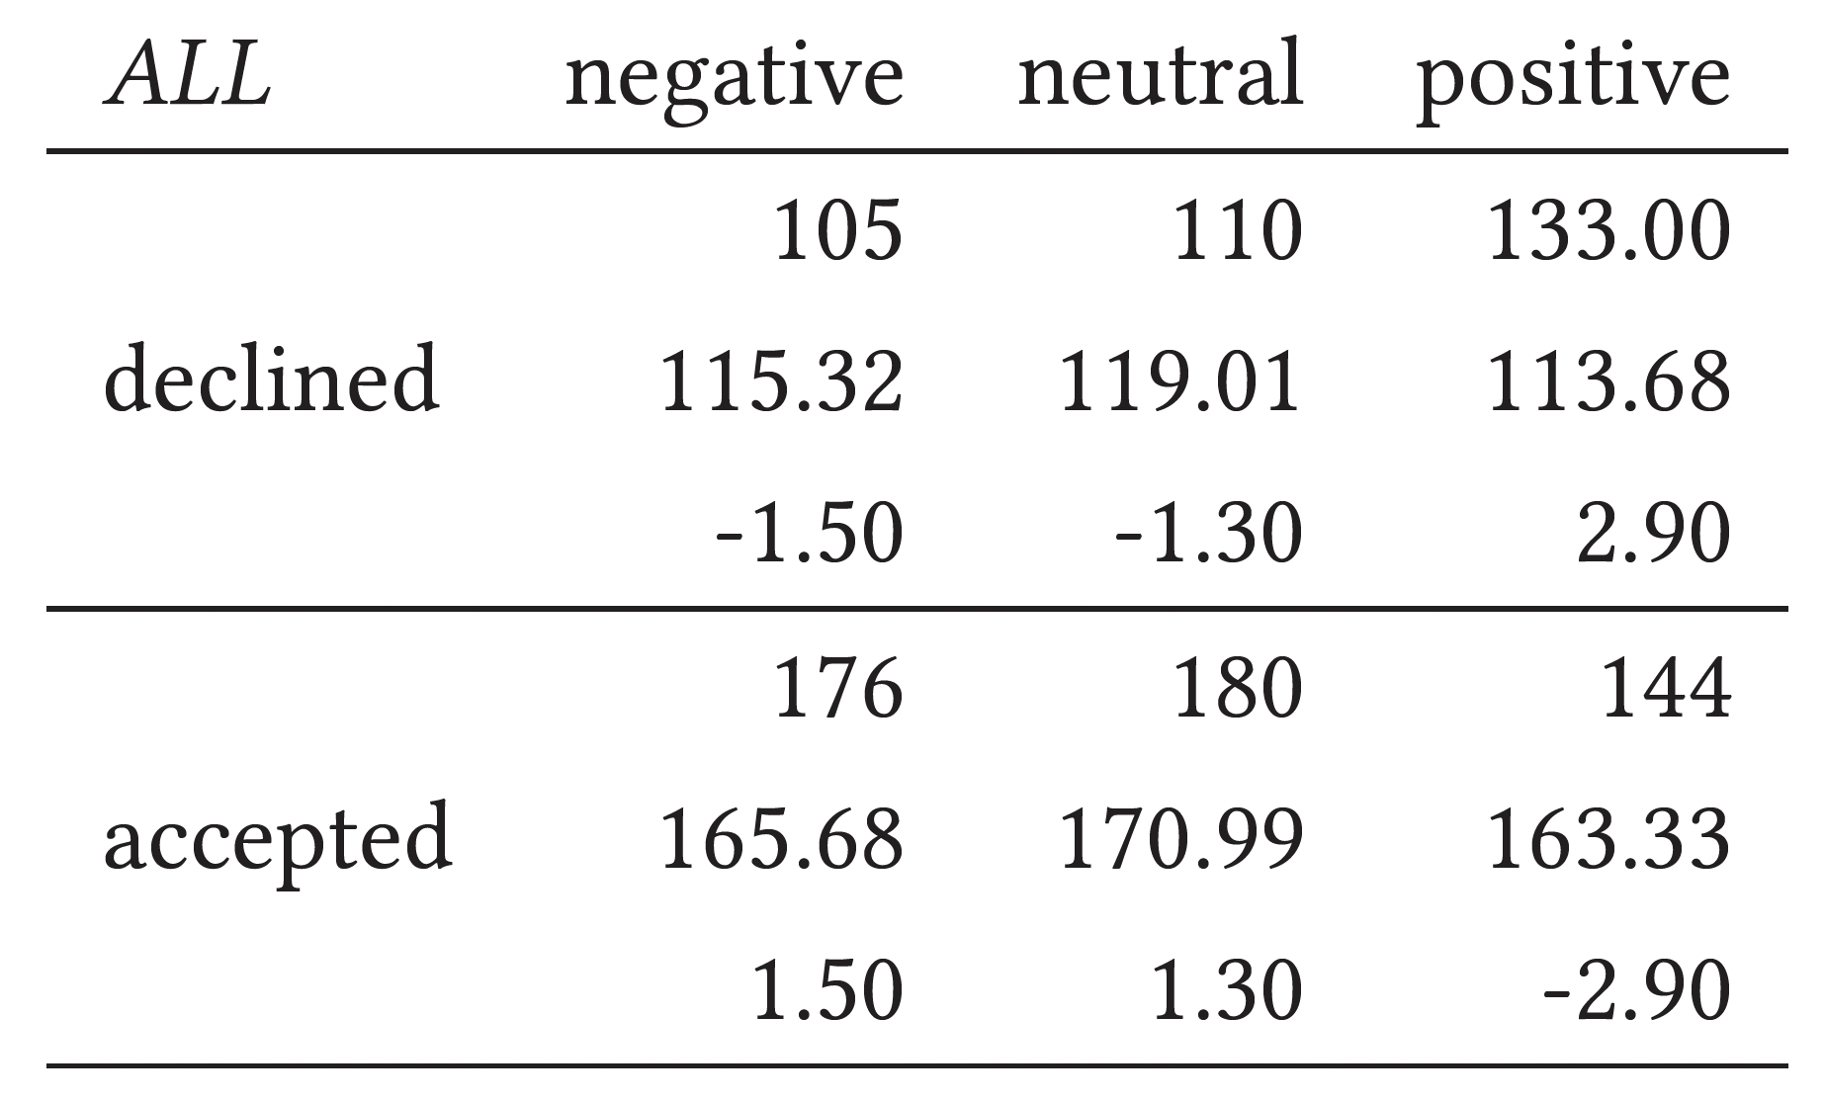
Results
Right-tailed 𝜒2 test of connection between framings and accepting/declining the app permission request with observed and expected frequency, adjusted residuals. 𝜒2 (2, 848) = 8.294, p = .016
RQ1
In contrast to our hypothesis,
Positive framing significantly increased rejection of permission request
Does framing effect disclosure behaviour?
YES!

Slide 12
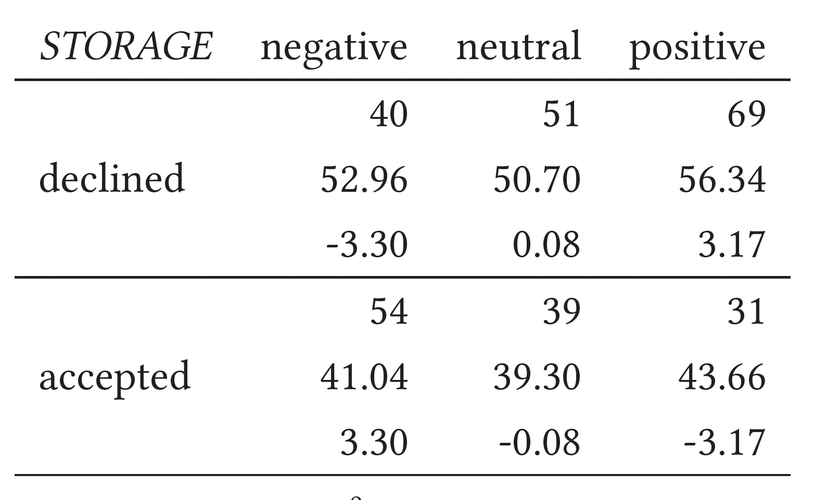
Results
Right-tailed 𝜒2 test on storage permission for three framings with observed and expected frequency,
adjusted residuals. 𝜒2 (2,284) = 13.7832, p= .001
RQ2
In a medium-certainty level we found some negative effect of positive framing and of positive effect of negative framing to acceptance*
What are the effects for different levels of (un)certainty?
YES!
Certainty
*
Positive - neutral z = -1.760, CI -.274;.015,p (one-sided) = .039
Neutral - negative z = -1.914, CI -.280;.015, p(one-sided) = .028
Positive - negative z = -3.710, CI -.398;-.127, p <.001)

Slide 13
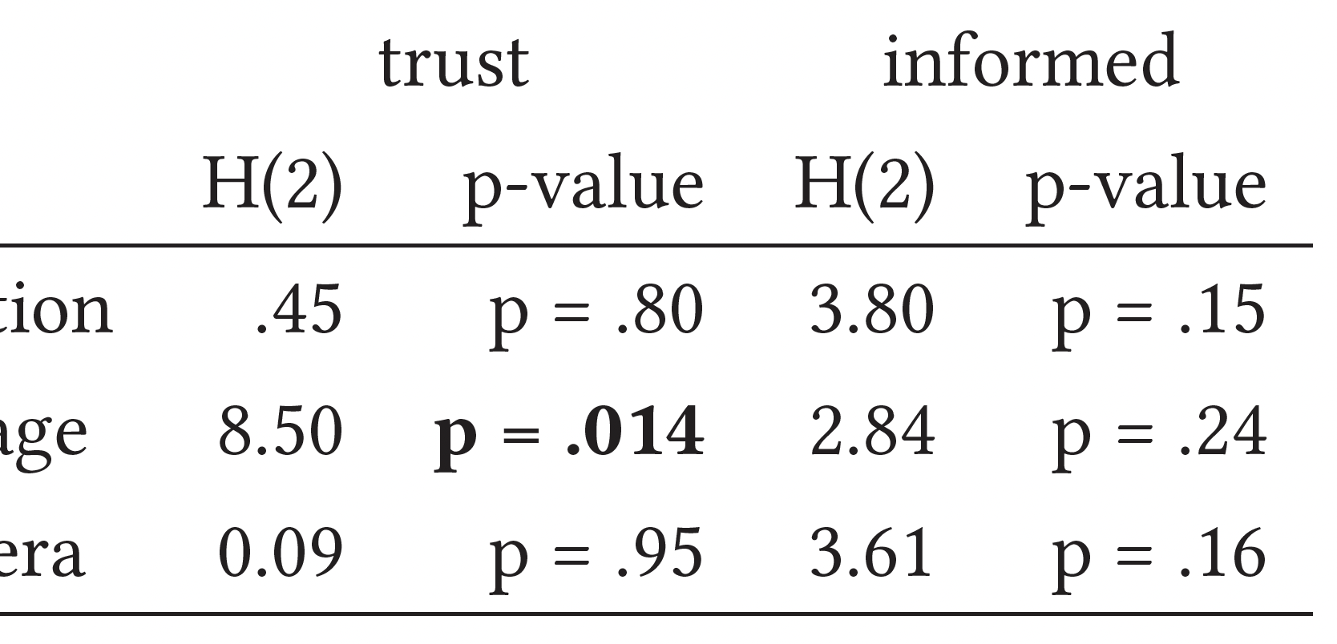
Results
Result of Kruskall-Wallis analysis of perceived
trustworthiness and perception of being informed ratings across permission request types
RQ2
We did not find significant differences between users perception of being informed across conditions.
What are effects
of framing and uncertainty on the perception of being informed and trustworthiness?
We found significant difference between positive and negative framing in trustworthiness.
YES!
Negative-framed app. permissions are perceived as significantly MORE trustworthy.

Slide 14
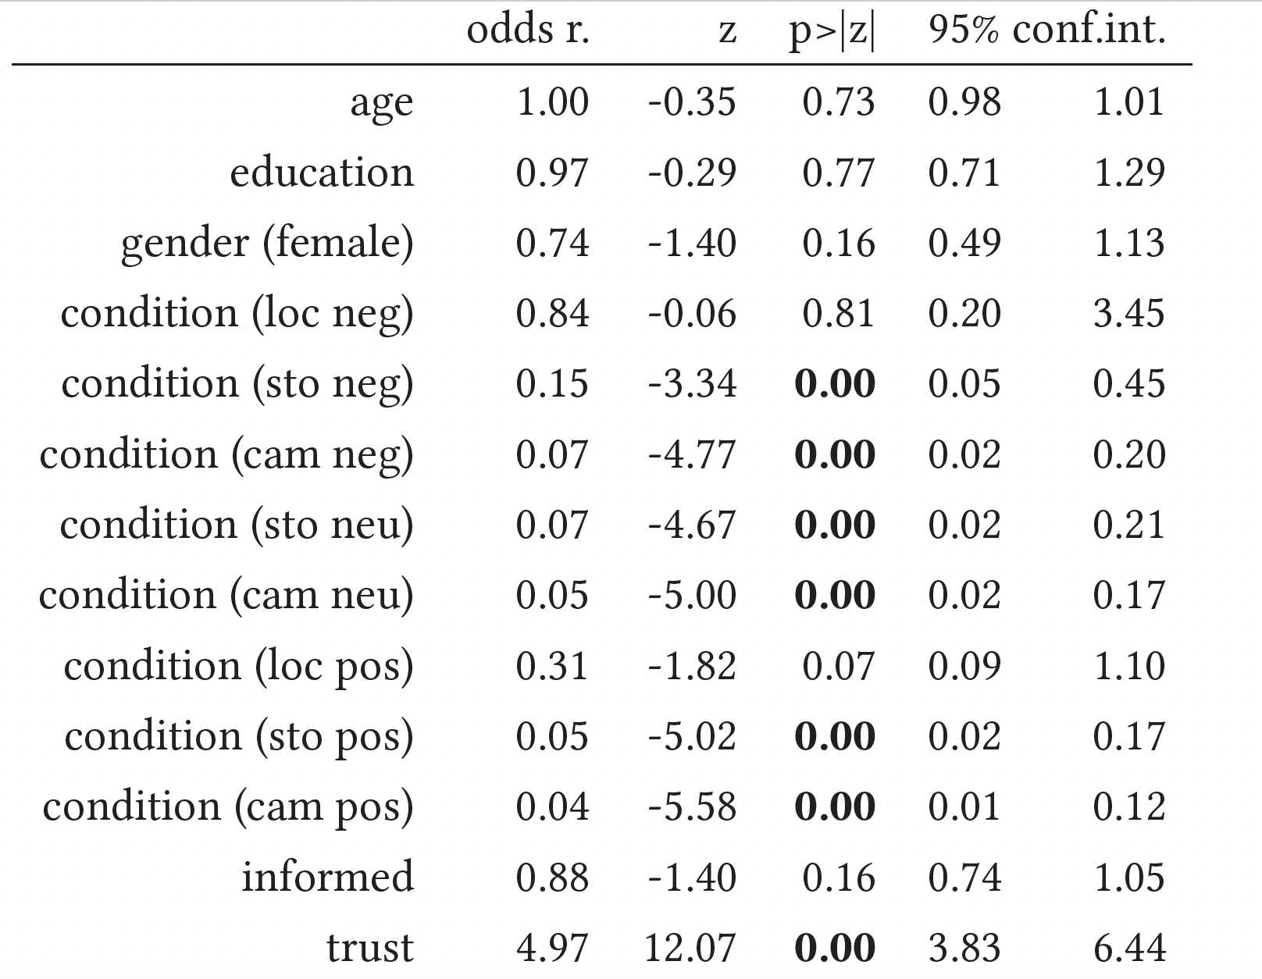
Results
Log. Regression for permission acceptance [Dep Var] and age, education, gender (baseline male), condition (baseline location neutral), feeling informed, feeling trust [Indep. Var]. Significant results in bold.
Obs. = 839, LR 𝜒2(6) = 555.91; Prob > 𝜒2 = 0.000; Pseudo R2 = 0.4895
RQ2
What are
predictors of disclosure behaviour?
Trustworthiness is highly predicting acceptance of app permissions
We did not find effect of demographic factors on acceptance
YES!

Slide 15
Self-reported reasons for disclosure choices
believed the permissions were somewhat necessary for a proper app functioning
reported reflective behaviour, but did not reach a satisfying conclusion.
44%
31%
19%
15%
14%
10%
1%
pointed to their
pointed
explicitly
thought
general distrust in app providers and stated a decline by default behaviour
to their accept by default behaviour
stated privacy concerns
the app would not work if they did not grant all permissions
messages

Slide 16
Self-reported reasons for disclosure choices
> 1% explicitly mentioned the messages as a factor. The request framing did not seem to draw the participants’ attention.
10% of the participants thought the app would not work if they did not grant all permissions.
44% believed the permissions were somewhat necessary for a proper app functioning
31% reported reflective behaviour, but they did not reach a satisfying conclusion and were uncertain about their choice. The participants who reported their reflections understood why the app would ask for access to location and camera and what it was needed for. However, this was less the case for storage.
19% pointed to their general distrust in app providers and stated a decline by default behaviour
15% pointed to their accept by default behaviour
14% explicitly stated privacy concerns
*percentages do not add up tp 100 as participants freely commented their choices, and often gave more than one argument

Slide 17
Summary of results:
Exploring loss-gain framing in privacy dark patterns;
Empirical study: impact of framing on privacy disclosure in mobile apps;
Both negative & positive framings influence user behavior;
Only negative framing boosts disclosure; positive framing has opposite effect;
Positive framing might decrease people’s perceived trust in the permission request;
Higher perceived trustworthiness of the app is associated with higher acceptance rates.

Slide 18
Summary of results
User behavior
Exploring loss-gain framing in privacy dark patterns
boosts disclosure
Disclosure
opposite effect
decrease people’s perceived trust
Trust
Empirical study: Impact of framing on privacy disclosure in mobile apps
Higher trustworthiness
Higher acceptance
Notes:
What is the role of purpose uncertainty in the process?

Slide 19
Thank you for your attention!
Euro USEC 2023 October 16 & 17, Copenhagen, Denmark
SUPPORTED BY THE LUXEMBOURG
NATIONAL RESEARCH FUND (FNR) IS/14717072
Photo by Tengyart on Unsplash
Photo by Sivani Bandaru on Unsplash
Icons: Thenounproject.com
Presentation Design: Sophie Doublet

