Slide 1
Decolonising EMI lecturer training
Katrien L. B. Deroey
BAAL Conference: Opening up applied linguistics, York, 25 8 2023

Slide 2
Interdisciplinary collaboration
Lecturer empowerment

Slide 3
‘A change in the language of instruction can […] be seen as an opportunity leading to consideration of other elements in the training of lecturers which help determine the quality of the education provided to students in international classrooms.’
(Dafouz et al, 2020, p. 327)

Slide 4
Language
Pedagogy
Communication
EMI awareness

Slide 5
Contextualisation
Affect
Workload

Slide 6
Institutional involvement
Local expertise
CPD
Lecturer involvement
Knowledge-centered
Peer learning & support

Slide 7
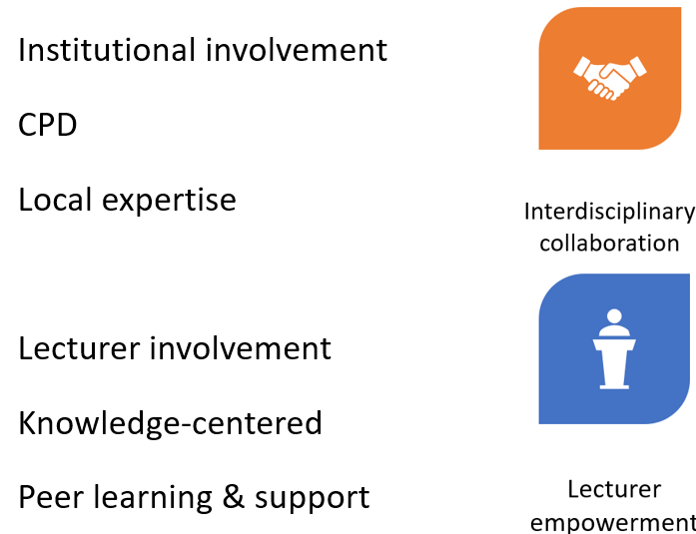
Deroey, K. L. B. (2023). English medium instruction lecturer training programmes: Content, delivery, ways forward. Journal of English for Academic Purposes, 62, 101223, 1-16. doi.org/10.1016/j.jeap.2023.101223
Reference
Dafouz, E., Haines, K., & Pagèze, J. (2020). Supporting educational developers in the era of internationalised higher education: insights from a European project. International Journal of Bilingual Education and Bilingualism, 23(3), 326-339.
katrien.deroey@uni.lu

