Slide 1
MTA Conference of Subject Pedagogy
Eötvös-Loránd-University, 5 July 2023
Prof. Prof. h.c. Dr Damien François Sagrillo
Research in Music Methodology in the 21st Century

Slide 2

“Education in music is most sovereign, because more than anything else rhythm and harmony find their way to the inmost soul and take strongest hold upon it” Plato, Republic III. 401c-402b
Research in Music Methodology in the 21st Century
Solfège: From Content-based to Competence-based Music Education
Damien François Sagrillo

Slide 3
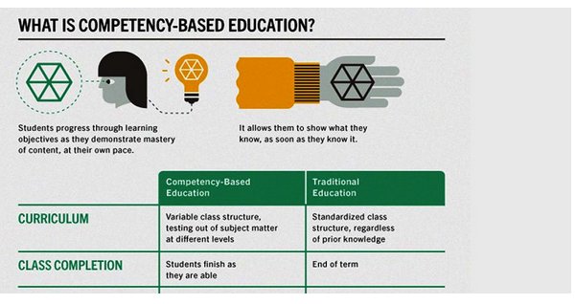
Content (Subject?) or Competence
https://www.entab.in/CBSE-Introduces-Competency-Based-Assessment-Reforms.html
Notes:
https://www.entab.in/CBSE-Introduces-Competency-Based-Assessment-Reforms.html

Slide 4
Content (Subject?) or Competence
From content-based (process-based) [formalised] to competence-based music education
Content-based: what the teacher teaches
Competence-based: learning at its own speed with the teacher as facilitator
Questions that arise:
Content or competence? or…
… Content before competence? or…
… Content AND competence?
Is it possible to teach solfège competence-based?

Slide 5
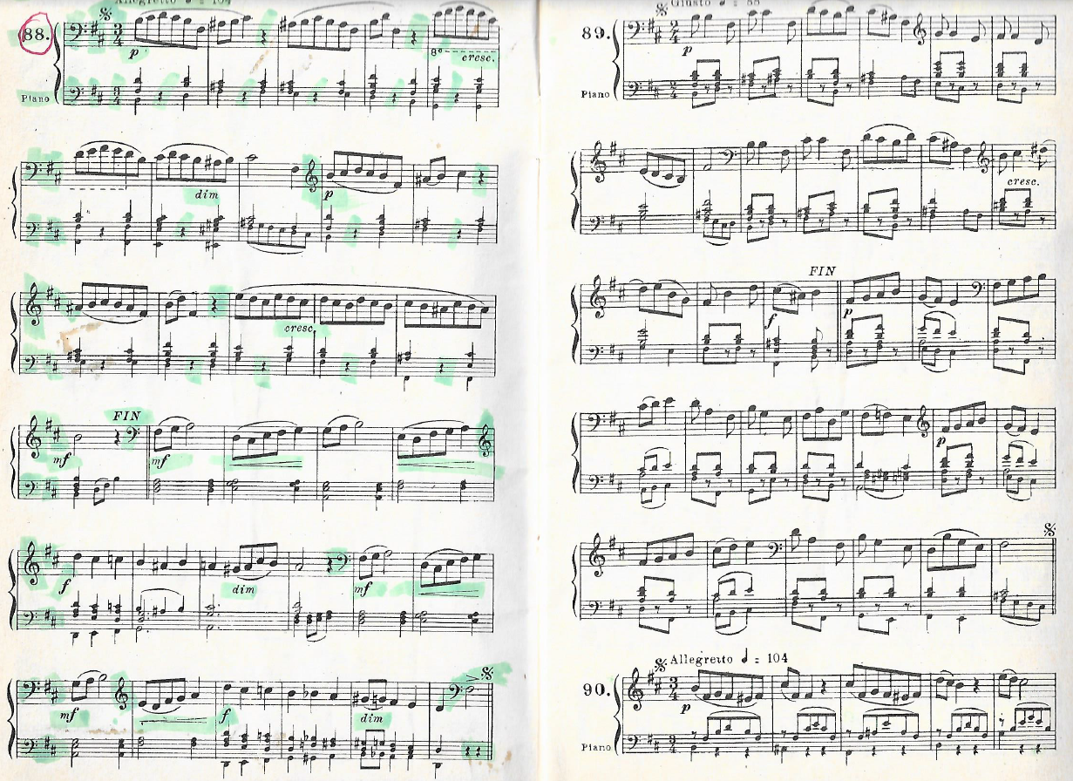
SolfègeLU, 3rd grade, during "my time«
Solfège in abberation (1)
3rd graders are 10-11 years old
Notes:
dissuasive example (1) Armand Lenain, Solfège Lenain 3 à changement de clés, sol et fa, Bruxelles/Paris: Schott Frères, Year?

Slide 6
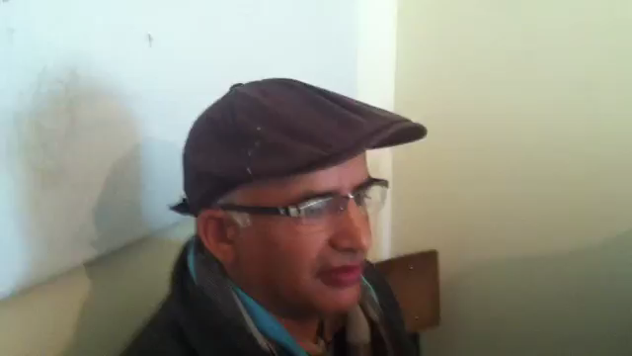
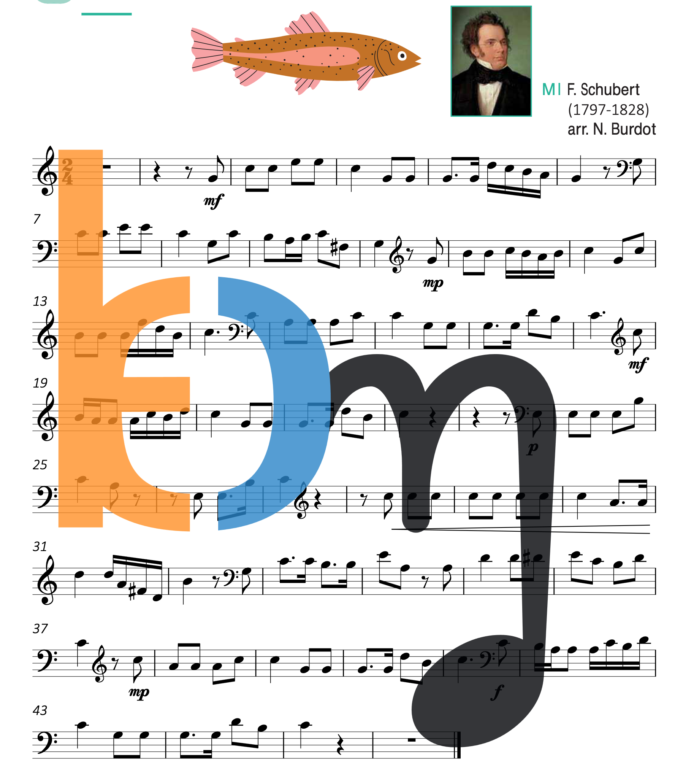
Comparison of didactic approaches
Solfège in aberration (2)
Example of a solfège lesson at the conservatoire of Taza in Marocco, added to YT in 2013!
Example of a solfège lesson from a new solfège book in Luxembourg
Notes:
dissuasive example 2
https://www.youtube.com/watch?v=rsLII9ZXDpg
https://blueorangemusic.com/solfi_preview_pdf/2022-Solfi4-Schueler-Buch.pdf

Slide 7
Consequence of this kind of aberration Dropout of music pupils, mainly due to SolfègeLU

Slide 8
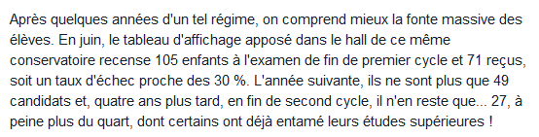
Dropout of music lessons due to solfègeFR
Critical review strategies have forced authorities to rethink programmes
Le Monde: Conservatoire F.Chopin, Paris 15e

Slide 9
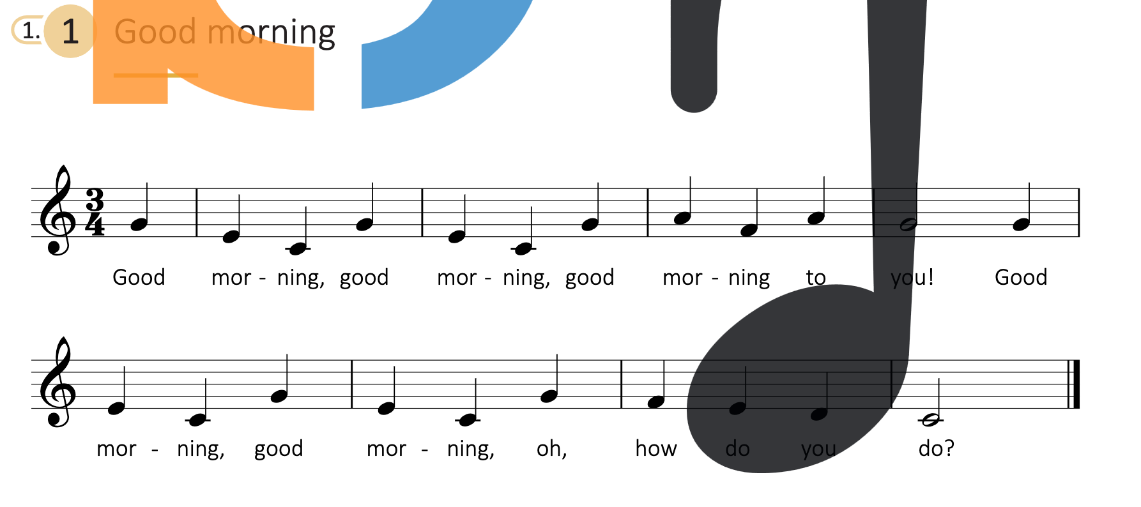
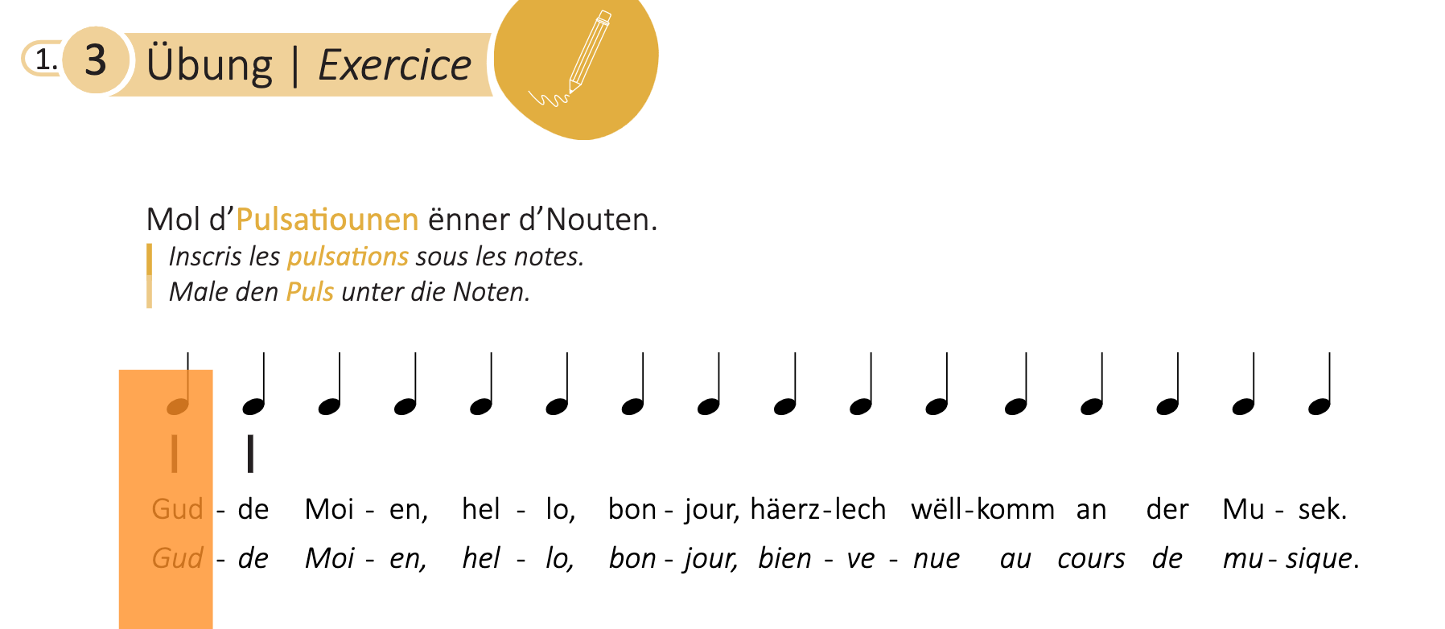
SolfègeLU, 1st grade today: Attempts for more acceptance
Advantages
Easy exercise based on a song with a text
Rhythmical exercise underlays quarter notes with text
Disadvantages
Half tones at an age where they are not yet internalised
Based on absolute solfège (not to be seen here)
Learning melody and rhythm in different exercises
No rhythmical differentiation
Notes:
https://blueorangemusic.com/solfi_preview_pdf/2021-Solfi1-Schueler.pdf https://digikotta.emb.hu/view/1601346042

Slide 10
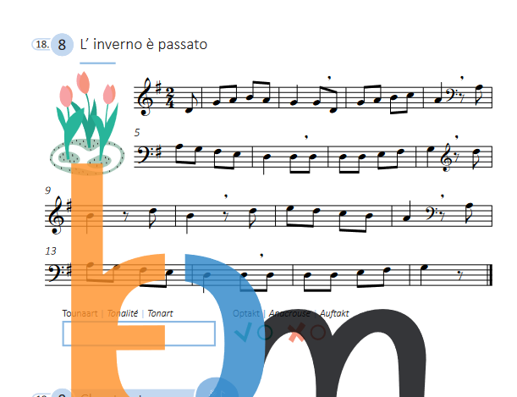
SolfègeLU, 3rd grade today and then
Advantages
Exercise based on a folksong from Ticino
Disadvantages
No text
Change of keys
Notes:
https://blueorangemusic.com/solfi_preview_pdf/2021-Solfi3-Schueler-Buch.pdf
Lenain, cf above

Slide 11
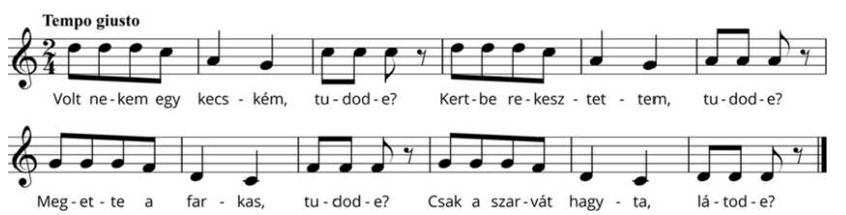
SolfègeHU, 1st (?) grade, built on an successful tradition
Singing lesson based on the long tradition of Hungarian music pedagogy
Many aspects can be learned in one example
Pentatonic halftoneless / relative solfège / quarter notes and eighth notes
Music theory => variants, sorting tones according to their pitch
Singing in canon
Creativity => Találj ki te is változatokat! (Find variations as well) (?)
Studying the rhythm
Good example of content- and competence-based music education
Notes:
https://digikotta.emb.hu/view/1601346042
Zoltán Kodály, Canon arranged for 2 voices by Zoltán Kodály in Bicinia Hungarica I, 1922

Slide 12
Discussion
Solfège from a subject-based to a competence-based to a subject
Focus
Learning objectives
Structure
Application
Hungary vs Luxembourg

Slide 13
Learning theories (for solfège)
Constructivism
(Active knowledge generation)
Content-based
("old" solfège)
Positivism
(knowledge verifiable)
What learning theories tell us
Behaviourism (stimuli from outside are learned)
Competence-based (“new" solfège)
Music education
Children creat own learning patterns

Slide 14
Muito obrigado pela atenção
Merci fir Äert Nolauschteren
Благодарю вас за внимание
Danke für Ihre Aufmerksamkeit
Grazie per l'attenzione
Merci pour votre attention
Köszönöm a figyelmet
Damien Sagrillo, Université du Luxembourg
Thank you for your attention
Muchas gracias por su atención

