Slide 1


Conditional on the Environment? The Contextual Embeddedness of Age, Health, and Socioeconomic Status as Predictors of Remote Work among Older Europeans through the COVID-19 Pandemic
Jason Settels, PhD
Postdoctoral Researcher
Department of Social Sciences
Institute for Research on Socio-Economic Inequality
University of Luxembourg
Population Association of America 2023 Annual Meeting
April 14th, 2023
jason.settels@uni.lu

Slide 2
Introduction
The COVID-19 pandemic is a global medical crisis announced by the World Health Organization (WHO) in January 2020 as a Public Health Emergency of International Concern (Metelmann and Busemann 2020).
COVID-19-era lockdown measures restricted many individuals from working from their usual locations (Russo et al. 2021).
The economic and well-being impacts of these remote work arrangements (Béland, Brodeur, and Wright 2020; Dubey and Tripathi 2020), beyond containment of the COVID-19 virus’ spread.
Negotiations between employees and employers concerning remote work arrangements (Davies 2021; Fana et al. 2020).
Lack of research on heterogeneity in how personal characteristics predicted working remotely based on contextual factors.
This knowledge will help prepare responses to future large-scale epidemics.

Slide 3
Research Questions
How did country-level
digitization
stringency of government restrictions
health impacts of COVID-19
moderate the relationships of individual-level
education and household income (measures of socioeconomic status)
age
general health
with pandemic-era remote work?

Slide 4
Previous Research, Conceptual, and Theoretical Framework
Discussions of individual-level predictors of remote work:
education, occupations, and types of work (Dingel and Neiman 2020)
age and health (Camacho-Rivera, Islam, and Vidot 2020)
Discussions of contextual-level predictors of remote work:
general extents of socioeconomic status (Kavanagh, Goel, and Venkataramani 2021)
workforce involvement of advanced computer technologies (Sostero et al. 2020)
pandemic-era health burdens (Brynjolfsson et al. 2020)

Slide 5
Previous Research, Conceptual, and Theoretical Framework
Theoretical perspectives:
fundamental cause theory of health, see Link and Phelan (1995) and Phelan et al. (2010)
health belief model, see Abraham and Sheeran (2015)
Plausible Cross-Level Interactions and Associated Hypotheses:
I expect that among older Europeans working continuously through the pandemic, the positive associations of education and income with remote work are reduced by societal digitalization (H1.1).
I expect that among older Europeans working continuously through the pandemic, the positive associations of more advanced age and worse health with remote work are increased by societal digitalization (H1.2).

Slide 6
Previous Research, Conceptual, and Theoretical Framework
I expect that among older Europeans working continuously through the pandemic, the positive associations of education and income (H2.1), and more advanced age and worse health (H2.2), with remote work are reduced by more stringent government containment measures.
I expect that among older Europeans working continuously through the pandemic, the positive associations of education and income with remote work are increased by greater contextual COVID-19 health impacts (H3.1).
I expect that among older Europeans working continuously through the pandemic, the positive associations of more advanced age and worse health with remote work are increased by greater contextual COVID-19 health impacts (H3.2).

Slide 7
Methods
Dataset: the Survey of Health, Ageing and Retirement in Europe’s (SHARE) first COVID-19 module
Constituent interviews across 27 nations of Europe and Israel took place between June and August 2020, thus at the height of the COVID-19 crisis and lockdowns.
Sample: this study’s sample were 50-89 years of age during the first COVID-19 module and were employed when the pandemic began (N=8,121).

Slide 8
Methods
Due to non-available country-level data on the European Commission’s Digital Economy and Society Index, Israel and Switzerland were the only countries excluded.
Because they were not assessed within the SHARE’s first COVID-19 module, some required variables were obtained from other SHARE waves.
Variables
Dependent variable: Employment circumstances: worked at the usual workplace (reference category), worked at home and at the usual workplace, and worked only at home

Slide 9
Methods
Independent variables, individual-level:
-age (50 to 89 years)
-self-perceived pre-pandemic health:
- good/very good/excellent (ref.)
- poor/fair
- years of education
- 20 quantiles of household income, computed
separately within each nation

Slide 10
Methods
Independent variables, country-level:
-Digital Economy and Society Index (DESI), year 2020,
(European Commission 2021)
-stringency index (Our World in Data 2021)
-excess mortality (EM) p-scores (Karlinsky and Kobak
2021)

Slide 11
Methods
Control variables, individual-level:
-gender
-marital/relationship circumstances
-parental status
-self having been infected with COVID-19
-a close contact having been infected with COVID-19
Control variables, country-level:
-median age of the population in 2020 (Eurostat 2021)
-GDP per capita in 2020 (World Bank Group 2022)

Slide 12
Methods
Analysis
The focus is on three sets of multinomial logistic regressions, one for each country-level independent variable: -DESI
-stringency index
-EM p-scores
Within each set are four models, in which the respective country-level independent variable is sequentially studied in interaction with each individual-level independent variable: -age
-self-perceived health
-years of education
-20 quantiles of household income

Slide 13
Methods
Missing data were dealt with through multiple imputation using chained equations.
All models were weighted with the SHARE’s survey weights.
Standard errors were adapted for clustering according to country of residence during the first COVID-19 module.

Slide 14
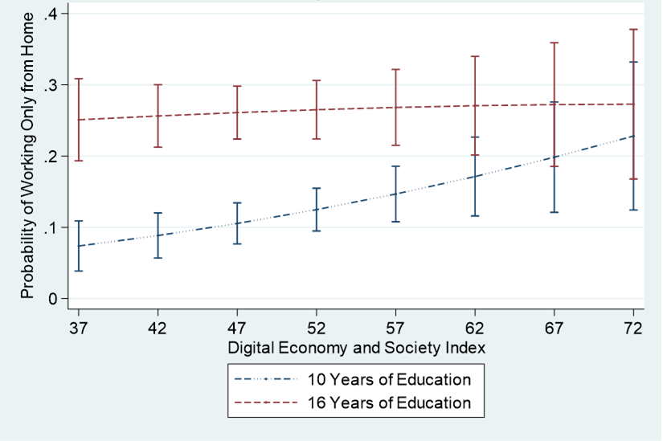
Results
Figure 1. Predicted Probabilities of Working Only from Home, DESI in Interaction with Years of Education, 95% Confidence Intervals Included

Slide 15
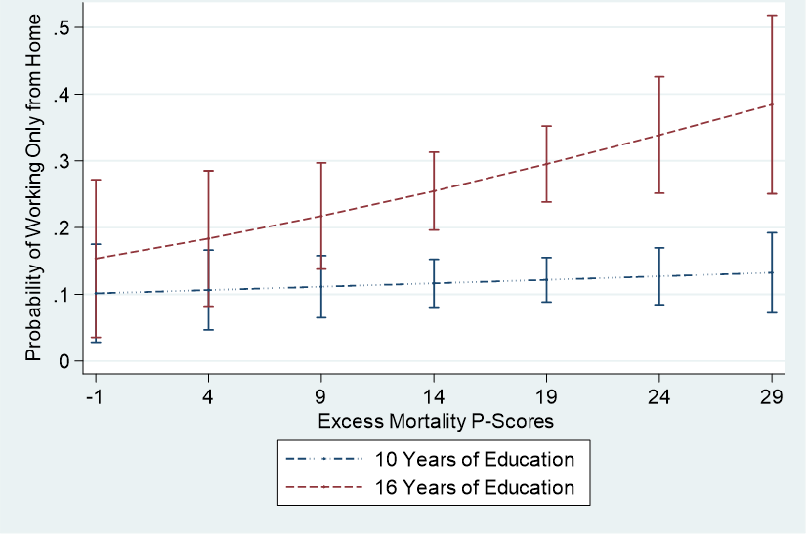
Results
Figure 2. Predicted Probabilities of Working Only from Home, Excess Mortality P-Scores in Interaction with Years of Education, 95% Confidence Intervals Included

Slide 16
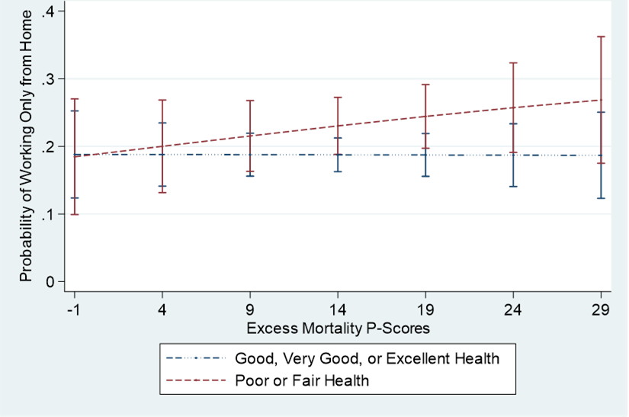
Results
Figure 3. Predicted Probabilities of Working Only from Home, Excess Mortality P-Scores in Interaction with Self-Perceived Health, 95% Confidence Intervals Included

Slide 17
Discussion
Additional finding: greater stringency of government pandemic response reduced the positive association of household income, but not education, with working partly remotely among continuously working older Europeans.
The most substantial findings are for working completely from home.
H1.1 partially supported: among older continuously working Europeans, the positive impact of education, but not household income, upon fully remote work was reduced within more digitalized nations.
Implications for the fundamental cause theory of health.

Slide 18
Discussion
H1.2 not supported: no consistent patterns of the effects of age or of self-perceived health being significantly moderated by societal digitalization.
In partial support of H2.1 and in contradiction of H2.2, greater stringency of government pandemic response only reduced the positive association of household income with working partly remotely among continuously working older Europeans.
H3.1 partially supported: among older Europeans continuing to work through the pandemic, education, but not household income, was more strongly positively associated with working completely remotely within nations undergoing more excess mortality.

Slide 19
Discussion
H3.2 partially supported: worse self-perceived health, but not more advanced age, was positively moderated by country-level excess mortality in its predictions of partially and fully remote work among older Europeans continuously working through the pandemic.
Implications for the health belief model.

Slide 20
Discussion
Theoretical Implications
Fundamental Cause Theory of Health
More focus on geographical variations.
The importance of unpredictable chance events.
Health Belief Model
Beyond the individual level, the COVID-19 pandemic exemplifies how this model also applies at the structural levels of work organizations and governments (meso and macro levels).

Slide 21
Discussion
Policy Implications
Especially within national circumstances of lower digitalization and/or greater health impacts, further provisions should be made for remote work and/or more sanitary employment environments, particularly for workers with less education, whose choices will be further restricted.
Moreover, especially among those with less education, policies and programs should help older adults with fewer skills with information, communication, and internet technologies in acquiring these capabilities (Seifert et al. 2021).
Governments and employers should give priority to those in worse health when making decisions concerning work arrangements.

Slide 22
Thank you for your attention!
jason.settels@uni.lu

Slide 23
References
Abraham, Charles, and Paschal Sheeran. 2015. "The health belief model." Pp. 28-80 in Predicting health behaviour: Research
and practice with social cognition models, edited by M. Conner and P. Norman. Buckingham, United Kingdom: Open
University Press.
Béland Louis-Philippe, Abel Brodeur, and Taylor Wright. 2020. “Covid-19, stay-at-home orders and employment: evidence
from CPS data.” IZA Discussion Paper (13282): 1-110.
Brynjolfsson, Erik, John J. Horton, Adam Ozimek, Daniel Rock, Garima Sharma, and Hong-Yi TuYe. 2020. “COVID-19 and remote
work: an early look at US data.” NBER Working Paper Series (27344): 1-25.
Camacho-Rivera, Marlene, Jessica Y. Islam, and Denise C. Vidot. 2020. “Associations between Chronic Health Conditions and
COVID-19 Preventive Behaviors among a Nationally Representative Sample of U.S. Adults: An Analysis of the COVID Impact
Survey.” Health Equity 4(1): 336–44.
Davies, Amanda. 2021. “COVID-19 and ICT-Supported Remote Working: Opportunities for Rural Economies.” World 2(1):139–
52.
Dingel, Jonathan I., and Brent Neiman. 2020. “How Many Jobs Can Be Done at Home?” Journal of Public Economics 189: 1-8.
Dubey, Akash Dutt, and Shreya Tripathi. 2020. “Analysing the Sentiments towards Work-From-Home Experience during COVID-
19 Pandemic.” Journal of Innovation Management 8(1): 13–19.
European Commission. 2021. “DESI composite index.” Retrieved June 27, 2021.
Eurostat. 2021. “Population structure indicators at national level.” Retrieved Oct. 2, 2021.
Fana, Marta, Santo Milasi, Joanna Napierala, Enrique Fernandez-Macias, and Ignacio González Vázquez. 2020. Telework, work
organisation and job quality during the COVID-19 crisis: a qualitative study. No. 2020/11. JRC Working Papers Series
on Labour, Education and Technology.

Slide 24
References
Karlinsky, Ariel, and Dmitry Kobak. 2021. “Tracking Excess Mortality across Countries during the Covid-19 Pandemic with the
World Mortality Dataset.” ELife 10.
Kavanagh, Nolan M., Rishi R. Goel, and Atheendar S. Venkataramani. 2021. “County-Level Socioeconomic and Political
Predictors of Distancing for COVID-19.” American Journal of Preventive Medicine 61(1): 13–19.
Link, Bruce G., and Jo Phelan. 1995. "Social conditions as fundamental causes of disease." Journal of health and social behavior
extra issue: 80-94.
Metelmann, Isabella B., and Alexandra Busemann. 2020. "Elective surgery in times of COVID-19: A two-centre analysis of postponed
operations and disease-related morbidity and mortality." Zeitschrift für Evidenz, Fortbildung und Qualität im Gesundheitswesen
158: 62-65.
Our World in Data. 2021. “Stringency Index.” Retrieved Oct. 2, 2021.
Phelan, Jo C., Bruce G. Link, and Parisa Tehranifar. 2010. “Social Conditions as Fundamental Causes of Health Inequalities:
Theory, Evidence, and Policy Implications.” Journal of Health and Social Behavior 51(1_suppl):S28–40.
Russo, Daniel, Paul H. P. Hanel, Seraphina Altnickel, and Niels van Berkel. 2021. “Predictors of Well-Being and Productivity
among Software Professionals during the COVID-19 Pandemic – a Longitudinal Study.” Empirical Software
Engineering 26(4): 1-63.
Seifert, Alexander, Shelia R. Cotten, and Bo Xie. 2021. “A Double Burden of Exclusion? Digital and Social Exclusion of Older
Adults in Times of COVID-19.” The Journals of Gerontology. Series B, Psychological Sciences and Social Sciences
76(3):e99–103.
Sostero, Matteo, Santo Milasi, John Hurley, Enrique Fernandez-Macias, and Martina Bisello. 2020. Teleworkability and the
COVID-19 crisis: a new digital divide?. No. 2020/05. JRC working papers series on labour, education and technology.
World Bank Group. 2022. “GDP per capita (current US$).” Retrieved April 21, 2022.

