Slide 1
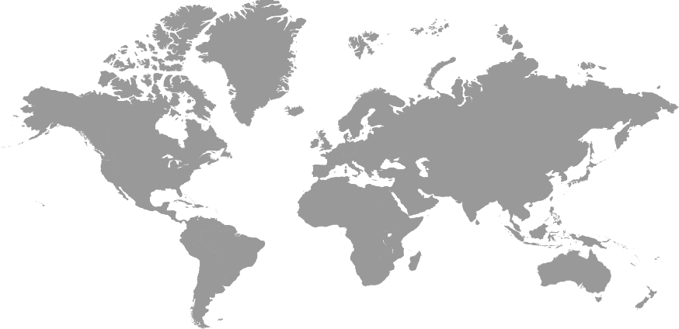
Human rights: INSIGHTS TO TODAY’S CHALLENGES
-Human rights and environment-
Patrick Lentz
University of Luxembourg
02/06/2020
-1-

Slide 2
Roadmap
1
2
3
4
5
Introduction
Procedural human rights
Substantive human rights
Problematics
Conclusion
-2-

Slide 3
1
3
2
4
5
-3-

Slide 4
1
3
2
4
5
-4-

Slide 5
Anthropocentric rights
Biocentric rights
Attribution of rights to animated non human beings
Protection of the human being
Indirect protection of the environment
Ecocentric rights
Attribution of rights to eco systems
Intrinsic worth of living creatures
f.e. rivers, forests, lakes...
f.e. orang outans, chimpanzees…
Intrinsic worth of Nature
Environment is a commodity → no intrinsic worth.
Human dignity
Animal dignity
1
1
3 conceptions of environmental rights
-5-

Slide 6
Anthropocentric rights
Biocentric rights
Attribution of rights to animated non human beings
Protection of the human being
Indirect protection of the environment
Ecocentric rights
Attribution of rights to eco systems
Intrinsic worth of living creatures
f.e. rivers, forests, lakes...
f.e. orang outans, chimpanzees…
Intrinsic worth of Nature
Environment is a commodity → no intrinsic worth.
Human dignity
Animal dignity
1
1
3 conceptions of environmental rights
-6-
Notes:
Our enviromnment: what surrounds us

Slide 7
Anthropocentric rights
Biocentric rights
Attribution of rights to animated non human beings
Protection of the human being
Indirect protection of the environment
Ecocentric rights
Attribution of rights to eco systems
Intrinsic worth of living creatures
f.e. rivers, forests, lakes...
f.e. orang outans, chimpanzees…
Intrinsic worth of Nature
Environment is a commodity → no intrinsic worth.
Human dignity
Animal dignity
1
1
3 conceptions of environmental rights
-7-

Slide 8
Anthropocentric rights
Biocentric rights
Attribution of rights to animated non human beings
Protection of the human being
Indirect protection of the environment
Ecocentric rights
Attribution of rights to eco systems
Intrinsic worth of living creatures
f.e. rivers, forests, lakes...
f.e. orang outans, chimpanzees…
Intrinsic worth of Nature
Environment is a commodity → no intrinsic worth.
Human dignity
Animal dignity
1
1
3 conceptions of environmental rights
-8-
Notes:
Eco centric concepts are emerging chiefly at State level. The declaration of rights of mother earth, or the conferral of legal personality to a river. It appears that States with a closer link to nature or States that are already exposed to natural changes are keener of going a step further.
World charter for nature or the universal declaration of rights of mother earth
Ecuador has granted rights to its forests, lakes and waterways. Its 2008 constitution contains in its title II on rights a chapter 7 comprising four articles on the rights of nature (articles 71 to 74). The constitution allocates direct rights to Nature or Pacha Mama

Slide 9

Rachael Carson
Silent spring
1969
Stockholm declaration 1979
Rio declaration 1992
Ksentini report 1994
Aarrhus convention 1998
UNFCCC
1992
Espoo Convention 1991
1
1
Milestones of environmental HR
-9-
Notes:
Rachael Carson: The need to know. She made aware of the aderse environmental effects caused by the indiscriminate use of pesticides. Carson accused the chemical industry of spreading disinformation. The book brought environmental concerns to public discussion.
Already in 1979, in the Stockholm declaration the link between human rights and the need to protecting the environment was put forth.
CONVENTION ON ENVIRONMENTAL IMPACT ASSESSMENT IN A TRANSBOUNDARY CONTEXT. Public access to information on climate change and its effects 6 a) (ii)
The United Nations Framework Convention on Climate Change has been ratified by 195 States.
In 1994 one of the conclusions of the Ksentini report was that there was a shift from environmental law towards the right to live in a healthy environment and recognized such right was in the draft declaration of principles on human rights and the environment.
Aarhus convention: Linking HR and the environment

Slide 10
Rachel Carson
Silent spring
1969
Stockholm declaration 1979
Rio declaration 1992
Ksentini report 1994
Aarrhus convention 1998
UNFCCC
1992
Espoo Convention 1991
1
1
Milestones of environmental HR
-10-
Notes:
Rachael Carson: The need to know. She made aware of the adverse environmental effects caused by the wide use of pesticides.
Carson accused the chemical industry of spreading disinformation. The book brought environmental concerns to public discussion.
dangers to all natural systems from the misuse of chemical pesticides such as DDT
Carson shows how the toxins in pesticides can travel through the food chain to kill animals who don't linger near them such as birds, including eagles.
The human race is challenged more than ever before to demonstrate our mastery, not over nature but of ourselves.

Slide 11
Rachael Carson
Silent spring
1969
Stockholm declaration 1979
Rio declaration 1992
Ksentini report 1994
Aarrhus convention 1998
UNFCCC
1992
Espoo Convention 1991
1
1
Milestones of environmental HR
-11-
Notes:
Already in 1979, in the Stockholm declaration the link between human rights and the need to protect the environment was put forth.
Man has the fundamental right to freedom, equality and adequate conditions of life, in an environment of a quality that permits a life of dignity and well-being.

Slide 12
Rachael Carson
Silent spring
1969
Stockholm declaration 1979
Rio declaration 1992
Ksentini report 1994
Aarrhus convention 1998
UNFCCC
1992
Espoo Convention 1991
1
1
Milestones of environmental HR
-12-
Notes:
CONVENTION ON ENVIRONMENTAL IMPACT ASSESSMENT IN A TRANSBOUNDARY CONTEXT.
State governments
must notify and consult each other on all major projects under consideration that might have adverse environmental impact across borders.

Slide 13
Rachael Carson
Silent spring
1969
Stockholm declaration 1979
Rio declaration 1992
Ksentini report 1994
Aarrhus convention 1998
UNFCCC
1992
Espoo Convention 1991
1
1
Milestones of environmental HR
-13-
Notes:
Rio Declaration: right to a healthy and productive life in harmony with nature
environmental needs of present and future generations

Slide 14
Rachael Carson
Silent spring
1969
Stockholm declaration 1979
Rio declaration 1992
Ksentini report 1994
Aarrhus convention 1998
UNFCCC
1992
Espoo Convention 1991
1
1
Milestones of environmental HR
-14-
Notes:
The United Nations Framework Convention on Climate Change has been ratified by 195 States.
Public access to information on climate change and its effects 6 a) (ii)

Slide 15
Rachael Carson
Silent spring
1969
Stockholm declaration 1979
Rio declaration 1992
Ksentini report 1994
Aarrhus convention 1998
UNFCCC
1992
Espoo Convention 1991
1
1
Milestones of environmental HR
-15-
Notes:
In 1994 one of the conclusions of the Ksentini report was that there was a shift from environmental law towards the right to live in a healthy environment and recognized such right was in the draft declaration of principles on human rights and the environment.

Slide 16
Rachael Carson
Silent spring
1969
Stockholm declaration 1979
Rio declaration 1992
Ksentini report 1994
Aarhus convention 1998
UNFCCC
1992
Espoo Convention 1991
1
Milestones of environmental HR
-16-
Notes:
Aarhus convention: Linking HR and the environment.
The access to information in the Aarhus convention has been considered to be more extensive as there is no need to prove a legal interest

Slide 17
A multilayered framework
Global level
Regional level
Subregional level
National level
Council of Europe
European Convention of Human rights
European social charter
Chapter 2
1
Political forums
United Nations
Universal declaration of human rights
International Covenant on Civil and Political Rights
International Covenant on Economic, Social and Cultural Rights
…
European Union
Charter of fundamental rights of the EU
Article 37 on environmental protection
United Nations Economic Commission for Europe
Espoo convention
Aarhus Convention
Convention on Long-range Transboundary Air Pollution
Convention on the Protection and Use of Transboundary Watercourses and International Lakes
Convention on the Transboundary Effects of Industrial Accidents
Convention on Biological Diversity
Individual States
Constitutional guarantees
Within a federal state, MS constitutions with environmental rights

Slide 18
A multilayered framework
Global level
Regional level
Subregional level
National level
Chapter 2
1
Political forums
United Nations
Universal declaration of human rights
International Covenant on Civil and Political Rights
International Covenant on Economic, Social and Cultural Rights
…
Regional commissions of the United Nations
European Union
Charter of fundamental rights of the EU
Article 37 on environmental protection
Organization of American States
American Convention on Human Rights
Individual States
Constitutional guarantees
Within a federal state, MS constitutions with environmental rights
African Union
African (Banjul) Charter on Human and Peoples' Rights
Asian Human Rights Commission
Asian Human rights charter
Organisation of Islamic Cooperation
Cairo Declaration on Human Rights in Islam

Slide 19
Protection of HR through environmental law
Protection of the environment through HR
1
Environmental protection is a precondition to traditional human rights.
If the natural habitat is not viable for mankind, enjoyment of human rights is impossible.
Connection between human rights and environmental protection
-19-

Slide 20
Protection of HR through environmental law
Protection of the environment through HR
1
Protecting HR has a positive spill over effect on the environment.
i.e. environmental impact assessments: decisions are based on more information. HR are a powerful instrument to foster environmental protection.
Besides international conventions, human rights and fundamental freedoms are often also implemented in national constitutions.
As such they rank at a very high normative level and are capable to override uncompliant rules.
Connection between human rights and environmental protection
-20-

Slide 21
Traditional HR
Direct indirect protection
Indirect protection of the environment for the sake of humanity because a HR has been affected.
Protection of the environment for the sake of humanity because this is a HR by itself.
1
“TRADITIONAL HR” and “ENVIRONMENTAL HR”
-21-
Notes:
Most international human rights treaties predate environmental concerns and are silent concerning environmental human rights.

Slide 22
Traditional HR
Environmental HR
Indirect protection of the environment for the sake of humanity because a HR has been affected.
“Semi direct” protection of the environment for the sake of humanity because this is a HR in itself.
1
TRADITIONAL HR VERSUS ENVIRONMENTAL HR
-22-

Slide 23
Substantial rights
Procedural rights
The right to live in a healthy environment
The right to life
The right to health
The right to home and family life
the right to an adequate standard of living
The right to peaceful enjoyment of property
The right to receive and impart information
democracy rights
Access to information,
to participation
to consultation
consent
1
1
Substantive HR versus procedural HR
-23-

Slide 24
Substantive rights
Procedural rights
The right to live in a healthy environment
The right to life
The right to health
The right to home and family life
the right to an adequate standard of living
The right to peaceful enjoyment of property
The right to receive and impart information
democracy rights
Access to information,
to participation
to consultation
consent
1
1
Substantial HR versus procedural HR
-24-

Slide 25
Substantive rights
Procedural rights
The right to live in a healthy environment
The right to life
The right to health
The right to home and family life
the right to an adequate standard of living
The right to peaceful enjoyment of property
The right to receive and impart information
Democracy rights
Access to information,
Participation
Consultation
Consent
Access to justice and fair trial rights
1
-25-

Slide 26
1
3
2
4
5
-26-

Slide 27
2
Substantive Human Rights
-27-

Slide 28
Right to a healthy environment
Different actors expressed the right to a healthy environment in different terms
healthy, healthful,
unpolluted, clean, safe, secure,
ecologically sound, sustainable, balanced, diverse, lasting, wholesome, preserved, protected,
adequate,
viable,
Satisfactory, pleasant, favorable, satisfying, decent,
natural
good, productive
2
-28-
Notes:
24

Slide 29
Right to a healthy environment
2
An essential right
Sine qua non condition for other important human rights (i.e. the right to life, the right to health)
might be a recipient for other rights such as the right to
clean air,
drinkable water,
productive soil
biodiversity
The right to a healthy environment empowers judges to consider the environment in their rulings.
Judges balance social and economic issues with environmental concerns.
-29-
Notes:
ECHR: The Parliamentary Assembly intended to introduce such right, but the Council of Ministers held that existing rights would already allow deriving such right.

Slide 30
The right to health
Depends on a healthy environment.
pollution heavy activities have been dislocated from populated zones to less populated areas.
However polluting activities can nevertheless be detrimental to public health even if the distance is increased or if people do not see pollution.
2
-30-

Slide 31
The right to life
Traditional human right
Depends on a healthy environment
Environmental concerns need to be very severe → direct threat to life
State owes a positive obligation to protect the lives of the people within its jurisdiction by taking necessary precautionary steps, even if the danger does not originate from the State or its representatives.
Such right might include right to water, food and shelter.
2
-31-

Slide 32
The right to an adequate standard of living
covers the basic needs to live a decent life:
Right to adequate housing
Right to food
Right to water.
i.e. pollution impact on drinking water must be addressed. This has been acknowledged by the United Nations Conference on Water in Mar del Plata in Argentina in 1977.
2
-32-

Slide 33
The right to home and family life
The right to home and family life (article 8 ECHR) as interpreted by the ECtHR is twofold.
It protects the people against unnecessary and disproportional adverse State activity
It protects the people from a State’s failure to protect from obnoxious non-State activities.
This right is used when life is not directly threatened but the private and family life directly is affected.
The harm must reach a certain level
i.e. noise, emissions or smells.
An economic activity that is beneficial for the community (legitimate aim) should not constitute an excessive burden (proportionality) to home and family life.
States enjoy quite a broad discretion.
2
-33-

Slide 34
The right to peaceful enjoyment of property
2
The right for a peaceful enjoyment of the possessions can be endangered by adverse environmental effects. An unhealthy environment diminishes the value of real estate property. It can affect the property to the extent that it can no longer be sold. States must safeguard the right to peaceful enjoyment by environmental protection measures.
It can be used to either foster or hinder environmental protection measures.
The right to property might be balanced against environmental concerns. In Fredin versus Sweden the ECtHR has held that an extraction permit has been retrieved to prevent environmental harm. Environmental rights justify limitations or breaches to/of other rights such as property rights.
-34-
Notes:
Thinking for example about the right to property, on the one hand, people living on sea level at the coastline could argue that the ongoing emission of greenhouse gases influencing the sea level, affects their right to property. The flooding displaces those peoples from their land. On the other side, owners of oil resources could argue that they are entitled to extract the resources from their ground despite detrimental side effects caused by the extraction process.
In Fredin versus Sweden the ECtHR has held that an extraction permit has been retrieved to prevent environmental harm. Environmental rights justify limitations or breaches to/of other rights such as property rights.

Slide 35
Freedom of expression: The right to receive and impart information
IThe freedom of expression has also been instrumental to support the participatory rights.
2
-35-

Slide 36
1
3
2
4
5
-36-

Slide 37
3
Procedural Human Rights
-37-

Slide 38
The right to know
3
It allows citizens to protect themselves and their homes from pollution or toxins.
The State administrations must provide information to the public and not hold back important elements.
Access to information has been considered a basic human right by the ECHR in Öneryildiz versus Turkey.
-38-

Slide 39
Participatory rights
The procedural rights strengthen democracy, therefore they are sometimes called “democracy rights” or “participatory rights”.
The freedom of expression has also been instrumental to support the right to environmental information.
According to the ECtHR, a duty to give access to information can be derived from the right to life and the right to home and family life (articles 2 and 8).
The public can be involved through
mere access to information,
participation
consultation
3
-39-
Notes:
The access to information in the Aarhus convention has been considered to be more extensive as there is no need to prove a legal interest

Slide 40
Environmental Impact Assessments
EIAs are useful to determine whether a given activity causes disproportional an unnecessary harm to peoples’ rights or in other words whether a give interference with citizen’s right can be justified.
Decisions are being based on an increased amount of information and the public is enabled to foster environmental protection and public health.
The State administrations must provide information to the public and not hold back important elements.
3
Consent:
Indigenous Peoples should enjoy more than mere participation rights. There is a need to prior informed consent according to the UN Declaration on the Rights of Indigenous Peoples.
-40-
Notes:
The access to information in the Aarhus convention has been considered to be more extensive as there is no need to prove a legal interest

Slide 41
1
3
2
4
5
-41-

Slide 42
4
Problematics
-42-
Notes:
Companies might be as powerful or even more powerful than States. They have tremendous economic power, their private security forces might be as powerful as the State’s police and military forces., they engage the best lawyers etc.

Slide 43


State sovereignty and HR
4
National environmental law is a manifestation of State sovereignty and might therefore not be protective to the environment.
State sovereignty entitles States to pollute their own territory.
If there are no side effects to other States or major human rights impacts, other States must not intervene.
-43-
Notes:
Companies might be as powerful or even more powerful than States. They have tremendous economic power, their private security forces might be as powerful as the State’s police and military forces., they engage the best lawyers etc.

Slide 44
Vertical conception of human rights
Corporations are not States: they are viewed as right holders and not as duty bearers.
4
Horizontal / diagonal human rights conceptions
Horizontal effects of human rights, meaning that a state can claim enforcement of human rights against another state.
Diagonal human rights, meaning that a citizen can claim enforcement of human rights against another State.
-44-
Notes:
Companies might be as powerful or even more powerful than States. They have tremendous economic power, their private security forces might be as powerful as the State’s police and military forces., they engage the best lawyers etc.

Slide 45

Environmentally displaced people / environmental refugees
4
Rights holders if displaced within their state
No rights towards other States
-45-
Notes:
Companies might be as powerful or even more powerful than States. They have tremendous economic power, their private security forces might be as powerful as the State’s police and military forces., they engage the best lawyers etc.

Slide 46
The trias politica:
Some courts have been very proactive in environmental matters, which raised concerns about the legitimacy of judicial decisions and about the separation of powers doctrine.
4
-46-
Notes:
Companies might be as powerful or even more powerful than States. They have tremendous economic power, their private security forces might be as powerful as the State’s police and military forces., they engage the best lawyers etc.

Slide 47
1
3
2
4
5
-47-

Slide 48
5
Concluding remarks
-48-

Slide 49
5
Human rights are powerful instruments to bring about legislative change, to extend judicial protection, to constrain executive wrongdoings. They can be applied at national level and/or international level.
Human rights may trump over other normative obligations because they benefit from large legitimacy
can be used to challenge state sovereignty.
The Human Rights Approach could support a shift of priorities.
Implementation in national constitutions.
-49-

Slide 50
5
Human rights can be used both to foster environmental protection and to limit environmental protection.
HR are anthropocentric rights
-50-

Slide 51
5
Despite the many benefits of human rights and the claim that they are universal and inalienable, human rights are being violated daily. Not only small violation but massive ones.
-51-

Slide 52
1
3
2
4
5
-52-

Slide 53
1
3
2
5
4
-53-

Slide 54
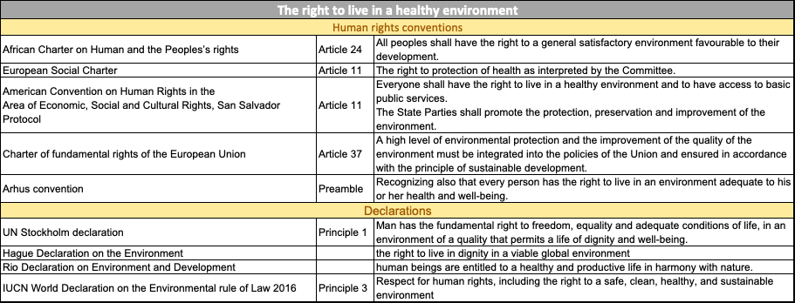
Right to a healthy environment
2
-54-

Slide 55
The right to health
2
-55-

Slide 56
The right to life
2
-56-

Slide 57
The right to an adequate standard of living
2
-57-

Slide 58
The right to home and family life
2
-58-

Slide 59

The right to peaceful enjoyment of property
2
-59-

Slide 60
Freedom of expression: The right to receive and impart information
2
-60-

Slide 61
Participatory rights
3
-61-

Slide 62
Access to justice and effectiveness of rights
3
to Justice
-62-
Notes:
The access to information in the Aarhus convention has been considered to be more extensive as there is no need to prove a legal interest

Slide 63
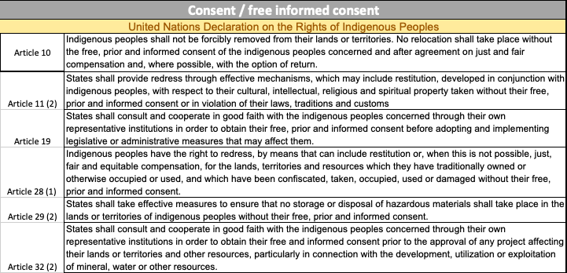
Free prior and informed consent
3
Indigenous Peoples should enjoy more than mere participation rights. There should be free prior and informed consent according to the UN Declaration on the Rights of Indigenous Peoples i.e. before States adopt or implement legislative or administrative measures affecting them.
-63-
Notes:
The access to information in the Aarhus convention has been considered to be more extensive as there is no need to prove a legal interest

