Slide 1
Investigation of OpenFOAM-XDEM momentum coupling results for
AWJC Nozzle using preCICE
preCICE Workshop 2023
by Prasad ADHAV, Xavier BESSERON, Bernhard PETERS
Luxembourg XDEM Research Centre
http://luxdem.uni.lu/

Slide 2
Contents
Brief Introduction & recap
AWJC Nozzle Case Setup & Results
preCICE coupling performance analysis
Conclusions, WIP & Future work

Slide 3
Contents
Brief Introduction & recap
AWJC Nozzle Case Setup & Results
preCICE coupling performance analysis
Conclusions, WIP & Future work

Slide 4
Introduction to
eXtended Discrete Element Methods (XDEM)
Dynamics
Particle Motion
Forces, and torques
Conversion
Heat & Mass Transfer
Chemical Reactions
AD-Hoc Coupling
CFD: OpenFOAM/Foam-Extend
FEM: Diffpack
License/Usage: No public Distribution yet
Binaries/Source Code available on request
(bernhard.peters@uni.lu, xavier.besseron@uni.lu)

Slide 5
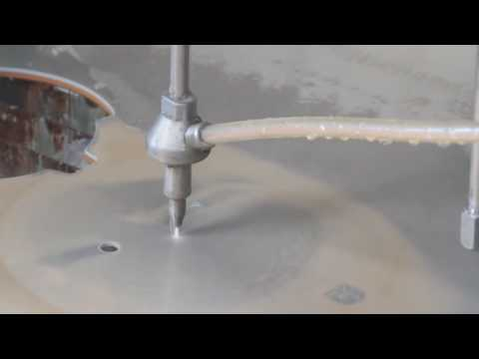
Abrasive Water Jet Cutting (AWJC) in action

Slide 6
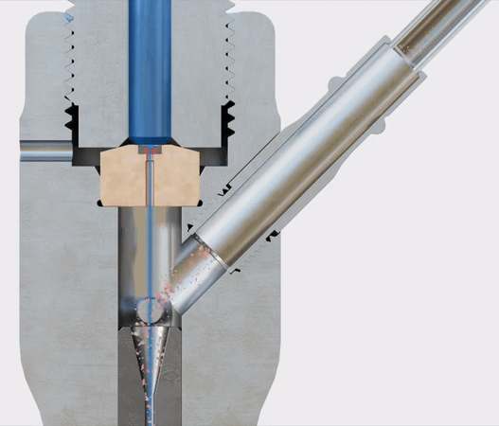
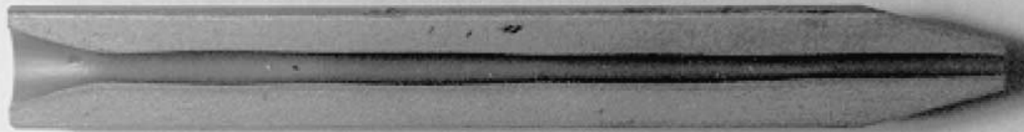
Research Aim
Development of multiphysics simulation environment
Evaluation of erosion in AWJC Nozzle by DEM+CFD+FEM coupling
[1] Sectioned Nozzle with erosion
[1] Nanduri, Madhusarathi, David G. Taggart, and Thomas J. Kim. "The effects of system and geometric parameters on
abrasive water jet nozzle wear." International Journal of Machine Tools and Manufacture 42.5 (2002): 615-623.
Notes:
AWJC nozzle uses high-speed water jet entrained with abrasive particles for cutting. But the Nozzle itself is often the first target of these particles. Which causes erosion inside the nozzle.
This erosion inside the nozzle is very difficult to capture through experimentation. So it makes it desirable to have simulations.
The plan is to evaluate the erosion through a DEM+CFD+FEM coupling.

Slide 7
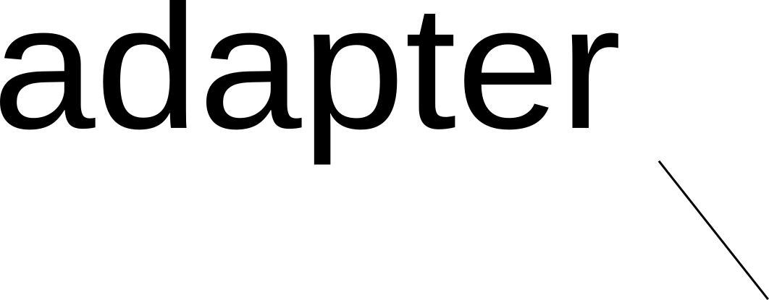



CFD-DEM Momentum coupling summary
Physical
properties,
flow conditions
Momentum source
(explicit + implicit),
Porosity
Add momentum source with fvOptions/fvModels
Compute Drag & Buoyancy force on particles
Compute momentum source terms[2]
[2] Xiao H, Sun J. Algorithms in a robust hybrid CFD-DEM solver for particle-laden flows. Communications in Computational Physics. 2011;9(2):297-323.
[-] preCICE 2021, Momentum coupling: https://youtu.be/7fpRsB55Oss
Notes:
We don’t have much to talk in case of OF and CalculiX, we will directly see DEM and CFD coupling
Apart from flow conditions, XDEM now receives flow conditions, such as pressures gradient, gradient of alpha.
depending on the flow conditions, suitable buoyancy force is calculated and applied on the particle. Drag force acting on the particle is calculated depending on drag law selected from the various drag laws in-built in XDEM.
For single phase flows, particles can be modelled in fluid only by using porosity. but for multiphase flow, the porosity is not enough to model the particles in the fluid. So, an implicit and explicit momentum source term is calculated, which can be found in literature denoted.
The momentum source terms are then transferred to Openfoam.Which are added through fvOptions to the momentum equation.

Slide 8
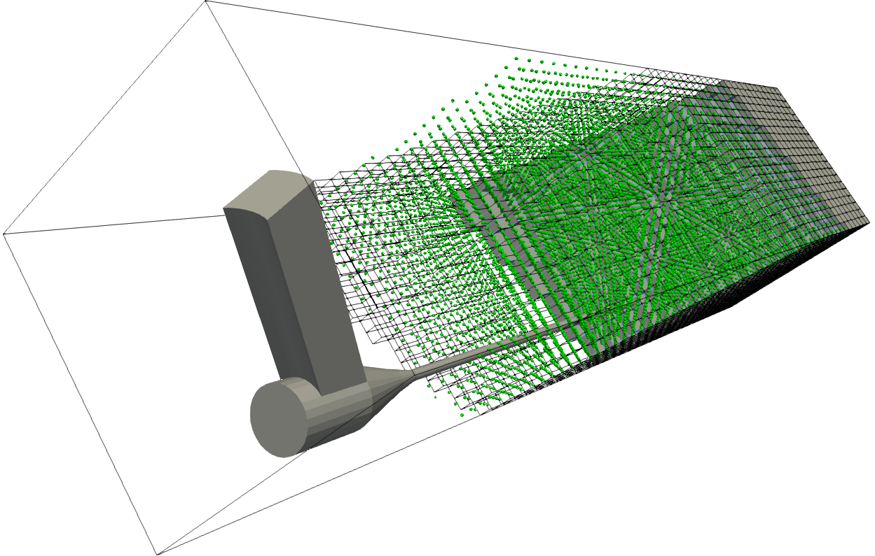
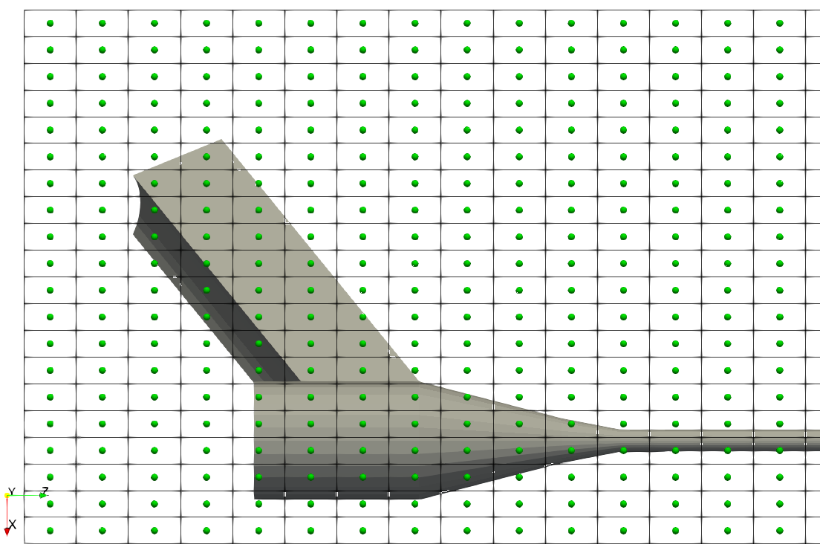
XDEM cell centers used mapping data
to & from CFD mesh (volume coupling)

Slide 9
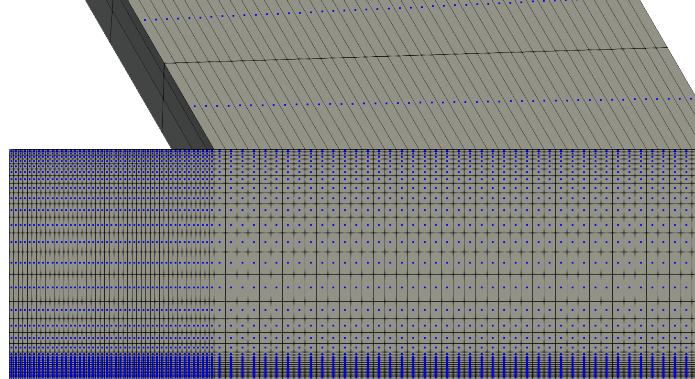
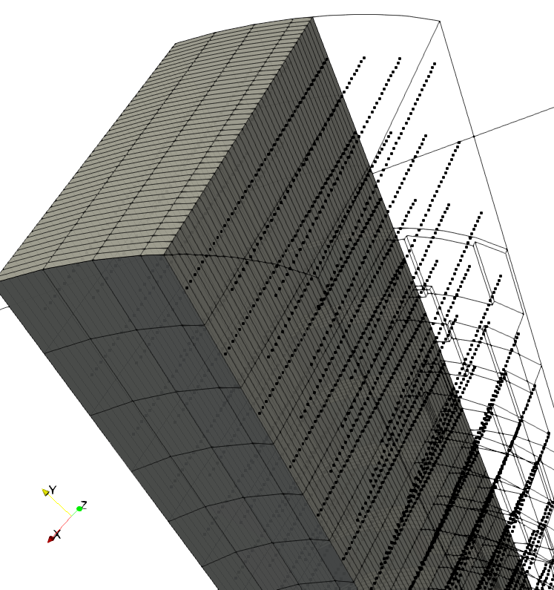
Data from XDEM mapped to CFD cell centers

Slide 10
Contents
Brief Introduction & recap
AWJC Nozzle Case Setup & Results
preCICE coupling performance analysis
Conclusions, WIP & Future work

Slide 11
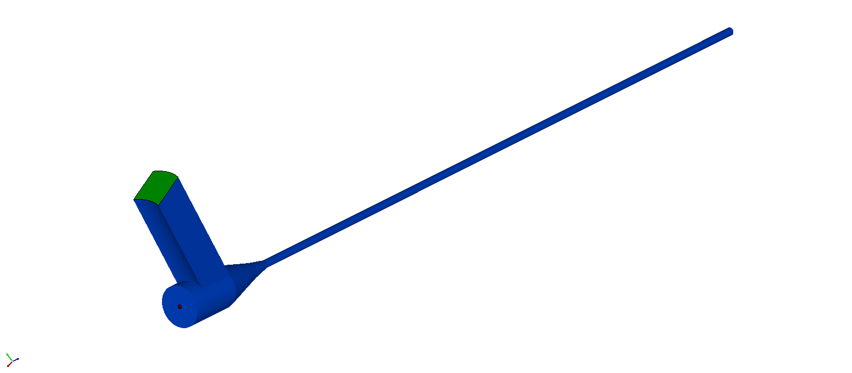
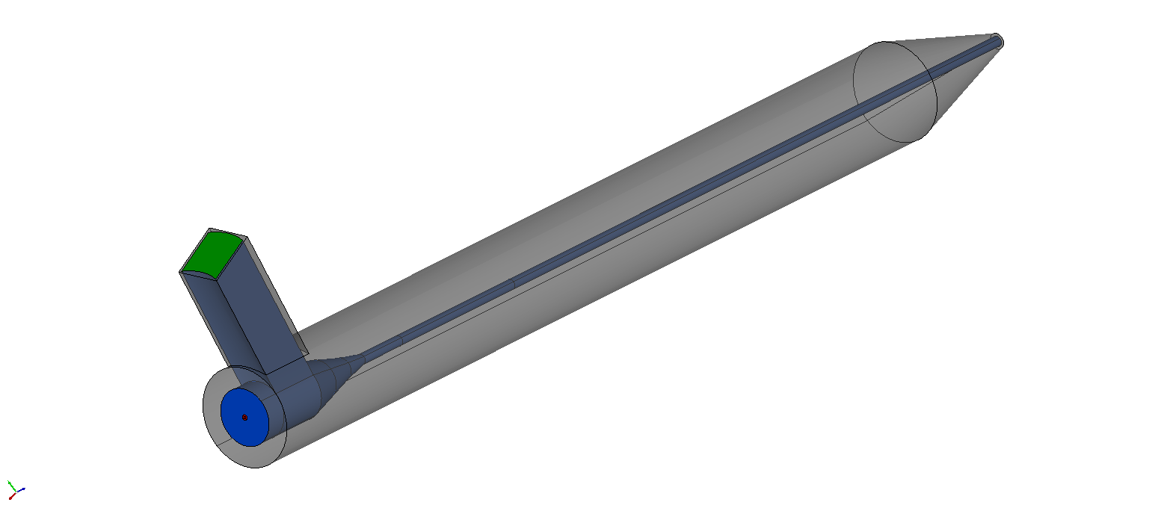
Nozzle set-up
Fluid outlet
Particle inlet (1 to 10 gm/s)
Air inlet
Fluid Part^{[3]}
Water jet Inlet (300m/s)
[3] Pozzetti, Gabriele, and Bernhard Peters. "Evaluating Erosion Patterns in an abrasive water jet cutting nozzle
using XDEM." Advances in Powder Metallurgy & Particulate Materials (2017): 191-205.

Slide 12
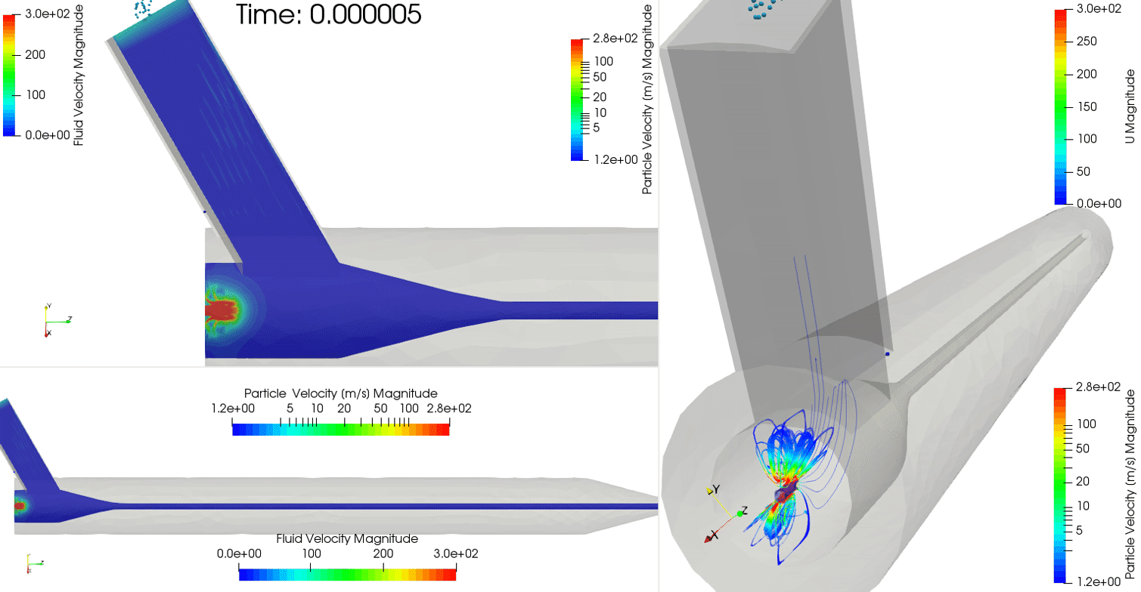

Nozzle unstable results with complex interaction particle-entrained air interaction

Slide 13
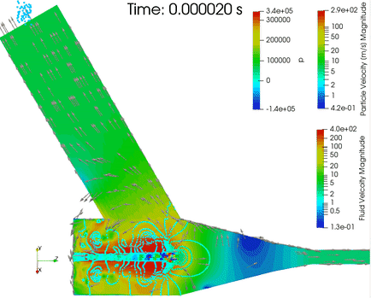
Negative fluid pressures in the focusing tube pull particles in the mixing chamber

Slide 14
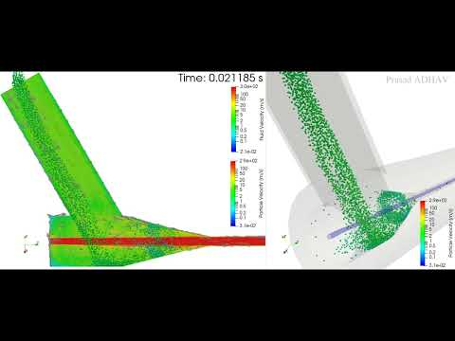
Particle flow and interaction with waterjet

Slide 15
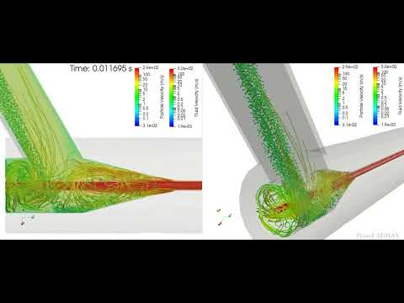
Streamlines to demonstrate turbulence
& it’s effect on particle flow

Slide 16
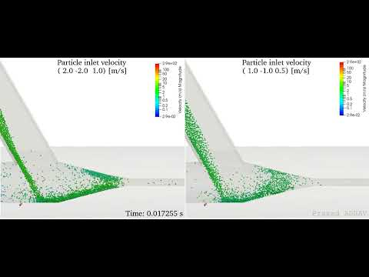
Comparison of different particle inlet velocities & it’s effects on flow

Slide 17
Contents
Brief Introduction & recap
AWJC Nozzle Case Setup & Results
preCICE coupling performance analysis
Conclusions, WIP & Future work

Slide 18
preCICE coupling performance analysis
AWJC Nozzle case unsuitable to run on a workstation
Momentum Case: Rotating drum with Gravel & water^{[4]}
Only CFD-DEM cases compared with Legacy coupling
Identical set-up and same machine
[4] Schneider, D., R. Kaitna, W. E. Dietrich, L. Hsu, C. Huggel, and B. W. McArdell. "Frictional behavior of granular gravel–ice mixtures in vertically rotating drum experiments and implications for rock–ice avalanches." Cold Regions Science and Technology 69, no. 1 (2011): 70-90.

Slide 19
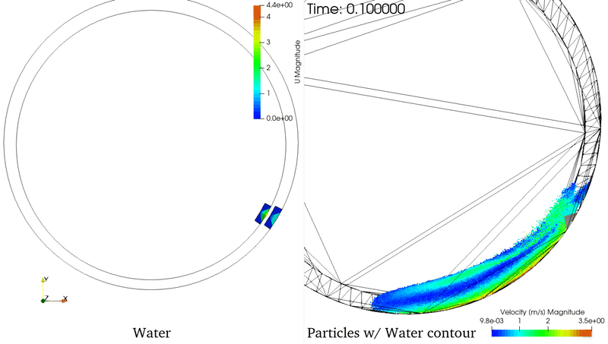
preCICE Momentum coupling
performance analysis
Momentum Case : Rotating drum with Gravel & water
No. of particles: 125,000
XDEM Domain cells: 12,800
OF cells: 12,000
Coupling time step: 1e-05 s
Simulated time: 50 s
OF solver: interFoam
preCICE coupling ~21% faster
than legacy coupling

Slide 20
Contents
Brief Introduction & recap
AWJC Nozzle Case Setup & Results
preCICE coupling performance analysis
Conclusions, WIP & Future work

Slide 21

Conclusions, Work In Progress
& Future work
Particle laden flow characteristics same as the literature^{[3]}
Simulate different operating conditions
WIP: Run simulation on HPC (multi-thread)
Performance analysis for Nozzle case
Add tutorial case with XDEM binaries to community projects
Luxembourg XDEM Research Centre
http://luxdem.uni.lu/

