Slide 1





Space Robotics Research Group
Nvidia Omniverse for Active Space Debris Removal Missions,
an Overview
X.LI, A. Richard, O. Christidi-Loumpasefski, B. C. Yalcin, C. Martinez, M. Hubert Delisle, G. Rodriguez, J. Zheng, M. Olivares Mendez
Xiao LI
Ph.D. student from SpaceR University of Luxembourg
Clean Space Industry Days 2022
13th October 2022

Slide 2
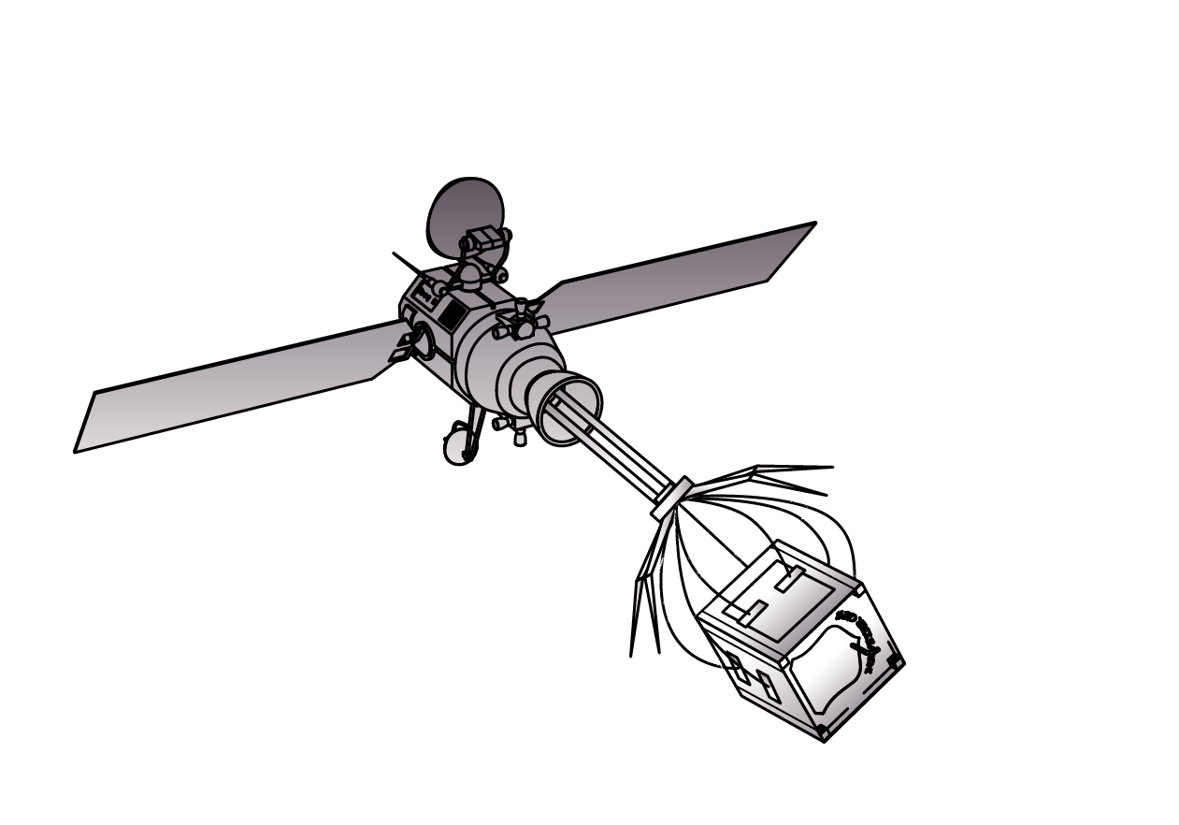


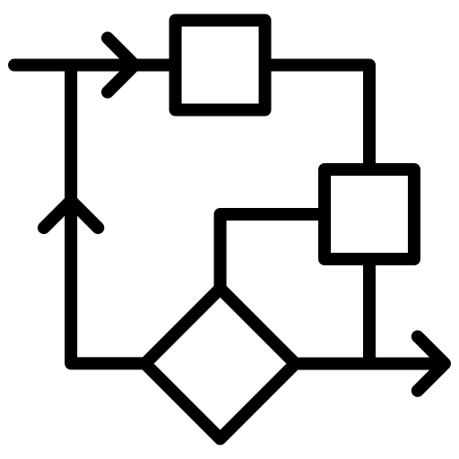
Table of contents
1. Introduction
2. HELEN project
3. High-fidelity simulations
4. Future work

Slide 3
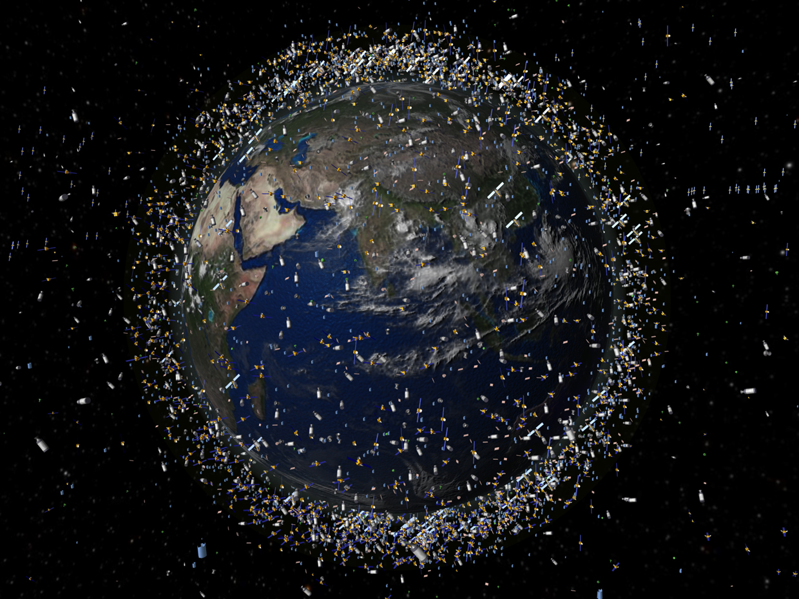
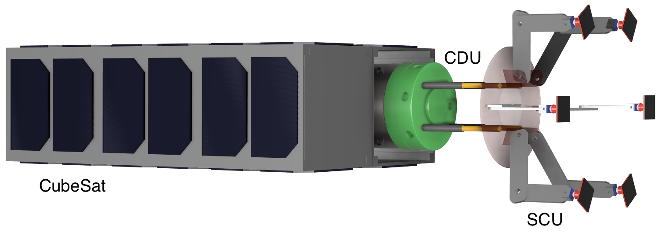
1. Introduction: Active Space Debris Removal (ASDR)
ASDR projects in SpaceR – University of Luxembourg:
Title: CASED – design of a Capturing, Absorbing, SEcuring system for active space Debris removal
Industrial partner: Spacety Luxembourg, SnT partnership
​
Title: HELEN - High-fidELity tEsting enviroNment for active space debris removal​
Industrial partner: Spacety Luxembourg​
FNR-Bridges​
3

Slide 4
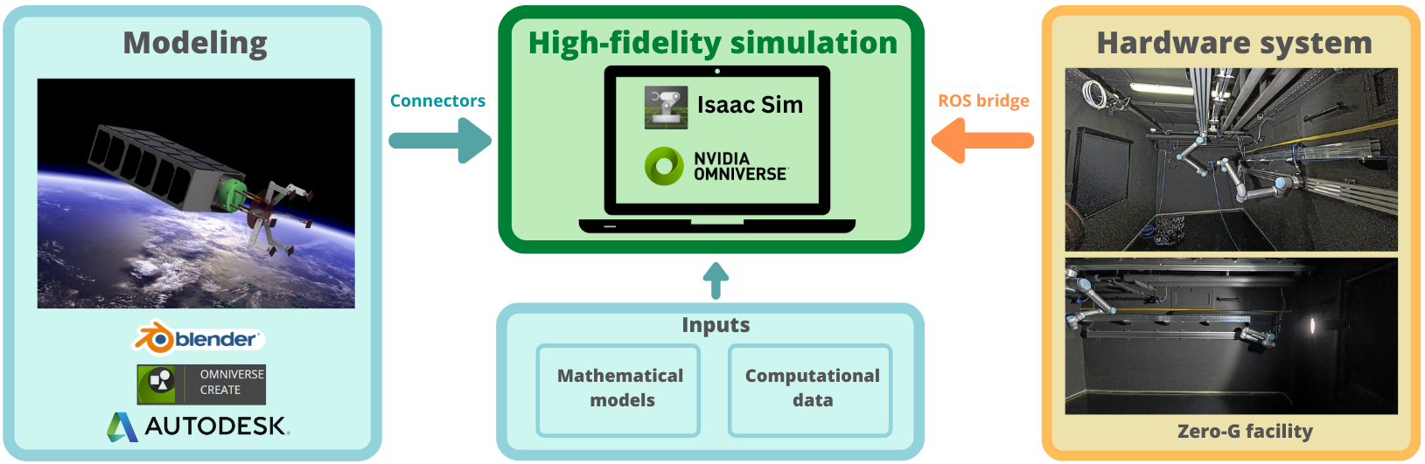
2. HELEN Project
High-fidELity tEsting enviroNment for Active Space Debris Removal
Digital twin concept for on-orbit operations
4

Slide 5

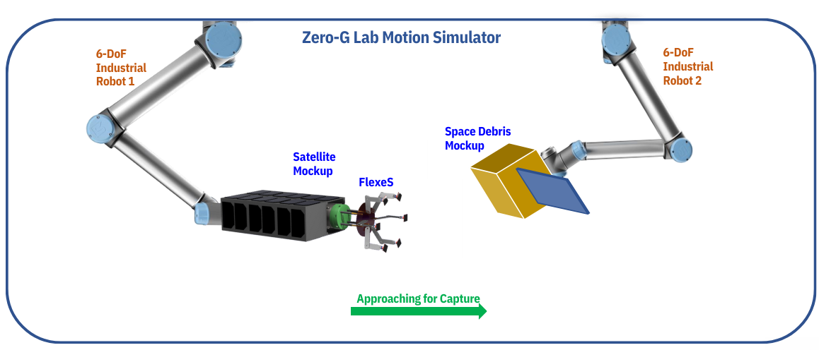
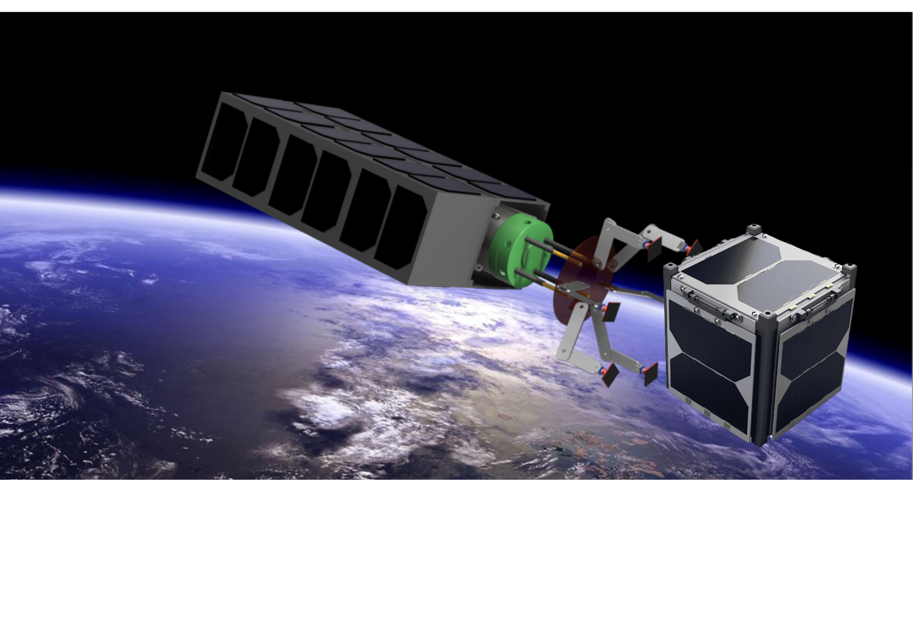
2. HELEN Project
High-fidELity tEsting enviroNment for Active Space Debris Removal
Real-time
communication
Simulator
Hardware-In-the-Loop (HIL) testing
in Zero-G robotic facility
5

Slide 6
3.1 Simulator : requirements
3. High-fidelity simulations
Physical Accuracy
Photo-Realistic
Graphics
HIL
Communication
Sensors
Micro-Gravity
Environment
Visualizations
ROS Bridge
Camera
Contact
Dynamics
Computer
Vision
Controllable Physics
Time Stepping
Contacts
IMU
6

Slide 7
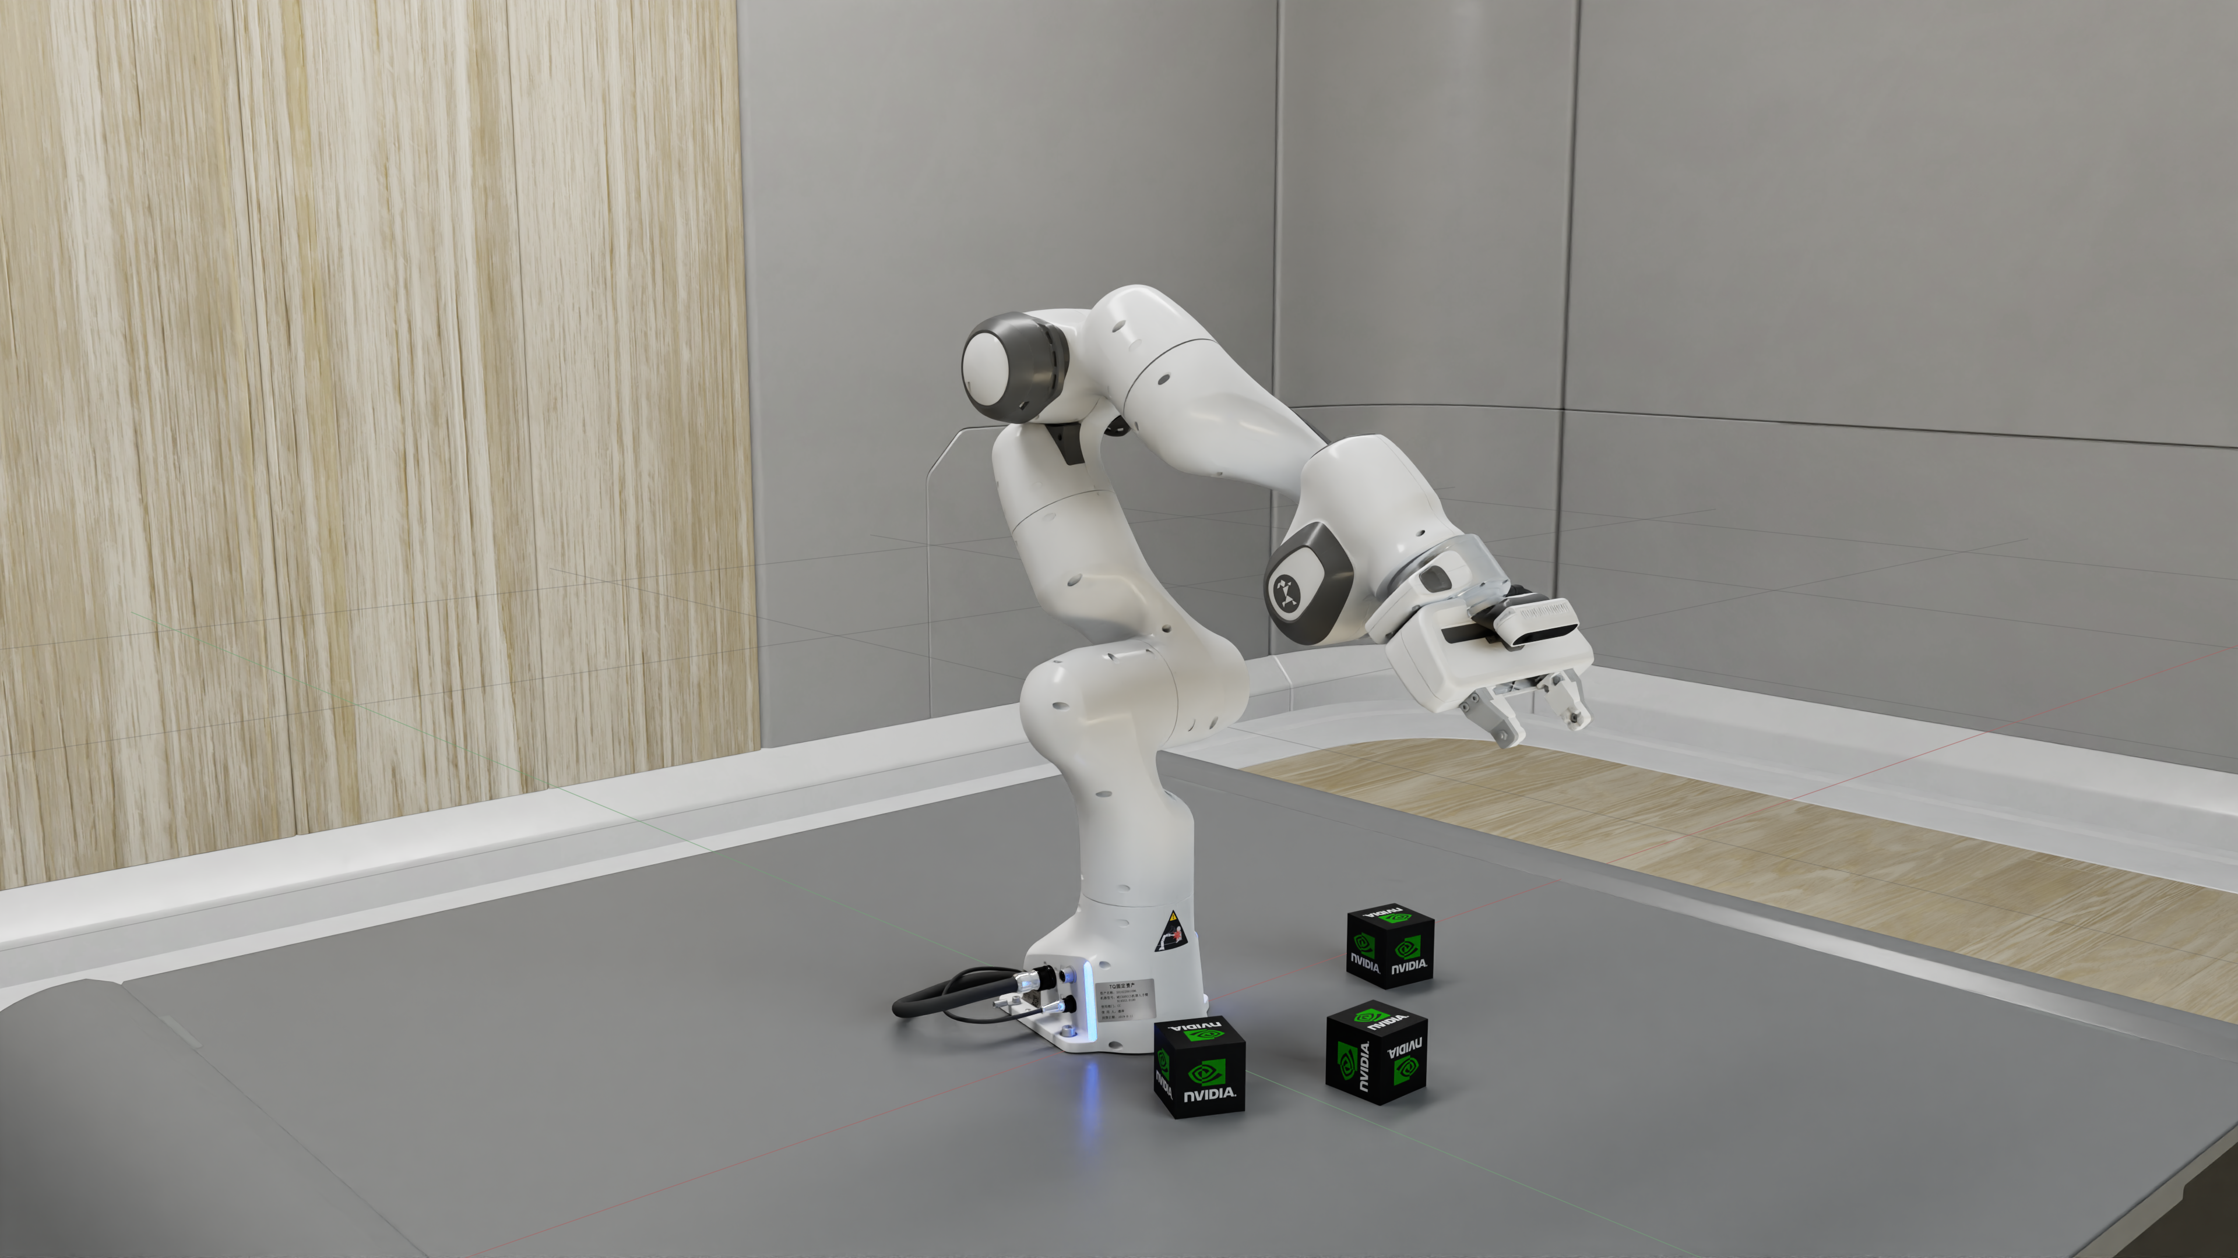

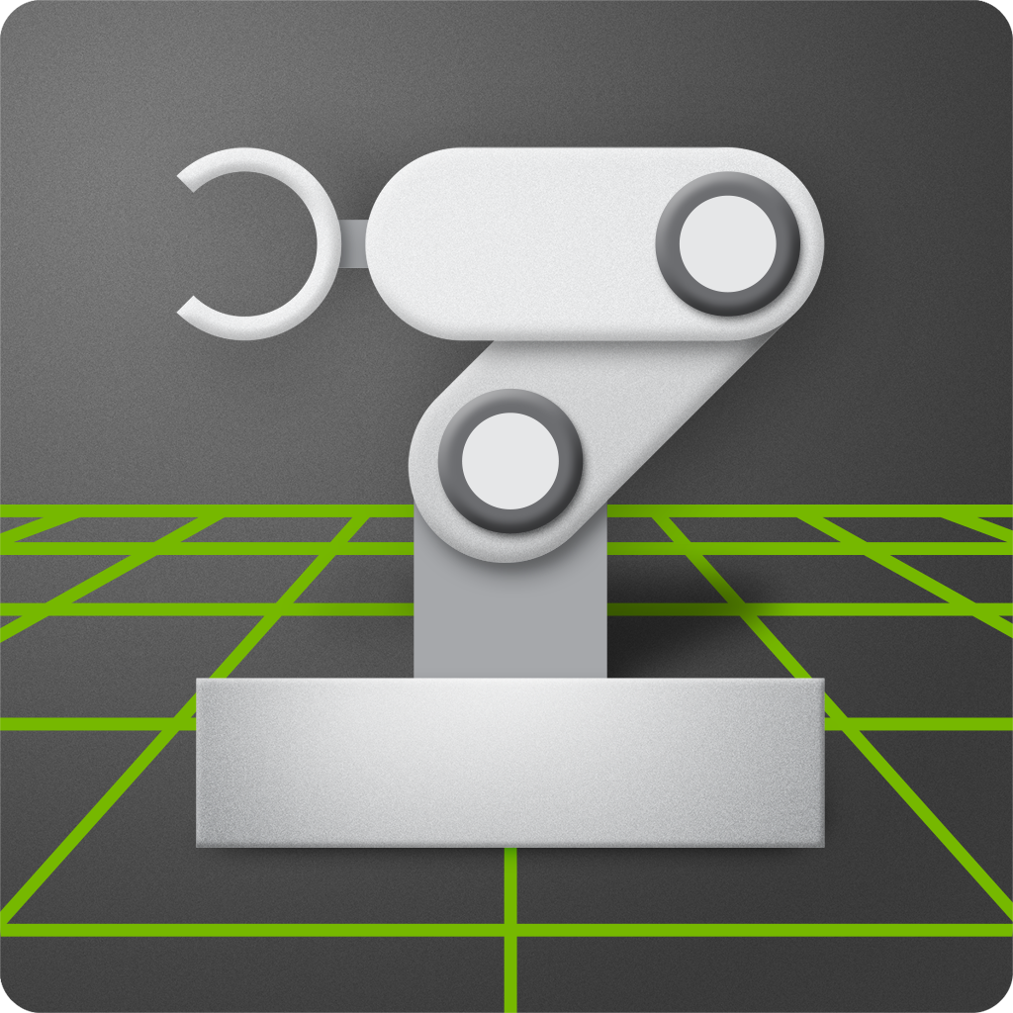

3.2 Simulator : Nvidia Isaac Sim
3. High-fidelity simulations
Isaac Sim
HIL
Communication
Physical Accuracy
HIL
Communication
Physical Accuracy
Photo-Realistic
Graphics
Photo-Realistic
Graphics
Sensors
Sensors
ROS Bridge
Micro-Gravity
Environment
ROS Bridge
Micro-Gravity
Environment
Visualizations
Visualizations
Camera
Camera
Controllable Physics
Time Stepping
Contact
Dynamics
Controllable Physics
Time Stepping
Contact
Dynamics
Computer
Vision
Computer
Vision
Contacts
Contacts
Easy Code
Integration
IMU
Controllable Render
Time Stepping
IMU
Lidar

Slide 8
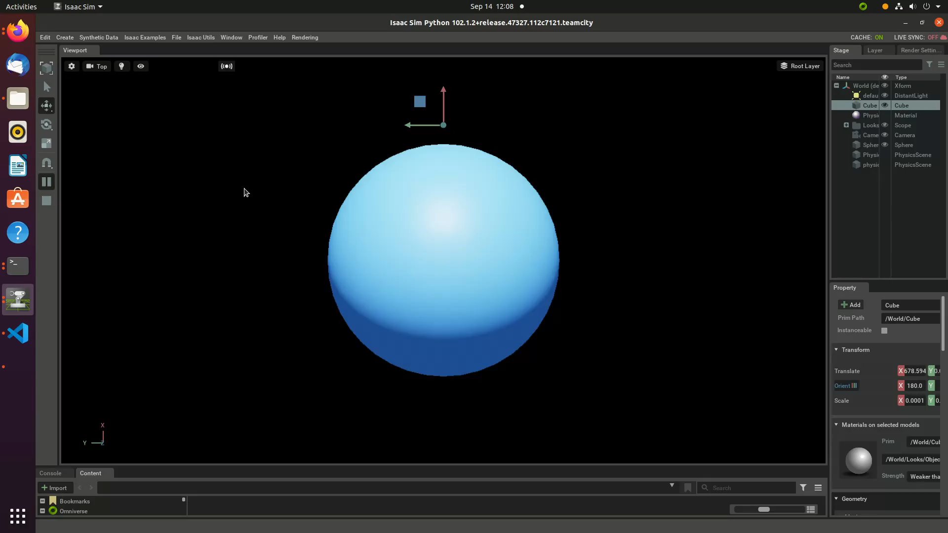

3. High-fidelity simulations
3.3 Gravitational equations implementation
Force-based astrodynamics:
Gravitational equation
Scaled real-life values:
Mass
Orbital velocity
Altitude
Numerical models with scaled dimensions
Demo video: Orbital motion of a satellite circling around Earth without textures in Isaac Sim

Slide 9
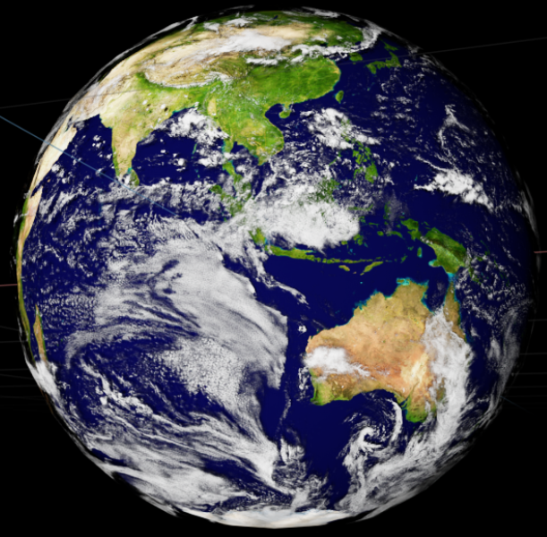
3. High-fidelity simulations
3.3 Simulations: Photo-realistic Earth Scene
Can be Created directly within Nvidia Omniverse
Lifelike visualizations
Scaled size
Photo-realistic rendering of Earth in Isaac Sim

Slide 10
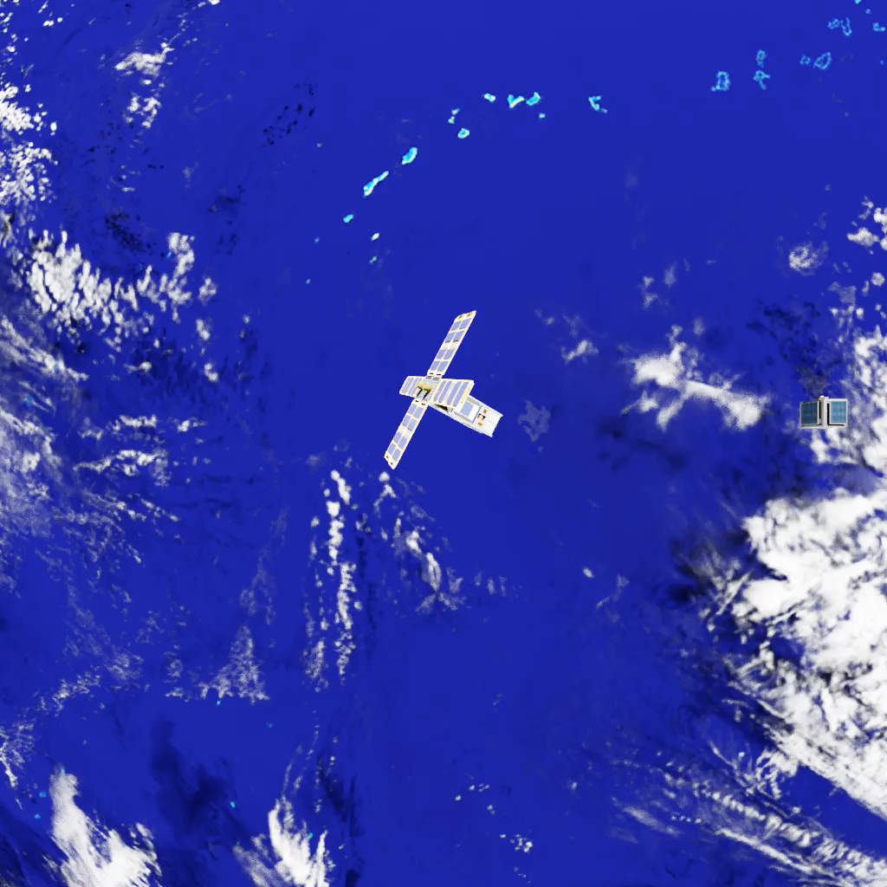
3. High-fidelity simulations
3.4 Simulations: Satellite & Debris in Orbit
Demo video: simulation of the approaching phase of an ASDR mission in Isaac Sim

Slide 11
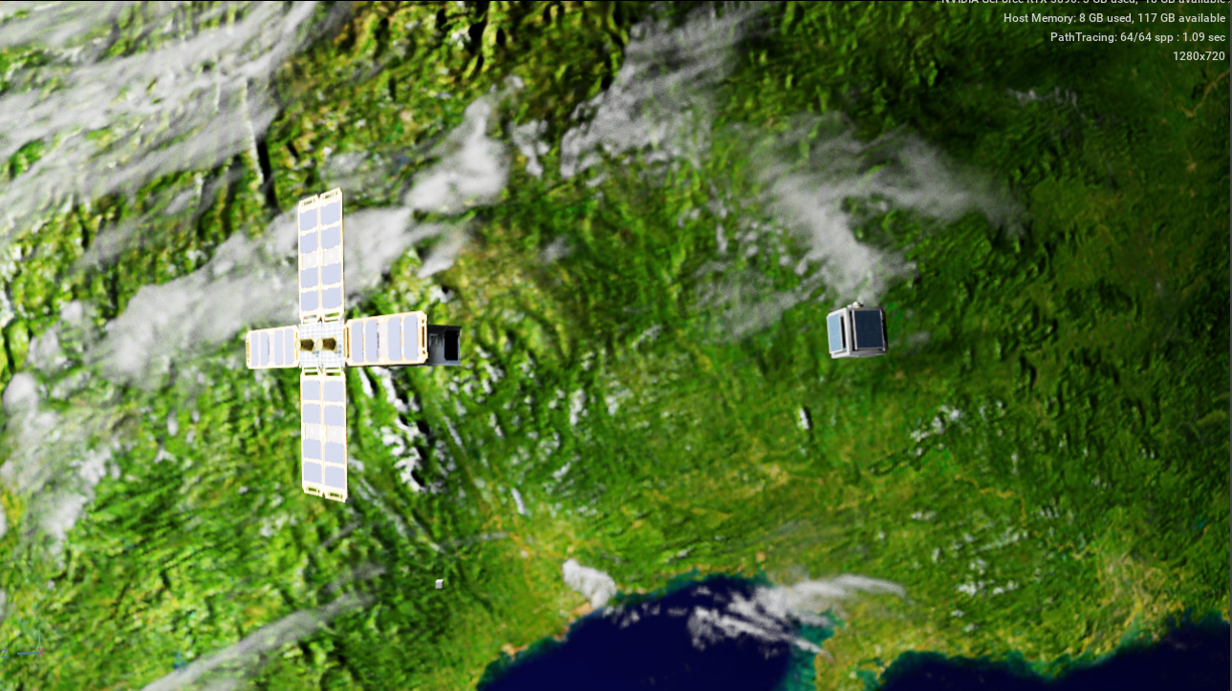
3. High-fidelity simulations
3.4 Simulations: Satellite & Debris in Orbit
On-orbit scenario:
Earth texture
CubeSat model for the capturing system
Debris
Simulation of a satellite and debris circling around Earth in Isaac Sim

Slide 12

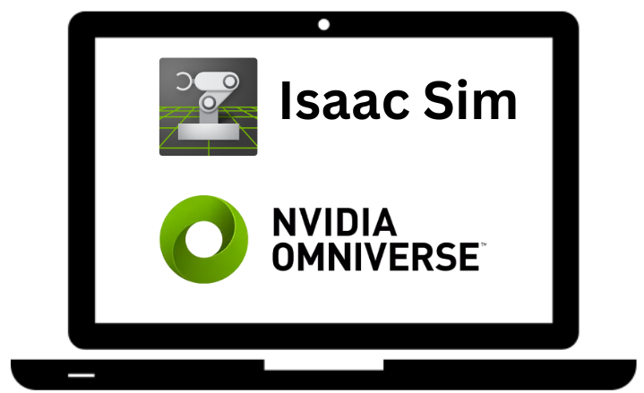

3. High-fidelity simulations
3.5 Simulations - Implementations
Result:
Python script
Isaac Sim
Faithful velocities and positions
Contact dynamics
Photo-realistic rendering
Force-based astrodynamics:
Gravitational equation
On-orbit scenario:
Satellite
Debris
Earth
Scaled real-life values:
Mass
Orbital velocity
Altitude
RTX render engine
PhysX physics engine

Slide 13

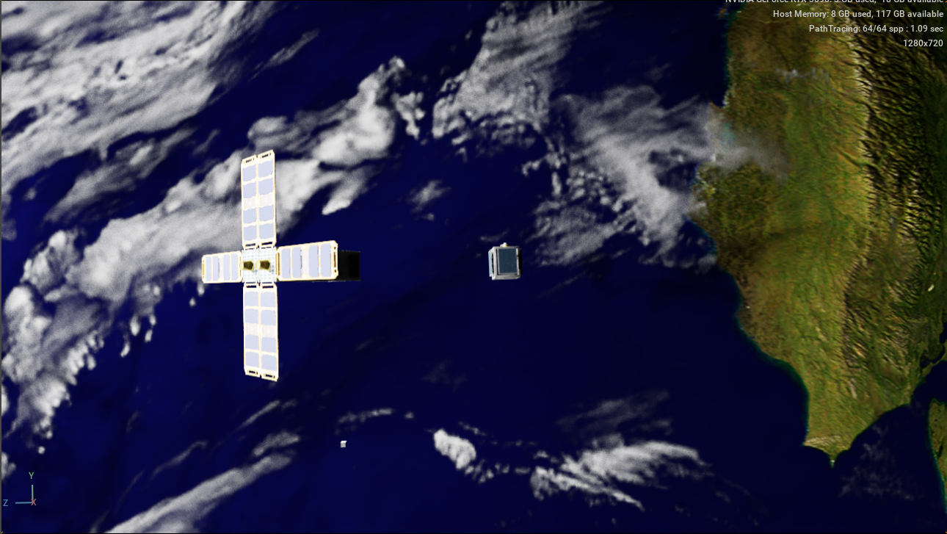
4. Future work: Hardware-In-the-Loop testing
Visual feedback
Motion
& force
feedback
Isaac Sim
The Zero-G lab control system
Motion
& force
commands
Controllable
physics
time stepping

Slide 14
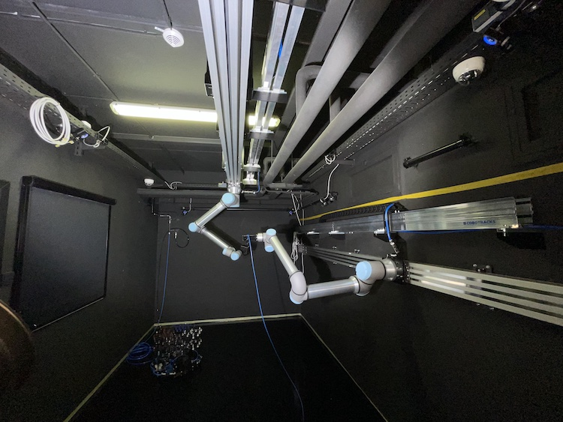
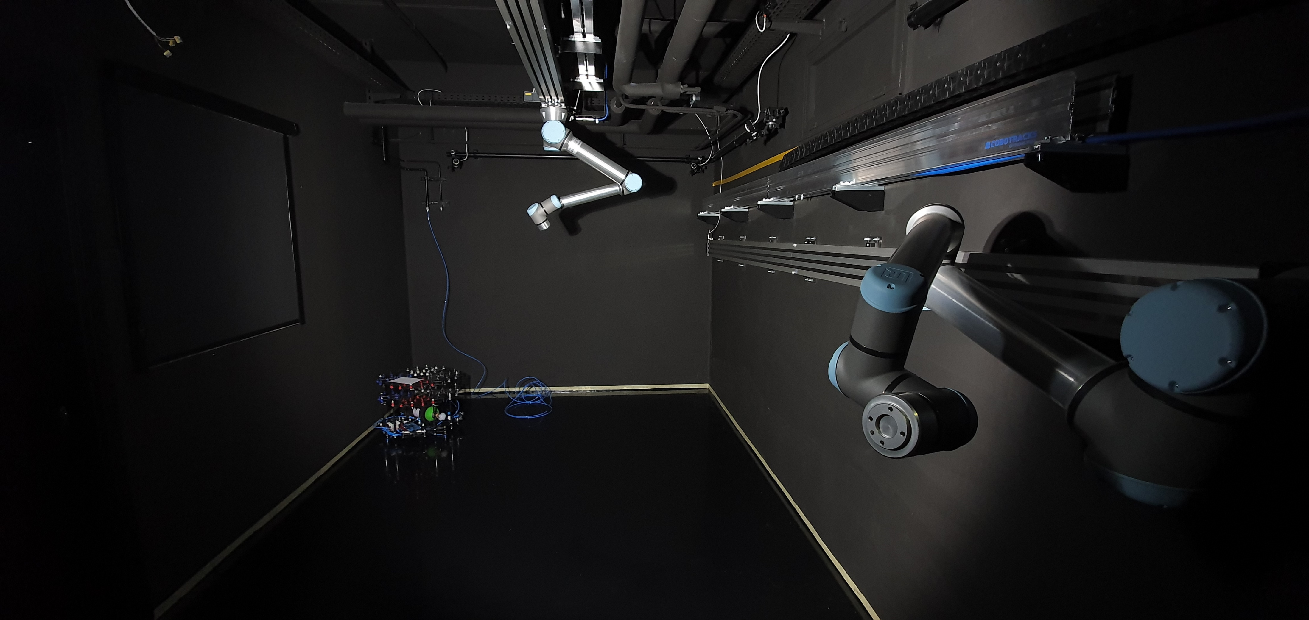
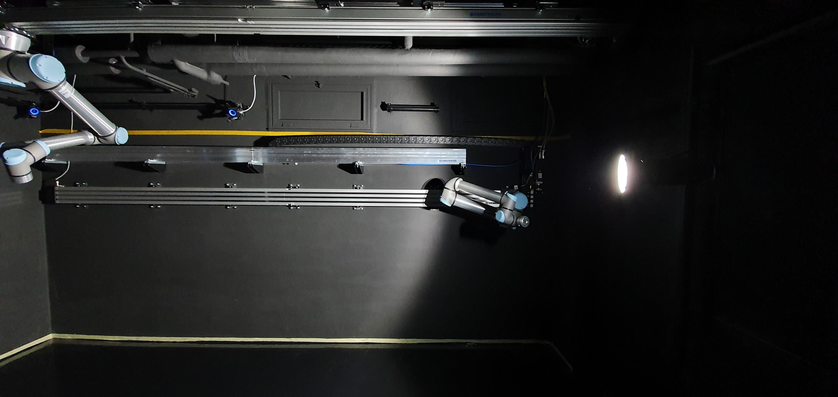
Hardware-In-the-Loop testing system
The Zero-G robotic facility of the University of Luxembourg:
Robotic arms on rails (UR10)
Floating platform (Air-bearing)
OptiTrack – Motion Capture Systems
Perfectly flat & friction-reduced floor
Dark-painted walls & sun simulator for the light source

Slide 15

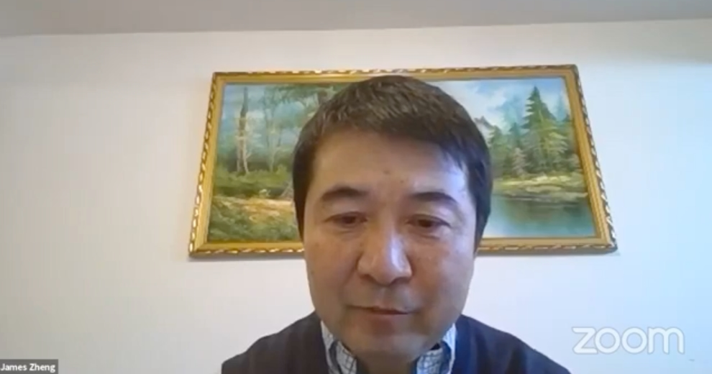
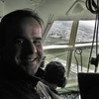


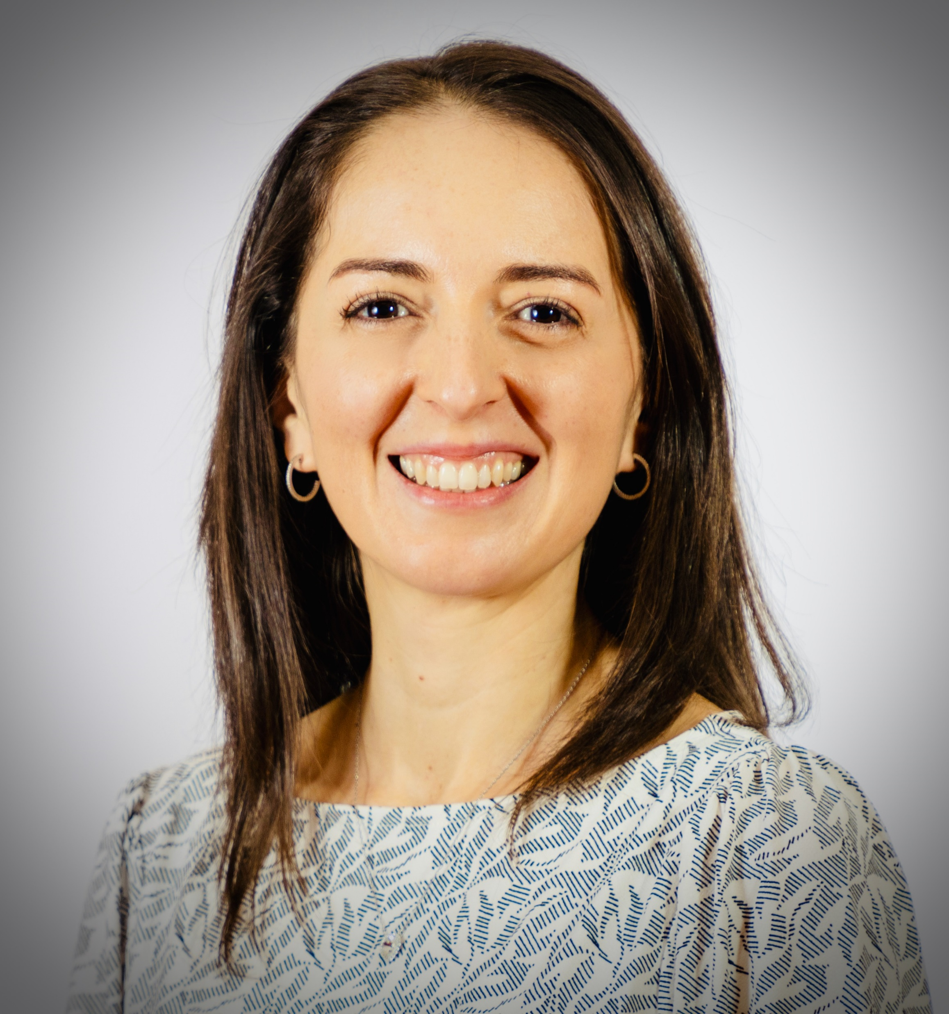
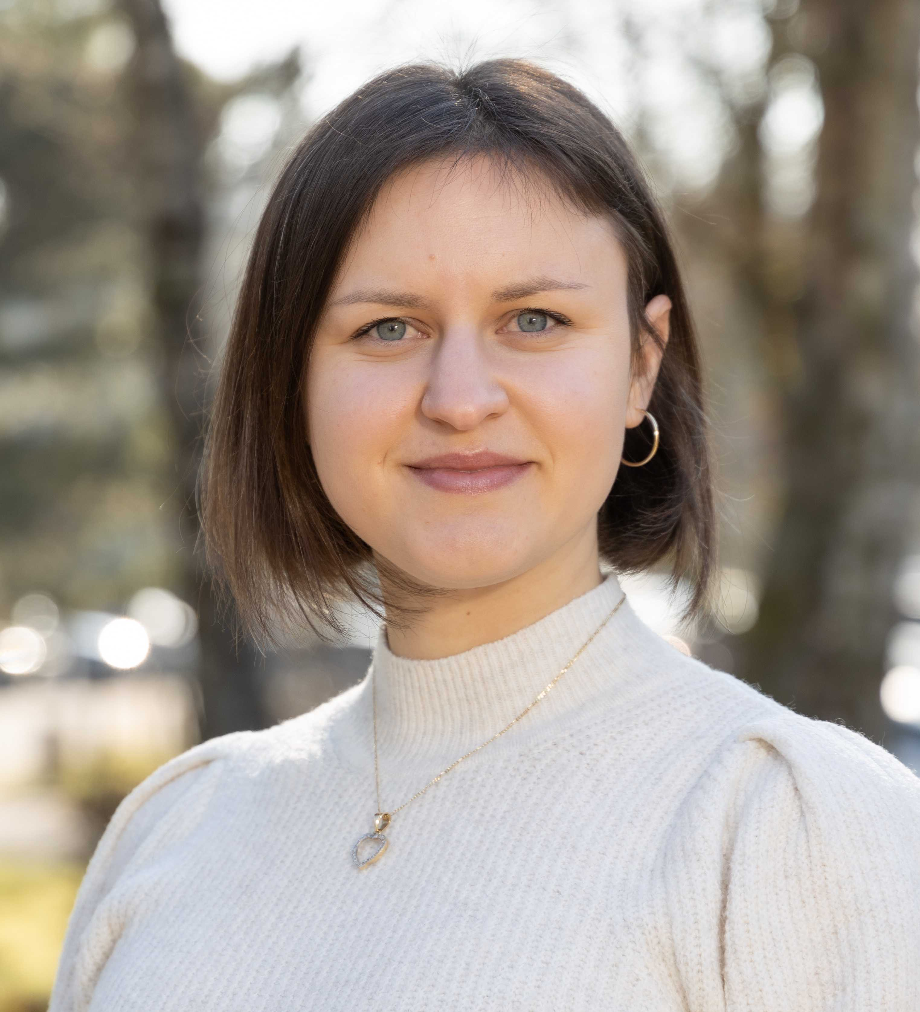
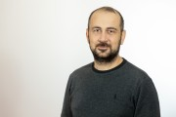

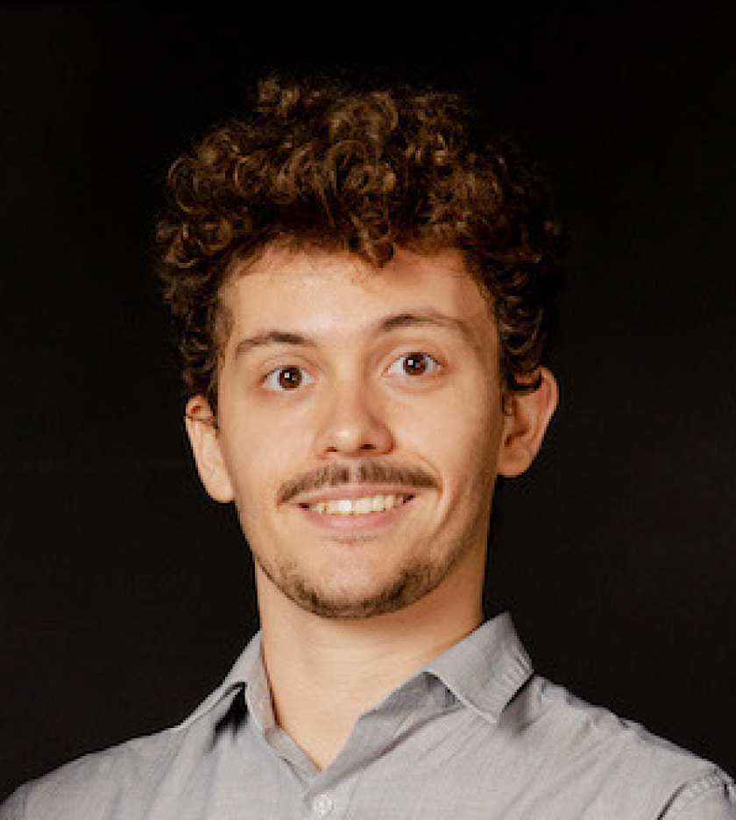


James
Gonzalo
SnT-SpaceR
Thanks
Miguel
Carol
xiao.li@uni.lu
Olga
Baris
Connect with us
@SnT_uni_lu
SnT, Interdisciplinary Centre for
Security, Reliability and Trust
Xiao
Maxime

