Slide 1
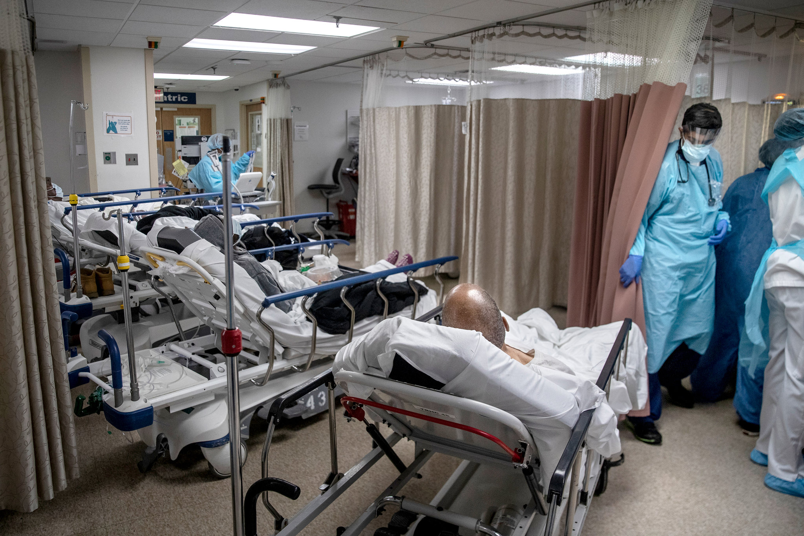
Country-Level Availability and Generosity of Healthcare Services, and Ageism’s Effects upon COVID-19 Era Missed Healthcare
Jason Settels, PhD and Anja K. Leist, PhD
University of Luxembourg
American Sociological Association 2022 Annual Meeting
Session: Cross-National Differences in Life Course Dynamics and Aging
August 8th 2022

Slide 2
Introduction
Reduced access to healthcare for non-COVID-19 concerns in overwhelmed healthcare systems (Bambra et al., 2020) and its health consequences
The need to ensure healthcare systems’ responsiveness to people with severe COVID-19 illness
in anticipation of strained physical and human resources (Anderson et al., 2021; Lawson et al., 2021)
in response to concerns that COVID-19 infections could spread to both patients and staff within medical settings (Anderson et al., 2021; Metelmann & Busemann, 2020)
Thus, many medical appointments and treatments were forgone, postponed, or denied
However, there are limited comprehensive assessments of missed healthcare during COVID-19

Slide 3
Introduction
Older individuals:
the main users of primary healthcare services (Gerich et al., 2020; Rennemark et al., 2009)
more often need regular medical treatment due to aging-associated chronic conditions (OECD, 2019)
during COVID-19, this compounds older adults’ health anxieties based on their greater vulnerability to the consequences of COVID-19 infection (Barber & Kim, 2021; Ribal et al., 2020)
In Europe, during 2020, only a few regions’ healthcare services were considered overwhelmed
Nonetheless, reduced access to medical services during the lockdown periods was observed in many countries (Nunez et al., 2021)

Slide 4
Introduction
Study goals:
to estimate from a user perspective the extent to which medical appointments and treatments of older adults in Europe in 2020 were forgone, postponed, or denied
to investigate the demographic, social, and socioeconomic (individual-level) determinants of missed healthcare
to explore country-level determinants of missed healthcare, focusing on healthcare systems’ infrastructure, healthcare systems’ generosity, and old-age ageism

Slide 5
Theoretical Perspectives
Paccoud et al. (2020) highlight the significance of Bourdieu’s (1986) concepts of economic, cultural, and social capital for older adults’ healthcare use
Higher amounts of economic and cultural capitals increase inclinations to regularly seek medical care, value placed on good health, and medical literacy (Paccoud et al., 2020)
They might thus raise likelihoods of having had forgone, postponed, or denied medical appointments and treatments through the pandemic
Also, they might – in relation to medical literacy (see Paccoud et al., 2020) – increase awareness of risk of COVID-19 infection when leaving the home
More generally, stronger sentiments of risk of COVID-19 infection and morbidity raised likelihoods of avoiding healthcare (Lu et al., 2021)

Slide 6
Earlier Research on Missed Healthcare during COVID-19
Individual-level variables that increased likelihoods of missed medical treatments:
Severity of conditions and fragility of patients decreased likelihoods of medical professionals postponing medical treatments and the lengths of these postponements when they occurred (Metelmann & Busemann, 2020)
Tendencies to factually analyze circumstances and coping strategies based on cognitive restructuring increased probabilities of postponed healthcare (Lawson et al., 2021)
Stronger emotional reactions to the COVID-19 pandemic increased likelihoods of postponed healthcare (Hajek et al., 2021)

Slide 7
Earlier Research on Missed Healthcare during COVID-19
Further individual-level predictors:
Women and those over 65 years of age were less likely to want to proceed with a surgery with high risk of COVID-19 infection and mortality (Brown et al., 2021)
Anderson et al. (2021) found in a United States sample increased rates of forgone medical services among:
Hispanics (compared to Whites)
Younger persons
Those with lower household incomes
Those either unemployed or out of the workforce because of disability
Those in worse health
Those not taking a prescription medication
Those with a mental health condition

Slide 8
Earlier Research on Missed Healthcare during COVID-19
Further differences by gender:
Relative to their higher morbidity burden and functional limitations, older women underuse healthcare services (Cameron et al., 2010)
Women experienced greater feelings of risk concerning the COVID-19 pandemic and showed higher willingness to adhere to government recommendations (Dryhurst et al., 2020; Lu et al., 2021; Rana et al., 2021)
This suggests that women might have been more likely to forgo medical appointments, or agree to their postponement, during the pandemic.

Slide 9
The Importance of Country-Level Predictors
Because of the extent to which medical systems were overburdened during the COVID-19 era (Metelmann & Busemann, 2020):
We are interested in national healthcare systems’ infrastructure based on amounts of doctors and hospital beds.
We are further interested in national healthcare systems’ generosity, indicated by healthcare expenditures per capita and population coverage for medical services
The importance of national values and norms:
may define which healthcare needs of which population groups should be prioritized, leading to disadvantages for certain segments of the population
which healthcare needs are seen as essential and are thus reimbursed by the state, and which may need co-payment or out-of-pocket (private) payment

Slide 10
The Importance of Country-Level Predictors
During a pandemic, as medical services and treatments are managed with scarce resources, these values and norms may become more important, affecting which services are prioritized over others
Some examples
Old-age ageism may negatively impact healthcare allocation and use
old-age ageist views may affect political leaders’ prioritization of healthcare resources to younger people
country-level old-age ageist views may be internalized by older adults (Weiss & Kornadt, 2018), changing their healthcare use behavior
even when old-age ageism does not become explicit, we hypothesize that in times of scarce resources, subtle barriers to healthcare access may develop, and particular needs might thus be neglected

Slide 11
The Importance of Country-Level Predictors
Old-age ageist statements in the media, in public discourse, and even by some countries’ political leaders were quite common during the COVID-19 pandemic (Ayalon et al., 2021; Fletcher, 2021; Graf & Carney, 2021)
Negative attitudes towards aging may have become more explicit during the COVID-19 pandemic and may have had substantial impact on political decisions to prioritize healthcare services to different population groups

Slide 12
Methods
Dataset and Sample
First COVID-19 module of the Survey of Health, Ageing and Retirement in Europe (SHARE)
Conducted from June to August 2020 in 27 European countries and Israel
Complemented by data from waves six (2015), seven (2017), and eight (2019-2020), as well as the easySHARE dataset

Slide 13
Methods
The SHARE studies the economic, social, and health situations of respondents of 50 years of age and older
The COVID-19 module of the SHARE further includes assessments of respondents’ lives through the COVID-19 pandemic
This study’s sample took part in the COVID-19 module and was then at least 50 years of age (analytical sample of 57,025 respondents)

Slide 14
Methods
Variables
Dependent variables
Respondents answered “yes” (1) or “no” (0) to each of these questions within the COVID-19 module:
“Since the outbreak of Corona, did you forgo medical treatment because you were afraid to become infected by the corona virus?”
“Did you have a medical appointment scheduled, which the doctor or medical facility decided to postpone due to Corona?”
“Did you ask for an appointment for a medical treatment since the outbreak of Corona and did not get one?”

Slide 15
Methods
Independent variables
Respondent-level
Years of education
Total household income: categorized into household income quintiles, specific to respondents’ particular countries
Gender (reference (ref.)=men)
Age group (50-59, 60-69, 70-79, and 80 years and older (ref.)).

Slide 16
Methods
Country-level
Healthcare systems’ infrastructure
OECD. (2020). Health at a Glance: Europe 2020:
number of practicing doctors per 1,000 population (2018, or nearest year)
number of hospital beds per 1,000 population (2018, or nearest year)
Healthcare systems’ generosity
OECD. (2020). Health at a Glance: Europe 2020:
health expenditures per capita (2019, or nearest year) (adjusted for unequal PPPs); to produce more substantial odds ratios, this variable was divided by 1,000
combined total public and primary private coverage for a core set of medical services (2018, or nearest year) (in percentages)

Slide 17
Methods
Ageism
2008 module of the European Social Survey (ESS Round 4 2008):
“And overall, how negative or positive do you feel towards people over 70?”
zero (extremely negative) to ten (extremely positive)
“Please tell me whether or not you think people over 70 are a burden on [country]’s health service these days?”
zero (no burden) to ten (a great burden)
Earlier research has shown that societal-level negative attitudes towards aging are quite stable through time (Abrams et al., 2015; Azulai, 2014)

Slide 18
Methods
Control variables
Marital/relationship status
Parental status
Self-perceived health
excellent
very good
good
fair
poor (ref.)
Extent of neuroticism (1-5)
Extent of agreement with, “I see myself as someone who is generally trusting”

Slide 19
Methods
Analysis
Three sets of multilevel logistic regression analyses, one for each dependent variable
The first model regressed the dependent variable upon all the individual-level variables

Slide 20
Methods
The second through seventh models sequentially and individually added to the first model the six country-level predictors in the following order:
number of practicing doctors per 1,000 population
number of hospital beds per 1,000 population
health expenditures per capita (divided by 1,000)
extent of population coverage for a core set of medical services
positive feelings towards people over 70
extent to which people over 70 are a health services burden

Slide 21
Methods
Missing data were dealt with through multiple imputation using chained equations (ten imputed datasets)
All models were weighted with the SHARE’s COVID-19 module design weight
Standard errors were adjusted for clustering at the level of country of residence during the SHARE’s COVID-19 module
Analyses were conducted with the Stata 17 statistical software package

Slide 22
Results

Slide 23
Results
Summary of individual-level results:
Women respondents were more likely to report forgone, postponed, and denied healthcare
Respondents from 70 to 79 years of age were the most likely to have had forgone and postponed medical appointments and treatments
In contrast, more advanced age was negatively associated with denied medical appointments and treatments
There was evidence that more educated respondents had higher likelihoods of forgone and postponed healthcare
Worse self-perceived health was positively associated with forgone, postponed, and denied healthcare
Higher neuroticism implied higher likelihood of foregone healthcare

Slide 24
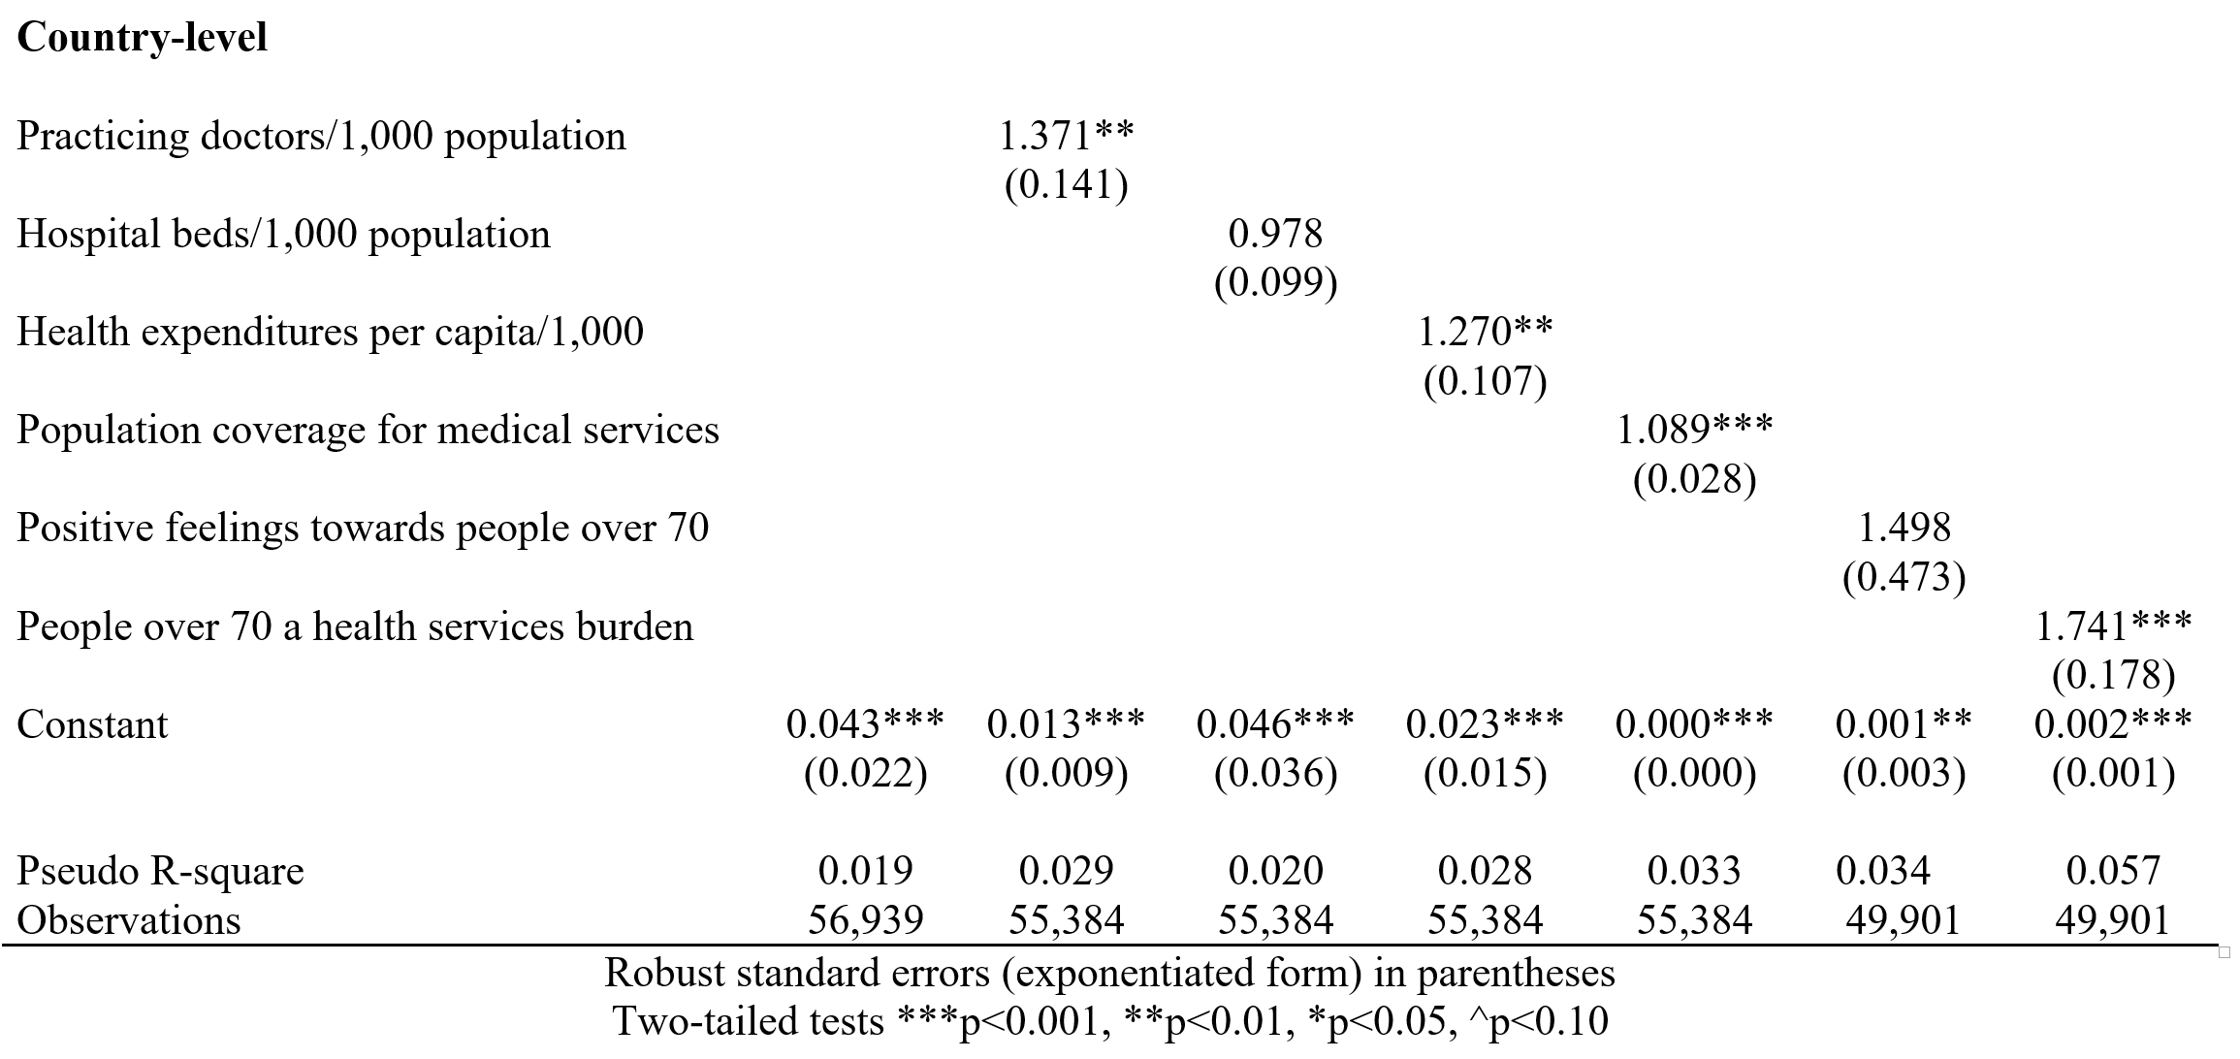
Results

Slide 25
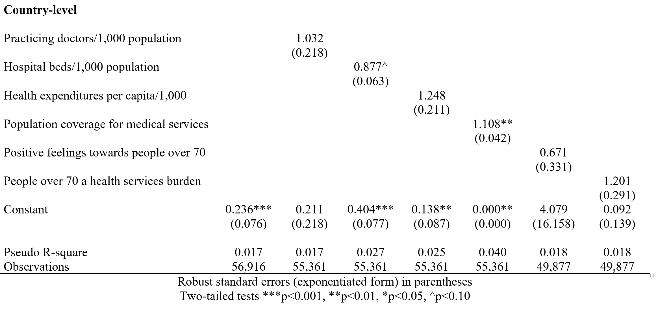
Results

Slide 26
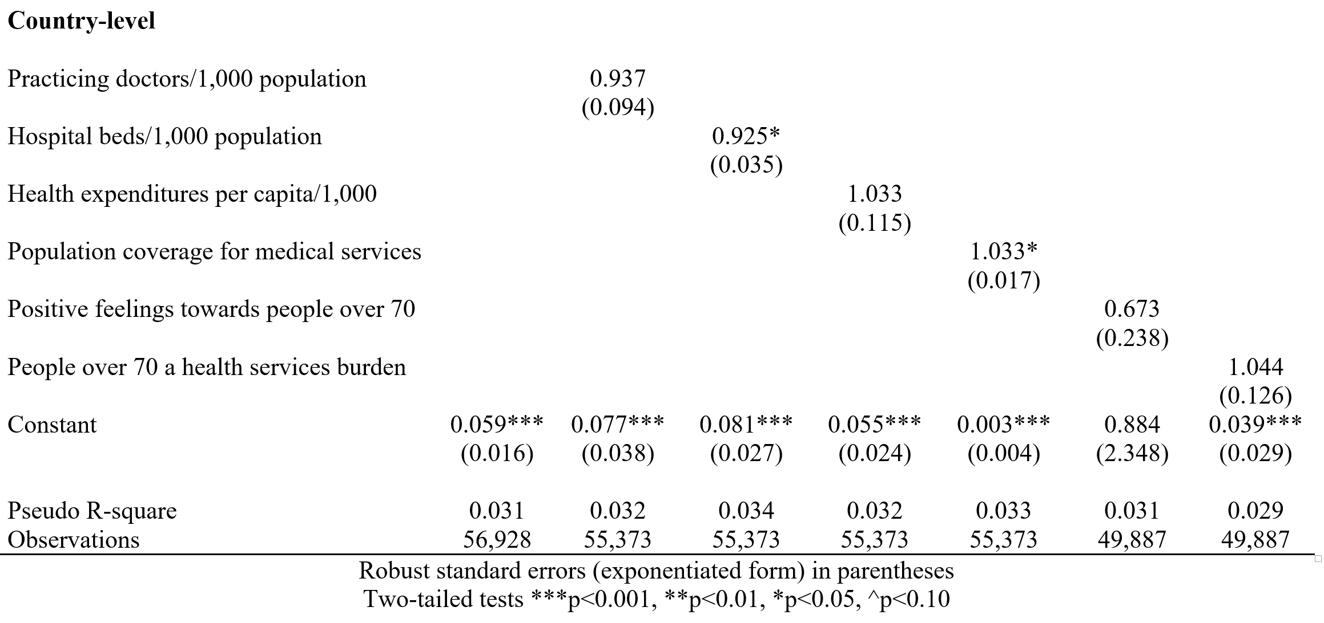
Results

Slide 27
Discussion
Prevalences of forgone and postponed healthcare appointments across Europe were substantial
Prevalence of denied healthcare was quite small – a cause for optimism
Discussion of individual-level predictors
Women showed more forgone, postponed, and denied healthcare
Concordant with earlier studies on gender differences in healthcare needs, use, and risk perception (Cameron et al., 2010; Dryhurst et al., 2020; Lu et al., 2021; Rana et al., 2021)
Respondents from 70 to 79 years of age were the most likely to have had forgone and postponed healthcare
Possibly based on their location within the nexus between anxiety concerning COVID-19 infection and perceived severity of health concerns

Slide 28
Discussion
In contrast, more advanced age was negatively associated with denied medical appointments and treatments
Perhaps due to the association between age and the severity of the health problem for which medical care was sought
There was evidence that more educated respondents had higher likelihoods of forgone and postponed healthcare
Abel, 2008; Malat, 2006; Paccoud et al., 2020:
more regularly seek medical care
place higher value on effective medical care and personal health practices
have higher medical literacy
might possess the cultural, social, and informational resources to acquire needed care through means other than formal medical institutions
might be more aware of COVID-19-related pressures on healthcare systems, inclining them to agree with their medical appointments and treatments being postponed.

Slide 29
Discussion
Worse self-perceived health was positively associated with all three types of missed healthcare
Likely because of greater medical needs, increasing the numbers of potential medical appointments and treatments that might be missed
Worryingly, this suggests that individuals with the highest healthcare needs were also the most likely to suffer from missed healthcare
Higher neuroticism increases rates of forgone healthcare
Individuals higher in neuroticism tend to seek out more medical appointments and visits (Hajek et al., 2020)
Higher neuroticism might accentuate feelings of risk regarding potential COVID-19 infection
Discussion of country-level predictors
In countries with higher numbers of practicing doctors per 1,000 population and healthcare expenditures, rates of forgone healthcare were higher
Higher rates of healthcare services use may have been for prevention
Respondents may have acted in line with public health messages

Slide 30
Discussion
Higher population coverage for a core set of medical services was positively associated with all three types of missed healthcare
From a service provider perspective - the necessity to limit medical services for non-COVID-19 healthcare
From a user perspective - individuals voluntarily refraining from medical services due to public health messages
Stronger containment policies may have led to higher rates of postponed healthcare
Higher numbers of hospital beds per 1,000 population predicted less denied healthcare
higher hospital capacity buffered increased demands due to COVID-19 patients, and
expanded sanitary measures for a broad range of healthcare services

Slide 31
Discussion
Stronger views of older people as a burden for health services on a population level were positively associated with forgone healthcare
older individuals may have internalized these negative views (Weiss & Kornadt, 2018) and acted accordingly within circumstances of scarce healthcare resources
The absence of links between population-level views of older people as a burden for health services and postponed or denied healthcare
suggests that service providers did not (systematically) increase barriers to healthcare use for older people during the pandemic in Europe

Slide 32
Discussion
These country-level findings held after controlling for numerous individual-level covariates, suggesting their robust roles
Policy Implications
Future responses to large-scale medical crises will require greater investments in medical personnel and infrastructure to increase pandemic preparedness (Kuhlmann et al., 2021)
These investments should be especially dedicated to vulnerable segments of the population who are more likely to miss needed healthcare during an epidemic

Slide 33
Discussion
In countries with more negative societal views of older people as burdens on healthcare services, public health messages should convey the importance of healthcare visits for older adults
So that (short-term) forgone healthcare during pandemic control measures does not raise older adults’ longer-term morbidity burden
Availability and generosity of healthcare services increased likelihoods of (voluntarily) forgoing healthcare
It is important to offer health education to increase individual capacities to plan healthcare visits according to medical needs

Slide 34
Thank You!
jason.settels@uni.lu
anja.leist@uni.lu

Slide 35
References
Abel, T. (2008). Cultural capital and social inequality in health. Journal of Epidemiology and Community Health, 62(7), e13.
Abrams, D., Swift, H. J., Lamont, R. A., & Drury, L. (2015). The barriers to and enablers of positive attitudes to ageing and older people, at the societal and individual level. Technical report. Government Office for Science, Kent, UK, 1-35.
Anderson, K. E., McGinty, E. E., Presskreischer, R., & Barry, C. L. (2021). Reports of Forgone Medical Care Among US Adults During the Initial Phase of the COVID-19 Pandemic. JAMA Network Open, 4(1), e2034882.
Ayalon, L., Chasteen, A., Diehl, M., Levy, B. R., Neupert, S. D., Rothermund, K., Tesch-Römer, C., & Wahl, H. W. (2021). Aging in Times of the COVID-19 Pandemic: Avoiding Ageism and Fostering Intergenerational Solidarity. Journals of Gerontology - Series B Psychological Sciences and Social Sciences, 76(2), E49–E52.
Azulai, A. (2014). Ageism and Future Cohorts of Elderly: Implications for Social Work. Journal of Social Work Values & Ethics, 11(2), 2-12.
Bambra, C., Riordan, R., Ford, J., & Matthews, F. (2020). The COVID-19 pandemic and health inequalities. J Epidemiol Community Health, 74(11), 964-968.
Barber, S. J., & Kim, H. (2021). COVID-19 Worries and Behavior Changes in Older and Younger Men and Women. Journals of Gerontology - Series B Psychological Sciences and Social Sciences, 76(2), E17–E23.
Bourdieu, P. (1986). The forms of capital. In J. G. Richardson (Ed.), Handbook of theory and research for the sociology of education (pp. 241-258). New York: Greenwood.
Brown, T. S., Bedard, N. A., Rojas, E. O., Anthony, C. A., Schwarzkopf, R., Stambough, J. B., Nandi, S., Prieto, H., Parvizi, J., Bini, S. A., & Higuera, C. A., Piuzzi, N. S., Blankstein, M., Wellman, S. S., Dietz, M. J., Jennings, J. M., Dasa, V., & AAHKS Research Committee (2021). A Brief Update on the Effect of the COVID-19 Pandemic on Hip and Knee Arthroplasty Patients in the United States: A Multicenter Update to a Previous Survey Study of Patients’ Surgeries Postponed by the Pandemic. Arthroplasty Today, (January), 1–8.

Slide 36
References
Cameron, K. A., Song, J., Manheim, L. M., & Dunlop, D. D. (2010). Gender disparities in health and healthcare use among older adults. Journal of women's health, 19(9), 1643-1650.
Dryhurst, S., Schneider, C. R., Kerr, J., Freeman, A. L., Recchia, G., Van Der Bles, A. M., Spiegelhalter, D., & Van Der Linden, S. (2020). Risk perceptions of COVID-19 around the world. Journal of Risk Research, 23(7-8), 994-1006.
Fletcher, J. R. (2021). Chronological quarantine and ageism: COVID-19 and gerontology's relationship with age categorisation. Ageing & Society, 41(3), 479-492.
Gerich, J., Moosbrugger, R., & Heigl, C. (2020). Health literacy and age-related health-care utilisation: A multi-dimensional approach. Ageing & Society, 1–22.
Graf, A. S., & Knepple Carney, A. (2021). Ageism as a Modifying Influence on COVID-19 Health Beliefs and Intention to Social Distance. Journal of Aging and Health, 33(7–8), 518–530.
Hajek, A., De Bock, F., Huebl, L., Kretzler, B., & König, H.-H. (2021). Postponed Dental Visits during the COVID-19 Pandemic and their Correlates. Evidence from the Nationally Representative COVID-19 Snapshot Monitoring in Germany (COSMO). Healthcare, 9(1), 50-58.
Hajek, A., Kretzler, B., & König, H. H. (2020, September). Personality, healthcare use and costs—a systematic review. In Healthcare (Vol. 8, No. 3, p. 329). Multidisciplinary Digital Publishing Institute.
Kuhlmann, E., Dussault, G., & Correia, T. (2021). Global health and health workforce development: what to learn from COVID‐19 on health workforce preparedness and resilience. Editorial for the Special Issue: Global health and health workforce development: Education, management and policy during the COVID‐19 crisis and beyond. The International Journal of Health Planning and Management, 36(S1), 5-8.

Slide 37
References
Lawson, A. K., McQueen, D. B., Swanson, A. C., Confino, R., Feinberg, E. C., & Pavone, M. E. (2021). Psychological distress and postponed fertility care during the COVID-19 pandemic. Journal of Assisted Reproduction and Genetics, 38(2), 333-341.
Lu, P., Kong, D., & Shelley, M. (2021). Risk Perception, Preventive Behavior, and Medical Care Avoidance among American Older Adults During the COVID-19 Pandemic. Journal of Aging and Health, 33(7–8), 577–584.
Malat, J. (2006). Expanding research on the racial disparity in medical treatment with ideas from sociology. Health, 10(3), 303–321.
Metelmann, I. B., & Busemann, A. (2020). Elective surgery in times of COVID-19: A two-centre analysis of postponed operations and disease-related morbidity and mortality. Zeitschrift für Evidenz, Fortbildung und Qualität im Gesundheitswesen, 158, 62-65.
Núñez, A., Sreeganga, S. D., & Ramaprasad, A. (2021). Access to Healthcare during COVID-19. International Journal of Environmental Research and Public Health, 18(6), 2980-2991.
OECD (2019), Health at a Glance 2019: OECD Indicators, OECD Publishing, Paris, https://doi.org/10.1787/4dd50c09-en.
OECD. (2020). Health at a Glance: Europe 2020. Available online at https://www.oecd.org/health/health-at-a-glance-europe/ [Accessed 19 March 2021].
Paccoud, I., Nazroo, J., & Leist, A. (2020). A Bourdieusian approach to class-related inequalities: the role of capitals and capital structure in the utilisation of healthcare services in later life. Sociology of Health and Illness, 42(3), 510–525.
Rana, I. A., Bhatti, S. S., Aslam, A. B., Jamshed, A., Ahmad, J., & Shah, A. A. (2021). COVID-19 risk perception and coping mechanisms: Does gender make a difference?. International Journal of Disaster Risk Reduction, 55, 1-10.

Slide 38
References
Rennemark, M., Holst, G., Fagerstrom, C., & Halling, A. (2009). Factors related to frequent usage of the primary healthcare services in old age: findings from The Swedish National Study on Aging and Care. Health & social care in the community, 17(3), 304-311.
Ribal, M. J., Cornford, P., Briganti, A., Knoll, T., Gravas, S., Babjuk, M., Harding, C., Breda, A., Bex, A., Rassweiler, J. J., Gözen, A. S., Pini, G., Liatsikos, E., Giannarini, G., Mottrie, A., Subramaniam, R., Sofikitis, N., Rocco, B. M. C., Xie, L. P,… N’Dow, J. (2020). European Association of Urology Guidelines Office Rapid Reaction Group: An Organisation-wide Collaborative Effort to Adapt the European Association of Urology Guidelines Recommendations to the Coronavirus Disease 2019 Era. European Urology, 78(1), 21–28.
Weiss, D., & Kornadt, A. E. (2018). Age-stereotype internalization and dissociation: Contradictory processes or two sides of the same coin?. Current Directions in Psychological Science, 27(6), 477-483.

