Slide 1
Complex particle-laden
Fluid structure interaction
PhD Day - May 10th
by Prasad ADHAV
Ph.D. Guide: Bernhard PETERS
Advisor: Xavier BESSERON
Luxembourg XDEM Research Centre
http://luxdem.uni.lu/
Notes:
Part of LuXDEM team
Particle - - Fluid - - Solids

Slide 2
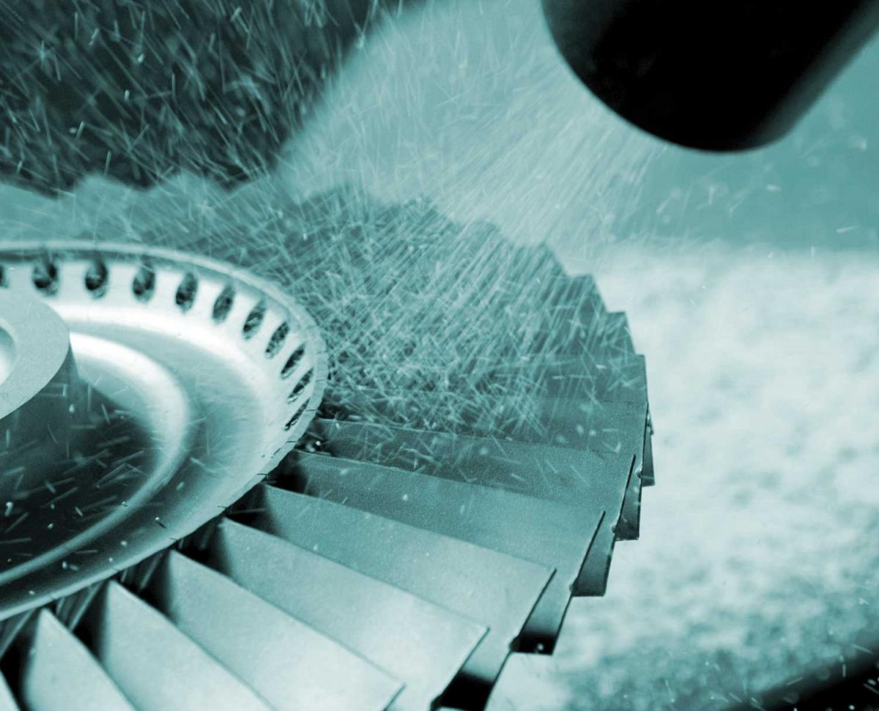
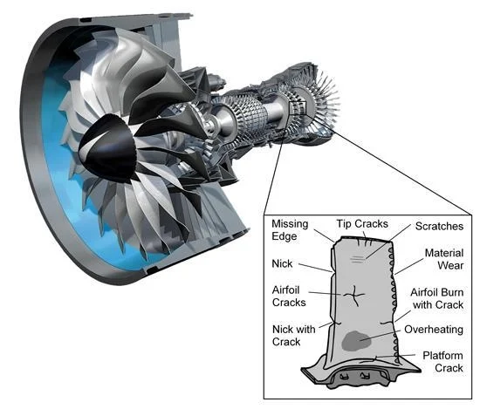
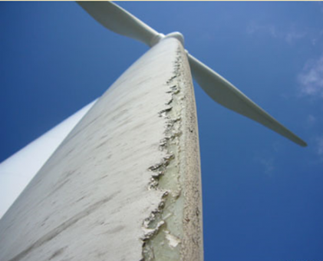
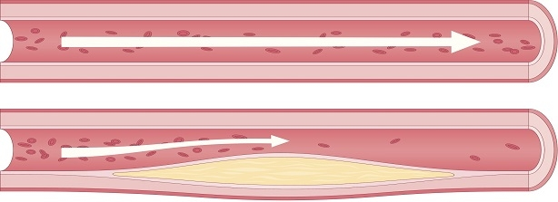
Applications where real time
experimentation is difficult
Manufacturing
Aerospace
Energy
Medical
Notes:
What are the possible applications when you think of particles, fluid and solids?
Many …
Now try and think, what is in common with these applications? - - - > Difficult to perform experiments in real time.

Slide 3
Notes:
What do we do to solve such problems? == simulations!
But multiphysics simulations not easy and trivial.
Solution?

Slide 4
Multiphysics simulations by coupling established (open source) software
Fluid
Solid/Structure
Particles
Communicator
Notes:
modular design allowing coupling of single physics software to perform multiphysics simulations
open source

Slide 5
Notes:
What is an example of utilizing such multiphysics simulations?
How can we use this?
== AWJC Nozzle

Slide 6
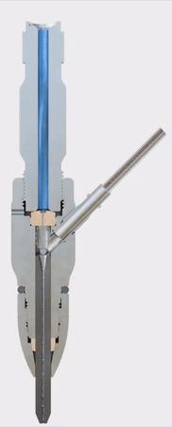
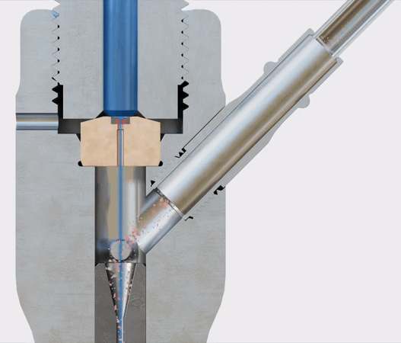
Abrasive Water Jet Cutting Nozzle (AWJCN)
Water Jet
Abrasive Particles
Nozzle
Notes:
What is AWJC Nozzle?
As name suggests particles, water jet and nozzle.

Slide 7
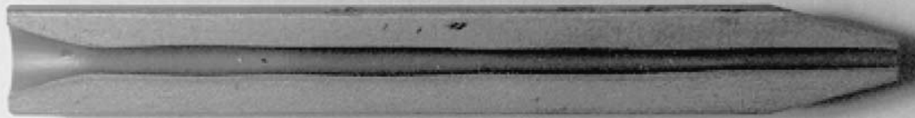
Reduced Nozzle life due to erosion
inside the Nozzle
[1] Sectioned Nozzle with erosion
[1] Nanduri, Madhusarathi, David G. Taggart, and Thomas J. Kim. "The effects of system and geometric parameters on
abrasive water jet nozzle wear." International Journal of Machine Tools and Manufacture 42.5 (2002): 615-623.
Notes:
Nozzle itself 1st target of abrasive particles
particles cause erosion
erosion affects cutting (life of nozzle)

Slide 8

Multiphysics, Multiscale simulations by coupling singlephysics software
Capture missing physics for better erosion predictions[2]
Help improve Nozzle design & life[3,4]
Ease of access to users (open source)
Luxembourg XDEM Research Centre
http://luxdem.uni.lu/
[2] Pozzetti, Gabriele, and Bernhard Peters. "Evaluating Erosion Patterns in an abrasive water
jet cutting nozzle using XDEM." Advances in Powder Metallurgy & Particulate Materials (2017): 191-205.
[3] Copertaro, Edoardo, et al. "Focusing tube operational vibration as a means for monitoring the abrasive
waterjet cutting capability." Journal of Manufacturing Processes 59 (2020): 1-10.
[4] Copertaro, Edoardo, Francesco Perotti, and Massimiliano Annoni. "Operational vibration of a waterjet focuser as means for monitoring its wear progression." The International Journal of Advanced Manufacturing Technology 116.5 (2021): 1937-1949.
[5] https://www.precice.org
Notes:
To conclude: Multiphysics multiscale simulations can be performed
Capture missing physics for better erosion predictions
Ease of access (open source)

Slide 9
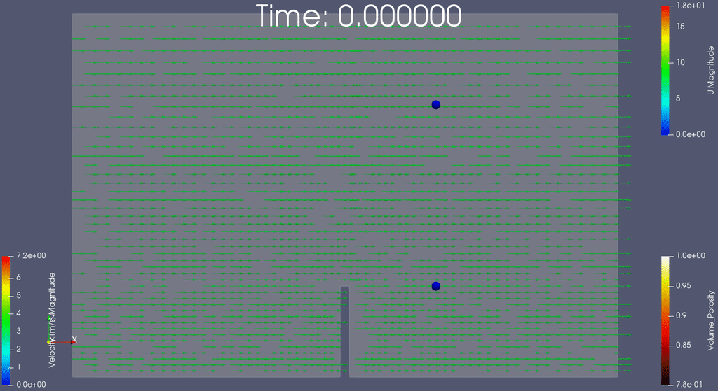
Particle-laden Fluid - Structure Interaction
(CFD + FEM + DEM)

Slide 10
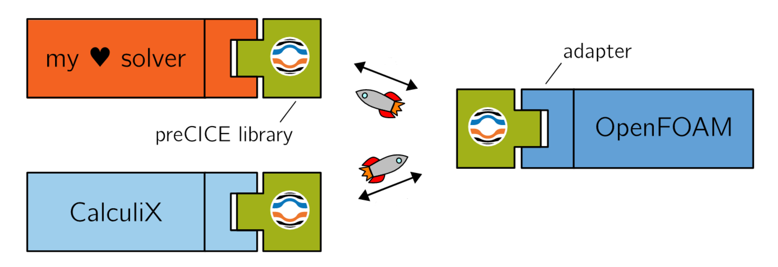
How is the Fluid - Structure - Particle coupling done?
XDEM
DEM
CFD
[4]
FEM
[3] Hans-Joachim Bungartz, Bernhard Gatzhammer, Florian Lindner, Miriam Mehl, Klaudius Scheufele, Alexander Shukaev, Benjamin Uekermann, "preCICE -- A Fully Parallel Library for Multi-Physics Surface Coupling" , 2016
in Computers and Fluids, Volume 141, p. 250––258. Elsevier.
[4] https://www.precice.org

Slide 11
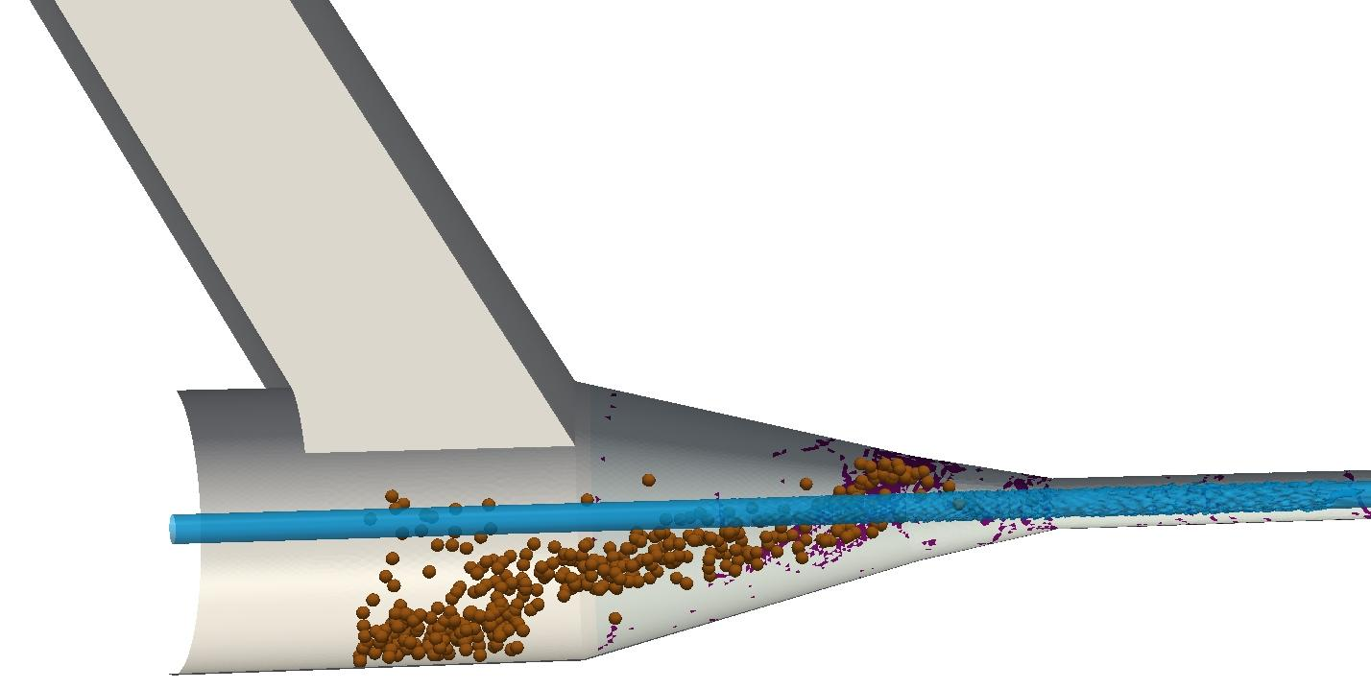
Challenges
DEM+CFD coupling used to identify erosion zones
Particle impact velocity and angle of attack ignored
Change in Nozzle interior profile
[2] Gas, liquid and abrasive particles flow in a AWJC Nozzle
[2] Pozzetti, Gabriele, and Bernhard Peters. "Evaluating Erosion Patterns in an abrasive water jet cutting nozzle
using XDEM." Advances in Powder Metallurgy & Particulate Materials (2017): 191-205.
Notes:
*1 Up until now only erosion concentrations zones have been identified through DEM and CFD coupling. The erosion is estimated through the number of impacts over time.
*2 But, Very crucial factors causing erosions, that is particle velocity at impact and angle of attack are ignored. Thus giving an incomplete picture of the erosion phenomenon.
By Having a full coupling, I plan to include these factors for evaluation of the erosion.

Slide 12
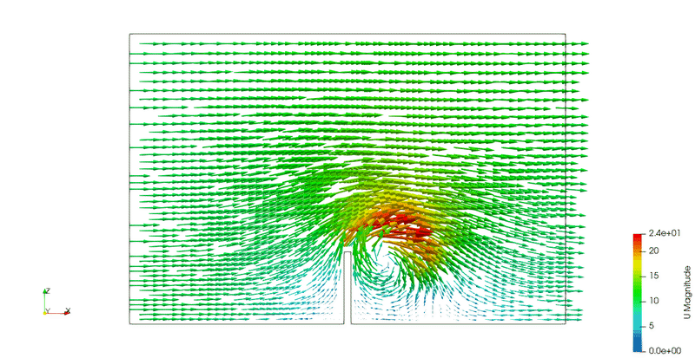
Computational Fluid Dynamics
(CFD)

Slide 13
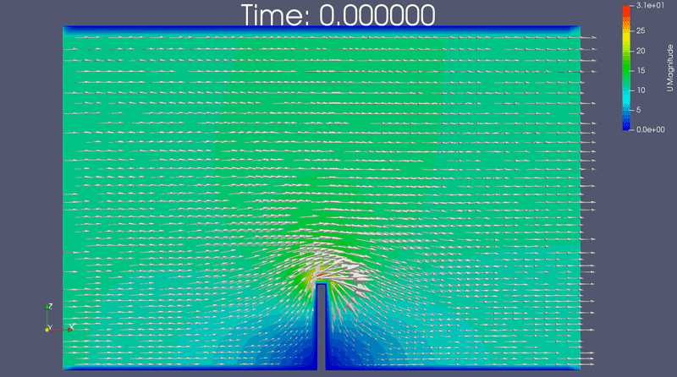
Fluid - Structure interaction
(CFD + FEM)

