Slide 1
University of Luxembourg
Research Data Management
and Data Management Plans

Slide 2



Research Data Management & Data Management Plans
Research Facilitators
Jonathan England
Librarian for Scholarly Communication and Research Process; ORBi^{lu} coordinator
jonathan.england@uni.lu
@jonatortue
https://orcid.org/0000-0001-6715-8628

Slide 3
What is research data?

Slide 4
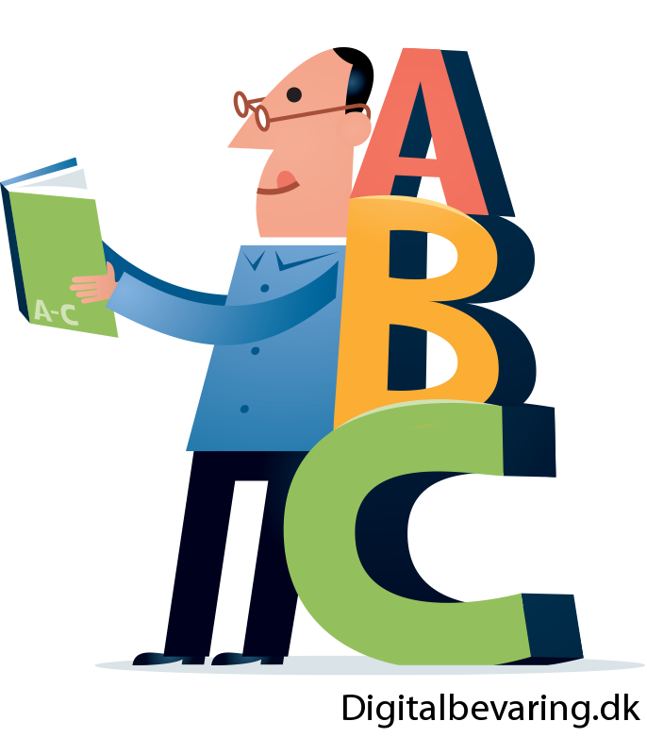
Research Data Management & DMP
webinar – April 2021
Definitions
ions
DATA = “factual information used as a basis for reasoning, discussion or calculation” (Merriam-Webster)
RESEARCH DATA = “recorded factual material commonly retained by and accepted in the scientific community as necessary to validate research findings” (EPSRC)
RESEARCH DATA = all of the information that you use as an integral part of your research
Are excluded: incidental or administrative data generated in the course of personal activities, desktop or mailbox backup, or data produced by non-research activities (teaching, administrative tasks) [LINK]
Share and reuse by citing: Jonathan England, 2021, https://doi.org/10.5281/zenodo.4714628 under CC-BY 4.0 International

Slide 5
Research Data Management & DMP
webinar – April 2021
Types of research data
Observational: data captured in real time that is usually unique and irreplaceable (e.g. remote sensing data, survey data, field recordings, sample data).
Experimental: data captured from lab equipment that is often reproducible (e.g. gene sequences, magnetic field data, electron microscope images)
Models or simulation: data generated from test models where model and metadata may be more important than output data from the model (e.g. climate models, economic models).
Derived or compiled: resulting from processing or combining 'raw' data (e.g. text and data mining, compiled databases, 3D models).
Reference or canonical: a static or organic conglomeration or collection of datasets, probably published and curated (e.g. gene sequence databanks, collection of letters or archive of historical images).
https://library.leeds.ac.uk/info/14062/research_data_management/61/research_data_management_explained
Share and reuse by citing: Jonathan England, 2021, https://doi.org/10.5281/zenodo.4714628 under CC-BY 4.0 International

Slide 6
Research Data Management & DMP
webinar – April 2021
https://library.leeds.ac.uk/info/14062/research_data_management/61/research_data_management_explained
Examples of research data
Documents (text, MS Word), spreadsheets
Scanned laboratory notebooks, field notebooks, diaries
Online questionnaires, transcripts, surveys or codebooks
Digital audiotapes, videotapes and other digital recording media
Scanned photographs or films
Transcribed test responses
Database contents (video, audio, text, images)
Digital models, algorithms, scripts
Contents of an application (input, output, logfiles for analysis software, simulations)
Documented methodologies and workflows
Records of standard operating procedures and protocols
Share and reuse by citing: Jonathan England, 2021, https://doi.org/10.5281/zenodo.4714628 under CC-BY 4.0 International

Slide 7
Research Data Management & DMP
webinar – April 2021
Examples of research data formats
Text - flat text files, Word, Portable Document Format (PDF), Rich Text Format (RTF), Extensible Markup Languague (XML).
Numerical - Statistical Package for the Social Sciences (SPSS), Stata, Excel.
Multimedia - jpeg, tiff, dicom, mpeg, quicktime.
Models - 3D, statistical.
Software - Java, C.
Discipline specific - Flexible Image Transport System (FITS) in astronomy, Crystallographic Information File (CIF) in chemistry.
Instrument specific - Olympus Confocal Microscope Data Format, Carl Zeiss Digital Microscopic Image Format (ZVI).
Share and reuse by citing: Jonathan England, 2021, https://doi.org/10.5281/zenodo.4714628 under CC-BY 4.0 International

Slide 8
What is a DMP?

Slide 9



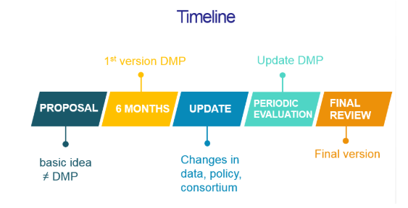
Research Data Management & DMP
webinar – April 2021
A formal ‘living’ document
Formal document that specifies how research data will be handled both during and after a research project.
It identifies key actions and strategies to ensure that research data are of a high quality, safe, sustainable and – where possible – accessible and reusable.
More and more research funders require a DMP as part of the grant proposal process, or after funding has been approved.
It is a ‘living’ document that is ideally created before or at the start of a research project, but updated when necessary as the project progresses. It’s a process…
OpenAIRE FAQ - https://www.openaire.eu/faqs#ifaqCat-170
Share and reuse by citing: Jonathan England, 2021, https://doi.org/10.5281/zenodo.4714628 under CC-BY 4.0 International

Slide 10
Research Data Management & DMP
webinar – April 2021
What makes a good DMP?
No universal DMP template and not all funders provide with a template to use
There are no absolute right answers
But be clear, specific and detailed…
And justify decisions
The DMP is to prove to the funder that the researcher has taken time to reflect on what to do, that consideration has been given and the approach seems reasonable
And that your data is “As open as possible, as closed as necessary” (FAIR principles)
Venkataraman, S. (2018, November). RDM, Open Research and DMP presentations and associated files. Zenodo. http://doi.org/10.5281/zenodo.1489929
Share and reuse by citing: Jonathan England, 2021, https://doi.org/10.5281/zenodo.4714628 under CC-BY 4.0 International

Slide 11
Research Data Management & DMP
webinar – April 2021
Useful tools
DMPonline – provide a number of templates of different funders
DCC template
H2020 template (DCC website)
Downloadable H2020 template (EC website)
Downloadable ERC template (EC website)
H2020 guidelines
FNR Data Management Policy
OpenAIRE FAQ
Share and reuse by citing: Jonathan England, 2021, https://doi.org/10.5281/zenodo.4714628 under CC-BY 4.0 International

Slide 12
Best practices in RDM

Slide 13
Research Data Management & DMP
webinar – April 2021
Planning
Documenting
Formatting
Storing
Protecting
Archiving
Sharing
A Data Management Plan outlines what you will be doing with the data
How you manage, process, format, store, document, etc. the data might be different during and after the project.
Share and reuse by citing: Jonathan England, 2021, https://doi.org/10.5281/zenodo.4714628 under CC-BY 4.0 International

Slide 14
Research Data Management & DMP
webinar – April 2021
Storing
during the project
Where is your data stored? ATLAS, laptop, USB stick?
Is a backup created on a regular basis?
Who has access to the data? Can someone delete/overwrite it by accident?
What would happen if your file became corrupt? Do you create versions?
Dealing with personal data? How will you unsure the protection of this data?
How are you sharing with collaborators? Dropbox?
What if something happened to you? Anyone else has access to the data?
Think worst case scenario (Zombie attack?), you might not be safe, but your data will be preserved.
Share and reuse by citing: Jonathan England, 2021, https://doi.org/10.5281/zenodo.4714628 under CC-BY 4.0 International

Slide 15
Research Data Management & DMP
webinar – April 2021
Not so good | Best practice
Storing
Laptops, USB sticks are not necessarily secure (not GDPR compliant) and can be lost, then what… | Storing your data on ATLAS is secure, backups are done daily, and you can access it from anywhere through Cisco AnyConnect
Versions
Do you ‘Save’ or ‘Save as’ your files? What happens if the file gets corrupted or deleted? | Take the habit to ‘Save as’ and create different versions of your file (see best practices for file naming). Any mistakes can be easily undone. Version once a day or when you have made big changes to a file
Backup
Having all your versions/”backups” in one folder. But what if the folder gets deleted by mistake? | A backup is different from versioning. Save a copy of a folder (and subfolders) in an actual backup folder that is write- and/or access-restricted
Share and reuse by citing: Jonathan England, 2021, https://doi.org/10.5281/zenodo.4714628 under CC-BY 4.0 International

Slide 16
Research Data Management & DMP
webinar – April 2021
Not so good | Best practice
Sharing with collaborators (outside the University)
Dropbox and Google Docs/Sheets have their servers in the USA, which can be a problem with GDPR. They can still be used, but you need to justify why in the DMP | ‘Dropit’ can share any files with external collaborators (including read-only or read-write options, versions history, password protected, etc.)
Access
Letting everyone in your team or all collaborators have access to the data can be a problem when dealing with personal data and you run the risk of files being deleted by mistake. But being the only one with the data is not safe either. What if something happens to you? | Decide on who ‘needs’ access to the data (e.g. one collaborator only), create (sub)folders with limited access, etc.
Share and reuse by citing: Jonathan England, 2021, https://doi.org/10.5281/zenodo.4714628 under CC-BY 4.0 International

Slide 17
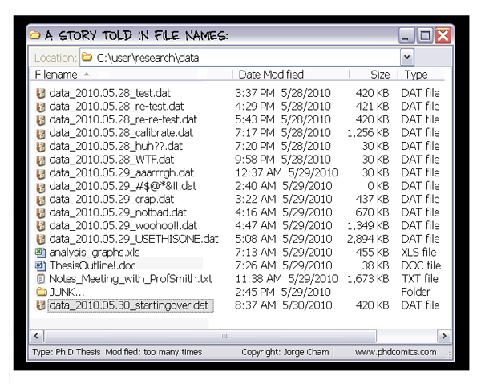
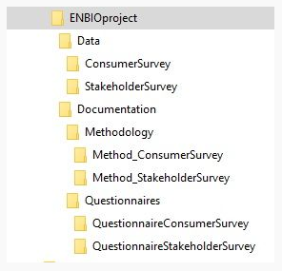
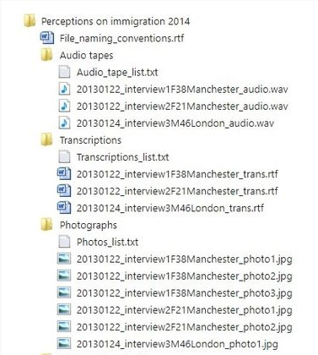
Research Data Management & DMP
webinar – April 2021
Folders structure
Structuring your files in folders is important to make it easier to locate and organise files and versions. Even more important when collaborating with others
Structure depends on the study. All material relevant to the data should be included (i.e. documentation “README” file, information on data collection and data processing procedures).
Consortium of European Social Science Data Archives - CESSDA Training - File naming and folder structure - https://www.cessda.eu/Training/Training-Resources/Library/Data-Management-Expert-Guide/2.-Organise-Document/File-naming-and-folder-structure
Share and reuse by citing: Jonathan England, 2021, https://doi.org/10.5281/zenodo.4714628 under CC-BY 4.0 International

Slide 18
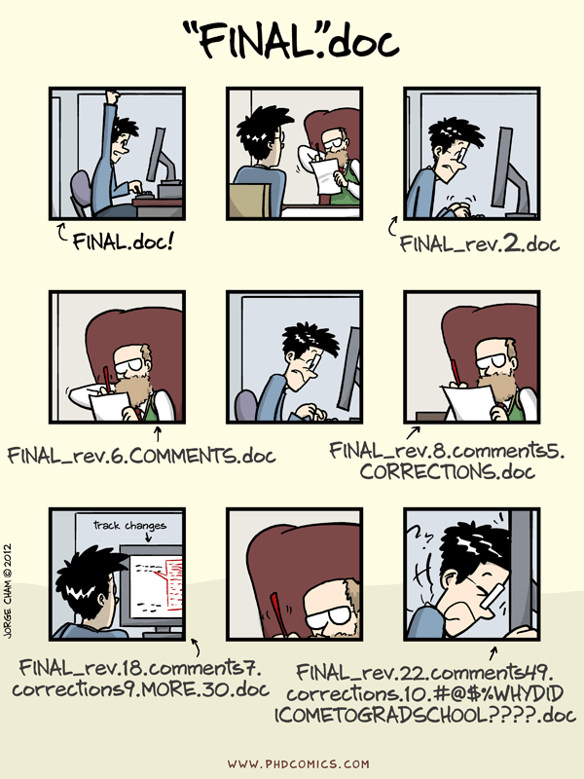
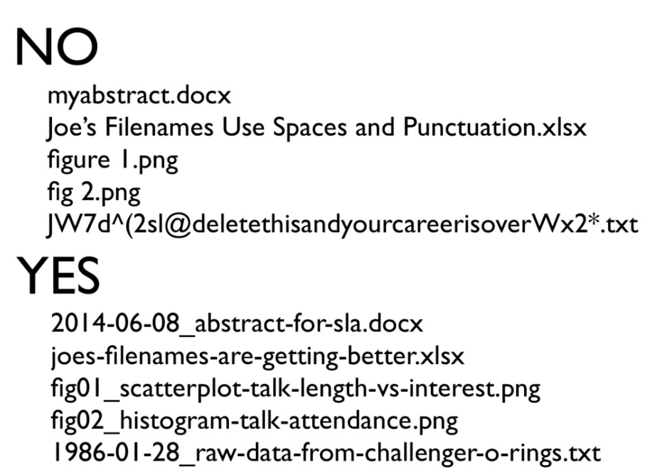
Research Data Management & DMP
webinar – April 2021
File naming
Bryan, J. (2015) Naming things - https://speakerdeck.com/jennybc/how-to-name-files
Share and reuse by citing: Jonathan England, 2021, https://doi.org/10.5281/zenodo.4714628 under CC-BY 4.0 International

Slide 19
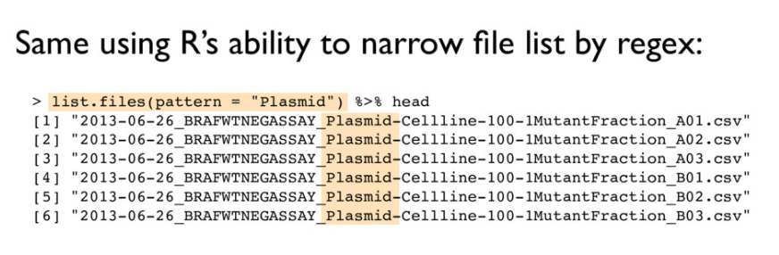
Research Data Management & DMP
webinar – April 2021
File naming
Machine readable:
  Avoid spaces, punctuation, accented characters, case sensitivity
  Use “_” and “-” to recover metadata from filenames
  “_” underscore used to delimit units of metadata I want later
  “-” hyphen used to delimit words so my eyes don’t bleed
Bryan, J. (2015) Naming things - https://speakerdeck.com/jennybc/how-to-name-files
Share and reuse by citing: Jonathan England, 2021, https://doi.org/10.5281/zenodo.4714628 under CC-BY 4.0 International

Slide 20
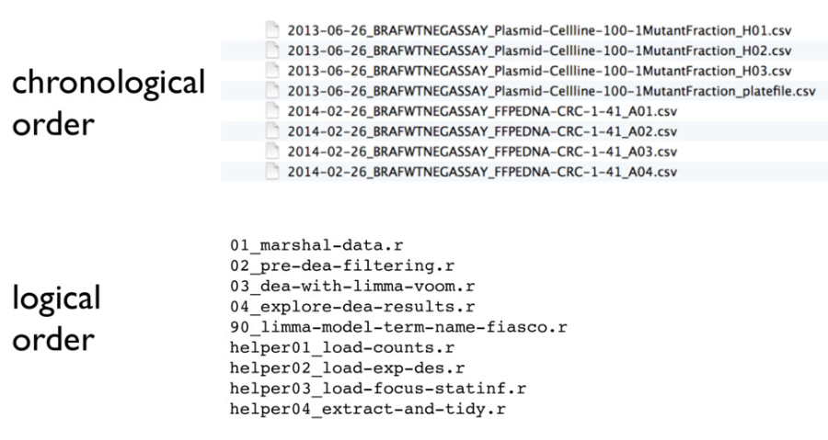
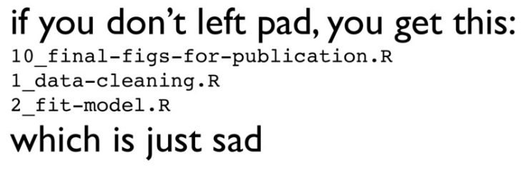
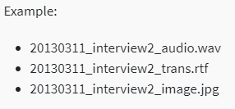
Research Data Management & DMP
webinar – April 2021
File naming
Human readable:
  Name contains info on content
  Default ordering by chronological and/or logical order
  Put something numeric first (e.g. date)
  Use YYYY-MM-DD (ISO 8601) for dates (or YYYYMMDD)
  Left pad other numbers with zeros
  Example: <date><type><ID1><gender><age><datatype><ID2>
  Need batch renaming of automatically generated files? LINK
Bryan, J. (2015) Naming things - https://speakerdeck.com/jennybc/how-to-name-files
Share and reuse by citing: Jonathan England, 2021, https://doi.org/10.5281/zenodo.4714628 under CC-BY 4.0 International

Slide 21
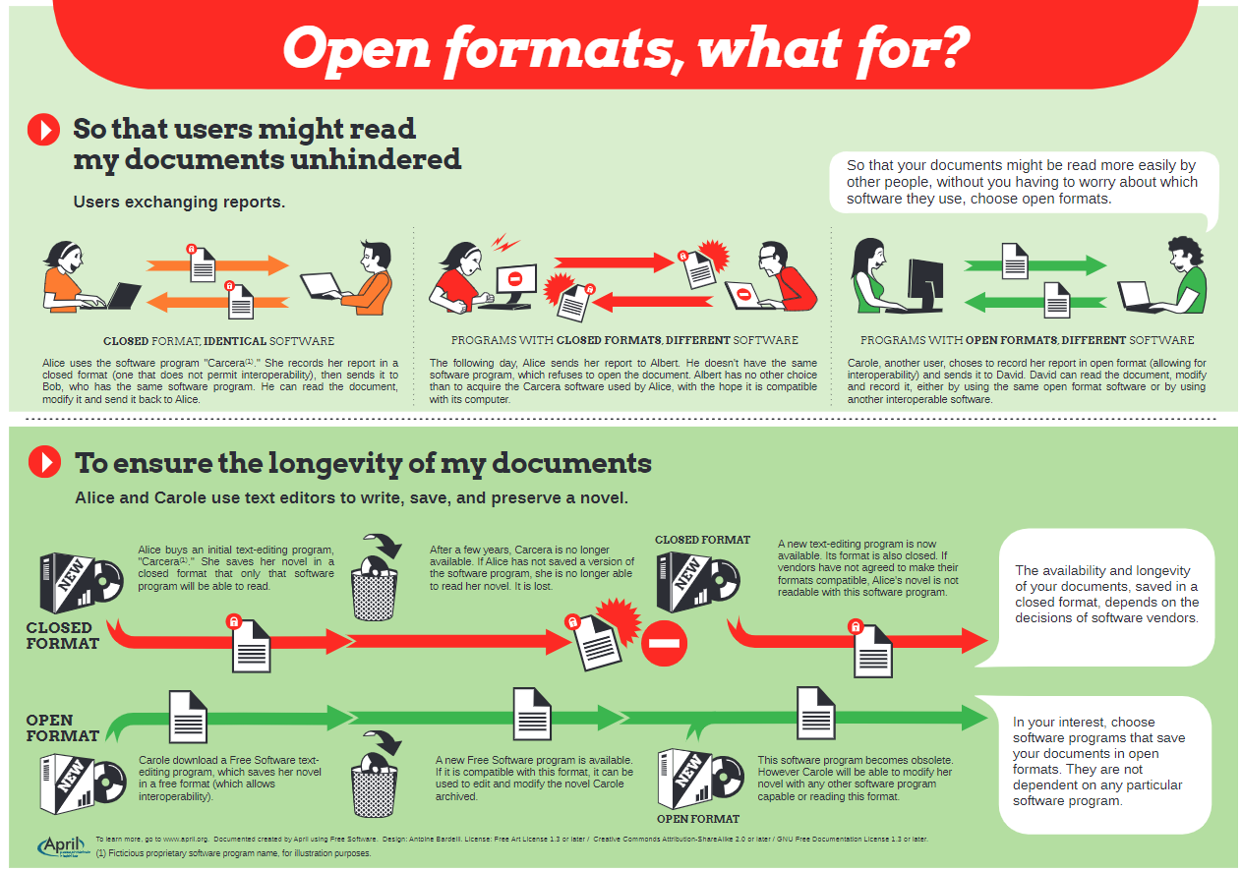
Research Data Management & DMP
webinar – April 2021
File format (1/2)
Document designed by April with Free Software. Graphics: Antoine Bardelli. Free Art License 1.3 or higher / Creative Commons Paternity, Share alike 2.0 or higher / GFDL 1.3 or higher.
https://www.april.org/en/open-formats
Share and reuse by citing: Jonathan England, 2021, https://doi.org/10.5281/zenodo.4714628 under CC-BY 4.0 International

Slide 22
Research Data Management & DMP
webinar – April 2021
File format (2/2)
If you are not aware of any disciplinary standards these are some good file formats for the preservation of the most common data types:
Textual data: XML, TXT, HTML, PDF/A (Archival PDF)
Tabular data (including spreadsheets): CSV (instead of Excel’s proprietary XLSX)
Databases: XML, CSV
Images: TIFF, PNG, JPEG (note: JPEG is a 'lossy' format which lose information when re-saved, so only use it if you are not concerned about image quality)
Audio: WAV, FLAC, MP3 (lossy format)
University of Cambridge - Data Management Guide - Choosing Formats - https://www.data.cam.ac.uk/data-management-guide/creating-your-data/choosing-formats
Share and reuse by citing: Jonathan England, 2021, https://doi.org/10.5281/zenodo.4714628 under CC-BY 4.0 International

Slide 23
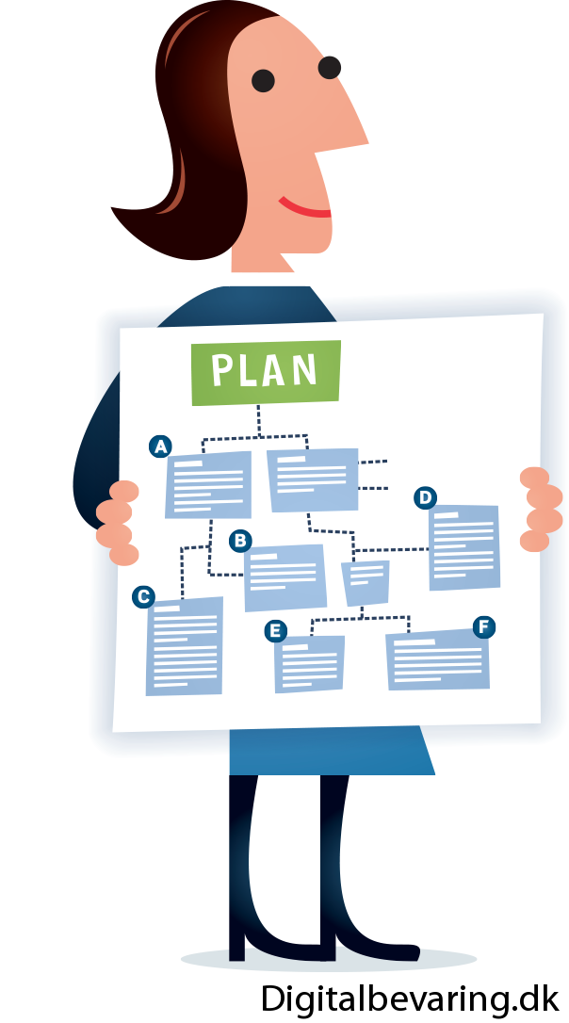
Research Data Management & DMP
webinar – April 2021
Planning
Who is responsible for which part of data management?
Are new skills required for any activities?
Do you need extra resources to manage data, such as people, time or hardware?
Have you accounted for costs associated with depositing data for longer-term preservation and access?
UK Data Service - Data management checklist - https://www.ukdataservice.ac.uk/manage-data/plan/checklist.aspx
Share and reuse by citing: Jonathan England, 2021, https://doi.org/10.5281/zenodo.4714628 under CC-BY 4.0 International

Slide 24
Research Data Management & DMP
webinar – April 2021
RDM costs covered by funders
There are no default costs that can be given, but there are tools that can help
Indirect costs
  Human resources (e.g. data curator)
Overhead costs
  Existing university services and infrastructure
Direct costs
  Costs related to database or dataset access (e.g. licensing costs)
  Data storage and backup costs (e.g. cloud storage)
  Data formatting or data cleaning costs (e.g. if external service)
  Transcription of qualitative data (e.g. interview transcripts)
  Data encryption software
  Digitalisation of analogue or paper-based research data
  Data storage and preservation costs in a repository (e.g. https://datadryad.org/; 120USD/20GB)
Sources: Tom Jakobs (FNR), OpenAIRE
Share and reuse by citing: Jonathan England, 2021, https://doi.org/10.5281/zenodo.4714628 under CC-BY 4.0 International

Slide 25
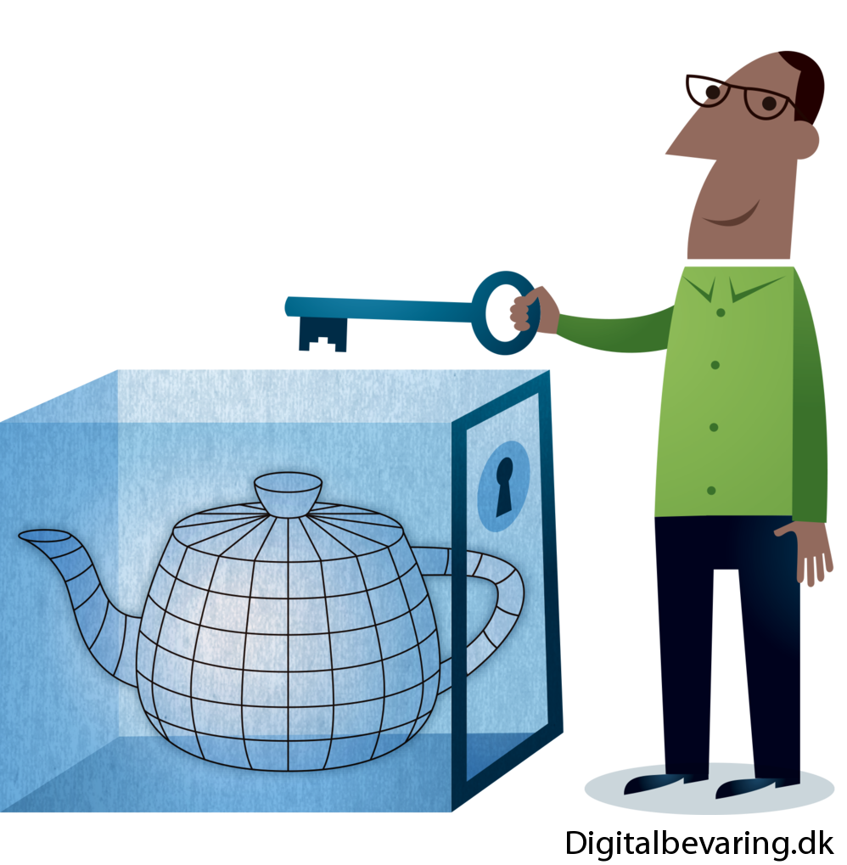
Research Data Management & DMP
webinar – April 2021
Protecting
Do your data contain confidential or sensitive information? If so, have you discussed data sharing with the respondents from whom you collected the data?
Have you discussed it with the Data Protection Officer? (DPO – Sandrine Munoz). And the Chief Information Security Officer? (CISO – Niek Nigg)
Are you gaining written consent from respondents to share data beyond your research?
Do you need to anonymise data, for example, to remove identifying information or personal data, during research or in preparation for sharing?
Consent
GDPR
Ethics
Confidentiality
UK Data Service - Data management checklist - https://www.ukdataservice.ac.uk/manage-data/plan/checklist.aspx
Share and reuse by citing: Jonathan England, 2021, https://doi.org/10.5281/zenodo.4714628 under CC-BY 4.0 International

Slide 26
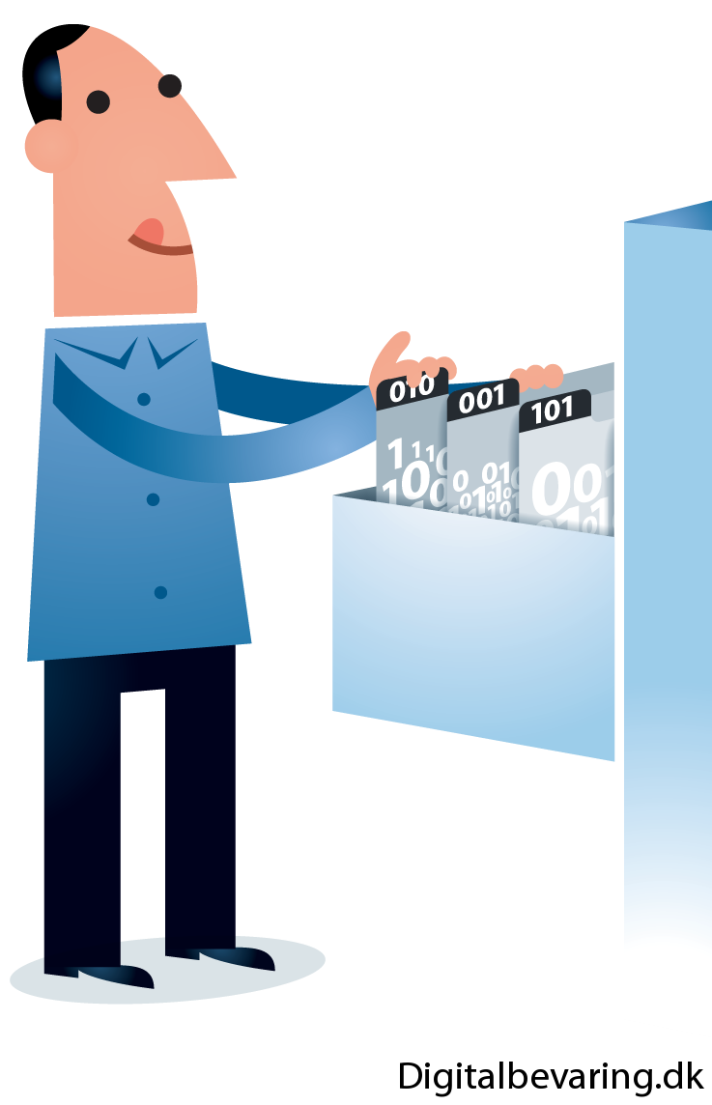
Research Data Management & DMP
webinar – April 2021
Archiving
Long-term preservation
While storing issues concern the data during the research project, archiving focuses on what happens to the data after the end of the project?
Who has access to which data during and after research? Is there a need for access restrictions? How will these be managed after you have finished your PhD ? or when you are dead (in a long time I hope for you)…
How long will you store your data for and do you need to select which data to keep and which to destroy?
Answers to those questions will depend on the best practices in your field of research
UK Data Service - Data management checklist - https://www.ukdataservice.ac.uk/manage-data/plan/checklist.aspx
Share and reuse by citing: Jonathan England, 2021, https://doi.org/10.5281/zenodo.4714628 under CC-BY 4.0 International

Slide 27
Research Data Management & DMP
webinar – April 2021
Licences
FAIR principles
after the project
Sharing
Copyright
Do you intend to make all your data available for sharing or how will you select which data to preserve and share?
How and where will you preserve your research data for the longer-term?
How will you make your data accessible to future users?
Have you established who owns the copyright in your data? Might there be joint copyright?
Have you considered which kind of license is appropriate for sharing your data and what, if any, restrictions there might be on re-use?
If you are purchasing or re-using someone else’s data sources have you considered how that data might be shareable, for example negotiating a new licence with the original supplier?
Can you preserve for the long-term, personal information so that it can be used in the future?
UK Data Service - Data management checklist - https://www.ukdataservice.ac.uk/manage-data/plan/checklist.aspx
Share and reuse by citing: Jonathan England, 2021, https://doi.org/10.5281/zenodo.4714628 under CC-BY 4.0 International

Slide 28
FAIR principles

Slide 29
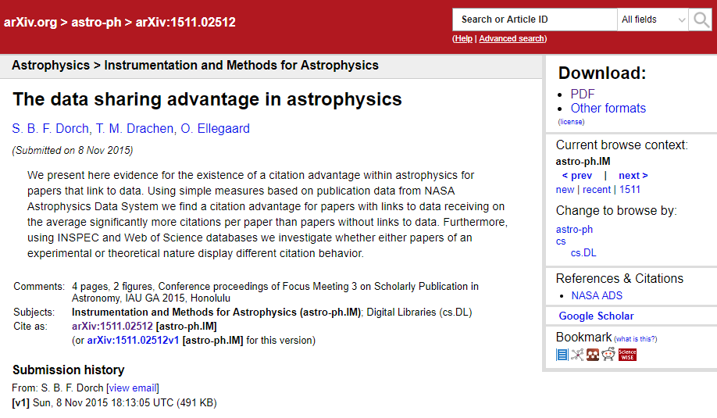
Research Data Management & DMP
webinar – April 2021
How useful would it for your own research to have access to others data?
… publish data in your own interest…
Share and reuse by citing: Jonathan England, 2021, https://doi.org/10.5281/zenodo.4714628 under CC-BY 4.0 International

Slide 30
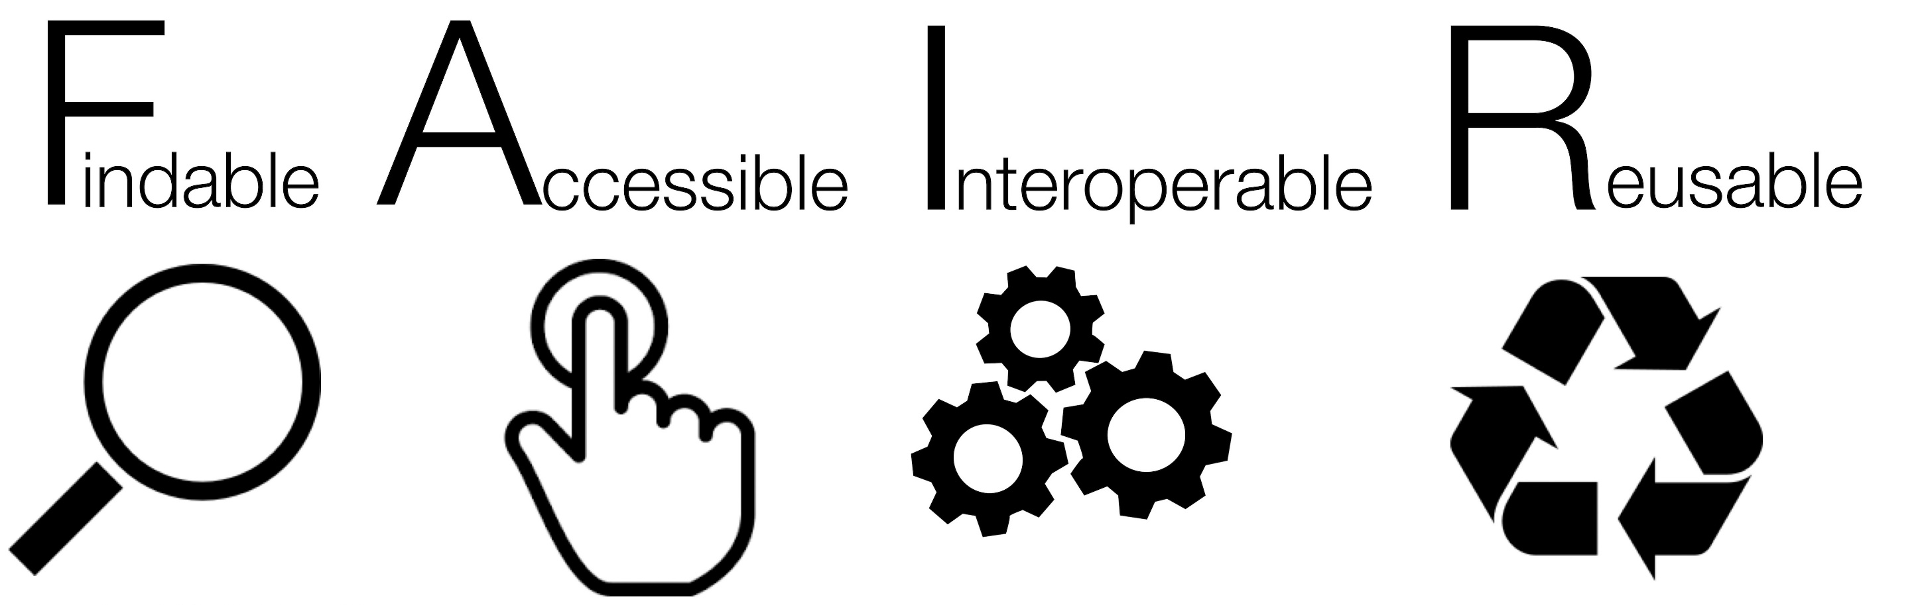
Research Data Management & DMP
webinar – April 2021
But wanting to share data is not enough…
… it has to be reusable by others…
A set of principles that describe the attributes data need to have to enable and enhance reuse, by humans and machines
Share and reuse by citing: Jonathan England, 2021, https://doi.org/10.5281/zenodo.4714628 under CC-BY 4.0 International

Slide 31
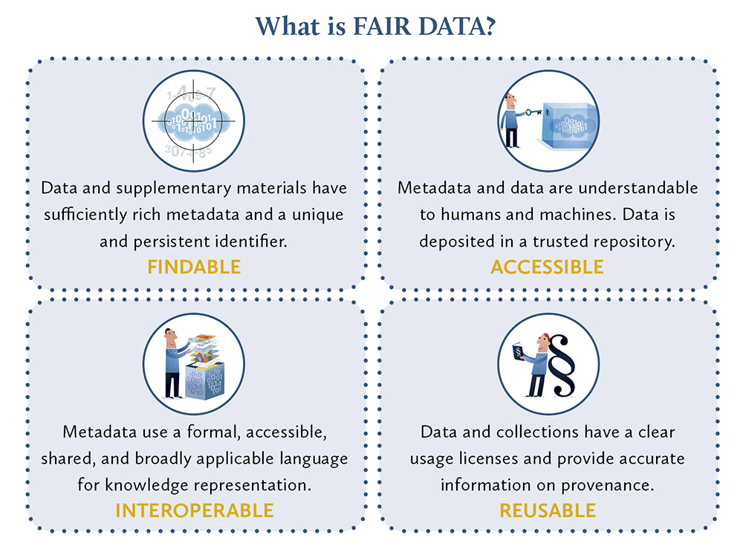
Research Data Management & DMP
webinar – April 2021
PersistentIdentifiers
Repository
Open file formats
Licence
LIBER
Share and reuse by citing: Jonathan England, 2021, https://doi.org/10.5281/zenodo.4714628 under CC-BY 4.0 International

Slide 32
Research Data Management & DMP
webinar – April 2021
“As open as possible, as closed as necessary”
FAIR data does not mean it has to be open. You can make data open, but if it is not FAIR it is useless:
  Findable – the data is online, but no one can find it because it has no metadata attached to it and no PIDs
  Accessible – the data is open but you need to “contact the author to have access to it”
  Interoperable – the data is open, findable, accessible and reusable but no documentation is included and the data’s variable names are not explained
  Reusable – the data is open, findable and accessible but you did not provide a licence, so people do not know if they can reuse the data
Data can be FAIR and closed, e.g. sensitive data can still be accessible on an online platform available to authorised people (a licence would still be needed to provide reuse, but the new data would not be openly shareable either).
Share and reuse by citing: Jonathan England, 2021, https://doi.org/10.5281/zenodo.4714628 under CC-BY 4.0 International

Slide 33


Research Data Management & DMP
webinar – April 2021
Persistent Identifiers
Share and reuse by citing: Jonathan England, 2021, https://doi.org/10.5281/zenodo.4714628 under CC-BY 4.0 International

Slide 34

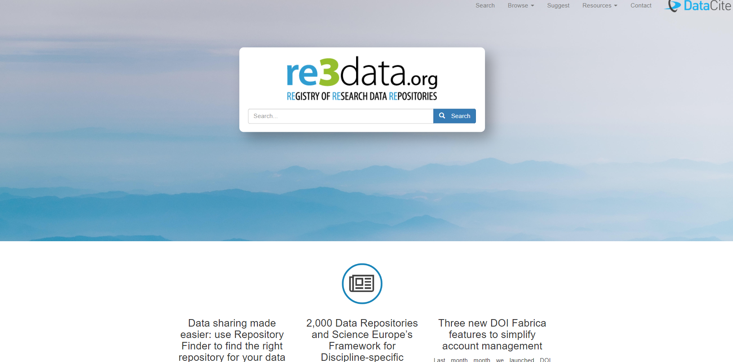
Research Data Management & DMP
webinar – April 2021
Repository
Share and reuse by citing: Jonathan England, 2021, https://doi.org/10.5281/zenodo.4714628 under CC-BY 4.0 International

Slide 35
Research Data Management & DMP
webinar – April 2021
Documenting (1/4)
Imagine your new on a project and trying to decipher other people’s datasets. What kind of information and metadata would you like to have to understand what the data is about, how it was processed, etc.
Compile this information for your own research data, it is like a “README” file
Distinguish:
  Project-level documentation
  Data-level documentation
  Metadata and other resources
https://www.ukdataservice.ac.uk/manage-data/document.aspx
https://www.cessda.eu/Training/Training-Resources/Library/Data-Management-Expert-Guide/2.-Organise-Document/Documentation-and-metadata
Share and reuse by citing: Jonathan England, 2021, https://doi.org/10.5281/zenodo.4714628 under CC-BY 4.0 International

Slide 36
Research Data Management & DMP
webinar – April 2021
Documenting (2/4)
Project-level documentation:
  For what purpose was the data created?
  What does the dataset contain?
  How was data collected?
  Who collected the data and when?
  How the data processed?
  What possible manipulations were done to the data?
  What were the quality assurance procedures?
  How can the data be accessed?
  Example: https://beta.ukdataservice.ac.uk/datacatalogue/studies/study?id=6986&type=Data%20catalogue#!#documentation
Share and reuse by citing: Jonathan England, 2021, https://doi.org/10.5281/zenodo.4714628 under CC-BY 4.0 International

Slide 37
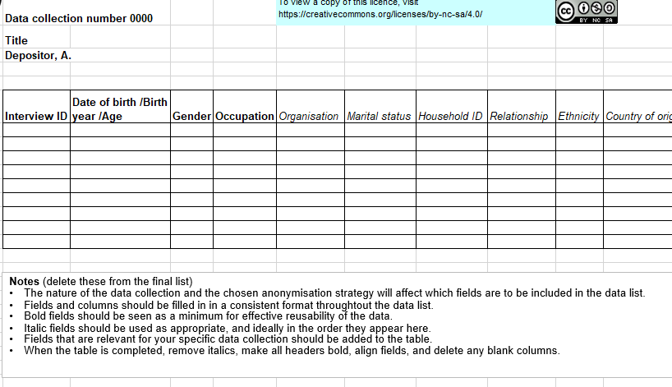
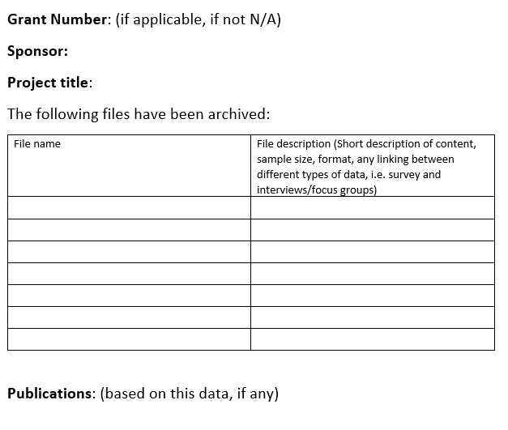
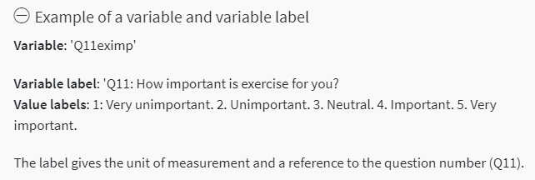
Research Data Management & DMP
webinar – April 2021
Documenting (3/4)
Data-level documentation:
  Quantitative data
    Embedded within a data file itself
    Data type, file type, format, size, etc.
    Names, labels and descriptions of variables, unit of measurement, reference the question number of a survey or questionnaire.
  Qualitative data
    Provide the data list (e.g. ID, age, gender, location)
    Create a data list for audiovisual data files
Share and reuse by citing: Jonathan England, 2021, https://doi.org/10.5281/zenodo.4714628 under CC-BY 4.0 International

Slide 38
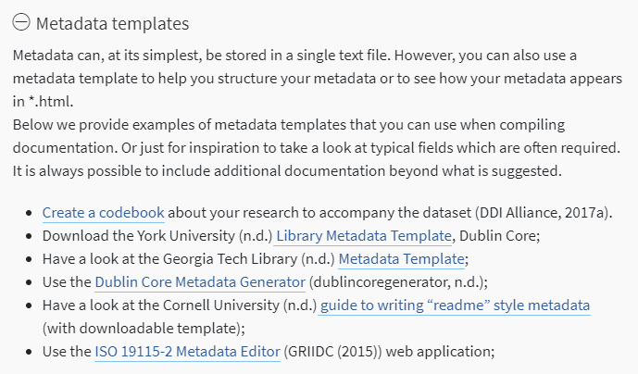
Research Data Management & DMP
webinar – April 2021
Documenting (4/4)
Metadata = machine-readable data documentation = data about data:
  Author, creation date, etc.
  Check out the Dublin Core Metadata Generator, metadata templates and metadata standards
https://www.cessda.eu/Training/Training-Resources/Library/Data-Management-Expert-Guide/2.-Organise-Document/Documentation-and-metadata
Share and reuse by citing: Jonathan England, 2021, https://doi.org/10.5281/zenodo.4714628 under CC-BY 4.0 International

Slide 39
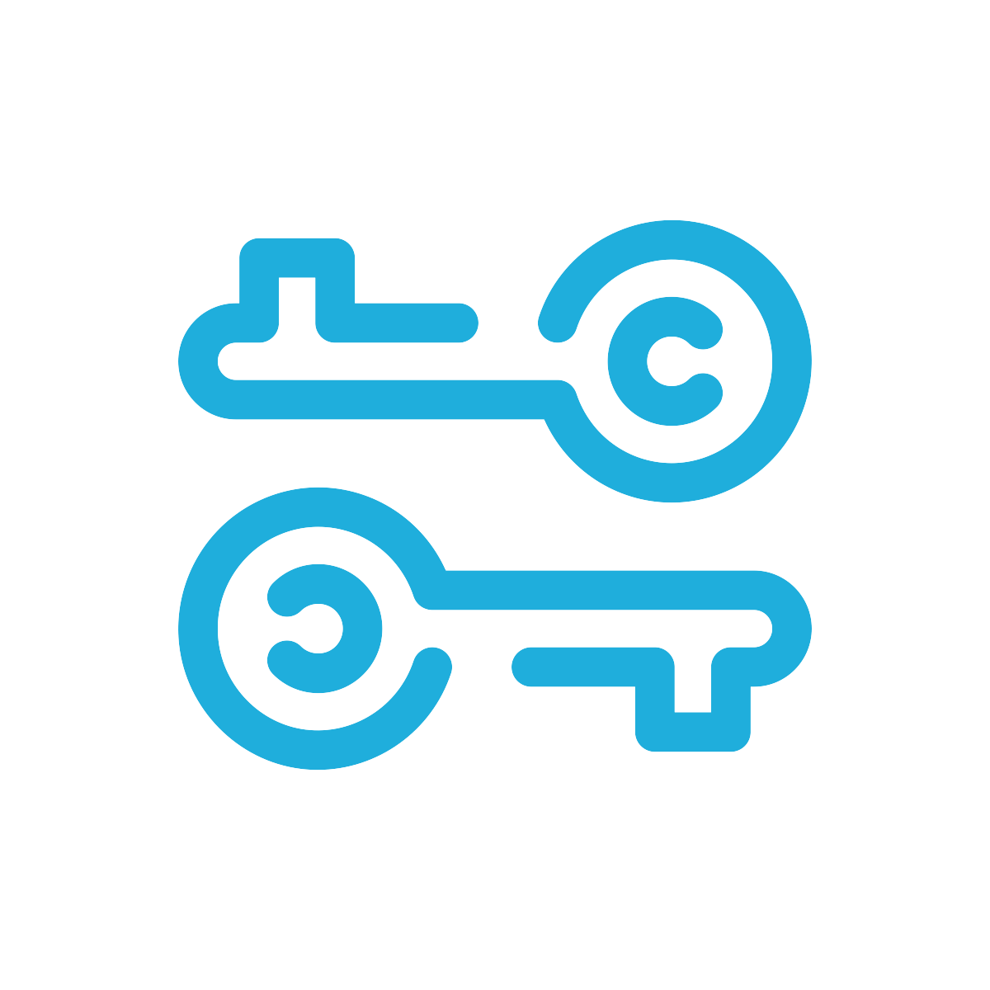
Research Data Management & DMP
webinar – April 2021
Open License: middle ground between © and Public Domain
Removes ambiguity over what others can and cannot do with your work
As rights owner, you modify the conditions of what can and cannot be done with your work (combining different conditions)
Removes uncertainty about © status for re-user
You still keep (certain) rights, but you grant certain reuses without them needing to contact you
Infringements against the conditions of the license are a © infringement
Different types of licenses are suitable for different types of content
Slides from ‘Open Licenses and Copyright 101’, Gwen Franck (CC-BY 4.0)
https://doi.org/10.5281/zenodo.1488616

Slide 40
Research Data Management & DMP
webinar – April 2021
A Creative Commons license (or the public domain tool) is universally recognisable, juridically sound, easily applicable and leaves the user in no doubt about the intentions of the author.
CC licenses let you easily change your copyright terms from the default of “all rights reserved” to “some rights reserved.”
The easier you make it for somebody to figure out their re-use rights, the more likely it is that they will respect them!
Be clear and unambiguous when creating and displaying your work's metadata (i.e. the information about your work)
Use license logo and link to the human-readable license text
Make sure people can reach you or the platform when in doubt
Slides from ‘Open Licenses and Copyright 101’, Gwen Franck (CC-BY 4.0)
https://doi.org/10.5281/zenodo.1488616

Slide 41








Research Data Management & DMP
webinar – April 2021
Share and reuse by citing: Jonathan England, 2021, https://doi.org/10.5281/zenodo.4714628 under CC-BY 4.0 International

Slide 42

Research Data Management & DMP
webinar – April 2021
ATTRIBUTION (“BY”)
You are free to:
Share — copy and redistribute the material in any medium or format
Adapt — remix, transform, and build upon the material
for any purpose, even commercially
Under the following terms:
Attribution — You must give appropriate credit, provide a link to the license, and indicate if changes were made. You may do so in any reasonable manner, but not in any way that suggests the licensor endorses you or your use.
Slides from ‘Open Licenses and Copyright 101’, Gwen Franck (CC-BY 4.0)
https://doi.org/10.5281/zenodo.1488616

Slide 43

Research Data Management & DMP
webinar – April 2021
SHARE ALIKE (“SA”)
You are free to:
Share — copy and redistribute the material in any medium or format
Adapt — remix, transform, and build upon the material
for any purpose, even commercially
Under the following terms:
Attribution — You must give appropriate credit, provide a link to the license, and indicate if changes were made
ShareAlike — If you remix, transform, or build upon the material, you must distribute your contributions under the same license as the original.
Slides from ‘Open Licenses and Copyright 101’, Gwen Franck (CC-BY 4.0)
https://doi.org/10.5281/zenodo.1488616

Slide 44

Research Data Management & DMP
webinar – April 2021
NON-COMMERCIAL (“NC”)
You are free to:
Share — copy and redistribute the material in any medium or format
Adapt — remix, transform, and build upon the material
Under the following terms:
Attribution — You must give appropriate credit, provide a link to the license, and indicate if changes were made
NonCommercial — You may not use the material for commercial purposes
Slides from ‘Open Licenses and Copyright 101’, Gwen Franck (CC-BY 4.0)
https://doi.org/10.5281/zenodo.1488616

Slide 45

Research Data Management & DMP
webinar – April 2021
NO DERIVATIVES (“ND”)
You are free to:
Share — copy and redistribute the material in any medium or format
Adapt — remix, transform, and build upon the material
Under the following terms:
Attribution — You must give appropriate credit, provide a link to the license, and indicate if changes were made
NoDerivatives — If you remix, transform, or build upon the material, you may not distribute the modified material.
Slides from ‘Open Licenses and Copyright 101’, Gwen Franck (CC-BY 4.0)
https://doi.org/10.5281/zenodo.1488616

Slide 46

Research Data Management & DMP
webinar – April 2021
CC ‘ZERO’
It is different from ‘Public Domain’ because it is an actual licence, but the rights are the same
You are free to:
Share — copy and redistribute the material in any medium or format
Adapt — remix, transform, and build upon the material
for any purpose, even commercially
No Attribution required — You are free to give appropriate credit (best practice) but it is not required
The CC 0 is the most appropriate licence for sharing data, as it avoid attribution stacking, allows commercial reuse such as consulting and allows meta-analyses to be freely carried out.
Share and reuse by citing: Jonathan England, 2021, https://doi.org/10.5281/zenodo.4714628 under CC-BY 4.0 International

Slide 47
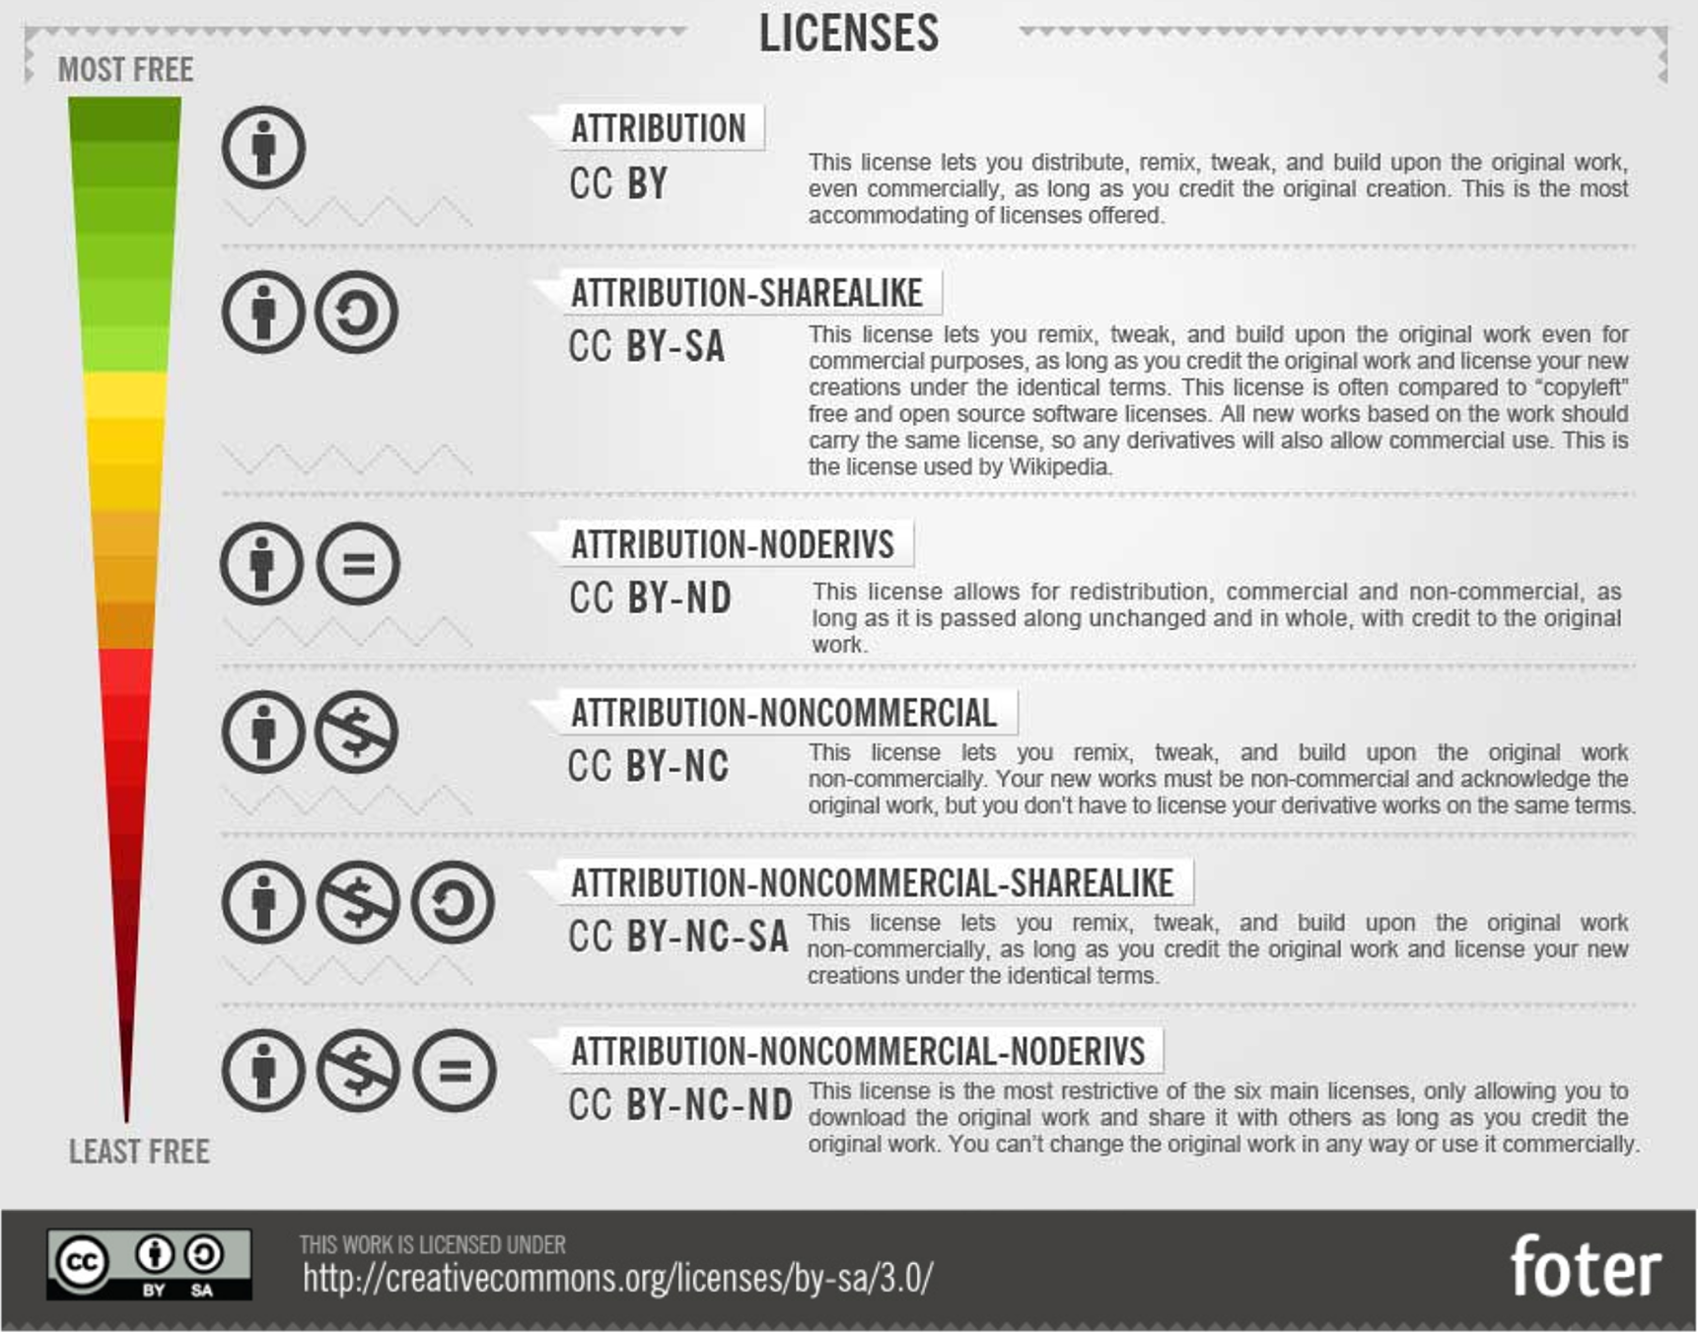

Research Data Management & DMP
webinar – April 2021
for publications (including AAM/postprint)
for sharing data
Share and reuse by citing: Jonathan England, 2021, https://doi.org/10.5281/zenodo.4714628 under CC-BY 4.0 International
From: How To Attribute Creative Commons Photos by Foter

Slide 48
Data Description
Evaluating a DMP
Standards and metadata
Data sharing
Archiving and preservation

Slide 49
Research Data Management & DMP
webinar – April 2021
Check (1/3)
Full description of the data to be produced?
  Statistics about the size, quantity and duration help reviewers get a proper sense of scale
Sharing considered in the consent and licence agreements if third-party data being reused or working with human subjects?
Will sufficient metadata and documentation be provided to allow others to find, understand the reuse the data?
Is the choice of file format explained, so it is clear that appropriate decisions have been made?
Venkataraman, S. (2018, November). RDM, Open Research and DMP presentations and associated files. Zenodo. http://doi.org/10.5281/zenodo.1489929
Share and reuse by citing: Jonathan England, 2021, https://doi.org/10.5281/zenodo.4714628 under CC-BY 4.0 International

Slide 50
Research Data Management & DMP
webinar – April 2021
Check (2/3)
Is it clear which data will be shared and with whom?
How will the data be shared? E.g. deposit in a repository (re3data)
If an embargo period is planned, is that in line with norms for that discipline?
Will the data be deposited in a suitable community database, repository or archive?
Is it clear which data should be preserved and for how long?
Are there any costs associated with preservation, and if so, how will these be covered?
Venkataraman, S. (2018, November). RDM, Open Research and DMP presentations and associated files. Zenodo. http://doi.org/10.5281/zenodo.1489929
Share and reuse by citing: Jonathan England, 2021, https://doi.org/10.5281/zenodo.4714628 under CC-BY 4.0 International

Slide 51
Research Data Management & DMP
webinar – April 2021
Check (3/3)
Is the plan appropriate?
  e.g. adopting relevant standards; practices in line with norms for that field; use of university storage, subject repositories
Seem feasible to implement?
Sufficient detailed information provided?
Advice sought where needed?
Restrictions and costs properly justified?
Venkataraman, S. (2018, November). RDM, Open Research and DMP presentations and associated files. Zenodo. http://doi.org/10.5281/zenodo.1489929
Share and reuse by citing: Jonathan England, 2021, https://doi.org/10.5281/zenodo.4714628 under CC-BY 4.0 International

Slide 52
Research Data Management & DMP
webinar – April 2021
Specific information
“we will use suitable formats to ensure that our data can be preserved and sustained over the long term”
Which standards? Name them
Does the team know which are suitable?
Does the chosen repository have preferences?
Be clear, specific and detailed
Justify decisions
“we will provide MP3 audio files for online dissemination. While this is not an open format, it is well-established and the most widely supported. High-resolution WAV files will be used for the archival master recordings”.
Venkataraman, S. (2018, November). RDM, Open Research and DMP presentations and associated files. Zenodo. http://doi.org/10.5281/zenodo.1489929
Share and reuse by citing: Jonathan England, 2021, https://doi.org/10.5281/zenodo.4714628 under CC-BY 4.0 International

Slide 53
Research Data Management & DMP
webinar – April 2021
Easy to evaluate
“Online resource development will cost 21,000 €”
VS
“Online resource development, 60 days at 350 €”
Don’t make reviewers dig around for information
Be consistent in what you say
Stick to page limits, follow the template (if provided)
Beware of blanket copy/paste
Venkataraman, S. (2018, November). RDM, Open Research and DMP presentations and associated files. Zenodo. http://doi.org/10.5281/zenodo.1489929
Share and reuse by citing: Jonathan England, 2021, https://doi.org/10.5281/zenodo.4714628 under CC-BY 4.0 International

Slide 54
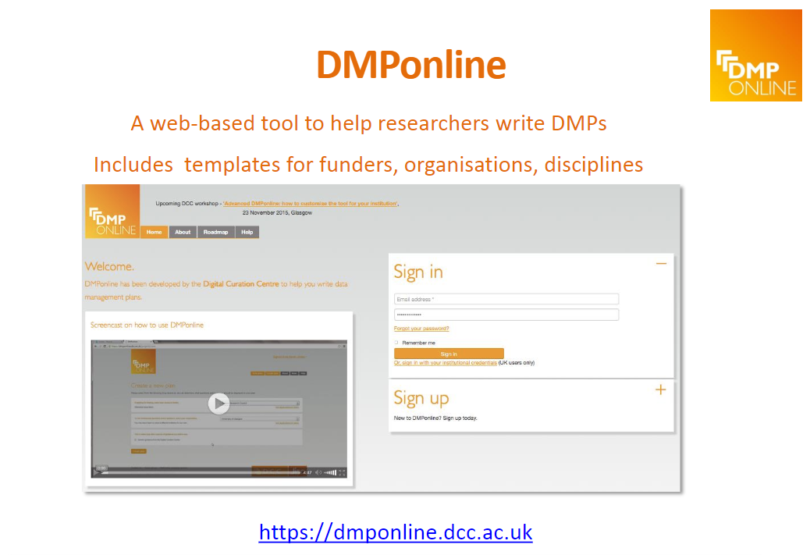
Research Data Management & DMP
webinar – April 2021
An example
Share and reuse by citing: Jonathan England, 2021, https://doi.org/10.5281/zenodo.4714628 under CC-BY 4.0 International

Slide 55
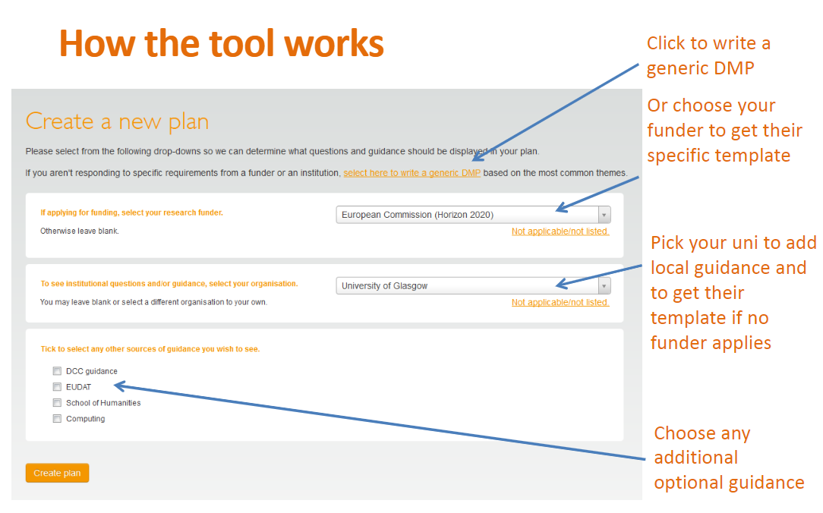
Research Data Management & DMP
webinar – April 2021
An example
Share and reuse by citing: Jonathan England, 2021, https://doi.org/10.5281/zenodo.4714628 under CC-BY 4.0 International

Slide 56
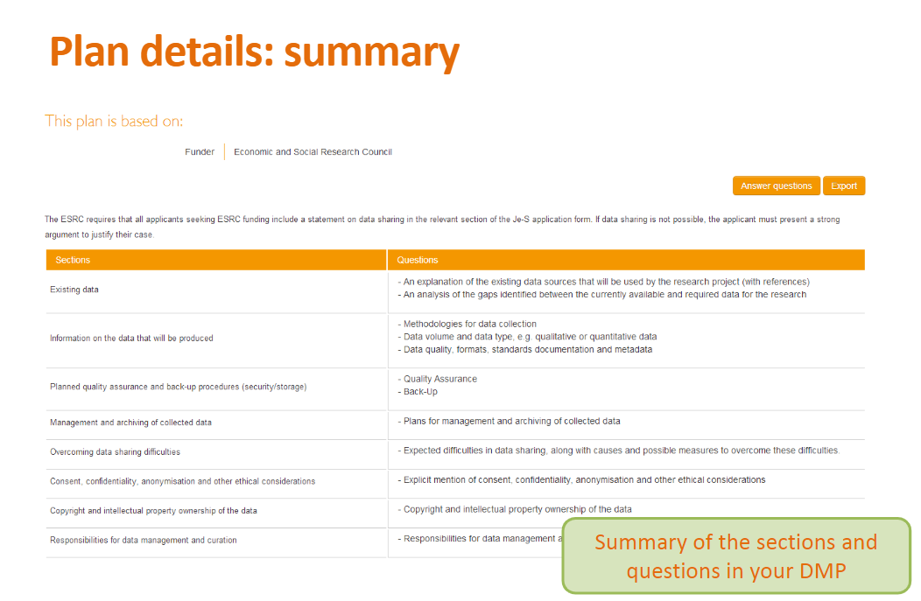
Create a Data Management Plan
webinar – April 2021
An example
Share and reuse by citing: Jonathan England, 2021, https://doi.org/10.5281/zenodo.4714628 under CC-BY 4.0 International

Slide 57
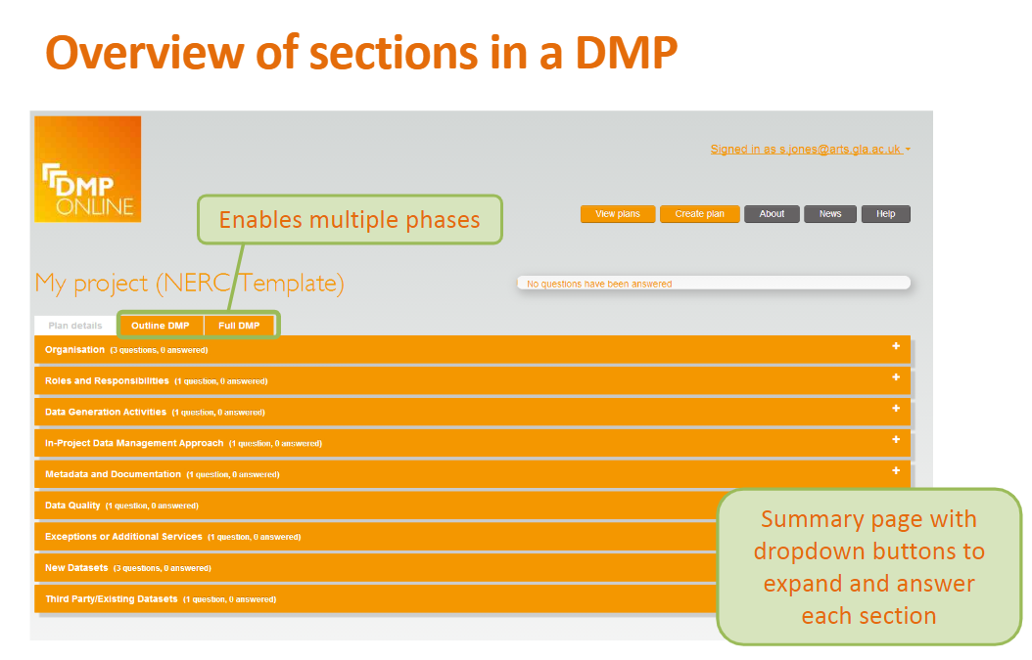
Research Data Management & DMP
webinar – April 2021
An example
Share and reuse by citing: Jonathan England, 2021, https://doi.org/10.5281/zenodo.4714628 under CC-BY 4.0 International

Slide 58
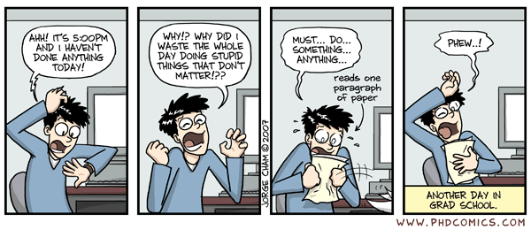
Research Data Management & DMP
webinar – April 2021
Remind to…
Organise your research data, you will thank yourself later I promise!
Take the time to think about what kind of data you are producing and processing.
Design your data folder structure, decide on a file naming routine, think which file format you are using to save/share, document everything as you go along, backup your data.
Stick to your system! (but remain flexible)
Share and reuse by citing: Jonathan England, 2021, https://doi.org/10.5281/zenodo.4714628 under CC-BY 4.0 International

Slide 59
Research Data Management & DMP
webinar – April 2021
Sources and other useful references
RESEARCH DATA MANAGEMENT
Venkataraman, S. (2018, November). RDM, Open Research and DMP presentations and associated files. Zenodo.
  http://doi.org/10.5281/zenodo.1489929
Science Europe- RDM guide
  https://scienceeurope.org/our-resources/practical-guide-to-the-international-alignment-of-research-data-management/
Research data management (RDM) open training materials
  https://zenodo.org/communities/dcc-rdm-training-materials/?page=1&size=20
OpenAIRE Research Data Management Hand Book
  https://www.openaire.eu/rdm-handbook
Research Data Management Adventure (serious game)
  https://rdm-games.gitlab.io/rdm-adventure/
WHAT IS DATA & FAIR DATA
What counts as research data? (University of Bristol)
  https://data.blogs.bristol.ac.uk/bootcamp/data/
Data Management Expert Guide – Research Data (CESSDA ERIC)
  https://www.cessda.eu/Training/Training-Resources/Library/Data-Management-Expert-Guide/1.-Plan/Research-data
Research Data in context (MANTRA)
  https://mantra.edina.ac.uk/researchdataexplained/
What is data? (University of Leicester)
  https://www2.le.ac.uk/services/research-data/rdm/what-is-rdm/research-data
Zenodo-FAIR principles
  https://about.zenodo.org/principles/
"A love letter to your future self": What scientists need to know about FAIR data
  https://www.natureindex.com/news-blog/what-scientists-need-to-know-about-fair-data
FAIRsFAIR Europe
  https://www.fairsfair.eu/
GO FAIR
  https://www.go-fair.org/
DATA ORGANISATION
Prepare and manage data (UK Data Service)
  https://www.ukdataservice.ac.uk/manage-data
Towards a Standardized Research Folder Structure
  https://genr.eu/wp/towards-a-standardized-research-folder-structure/
UK Data Service recommended file formats
  https://www.ukdataservice.ac.uk/manage-data/format/recommended-formats
Creating data – Choosing Formats (University of Cambridge)
  https://www.data.cam.ac.uk/data-management-guide/creating-your-data/choosing-formats
Naming things
  https://speakerdeck.com/jennybc/how-to-name-files

Slide 60
Research Data Management & DMP
webinar – April 2021
Sources and other useful references
BEST PRACTICES
‘I ain’t afraid of no myth’ – busting the myths on data sharing
  https://blog.wellcomeopenresearch.org/2020/08/20/i-aint-afraid-of-no-myth-busting-the-myths-on-data-sharing/
Guide de bonnes pratiques sur la gestion des données de la recherche
  https://mi-gt-donnees.pages.math.unistra.fr/guide/00-introduction.html
DATA MANAGEMENT PLAN
DMP Online (Digital Curation Centre)
  https://dmponline.dcc.ac.uk/
Registry of Research Data Repositories – re3data
  https://re3data.org
How guides – develop a data plan
  http://www.dcc.ac.uk/resources/how-guides/develop-data-plan#f3
Data Management Plans (TUDelft)
  https://www.tudelft.nl/en/library/research-data-management/r/plan/data-management-plans
Guidelines on FAIR Data Management in Horizon 2020
  https://ec.europa.eu/research/participants/data/ref/h2020/grants_manual/hi/oa_pilot/h2020-hi-oa-data-mgt_en.pdf
  https://ec.europa.eu/research/participants/docs/h2020-funding-guide/cross-cutting-issues/open-access-data-management/data-management_en.htm
Data Management costs
  https://www.tudelft.nl/en/library/research-data-management/r/plan/data-management-costs
What will it cost to manage and share my data?
  https://www.openaire.eu/what-will-it-cost-to-manage-and-share-my-data
RDM costs estimation tool
  https://www.openaire.eu/how-to-comply-to-h2020-mandates-rdm-costs
OPEN SOURCE & OPEN LICENSING
Open source software and open data: open licensing of software and data for public policy analysis and for collaborative research
  https://doi.org/10.5281/zenodo.4537157
OPEN SCIENCE
Open Science Hand Book
  https://doi.org/10.5281/zenodo.1212496
Open Data Hand Book
  https://opendatahandbook.org/guide/en/why-open-data/
Open Science, Open Data, Open Source. 21st century research skills for the life science
  http://doi.org/10.5281/zenodo.1015288
Open Scientist Handbook
  https://openscientist.pubpub.org/
Winning Horizon 2020 with Open Science
  https://doi.org/10.5281/zenodo.12247

Slide 61
Questions?

