Slide 1

Practical Application of Functionally Graded Lattice Structures in a Bicycle Crank Arm
Vienna, 25th of November 2020
Authors: Thierry Decker, Slawomir Kedziora and Claude Wolf
University of Luxembourg
Faculty of Science, Technology and Medicine
Department of Engineering
885th International Conference of Science, Technology, Engineering and Management (ICSTEM)

Slide 2
Practical Application of Functionally Graded Lattice Structures in a Bicycle Crank Arm
Contents
State of the Art
Our Goal
Choice of Software
Generalized Procedure
CAD Models and Materials
Simulation Models and Design of Experiment
Results
Tests Prints and Outlook

Slide 3
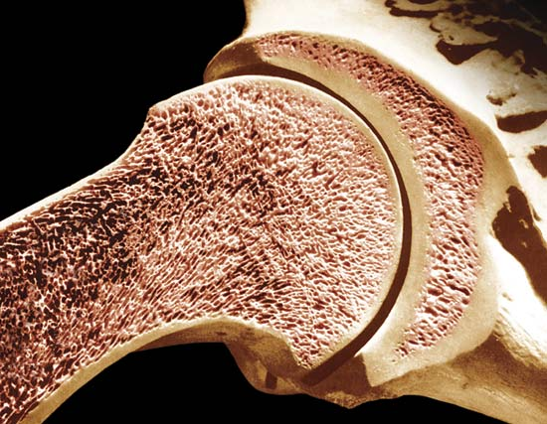

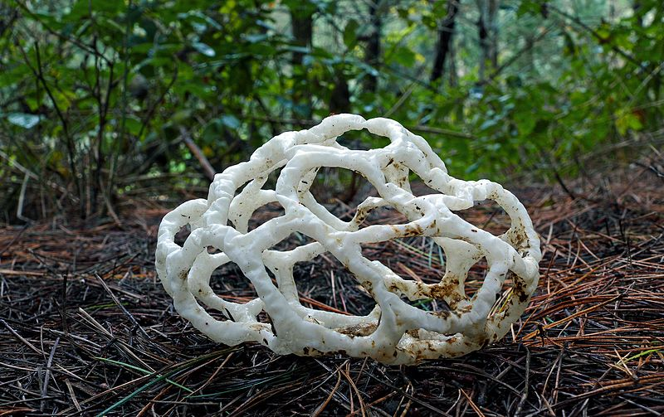
Practical Application of Functionally Graded Lattice Structures in a Bicycle Crank Arm
State of the Art
1.1 What are Functionally Graded Lattice Structures?
→ Lattice structure locally or completely replaces solid regions of a body, is adapted to specific needs
→ Principle based on cellular solids widely found widely in nature like cancellous bone, fungi mushrooms etc.
→ Pores can be open or closed, regular or stochastic
[1]
[2]
[3]
[1] http://medicalpicturesinfo.com/cancellous-bone/
[2] https://www.anbg.gov.au/fungi/mycelium.html
[3] https://commons.wikimedia.org/wiki/File:Basket_Fungi.(Ileodictyon_cibarium)_(33310278744).jpg

Slide 4
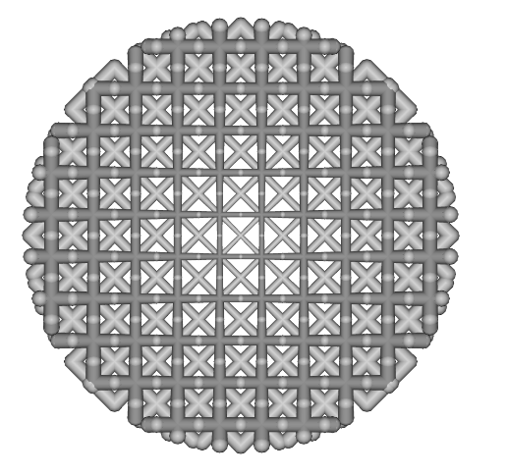
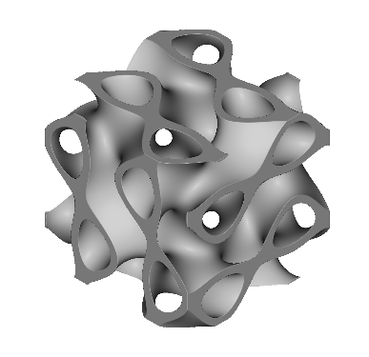
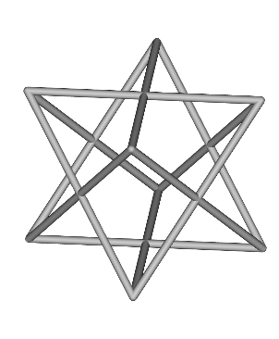

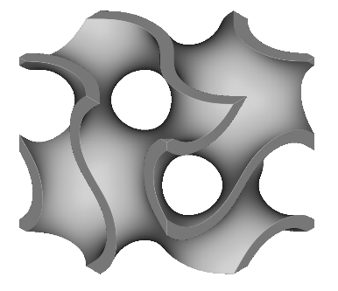
Practical Application of Functionally Graded Lattice Structures in a Bicycle Crank Arm
State of the Art
1.2 Functionally Graded Lattice Structures in Additive Manufacturing
→ FGLS researched a lot, but very rarely applied in actual parts
→ Beam-based or surface-based unit cells repeated throughout domain
→ Specific adaptation following special use cases (thickness, orientation, unit cell type…)
→ But which software to use? Most lattices in research papers created manually or by custom scripts
Notes:
Lattices used as infill to save material and gain a little stability, but they are mainly uniform

Slide 5
Practical Application of Functionally Graded Lattice Structures in a Bicycle Crank Arm
2. Our Goal
→ Show that Functionally Graded Lattice Structures can bring real benefit to mechanical parts
→ Intermediate steps:
1. Find suitable software for efficient and versatile lattice creation/manipulation
2. Establish generalized workflow to optimize for given application
3. Create strategy for Additive Manufacturing
Notes:
What is our goal to be reached? → First search suitable software. Then show that applying FGLS to a mechanical can have a real world benefit compared to classic fully solid part. Until now, most papers relied only on synthetic tests or simulations. Based on this, create generalized workflow to adapt FGLS to specific needs.
What software can be used? Mostly manual lattice creation, but we used nTop Platform. What is our goal to be reached? → Show that applying FGLS to a mechanical can have a real world benefit compared to classic fully solid part. Based on this, create generalized workflow to adapt FGLS to specific needs.

Slide 6
Practical Application of Functionally Graded Lattice Structures in a Bicycle Crank Arm
3. Software of choice
→ Lattice creation and manipulation: nTopology Platform
→ Lattice file conversion: custom Matlab script (.LTCX to .FEM)
→ Finite Element Analysis: Altair OptiStruct
→ Design of Experiment and Optimization: Altair Hyperstudy
Notes:
Lattice creation: many were tested, some limited options are offered in Ansys and Netfabb (only trilinear lattices, very restricted customization) and Optistruct (problems in postprocessing, export only through 3rd party software). Rhino3D and Grasshopper might be OK, but complex.
Only nTop Platform remained as it offers the most options. Simulation done in Optistruct, beam lattice import through custom Matlab script capable of importing straight or tapered beams. DOE in Hyperstudy. Then in nTop, implement results, create STL file and print.
Global procedure: create CAD model, hollow it out, import to nTop, fill with beam-based lattice, try all lattice types with FE analysis in nTop, compare deflection, choose two best lattices, rotate around y-axis and find best arrangement. Section lattice into 8 regions. Then export to Optistruct via Matlab script, create baseline results. Then feed into DOE in Hyperstudy to find optimal beam diameter for each region while limiting von Mises stress and total weight.

Slide 7
Practical Application of Functionally Graded Lattice Structures in a Bicycle Crank Arm
4. Generalized Procedure
1. Choose mechanical part to be improved
2. Define desired wall thickness and shell part
3. Fill hollow volume with lattice
4. Perform basic lattice manipulation to approach optimum in nTop Platform (rotation, size, cell type)
5. Optimize lattice size/diameters with Design of Experiment using OptiStruct and HyperStudy
6. Implement results in nTop, export and create final model using AM
→ In this case, the workflow is applied to bicycle crank arm as first proof of concept
Notes:
Load cases: DIN 4210-8 for MTB. LC2 shows greatest displacement and is used for comparisons → describe
Lattice creation: many were tested, some limited options are offered in Ansys and Netfabb (only trilinear lattices, very restricted customization) and Optistruct (problems in postprocessing, export only through 3rd party software). Rhino3D and Grasshopper might be OK, but complex.
Only nTop Platform remained as it offers the most options. Simulation done in Optistruct, beam lattice import through custom Matlab script capable of importing straight or tapered beams. DOE in Hyperstudy. Then in nTop, implement results, create STL file and print.
Global procedure: create CAD model, hollow it out, import to nTop, fill with beam-based lattice, try all lattice types with FE analysis in nTop, compare deflection, choose two best lattices, rotate around y-axis and find best arrangement. Section lattice into 8 regions. Then export to Optistruct via Matlab script, create baseline results. Then feed into DOE in Hyperstudy to find optimal beam diameter for each region while limiting von Mises stress and total weight.

Slide 8
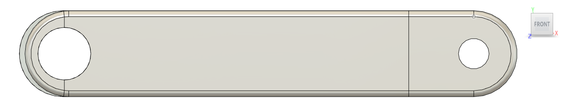
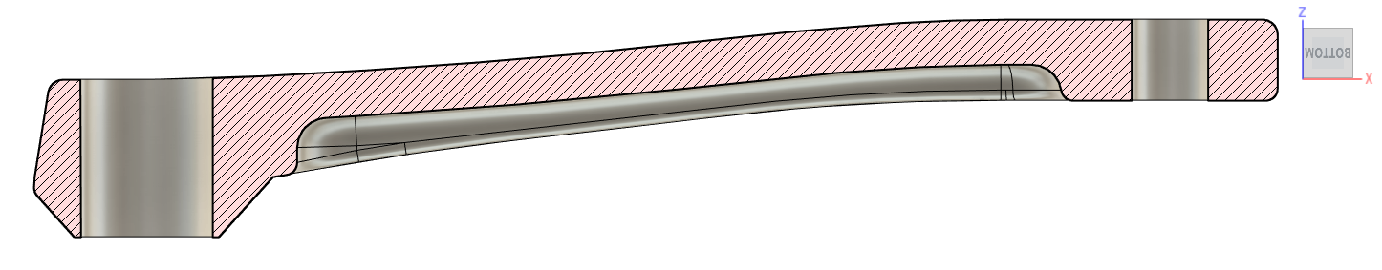
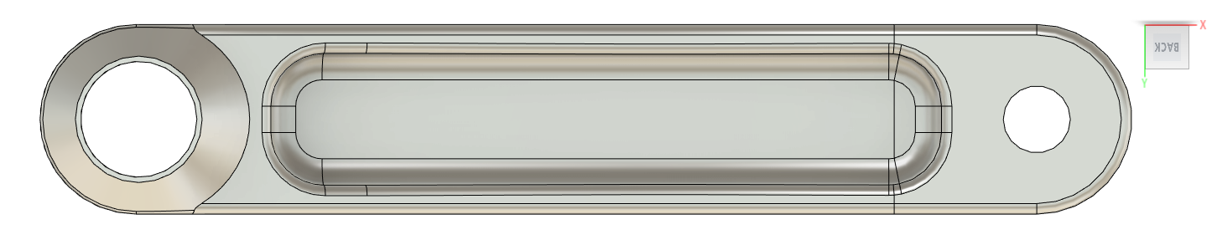
Practical Application of Functionally Graded Lattice Structures in a Bicycle Crank Arm
5. CAD Models and Materials
5.1 Reference crank arm
→ Design based on Shimano FC-R450/453 crank
→ Material assumption: 6061-T6 aluminium
→ Bore distance: 170mm
→ Bore diameters: 22mm & 12.9mm
→ Model weight 213g, original weight 225g
Aluminium 6061-T6 [4]
Ultimate Tensile Strength [MPa] | 310
0.2% Yield Strength [MPa] | 276
Elongation at Break [%] | 17
Tensile Modulus [GPa] | 68.9
Density [g/cm³] | 2.7
[4] http://www.matweb.com/search/datasheet.aspx?MatGUID=ff6d4e6d529e4b3d97c77d6538b29693
Notes:
Aluminium crank design based on Shimano FC-R450/453
Crank length of 170mm
Shaft mounting bore diameter of 22mm, pedal thread diameter 12.9mm
Original weight 225g, model weight 213g

Slide 9
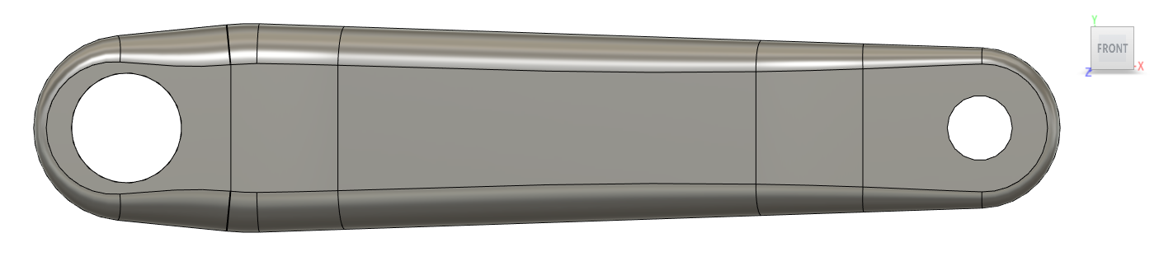
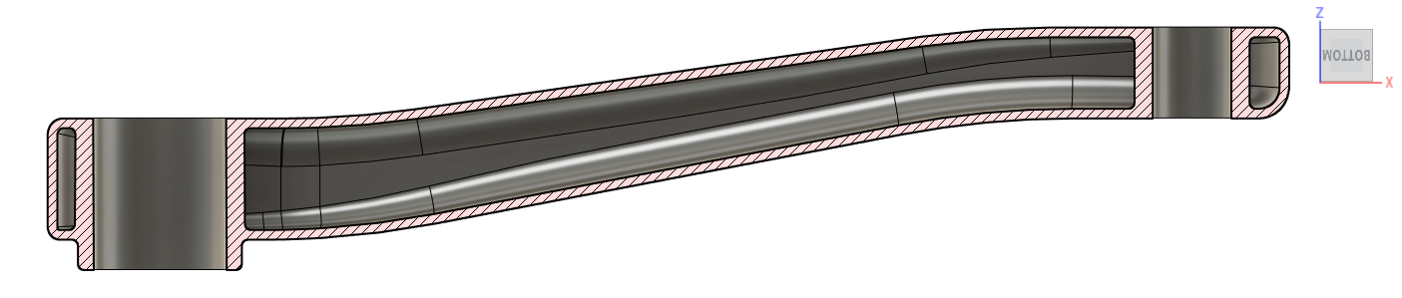
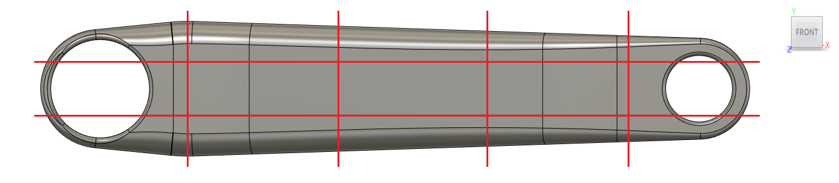
Practical Application of Functionally Graded Lattice Structures in a Bicycle Crank Arm
5. CAD Models and Materials
5.2 Steel crank arm
→ Redesign with 1.6mm wall thickness, 3mm at bores
→ 276g total weight
→ Negative body sectioned for lattice optimization
→ Fatigue strength assumed to be 50% of yield strength
17-4 PH SS as sintered [5]
Ultimate Tensile Strength [MPa] | 1050
0.2% Yield Strength [MPa] | 800
Elongation at Break [%] | 5
Tensile Modulus [GPa] | 140
Density [g/cm³] | 7.5 – 7.8
[5] Markforged Material Datasheet 17-4 PH Stainless Steel
Notes:
Choice of material was steel since no titanium or aluminium available for Markforged printers yet

Slide 10
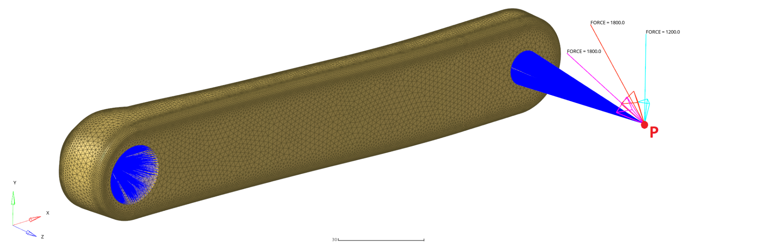
Practical Application of Functionally Graded Lattice Structures in a Bicycle Crank Arm
6. Calculations
6.1 Model Setup
→ Load cases according to EN ISO 4210-8
Case 1: static load of 1200N perpendicular to crank arm
Case 2: dynamic load of 1800N at angle of 45°, 50.000 cycles (assumed static)
Case 3: dynamic load of 1800N at angle of 30°, 50.000 cycles (assumed static)
Notes:
EN ISO 4210-8: LC1 is 1500N at 90°, 65mm from outer surface. Gear ratio of 0.8 results in 1200N. LC2 and LC3 specify 1800N at angles of 45° and 30° respectively.
Dynamic cases treated as static cases, but allowable stress is restricted to fatigue strength

Slide 11
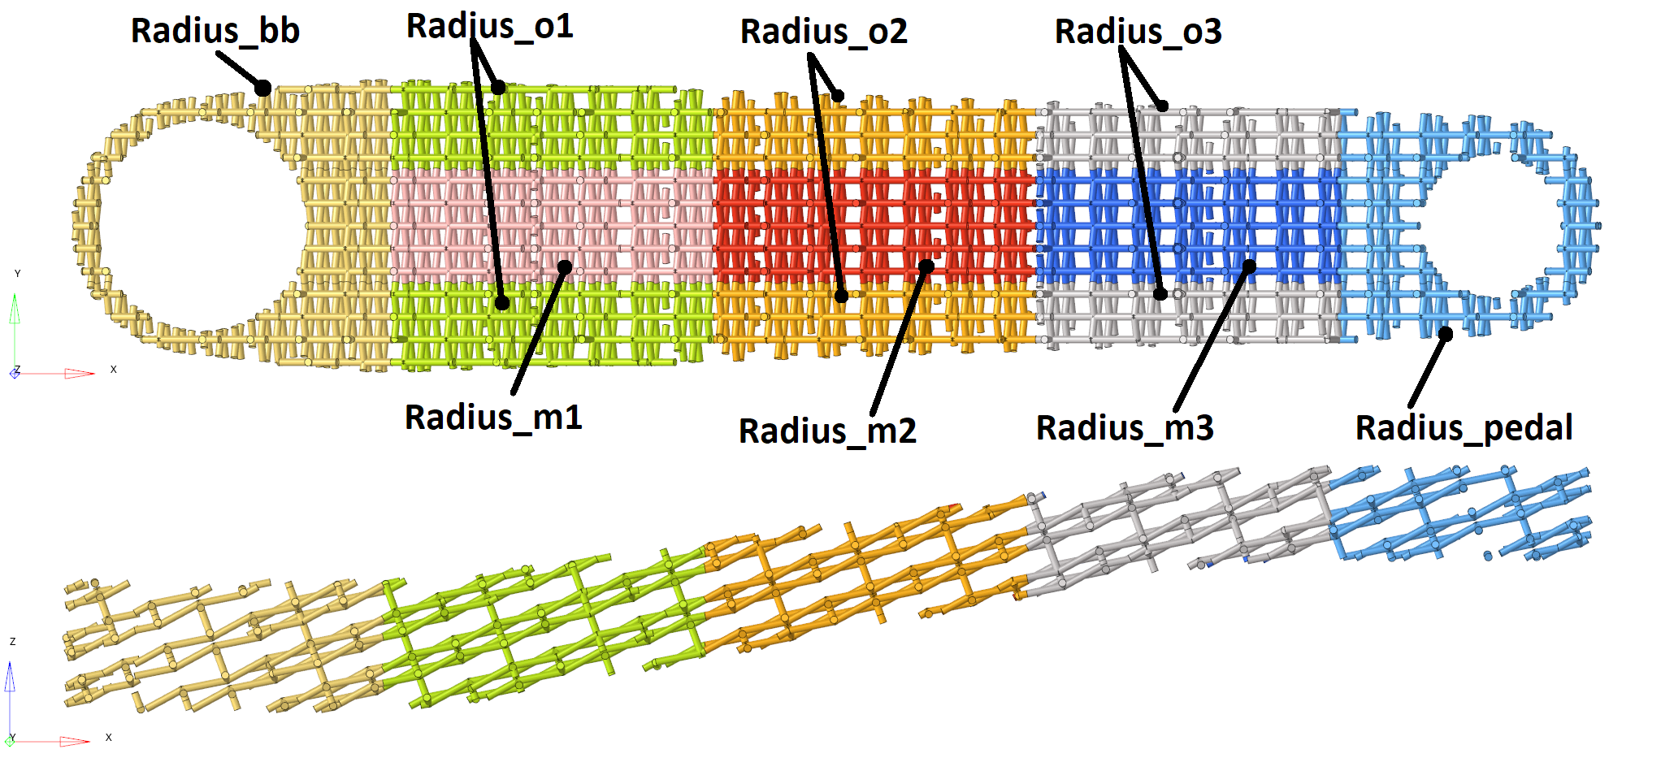
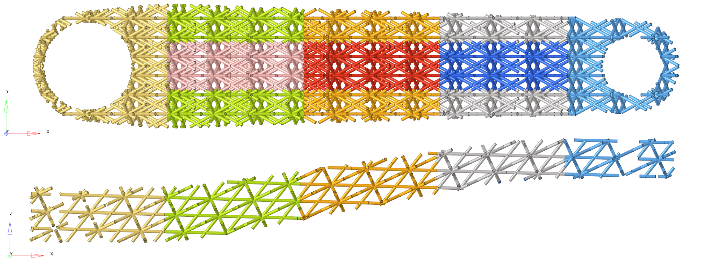
Practical Application of Functionally Graded Lattice Structures in a Bicycle Crank Arm
6. Calculations
6.2 Lattices
Re-entrant lattice
Face-centered cubic lattice
Notes:
Here we chose beam-based lattice, surface-based lattice will follow in other paper
Sectioning of lattice into 8 separate regions with uniform beam diameter to reduce optimization complexity

Slide 12
Practical Application of Functionally Graded Lattice Structures in a Bicycle Crank Arm
6. Calculations
6.3 Simulation Setup and Design of Experiment
→ OptiStruct
Only load case 2 considered since it shows greatest deflection
Static load case, linear material and geometry behavior
Second order tetrahedra and beam elements connected via freeze contact
Track displacement at pedal center point
→ HyperStudy
Allowable beam diameter continuous range of 0.8mm - 2mm per region
Design of Experiment study using MELS, FAST and GRSM
Minimize displacement, restrict maximum weight to 360g and von Mises stresses to 320MPa
→ OptiStruct
Validate results with models consisting only of tetrahedral elements
Notes:
Software settings in Optistruct: Static analysis, linear geometry and material behavior. Hollow body is meshed by quadratic tetra elements, lattice via beam elements (6DOF) connected via freeze contact to solid body. Deflection at pedal midpoint is measured and compared. Starting lattice diameter 1mm for baseline results.
Hyperstudy: Design of Experiment study based on 50 base runs using Modified Extensible Lattice Sequence (MELS) method. Response surface (fit) is created by Fit Automatically Selected by Training (FAST). Optimization done via Global Response Search Method (GRSM). Goal: minimize displacement while limiting mass to 360g and stress at 320MPa, i.e. 40% of yield strength for fatigue limit assumption. Values up to 400MPa are still accepted. Beam diameters can range from 0.8mm to 2mm.

Slide 13
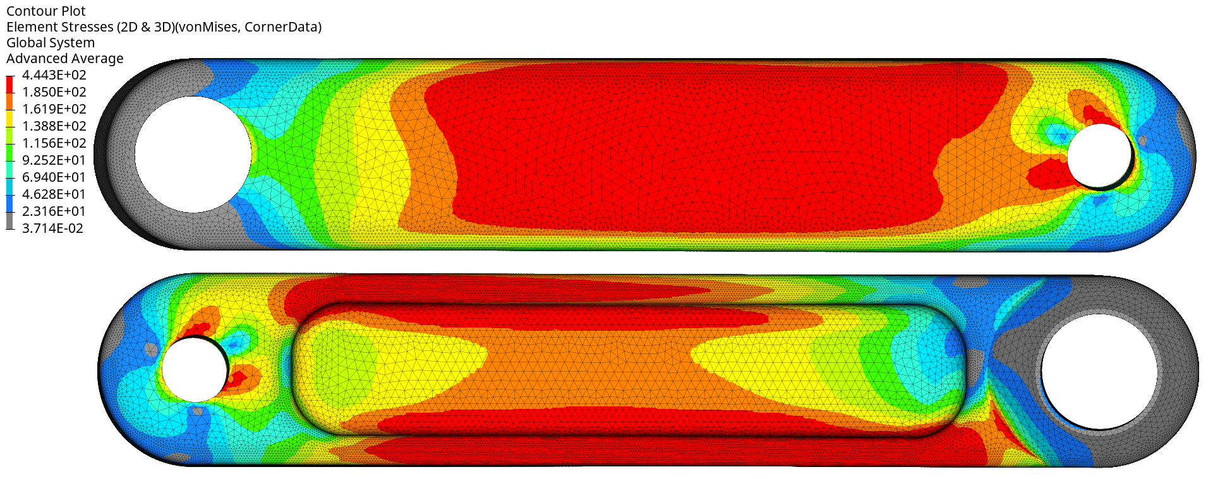
Practical Application of Functionally Graded Lattice Structures in a Bicycle Crank Arm
7. Results
7.1 Reference crank arm
→ Significant yielding
→ Large regions with stresses above fatigue strength
→ Large displacement of 7.1mm at pedal center
Notes:
Results: Solid aluminium crank has significant deflection of 7.1mm at pedal center and yielding
Red regions show von Mises stress above fatigue strength of 185MPa for 50k cycles, some spots surpass its yield strength
Steel crank with lattice has significantly lower deflection

Slide 14
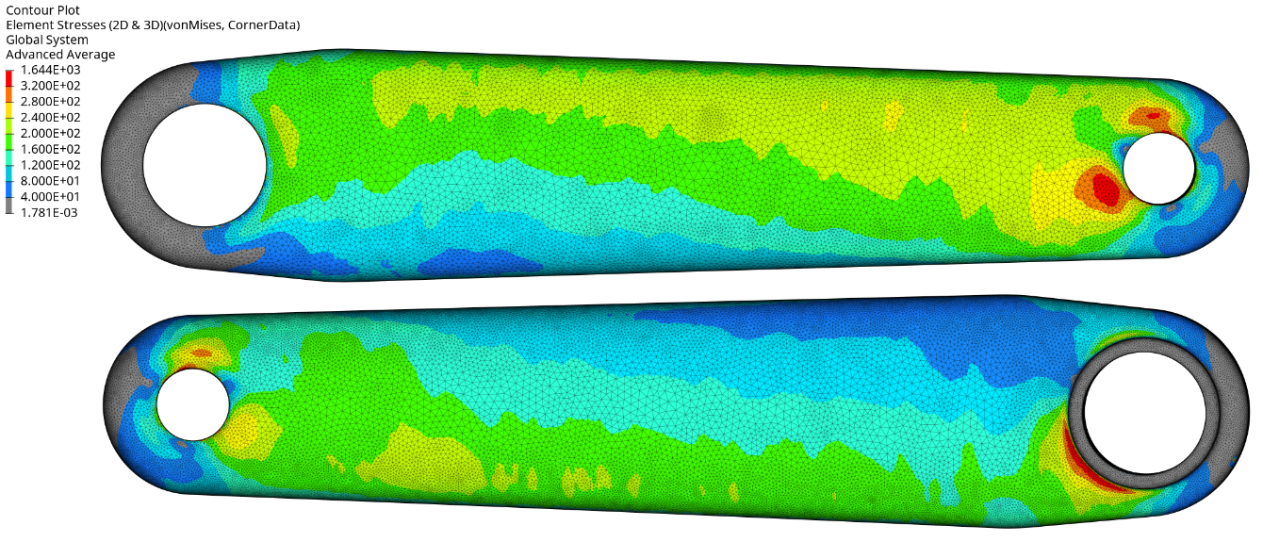
Practical Application of Functionally Graded Lattice Structures in a Bicycle Crank Arm
7. Results
7.2 Steel crank arm with lattice
→ No yielding
→ Approx. 2.6mm deflection at pedal center
→ Stresses mostly below fatigue strength
Notes:
Steel crank after optimization
Crank with lattice has significantly lower deflection of roughly 2.6mm for both lattice types
Re-entrant lattice crank variant: red regions surpass stress limit of 320MPa on outside of body, but stay below 400MPa which is still considered acceptable
FCC not shown since outside looks similar

Slide 15
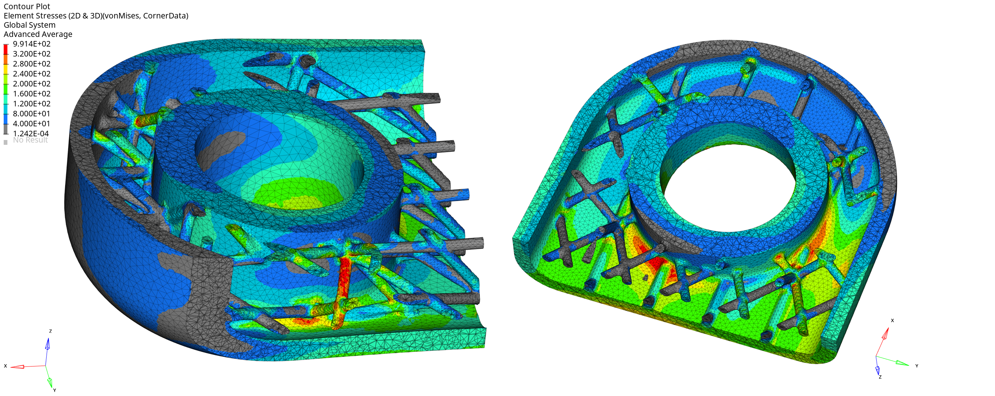
Practical Application of Functionally Graded Lattice Structures in a Bicycle Crank Arm
7. Results
7.3 Steel crank arm with lattice
System response | Re-entrant |  | FCC
 | Initial | Final | Initial | Final
Radius_bb [mm] | 0.50 | 0.47 | 0.50 | 0.64
Radius_o1 [mm] | 0.50 | 0.52 | 0.50 | 0.54
Radius_o2 [mm] | 0.50 | 0.50 | 0.50 | 0.49
Radius_o3 [mm] | 0.50 | 0.43 | 0.50 | 0.43
Radius_pedal [mm] | 0.50 | 0.47 | 0.50 | 0.49
Radius_m1 [mm] | 0.50 | 0.41 | 0.50 | 0.40
Radius_m2 [mm] | 0.50 | 0.40 | 0.50 | 0.59
Radius_m3 [mm] | 0.50 | 0.46 | 0.50 | 0.40
Displacement [mm] | 2.59 | 2.61 | 2.57 | 2.55
Solid stress [MPa] | 311.7 | 313.5 | 309.8 | 307.9
Beam stress [MPa] | 248.5 | 261.8 | 221.7 | 223.2
Mass [g] | 369 | 357 | 355 | 360
→ Some stresses above limit in FCC crank variant
→ Little improvement compared to baseline results
Notes:
On the inside of FCC crank variant, the lattice shows some stress peaks up to 490MPa. Re-entrant crank variant stresses in lattice are below 400MPa.
DOE + optimization didn’t yield as much performance enhancement as hoped, weight is high compared to aluminium model

Slide 16
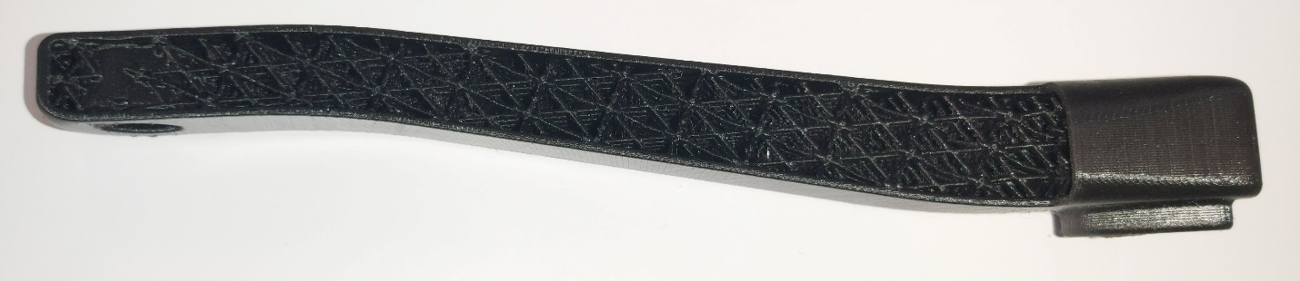
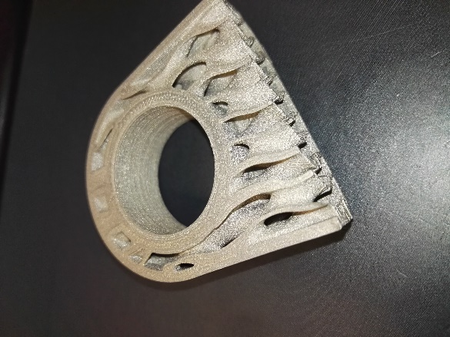
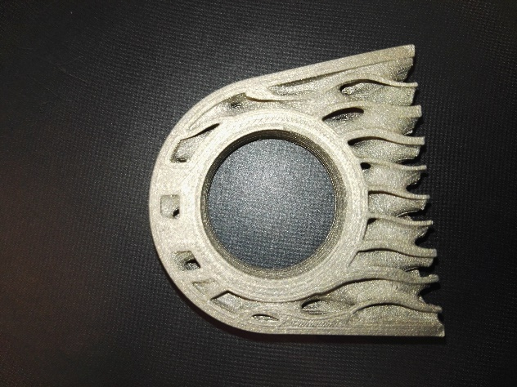
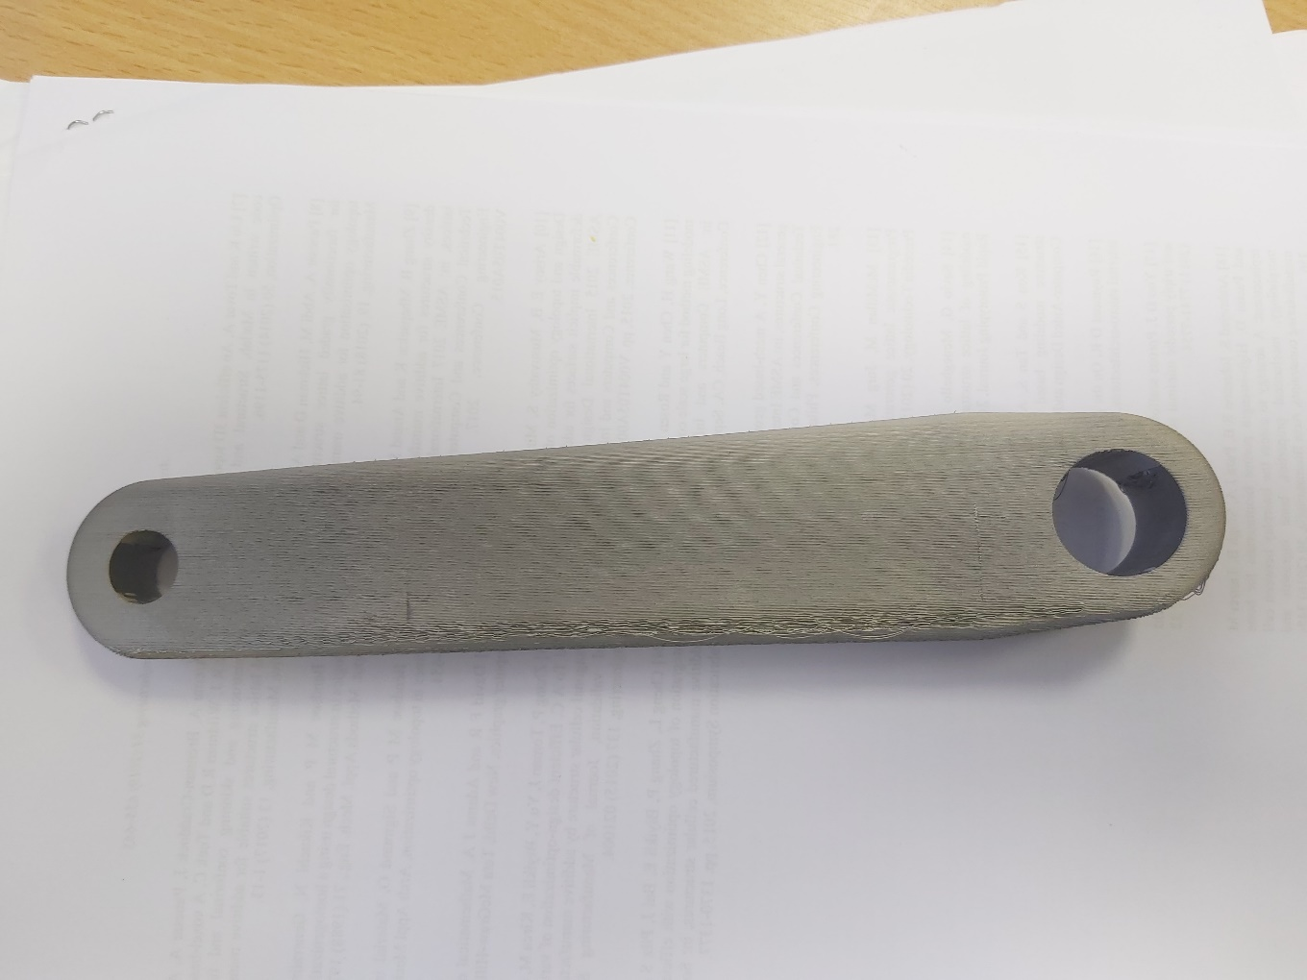
Practical Application of Functionally Graded Lattice Structures in a Bicycle Crank Arm
8. Test Prints and Outlook
→ Successful test prints in PLA and 316L
→ Markforged preprocessor very restrictive
→ Tests with other printers and materials will follow
→ Generally feasible, but challenging to produce
→ Material and part testing needed
→ Future projects: bicycle helmet, bike frame?
Crank with FCC lattice printed in PLA on Ultimaker 2 (section cut)
Test print on Markforged Metal X with triangular infill
Gyroid-based lattice printed with BASF Ultrafuse 316L (section cut)
Notes:
Results: Solid aluminium crank has significant deflection and yielding
Steel crank with lattice has significantly lower deflection
Succesful Ultrafuse 316L FDM print by UAS Trier
Limits: Custom Matlab script necessary for transfer between software
File handling (STL) can be challenging
Crank design not optimized for AM

