Slide 7
Source: Petri, I.; Kubicki, S.; Rezgui, Y.; Guerriero, A.; Li, H. Optimizing Energy Efficiency in Operating Built Environment Assets through Building Information Modeling: A Case Study. ENERGIES 2017, 10.

Slide 8
Source: Ecophi - Ecophi Architecture & BioClimatic Analysis Available online: https://www.eco-phi.com/

Slide 9
Software: Autodesk Revit 2019

Slide 10
Source: Sacks, R.; Eastman, C.; Lee, G.; Teicholz, P. BIM handbook : a guide to building information modeling for owners, managers, designers, engineers and contractors; Third edition..; 2018; ISBN 978-1-119-28755-1

Slide 12
Source: Webinar 1 : Let’s disrupt together - Timber Hybrid Buildings of the Future - YouTube Available online: https://www.youtube.com/watch?v=bDuDGTILHyM&feature=youtu.be

Slide 13
Source: Sacks, R.; Eastman, C.; Lee, G.; Teicholz, P. BIM handbook : a guide to building information modeling for owners, managers, designers, engineers and contractors; Third edition..; 2018; ISBN 978-1-119-28755-1

Slide 14
Source: BIM adoption around the world: how good are we? Available online: https://www.geospatialworld.net/article/bim-adoption-around-the-world-how-good-are-we/

Slide 15
Source: Sacks, R.; Eastman, C.; Lee, G.; Teicholz, P. BIM handbook : a guide to building information modeling for owners, managers, designers, engineers and contractors; Third edition..; 2018; ISBN 978-1-119-28755-1

Slide 19
Source: Sacks, R.; Eastman, C.; Lee, G.; Teicholz, P. BIM handbook : a guide to building information modeling for owners, managers, designers, engineers and contractors; Third edition..; 2018; ISBN 978-1-119-28755-1

Slide 20
Source: A history of BIM - LetsBuild Available online: https://www.letsbuild.com/blog/a-history-of-bim

Slide 25
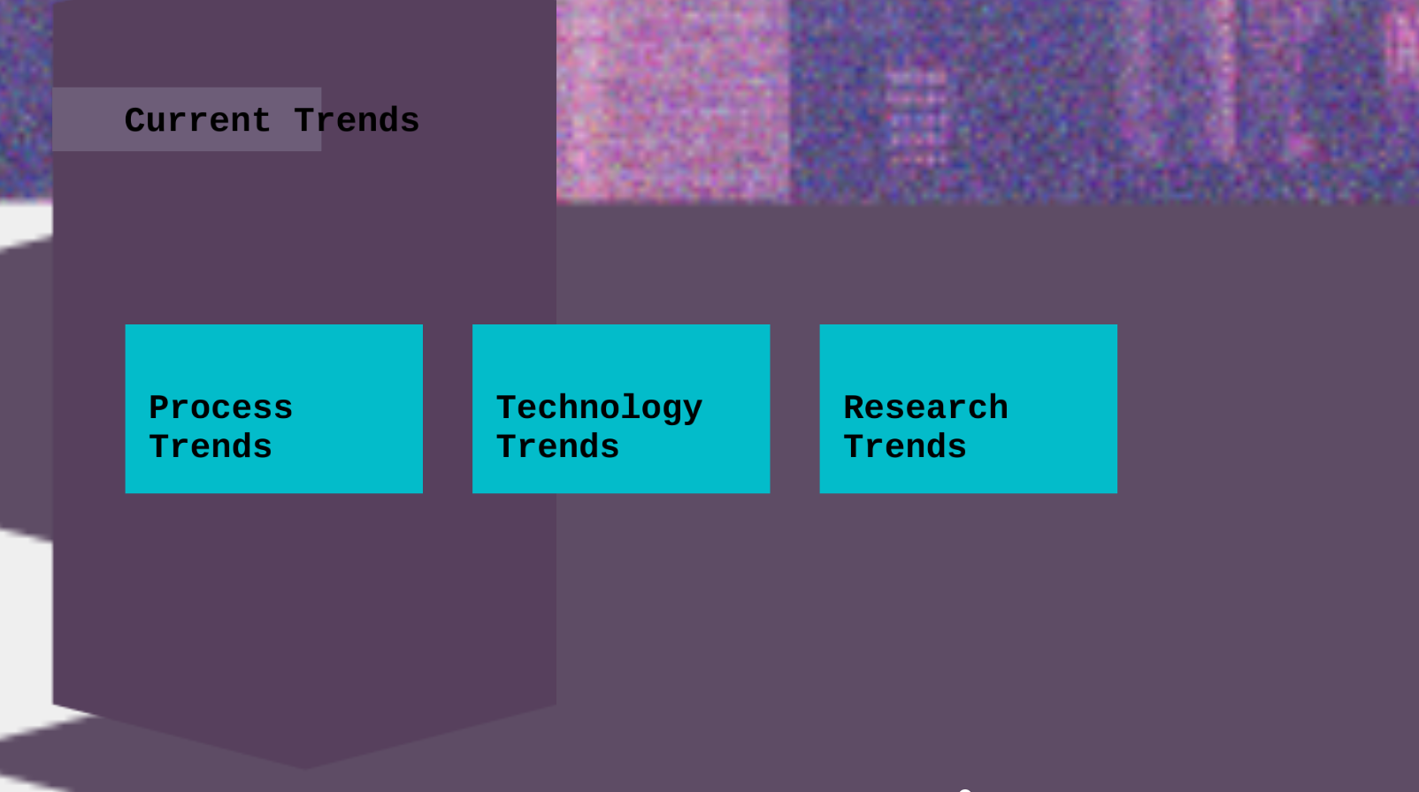
Source: Sacks, R.; Eastman, C.; Lee, G.; Teicholz, P. BIM handbook : a guide to building information modeling for owners, managers, designers, engineers and contractors; Third edition..; 2018; ISBN 978-1-119-28755-1

Slide 29
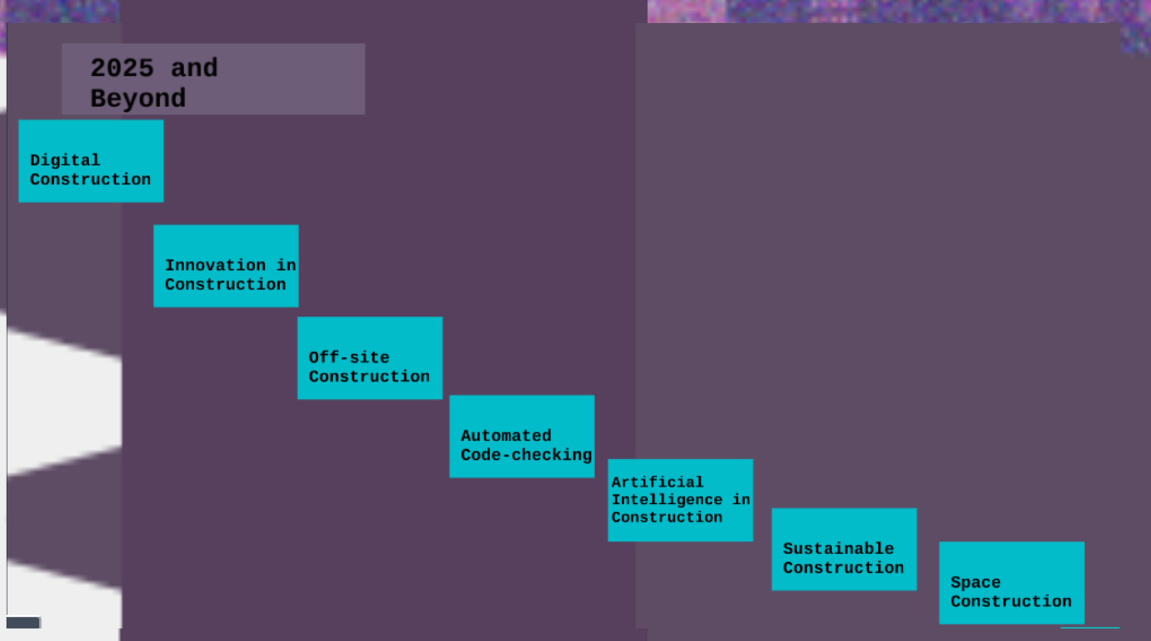
Source: Sacks, R.; Eastman, C.; Lee, G.; Teicholz, P. BIM handbook : a guide to building information modeling for owners, managers, designers, engineers and contractors; Third edition..; 2018; ISBN 978-1-119-28755-1

Slide 32
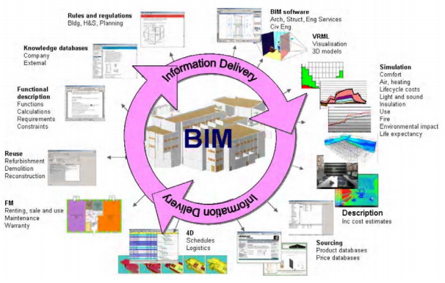
Source: Haagenrud, S.; Wix, J.; Bjørkhaug; Trinius, W.; Huovila, P. EU-project STAND-INN –Integration of Standards for Sustainable Construction into Business Processes Using IFC Standards.; ISTANBUL, Turkey, 2008.

Slide 33
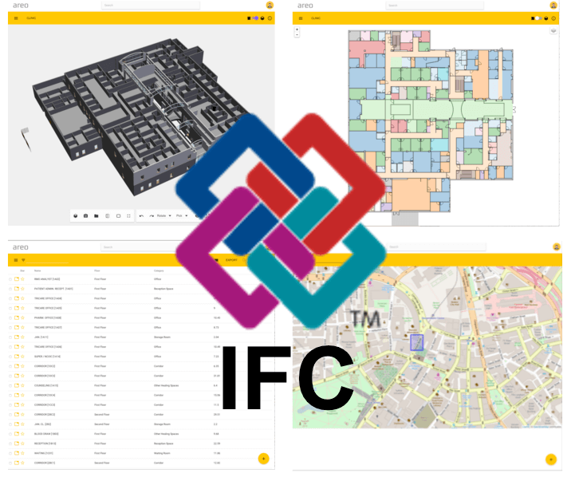
Source: What is IFC and what do you need to know about it? Available online: https://blog.areo.io/what-is-ifc/

Slide 34
Source: Sacks, R.; Eastman, C.; Lee, G.; Teicholz, P. BIM handbook : a guide to building information modeling for owners, managers, designers, engineers and contractors; Third edition..; 2018; ISBN 978-1-119-28755-1

Slide 35
Source: Sacks, R.; Eastman, C.; Lee, G.; Teicholz, P. BIM handbook : a guide to building information modeling for owners, managers, designers, engineers and contractors; Third edition..; 2018; ISBN 978-1-119-28755-1

Slide 36
Source: Sacks, R.; Eastman, C.; Lee, G.; Teicholz, P. BIM handbook : a guide to building information modeling for owners, managers, designers, engineers and contractors; Third edition..; 2018; ISBN 978-1-119-28755-1

Slide 37
Source: buildingSmart

Slide 38
Thanks for your attention!

