Slide 1


Wind Music during the Nazi occupation in Luxembourg from 1940 to 1944
Damien François Sagrillo
IGEB, Virtual Conference 17-18 December

Slide 2
Context and Scope
Wind musich during the Nazi Occupation in Luxembourg
Music during the 3rd Reich in Luxembourg
Music history of the 20th century in Luxembourg
Music history as a part of cultural history in Luxembourg
Cultural history of Luxembourg

Slide 3


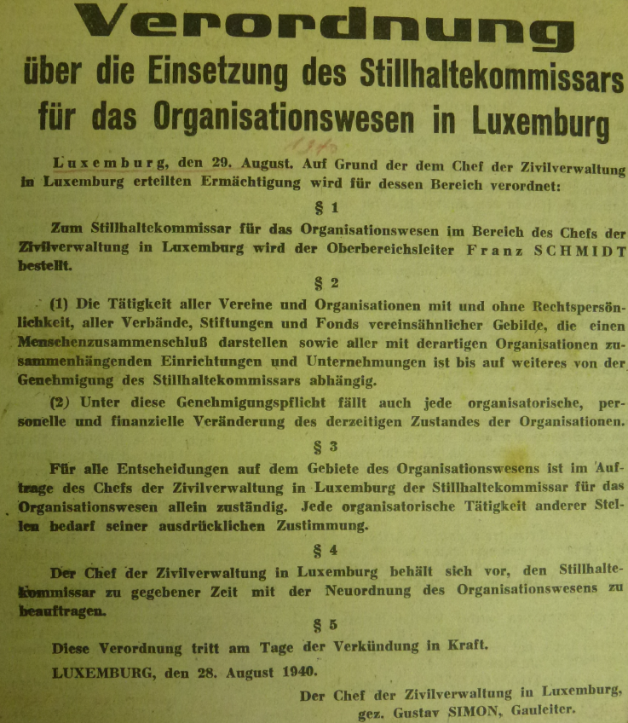

The Standstill Commissioner and associations. regulations
"Stillhaltekommissar"
StiKo (Franz Schmidt) is subordinated to the Head of the Civil Administration (Chef der Zivilverwaltung ,CdZ, Gustav Simon)
Control of people coming together
Wind bands must obtain permission
For changes
Financial nature
Regarding the organisational structure
StiKo can carry out the reorganisation of the organisational structure at the behest of the CdZ
from the documents of the Philharmonie Municipale de Diekirch
Christina Klein, The National Socialist Cultural Policy in Luxembourg 1940 - 1944, BA thesis, University of Düsseldorf 2011

Slide 4
The "Stillhaltekommissar" and his missions
Extract from the Obermoselzeitung of 3 November 1940, p. 4.
Tasks
Force wind bands to observe national socialist orientation
Dispositions taken by the StiKo are not contestable
StiKo has legal authority under exclusion of jurisdiction
However: disadvantaged persons could be compensated in individual cases
the alignment or liquidation of clubs in the occupied or annexed territories
Often means transfer to ideologically close organisations; in Luxembourg, for example, the GEDELIT
Gleichschaltung means recognition of the National Socialist ideology
Monitoring of association activities
If necessary: confiscation of the association's assets
Assets must be reported to the StiKo

Slide 5
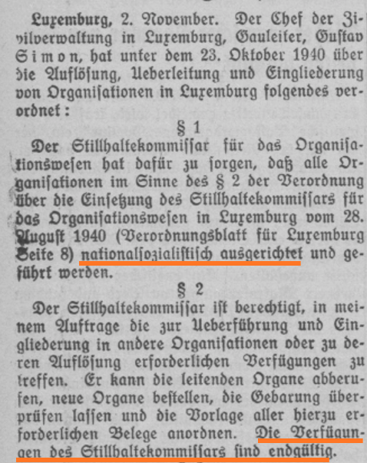
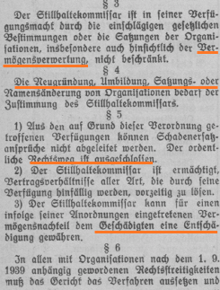
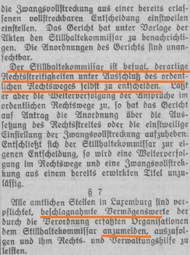
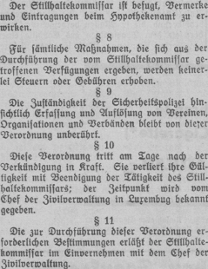


Extract from the Obermoselzeitung of 3 November 1940, p. 4.

Slide 6
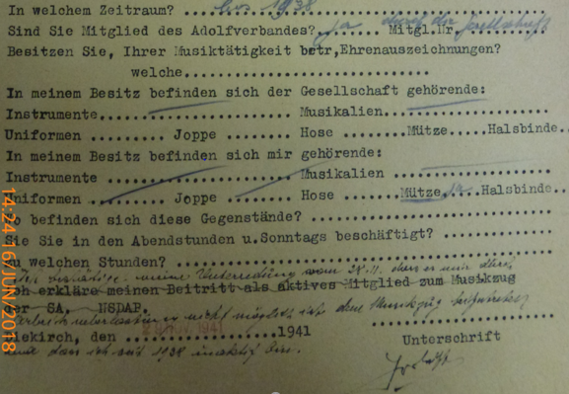
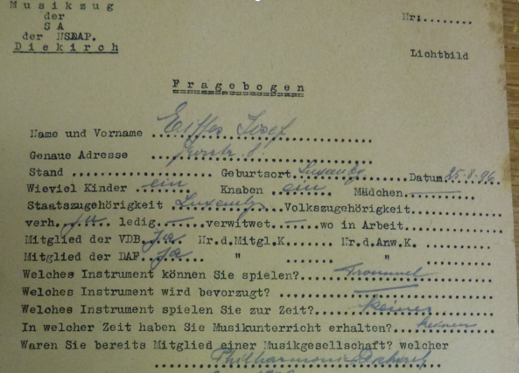
Questionnaire
Individual questionnaire from the documents of the Philharmonie Municipale de Diekirch

Slide 7
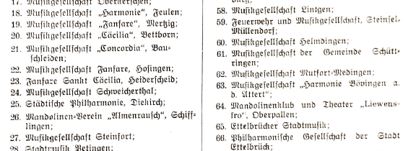
Exemption for music companies
Newsletter No. 4, 15 May 1941, p. 51

Slide 8
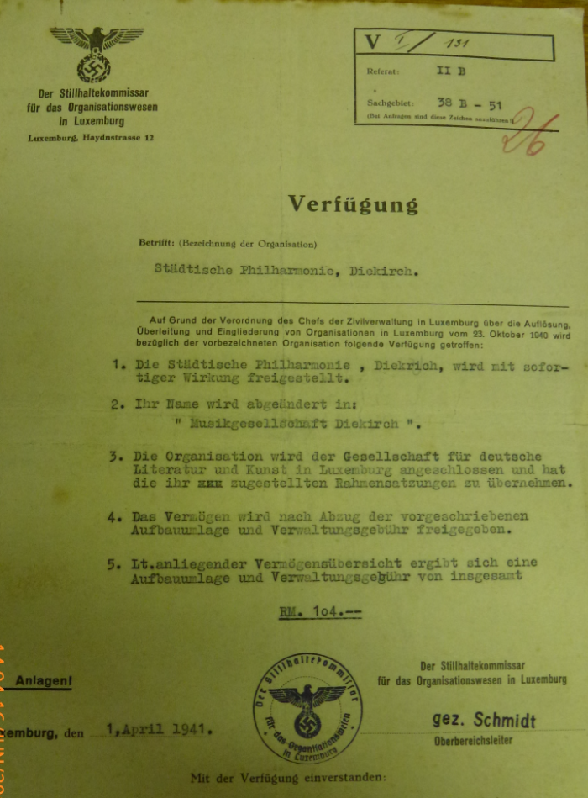
Exemption for music companies
from the documents of the Philharmonie Municipale de Diekirch

Slide 9
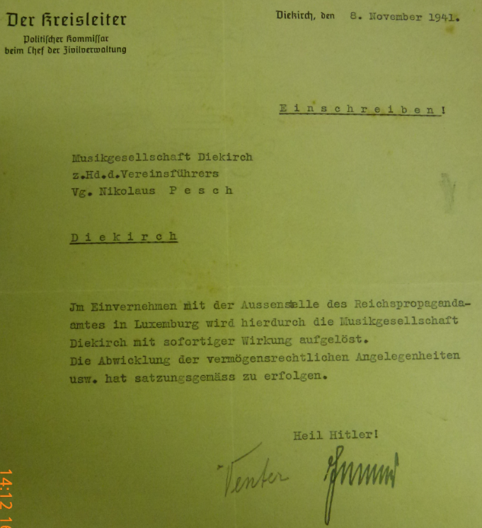
Dissolution of the Philharmonie Diekirch
from the documents of the Philharmonie Municipale de Diekirch

Slide 10
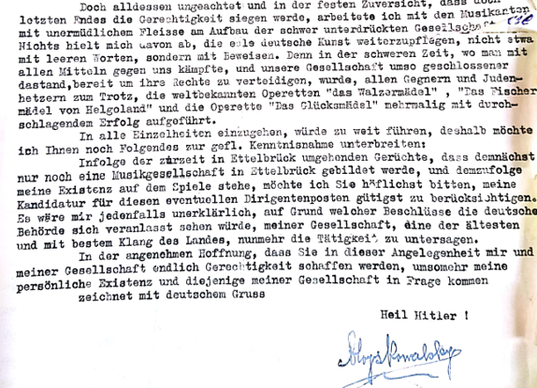
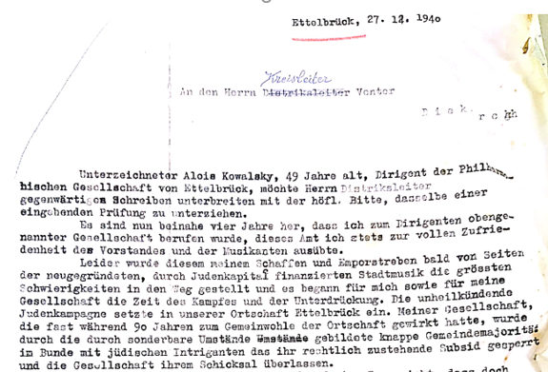
Letter from Alois Kowalsky to the district leader Venter
Alois Kowalsky remained conductor of the merged association until 1942, when he was replaced by Robert Henx
who was the conductor of the association until 1950 Philharmonie, p. 180
from the documents of the Philharmonie Municipale de Diekirch

Slide 11
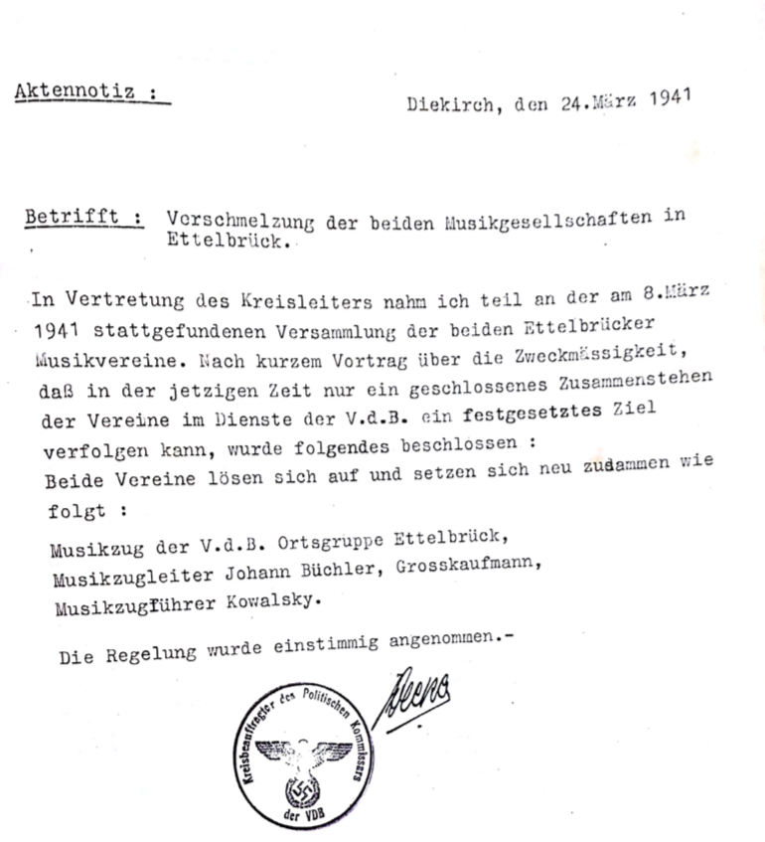
fusion of the two music companies in Ettelbrück
from the documents of the Philharmonie Municipale de Diekirch

Slide 12
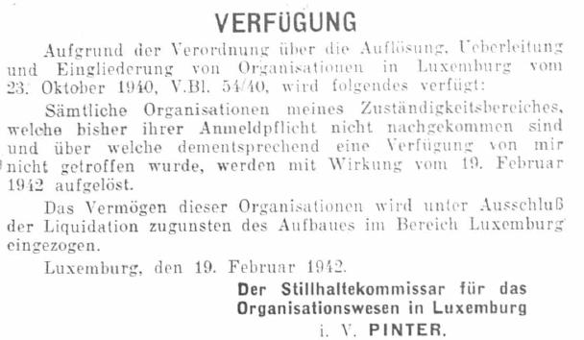
End of activity of the stiko in 1942
from the documents of the Philharmonie Municipale de Diekirch
Any music society that has not reported by this time will be disbanded.
from the documents of the Philharmonie Municipale de Diekirch

Slide 13
2) 2. world war - music education

Slide 14
The musical education of luxembourg from 1940-1944
Luxembourg City Conservatory renamed the National School of Music
Director Lucien Lambotte is replaced by Hans Herwig between 1940 and 1944, although the latter gives him a good report card:
"The great value of solfeggios is recognised, just as it remains recognised at the National Music School in Luxembourg. Reading notes and keys is a prerequisite for anyone who wants to penetrate deeper into the secrets of music. Reading from the page, transposing, quick understanding of the tricky intervals in harmony and counterpoint, these are all things that can hold back the more advanced student, because he will have to work on them bit by bit and from case to case, if he has not acquired them at the very beginning of his studies in an albeit laborious course in the course for general musicology. In any case, what struck both the director of the Escher Music School, Dr. Kollin, and the director of the Landesmusikschule in Luxembourg, H. Herwig, from the very first moment they were here, was the astounding virtuosity with which the students were able to divide the most daring bars, neatly stroke by stroke, and to play the notes in all possible keys. However, and this is probably the main argument of the opponents of these exercises, the time spent on drilling for the exaggerated mechanization of solfeggios seems to be largely lost for the training of the students' general musicality. Moreover, the endless solming of exercises, which in their often flat form make a mockery of all artistic sensibilities, could all too easily fill the pupil with displeasure, to say the least, and in the long run make him dislike music in general.
From the work of our music schools, in: Luxemburger Wort, 29.9.1943 cf. also Jourdain, Conservatoire 75, p. 104
Notes:
o. A., "From the work of our music schools. Fundamental change in education for music", in: Luxemburger Wort, 29.9.1943, <https://persist.lu/ark:70795/4sp42w/pages/3/articles/DTL141>, here p. 3.

Slide 15
musical education in luxembourg from 1940-1944
N.B. While Alfred Kowalsky is dismissed by the National Socialist occupiers in Esch, his brother Alois offers himself to them in Ettelbrück in a repulsive manner
Music school in Esch becomes a folk music school
Director Alfred Kowalsky is replaced by Fernand Collignon (?) (Ferdinand Kollin)
The school was to be organised according to National Socialist principles and the teaching staff was to be 're-educated' in such a way that the main focus was on folk music.
The social aspect of music should be taken into account
"In our Ore Lands is a fertile soil for musical societies"
Extension of the Escher Music School (1), in: Escher Tageblatt, 12.7.1941
Notes:
See above, "Ausbau der Escher Musikschule (1)", in: Escher Tageblatt, 12.7.1941, <https://persist.lu/ark:70795/zp6c2f/pages/3/articles/DTL77>, here p. 3.

Slide 16
musical education in luxembourg from 1940-1944
1943: Foundation of a folk music school in Diekirch
Director will be - as in Esch - Ferdinand Kollin
1944: Shortly before the end of the occupation: foundation of a third folk music school in Wiltz
Foundation of a music school in Wilz, in: Escher Tageblatt, 12.6.1944
Notes:
See Hans Lonnendonker, Michael Hermesdorff, 2001, <https://web.archive.org/web/20010307083326/http://www.trierer-orgelpunkt.de/mhermesdorff.htm>
Key dates in the history of the Conservatoire de Musique du Nord, <https://www.cmnord.lu/a-propos/historique-du-cmnord>
o. A., "Gründung einer Musikschule in Wilz [sic!]", in: Escher Tageblatt, 12.6.1944, <https://persist.lu/ark:70795/2swnkz/pages/4/articles/DTL61>, here p. 4.

Slide 17
Muito obrigado pela atenção
Merci fir Äert Nolauschteren
Благодарю вас за внимание
Danke für Ihre Aufmerksamkeit
Grazie per l'attenzione
Merci pour votre attention
Köszönöm a figyelmet
Damien Sagrillo, Université du Luxembourg
Thank you for your attention
Muchas gracias por su atención

