Slide 1
Separation Of Concerns Within Robotic Systems Through Proactive Computing
Alexandre Frantz
Denis Zampunieris
University of Luxembourg

Slide 2
Table of Contents
Problem Statement
Proposed Solution Model
Proof of Concept
Robot Side
Engine Side
Proactive Scenarios
Scenario Relation
Conclusion and Future Work

Slide 3
Problem Statement
Proactive Computing applied to Robotic Simulations
Why?
Lack of separation of concerns
Additional way of fusing Software Engineering & Robotics
How?
Proactive behavior & Scenarios
Use of Webots™ Simulator, Database and Proactive Engine

Slide 4

Proposed Solution Model

Slide 5
Robot Side
Engine Side
A robot is controlled by a controller file
Receives messages (i.e. commands) from P.E
How?
Database (middleware)
Sends data to P.E through database
Data?
Sensor Values: GPS, Inertial Unit (IU), Distance Sensors (DS), Battery Levels
Consists of Scenarios made of rules
Each Scenario handles 1 concern only and suggests the next step for the robot to achieve the goal
Receives data from Robot and determines next move
Brain of our Robot

Slide 6
Proof of Concept
Goal: Move towards an objective
Achieved with 5 Scenarios:
Data Acquisition
Reach Destination
Avoid Obstacles
Battery Monitor
Decision Making and Strategy
All Scenarios are running in parallel

Slide 7
Proof of Concept– Scenario Example
Reach Destination:
Rules : GetCheckpoint & MoveToCheckpoint
Has to reach a set of GPS coordinates (defined on the DB)
Independent Execution
-> Does not know about the other Scenarios
-> Is not concerned about other constraints
-> Only instructs the robot to go from A -> … -> Z

Slide 8
Proof of Concept – Decision Making & Strategy
Decision Making and Strategy
2 arrays : PriorityArray & CommandArray
Main rule: ReadRobotCommands
Factors for sending Commands:
Scenario Priority
Strategy Selected
Strategies: Offensive + Defensive

Slide 9
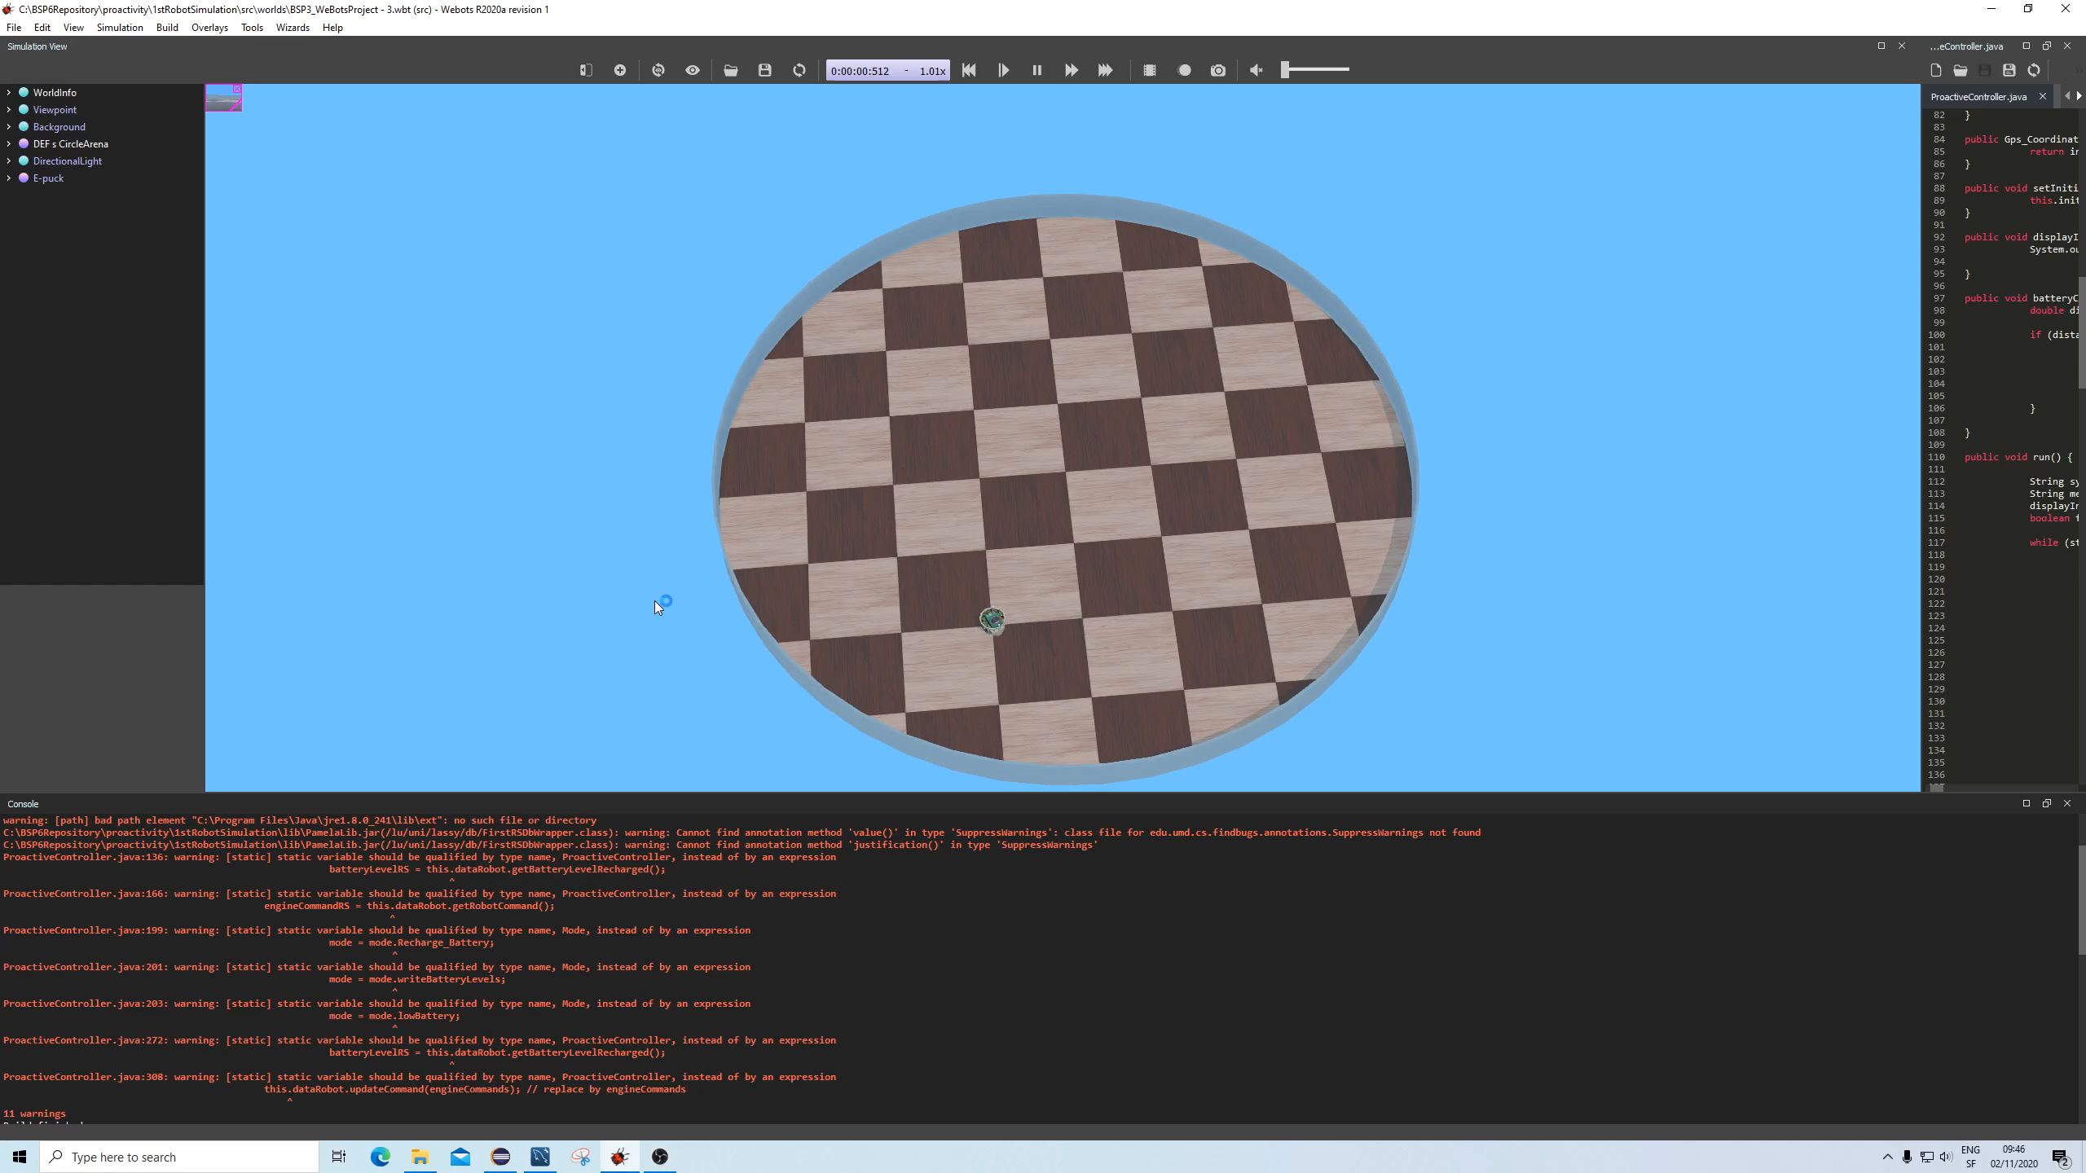

Slide 10
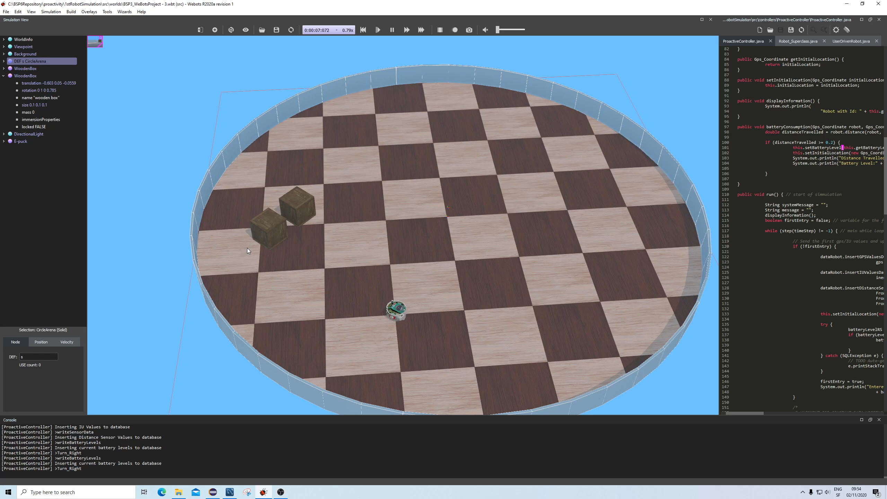

Slide 11
Conclusion and Future Work
Separation of Concerns achieved:
Rule-driven programming
Proactive Behavior
Scenarios & Rules
System is easily extended by adding new scenarios
New model to fuse S.E with Robotics
Expand towards real life applications
Robots
Smart homes
Medicine & Teaching

Slide 12
Thank you for your attention!

