Slide 1
University of Luxembourg
Working, Yet Poor and the EPSR – How in-work poverty became the priority for EU labour law and social policy
Prof. Dr. Luca RATTI

Slide 2
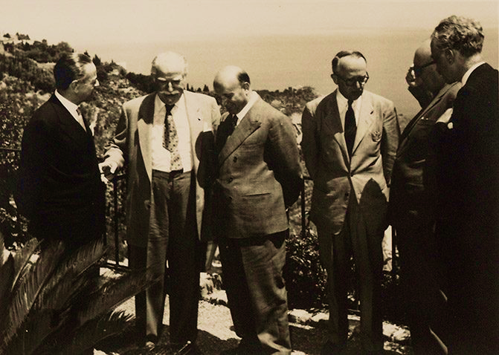
Setting the scene: Messina, 1955
Paul-Henri Spaak (BE), Walter Hallstein (Ger), Antoine Pinay (FR),
Joseph Bech (LU), Gaetano Martino (IT) and Johan Willem Beyen (NL)

Slide 3

Anywhere in Europe
1975-1994 European Commission Poverty Programmes

Slide 4
Bruxelles, EU Commission
Sunday 15 November, 2020

Slide 5
In-work at-risk-of-poverty (EU-SILC)

Slide 6
European Pillar of Social Rights
Proposition no. 6: “Workers have the right to fair wages that provide for a decent standard of living. Adequate minimum wages shall be ensured […] In-work poverty shall be prevented.”
Proposition no. 14: “Everyone lacking sufficient resources has the right to adequate minimum income benefits ensuring a life in dignity at all stages of life […]”

Slide 7
Proposal for a Directive on adequate minimum wages in the European Union (COM(2020) 682 final)
(7) When set at adequate levels, minimum wages protect the income of disadvantaged workers, help ensure a decent living, and limit the fall in income during bad times, as recognised in Convention 131 of the International Labour Organisation on the establishment of a system of minimum wage fixing. Minimum wages contribute to sustaining domestic demand, strengthen incentives to work, reduce wage inequalities and in-work poverty.

Slide 8

What’s next?

Slide 9
THANKS FOR YOUR ATTENTION!
More at:
luca.ratti@uni.lu

