Slide 1

BioKC: a platform for quality controlled curation and annotation of systems biology models
BioNetVisA, 2020 Workshop
4th of September
Dr. Carlos Vega
Bioinformatics Core
Luxembourg Centre for Systems Biomedicine
Notes:
Hello everyone, my name is Carlos Vega, I'm a postdoctoral researcher at the Bioinformatics Core in the Luxembourg Centre for Systems Biomedicine.
I will present to you BioKC, a platform for quality controlled curation and annotation of systems biology models.

Slide 2
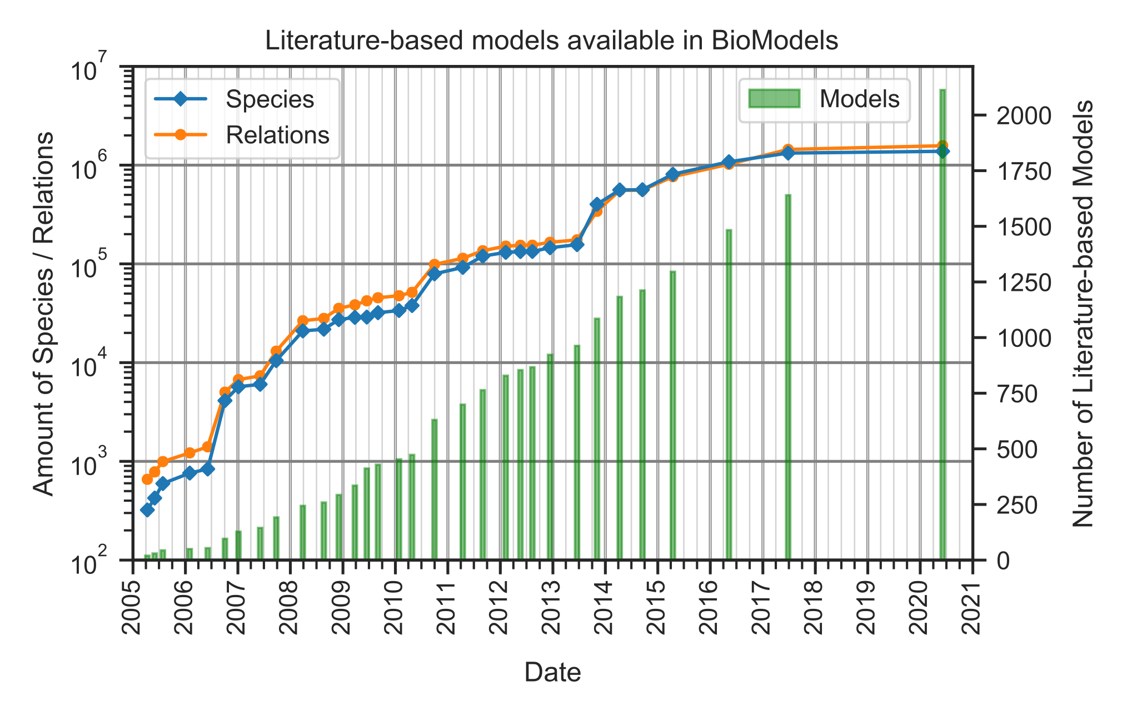
Motivation
The demand for systems biology knowledge increases with new findings demonstrating elaborate relationships between molecules, pathways and cells.
Currently, high quality curation efforts concentrate around dedicated pathway databases, with a limited input from the research community.
There is a need for novel collaborative tools and platforms allowing to improve the quality and the output of the curation process.
Notes:
Biomedical knowledge curation is a laborious manual process aggravated by the ever increasing growth of biomedical literature.
Currently, high quality curation efforts concentrate around dedicated pathway databases, with a limited input from the research community.
We need curators to filter out noise from signal, and highlight the most relevant pieces of knowledge.
There is a need for novel collaborative tools and platforms allowing to improve the quality and the output of the curation process.

Slide 3
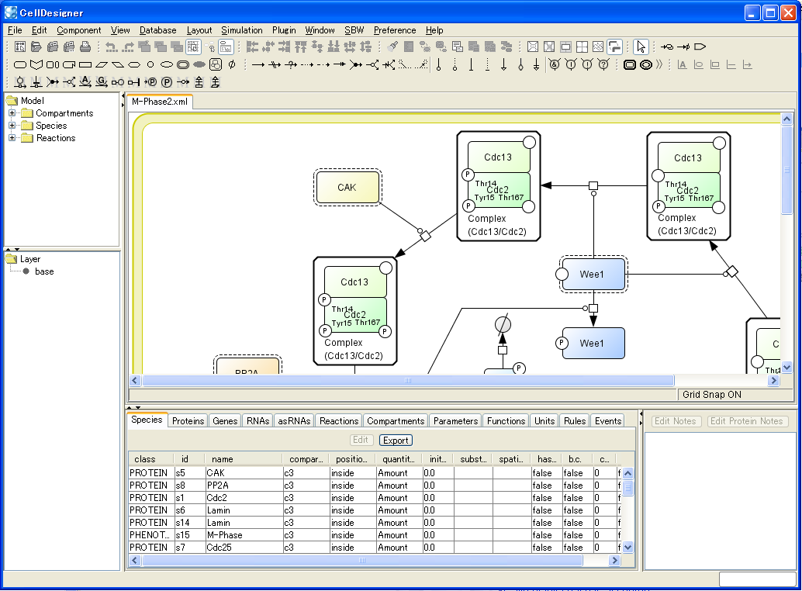




Traditional approach
Implicitly requires working on the layout since the beginning
Diagram Editors
Single user
Standalone application
Layout Editor
Lack of review process
No collaborative work
Limited annotation features
BioModels
Notes:
In this sense, the traditional approach is limited, since curation starts in diagram editors which do not provide collaborative features for community work.
This limits the review process, and the speed to communicate work. Also, is often preferable to first work on the model components, its annotations and supporting evidence, and once a model is matured, it makes sense to work on the visualization. Moreover, the same model could be visualised in different ways, which motivates separating the model from the visualization.

Slide 4
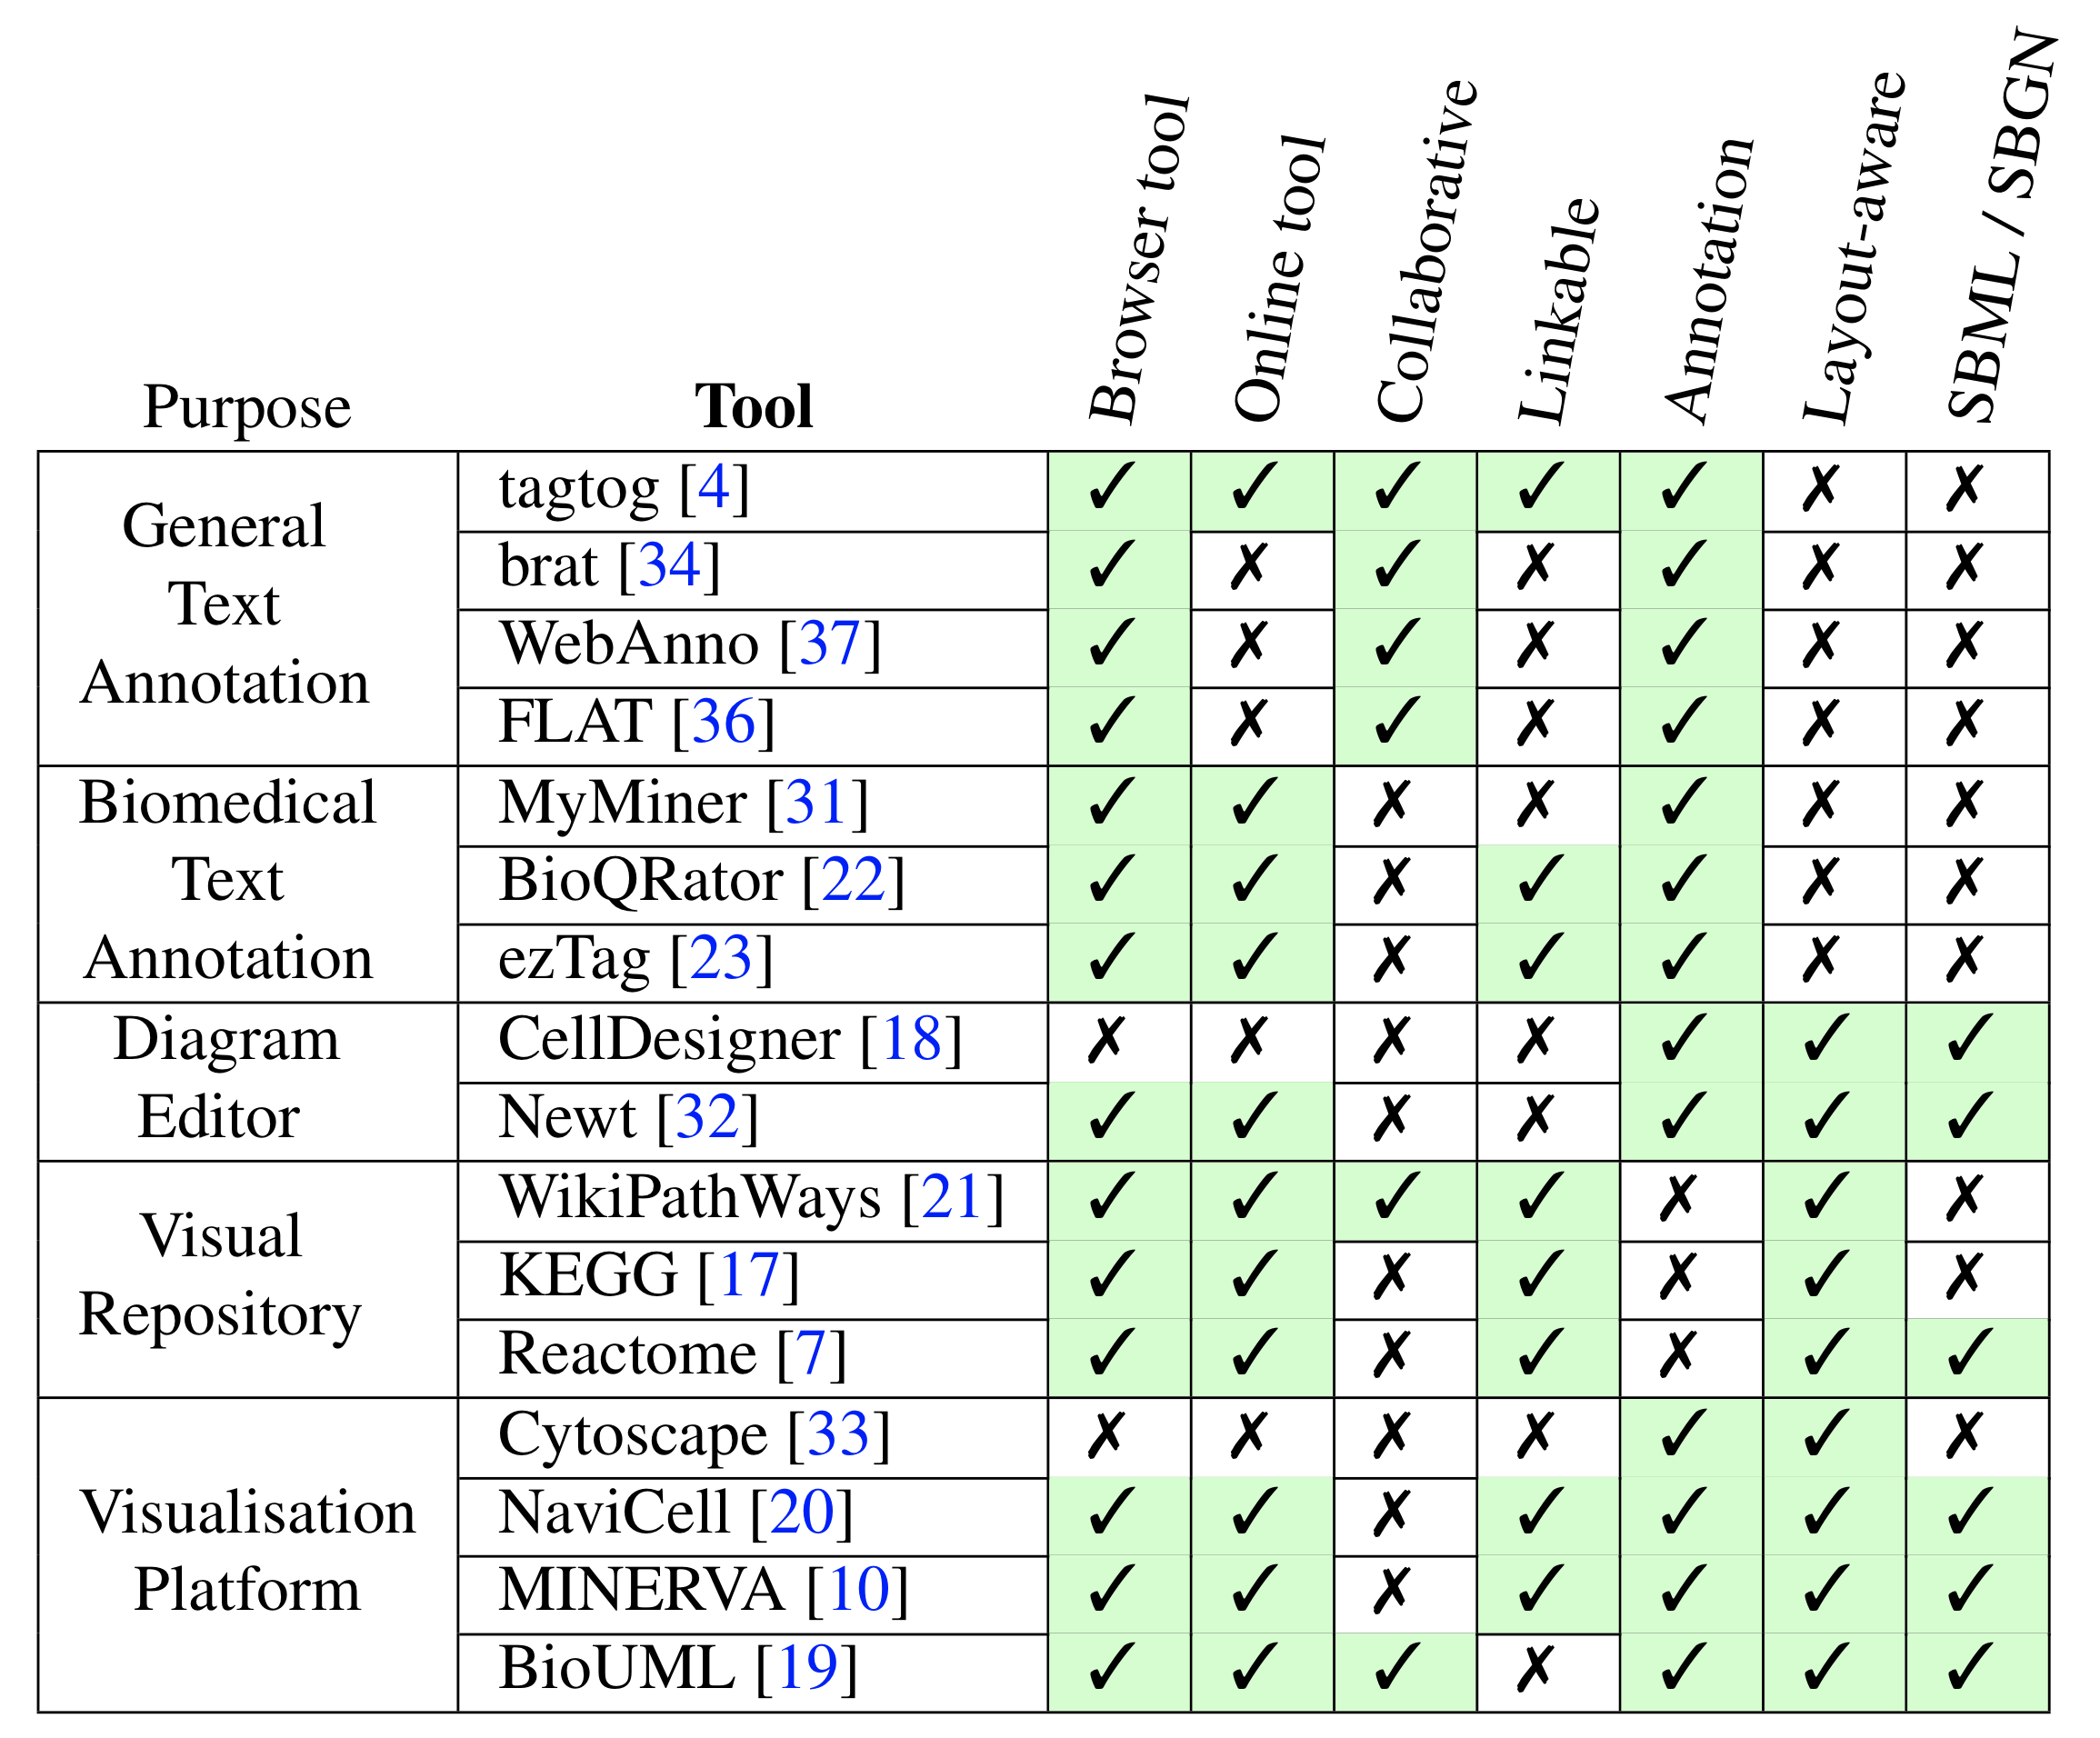
Traditional approach
Implicitly requires working on the layout since the beginning
Table from paper in progress
Notes:
We took a look at similar tools from the biomedical field as well as general text annotation tools and compared some of their features.

Slide 5
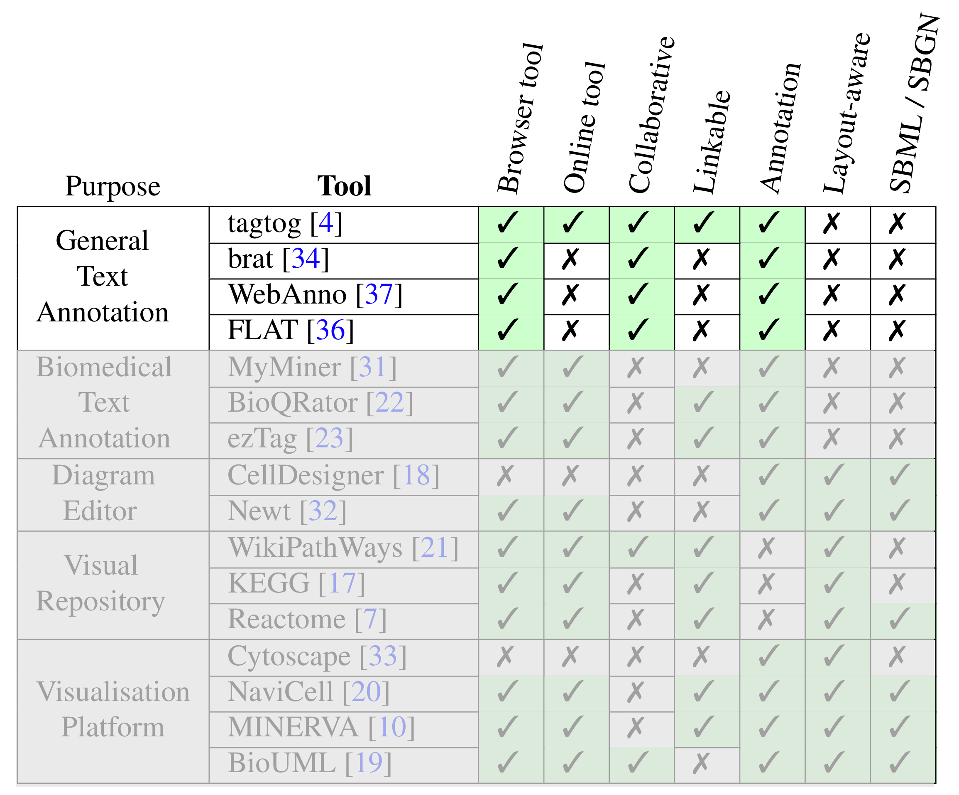
Traditional approach
Implicitly requires working on the layout since the beginning
Table from paper in progress
Notes:
General text annotation tools have many interesting features.

Slide 6

Traditional approach
Implicitly requires working on the layout since the beginning
Table from paper in progress
Notes:
Many of them provide collaborative features, but can’t work with SBML since they are not oriented to the biomedical field

Slide 7
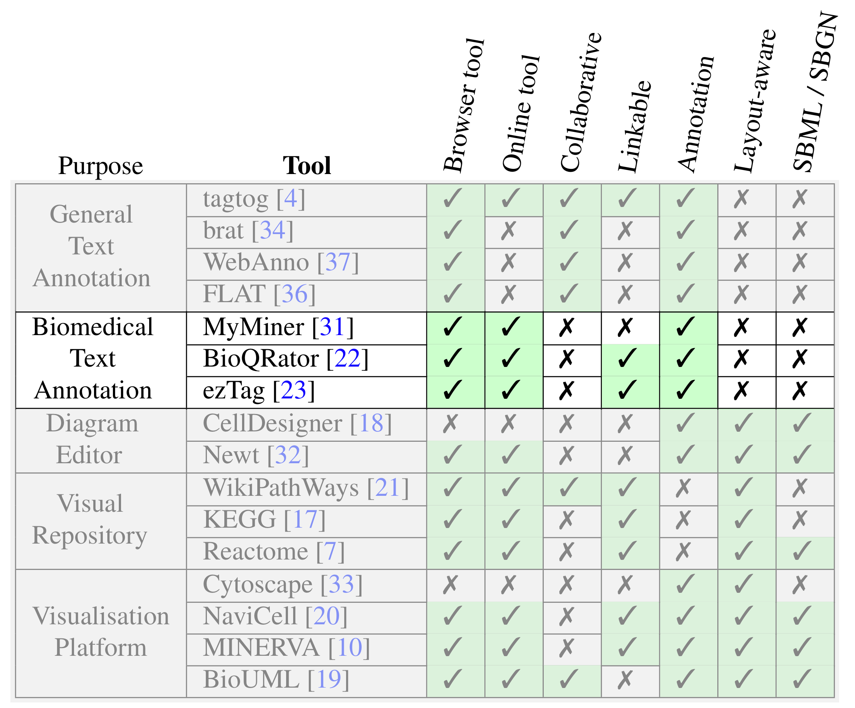


Traditional approach
Implicitly requires working on the layout since the beginning
Table from paper in progress
Notes:
Still, biomedical annotation tools do not support SBML format and don’t provide collaborative features.
Collaboration is crucial to curate complex interactions and annotate them with literature, creating trusted models reviewed and double checked by a group of researchers.

Slide 8
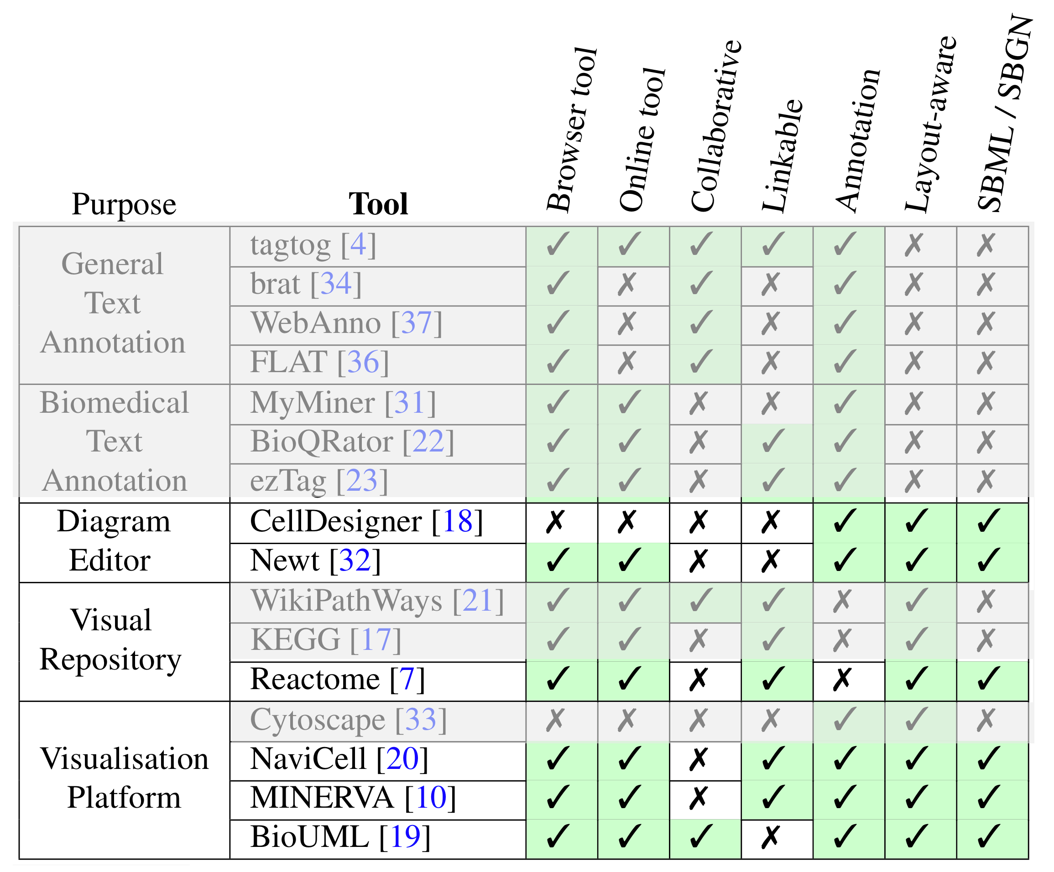

Traditional approach
Implicitly requires working on the layout since the beginning
Table from paper in progress
Notes:
Only diagram and visualization tools support SBML.
There is a clear interoperability gap between visual tools and annotation/curation tools

Slide 9
BioKC
Web platform for collaborative model curation and annotation
Granular facts, encoded in SBML.
Facts can be annotated with sentences and ontology terms from identifiers.org
Sentences from BioKB or 3rd party sources.
Collaborative and quality control features:
Tasks
Action log
Comments
Inter-annotator agreement.
Fact
Minimal piece of representative knowledge that can can be cited, referenced, attributed, and serialised to a common format (e.g. SBML).
Notes:
Therefore, we aim to decouple the layout editing from the model curation but also fill this gap so that tools can interoperate.
For that, we developed BioKC, which allows for the curation of facts, encoded in SBML.
We built BioKC on top of our text-mining pipeline called BioKB. A fact is a piece of knowledge encoded in SBML, but we want to direct the user to curate granular facts, clearly delimited and hence more reusable, but this is always at discretion of the user.
For the annotation of evidence, we allow the user to pick sentences from the results of our text mining pipeline BioKB, but also to import annotated sentences from third party sources
On top of that, BioKC has collaborative features including tasks or comments, which help organising and reviewing the curation process.

Slide 10

BioKC
Web platform for collaborative model curation and annotation
Role system similar to GitLab and GitHub.
Group-level role system:
Managers
Administrators of the group.
Curators
Permission to change the elements that compose a fact.
Annotators
Permission to annotate the facts.
Readers
Read only access to facts.
👩🏽‍💼
👩🏻‍🔧
🕵️‍♀️
👨🏼‍💻
Notes:
BioKC works with groups of facts and we use a group-level role system similar to GitLab or GitHub systems. Therefore, users can be members of multiple groups and have different roles on them.

Slide 11

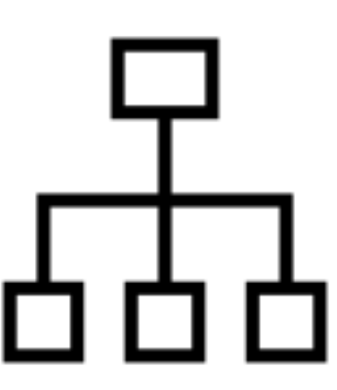


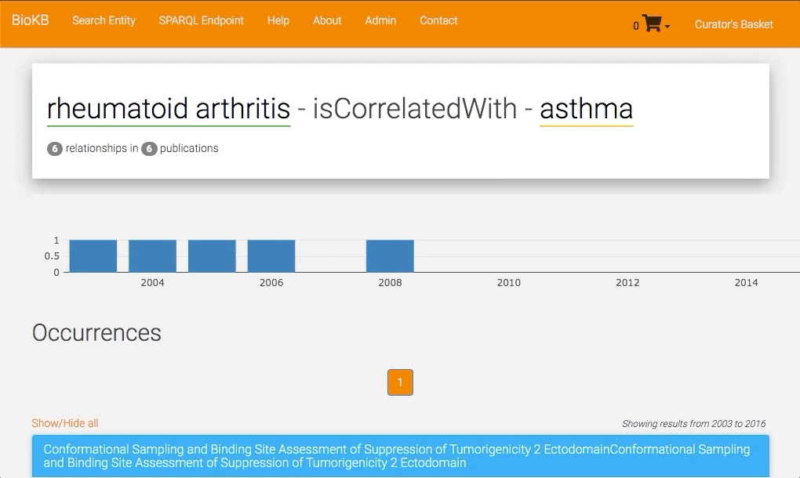

BioKC
🕵️‍♀️
Two workflows to start creating facts
Gather evidence
Curate Model
Evidence from:
BioKB
1
Notes:
We offer the user two complementary workflows to start creating facts. First workflow allows the user to gather evidence, and then create a model from it.
Here you can see a basket, and as we were shopping, we can include sentences found in BioKB into our basket for later use.

Slide 12
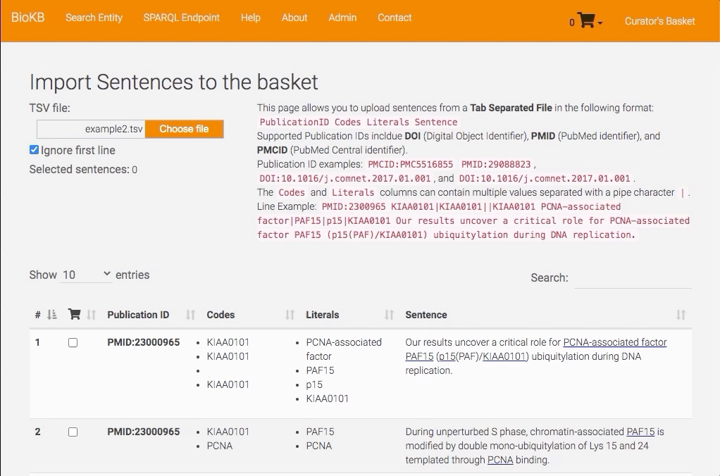

BioKC
🕵️‍♀️
Two workflows to start creating facts
Gather evidence
Curate Model
Evidence from:
Other
Text-Mining and Knowledge Bases
1
Notes:
We can also add these sentences from a file. For now we support TSV files, but we plan to improve the interoperability as we engage into more collaborations with other research teams.

Slide 13
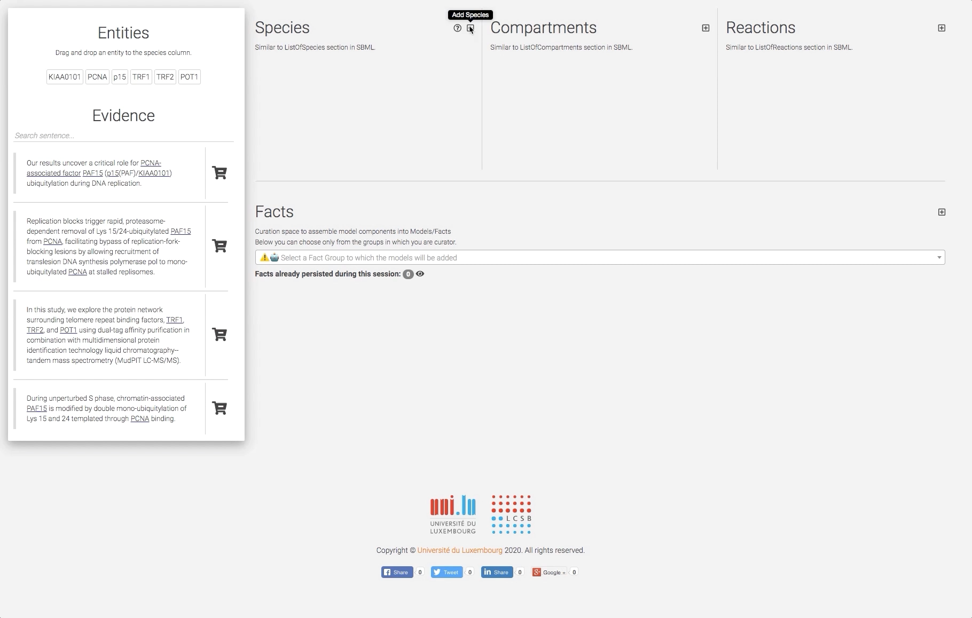
BioKC
🕵️‍♀️
Two workflows to start creating facts
Gather evidence
Curate Model
Curate Model Elements
1
Notes:
Once we have finished gathering sentences, we can checkout, and start building the components of our model.

Slide 14
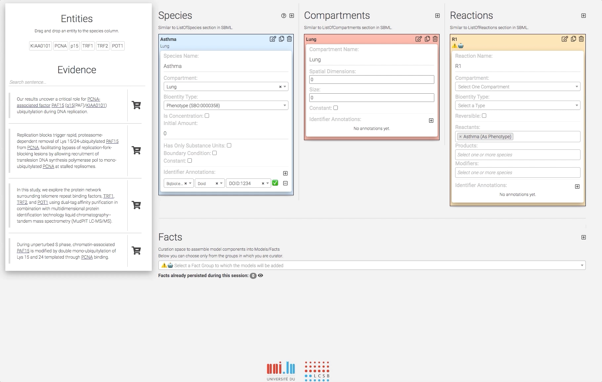
BioKC
🕵️‍♀️
Two workflows to start creating facts
Gather evidence
Curate Model
Assign
Gathered Evidence
1
Notes:
We can start building a fact, adding species, compartments of reactions. And later on, assign the sentences to the model. Once we are finished we can decide the group of our fact.
For example, we could have a group of facts about COVID-19. Once the fact is saved, we will be able to edit it in the fact view.

Slide 15
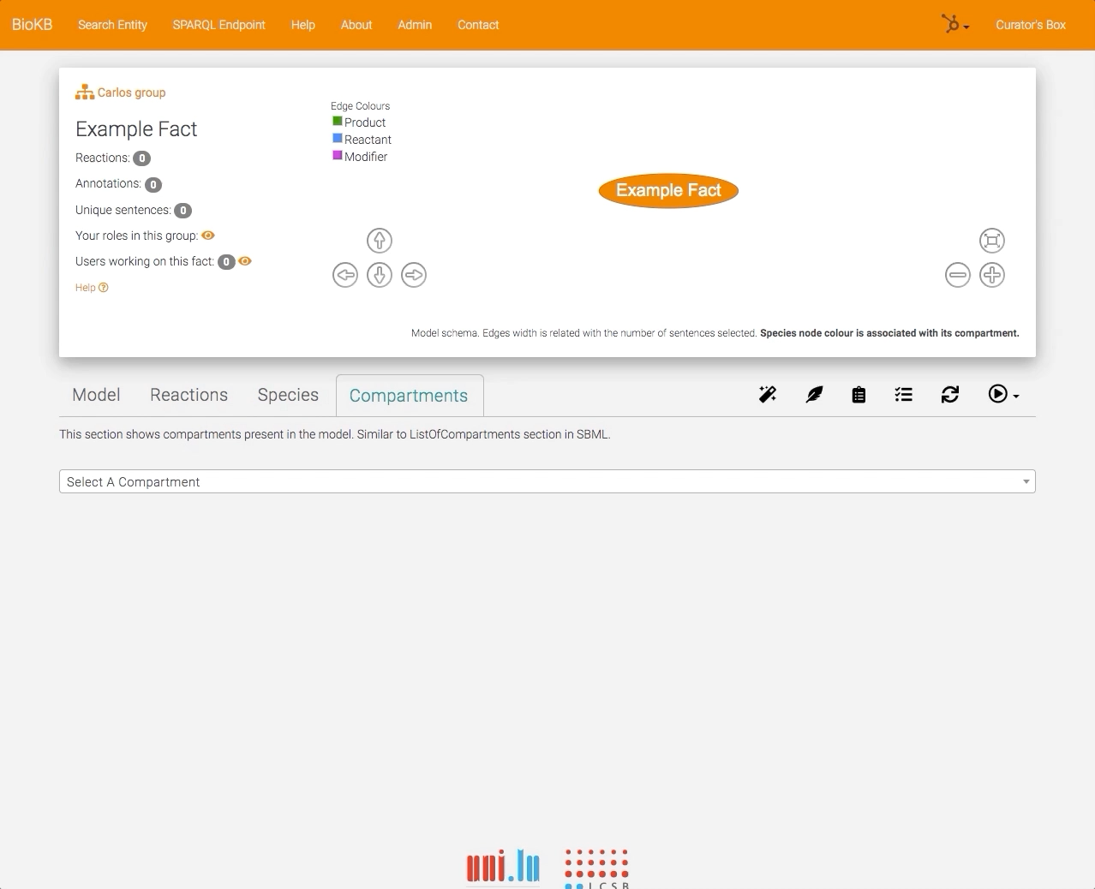
BioKC
👩🏻‍🔧
Two workflows to start creating facts
Curate Model
Annotate Model
Model Curation
2
Notes:
Is precisely in this fact view where the second workflow starts. In this view we can either edit our previously created facts, or we can start a new one.
Here we can edit the components of the model and add more of them.
We have two modes of operation. Curation mode, and annotation mode.
Curation mode allows us to edit the components of the fact.
Annotation mode allows us to assign evidence from BioKB or other sources.

Slide 16
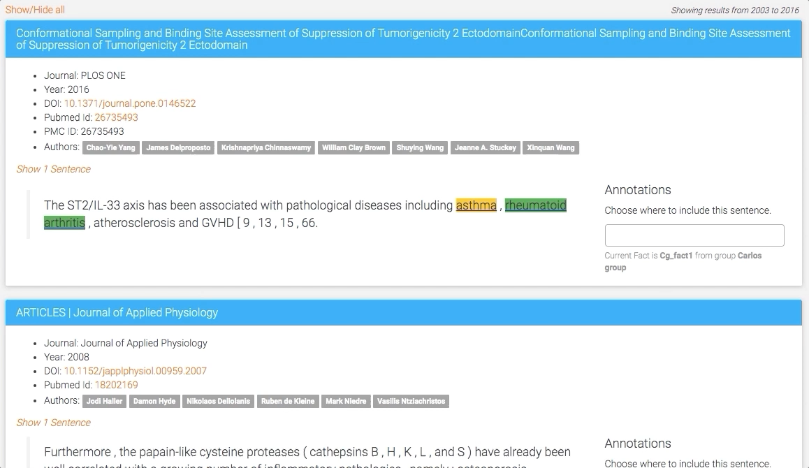
BioKC
👩🏻‍🔧
Two workflows to start creating facts
Curate Model
Annotate Model
Model Annotation
2
Notes:
On the annotation mode, we can pick sentences from BioKB and assign these sentences to one or multiple parts of our model.

Slide 17
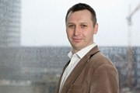
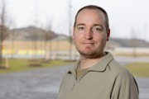
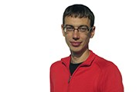
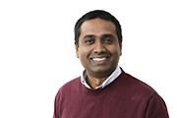
BioKC
Acknowledgements
Roadmap
Dr. Marek Ostaszewski
Fact publishing workflow:
Using stable identifiers to reference matured facts.
Lock a release, but enable versions.
Wider interoperability with external sources and tools.
Valentin Grouès
Dr. Piotr Gawron
Dr. Venkata Satagopam
Notes:
Once a fact reaches certain maturity, we will be able to release a version of it, which will be locked.
We are working to provide stable identifiers, so that these facts can be referenced. Of course, facts can be exported to SBML and we aim to improve interoperability with other tools such as cell designer and minerva. We strongly believe BioKC could improve model quality and speed up the curation process.

Slide 18
Questions
Register and share your thoughts
https://biokb.lcsb.uni.lu/
Notes:
Please, feel free to register and share your thoughts with us.

