Slide 1
Oral History and Technology
Session 036
SLC Sheraton: Wildcat
3:15 – 4:45 pm
Thursday, Oct. 17th, 2019

Slide 2
Oral History and Technology
Session 036
Alicia Barber, Stories in Place, LLC
Douglas Lambert, University of Luxembourg
Rob Perks, The British Library
Virginia Millington, StoryCorps

Slide 3

Oral History Choices in the Digital Age
An International Perspective
Douglas Lambert

Slide 4
Bio
Douglas Lambert
-BS, MS, PhD in Environmental Engineering
-15+ years with The Randforce Associates, Mike Frisch
-Developed and applied oral history indexing methods
-OH indexing for multidisciplinary research

Slide 5


Introduction
Expanding digital oral history in Luxembourg
University of Luxembourg’s
Centre for Contemporary and Digital History (C²DH)

Slide 6
Introduction
Take home…
OH indexing approaches from the US will need to be re-envisioned, retooled, and otherwise adapted for a new and different cultural and technological context.

Slide 7
Indexing Approaches
Indexing oral histories digitally at the timecode level is a practice increasingly adopted for collections, often with the goal of creating online access to recordings.
Notes:
Elaborating…
-Historically, transcriptions were the primary document for working with OH.
-Digital tools opened the possibility for linking media and text directly.
-Digital environments put a new emphasis on listening to original recordings, and distributing them online.

Slide 8
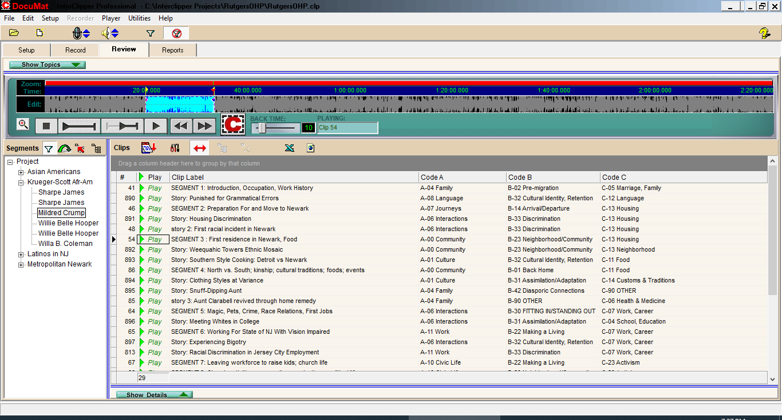
Indexing Approaches
Timecode indexing

Slide 9
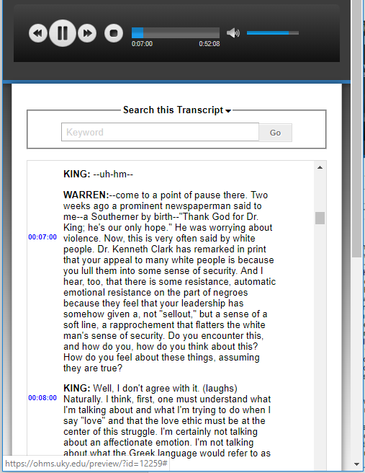
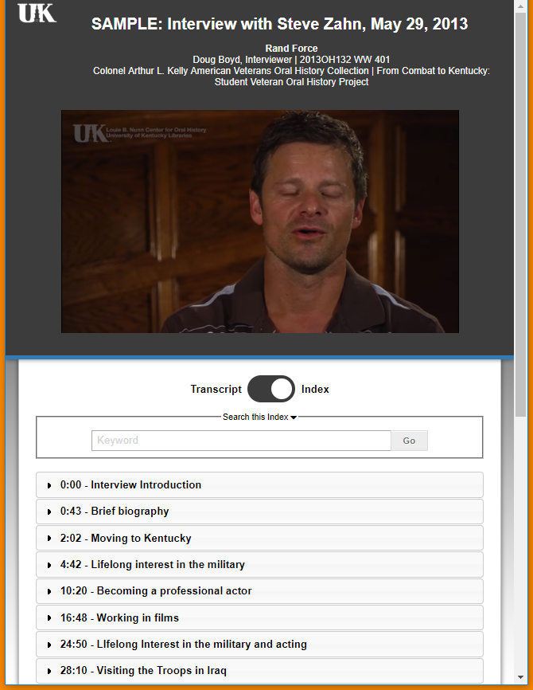

Indexing Approaches
Timecode indexing
Notes:
Take home: Timecodes link text to media
OHMS is a popular system for digital archives in the US at the moment

Slide 10
Indexing Approaches
Indexing-first approaches are attractive because they can be generated in less time than a transcript, especially when both must be done manually.
Notes:
Elaborating…
-Historically, transcriptions were the primary document for working with OH.
-Digital tools opened the possibility for linking media and text directly.
-Digital environments put a new emphasis on listening to original recordings, and distributing them online.

Slide 11
Indexing Approaches
Indexing before transcription
…you can always transcribe!
Index text:
Involved in the realization of the importance of DNAPL chemicals
Transcription:
“Probably an important part with regard to groundwater contamination that I was involved in in the early 80’s was, I guess, the realization of the importance of the DNAPL form of particular types of chemicals…”
Notes:
Annotation: in some contexts, the meaning of what is said may be equally or more important than what was literally said.

Slide 12
Indexing Approaches
Indexing approaches can include multiple layers of timecode markup and analysis…
…and controlled vocabulary focused on non-literal meanings
Notes:
Elaborating…
-Historically, transcriptions were the primary document for working with OH.
-Digital tools opened the possibility for linking media and text directly.
-Digital environments put a new emphasis on listening to original recordings, and distributing them online.

Slide 13
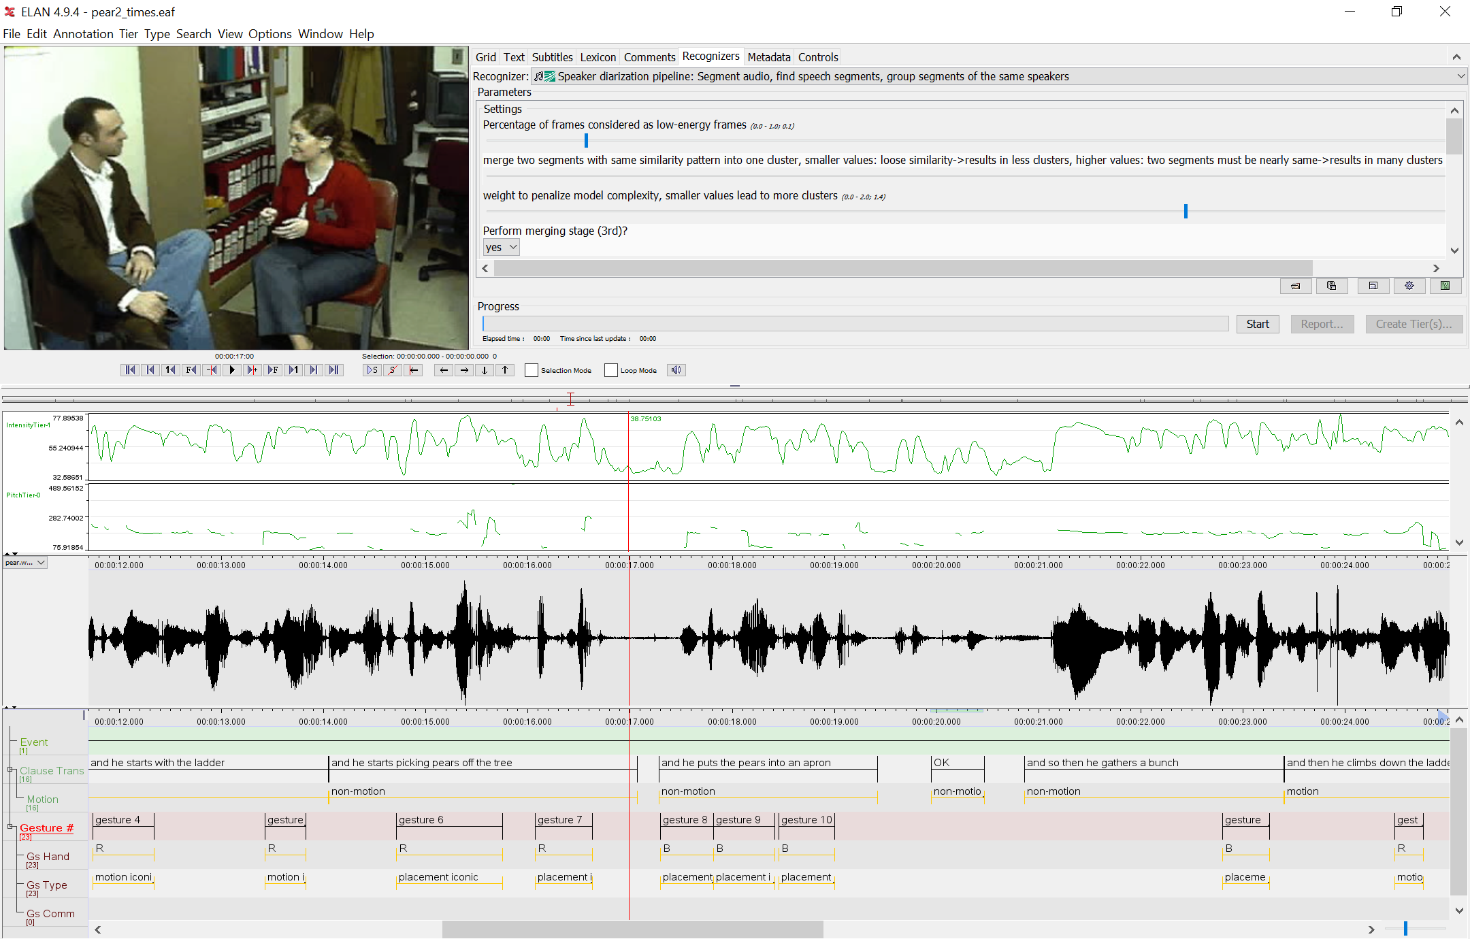
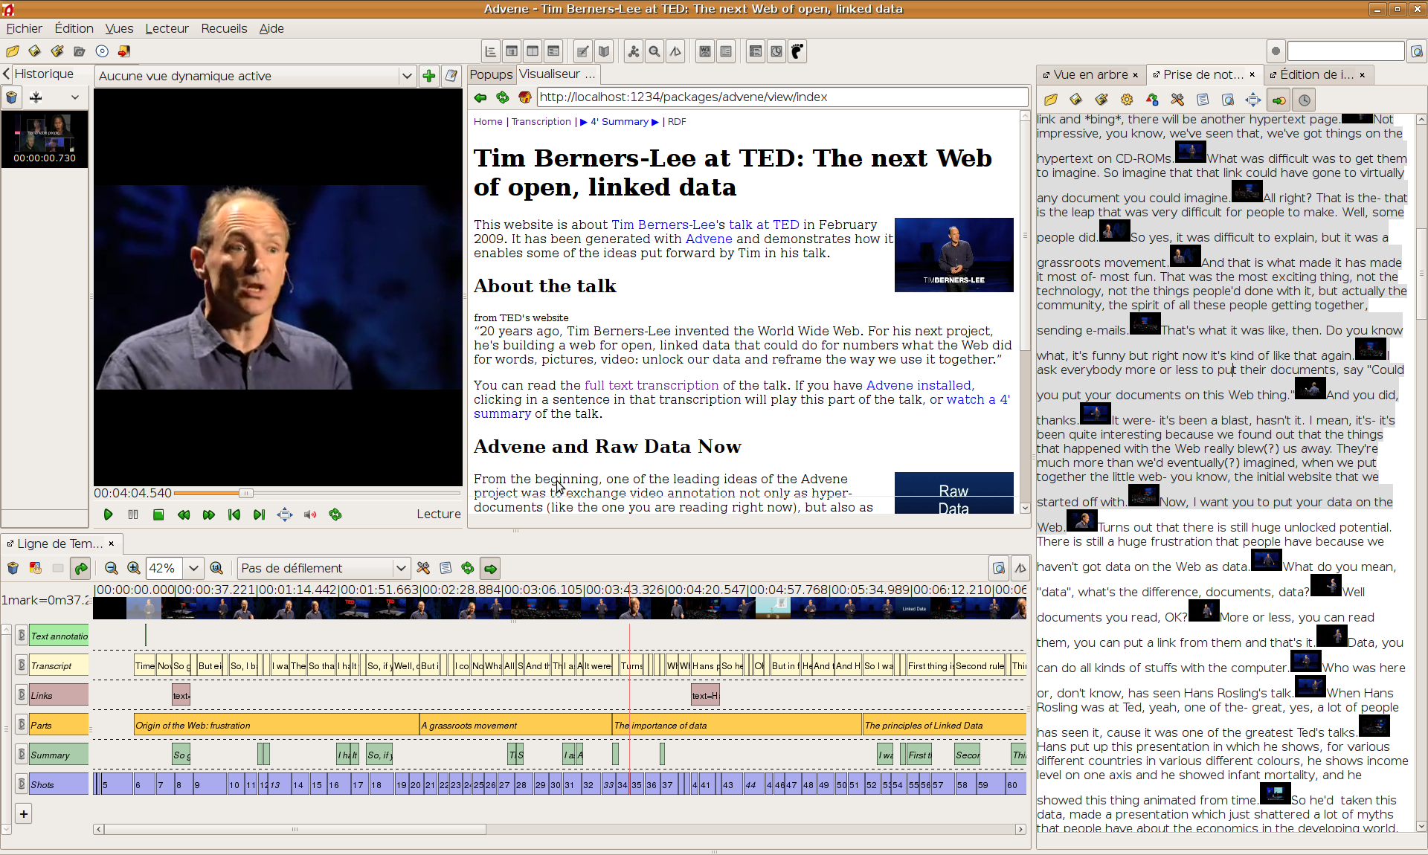
Indexing Approaches
Oral History Digital Indexing (OHDI)
Indexing digitally using media time codes
A variety of tools, methods, and workflows
Fluid multimedia access within and across collections
Notes:
OHDI

Slide 14
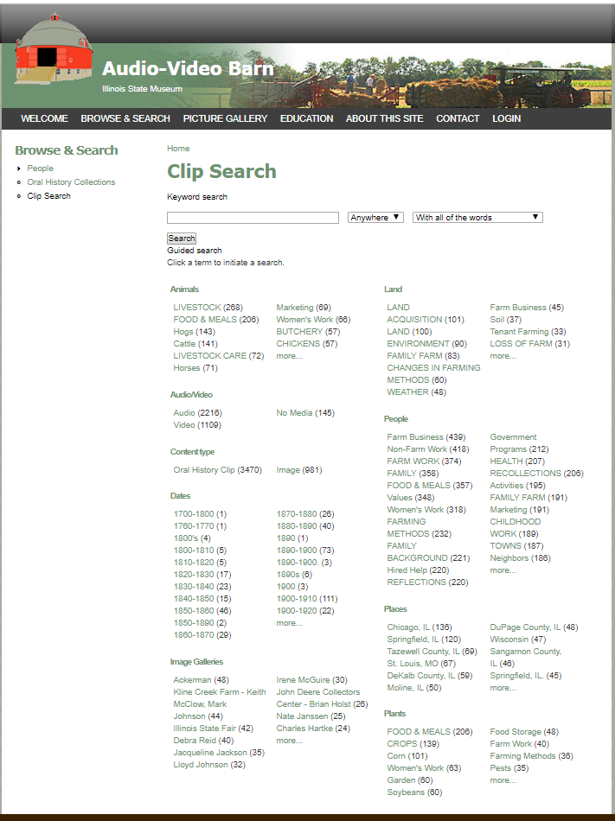
Indexing Approaches
Indexing with code frames
(controlled vocabulary)
Notes:
Portal to the content via meaningful CV terms…because users do not know what is in a collection.
Like an index in the back of a book.

Slide 15
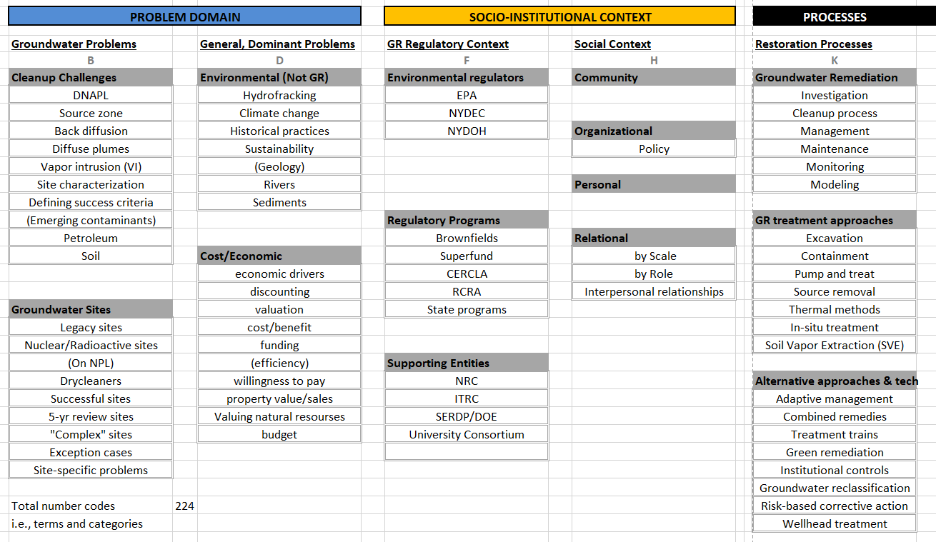
Indexing Approaches
Indexing with code frames
for interdisciplinary research…
Notes:
Codes from an interdisciplinary oral history project studying persistent environmental problems (groundwater contamination)

Slide 16
Indexing Approaches
Indexing can be a platform for decision-making about a collection over time, for researchers or collection stewards.
Notes:
Elaborating…
-Historically, transcriptions were the primary document for working with OH.
-Digital tools opened the possibility for linking media and text directly.
-Digital environments put a new emphasis on listening to original recordings, and distributing them online.

Slide 17
Linear Media Processing
Interview Recordings
Full Text Representation
Transcription

Slide 18
Non-Linear Model for OH Access
eBook
Pedagogy
Research
Book
Research
Book
Index
Web Interface
Interview Recordings
Film
Timecode Metadata
Research
Research
Classroom
Research
Full
Transcription
Set
Notes:
What OHDI leads to… non-linear model allowing layers of analysis, meaning, research over time
Transcription is always an option.

Slide 19
Challenge in Luxembourg
…encountered a more research-driven model for OH in Europe (Lux, Netherlands)
Curating, archiving, and publishing recordings online is not necessarily expected or assumed.
In Digital Humanities, research based on text corpora require transcripts

Slide 20
Interview Recordings
Digital Humanities context
ASR?
Automatic Speech
Recognition
Topic Modeling
Machine Translation
Full
Transcription
Set
Named Entity Recognition
Sentiment Analysis
Automatic Indexing
Notes:
Transcription as an independent workflow. ASR may be helpful, or essential on a big project.

Slide 21
The Luxembourgish Oral History Initiative
The Luxembourgish Oral History Initiative
Evaluation of options and opportunities for C2DH for expanding
collection, accessibility, research potential, and public distribution
of recorded interviews
Notes:
Another C2DH project running concurrently and cooperatively with ORATOR

Slide 22
The Luxembourgish Oral History Initiative
The Luxembourgish Oral History Initiative
Content Collection
Archive and Enliven
Research theory
Tools
Library
Notes:
Another C2DH project running concurrently and cooperatively with ORATOR

Slide 23
Thank you!
Douglas LAMBERT
douglas.lambert@uni.lu

