Slide 2

Bringing Digital Oral History to Luxembourg
Douglas Lambert

Slide 3
Overview
Background
Oral History Digital Indexing (OHDI)
The Luxembourgish Oral History Initiative

Slide 4
Background
Background
Oral History
Frisch & Interclipper

Slide 5
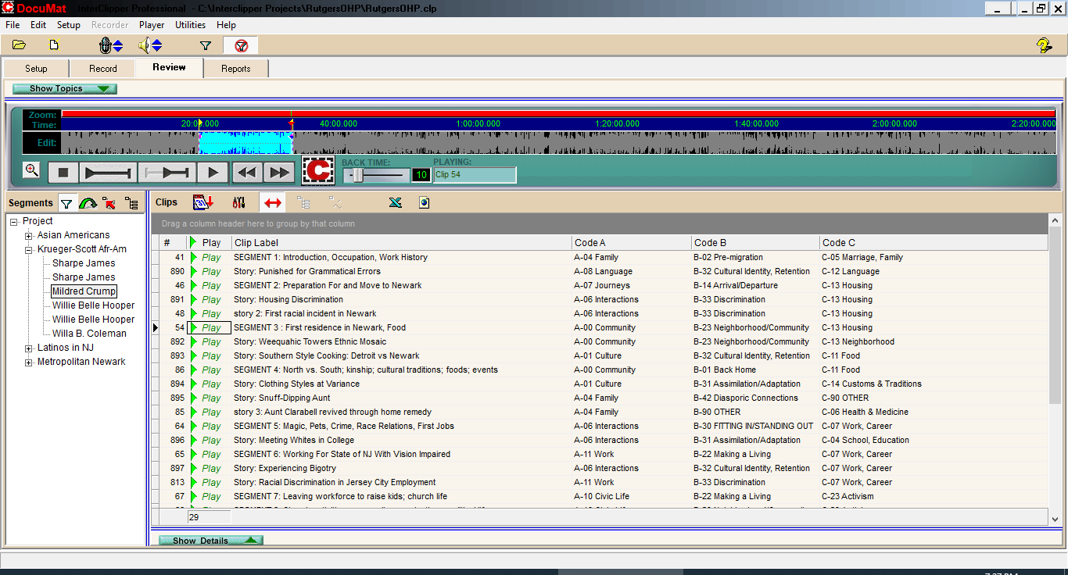
Background
Interclipper

Slide 6
Background
Background
Oral History
Frisch & Interclipper
Randforce & Me

Slide 7
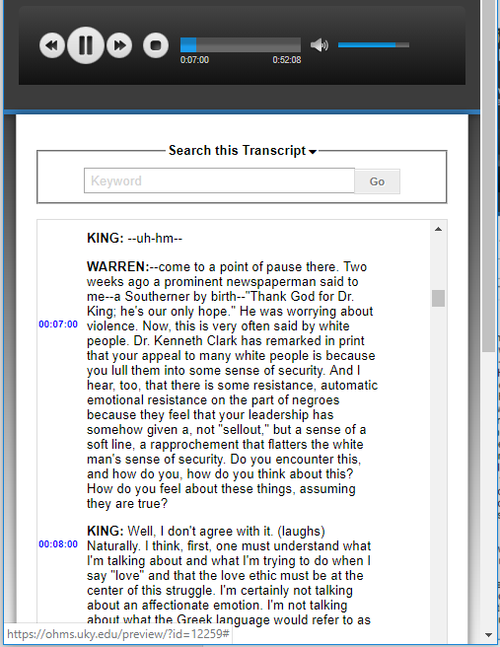
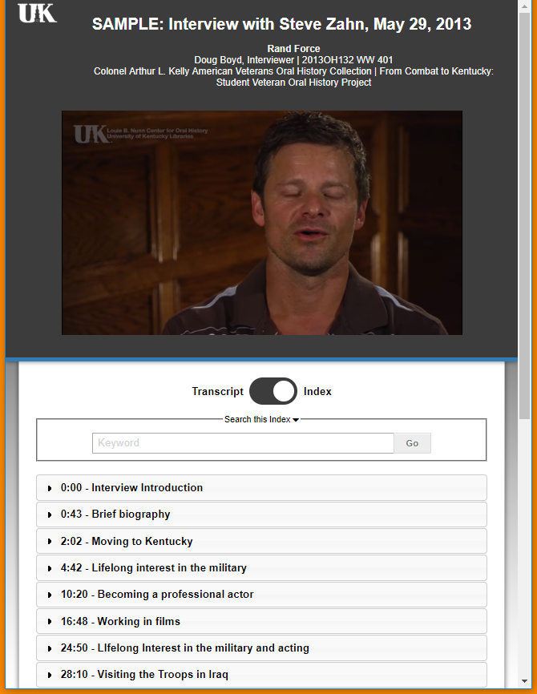

Oral History Digital Indexing (OHDI)
Timecode Indexing

Slide 8
Oral History Digital Indexing (OHDI)
Timecode Indexing
Annotation before transcription
Indexing with code frames

Slide 9
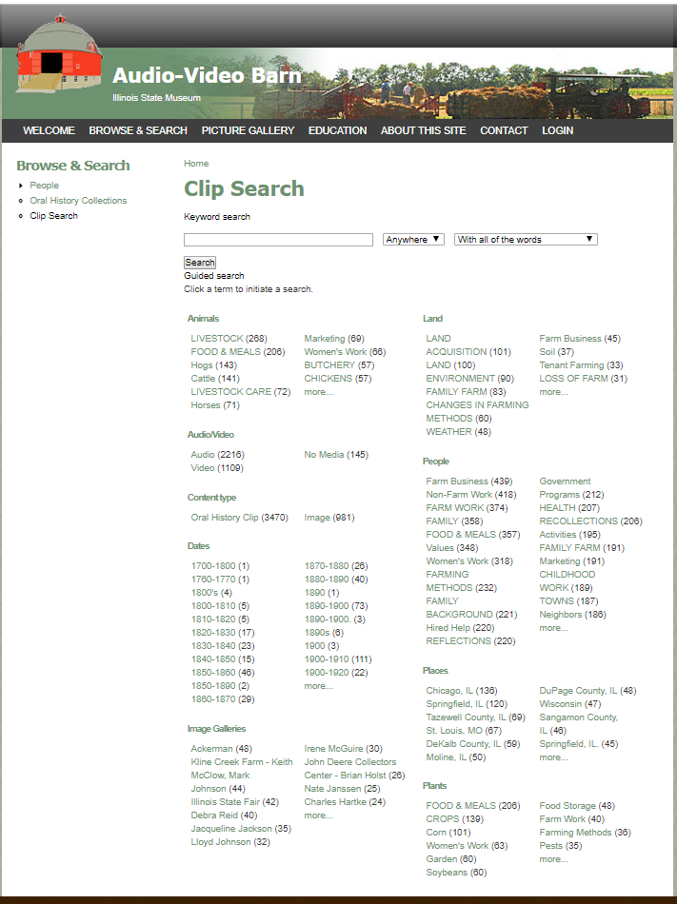
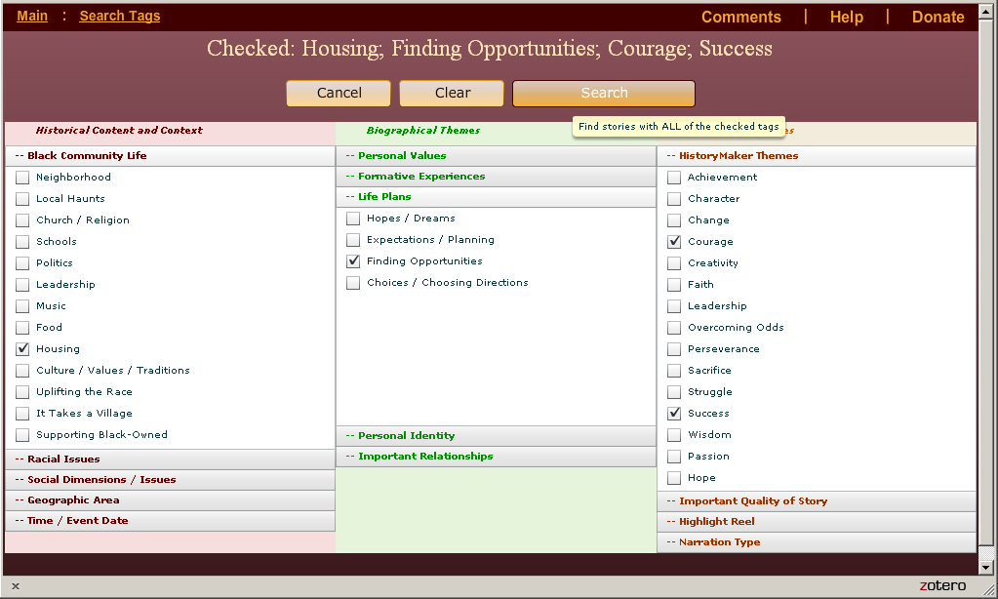
Oral History Digital Indexing (OHDI)
Code frames
Notes:
…because users do not know what we have

Slide 10
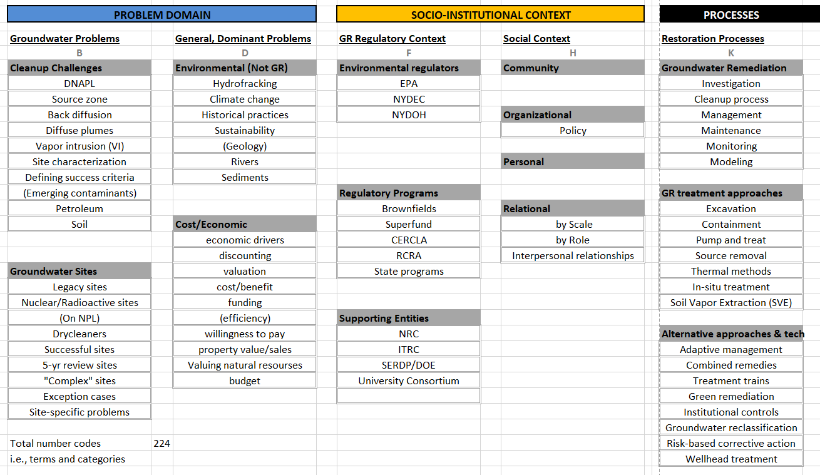
Oral History Digital Indexing
Code frames for interdisciplinary research…
Notes:
…when we need to find what we have.

Slide 11
Oral History Digital Indexing (OHDI)
Timecode Indexing
Annotation before transcription
Indexing with code frames
Indexing logic…

Slide 12
Linear Media Processing
Interview Recordings
Full Text Representation
Transcription

Slide 13
Non-Linear Model
Index
Interview Recordings
Timecode Metadata

Slide 14
Non-Linear Model
eBook
Pedagogy
Research
Book
Research
Book
Index
Web Interface
Interview Recordings
Film
Timecode Metadata
Research
Research
Classroom
Research
Full
Transcription
Set

Slide 15
Interview Recordings
ASR?
Topic Modeling
Machine Translation
Full
Transcription
Set
Named Entity Recognition
Sentiment Analysis
Automatic Indexing

Slide 16
The Luxembourgish Oral History Initiative
The Luxembourgish Oral History Initiative
Evaluation of options and opportunities for C2DH for expanding
collection, accessibility, research potential, and public distribution
of recorded interviews
Model

Slide 17
Oral History Conceptual Model
Organizing OH activities
Project scope
Small to Big
Examples
Notes:
Me background, role, whz oral historz, def of oral historz

Slide 18
Definitions
Collection
Curation
Dissemination
Full a/v interviews, digitized
Text representation of a/v content
Outputs
Notes:
Collection : InterviewER notes are important
Curation : optimized for an intended audience
Dissemination : Digital Archive, Exhibits, Podcasts, Films, Social Networks, OHMS websites,

Slide 19
Project Elements
Collection
Curation
Dissemination
Existing material
Transcription
Research
New Recordings
Indexing
Public consumption

Slide 20
Focus: Text Analysis
Collection
Curation
Dissemination
Existing material
Transcription
Research
New Recordings
Indexing
Public consumption

Slide 21
Focus: Low cost, High impact
Collection
Curation
Dissemination
Existing material
Transcription
Research
New Recordings
Indexing
Public consumption

Slide 22
Focus: Comprehensive
Collection
Curation
Dissemination
Existing material
Transcription
Research
New Recordings
Indexing
Public consumption

Slide 23
User Interfaces / Software Tools
Collection
Curation
Dissemination
Digitization
Existing material
Transcription
Research
Editing
Timecode
New Recordings
Indexing
Public consumption

Slide 24
User Interfaces / Software Tools
Collection
Curation
Dissemination
Digitization
Transcript Repository
Existing material
Transcription
Research
Editing
Timecode
OHMS
New Recordings
Indexing
Public consumption

Slide 25
Oral History Conceptual Model : Technology
Collection
Curation
Dissemination
Full Interviews digital
Text Representation
Outputs
Digitization
HQ audio affordable
HQ video
Speaker/shot change det.
Timecode indexing
ASR transcriptions
Transcript time-synch
Machine translation
Open source CMSs
Online distribution
Multimedia platforms
Text analyses
Topic modeling
Automatic indexing
Named Entity Recognition
Sentiment analysis

Slide 26
Oral History Conceptual Model : Challenges
Collection
Curation
Dissemination
Full Interviews digital
Text Representation
Outputs
Legal/Ethical issues
Metadata management
in CMS
Maintaining / Preserving

Slide 27

Thank you!
douglas.lambert@uni.lu

