Slide 1

D
Four Jewish stateless families between the millstones of Luxembourg authorities
Jakub Bronec / Marc Gloden / Denis Scuto

Slide 2
Luxembourg State policy towards Jews, 1930s-1950s
Main source: more than 1.600 individual and family files of the Police des étrangers in Luxembourg
(Archives nationales de Luxembourg,
Fonds Ministère de la Justice, MJPet)

Slide 3
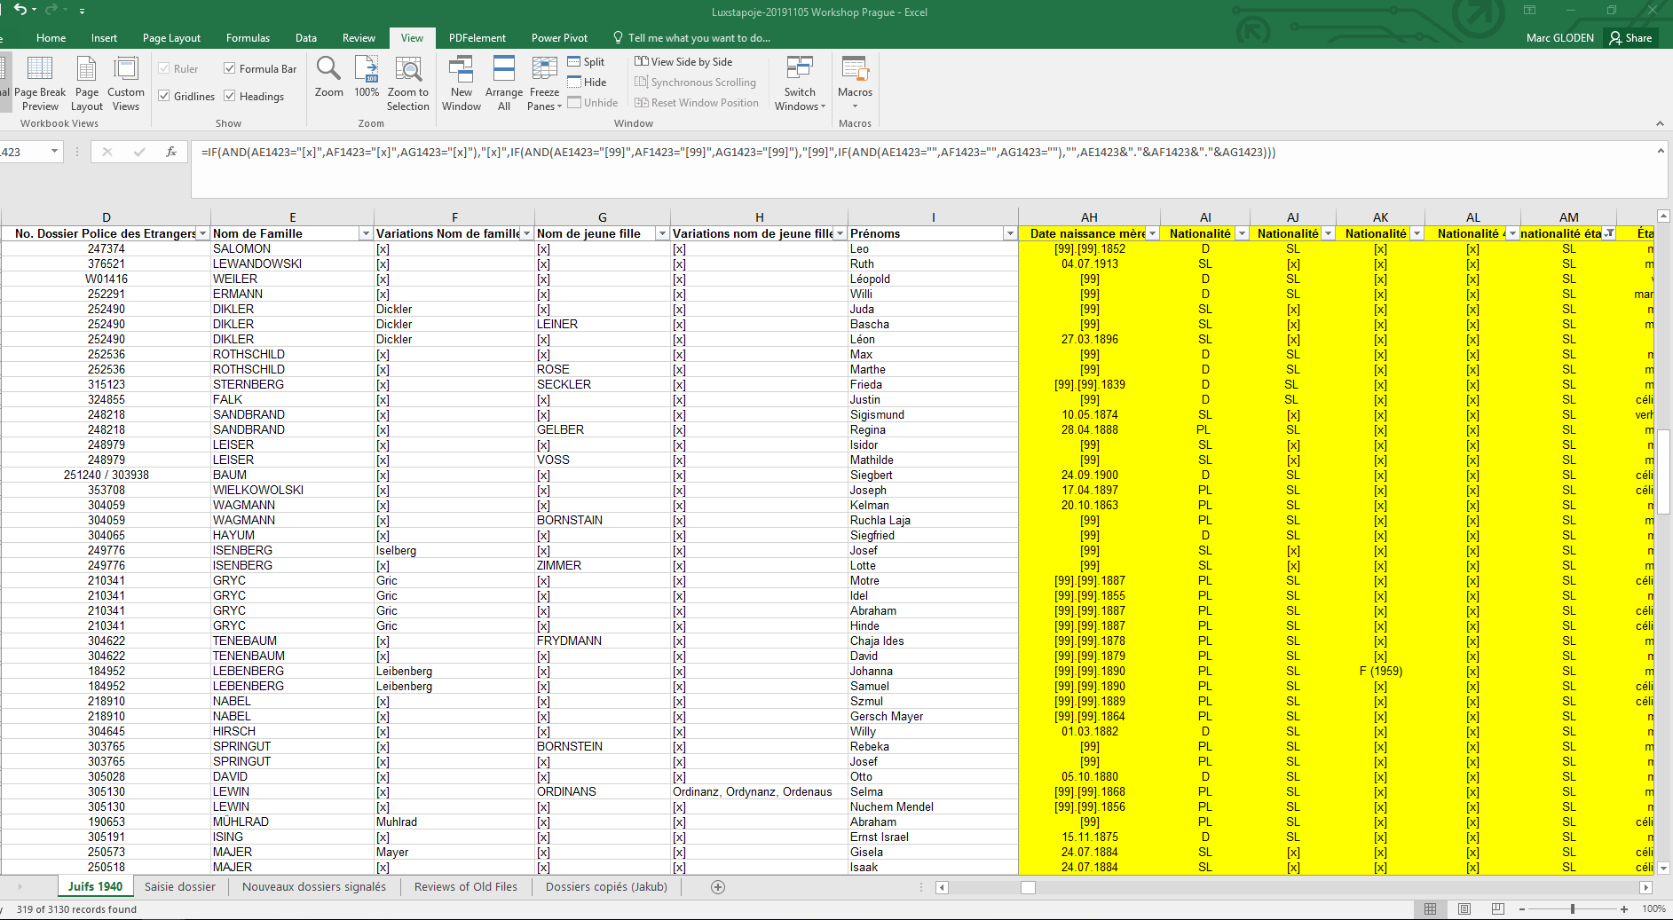
The Database of the project ‘Luxstapoje’
One aim of data collection: establish the citizenship of the immigrated ‘Jews’ and their changing nationalities during their stay in Luxembourg

Slide 4
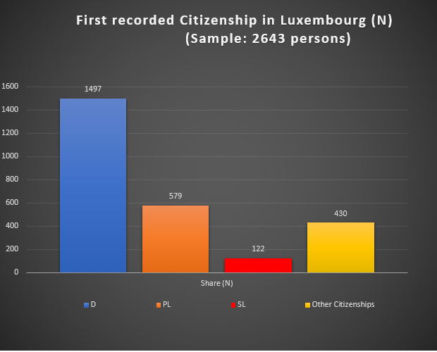
Immigrated ‘Jews’ before 1940
Immigration of stateless persons was not a ‘mass’ phenomenon:
122 people (5 %) were stateless when they were first recorded in Luxembourg

Slide 5
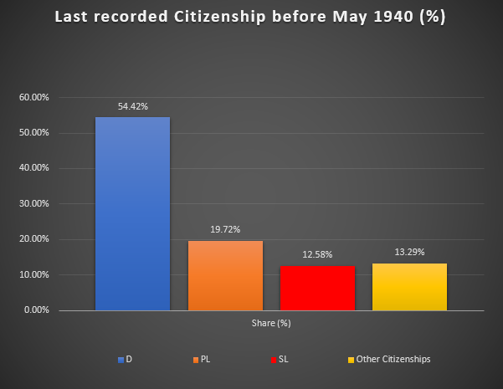
Immigrated ‘Jews’ before 1940
At the eve of war, more than 12% of Luxembourg’s Jews were stateless

Slide 6
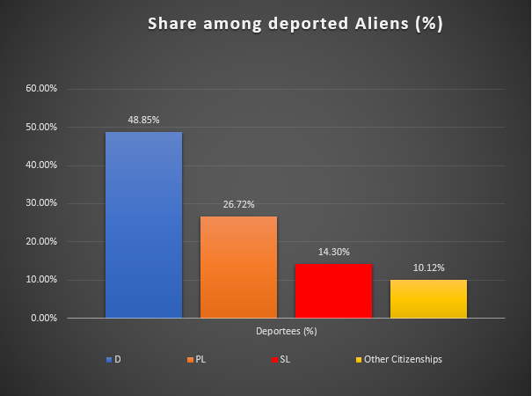
Deported alien ‘Jews’
Compared to the 12% of stateless persons on the eve of war, the proportion of deported stateless persons has been slightly, but not significantly higher

Slide 7
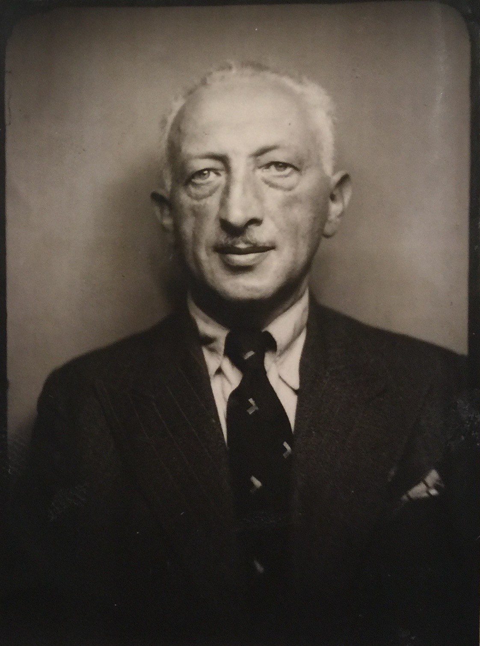
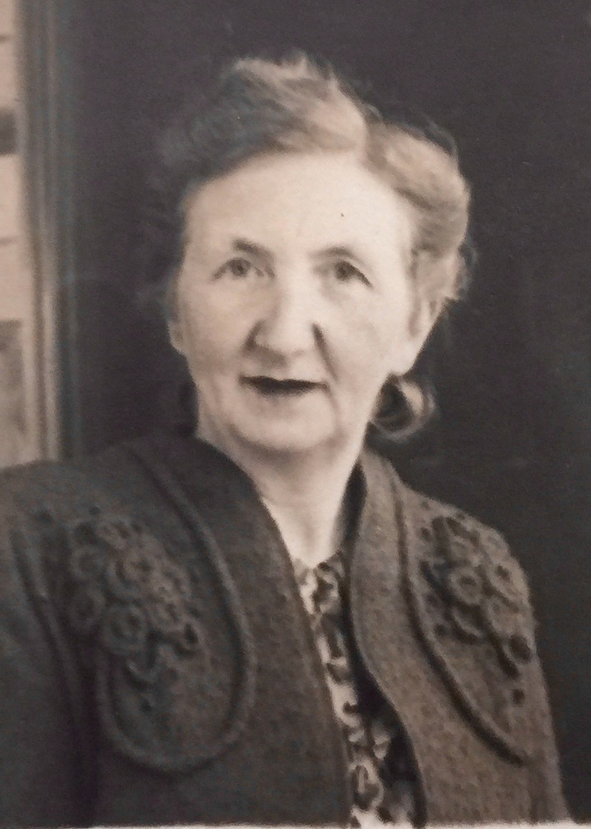
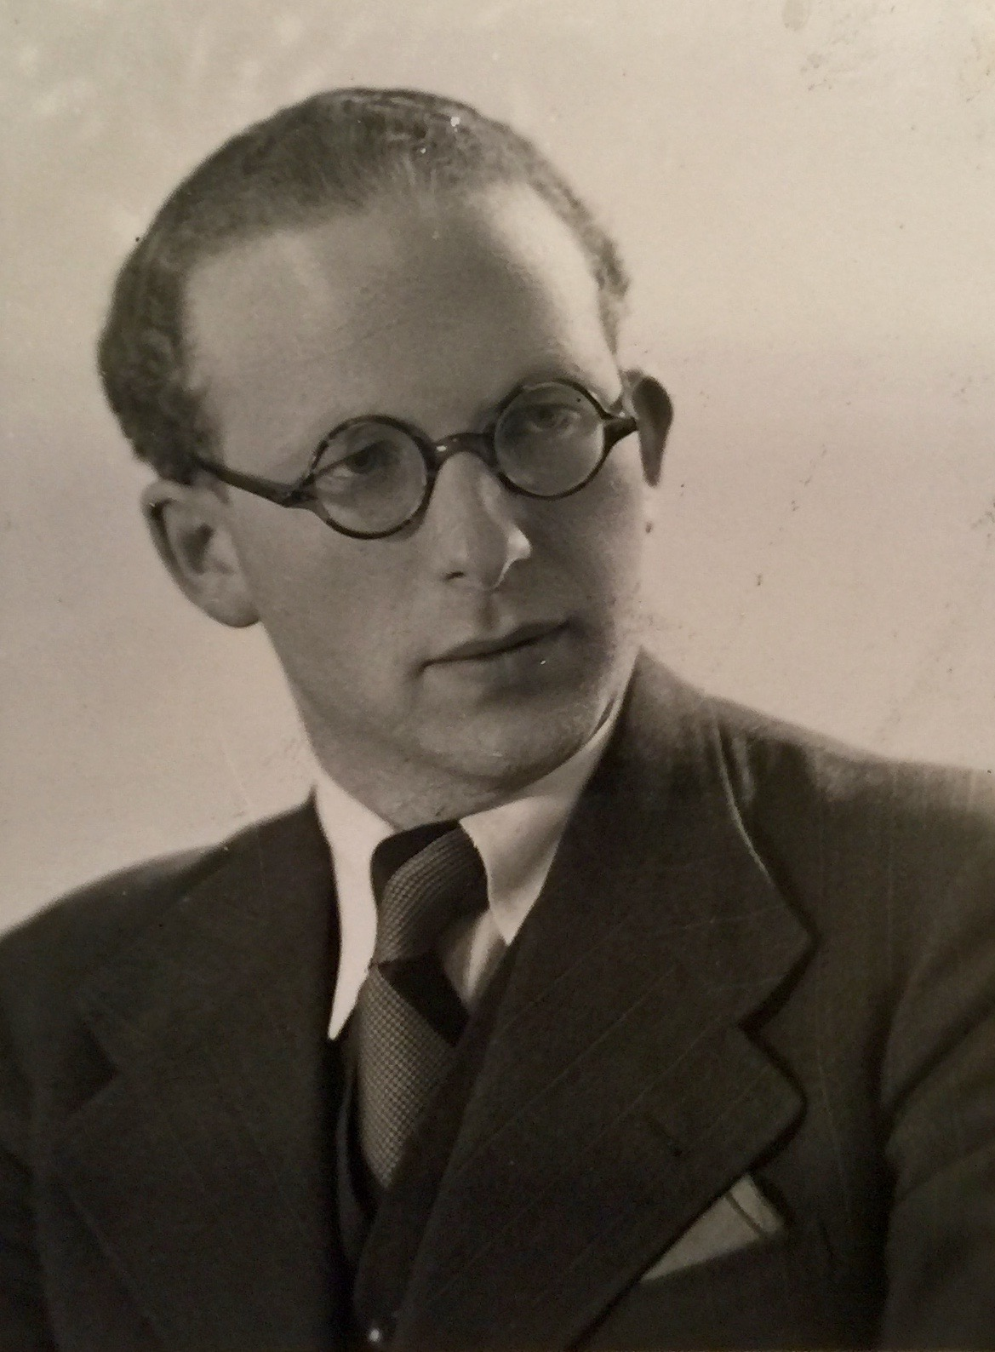
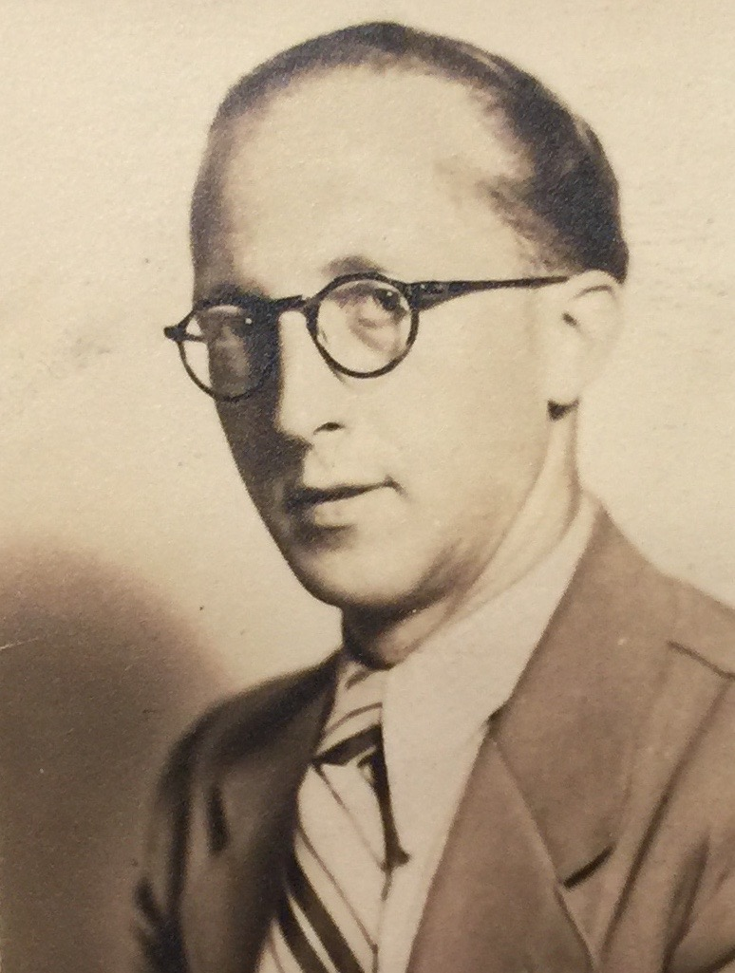
The Springut-Bornstein Family
Joseph Springut in 1940
(Archives Générales du Royaume, Bruxelles, Police des Etrangers,
A 138.432)
Regina Bornstein in 1940
(AGR, Police des Etrangers, A 138.432)
Willy Springut in 1940
(AGR, Police des Etrangers, A 200.243)
Arthur Springut in 1940
(AGR, Police des Etrangers, A 325.553)

Slide 8
Report Brigadier Sûreté Schott about Arthur Springut, 7.11.1939
(ANLux, MJPet, 222556)
(Source:
ANLux, MJPet,
222556)

Slide 9
The Nussbaum-Kleinberg Family
Gustave Nussbaum Helena Kleinberg
(*Baranow/A(?) 1867) (*Metz/F 1869)
Albert (*Monneren/F 1898)
Johanna (*Monneren/F 1900)
René (*Monneren/F 1901)
Madeleine (*Differdange/L 1907)
Martha (*Differdange/L 1907)

Slide 10
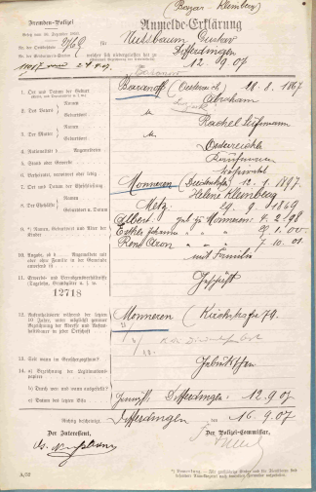
Gustav Nussbaum
Citizenship in 1907
(ANLux, Police des étrangers, 307224)

Slide 11
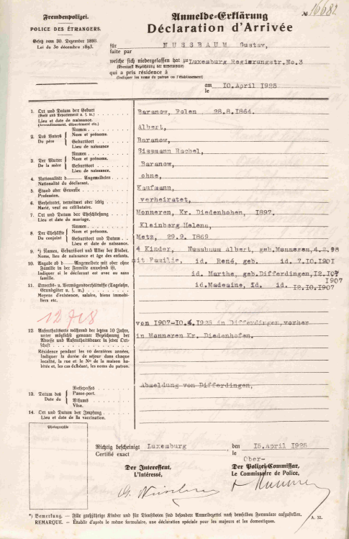
Gustav Nussbaum
Citizenship in 1925
(ANLux, Police des
étrangers, 307224)

Slide 12
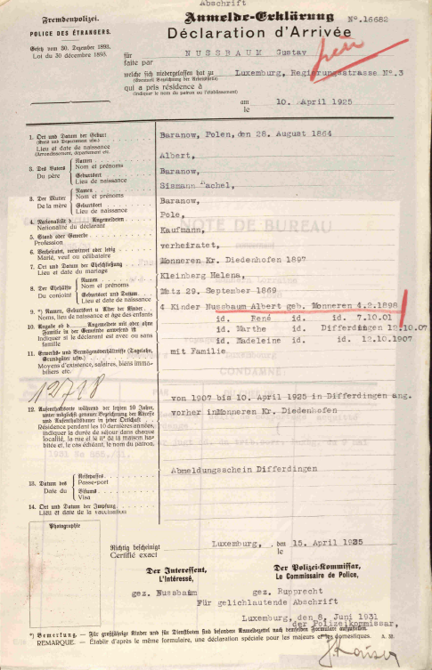
Gustav Nussbaum
Citizenship in 1925 (copy)
(ANLux, Police des
étrangers 307224)

Slide 13
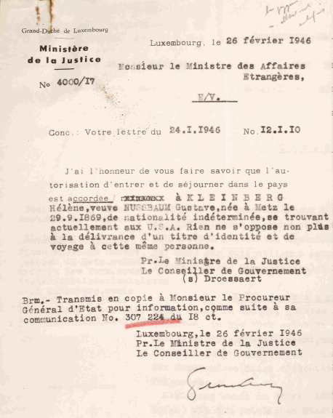
Helena Kleinberg
Settlement authorization in 1946
(ANLux, Police des
étrangers 307224)

Slide 14
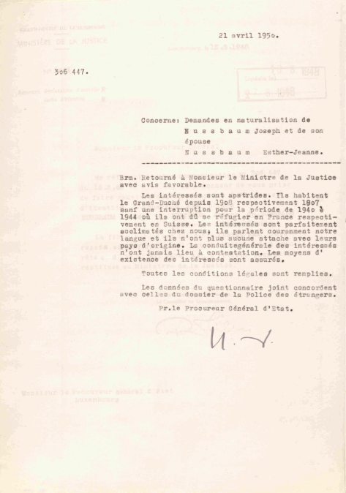
Jeanne Nussbaum
Naturalization approved in 1950
(ANLux, Police des
étrangers 306447)

Slide 15
Hope in the Dominican Republic
The convoy of 293 mostly stateless Jews, many holding a visa for the United States, Brazil, Cuba or for the Dominican Republic, had left Luxembourg for Portugal on November 7, 1940.
A first family of refugees with a connection to Luxembourg is found on passenger lists arriving in the Dominican Republic on August 19, 1940:

Slide 16
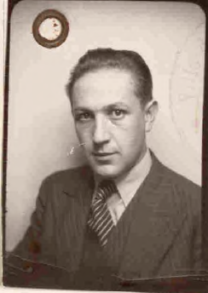
Emigrants to San Domingo:
Mayer Julius
Mayer Julius (3. 3. 1911), a driver from Echternach married to Levy Greta
He was deprived of German citizenship by the discharge certificate in1934 during his stay in Hoffenheim and he did not accept any other citizenship during his stay there.
„I have only the invalid passeport and as a car dealer I must travel a lot.“
Mayer paid taxes regularly and his behavior is both morally and politically correct.
München 1925-1928 / Mannheim 1928-1929 / Hoffenheim 1929-1933/Echternach 1934-
He emigrated to Santo Domingo and USA in 1940-1941 and came back to Luxembourg in 1946.
(ANLux, Police des étrangers, 314656)

Slide 17
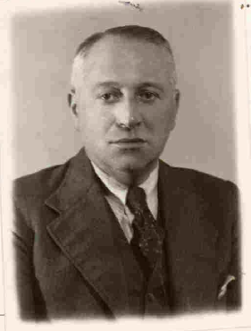
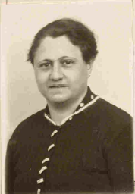
Emigrants to San Domingo:
Siegfried Salomon
Siegfried Salomon set up flourishing business in the company Bonalux.
He tried, without success, to redeem his nephew from the concentration camp Mauthausen by getting him to Luxembourg:
“I regret to inform you that your application can not be accepted. As a result of the excessive influx of foreigners to Grand Duchy, our country got upon its limit for accepting emigrants. It is up to larger countries to provide you asylum.“
Siegfried emigrated to Santo Domingo and the States and didn‘t come back.
(ANLux, Police des étrangers, 238702)

Slide 18



Stay connected with us!
@C2DH_LU
https://www.facebook.com/c2dh.lu/
www.c2dh.uni.lu

