Slide 1
Erasmus + - FamilySchool
Getting involved at preschool child’s schooling: the influence of parental role construction and parents’ sense of efficacy
Luxembourg
Débora Poncelet, Mélanie Tinnes-Vigne, Sylvie Kerger & Christophe Dierendonck
University of Luxembourg

Slide 2
Outline of the presentation
Theoretical framework
  School-family relationship and parental involvement
  Parents’ role construction and Parental self-efficacy
Methodology of MathPlay research
Main results
Discussion

Slide 3
Theoretical framework

Slide 4
School-Family relationship and
Parental involvement

Slide 5
School-family relationship and Parental involvement
Research highlights positive relationships between parental involvement and :
  School performance
  Motivation and school involvement
  Well-being
  School behaviour
  (Hoover-Dempsey, Battiato, Walker, Reed, DeJong & Jones, 2001 ; Gonzalez-Dehass Willems & Holbein, 2005 ; Izzo, Weissberg, Kasprow & Fendrich, 1999 ; Fan, 2001 ; Fantuzzo, McWayne, Perry & Childs, 2004 ; Singh, Bikley, Keith, Keith, Trivette & Anderson, 1995 ; Sui-Chu & Willms, 1996 ; Tam & Chan, 2009 ; Tan & Goldberg, 2009)
Meta-analysis (Henderson & Mapp, 2002) regarding school-family relationships and parental involvement indicates that :
  parental involvement in school is as important as what parents do and set up at home to support their children in their schooling
  and this, whatever the economic, social and cultural origin of these families.

Slide 6
School-family relationship and Parental involvement
Important results from the meta-analysis
↓
Students whose parents are involved in their education both at home and at school
are more likely to get better results,
are less likely to absenteeism,
develop better social skills,
adopt better behaviors,
and adapt better to school.
↓
So, it could really promote students’ school persistence

Slide 7
School-family relationship and Parental involvement
Importance and need to think about how ...
... to bring parents and professionals to contact and dialogue around what may be a shared understanding of the socio-educational environment
Reduce the distance between school and families,
Especially when families are from disadvantaged backgrounds.
  For a positive impact on children in terms of performance and attitudes and
  But also, for a positive impact on parents with, among other things,
  Better understanding of parental role construction regarding school work and
  Greater sense of parental self-efficacy regarding support they can give to their children about schoolwork

Slide 8
School-family relationship and Parental involvement
(Hoover-Dempsey and colleagues, 1995, 1997, 2005, 2007)
Why do parents become involved in children’s education?
What do they do when they are involved (i.e., what mechanisms of influence do they engage when they are involved)?
How does their involvement, once engaged, influence student outcomes?
School-Family-Community Relationship
Parental Involvement

Slide 9
Parents’ role construction and
Parental self-efficacy

Slide 10
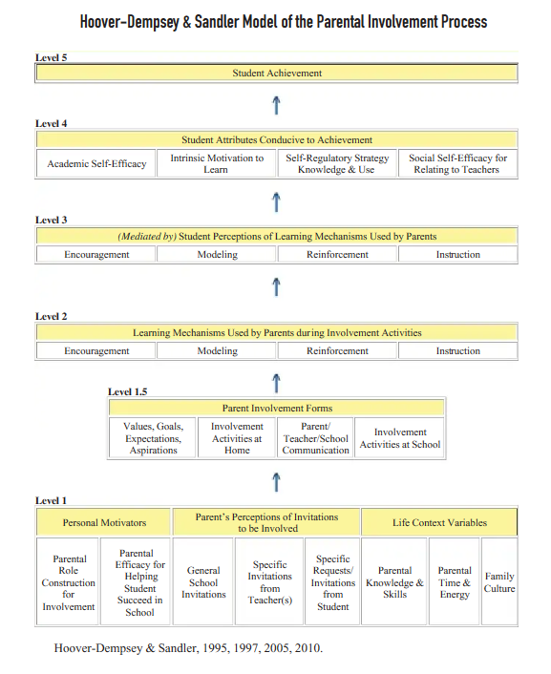
Hoover-Dempsey and Sandler’s (1995, 1997, 2005, 2007) model of the parental involvement process

Slide 11
Parents' Construction of the Parental Role
Parental role construction for involvement includes parents’ beliefs about what they should do in relation to their children’s education.
Influenced by parents’ beliefs regarding :
  Child’s education and
  Educational support (at school and at home) that seems appropriate
Also influenced by :
  Groups wherein parents have relationships : family, school, work place
    For example, if school ask few parental involvement, parents will be likely less involved in their child’s education (Deslandes, 2004).
Parents would therefore be more likely to be involved in their child's education if they consider this involvement as an integral part of their parenting role.

Slide 12
Parents' Construction of the Parental Role
The parent's understanding of their parenting role will determine the kind of activities he or she considers as important for their child's education.
In addition, a parent who develops an active vision of their parenting role would tend to be more involved in their child's education than a parent who has a more passive vision of his or her role (Green, Walker, Hoover-Dempsey & Sandler, 2007).

Slide 13
Parents' Sense of Efficacy for Helping Child(ren) Succeed in School
Parental sense of efficacy includes parents’ beliefs about their personal ability to make a difference in the child’s educational outcomes through their involvement.
This dimension refers to Bandura's sociocognitive theory
  Who is confident in his/her ability to solve a specific task is more willing to commit to it than if he/she negatively assesses his/her chances of success.
"Applied to parental participation, such a statement means that parents decide to engage if they believe they have the skills and knowledge to help, support or teach their child or can find additional resources if necessary. These parents believe that their interventions will help increase their child's learning and academic performance" (Deslandes, 2004, p.4).

Slide 14
Methodology

Slide 15
MathPlay research
The MathPlay research project:
aims at developing the first numerical competencies (counting, storage capacity and comparison of quantities, addition, composition and decomposition)
of preschool children (aged 4 to 5 years)
through an play-based approach intervention
Both in schools and at home.

Slide 16
Study objective
Develop and measure the effects of an intervention:
aimed at teaching a set of mathematical competencies (number and operations)
intentionally and planned through a play-based approach (informally) (Ramani & Siegler, 2014; Starkey et al., 2004; Scalise et al., 2017)
implemented in the classroom by the teacher (Codding et al., 2011; VanDerHeyden, Witt, & Gilbertson, 2007)
and offered to parents in the family context -> coeducation
because intercultural games, easily reproducible (Dillon et al., 2017; Scalise et al., 2017)
bring school and family closer and enhance parental involvement (Cannon & Ginsburg, 2008).

Slide 17

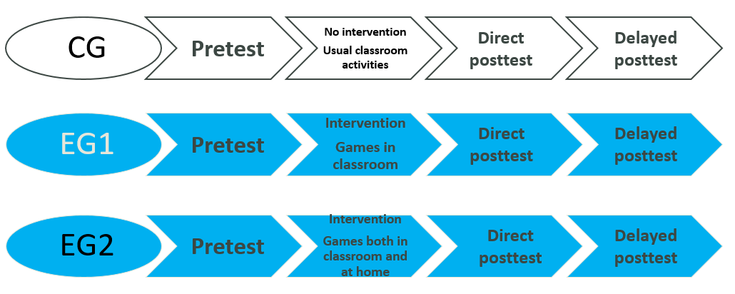
Experimental plan
4 partner countries -> implemantation of intervention in mirror
Experimental group (EG) -> 2 conditions of treatment
    EG1 – games at school – 4 classes (N = 72)
    EG2 – games in schools and at home – 7 classes (N = 87)
    Control group (CG) – 4 classes
For Luxembourg
Parent questionnaire
Parent questionnaire

Slide 18

Experimental plan
8-week intervention
Implementation by teachers themselves
Teachers benefited from a 20-hour professional development program on the following two themes:
    the development of the first numerical competencies through a play-based approach
    school-family relationship and parental involvement

Slide 19

Experimental plan
Parents' questionnaire: before intervention
    Collection of socio-demographic data + Collection of family beliefs and practices related to numeracy
    Return of 63% (// 569 children) -> under-representation of children with low skills
Communication booklet
    Bidirectional communication tool
    Compilation of the implementation of the "family games" scheme
    Frequency of games per week -> occurrence of games equal to or greater than 2X/week.
    Difficulties encountered, pleasure experienced, with whom the child plays,...
    58% of parents submitted at least 1 notebook during the 8 weeks / 50% submitted between 7 and 8

Slide 20
Measures
Parents' Construction of the Parental Role : 2 dimensions
  Beliefs about the activities specific to his or her role
    Hoover-Dempsey et al. (2005)
    7 items - 6 position agreement Likert scale – α = .77 father / .72 mother
  Beliefs about activities offered at home related to math
    Scale developed by the research team
    3 items – 6 position frequency Likert scale - α = .95 father / .96 mother
Parents' Sense of Efficacy : 2 dimensions
  Parental self-efficacy for helping child succeed in school
    Hoover-Dempsey et al. (2005)
    7 items - 6 position agreement Likert scale – α = .80 father / .85 mother
  Parental self-efficacy in supporting their child in specific activities
    Scale developed by the research team
    3 items – 6 position agreement Likert scale - α = .86 father / .89 mother

Slide 21
Measures
Parental involvement : 4 dimensions (2 -> in schools / 2 -> at home)
  General parenting practices (Home)
    Scale developed by the research team
    7 items - 6 position frequencies Likert scale – α = .74 father / .73 mother
  Numeracy activities (Home)
    Scale developed by the research team
    7 items - 6 position frequencies Likert scale – α = .74 father / .73 mother
  Participation in school and teacher-organized activities (School)
    FIQ questionnaire – Grover, Houlihan & Campana (2016)
    7 items - 6 position frequencies Likert scale – α = .76 father / .72 mother
  Family-School communication (School)
    FIQ questionnaire – Grover, Houlihan & Campana (2016)
    7 items - 6 position frequencies Likert scale – α = .92 father / .89 mother

Slide 22
Research question
  What is the influence of psychological determinants and more particularly, the motivational beliefs (parental role construction and parents' sense of efficacy) on the parents’ decision to be involved in their child’s schooling (Hoover-Dempsey et al., 1995, 1997, 2005) ?
  Linear regression
  Regression analysis try to estimate the relationships between :
    a dependent variables (here : parental involvement)
    and one or more independent variables (often called 'predictors’)
      parents’ motivational beliefs
      family background variables - home-speaking language, SSE, child’s gender.

Slide 23
Main results

Slide 24
Regression analysis
General parenting practices (Home) -> two predictors (18% explained variance)
    Home-speaking language : β = 0.183, p = 0.038
    Child’s gender : β = 0.166, p = 0.038
  All other things being equal, general practices seem to be more frequent in families where :
    Luxembourgish is not the main home-speaking language
    The child is a girl.
Numeracy activities (Home) -> two predictors (20% explained variance)
    Home-speaking language : β = -0.205, p = 0.20
    Parental self-efficacy for helping child succeed in school : β = 0.263, p = 0.007
  All other things being equal, numeracy activities seem to be more frequent in families where :
    Luxembourgish is the main home-speaking language
    The parental self-efficacy for helping child succeed in school is the highest

Slide 25
Regression analysis
Participation in school and teacher-organized activities (School) -> two predictors (17% explained variance)
    Child’s gender : β = -0.173, p = 0.032
    Parents’ construction of the parental role: β = 0.295, p = 0.001
  All other things being equal, parental participation seems to be more frequent in families where :
    The child is a girl.
    Parents have a more active vision regarding their educational role.
  Family-School communication (School) -> two predictors (14% explained variance)
    SSE : β = -0.204, p = 0.26
    Parents’ construction of the parental role: β = 0.248, p = 0.008
  All other things being equal, numeracy activities seem to be more frequent in families where :
    SSE is the lowest
    Parents have a more active vision regarding their educational role.

Slide 26
Discussion

Slide 27
Discussion
First, we point out the positive and significant influence of parents' construction of their educational role on parental involvement in school through its two dimensions: participation in activities and communication.
It would seem that parents need to understand that parental participation in school is part of their responsibilities before deciding to get involved.
It should also be noted that these decisions to engage at the school level are not influenced by family background variables, SSE and home-speaking language.

Slide 28
Discussion
Second, we note that parental self-efficacy for helping child succeed in school is part of the explanation for the frequency with which parents offer informal mathematical activities.
This trend is reported to be most prevalent among non-Luxembourgish-speaking parents.

Slide 29
Discussion
  These observations are both in favor of recommendations to schools and teachers :
  to support parents,
  whatever their socio-economic and cultural background,
  in building their educational role but also
  in strengthening their self-efficacy
  in order to support them to get involved in their child’s school education.

Slide 30
Thanks for your attention

