Slide 1
Academic writing across languages
Dr. Birgit Huemer
Université du Luxembourg
birgit.huemer@uni.lu

Slide 2
Content
Historical development of the languages of academia and science
Equivalence problems between the languages of academia and science

Slide 3
Written academic genres
Students: notes, assigments like essays, protocols, reports etc.
Professional academics: journal articles, conference papers, research proposals etc

Slide 4
Historical development
From Latin to national academic languages in Europe in the 18th and 19th century.

Slide 5
The common language of academia
Terminology ≠ common language of academia

Slide 6
The common language of academia
= Basic lexical inventory of all academic and scientific communication in one language.

Slide 7
The common language of academia
„fundamentalen sprachlichen Mittel […], derer sich die meisten Wissenschaften [Disziplinen] gleich oder ähnlich bedienen.“
Ehlich (1993: 33)
“fundamental linguistic means [...] which most disciplines use in the same or a similar way.”

Slide 8
Academic language use
Le français scientific (est) en chute libre
Das Französisch (ist) als Wissenschaftssprache im freien Fall
French as academic language (is) in free fall
Ammon (1998)

Slide 9
Each academic language has developed specialised
text structure
syntax
lexis
idiomatic phrases
practices for intertextual reference
modalisations=hedges

Slide 10
Equivalence problems
lexis and use of idiomatic phrases

Slide 11
Equivalence problems
English
use of words with latin roots
German
use of everyday words, which get new meaning in academic contexts

Slide 12
Equivalence problems
etwas herausarbeiten
etwas beleuchten

Slide 13
Equivalence problems
etwas herausarbeiten
to work out
to carve out

Slide 14
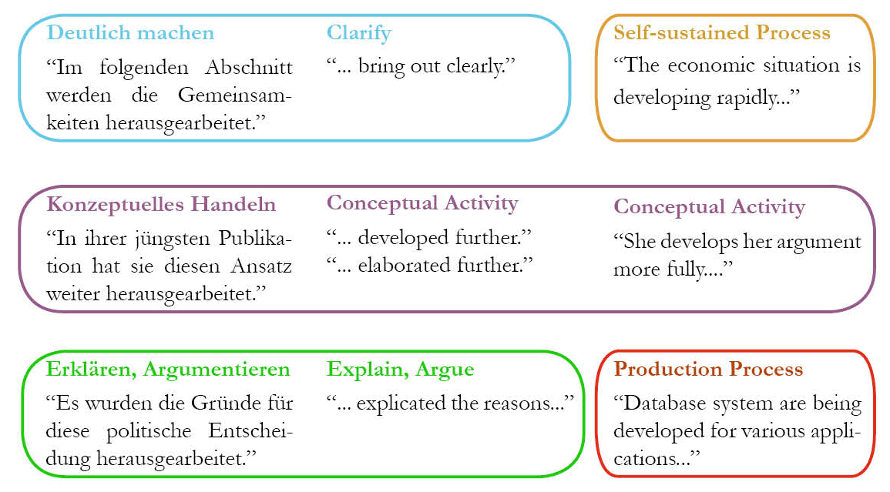
Huemer & Rheindorf 2015

Slide 15
Equivalence problems
Methodisch können zwei Wege beschritten werden…
Im Folgenden stütze ich mich auf die Untersuchung von…

Slide 16
Equivalence problems
Other concepts other ways of thinking

Slide 17
Birgit Huemer, Eve Lejot, Katrien L. B. Deroey (Hg.)
Academic writing across languages: multilingual and contrastive approaches in higher education L’écriture académique à travers les langues : approches multilingues et contrastives dans l’enseignement supérieur Wissenschaftliches Schreiben sprachübergreifend: mehrsprachige und kontrastive Ansätze in der Hochschulbildung

Slide 18
Hedges in academic writing
How authors take position

Slide 19
Hedges in academic writing
to make things fuzzier or less fuzzy
Lakoff (1972: 195)

Slide 20
Hedges
A penguin is sort of a bird
A penguin is a bird
Lakoff 1972

Slide 21
Hedges - Modalisierung
Academics refer to other authors to support their own statement and therefore present the referenced statement in a particularly positive light.
Academics want to distance themselves from a certain statement.
Academics add a degree of uncertainty to the truthfulness of a particular statement in order to make readers aware that certain facts should be further investigated or questioned.
Academics add reinforcement to the truthfulness of a particular statement in order to convince the reader of the accuracy and/or importance of the statement.

Slide 22
Adding Certainty and presenting statement in positive light
Clinical reports proof that it has a calming effect upon patients.
Vold 2019: 85

Slide 23
Taking distance, adding uncertainty
In other words, it seems that what Rieber has in mind is the sort of case in which a communicative act provides Direct evidence for information rather than Indirect evidence.
Vold 2019: 85

Slide 24
Taking distance, adding uncertainty
Quality-of-life data were missing at 1 or more time points in 19% of participants, and we cannot entirely exclude the possibility that differential loss of participants may have affected our results. However, we consider this unlikely because treatment assignment was not significantly different among women with complete vs incomplete data.
Vold 2019: 85

Slide 25
Hedges - Modalisierung
to subjectify statements,
to relativize responsibility for the truthfulness of the statement,
to limit the degree of certainty or doubt as to the validity of a finding,
to avoid absolute statements,
to transfer responsibility for statement content,
to express personal attitudes and to evaluate facts.
Clemen (1998:14)

Slide 26
Linguistic resources
Modal verbs: can, could, may, might, must, shall, should, will, would
Modal adverbs: possibly, unlikely, perhaps, conceivably, definitely,…
Epistemic verbs: proof, consider, believe, assume, suggest, c
Epistemic expressions: it seems that,…It might be suggested that,… it could be the case that,…the sort of case

Slide 27
Language comparison
Studies show that there are considerable cultural differences in the use of these linguistic means in academic texts.
(Vold 2019)
Especially the writing of texts in an L2 seems to cause difficulties in this respect, since it concerns fine linguistic nuances, which one must recognize.
(Rheindorf 2019)

Slide 28
Language comparison
In German academic language many and very differentiated hedges are used. Therefore, German scientists tend to maintain these habits and use too many hedges when writing a academic text in L2.
In this way, they deviate from the standards of other academic cultures, which negatively affect communication and lead to misunderstandings with members of their scientific community.

Slide 29
Ammon, Ulrich (1998). Ist Deutsch noch internationale Wissenschaftssprache? Englisch auch für die Lehre an den deutschsprachigen Hochschulen. Berlin/New York: de Gruyter.
Clemen, Gudrun (1998). Hecken in deutschen und englischen Texten der Wirtschaftskommunikation. Eine kontrastive Analyse. Univ. Dissertation. Siegen.
Ehlich, Konrad (1993). Deutsch als fremde Wissenschaftssprache. Jahrbuch Deutsch als Fremdsprache 19, 13-42
Fandrych, Christian (2002). Herausarbeiten vs. Illustrate: Kontraste bei der Versprachlichung von Sprechhandlungen in der englischen und deutschen Wissenschaftssprache. In Europäische Wissenschaft: Europäische Perspektiven. ed. by Ehlich, K. München.
Gardner, Sheena (2019). Pedagogical insights from contrastive studies of English and Chinese writers in the BAWE corpus. In B. Huemer & E. Lejot, Eve & K. Academic writing across languages: multilingual and contrastive approaches in higher education (= Schreibwissenschaft Band 1). Wien: Böhlau, S. 105-126.
Huemer, Birgit & Rheindorf, Markus (2015). Developing a German-English Dictionary of the Common Language of Academia. Journal of Academic Writing 5(1), 29-41.
Huemer, Birgit & Lejot, Eve & Deroey, Katrien (2019). Academic writing across languages: multilingual and contrastive approaches in higher education (= Schreibwissenschaft Band 1). Wien: Böhlau.
Lakoff, George (1972). Hedges: A Study In Meaning Criteria And The Logic Of Fuzzy Concepts. University of Chicago Press.
Rheindorf, Markus (2019). Doing stance and engagement: Austrian graduate students’ awareness of reporting signal and attitude in German (L1) and English (L2). In B. Huemer & E. Lejot, Eve & K. Academic writing across languages: multilingual and contrastive approaches in higher education (= Schreibwissenschaft Band 1). Wien: Böhlau, S. 209-232.
Vold, Eva (2019). L’atténuation à travers les langues et les disciplines : une approche plurilingue et interculturelle pour enseigner la rédaction scientifique dans des contextes multiculturels. In B. Huemer & E. Lejot, Eve & K. Academic writing across languages: multilingual and contrastive approaches in higher education (= Schreibwissenschaft Band 1). Wien: Böhlau, S. 79-103.

