Slide 1

Strategies for integrating Digital Humanities skills and practices in the Humanities Curriculum
Susan Aasman (University of Groningen)
Stef Scagliola (University of Luxembourg)

Slide 2
Challenges:
Huge variety of courses, certificates and degrees
Teaching general principles or engaging in specific research?
Variety in disciplines
Attracting students
Consensus about requirements of basic skills
Affordable software (commercial or open source?)
Clean ready to use and uncluttered data collections
Overview of tools often used in DH teaching
Literature and examples of DH research
Customized online environments
E-labs, computer labs, laptops for rent

Slide 3

Hands on
Part I
Defining the challenges
Introducing examples (3 cases: Stef and Susan)
Some more examples (your turn)
Re-defining the challenges (scaling them)
Part II:
Working on solutions in small groups
Presenting possible solutions
Part III:
Conclusions (drawings by Sebastiaan Kohler)
Writing a Manifesto

Slide 4
Case 1: MA Digital Humanities, RUG 2017-18
Week 1: Crash Course: intro DH Programme
Blok 1 | Coding for humanities | Analysing data | Understanding Digital Humanities
Blok 2 | Database design | Collecting data | Software and Data as culture
Blok 3 | Thesis lab | Visualizing data/GIS | Data in society
Blok 4 | Thesis | thesis | thesis

Slide 5
Case 2: Digital Humanities in Luxembourg

Slide 6
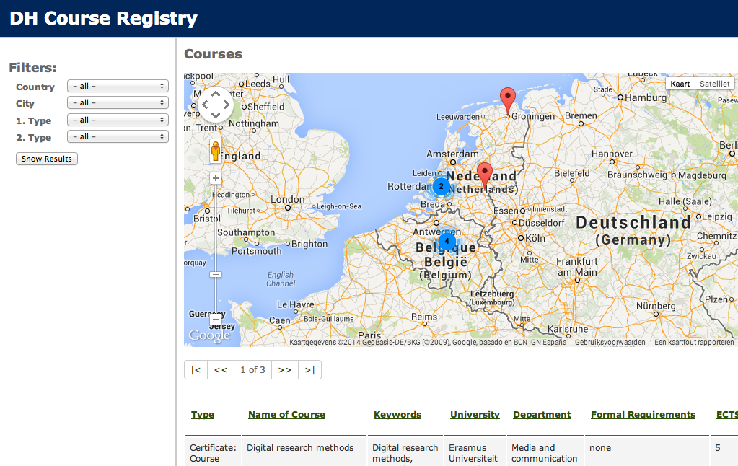
Case 3: Course registry
http://dhcoursereg.hki.uni-koeln.de

Slide 7
Hands on
Part I
Defining the challenges
Introducing examples (3 cases: Stef and Susan)
Some more examples (your turn)

Slide 8
Hands on
Part I
Defining the challenges
Introducing examples (3 cases: Stef and Susan)
Some more examples (your turn)
Re-defining the challenges (scaling them)

Slide 9
Hands on
Part I
Defining the challenges
Introducing examples (3 cases: Stef and Susan)
Some more examples (your turn)
Re-defining the challenges (scaling them)
Part II:
Working on solutions in small groups
Presenting possible solutions

Slide 10
Hands on
Part I
Defining the challenges
Introducing examples (3 cases: Stef and Susan)
Some more examples (your turn)
Re-defining the challenges (scaling them)
Part II:
Working on solutions in small groups
Presenting possible solutions
Part III:
Conclusions (drawings)
Writing a Manifesto

Slide 11
manifesto

Slide 12
manifesto
Avoid overlap in courses
Combine rather than divide the scarce expertise of teachers and limited student interest so far
Share best practices and course materials, to improve the quality of courses
Create space for new expertise in existing curricula
Support the integration of DH practices in regular courses
Support the integration of Information Sciences in DH
Do not underestimate the costs in terms of time and resources for teaching DH courses in small groups
Create space for new expertise in existing curricula
Support the integration of DH practices in regular courses
Support the integration of Information Sciences in DH
Do not underestimate the costs in terms of time and resources for teaching DH courses in small groups
……….

