Slide 1
Workshop Digital Source Criticism - Stefania Scagliola
26-6-2018

Slide 2
Workshop Digital Source Criticism - Stefania Scagliola
Who am I?
Italian passport, Dutch citizen, employee in Luxembourg
Researcher at C2DH- Luxembourg Centre for Contemporary and Digital History - Universite de Luxembourg
Task: creating a teaching platform on Digital Source Criticism for bachelor students of Humanities
Expectation for today:
Connect to your teaching context - what do you teach students?
What is your own experience with the digital in the classroom?
Teach you some basic digital research skills
Test some of my teaching material
Notes:
STEFANIA

Slide 3
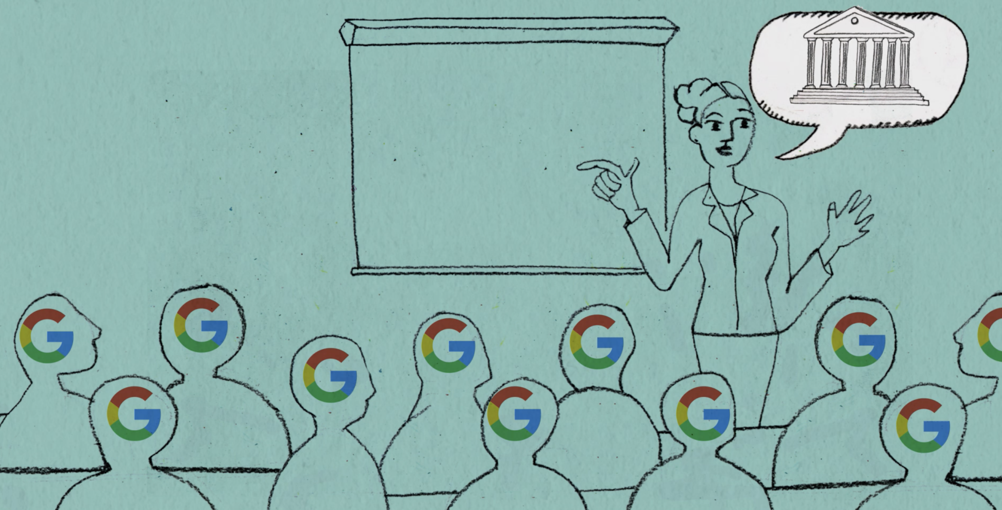
Workshop Digital Source Criticism - Stefania Scagliola
What are we going to do?
25 min presentation round with participants
15 min presentation by me:
The difference between ‘information literacy’, ‘digital literacy’, ‘digital source criticism’
Digital Source Criticism; why does it mean?
Show draft of our Teaching platform Ranke.2 – 1 clip and 1 assignment
60 min hands on assignment 1 : tracing the origin of an image that has been integrated in school history book
Pause 15 min
60 min hands on assignment 2 : analyzing a Youtube clip.
Who put it there? How does it work ?
Wrap up
Notes:
STEFANIA

Slide 4
Oh my God, where do I start?
Facts
Facts
Interpretation
Publicity
Propaganda
Digital literacy
Media
literacy
Knowledge
Literacy
Historical Context

Slide 5
Different forms of literacies
Literacy: Understanding something
Reading literacy: level of comprehension of material that you read
Writing literacy: level of mastering language to express oneself and communicate with others
Media literacy - Understanding of how media works, being conscious of the fact that a message is not always accurate and objective, being able to understand the concept of ‘bias’ and ‘perspective’
Information literacy - this is about the information itself, regardless of the medium
Technological literacy - your understanding of a technology and how well you can apply it in everyday life
Notes:
STEFANIA

Slide 6
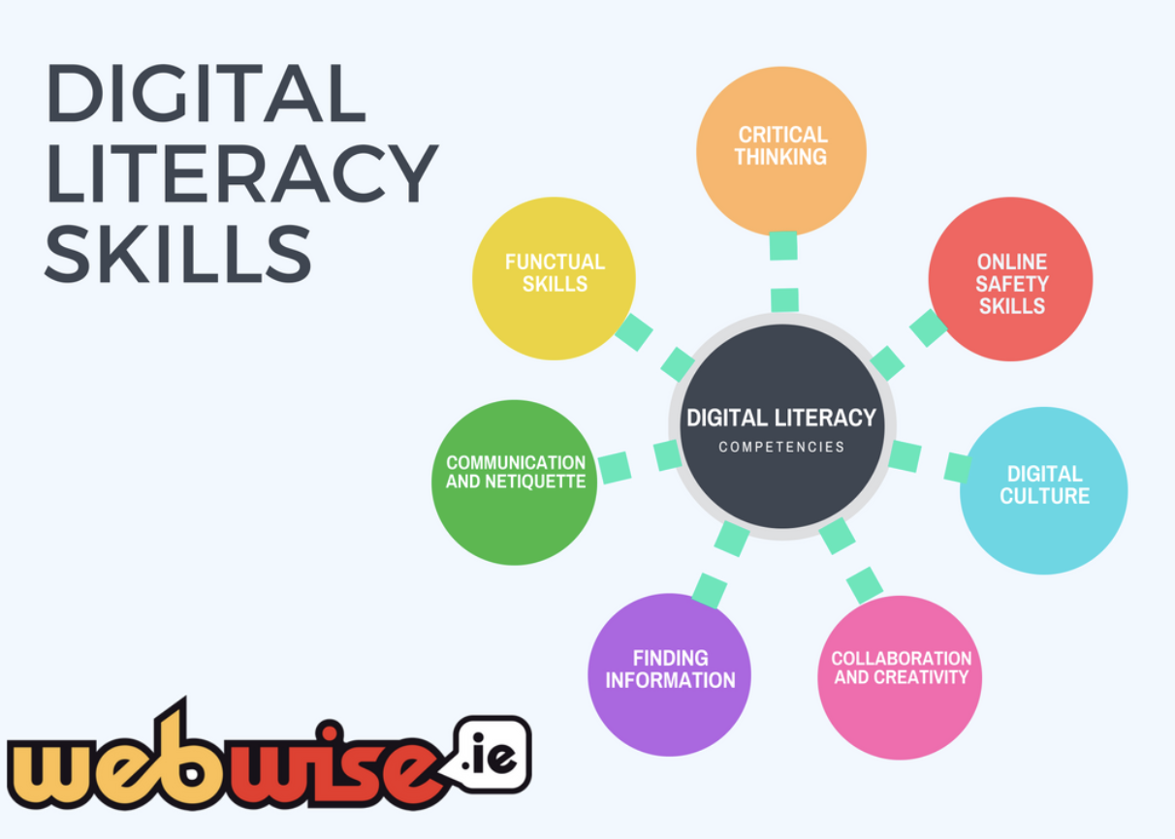
Digital Literacy
Digital Literacy: https://www.webwise.ie very useful website!
University of Derby GB https://youtu.be/p2k3C-iB88w
How do we translate
this to History and Source Criticism?
Notes:
STEFANIA

Slide 7
You start with asking a series of simple questions
What type of source is it?
Who created it?
When?
Where?
Why was it created?
Who is it being addressed to?
How has it been transmitted?
What is its informational value?
What is missing?
This applies to primary sources
Sources that have a direct relation to an event, object, person, or work of art. These type of sources provide first hand testimony or direct evidence.

Slide 8
Then there are questions for secondary sources
Who is the author?
What can you say about his or her background?
What is the topic that is addressed?
What point is the author trying to make
How is the source arranged and structured?
Do you find the author’s arguments convincing?
What kind of primary sources have been used?
How have these sources been interpreted?
Secondary sources
These sources contain an additional layer of interpretation by a second medium, that is generally added after an event has occurred. A secondary source describes, discusses, interprets, comments upon, analyses, evaluates, summarizes, or processes one or more primary sources.
And then comes digital source criticism, why is this different?

Slide 9
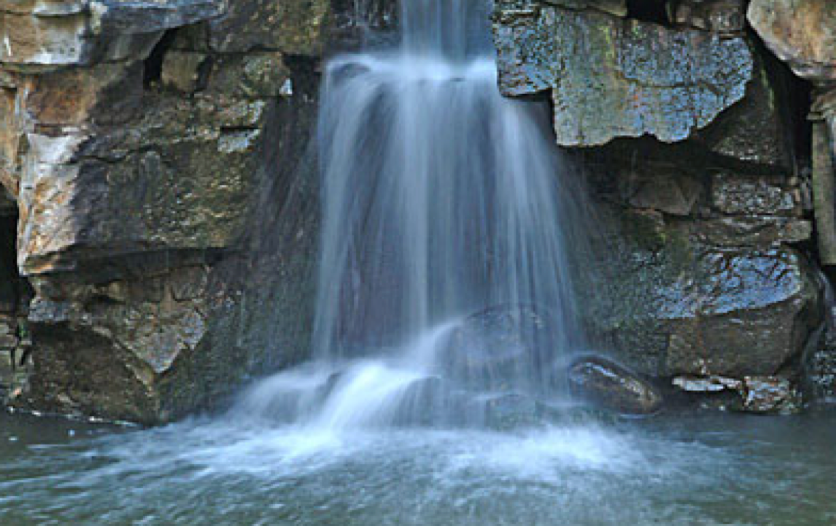
Digital Source Criticism
- human eye has identified
particular feature in landscape
- camera captures light particles
through sensors
- translation into digits
- pixels read signals and turn
them into color
- The image of a source springing
from a rock is fixed
- Google images search: ‘source,’ semantic link,
- Website about waterfilters,
- image has been uploaded on website,
no credits, no provenance, no location
mentioned
- I create print screen - duplicate image in
lower resolution
- no idea of where this is, of who has taken
the picture
IS THIS HAPPENING TO OUR HISTORICAL SOURCES!!!
HORROR !!!!!! FAKE NEWS ???? FAKE HISTORY????

Slide 10
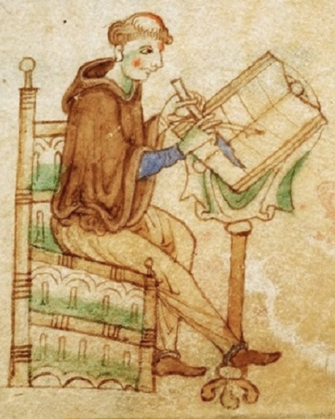
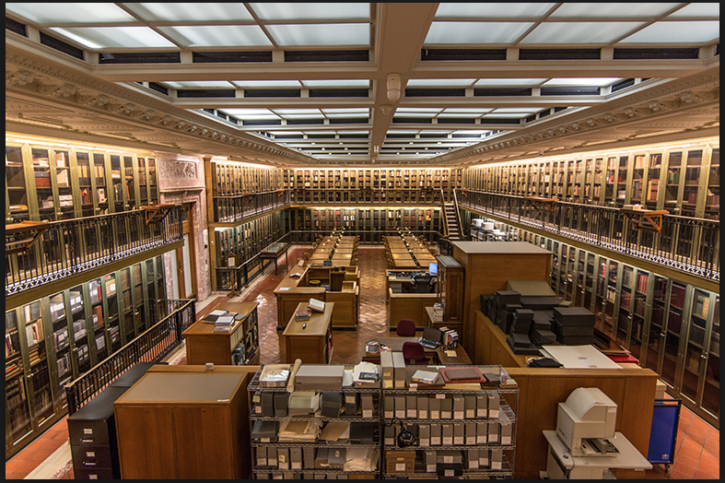
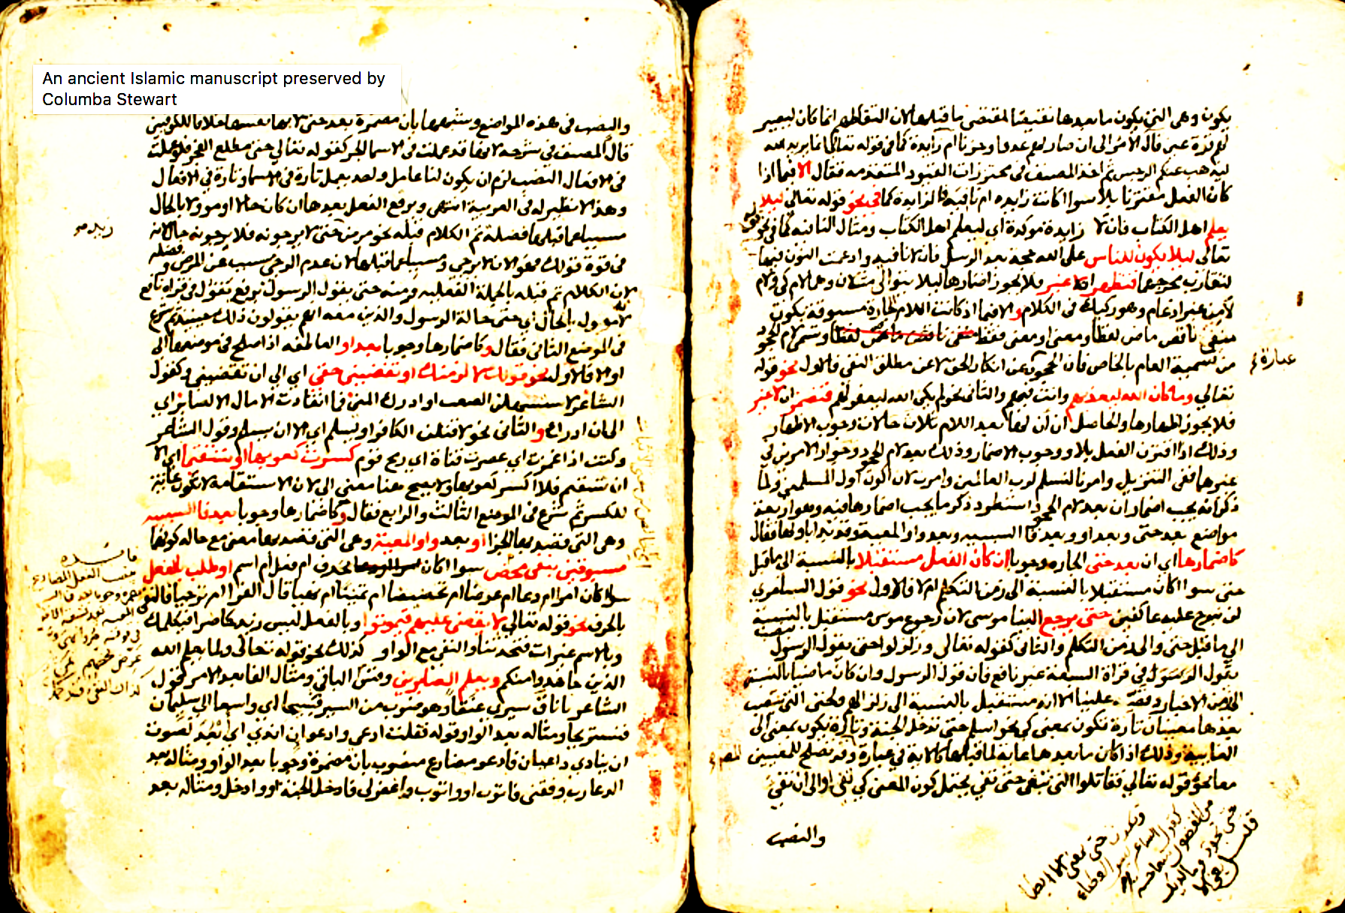
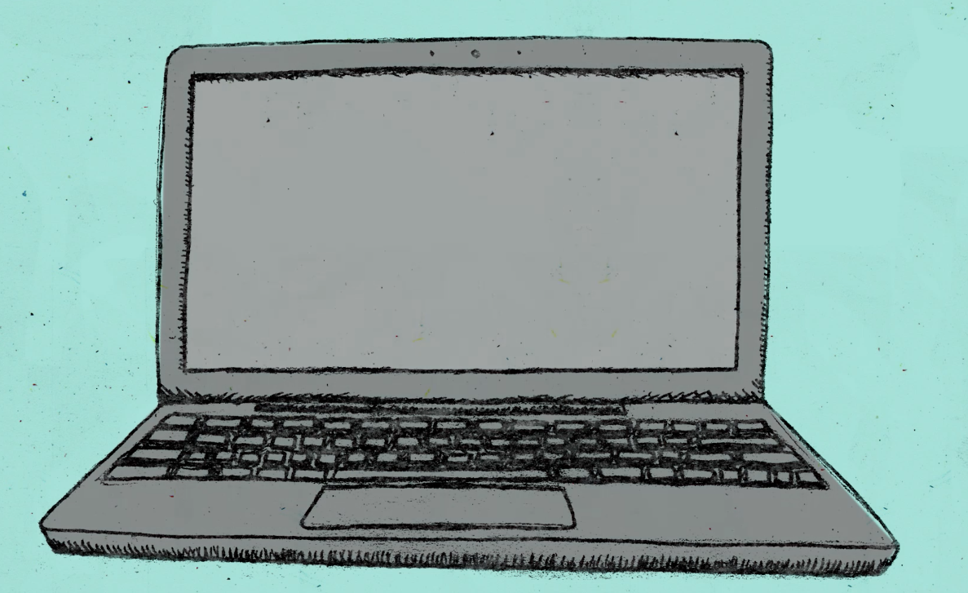
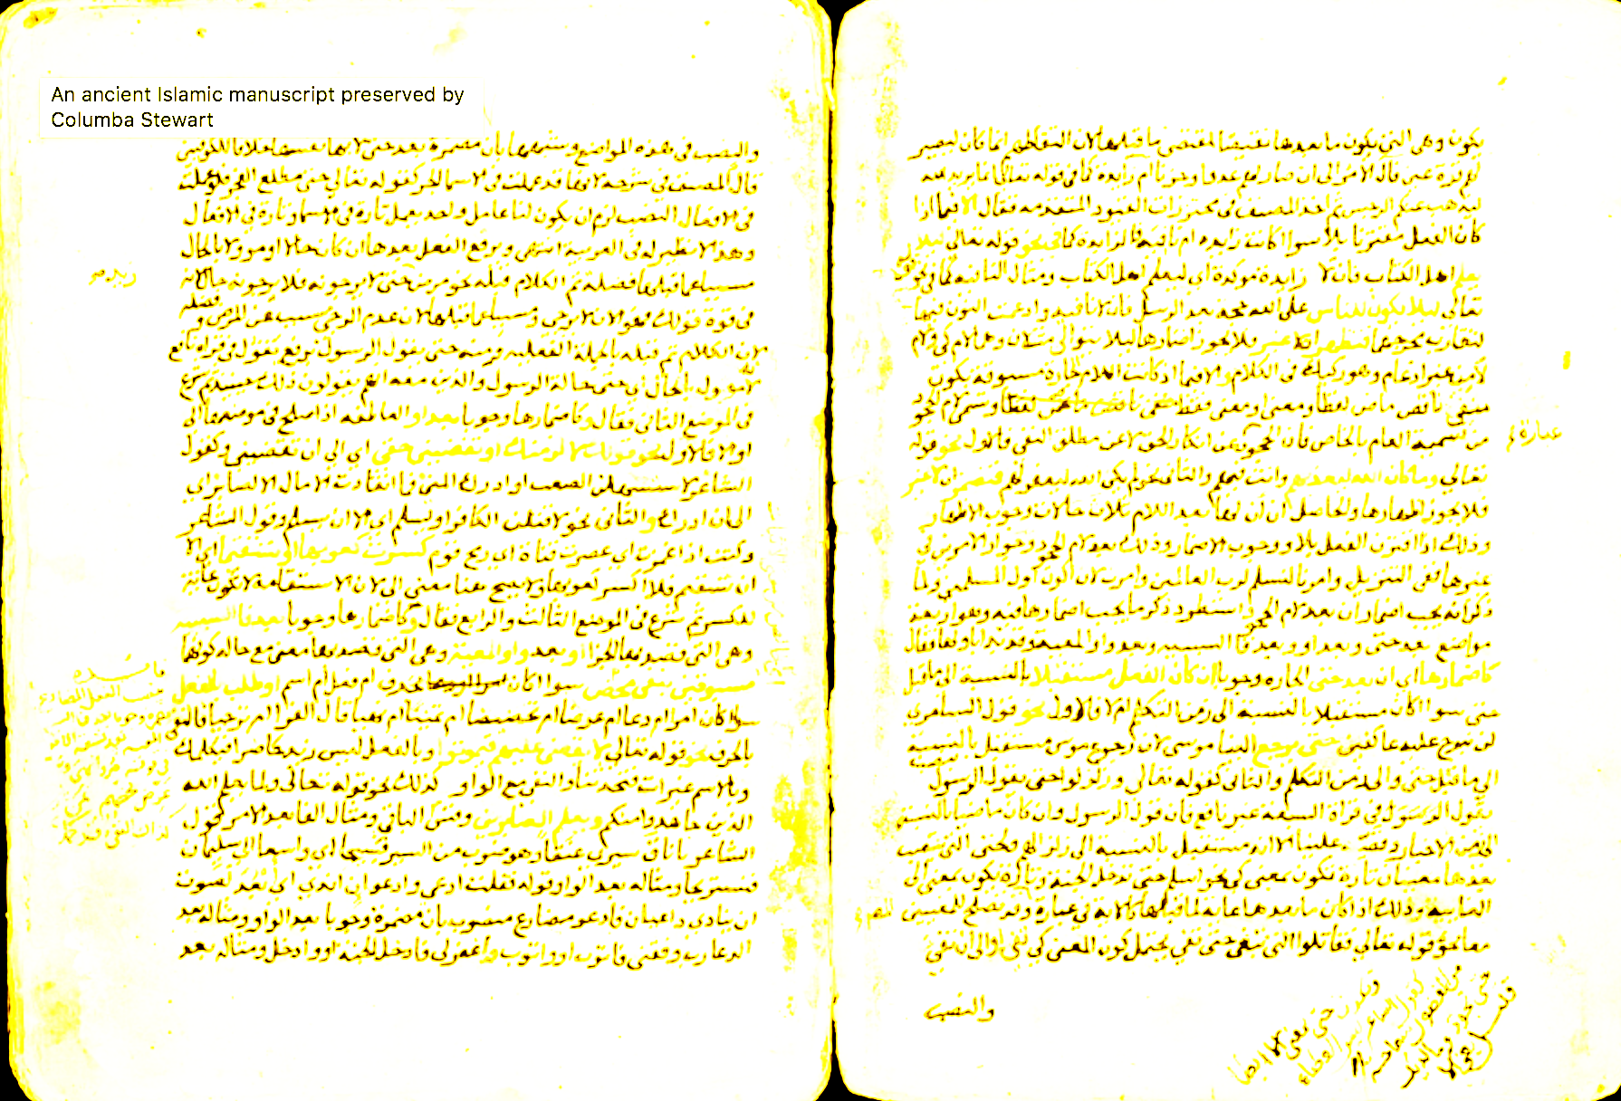
Different questions to different contexts
Source criticism: asking questions about a source
Who wrote this?
What does this say about the value of the document?
Why was this manuscript selected to be digitized?
How was it digitized? Was information lost?
How did it get into the archive?
When was it written?
For what purpose?
How was it made ?
What does it say about this person, this community or about society in general during this period?
What name and place does it have
In the archive?
Who published it online?
When was it published?
What is it made of?
Notes:
STEFANIA

Slide 11
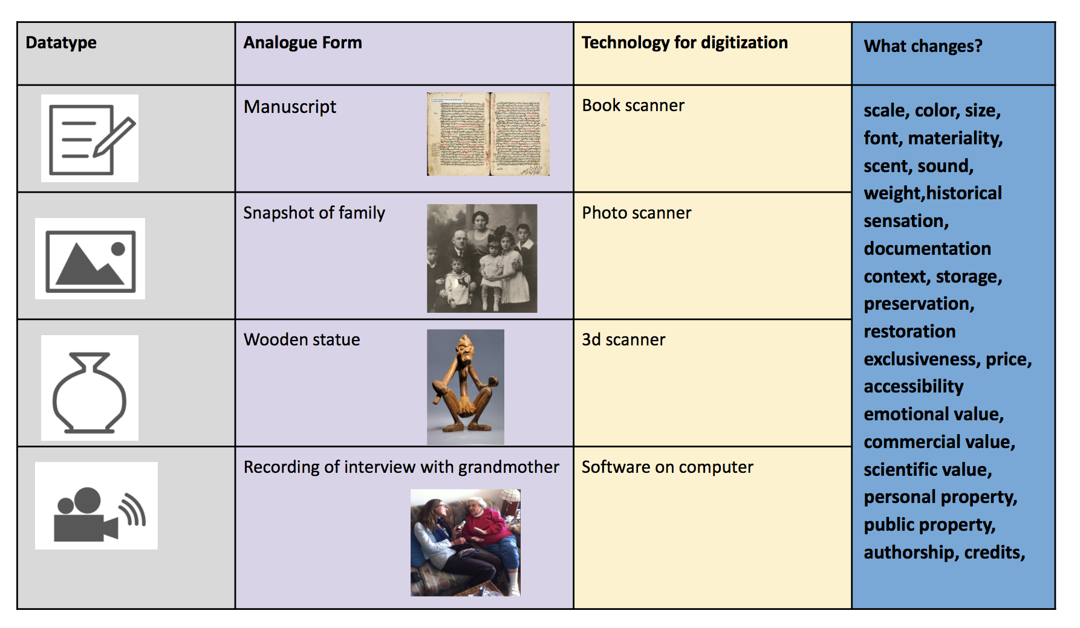
Different types of data
Notes:
STEFANIA

Slide 12
Draft Clip of Ranke

Slide 13
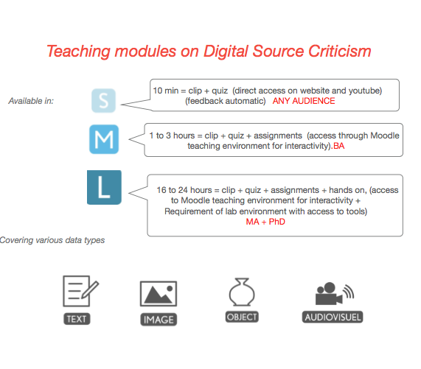
The difference between ‘information literacy’, ‘digital literacy’, ‘digital source criticism’
https://c2dh.github.io/ranketwo/
Notes:
STEFANIA

Slide 14
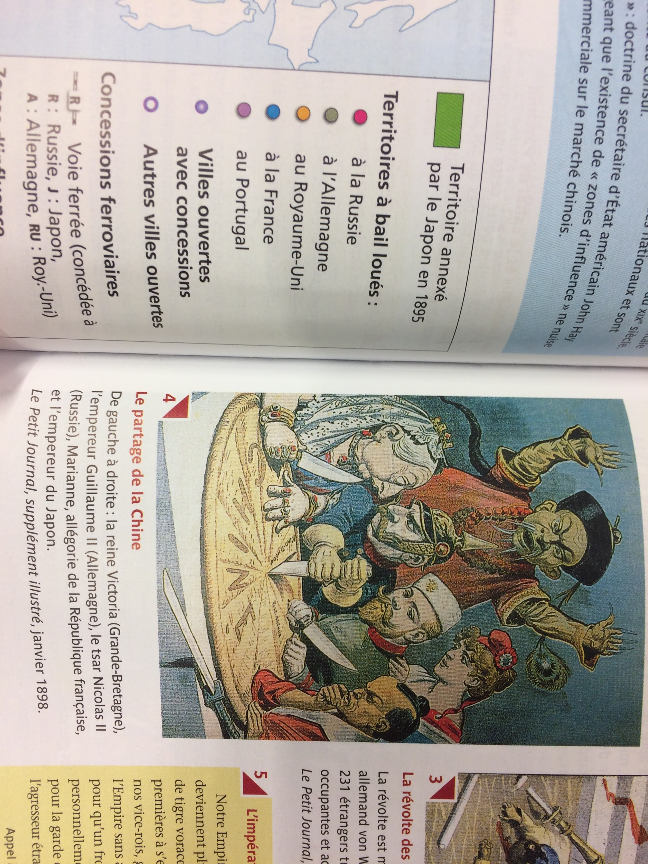
Assignment 1 - Transformation of a source
Choose an image from your text book -
Make a photo of it with your phone and send it to your computer
Upload the image in Google image
Assess the results
Are there similarities? Are the various images or just one?
What does the digital representation online say about a source?
Complete the scheme that has been sent to you
Le manuel d’Histoire franco-allemand
Tome 2 - L’Europe et le monde du congrès de Vienne à 1945, Nathan / Klett, Paris 2012, p.165
Notes:
Martine

Slide 15
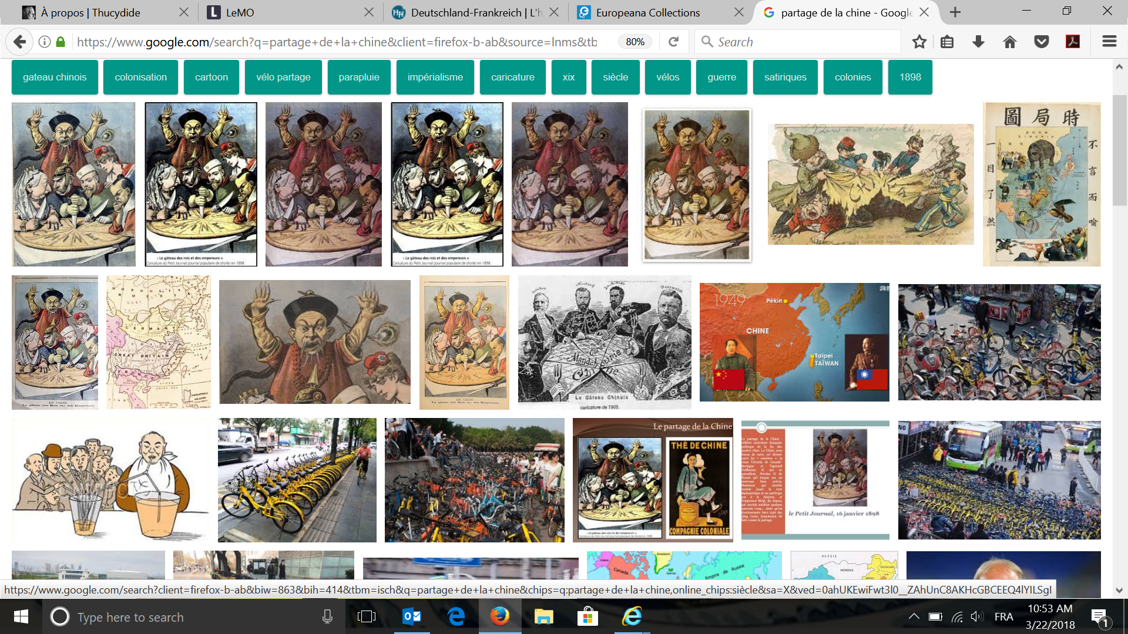
Analyse critique de sources numériques: ‘Hands on”
Notes:
Martine

Slide 16
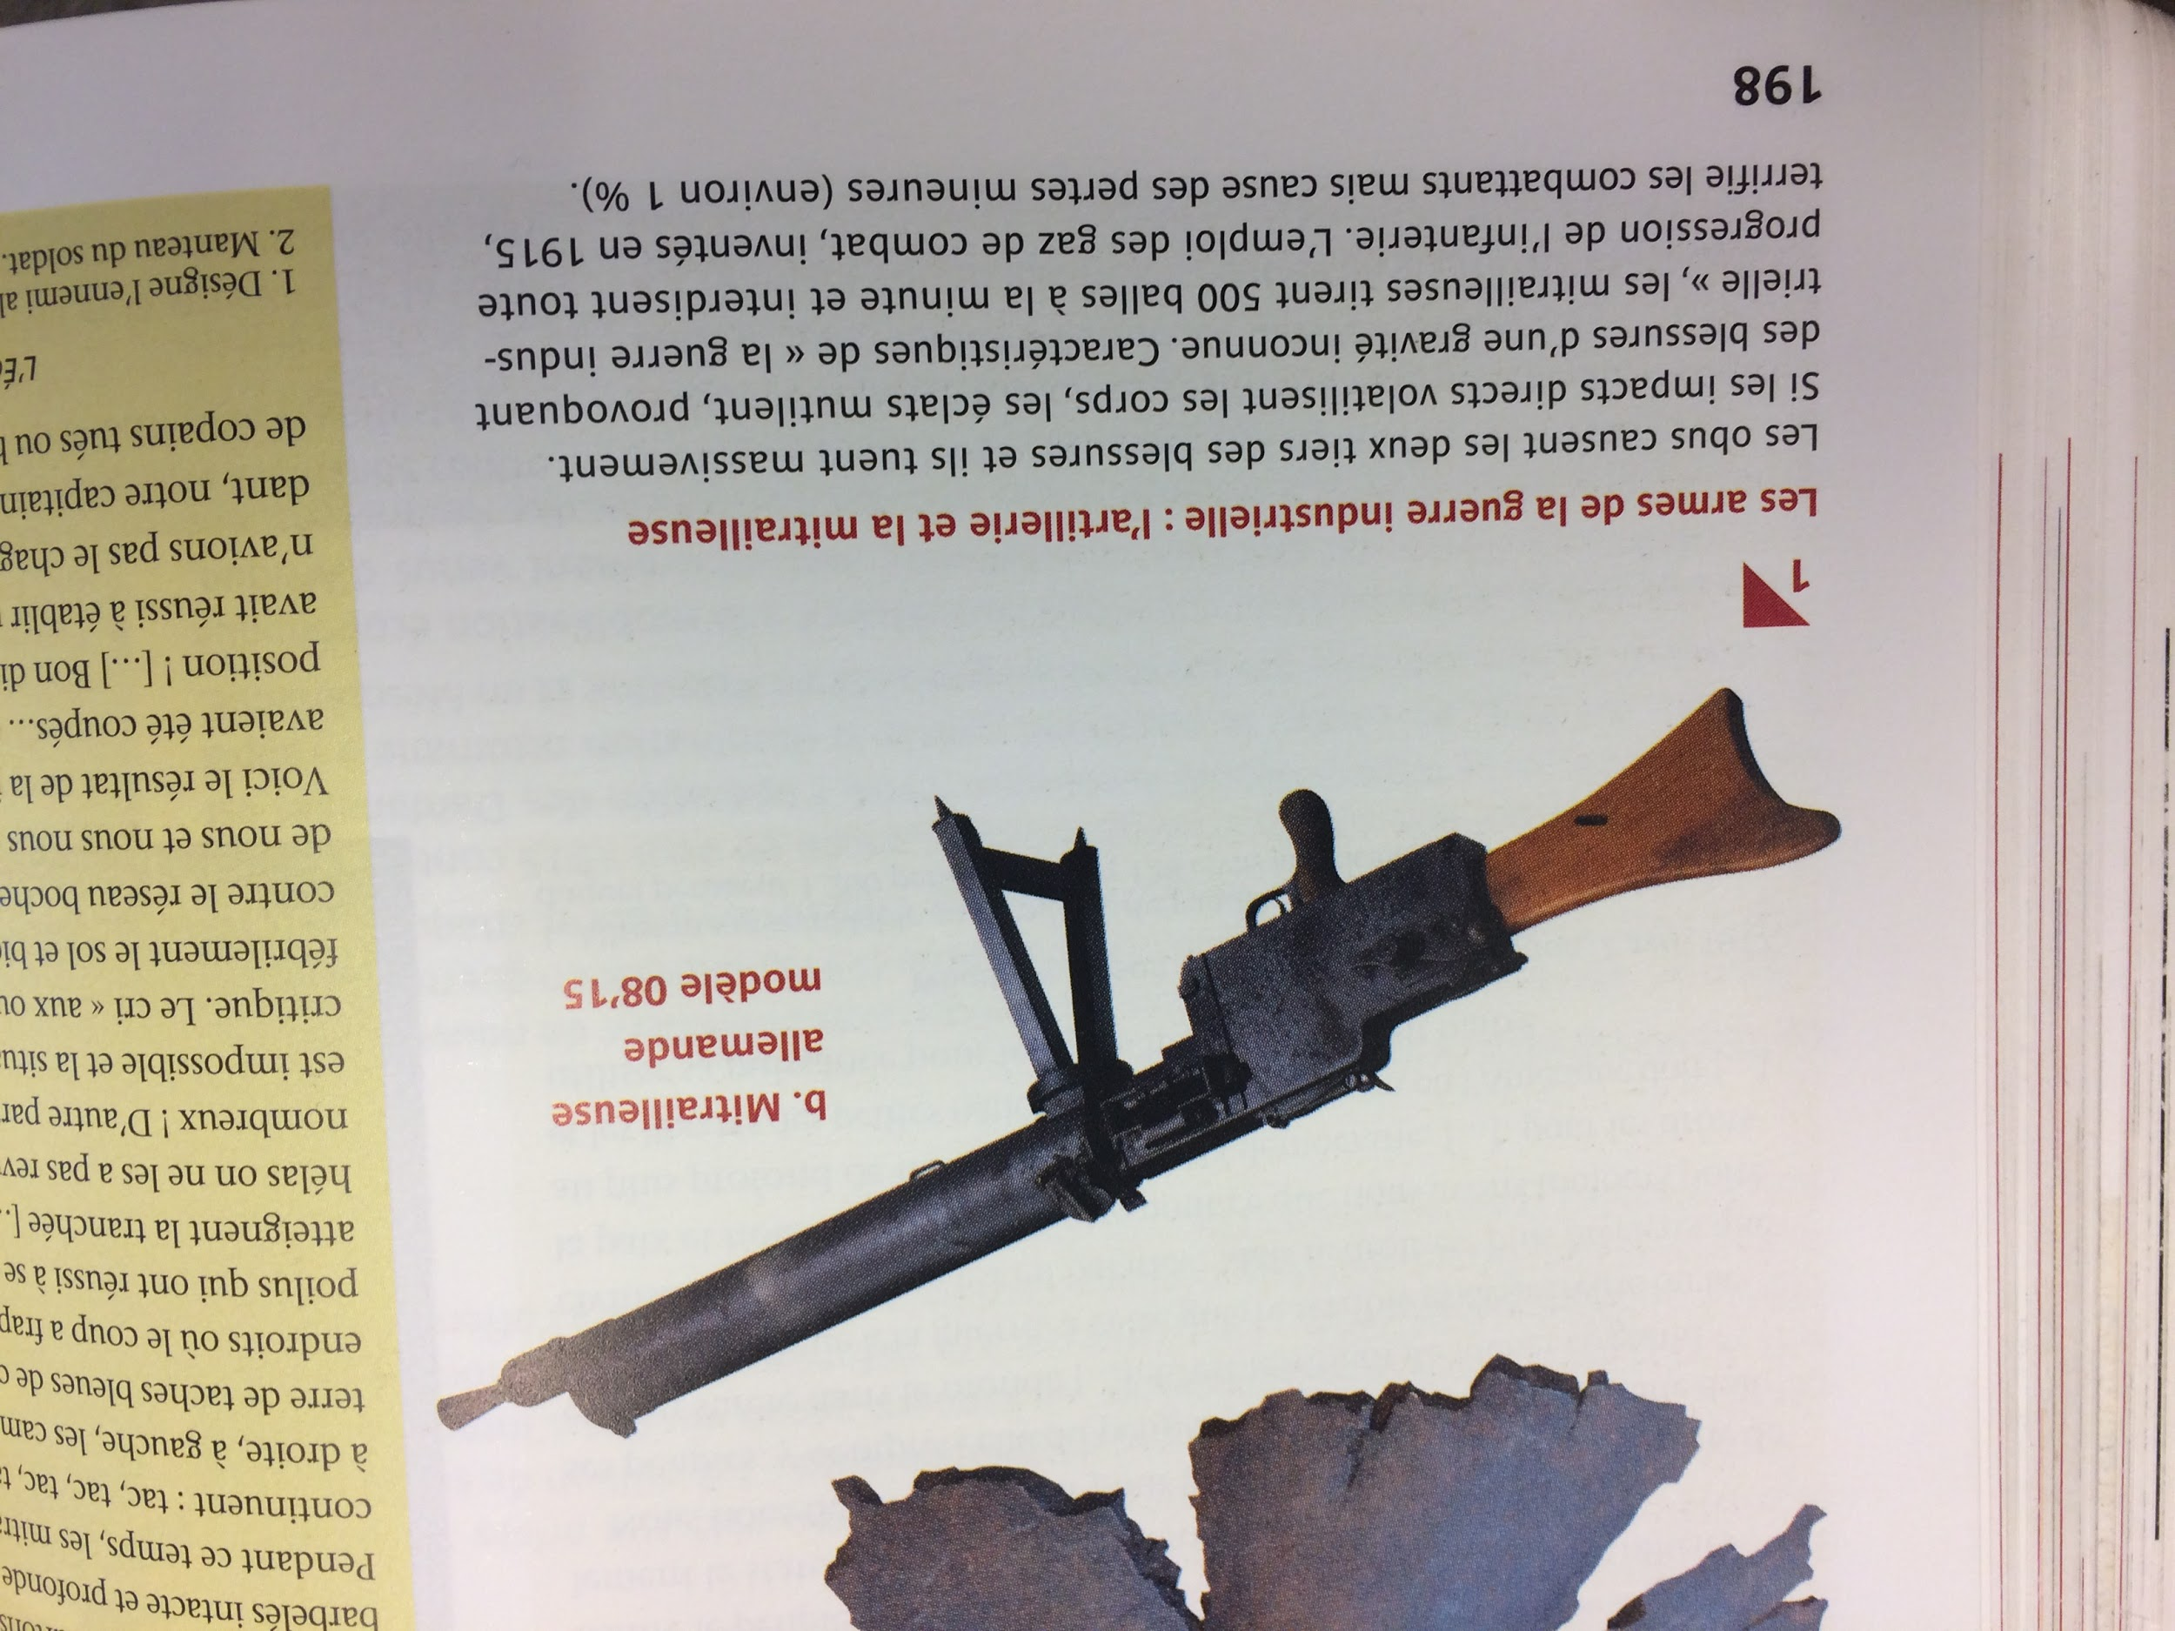
Analyse critique de sources numériques: `hands on’
Le manuel d’Histoire franco-allemand
Tome 2 - L’Europe et le monde du congrès de Vienne à 1945, Nathan / Klett, Paris 2012, p.165
Notes:
Guido

Slide 17
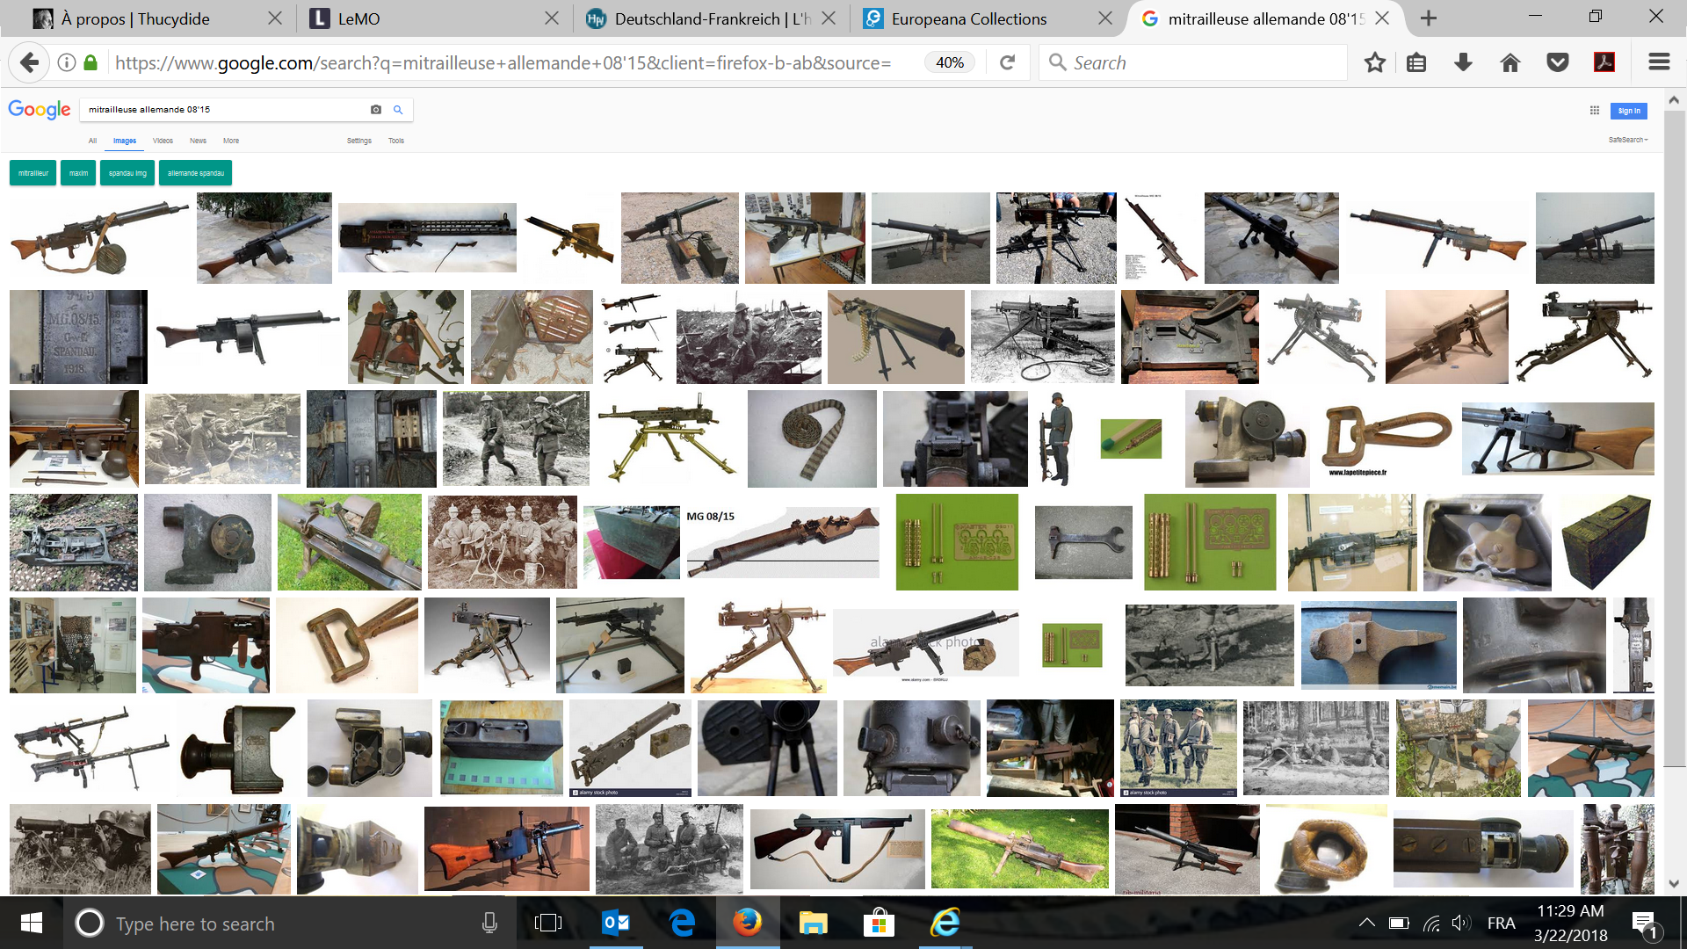
Analyse critique de sources numériques: ‘Hands on”
Notes:
Guido

Slide 18
 | Context of its first creation ANALOGUE | Context of its printed representation ANALOGUE | Context of its digital representation DIGITAL | Has it changed? What is authentic?
Who
When
Where
Why
How
Technology that is used
Material qualities
Informational qualities
historical/cultural/ political context

Slide 19
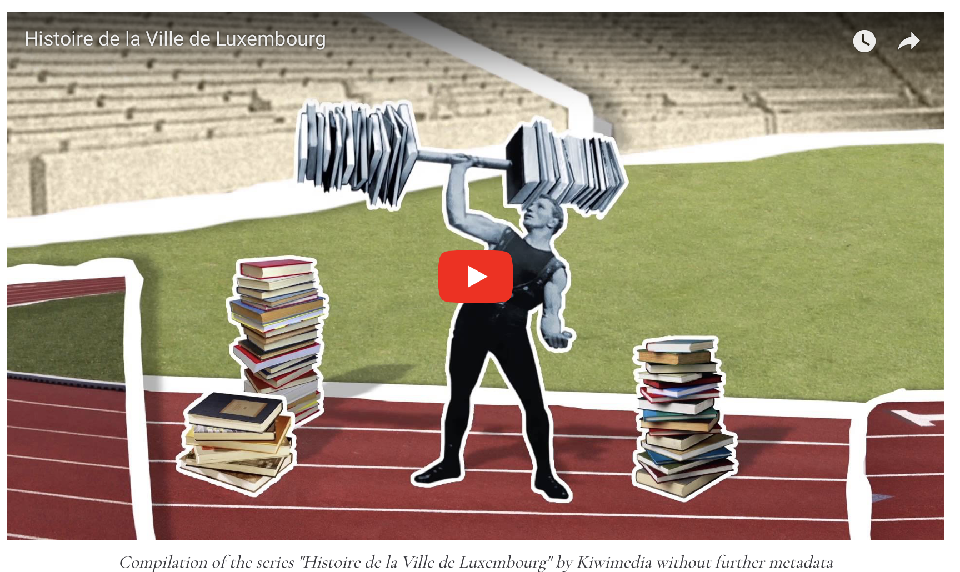
Example of applying source criticism to Youtube clip
Histoire de Luxembourg comme orphelin digitale
Notes:
STEFANIA

Slide 20
Assignment 2 - Analyzing a Youtube clip
Youtube
Who created it? Who owns it? How does it work?
https://en.wikipedia.org/wiki/YouTube
https://creatoracademy.youtube.com/page/lesson/jumpstart?cid=bootcamp-foundations&hl=en
https://www.youtube.com/watch?v=eEDX4E5LRQQ .
Choose a Youtube clip and explore all the navigation options
Apply source criticism to it

Slide 21
Analyse critique de sources numériques: l’Histoire du Luxembourg sur YouTube
Ressources web utiles dans l’enseignement: matériel historique online
https://www.europeana.eu/portal/de/german (art and history objects/documents from all over Europe)
http://la.historiana.eu/la/ (special section for teaching history in English)
http://www.dhm.de/lemo/ (teaching material Deutschen Historischen Museums)
https://www.histoire-image.org/fr/hors-series/france-allemagne (French/German historical themes, in French and German)
https://www.c2dh.uni.lu/thinkering/retrieval-digital-orphan-lhistoire-de-luxembourg (animations on 4 themes about
Luxemburgisch history in English, French and German)
http://www.euscreen.eu (collections of television clips from European countries, theme:European History)
Notes:
STEFANIA

Slide 22
Analyse critique de sources numériques: l’Histoire du Luxembourg sur YouTube
Ressources web utiles dans l’enseignement: matériel sur alphabétisation numérique
https://www.youtube.com/watch?v=FlPh0Z39Fqg (how learning starts with copying what others do, German)
http://bigthink.com/videos/the-digital-age-in-an-analog-world-2 (what the benefits are of digital signals, English)
https://www.zdf.de/kinder/loewenzahn/digitale-nachrichten-104.html (how an image is scanned through digital signals,
German)
https://21cif.com/directory.php (course on information literacy, English)
https://www.google.com/intl/ta/insidesearch/searcheducation/index.html (Google search education, English)
Notes:
STEFANIA

