Slide 1

The Mediterranean as the return of the repressed in French Thought (from Valéry until Attali))
Nathalie ROELENS
(University of Luxembourg,
MIS, Migration and Intercultural Studies)

Slide 2
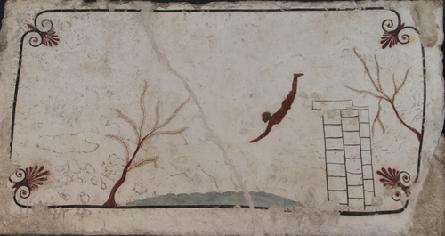
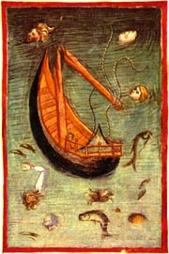
1. The Mediterranean vs the Atlantic Ocean
“The diver of Paestum is a marvellous incarnation of the de-siderium,
an inextricable intermingling of desire and bemoaning.”
(Bertrand Westphal, Le monde plausible, Paris, Minuit, 2011, p. 101)
“Considerate la vostra semenza:
fatti non foste a viver come bruti,
ma per seguir virtute e canoscenza.
Call to mind from whence ye sprang:
Ye were not form’d to live the life of brutes,
But virtue to pursue and knowledge high.”
Dante Alighieri, L’inferno, Canto XXVI, 115-117)
(transl. Henry Francis Cary, 1819)
e volta nostra poppa nel mattino,
de’ remi facemmo ali al folle volo [witless flight],
sempre acquistando dal lato mancino “ […]
Tre volte il fé girar con tutte l’acque;
a la quarta levar la poppa in suso
e la prora ire in giù, com' altrui piacque,
infin che ‘l mar fu sovra noi richiuso. ”
Dante Alighieri, Inferno, Canto XXVI (124– 142).
The diver, fresco, Paestum, 480 BC.
Anonimo fiorentino,
The shipwreck of Ulysses’ boat (1390)
Pillars of Hercules
“ Dante’s Ulysses, the one who crosses the Hercules’ Pillars, shows the beginning of a lack of moderation, whereby he risks even his survival to chase the desire to explore and to discover. » (Franco Cassano, Il pensiero meridiano, 1996/2015, p. 44/35)
“ The sea, like every freedom, holds within itself the risk of nihilism; and the ocean is the moment when the sea loses its moderation” ... (p. 46/36)
“smalltime seafarer […]: it took him ten years to reach Ithaca”
(Raffaele la Capria, L’occhio di Napoli, 1994 quoted by Cassano, p. 47/37)

Slide 3
Quando
mi diparti’ da Circe, che sottrasse
me più d’un anno là presso a Gaeta,
prima che sì Enëa la nomasse,
né dolcezza di figlio, né la pieta
del vecchio padre, né ‘l debito amore
lo qual dovea Penelopè far lieta,
vincer potero dentro a me l’ardore
ch’i’ ebbi a divenir del mondo esperto
e de li vizi umani e del valore;
ma misi me per l’alto mare aperto
[Forth I sail’d
Into the deep illimitable main,]
sol con un legno e con quella compagna
picciola da la qual non fui diserto.
L’un lito e l’altro vidi infin la Spagna,
fin nel Morrocco, e l’isola d’i Sardi,
e l’altre che quel mare intorno bagna.
Io e’ compagni eravam vecchi e tardi
quando venimmo a quella foce stretta
dov’ Ercule segnò li suoi riguardi
[To the strait pass, where Hercules ordain’d
The bound’ries not to be o’erstepp’ed by man].
acciò che l’uom più oltre non si metta;
da la man destra mi lasciai Sibilia [Sevilla],
da l’altra già m'avea lasciata Setta [Ceuta] (90-111)
“ … Ma misi me per l’alto mare aperto.
Di questo si, di questo sono sicuro, sono in grado di spiegare a Pikolo, di distinguere perché « misi me » non è « je me mis », è molto piu forte e più audace, è un vincolo infranto, è scagliare se stessi al di là di una barriera, noi conosciamo bene questo impulso.” (Primo Levi, “Il canto di Ulysse” in Se questo è un uomo, 1958)

Slide 4
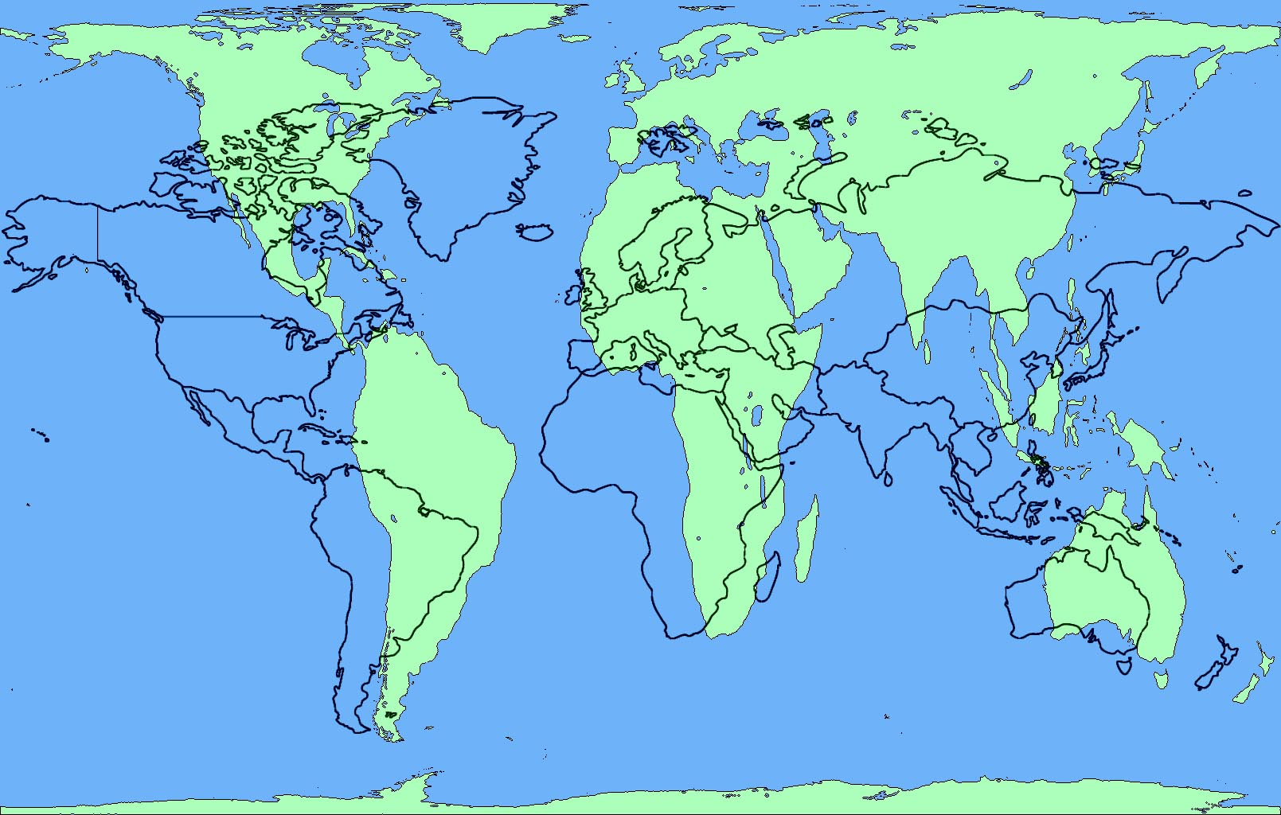
Mercator’s projection (1569) in black / Gall-Peters’ projection (19th-20th C) in green
“Will Europe become what it is in reality – that is, a little promontory on the continent of Asia? Or will it remain what it seems – that is, the elect portion of the terrestrial globe, the pearl of the sphere, the brain of a vast body?” mind, psyche, genius
“deminutio capitis” < caput : head/promontory
(Paul Valéry, The Crisis of the Mind, 2nd Letter, 1919, transl. D.Folliot and J. Mathews)

Slide 5
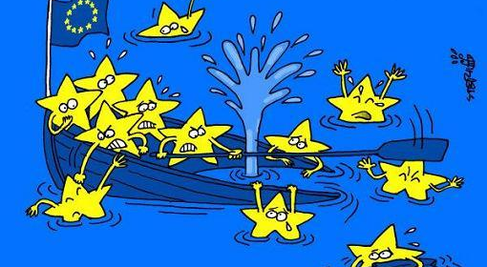
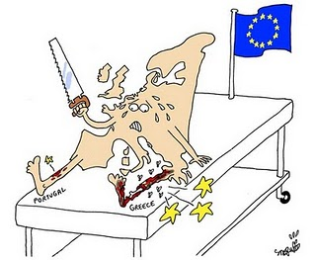
Courtesy Isabel Marcos

Slide 6
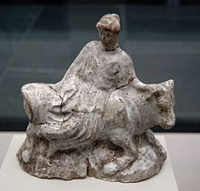
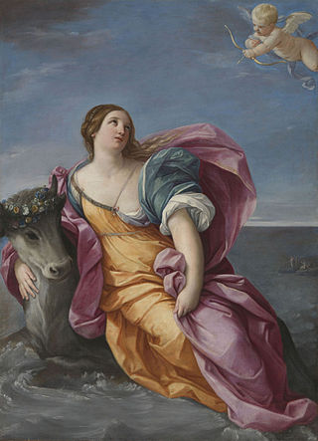
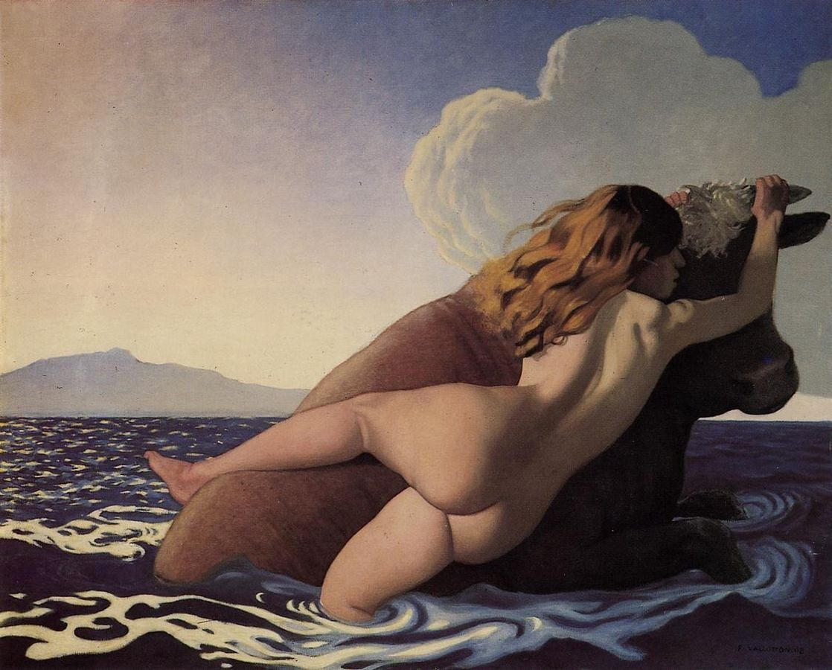
2. A question of arrows
2.1. The Abduction of Europa
“[…] mediique per aequora ponti
Fert praedam. Pavet haec litusque ablata relictum
Respicit et dextra cornum tenet, altera dorso
Imposita est; tremulae sinuantur flamine vestes
Thus swimming out farther, he carried his prey off
into the midst of the sea. Almost fainting with terror she glanced back, as she was carried away, at the shore left behind. As she gripped one horn in her right hand while clutching the back of the beast with the other, meanwhile her fluttering draperies billowed behind on the sea breeze.”
(Ovid, “The Rape of Europa”, Metamorphoses, Book II, 871-875, transl. Daryl Hine)
.
Europa on the bull, terracotta from Athens, 480-460 BC,
“ the first civilizations are born in the oriental Mediterranean of the Middle East.” “Troy, close to the Hellespont, shines already while Crete remains in the darkness. It is only around 2500 BC that a little light reaches her. The legend of Europe raped by Zeus on the coast of Phoenicia and conducted to Crete probably contains a part of truth.”
(Fernand Braudel, La Méditerranée, 1977, Paris, Flammarion, 2017, p. 79 and 88)
Guido Reni, 1639
Félix Valotton, 1908

Slide 7
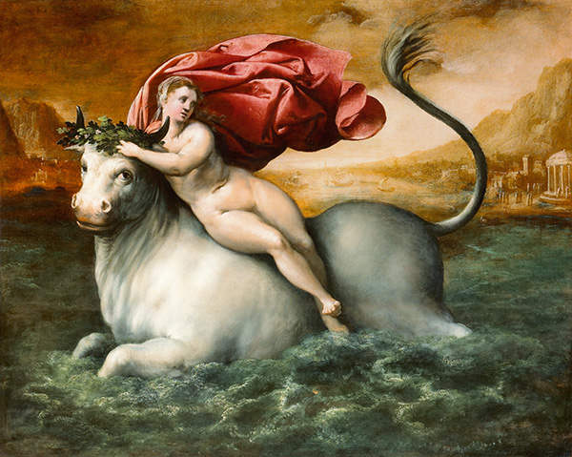
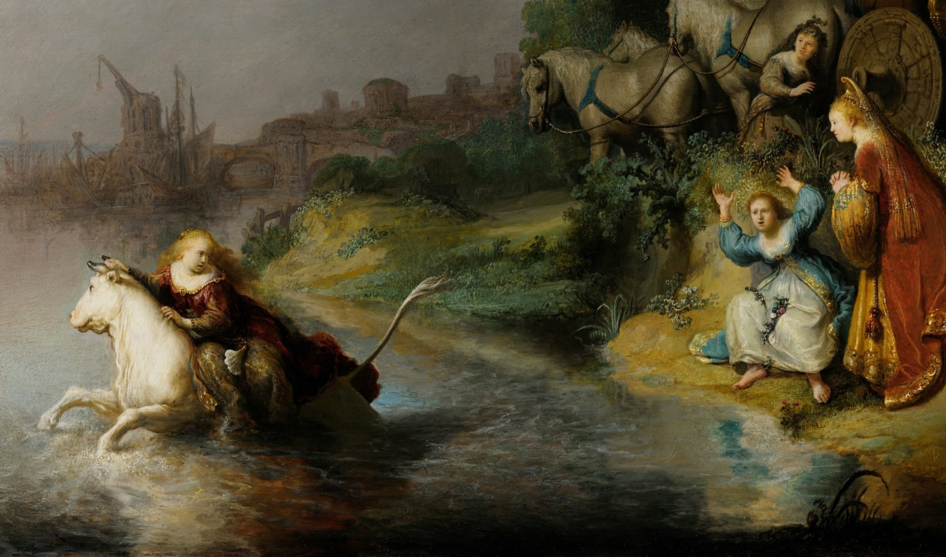
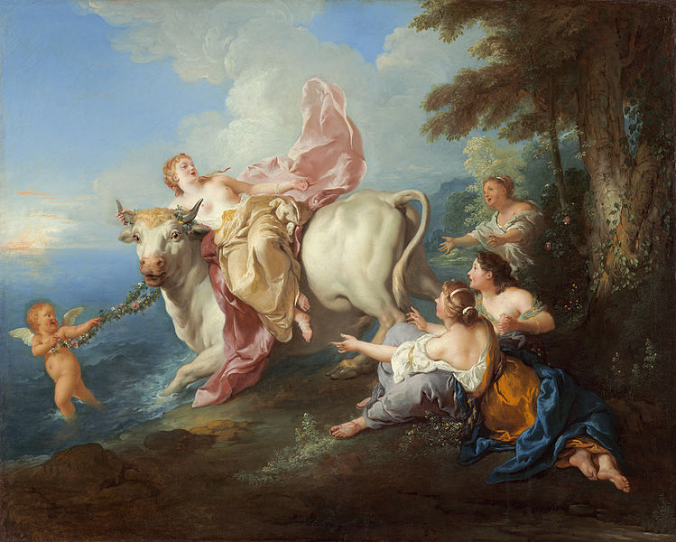
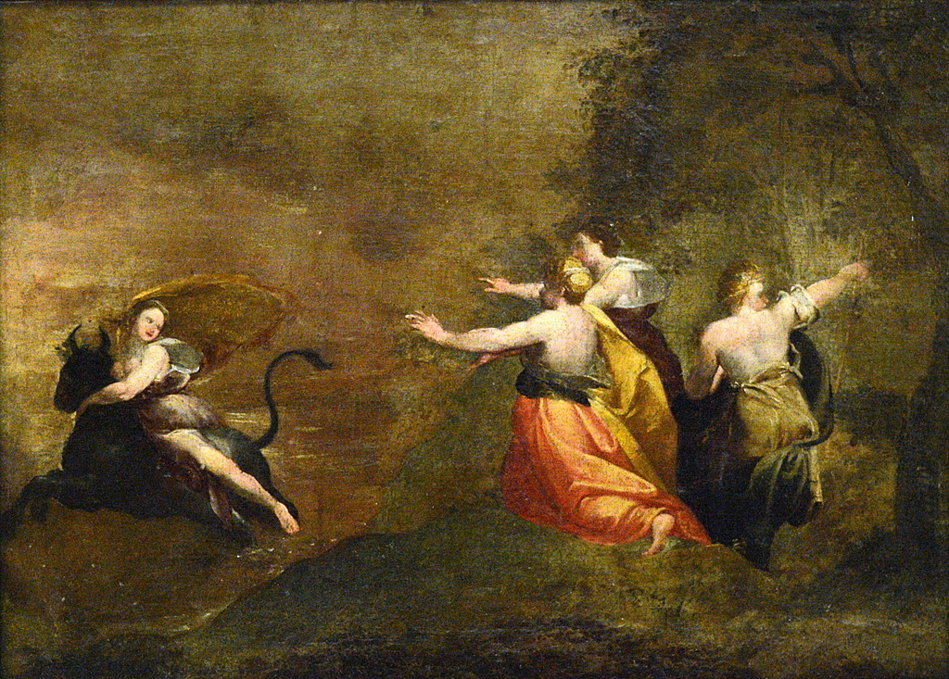
The Abduction of Europa
Gillis Coignet, 1542-1599
Rembrandt, 1632
Goya, 1772
Jean François de Troy, 1718

Slide 8
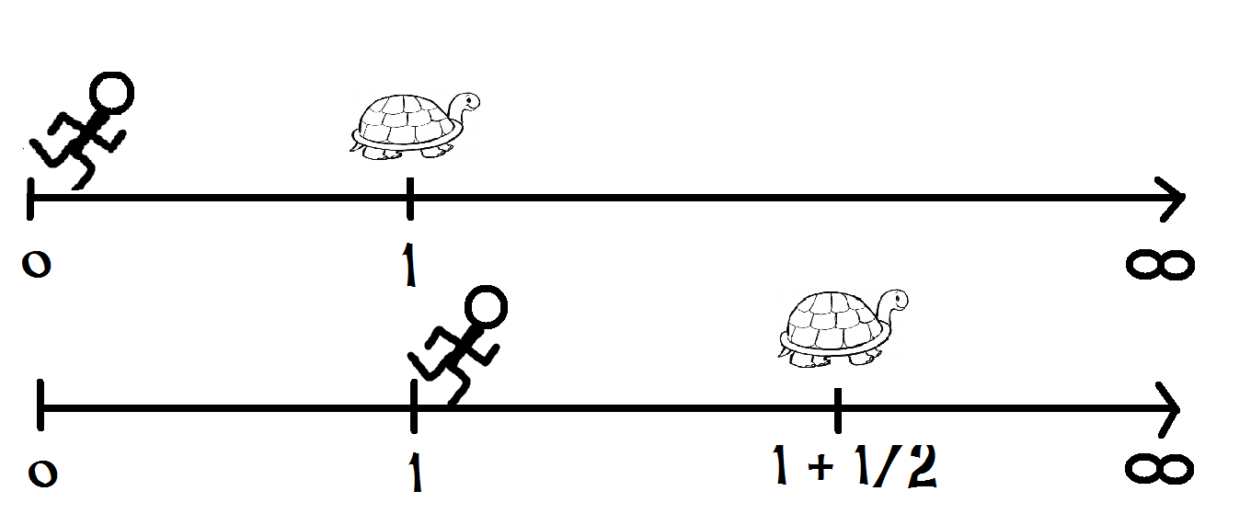
“Asyncronicity between southern and northern Europe”
Cees Noteboom, “Zeno’s arrow”, The Rape of Europa, 1993

Slide 9
TO GO
TO COME
Jacques Fontanille, Les espaces subjectifs. Introduction à la sémiotique de l’observateur, 1989
MIGRANT EXILED (narrative identity)
Alexis Nouss, La condition de l’exilé, 2015
NOMAD
Gilles Deleuze & Félix Guattari, « Traité de nomadologie : la machine de guerre », 1980

Slide 10
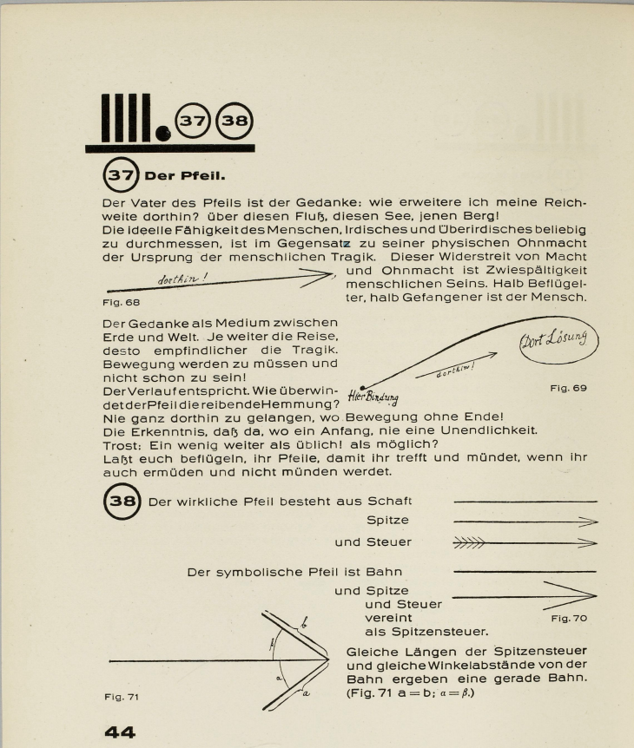
“The contradiction between our physical impotence and our capacity to embrace in spirit terrestrial and supra-terrestrial domains is the origine of the human tragic. This antinomy between power and helplessness is the tearing of human condition.”
there relief
up to there
here attachment
Paul Klee, Pädagogisches Skizzenbuch, 1925

Slide 11
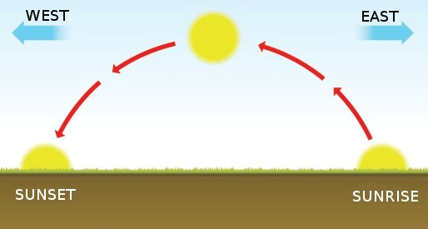
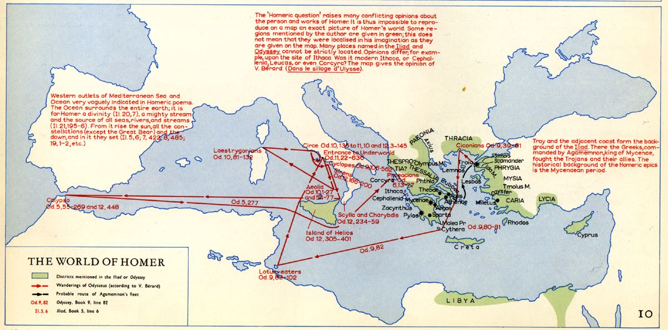
2.2. The wanderings of Ulysses and Aeneas
“The Iliad is oriented Eastward, from the vantage point of Greece, the Odyssey to the West ”
“As long as we continue to believe that the inevitable running toward the West is the only possible motion of the day, and that the Mediterranean is a sea of the past, we will be focusing our eyes in the wrong direction, and the decay that surrounds us will never cease to grow.” (Cassano, p. 45/35 and p. 47/ 38)
Levantine cunning + NOSTOS

Slide 12
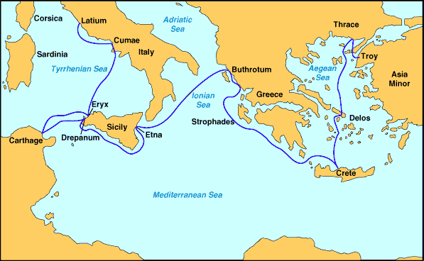
“the whole Mediterranean littoral must be counted in Europe. Smyrna and Alexandria
are as much a part of Europe as Athens and Marseilles” (Paul Valéry, 1919)
“Huc geminas nunc flecte acies, hanc aspice gentem
Romanosque tuos”
“Turn your two eyes this way and see this people,
your own Romans. Here is Caesar, and all the line of Iulus,
All who shall one day pass under the dome
Of the great sky: this is the man, this one,
Of whom so often you have heard the promise,
Caesar Augustus, son of the deified,
Who shall bring once again an Age of Gold
To Latium, to the land where Saturn reigned
In early times.”
Virgil, Aeneid, Book 6, 788-789 (transl. Fitzgerald 1983)
.

Slide 13
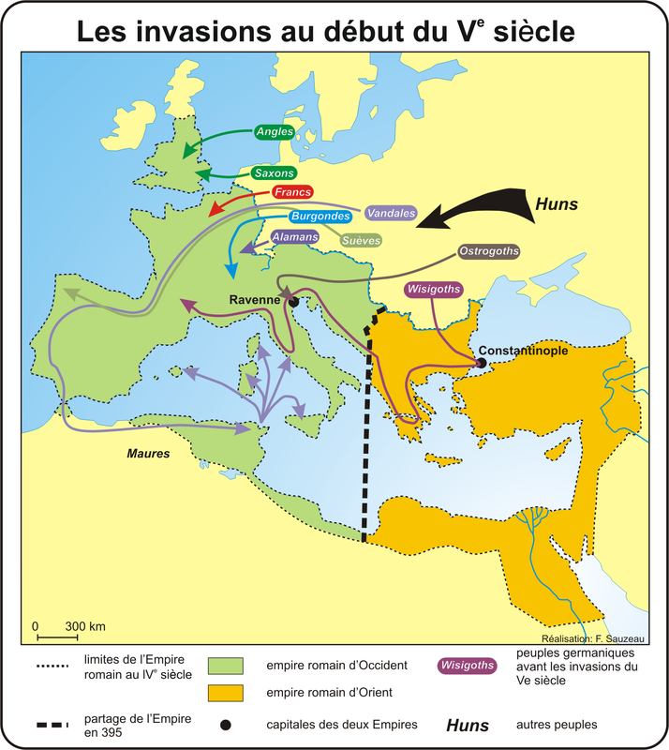
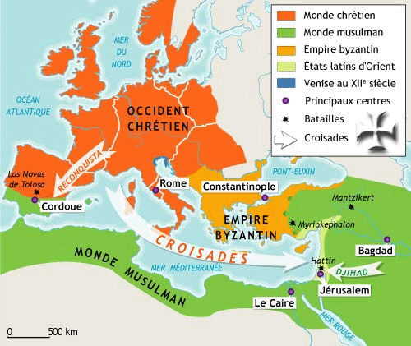
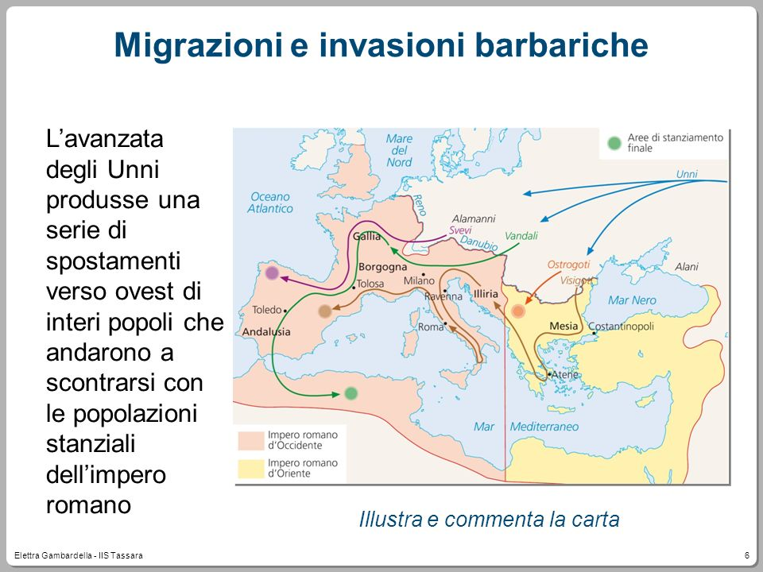
2.3. Other arrows

Slide 14
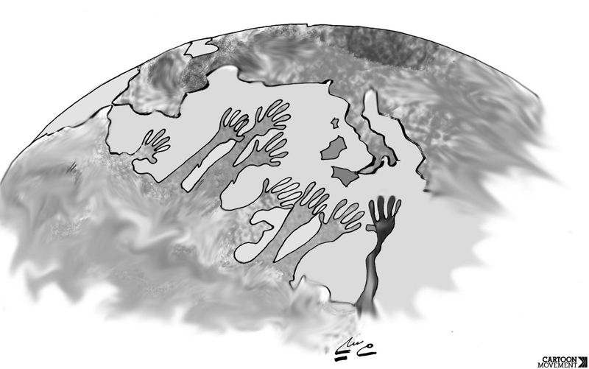
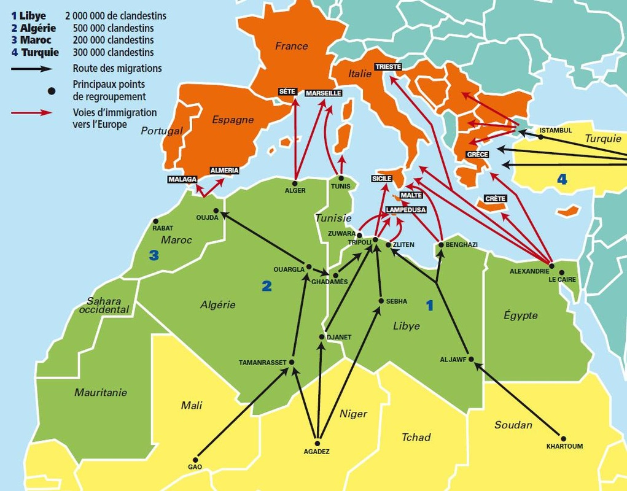
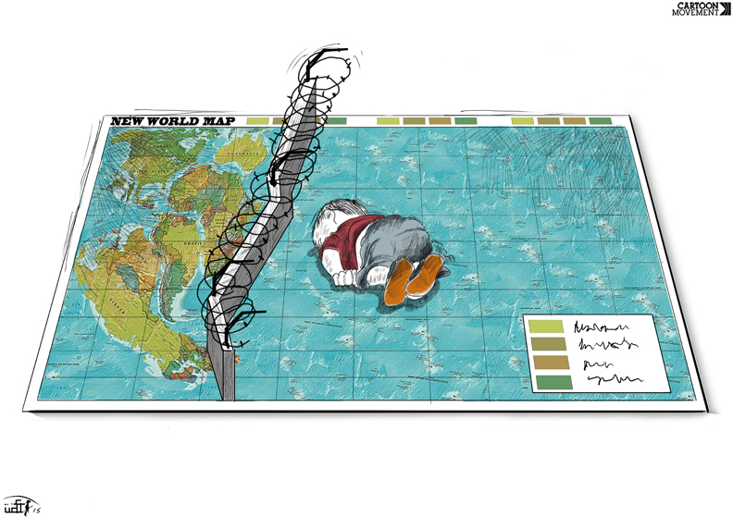
Aquarius, 13-17/6/18
Farid Ben Morsli, Reaching out to Europe,
Cartoon movement, 5/2/2009
http://hommelibre.blog.tdg.ch/archive/2017/08/13/exode-africain-que-faire-de-ces-gens-285597.html
Azzam Daaboul, The new world map
Aylan Kurdi, 4 septembre 2015

Slide 15
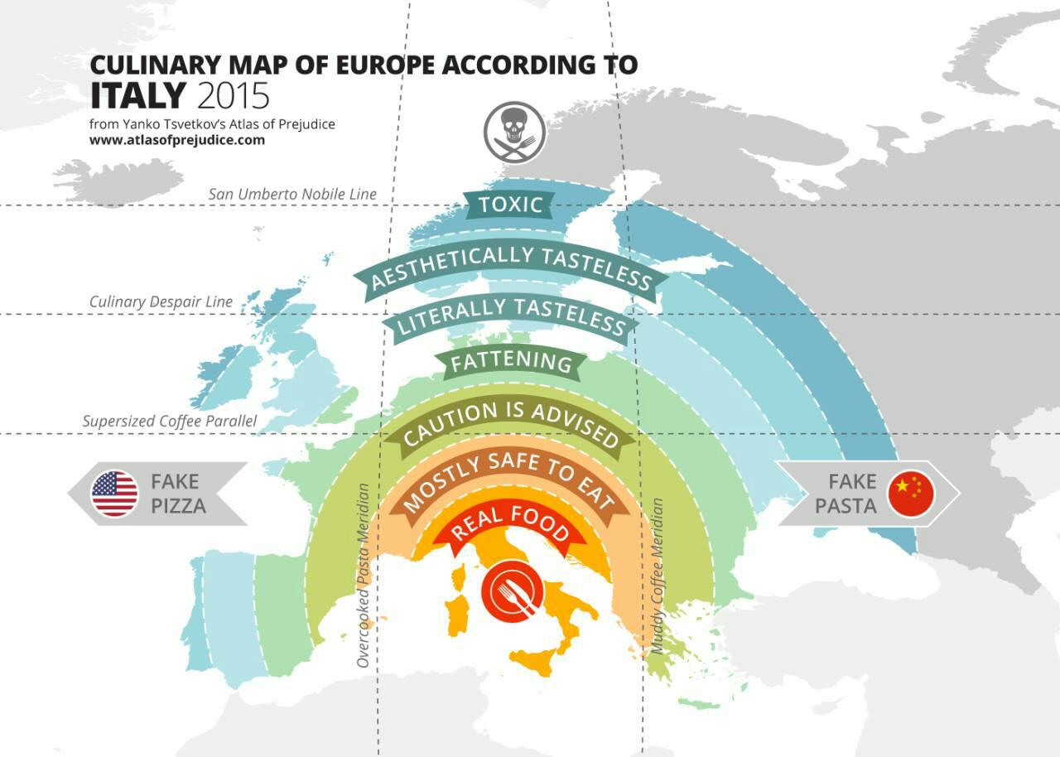

Slide 16


3. Beyond Narcisism
3.1. Three outrages to humanity’s narcissism
Copernicus (astronomic) earth → sun
Darwin (biological) human → animal
Freud (psychological) ego → unconscious
(Sigmund Freud, A General Introduction to Psychoanalysis, 1917)
Fourth outrage ?
Continental solipsism → decentration, mediterraneization
→ “mediterreanize thought (Edgar Morin), “decolonize provinces » (Michel Onfray)
“We need a Girondine ecosophy able to surpass Jacobine ecology”

Slide 17

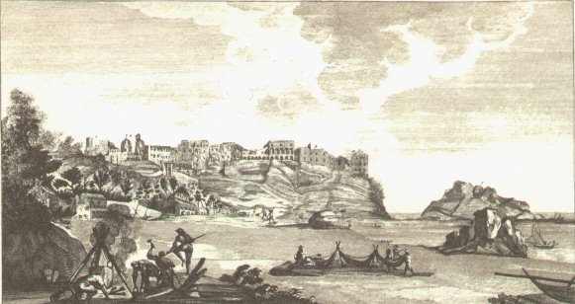
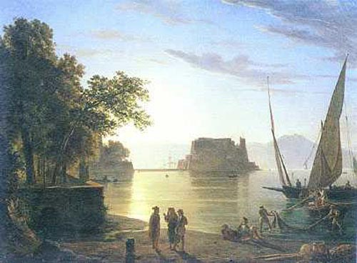
3.2. Harbour imaginary
“Paranoia of the centre” / Heidegger’s Geviert (sky, earth, humans, gods): verticality
vs horizontality “experience of the borderline (confine)” (Cassano, p. 36)
« Un jour, c’était au commencement de l’été, au moment où le golfe de Naples, bordé de ses collines, de ses maisons blanches, de ses rochers tapissés de vignes grimpantes et entourant sa mer plus bleue que son ciel, ressemble à une coupe de vert antique qui blanchit d’écume, et dont le lierre et le pampre festonnent les anses et les bords ; c’était la saison où les pêcheurs du Pausilippe, qui suspendent leur cabane à ses rochers et qui étendent leurs filets sur ses petites plages de sable fin, s’éloignent de la terre avec confiance et vont pêcher la nuit à deux ou trois lieues en mer jusque sous les falaises de Capri, de Procida, d’Ischia, et au milieu du golfe de Gaëte ». (Lamartine, Graziella, 1852)

Slide 18
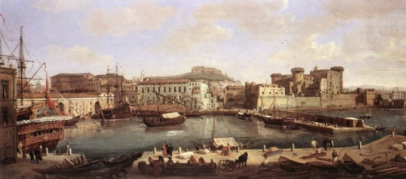
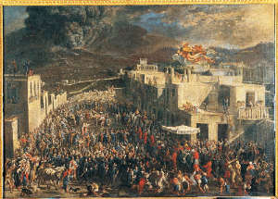


The harbour as centrifugal, excentric, excentred
centre vs periphery: “violation of semiotic boundaries” (Yuri Lotman, On the semiosphere, 1984, 2005)
experience (πεῖρα) ≈ pirat (πειρατής)

Slide 19
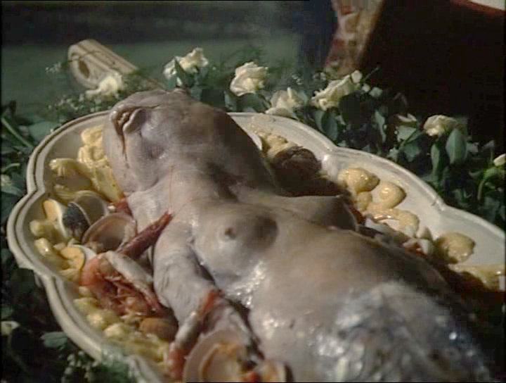
siren : girl/fish
«Tutti, in Europa, dissi, siamo più o meno napoletani » (p. 76)
«Io ero l’Europa. Ero la storia d’Europa, la civiltà d’Europa, la poesia, l’arte, tutte le glorie et tutti i misteri dell’Europa.
E mi sentivo inseime oppresso, distrutto, fucilato, invaso, liberato, mi sentivo viglacco ed eroe, bastard e charming, amicoe nemico, vinto e vincitore » (p. 195)
« Non è una bambina » dissi « è un pesce ».
[…] Non sono venuta in Europa perché il vostro amico Malaparte, and you, mi obbligiate a mangiare la carne umana, disse Mrs. Flat con voce tremante di sdegno « lasciamo a questo barbarous Italian people to eat children at dinner. I refuse. I am an honest american woman. I don’t eat Italian children! »
[…] « E è un pesce eccellente » risposi « e che importa se ha l’aspetto di una bambina ! E un pesce. In Europa, i pesci non sono obbligati ad assomiglare ad un pesce… In Europe, fish don’t have to look like fish » (p.214)
Curzio Malaparte, La pelle, 1947 (Liliana Cavani, 1981)

Slide 20
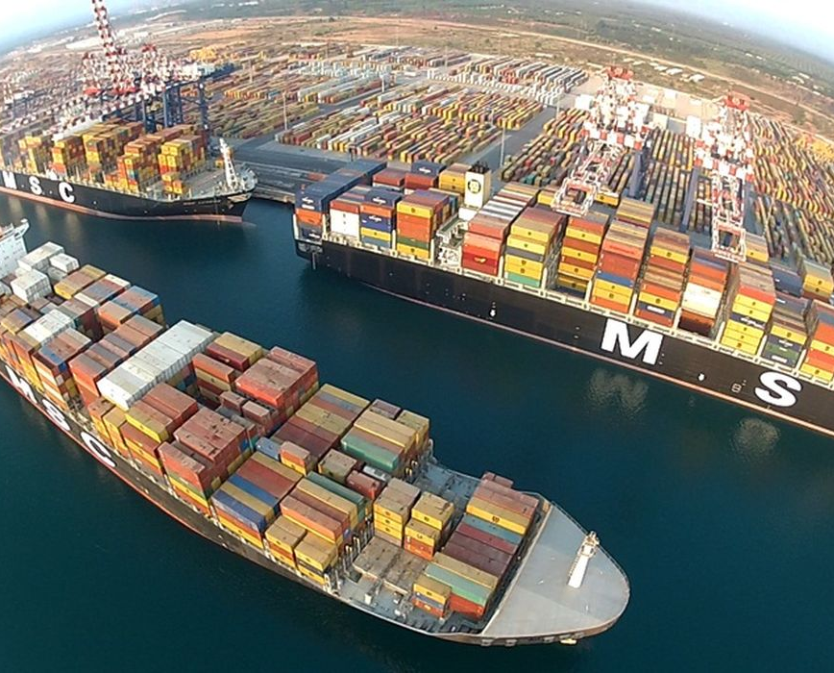
“Against the earth’s fundamentalism stands the fundamentalism of the sea, which pushes toward nihilism and the uncontrollable unleashing of technology.” (Franco Cassano)
3.3. Paradigmatic turn
“The sea of the gulf seems an immense bathtub full of hydrocarbon, not water, and bordered by the quay covered with thousands multi-coloured containers as an impassable barrier. Naples is surrounded by a wall of commodities, bulwarks which do not protect the city ; it is on the contrary a city which defends its bulwarks. No trace of the battalions of dockers, nor the picturesque populace of the harbours. One imagines the port as a noisy place, invaded by frenetic crowds, by the back and forth of men stitched by scars and speaking a lot of improbable languages. It is at the contrary the silence of a automatized factory that weights on it. » (Roberto Saviano, Gomorra, 2006)

Slide 21
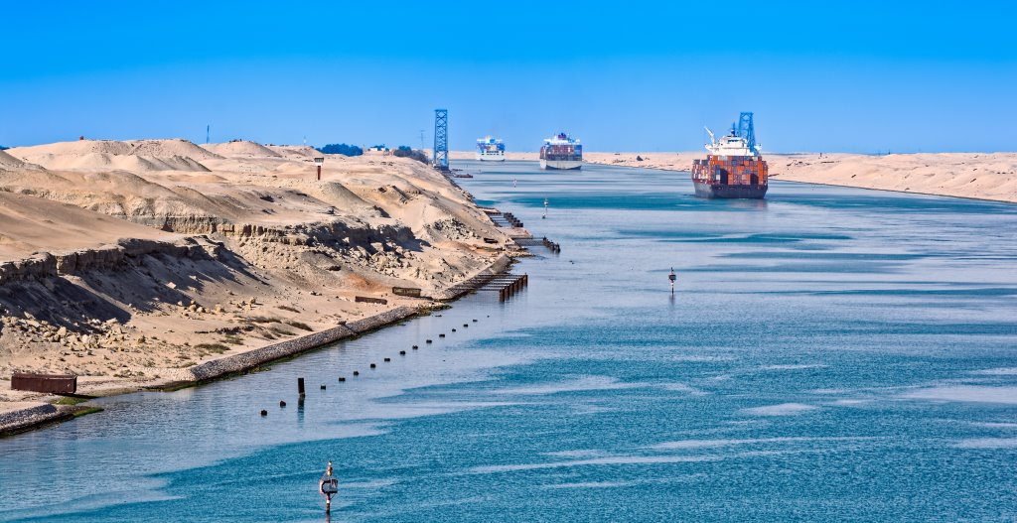
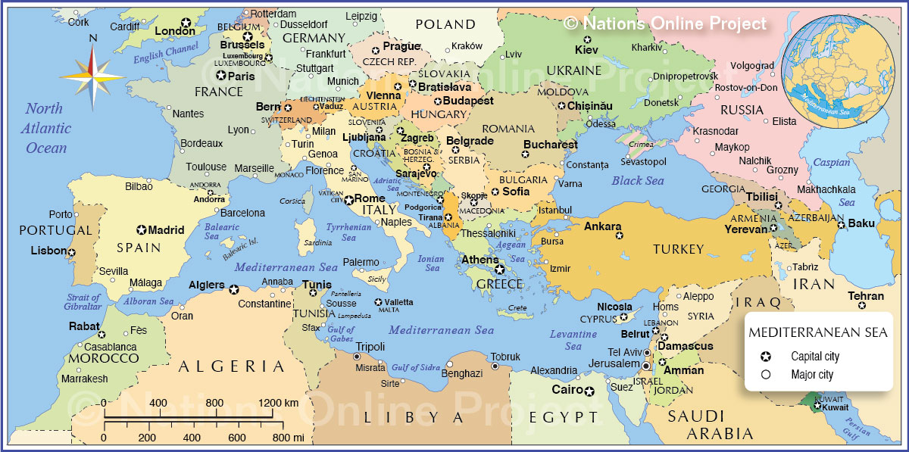
Ulysses shipwreck (DANTE), emblematic of suicidal
unbridled globalised trade ?
The expansion of the Suez Canal

Slide 22

Conclusion : the Mediterranean as a common property
Common:
c. 1300, “belonging to all, owned or used jointly, general, of a public nature or character,” from Latin communis “in common, public, shared by all or many; general, not specific; familiar, not pretentious.”
Common good (late 14c.) translates Latin bonum publicum "the common weal.“
Edgar Morin, « Penser la Méditerranée et méditerranéiser la pensée » “Thinking the Mediterranean and mediterraneize thinking”, Confluences Méditerranée, n°28, 1998-1999
To stop seeing the Mediterranean as a frontier of Europe but perceive it as a common good and a big communicator
To regenerate tricontinental communication
To recognize madre nuestra in our mare nostrum
Jacques Attali, Histoires de la mer, 2017
Against “continental tropism”
Sea and water in texts and images
12th international IAWIS/AIERTI conference (6-10 July 2020) at the University of Luxembourg

