Slide 1


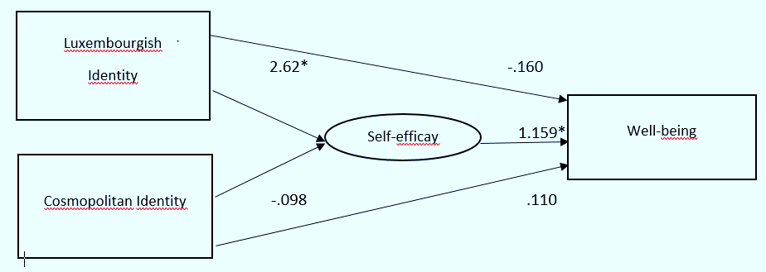
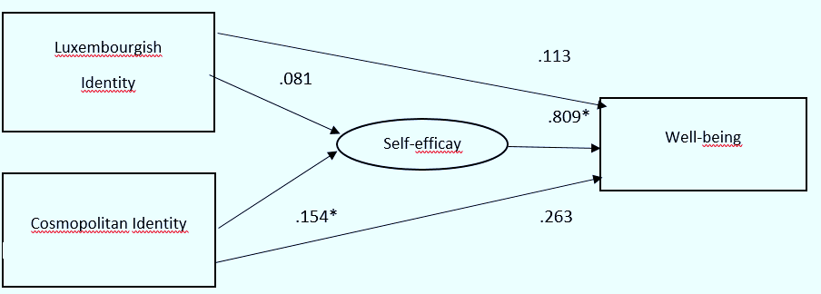

SSEA Thematic Conference: Self and Identity in Emerging Adulthood
May 17-19, 2018, Cluj-Napoca, Romania
Identification Patterns and Subjective Well-Being in Native and Migrant Emerging Adults: The Mediating Role of Self-Efficacy
Maria Stogianni & Elke Murdock, University of Luxembourg
contact: maria.stogianni@uni.lu
INTRODUCTION
SAMPLE
Luxembourg is one of the most diverse countries in Europe with a foreign population percentage of nearly 48%. Exposure to different cultures and switching between languages are normal everyday occurrences in Luxembourg. These culture contact situations have particular implications for the development of identity. Young adults with migration background are being socialized in two or more different cultures and native Luxembourgish citizens can find themselves in the minority in certain contexts. Research has shown that salience of national identification is heightened within this multicultural context while higher levels of national identification are associated with life satisfaction and better health outcomes (Murdock, Hirst, & Ferring, 2014; Phinney, Cantu, & Kurtz, 1997). Other findings provide evidence that new, shared identities can emerge in highly diverse areas (van de Vijver, Blommaert, Gkoumasi & Stogianni, 2015).
Building on these findings, we would like to investigate the relationship between identification patterns and psychological well-being for natives and migrant emerging adults living in this multicultural context. In addition, we set out to explore individual difference variables that may affect this relationship. Self-efficacy is an important predictor of psychological well-being (Karademas, 2016) and previous findings suggest that it is associated with ethnic identity (Smith, Walker, Fields, Brookins, & Seay, 1999). A positive sense of belonging to one’s ethnic group can enhance efficacy perceptions (Karademas, 2016).
Therefore, the present study aims to complement existing research by investigating the impact of multiple social identifications on self-efficacy perceptions and well-being. There is evidence that these variables are strongly related but they have not been conjointly considered in a common model. This method will enable us to develop a better understanding of the complex interplay between social identification patterns and personality factors that affect well-being.
Objectives:
To investigate differences in identification patterns among natives and emerging adults with migratory background
To investigate the influence of multiple social identifications on psychological well-being and the interrelationship between different identity components
To examine the role of self-efficacy as individual difference variable potentially affecting the link between identification patterns and life satisfaction. Specifically, we tested the mediating role of self-efficacy in the relationship between (supra)-national identification and well-being
The sample included 260 young adults.
As native Luxembourgish we classified those participants who were born in Luxembourg and whose parents were born in Luxembourg (n = 112). Participants with migration background (n = 148) comprise the 2nd generation, that is those who are born in Luxembourg (67,6%), but at least one parent was not. First generation migrants were not born in Luxembourg and have non-Luxembourgish parents.
Participants provided different nationalities – with the majority (77%) holding Luxembourg citizenship. A quarter indicated that they hold more than one nationality.
 | 1st and 2nd generation migrants | Luxembourg natives
N | 148 | 112
age | M = 22 SD = 2.563 | M = 21.48 SD = 2.044
gender | females 67.6 % males 31.8 % | females 60.7% males 39.3 %
MEASURES
Participants completed online self-report questionnaires available in two languages (French and German). The questionnaires were translated by native speakers and checked by a group of multilingual psychologists.
Satisfaction with Life Scale (Diener, Emmons, Larsen, & Griffin, 1985, α = .895)
5 items, e.g. “In most ways my life is close to my ideal”; 7-point Likert scale (1 = completely disagree; 7 = completely agree)
General Self-Efficacy Scale (Schwarzer & Jerusalem, 1995, α = .824)
10 items, e.g. “It is easy for me to stick to my aims and accomplish my goals”; 4-point Likert scale (1 = not at all true; 4 = exactly true)
Identification with Luxembourg was assessed with the Multigroup Ethnic Identity Measure (MEIM; Phinney, 1992, α = .887)
12 items, e.g. “I have a strong sense of belonging to my own ethnic group”, 5-point Likert scale (1 = completely disagree; 5 = completely agree)
Cosmopolitan Identity Scale (Saroglou & Hanique, 2006; van de Vijver et al., 2015, α = .588)
The scale assesses transnational identification and beliefs about global citizenship, 7 items, e.g. “I identify more strongly with humankind in general than with members of my own ethnic group”, 5-point Likert scale (1 = very slightly/not at all; 5 = totally)
RESULTS
Descriptive statistics and correlations for Natives and Participants with migration background
To examine the direct and indirect relationships among different identity components, self-efficacy perceptions, and life-satisfaction, we tested path mediation models. Identity components were used as indicators of well-being and self-efficacy was introduced as a mediator variable.
Path model of identity domains, self-efficacy, and well-being for native Luxembourgish emerging adults
Model fit χ²(1, N = 112) = .087, p = .768, RMSEA = .000, CFI = 1.00, SRMR = .0089
Ethnic and cosmopolitan identification were not directly associated with well-being. Self-efficacy fully mediated the relationship between ethnic identity and well-being
 | M | SD | 1 | 2 | 3
1.Luxembourgish Identity | 3.27 3.20 | .77 .81 | - | .028 .129 | .371** .174*
2.Cosmopolitan Identity | 4.03 4.24 | .53 .43 | .028 .129 | - | .205* .169*
3.Self-efficacy | 3.02 2.96 | .40 .42 | .371** .174* | .205* .169* | -
4.Well-being | 4.97 4.78 | 1.12 1.08 | .127 .149 | .129 .149 | .325** .353**
Notes: *p < .05. **p < .01.
Path model of identity domains, self-efficacy, and well-being for immigrant emerging adults
Model fit χ²(1, N =145) = 2.452, p = .117, RMSEA = .100, CFI = .946, SRMR = .0429
Identification patterns were not significant predictors of subjective well-being. A significant indirect effect was observed: Self-efficacy mediated the relationship between transnational identification and well-being.
There were no significant differences for Luxembourgish identification, self-efficacy, and subjective well-being natives and participants with migration background.
Participants with migration background scored higher on the Cosmopolitan identity scale, t(209.908) = -3.446, p < .01.
DISCUSSION
Our results indicate that Luxembourgish and cosmopolitan identity were relatively strong for all emerging adults. Self-efficacy was positively associated with well-being and both identity components. For native emerging adults, ethnic identity is an important source of self-efficacy and well-being. A different pattern of relationships emerged for young adults with migratory background. Self-efficacy acted as a mediator on the relationship between cosmopolitan identity and well-being, indicating that for this group supranational identification is particularly important in predicting positive psychological outcomes. In line with our hypothesis, the findings confirm the mediating role of self-efficacy and provide evidence that multiple social identifications create a sense of self-efficacy which enhances well-being.
References
Diener, E., Emmons, R. A., Larsen, R. J., & Griffin, S. (1985). The Satisfaction with Life Scale.Journal of Personality Assessment, 49(1), 71-75; Jaret, C., & Reitzes, D. C. (2009). Currents in a stream: college student identities and ethnic identities and their relationship with self‐esteem, efficacy, and grade point average in an urban university. Social Science Quarterly, 90(2), 345-367. Karademas, E. C. (2006). Self-efficacy, social support and well-being: The mediating role of optimism. Personality and Individual Differences, 40(6), 1281-1290. Murdock, E., Hirt, F. S., & Ferring, D. (2014). Salience of nationality in students’ spontaneous self-concept: A comparative study of a nationally homogeneous and a heterogeneous school context. Journal of Research in International Education, 13(2), 119-134. Phinney, J. S., Cantu, C. L., & Kurtz, D. A. (1997). Ethnic and American identity as predictors of self-esteem among African American, Latino, and White adolescents. Journal of Youth and Adolescence, 26(2), 165-185. Phinney, J. S. (1992). The multigroup ethnic identity measure: A new scale for use with diverse groups. Journal of Adolescent Research, 7(2), 156-176; Saroglou, V., & Hanique, B. (2006). Jewish identity, values, and religion in a globalized world: A study of late adolescents. Identity, 6(3), 231-249; Smith, E. P., Walker, K., Fields, L., Brookins, C. C., & Seay, R. C. (1999). Ethnic identity and its relationship to self-esteem, perceived efficacy and prosocial attitudes in early adolescence. Journal of Adolescence, 22(6), 867-880. Schwarzer, R., & Jerusalem, M. (1995). Generalized Self-Efficacy scale. In J. Weinman, S. Wright, & M. Johnston, Measures in health psychology: A user’s portfolio. Causal and control beliefs (pp. 35-37). Windsor, UK: NFER-Nelson; Van de Vijver, F. J., Blommaert, J., Gkoumasi, G., & Stogianni, M. (2015). On the need to broaden the concept of ethnic identity. International Journal of Intercultural Relations, 46, 36-46.
*This research was supported by a grant from the Fonds National de la Recherche, Luxembourg C16/SC/11337403/SWITCH/Murdock.

