Slide 1



“Because everybody does it” – student mobility as social norm? Case study Luxembourg
Emilia Kmiotek-Meier, M.A.
University of Luxembourg
Global Students: Mapping the Field of University Lives Research
7-9 December 2017, University of Bielefeld, ZiF
The research from the MOVE project leading to these results has received funding from Horizon 2020 under Grant Agreement N° 649263.

Slide 2
Student mobility in Luxembourg
2003 foundation of the University of Luxembourg
degree mobility from Luxembourg
75-80 % of all enrolled in tertiary education study abroad
mainly DE, FR, BE (language and geographical proximity)
credit mobility from Luxembourg
an obligatory semester abroad for undergraduates
mainly other EU-countries
almost 100% student mobility from Luxembourg

Slide 3
Luxembourgish Student Associations
umbrella associations of Lux student unions in many (mostly) European cities
  umbrella association ACEL - Cercles d’Etudiants Luxembourgeois
seen as elite formation / networking opportunity
  e.g. REEL (Réunion Européenne des Etudiants Luxembourgeois) where students meet politics and industry stakeholders
former presidents of the associations -> careers in politics, prominent industrialists, entrepreneurs and lawyers
“promotion prospects of mostly male Luxembourgish student youth across a political spectrum from conservative Catholic to liberal Catholic”
(Rohstock & Schreiber, 2013: 188ff)

Slide 4
Outgoing student mobility in Luxembourg – national discourse
“I am – with endlessness fanatism - against a Luxembourgish university, as I am afraid of blindness (German: Betriebsblindheit) of young Luxembourgers who have not studied abroad at least four years. I am afraid of the academic incest.” (Juncker 1997: 13, own translation)
for years: “migration of budding academics was considered a necessary requirement for an intellectual, cultural and scientific expansion of Luxembourg’s horizons and, thus, beneficial to the homeland.” (Rohstock & Schreiber, 2013: 175)
now: outgoing mobility linked with concepts such as knowledge economy and building of national elites, need for international know-how and networks brought into the country by Luxembourgish youth graduated from higher institutions abroad
(Kmiotek-Meier, Karl & Powell 2017)
during the foundation of the University: resulting from tradition of study abroad an obligatory mobility semester for all undergraduates; not too many should stay at home to study -> international orientation

Slide 5
Students University of Luxembourg
N=6153

Slide 6
Mobility as normality?
Discourse:
Outgoing mobility of Luxembourgish students seen as
needed / traditional / normal / good (but for who?)
Questions:
But what about young people?
-> until foundation of the UL : a norm – a must – no alternative
-> now: ?
How do young people relate to (forced) student mobility?
How does it fit with the national discourse on it?

Slide 7
Data overview
Data overview / QUALITATIV - Interviews
Data collection | from October 2015 until July 2017
Instrument | Semi-structured interview; German
Target group | Outgoing mobility: nationality or A-Level from Luxembourg
Study type | Credit: 7 / Degree: 8 = 15
Destination | Germany (5), Belgium (4), Austria (3), France (3), England (2), Holland (1) -> Ba/Ma/credit in different countries
Gender | Female: 9 / Male: 6
Programme | Humanities: 12 / Technical & Economical sciences: 3

Slide 8
Data overview
Data overview / QUANTITATIV – Survey(s)
Data collection | November 2016 until February 2017
Instrument | Self-administrated online survey; all official languages
Target group | Outgoing mobility: nationality or A-Level from Luxembourg, Germany, Romania, Spain, Norway and Hungary
N Luxembourg Germany Romania Spain Norway Hungary ALL | 970 2.085 1.330 2.131 1.153 1.137 8.706

Slide 9
Findings: survey

Slide 10
Findings: survey

Slide 11
Findings: narrations - degree
Strong similarities between narrations of young people and the national discourse: ALL degree mobile students refer to idea of studying abroad in Luxembourg as normal
“All have studied abroad” (Anna, degree mobility)
“I think if one went to Luxembourgish school, it was rather interesting for the most to study abroad, at least in the close-abroad, because Luxembourg has only one uni and it is very small (…) For me it was not an option to study in Luxembourg, it was just normal to go abroad” (Celine, degree mobility)
“I have registered at Uni.lu but as an emergency option… because I think a lot of us in Luxembourg want to leave someday [for study] (…) you did not want to be the one who stays at the Uni.lu” (Ingo, degree mobility)
-> referring to collective narration (“all”, “we”, …)
-> peers oriented / siblings/parents

Slide 12
Findings: narrations - degree
The social norm to go abroad: yes … reason(s): ?
Discourse:
strong knowledge-based economy, prosperity, know-how -> country level
Students:
personal development, freedom, being autonomous and independent, mostly in regard to their parents
open-mindedness, new cultures, new people, new horizons
leaving SMALL Luxembourg for some time, enormous social control
reason(s): DIFFERENT

Slide 13
Findings: narrations - credit
All interviewees from UL (credit mobility) have considered, have applied to or have studied abroad
the first idea was never the UL
BUT
divided opinions about the mobility imperative in Luxembourg among credit mobile students

Slide 14
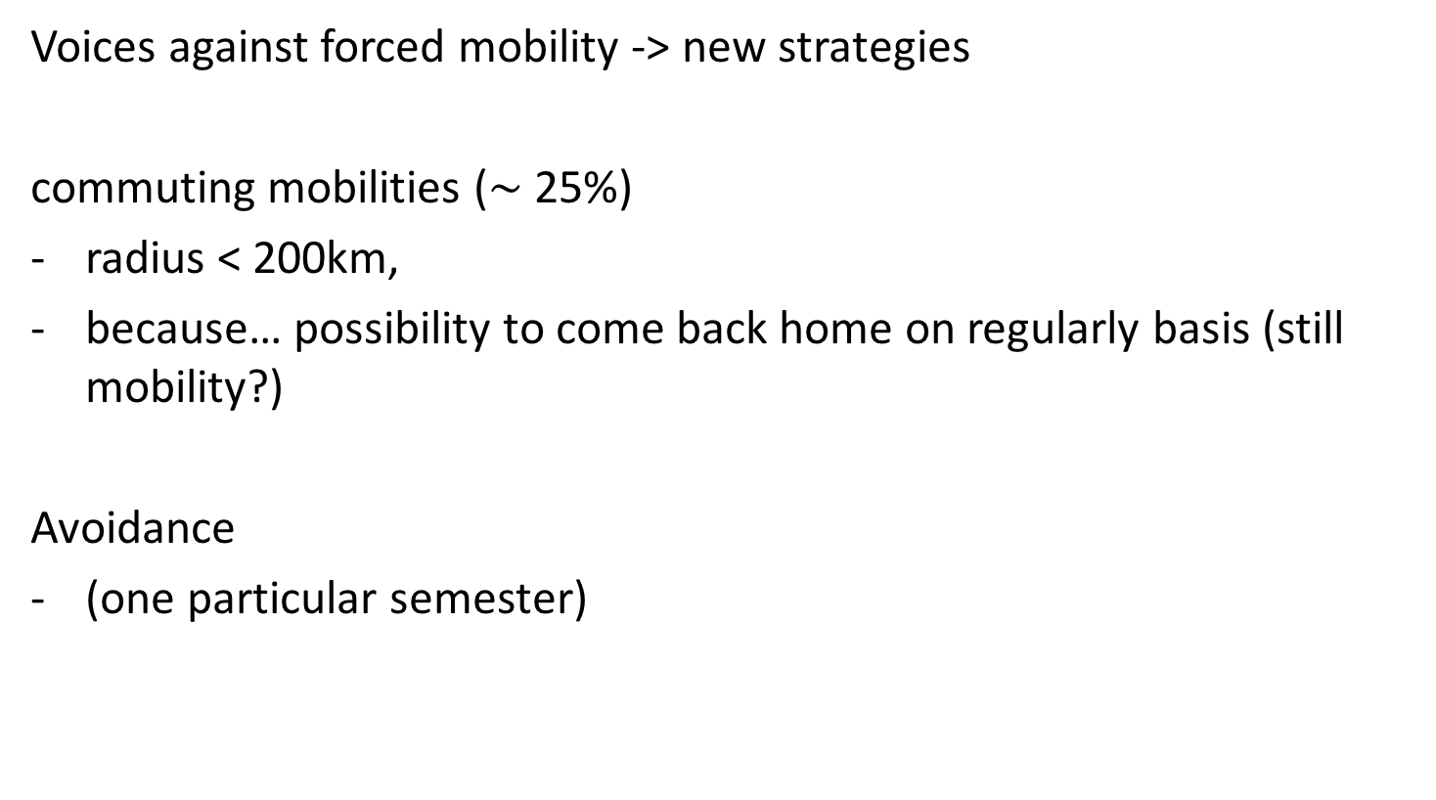
Findings: narrations - credit
Voices against forced mobility -> new strategies
commuting mobilities ($\sim$25%)
radius < 200km,
because… possibility to come back home on regularly basis (still mobility?)
Avoidance
(one particular semester)

Slide 15
Findings: Luxembourg
New actor: the UL opened new degrees of freedom -> new strategies
→ questioning the “normality” and the idea of student mobility
Redefining the idea of forced mobility -> redefining the Luxembourgish idea of study in general…
hitherto study = stay abroad
It is becoming legitim to study in Luxembourg
  at least a part of the studies
  at least in some professions
HOWEVER
still, more common to study abroad the entire programme
…let’s see in 10 years:>

Slide 16
Discussion
Study abroad as social norm? probably not only in Lux… which levels?
-> country / supra-national
-> subject (Petzold & Peter, 2015)
-> class / social status
-> profession (law?)?
-> ??
Transformations due to?
-> mass education?
-> new institutions (as UL)
-> legislation (why?)
sanctions???

Slide 17
References
Juncker, J.-C. (1997): Mit Sozialklauseln die Globalisierung abfedern. Ein forum-
Gespräch mit Premierminister Jean-Claude Juncker, In: forum, Nr. 175, S. 5–15.
Kmiotek-Meier, E., U. Karl & J. Powell (2017): Agenda for now and future – International Student Mobility in Luxembourg. Case study: Luxembourg (Manuscript in preparation).
Petzold, K., & Peter, T. (2015). The social norm to study abroad: determinants and effects. Higher Education, 69, 885–900.
Rohstock, A., & Schreiber, C. (2012). The Grand Duchy on the Grand Tour: a historical study of student migration in Luxembourg. Paedagogica Historica: International Journal of the History of Education, 49(2), 174–193. https://doi.org/10.1080/00309230.2012.701221

Slide 18
Thank you for your attention!
Contact:
Emilia Kmiotek-Meier
emilia.kmiotek@uni.lu
University of Luxembourg
Faculté des Lettres, des Sciences Humaines,
des Arts et des Sciences de l'Education
Institute of Geography and Spatial Planning
http://www.move-project.eu
FINAL CONFERENCE
Youth Mobility and Migration in Europe – Keep on Moving?
Pathways, Institutions and Structural Effects of Youth Mobility in Europe
7th – 9th of March 2018
University of Luxembourg
The research from the MOVE project leading to these results has received funding from Horizon 2020 under Grant Agreement N° 649263.

