Slide 1


Youth Mobility – experiencing (un)certainties
Emilia Kmiotek-Meier (University of Luxembourg)
Volha Vysotskaya (University of Luxembourg)
26. Kongress der DGfE, Universität Duisburg-Essen, 19.03.2018
Symposium: Moving to Nowhere Land?. (Un)Certainties in career and training pathways of the young generation
MOVE has received funding from the European Union’s Horizon 2020 research and innovation programme under Grant Agreement No. 649263

Slide 2
Overview
Introduction
Project MOVE
Data
Results
Discussion

Slide 3
I Introduction

Slide 4
Luxembourgish context
Three official languages: Luxembourgish, French, German
Employment mobility:
the biggest group in the labour force in Luxembourg is that of cross-border employees and workers from the Greater Region (Brosius et al. 2014)
Student mobility:
75 % of all enrolled in tertiary education study abroad
+ 50% of students enrolled have no LU nationality
an obligatory semester abroad for undergraduates

Slide 5
Mobility
Resource (proxy for openness, creativity, etc., Di Pietro 2013)
Successful
“Cool” / youth practice
Construct (vs. migration)
Tool (shortages in the EU labour market, knowledge economy, human capital)
“Although geographic mobility is not a goal in itself, it may offer people better career prospects or professional alternatives.” (COM 72 2002)
Different types of mobility

Slide 6
II Project MOVE
(May 2015 – April 2018)

Slide 7
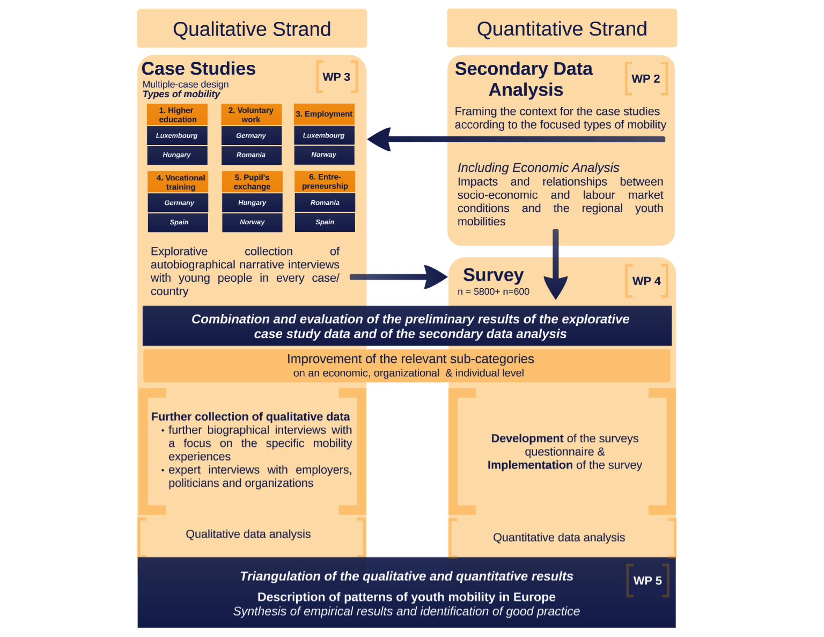

Slide 8
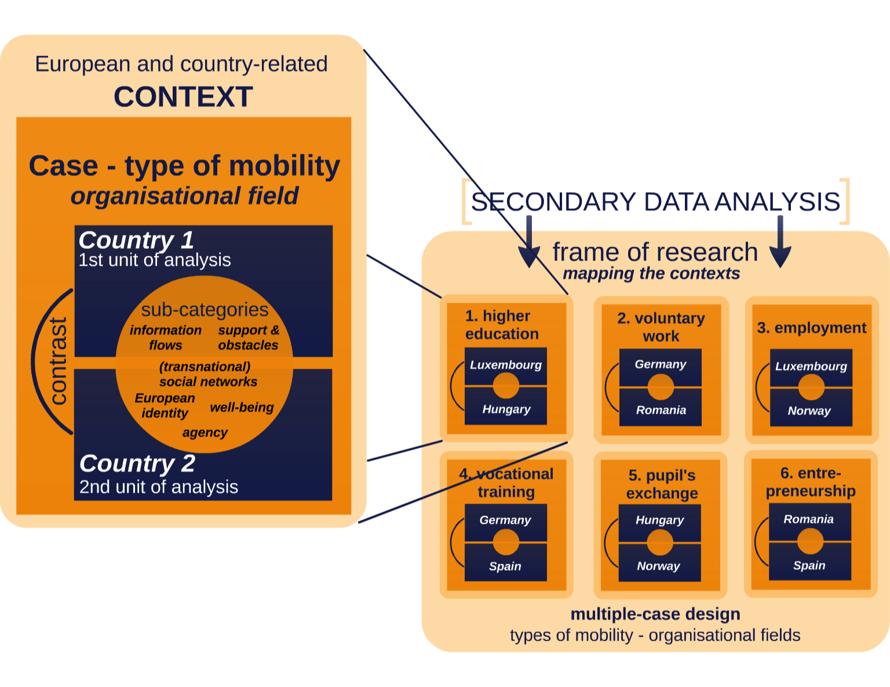

Slide 9
III Data

Slide 10
Data
Online survey (only mobile)
Representative part + snow ball part; N=5,275
November 2016 - January 2017
Interviews with young mobile people:
different stages (during & after)
January 2016 - Dezember 2016
Mobility type | incoming | outgoing | ALL
higher education | 3 | 15 | 18
employment | 12 | 3 | 15
 |  |  | 33

Slide 11
IV Results

Slide 12
Interviews

Slide 13
Security – economy
Financial security
Experience & stabilization and financial / material independence
Employment mobility & student degree mobility

Slide 14
Security – economy
“ You realise that you earn money, and you cannot even survive from first to first (month), so it is very important, the economy was very important for us (…)“
“ We just decided to come here, we packed out things, we stopped renting our apartment in [city B in Poland] and we said, okay, let's try somewhere else. Because in Poland,… maybe we can come back to Poland, we have nothing here, so we don't lose anything. and then maybe we can get something in Luxembourg, we'll find experience, our, I don't know, if it doesn't work, because it was easy for us because we had an apartment /with my mum/, we don't have to pay, we didn't have to pay for rent.”
(employment mobility from Poland to Luxembourg, EM5)

Slide 15
Security – economy
Flexicurity
Flexible – young people
Security – provided by family (safety net)

Slide 16
Security - body
Stable country (institutions)
Secure country
Mobility as strategy to escape insecure circumstances

Slide 17
Security - body
”I: You’ve mentioned good living conditions and small city. And you’ve mentioned this low criminality rate and did you feel insecure in your homeland?
IP: In my home? In my hometown. Jaa. I feel very insecure, although I live in a very (.) public and crowded… I live actually in a big plateau ((incomp)). And although the police station is some meters away from my building, where I live in (.) it’s quite scary me (.) in the winter, that gets dark really early you are very unsafe as a women to walk after eight o’clock in the street. Really I walk and I don’t I look in front of me, I look all the time behind me. And yeah, the government doesn’t provide us with the security, neither the police, nor the government.”
(student degree mobility from Greece to Luxembourg, HE2)

Slide 18
Security - body
“Y: So when I was actually contacted by the institutions in Luxembourg I was a bit disappointed that it was here, what did that have to happen. (I: hmm) But then, once it did happen ... it was actually good, fairly okay, or something and then I mean, not that that has anything to do with it, but I mean it was just high alert level in [city A in Belgium], just exactly at that (I: okay) time everybody was thinking you know, next bomb was gonna go up like within days and I thought, yeah maybe it's just a bit safer.”
(employment mobility from Germany to Luxembourg, EM8)

Slide 19
Safety
Limits < - > Safety
Escape social control (especially from parents)
but -> need to feel safe and protected
neglected by policy in the mobility discourse
Mobility as a challenge

Slide 20
Safety
”I have the scholarship and I have a loan, and I’m minimal supported by my parents. And the reason is that my father says, I should manage with the money I get… but if it is not enough then I just have to call and my mom, she will do it. ”
(student degree mobility from Luxembourg, HE9)

Slide 21
Safety
“Y: It is a matter of comparison, and for example, I am, why did I tell you that I feel lucky in Luxembourg? Because, that experience in Australia, now I have job security, I live in a European country, I can speak languages and meet wonderful people. It is amazing if you think about it. ... (…) Well, for example they [parents] told me, ya I mean, who, because you know, it is still Europe, it is close, and whatever you need, just ask us. I mean, whether it is money or anything else. You just ask us, and we are just one phone call away. SO that gave me a bit of safety. You know. At the time of leaving Italy, for Luxembourg. So I felt safer to have them back in Italy.”
(employment mobility from Italy to Luxembourg, EM3)

Slide 22
Survey

Slide 23
Main hindering factors *mobile: at least 2 weeks abroad other than holiday or family visit (only with at least one answer; multiple answer)
Obstacles | MOBILES % (N=1,644)
1 Lack of sufficient language skills | 38.7
2 Lack of support or information | 29.5
3 Difficulties to register in education/training | 14.8
4 Obstacles or differences in recognition of qualifications | 19.0
5 Difficulties finding a job abroad | 20.0
6 Difficulties to obtain a work permit abroad | 11.7
7 A worse welfare system (pensions/healthcare) | 14.8
8 My partner is not willing to move | 13.4
9 Psychological well-being (fear of suffering from stress/loneliness/sadness) | 24.3
10 Financial commitments in my current place of residency (e.g. bank loans or owning a property) | 11.6
11 Lack of financial resources to move abroad | 29.0

Slide 24
V Discussion

Slide 25
Mobility is an adventure

Slide 26
Mobility is an adventure (?) - finances - accommodation - struggle in new system

Slide 27
Mobility / migration… and the difference is? - different mobilities - way to survive - boundaries by labeling

Slide 28
Mobility imperative … costs a lot … but whom? State? Young people? Families?

Slide 29



Thank you for your attention!
Contact:
Emilia Kmiotek-Meier
emilia.kmiotek@uni.lu
University of Luxembourg
Faculté des Lettres, des Sciences Humaines,
des Arts et des Sciences de l'Education
Institute of Geography and Spatial Planning
http://www.move-project.eu
The research from the MOVE project leading to these results has received funding from Horizon 2020 under Grant Agreement N° 649263.

Slide 30
Literature
Brosius, J., J.-C. Ray, B. Verheyden, and D.R. Williams. 2014. Wage Differentials Between Natives and Cross-Border Workers Within and Across Establishments. Rochester, NY: Social Science Research Network. http://dx.doi.org/10.2139/ssrn.2615809.
COM 72 2002, „Action plan for skills and mobility“ in: Official Journal of the European Union, 2002, http:// europa.eu/legislation_summaries/internal_market/living _and_working_in_the _internal_market/c11056_en.htm, accessed 25 June 2015.
Di Pietro, G., „Do study abroad programs enhance the employability of graduates?“ in: IZA Discussion Paper, Institute for the Study of Labor, Bonn, 2013. Sowie: Jones, E., „Internationalization and employability: the role of intercultural experiences in the development of transferable skills“ in: Public Money and Management, 33 (2), 2013, S. 95-104.

