Slide 2


Myths and Realities around Open Access
Jonathan England
Luxembourg National Open Access Desk
University of Luxembourg Library
jonathan.england@uni.lu
https://orcid.org/0000-0001-6715-8628
Share and reuse by citing: Jonathan England, 2017, https://doi.org/10.5281/zenodo.1189190 under CC-BY 4.0 International

Slide 3
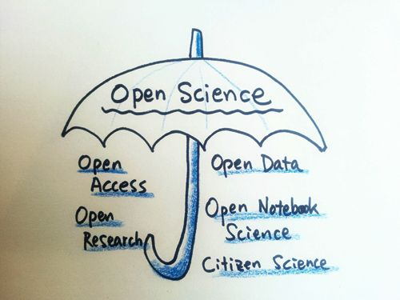
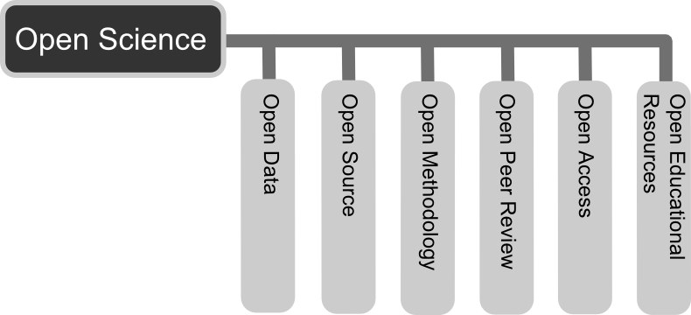


OPEN SCIENCE
= free unrestricted online access to peer-reviewed research publications
Images:
지우 황, Flikr, CC-BY 2.0
Andreas E. Neuhold, Wikimedia Commons, CC-BY 3.0
Share and reuse by citing: Jonathan England, 2017, https://doi.org/10.5281/zenodo.1189190 under CC-BY 4.0 International

Slide 4
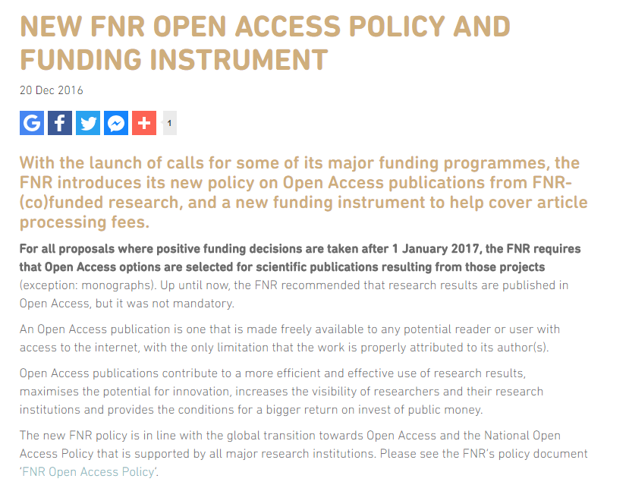
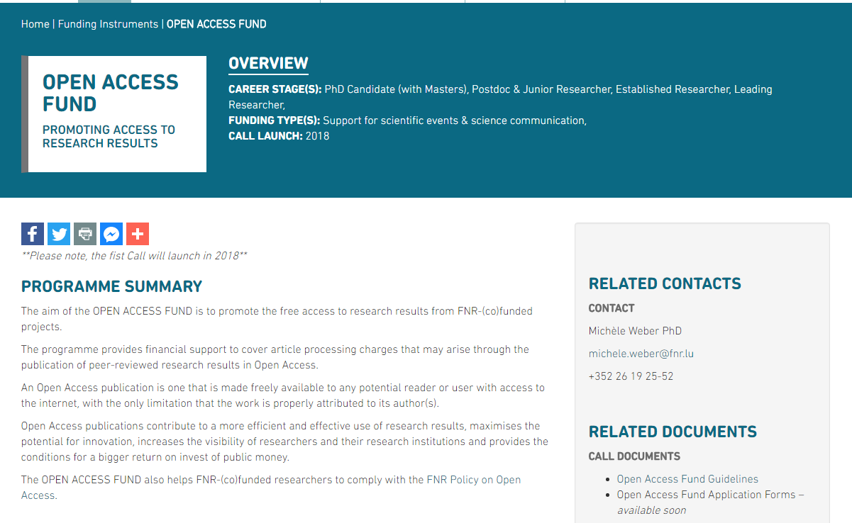
FUNDERS’ OA MANDATES
https://www.fnr.lu/new-fnr-open-access-policy-funding-instrument/
http://storage.fnr.lu/index.php/s/9k72EH61fXGL9oX#pdfviewer
https://www.fnr.lu/funding-instruments/open-access-fund/
Share and reuse by citing: Jonathan England, 2017, https://doi.org/10.5281/zenodo.1189190 under CC-BY 4.0 International

Slide 5


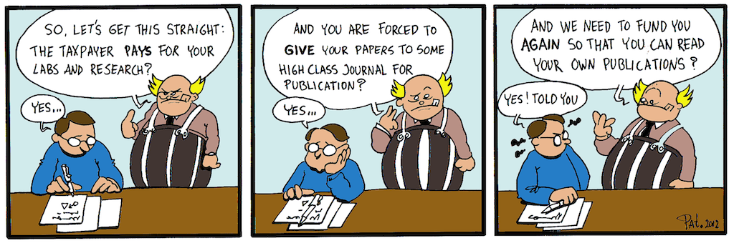
Yet another mandate!
I want to publish wherever and however I want !
Reality 1
Myth
Tax-payers are paying twice to access publicly-funded research outputs
Patrick Hochstenbach, “Yes! I told you!”, 2012
Share and reuse by citing: Jonathan England, 2017, https://doi.org/10.5281/zenodo.1189190 under CC-BY 4.0 International

Slide 6












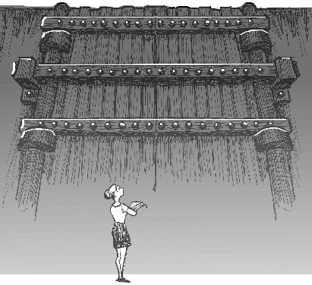

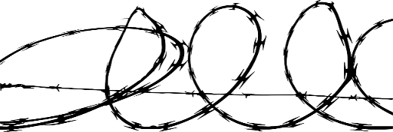

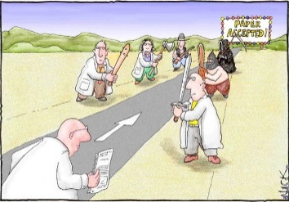
Government
Researcher
Research project
Public
Research Institutions
Library consortium
Manuscript
PAY-WALL
Publisher
Article published
Read article
Journal
Copy-editing
Journal editors
Reviewers
Images:
John R. McKiernan, Why Open Research?
Nick Kim, Science and Ink
Share and reuse by citing: Jonathan England, 2017, https://doi.org/10.5281/zenodo.1189190 under CC-BY 4.0 International

Slide 7
Luxembourg spends per year
>1.1M € (HTVA)
for journal subscriptions
Figures from 2016, kindly provided by Consortium Luxembourg
Share and reuse by citing: Jonathan England, 2017, https://doi.org/10.5281/zenodo.1189190 under CC-BY 4.0 International

Slide 8
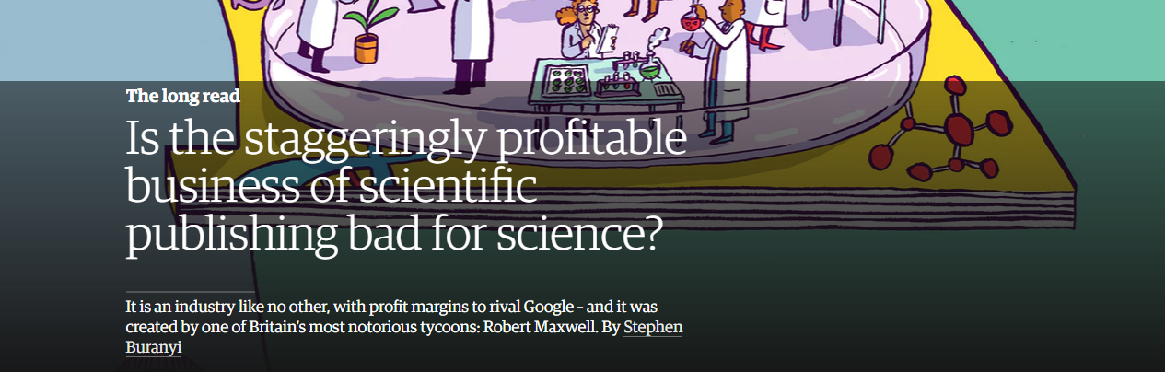
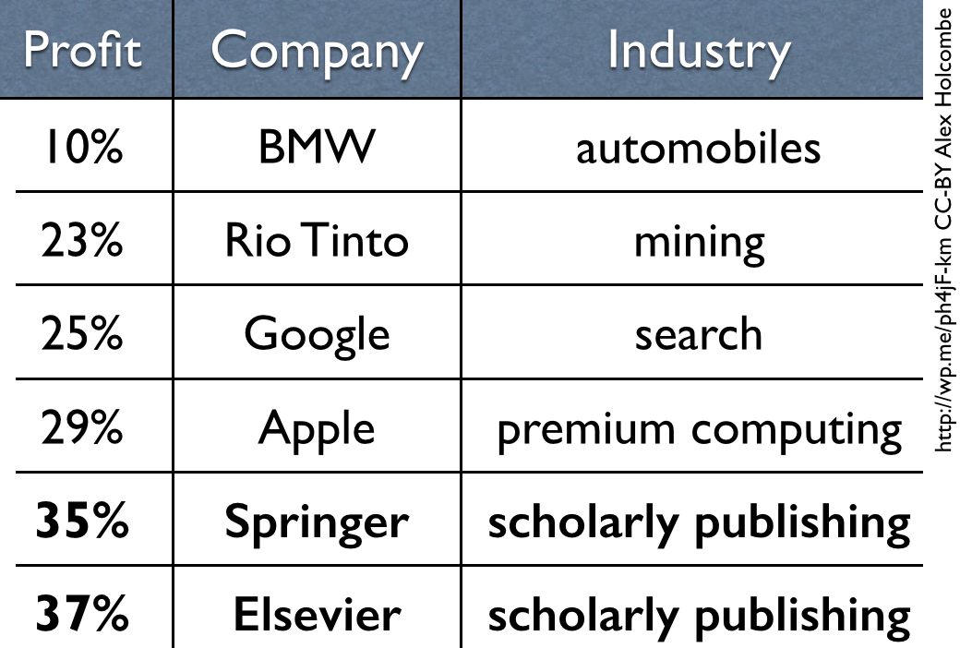
37% profit margin
Stephen Buranyi, The Guardian, 27/06/17 [link]
In 2014:
for Elsevier (in 2016*)
*RELX Group 2016 Results
Alex Holcombe, 21/05/15 [link]
Share and reuse by citing: Jonathan England, 2017, https://doi.org/10.5281/zenodo.1189190 under CC-BY 4.0 International

Slide 9

Is the reviewing process in OA journals as good as non OA journals?
Myth 1
Open Access = journal …
Open Access = archiving model / philosophy
It is NOT about where you publish but where it is made available
Share and reuse by citing: Jonathan England, 2017, https://doi.org/10.5281/zenodo.1189190 under CC-BY 4.0 International

Slide 10
I’d like to publish Open Access but I can’t pay the high costs
Myth 2
Open Access = author pays for Open Access
Several routes to make research outputs freely available
Share and reuse by citing: Jonathan England, 2017, https://doi.org/10.5281/zenodo.1189190 under CC-BY 4.0 International

Slide 11
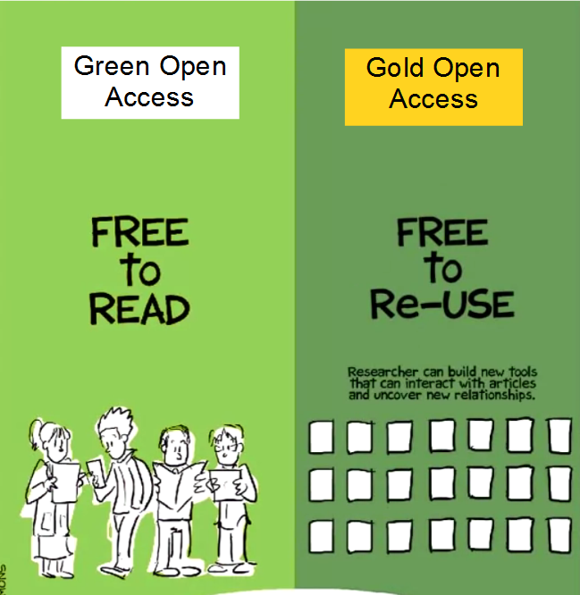


Freely available on publisher/journal website
Self-archiving
Might include Article Processing Charges (APC)
Open Access explained, Piled Higher and Deeper Production, CC-BY
Share and reuse by citing: Jonathan England, 2017, https://doi.org/10.5281/zenodo.1189190 under CC-BY 4.0 International

Slide 12
Minimum for Open Access
=
SELF-ARCHIVING
= deposit on a suitable repository
‘Myths and Realities around Open Access' – FNR Open Access Fund information session – 01/03/2018
Share and reuse by citing: Jonathan England, 2017, https://doi.org/10.5281/zenodo.1189190 under CC-BY 4.0 International

Slide 13





GREEN ROUTE
after embargo
Repository
post-print
Read article
Researcher
Research project
Public
Research Institutions
Library consortium
EMBARGO PERIOD
(6-24 months)
Manuscript
Publisher
Article published
Read article
Journal
Copy-editing
Journal editors
Reviewers
Copyright transferred to publisher
Images:
Nick Kim, Science and Ink
Share and reuse by citing: Jonathan England, 2017, https://doi.org/10.5281/zenodo.1189190 under CC-BY 4.0 International

Slide 14
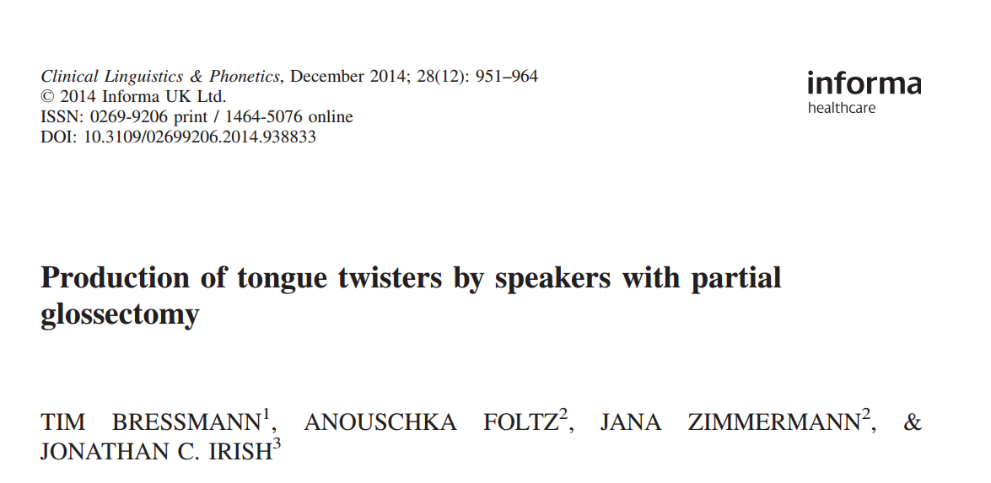
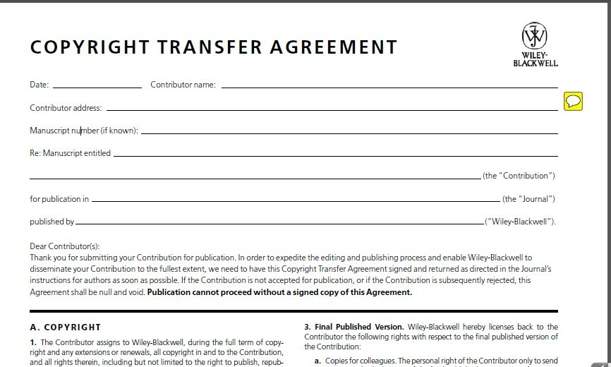
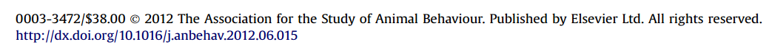
You do not own your article copyrights anymore
Reality 2
Share and reuse by citing: Jonathan England, 2017, https://doi.org/10.5281/zenodo.1189190 under CC-BY 4.0 International

Slide 15
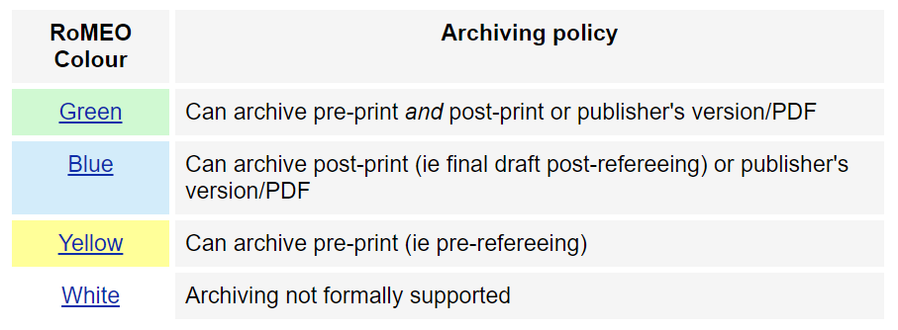
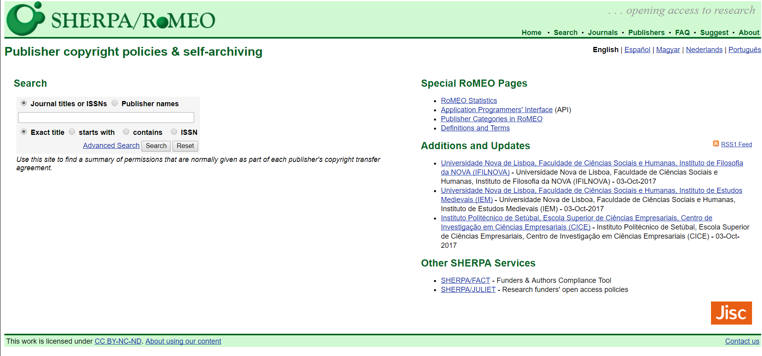
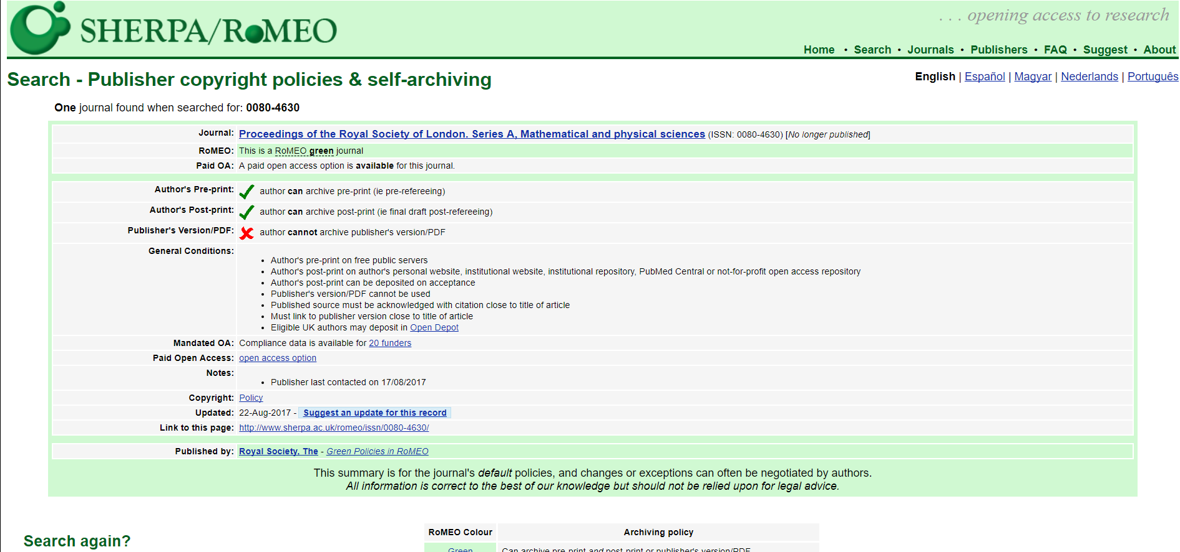
SHERPA/RoMEO
www.sherpa.ac.uk/romeo
Share and reuse by citing: Jonathan England, 2017, https://doi.org/10.5281/zenodo.1189190 under CC-BY 4.0 International

Slide 16
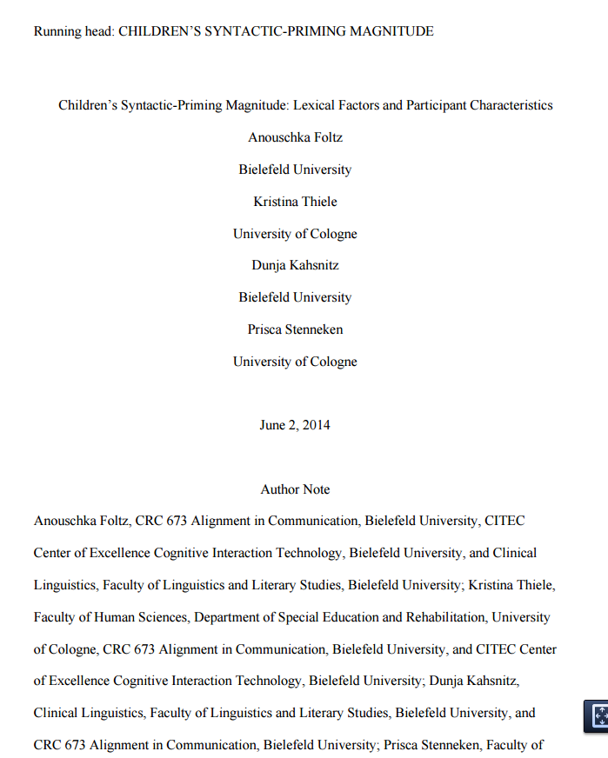
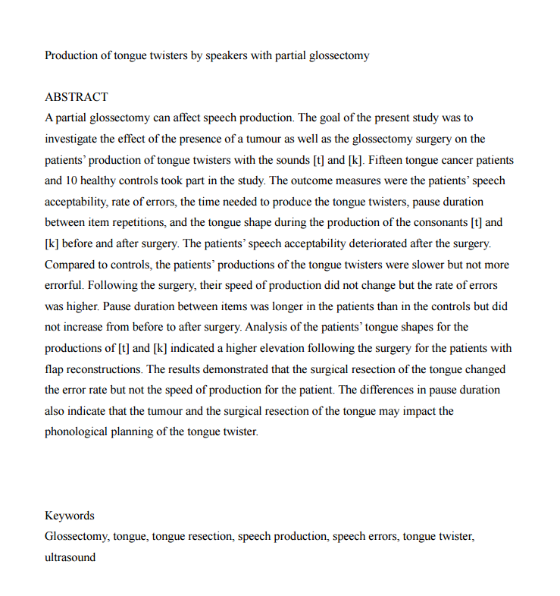
Pre-print
Share and reuse by citing: Jonathan England, 2017, https://doi.org/10.5281/zenodo.1189190 under CC-BY 4.0 International

Slide 17
Pre-print
PEER-REVIEW
Share and reuse by citing: Jonathan England, 2017, https://doi.org/10.5281/zenodo.1189190 under CC-BY 4.0 International

Slide 18

Pre-print
Post-print
PEER-REVIEW
Share and reuse by citing: Jonathan England, 2017, https://doi.org/10.5281/zenodo.1189190 under CC-BY 4.0 International

Slide 19
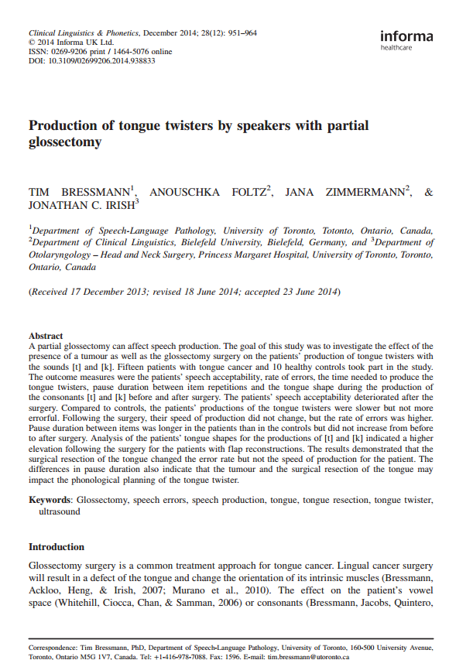
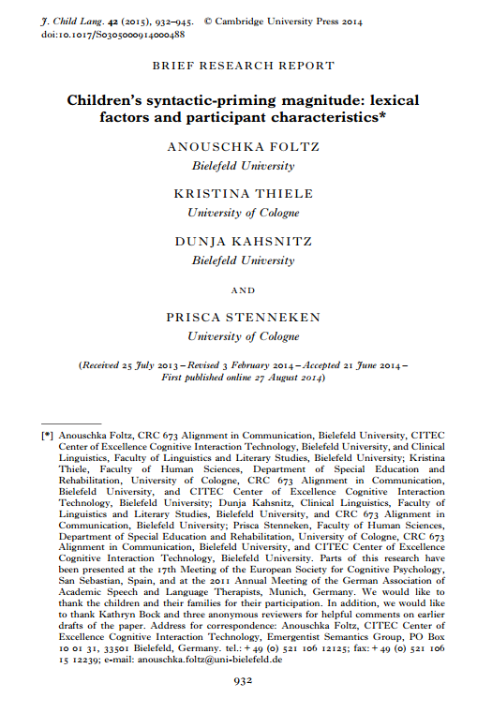
Pre-print
Post-print
Publisher’s version
Share and reuse by citing: Jonathan England, 2017, https://doi.org/10.5281/zenodo.1189190 under CC-BY 4.0 International

Slide 20
I put my papers in ResearchGate, is that enough for the open access policy?
Myth 3
A social networking site is not an open access repository
Provide free, unrestricted and permanent access
Share and reuse by citing: Jonathan England, 2017, https://doi.org/10.5281/zenodo.1189190 under CC-BY 4.0 International

Slide 21
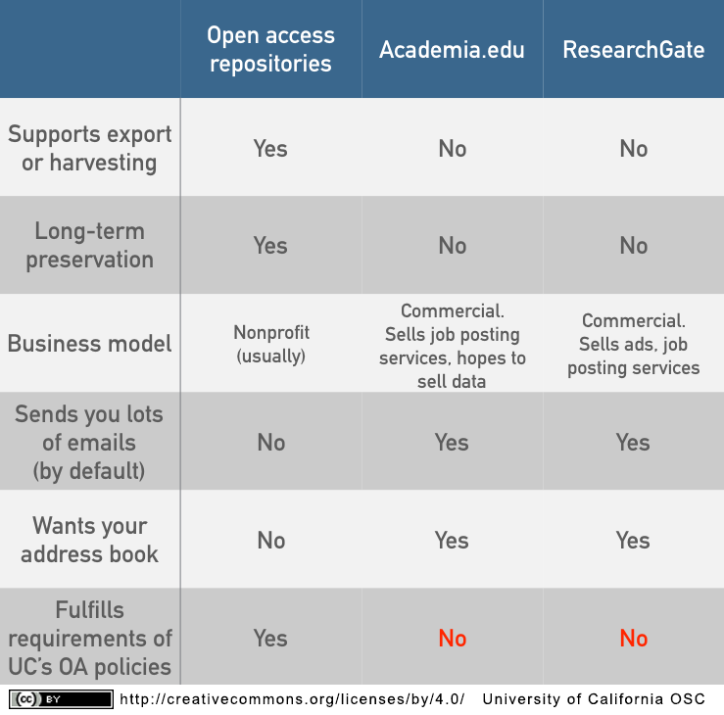
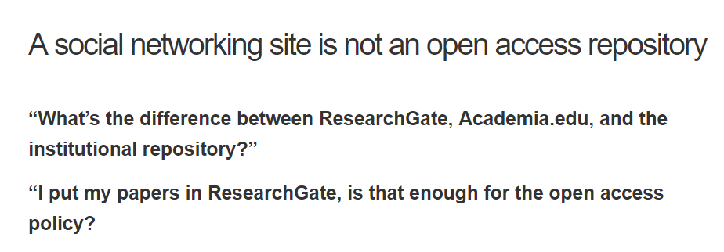


WHAT IS A REPOSITORY ?
KATIE FORTNEY AND JUSTIN GONDER [link]
University of California Office of Scholarly Communication, 01/12/2015
Share and reuse by citing: Jonathan England, 2017, https://doi.org/10.5281/zenodo.1189190 under CC-BY 4.0 International

Slide 22
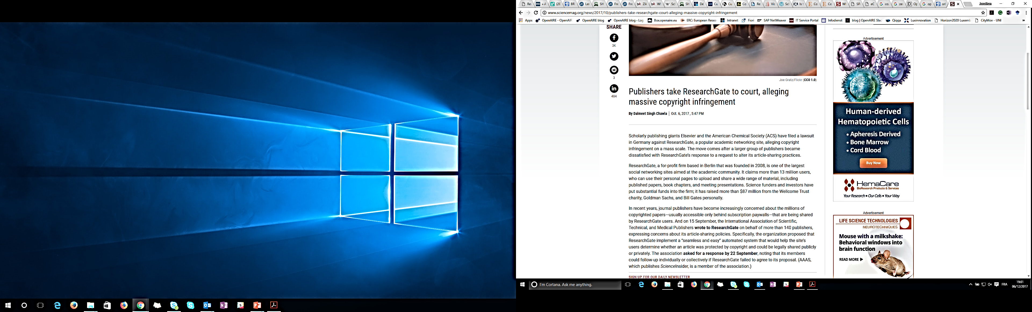
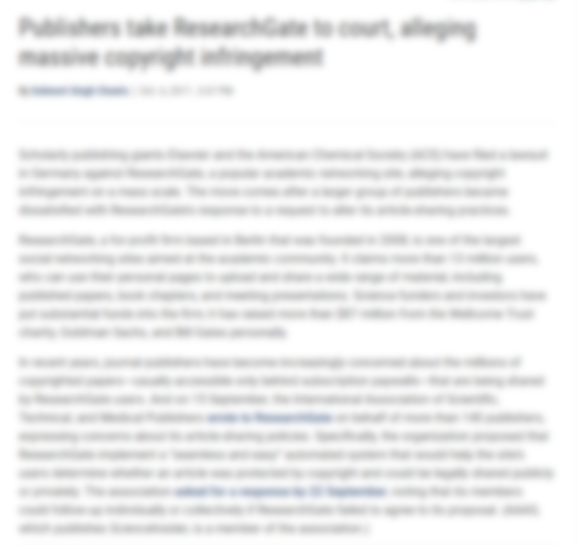
WHAT IS A REPOSITORY ?
Share and reuse by citing: Jonathan England, 2017, https://doi.org/10.5281/zenodo.1189190 under CC-BY 4.0 International

Slide 23
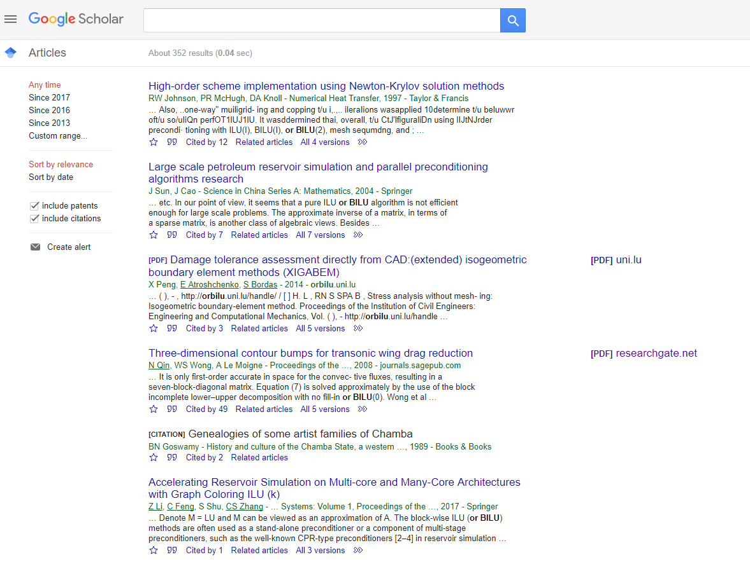

WHAT IS A REPOSITORY ?
Find your subject-specific repository:
Or choose a generic one:
Share and reuse by citing: Jonathan England, 2017, https://doi.org/10.5281/zenodo.1189190 under CC-BY 4.0 International

Slide 24
Freely available on publisher/journal website
Self-archiving
Might include Article Processing Charges (APC)
Open Access explained, Piled Higher and Deeper Production, CC-BY
Share and reuse by citing: Jonathan England, 2017, https://doi.org/10.5281/zenodo.1189190 under CC-BY 4.0 International

Slide 25
Minimum for Open Access
=
SELF-ARCHIVING
= deposit on a suitable repository (embargo period may apply)
‘Myths and Realities around Open Access' – FNR Open Access Fund information session – 01/03/2018
Share and reuse by citing: Jonathan England, 2017, https://doi.org/10.5281/zenodo.1189190 under CC-BY 4.0 International

Slide 26


Go even further
=
IMMEDIATE ACCESS + RETAIN RIGHTS
= read immediately from anywhere, including journal’s website (no embargo)
But you should still deposit on a suitable repository
‘Myths and Realities around Open Access' – FNR Open Access Fund information session – 01/03/2018
Share and reuse by citing: Jonathan England, 2017, https://doi.org/10.5281/zenodo.1189190 under CC-BY 4.0 International

Slide 27



GOLD ROUTE
IMMEDIATE ACCESS
Repository
Publisher’s version
Read article
Researcher
ARTICLE PROCESSING CHARGES
Research project
Public
Research Institutions
Library consortium
IMMEDIATE ACCESS
Manuscript
Publisher
Article published
Read article
Journal
Copy-editing
Journal editors
Reviewers
Creative Common Licence
Images:
Nick Kim, Science and Ink
Share and reuse by citing: Jonathan England, 2017, https://doi.org/10.5281/zenodo.1189190 under CC-BY 4.0 International

Slide 28
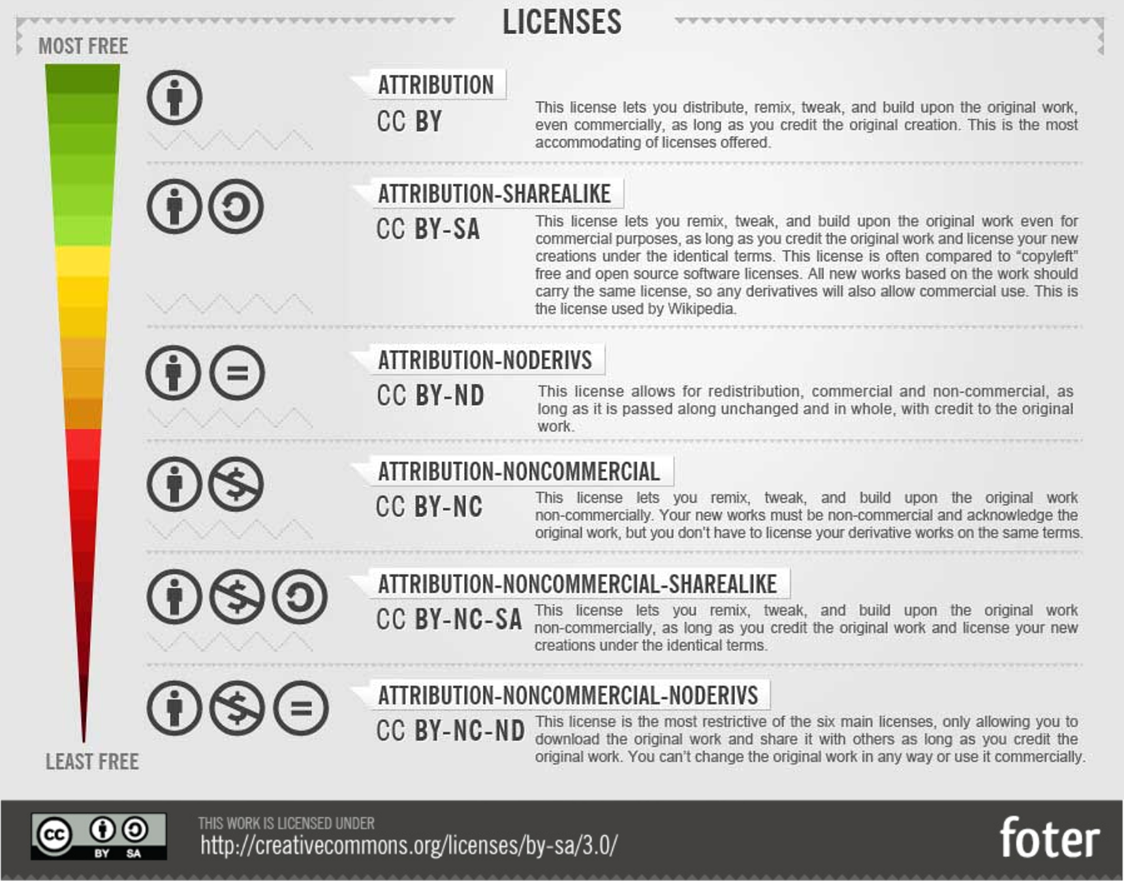

From: How To Attribute Creative Commons Photos by Foter
Share and reuse by citing: Jonathan England, 2017, https://doi.org/10.5281/zenodo.1189190 under CC-BY 4.0 International

Slide 29
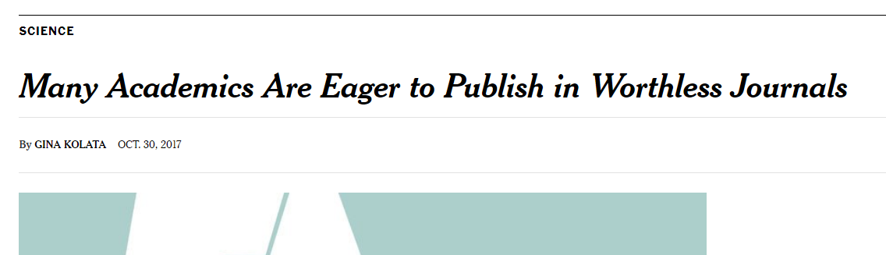
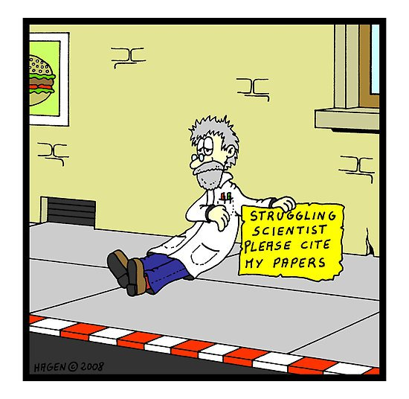
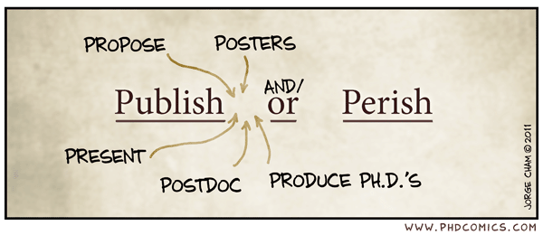
Beware of predatory OA journals
Reality 3
Publish or Perish
Link
Images:
PhD Comics, Publish or Perish
Hagen, 2008, CartoonStock
Share and reuse by citing: Jonathan England, 2017, https://doi.org/10.5281/zenodo.1189190 under CC-BY 4.0 International

Slide 30
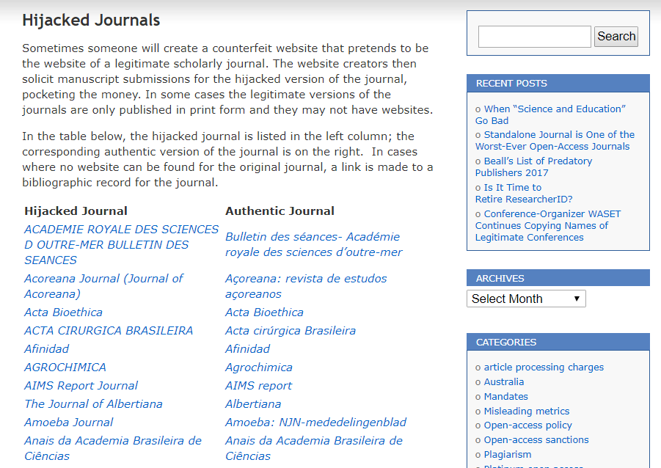

Link
Share and reuse by citing: Jonathan England, 2017, https://doi.org/10.5281/zenodo.1189190 under CC-BY 4.0 International

Slide 31
Minimum for Open Access
=
SELF-ARCHIVING
= deposit on a suitable repository (embargo period may apply)
‘Myths and Realities around Open Access' – FNR Open Access Fund information session – 01/03/2018
Share and reuse by citing: Jonathan England, 2017, https://doi.org/10.5281/zenodo.1189190 under CC-BY 4.0 International

Slide 32
‘Open Science’ is just ‘Science’
Open science describes the practice of carrying out scientific research in a completely transparent manner, and making the results of that research available to everyone. Isn’t that just ‘science’?
Mick Watson, Genome Biology 2015, doi:10.1186/s13059-015-0669-2
Share and reuse by citing: Jonathan England, 2017, https://doi.org/10.5281/zenodo.1189190 under CC-BY 4.0 International

Slide 33
Jonathan ENGLAND
jonathan.england@uni.lu
@jonatortue
0000-0001-6715-8628

