Slide 1



The idea has to be born – process of going abroad as a student
Emilia Kmiotek-Meier, M.A.
University of Luxembourg
2nd Transmobilities-Development Conference
Friction in a mobile world
Transmigrants, contested citizenship and human in/security
8-9 June, Radboud University, Nijmegen
The research from the MOVE project leading to these results has received funding from Horizon 2020 under Grant Agreement N° 649263.

Slide 2
Overview
Student mobility in Luxembourg
Empirical data
Main obstacles
Three different scenarios
Transparent information ?
Competences/knowledge transfer
Limited labour market at home
Discussion

Slide 3
0 Student mobility general (a)
student mobility
degree mobility
credit mobility
part of programme abroad
complete programme abroad

Slide 4
0 Student mobility general (b)
Mobility as a good opportunity for (young) people, to develop their personality and their skills, to gain new experience, and to learn foreign languages (e.g. 2008/C 320/03, 2)
Mobility as an antidote to labour market shortages in the EU (EC 613 2001; Zimmermann 2004)
“Erasmus+ student” is the EU’s mobility programme with the biggest budget (EC, 2015)
Leuven and Louvain-la-Neuve Communiqué (2009) -> at least 20% of all graduating in the European Higher Education Area should have a study or training period abroad.

Slide 5
0 Student mobility general (c)
Comparability of higher education system in the host country as obstacles to participation in ERASMUS (Souto-Otero et al. 2013). (Lesjak, Juvan, Ineson, Yap, & Podovsˇovnik Axelsson, 2015)
“Worthless” PhD degree in the country of origin (Pásztor, 2015)
but the over- all success of the internationally educated is un- even as recognition issues mean that employers may prefer applicants with local degrees (Brooks et al., 2012).
Brooks R, Waters J, Pimlott-Wilson H. 2012. International education and the employability of UK students

Slide 6
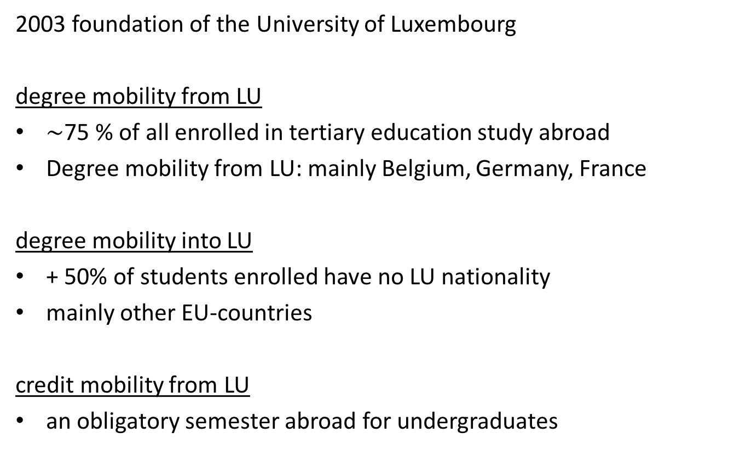
I Student mobility in Luxembourg
2003 foundation of the University of Luxembourg
degree mobility from LU
$\sim$75 % of all enrolled in tertiary education study abroad
Degree mobility from LU: mainly Belgium, Germany, France
degree mobility into LU
+ 50% of students enrolled have no LU nationality
mainly other EU-countries
credit mobility from LU
an obligatory semester abroad for undergraduates

Slide 7
II Empirical data
Qualitative Data
Data collection: from October 2015, ongoing
Outgoing mobility; credit and degree mobility balanced (N=14)
Quantitative Data
Data collection: December 2016 – February 2017
Outgoing (non)mobile
In Luxembourg only mobile students: credit and degree (N=424)
Other countries: Germany, Hungary, Norway, Romania, Spain
Outgoing: Luxembourgish nationality or A-level in Luxembourg

Slide 8
III Main obstacles
>>parts of data results removed<<

Slide 9
IV.1 Transparent information
-> Lack of transparent information, whether the qualification from abroad would be recognised in home country or not
>>parts of interviews removed<<

Slide 10
IV.2 Competences/knowledge transfer (a)
-> competences/knowledge obtained abroad would not match with national market’s demanding
-> not have enough practice experience when entering the professional field at home
-> students especially from social and educational sector

Slide 11
IV.2 Competences/knowledge transfer (b)
>>parts of interviews removed<<

Slide 12
IV.3 Limited labour market at home
-> gained knowledge cannot be fully used at home (lacking infrastructure)
>>parts of interviews removed<<
!!! Interviews only with return-mobilities – who stays abroad ???

Slide 13
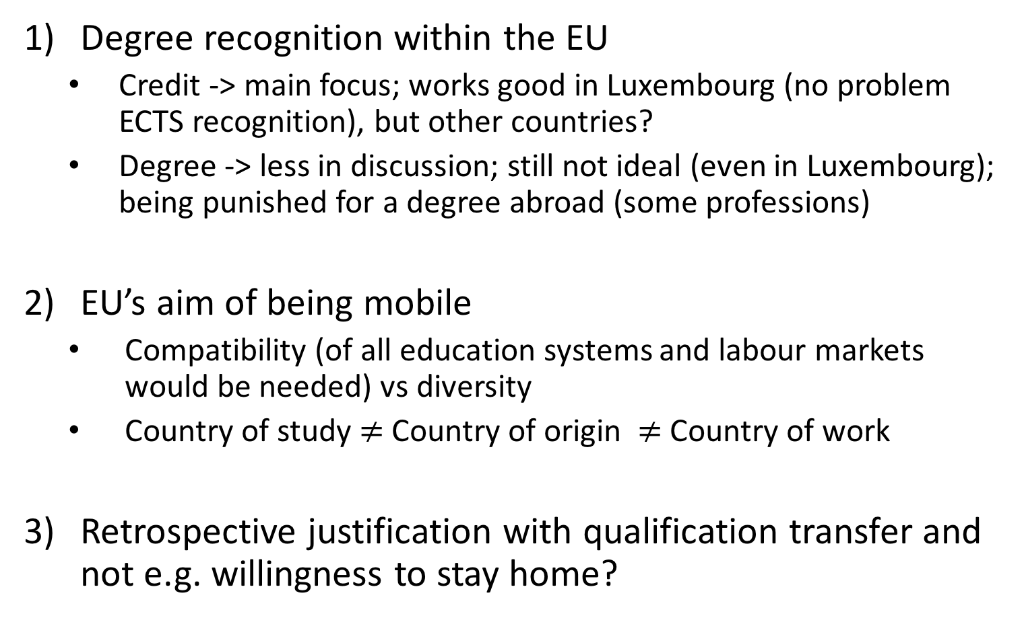
Summary / Outlook
Degree recognition within the EU
Credit -> main focus; works good in Luxembourg (no problem ECTS recognition), but other countries?
Degree -> less in discussion; still not ideal (even in Luxembourg); being punished for a degree abroad (some professions)
EU’s aim of being mobile
Compatibility (of all education systems and labour markets would be needed) vs diversity
Country of study $≠$Country of origin $≠$Country of work
Retrospective justification with qualification transfer and not e.g. willingness to stay home?

Slide 14
Thank you for your attention!
Contact:
Emilia Kmiotek-Meier
emilia.kmiotek@uni.lu
http://www.move-project.eu
University of Luxembourg
Faculté des Lettres, des Sciences Humaines,
des Arts et des Sciences de l'Education
Institute of Geography and Spatial Planning
The research from the MOVE project leading to these results has received funding from Horizon 2020 under Grant Agreement N° 649263.

Slide 15
References
EC 613. 2001. On mobility within the Community for students, persons undergoing training, volunteers, teachers and trainers: Recommendation of the European Parliament and of the Council. Accessed June 25, 2015. http://eur-lex.europa.eu/legalcontent /EN/TXT/PDF/?uri=CELEX:32001 H0613&from=EN.
EC. (2015). Erasmus+ Programme Annual Report 2015. Retrieved from https://ec.europa.eu/programmes/erasmus-plus/about_en#tab-1-5
2008/C 320/03. 2008. “Conclusion of the Council and of the Representatives of the Governments of the Mem-ber States, Meeting within the Council of 21 November 2008 on youth mobility.” Official Journal of the Euro-pean Union. Accessed June 25, 2015.
Pásztor, Adél. 2015. “Careers on the Move: International Doctoral Students at an Elite British University.” Population, Space and Place 21 (8): 832–42. doi:10.1002/psp.1875.
Zimmermann, K. 2004. “European Labour Mobility: Challenges and Potentials: DIW-Diskussionspapiere.”

