Slide 1
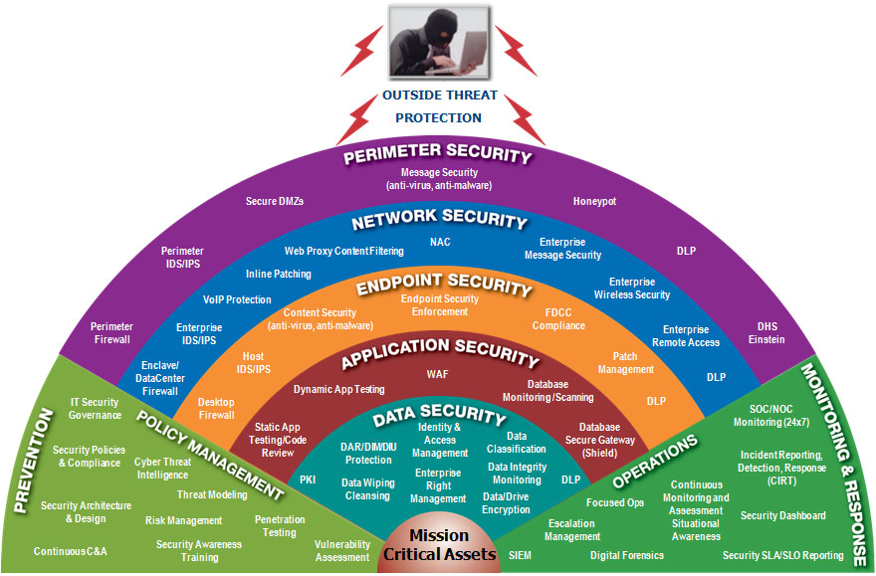
Notes:
Preemptive: IT security
After the fact protection: :Law
Hybrid: Privacy by design

Slide 2

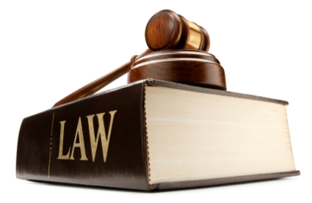
What is this?
https://www.youtube.com/watch?v=EQsZf2G4Sdc

Slide 3
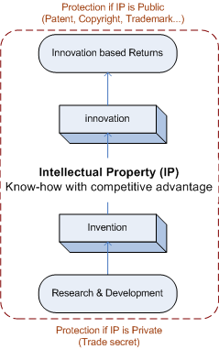

Intellectual Property
Min(probility(attack))
Max(probility(retribution))
https://www.youtube.com/watch?v=GuF9aidFtKg
https://slock.it/
Notes:
Preemptive and After the fact (hybrid): Privacy by design
Retribution: punishment for doing something wrong

Slide 4
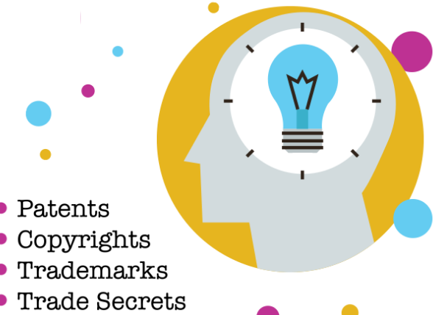
Intellectual Property Protection
Intellectual property (IP) is an know how that gives competitive advantage
How to protect IP (know how) by LAW?

Slide 5

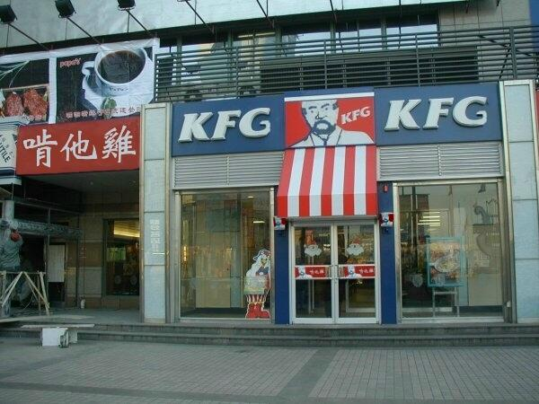
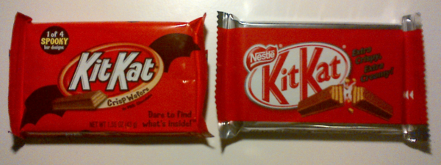
Types of Intellectual Property
  Trademark
    Anything that identify a product from particular source: color, word, phrase, name, logo, slogan, sound…
    Why Trademark?
      To protect consumer expectations
    What is entitled for trademark?
      “Water” as word?
    How to know my trademark is infringing?
      consumer confusion

Slide 6
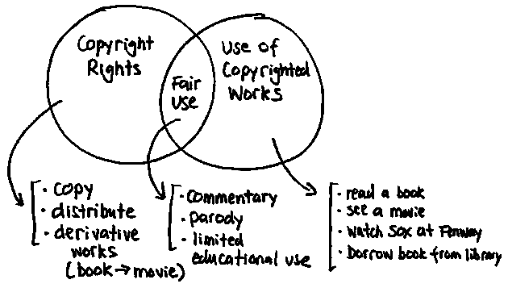

Types of Intellectual Property
  Copyrights
    Rights for work of authorship
    Work of authorship
      creative expression, especially literature, music, art, and graphic designs etc.
    Example: Instructional manual (box send to customer), Text on website, promotional video, logo (as it fall under artistic design category) etc.
    Copyright: Only protection from copying the logo but what is someone does not copy and create the same logo? Better to have “Trademark and copyright”

Slide 7

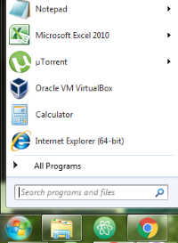
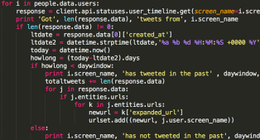
Types of Intellectual Property
  Trade Secret
    Any valuable information that is kept confidential for competitive advantage + not known to others + reasonable efforts are made to keep it secret (formula, computer code, pricing list etc.)
    Last for ever but risky (once out not protected any more)
    Non-disclosure agreement as a tool to protect trade secret
  Patent
    Utility (function), design (decorative aspects not function) …
    Example: Software (windows xp)

Slide 8
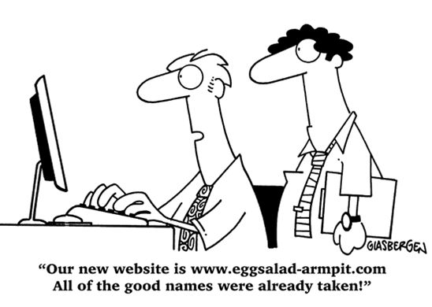
Infringement
Trademark
    URL (@autoeurope.com) make it easier for customer to find brand, however, its not a trademark
  Cybersquatting, no competition, but instead an unlicensed user registering the trademark as a domain name in order to pressure a payoff (or other benefit) from the lawful mark owner
  Internet Corporation for Assigned Names & Numbers (ICANN) or Lawsuit
URL - Uniform Resource Locator (web address):
http://www.autoeurope.com/cars/
Domain Name

Slide 9
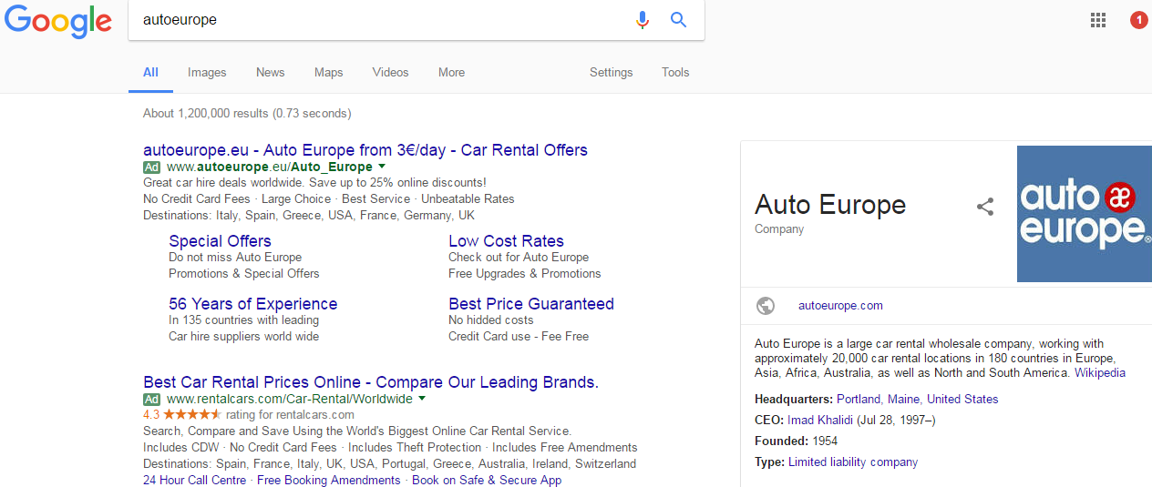
Infringement
    Recently interest has moved from Domain Name disputes (discussed last week) to the use of TMs on Search Engine Adverts (sponsored listings) and secondary markets (such as eBay)

Slide 10
Infringement
  Objections
    Likelihood of Confusion, Free Riding on image/effort, Loss of Sales
  How you get your advert onto Google is fascinating:
    Set monthly spend limit > every time one of your keywords is used Google host an auction > everyone wanting to advertise in that search return “bids” for inclusion > Whether or not your advert is displayed and where depends upon the outcome of that auction > You only pay for click through – not for displays
  Is Google or eBay responsible for infringement?
    Is the use made by Google or eBay in placing sponsored listings likely to dilute the value of the trade mark?

Slide 11
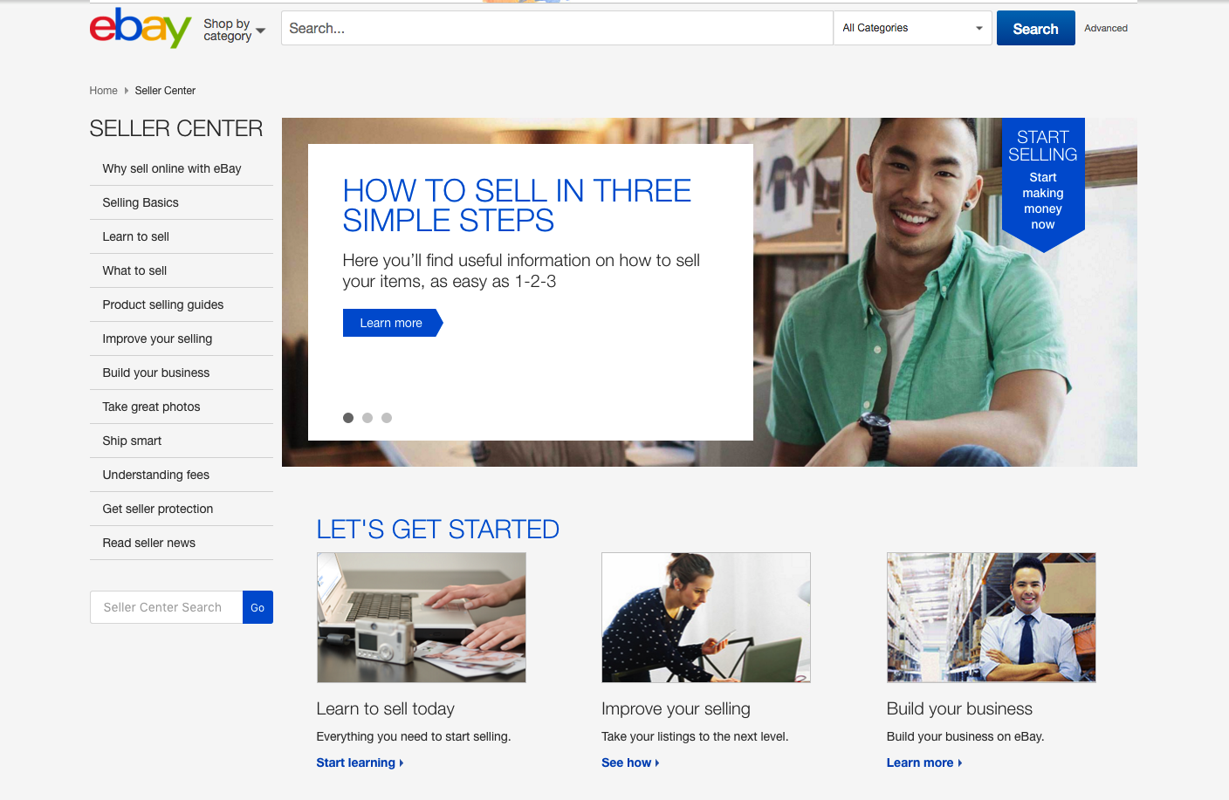
Infringement
  Tiffany v eBay (2008)
    Defense: Ebay connects buyers and sellers via online platform and does not itself sell, does not take possession, no knowledge of ultimate delivery
    Against: Earns revenues from both listing and sale + Conducts seminars/workshops to educate sellers on sales opportunities + Has expert sales consultants available for sellers + Powersellers programme; assistance & benefits
    Were eBay liable? No
  Much greater value is now attached to listing on search engines or secondary markets rather than URL representing Trademarks

Slide 12

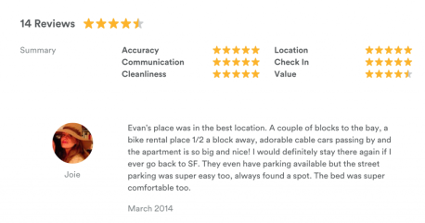
Infringement
Copyright Infringement
  Content (text, images, video, music…) on website?
    Company if it is made by company employees
    Independent contractor if it was outsourced
      Need a license in this case
  Software (SW) code behind the website?
    Website developer may give you a license (or copyright)
    SW: literal (copyright) and functional (patent) aspects
  User created content on website?
    Posts by users may be infringement of third-party copyrights
      Terms and conditions on website “not to upload content…”+ If still loaded by user, third-party can content… BUT if user contents are reviewed by company before posting…+ editing of post by company without consent of user… etc.“

Slide 13

Infringement
  SW Code: Navitaire Inc v Easyjet Airline [2004]
    Navitaire owned the “OpenRes” online booking system used by Easyjet > Easyjet through “Bulletproof Technologies” developed in-house system called “eRes” > Navitaire claimed that eRes had copied the 'look and feel' of OpenRes and that Easyjet had therefore infringed the copyright of Navitaire
  Judge awarded Navitaire copyright in the screen display, but found there to be no substantial copying
      Used the analogy of a chef creating a pudding. The written recipe would be a literary work protected by copyright. However, if a competing chef manages, after trial and error, to replicate a pudding that is in all respects identical to the original, and reduces this to writing in the form of a recipe, he cannot be said to have infringed the original recipe

Slide 14


1996
2010
“Picasso had a saying, ‘good artists copy, great artists steal’. We have always been Shameless about stealing great ideas”
“I am going to destroy android because it’s a stolen product. I am willing to go thermonuclear war on this.”

Slide 15

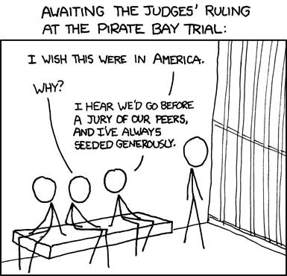
Infringement
  User Created Content: Is Pirate Bay Illegal?
    Two specific charges: (1) “involved in the production of copyrighted material (making copies available)” and (2) “involved to make copyrighted material available (making and indexing Torrent files via the site)”
    Understanding LAW is important ☺ Is it still active?? YES
https://youtu.be/IeTybKL1pM4

Slide 16
Something extra!
FAQ on IP in Europe
  Assignment of intellectual property rights
  Copyright
  Databases
  Domain names
  General
  Industrial Designs
  Infringement and Enforcement
  IP Audit
  IP Valuation
  Licensing
  Patent
  Trade Marks
  Trade secrets
  Utility Models
Creative Commons (https://www.youtube.com/watch?v=P1j0OA9N4hs)

Slide 17
Summary (so far)
What is Intellectual property?
  know how that gives competitive advantage
How to protect intellectual property (legally)?
  Patent, trade mark…
IPR infringements (developing stories)
  Search Engine (sponsored listings) Google, Tiffany v eBay (2008), Navitaire Inc v Easyjet Airline (2004), Pirate Bay…
IPR in EU

Slide 18
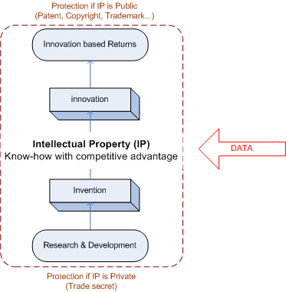
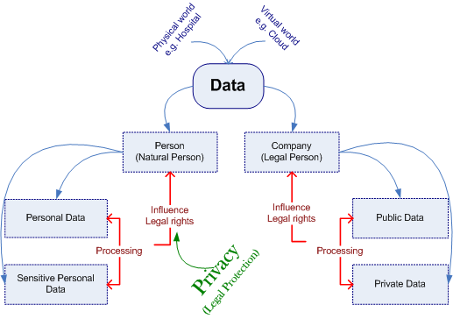
Next Topic

Slide 19

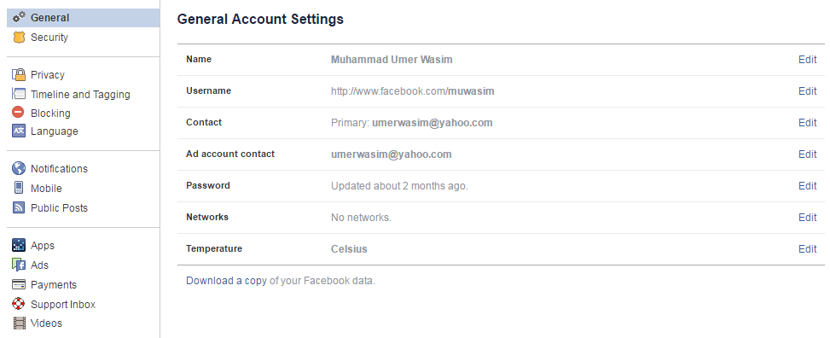
https://slock.it/
Online Privacy (contract with users)
  Collection and retention of consumer personal information (health data, bank data, insurance data etc.)
  Art 6(1)(e) of Data Protection Directive 95/46 EC: Personal data must be ‘kept in a form which permits identification of data subjects for no longer than is necessary for the purposes for which the data were collected or for which they are further processed’

Slide 20

Many thanks for the attention
umer.wasim@gmail.com
Interdisciplinary Lab for Intelligent and Adaptive Systems (ILIAS)

Slide 21
Privacy
Personal Data Protection
https://www.youtube.com/watch?v=QCOXARv6J9k

Slide 22
Concern: Impact of Data Processing on Legal Rights*
*legal rights are in Data Protection Directive 95/46 or Regulation (2018)

Slide 23
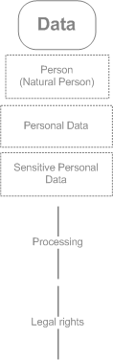

Concern: Impact of Data Processing on Legal Rights*
*legal rights are in Data Protection Directive 95/46 or Regulation (2018)
Dual Aims
Facilitate free movement of personal data in the EU Internal Market
Protect fundamental rights, in particular privacy
How?
1. Actors (responsible for compliance)
2. Identifies actor in respect of whom subjects exercise rights
3. Determines jurisdictional issues

Slide 24
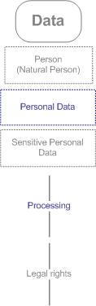
Dual Aims
Facilitate free movement of personal data in the EU Internal Market
Protect fundamental rights, in particular privacy
What?
‘Personal data’ is any information relating to any identified or identifiable natural person’
Processing must be: ‘wholly or partly by automatic means’ or manual processing of data forming ‘part of a filing system’.
‘filing system’ is ‘any structured set of personal data which are accessible according to specific criteria, whether centralized, decentralized or dispersed on a functional or geographical basis’
But what about if data is unstructured (data stream)??

Slide 25
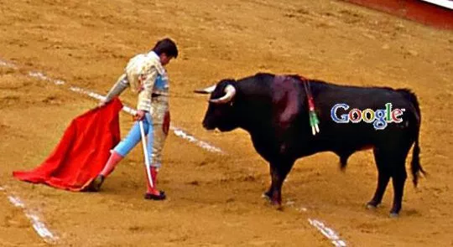
Dual Aims
Facilitate free movement of personal data in the EU Internal Market
Protect fundamental rights, in particular privacy
Where?
Controller established in a Member State or several Member States
Member State law applies in third country due to Public International Law
Third Country controllers makes use of equipment in an EU Member State for the purposes of processing
SPAIN v. Google: Search engines, right to be forgotten and data protection: regulating Google?

Slide 26
Facts
Proceedings in late 1990s reported in regional media and later online
Request refused for deletion of newspaper report and of links to article via Google
Spanish Data Protection Authority (DPA) ordered Google to remove links, decision of DPA appealed
Questions
  Does the Spanish Data Protection Authority have jurisdiction? Is Google a ‘data controller’ or a neutral intermediary? Does data subject (Costeja Gonzalez) have the right to have these links removed?

Slide 27
Is Google a ‘data controller’ or a neutral intermediary?
(one of arguments)
‘The internet search engine service provider has no relationship with the content of third-party source web pages on the internet where personal data may appear. Moreover, as the search engine works on the basis of copies of the source web pages (…), the service provider does not have any means of changing the information in the host servers. Provision of an information location tool does not imply any control over the content. It does not even enable the internet search engine service provider to distinguish between personal data, in the sense of the Directive, that relates to an identifiable living natural person, and other data.’

Slide 28
Is Google a ‘data controller’ or a neutral intermediary?
(one of arguments)
‘…the service provider would need to put itself in the position of the publisher of the source web page and verify whether dissemination of the personal data on the page can at present be considered as legal and legitimate for the purposes of the Directive. In other words, the service provider would need to abandon its intermediary function between the user and the publisher and assume responsibility for the content of the source web page, and when needed, to censure the content by preventing or limiting access to it.’

Slide 29
Results
Court departs from Opinion of Google as a data controller. Denied Google processed data for ‘journalistic purposes’. Out of sync with treatment of intermediaries in other areas of law?
Collision course with the United States over Freedom of Expression? Jurisdiction issues
Misleading ‘right to be forgotten’ terminology. Limits of individual control over data

Slide 30
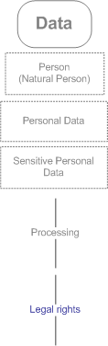
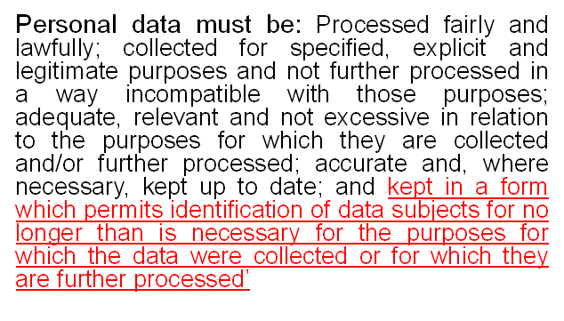
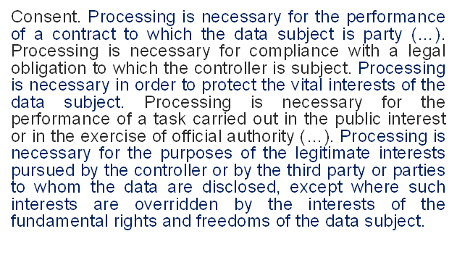
Dual Aims
Facilitate free movement of personal data in the EU Internal Market
Protect fundamental rights, in particular privacy
Why?
Right of information(Arts.10&11)
Right to object to direct marketing (Art. 14(b))
Prohibition on automated decision-making (Art. 15)
Right to rectify, block, erase or destroy inaccurate data (Art. 12(b))
Right to data portability (new)
Why?
https://www.youtube.com/watch?v=Wo9arZs21WI

Slide 31
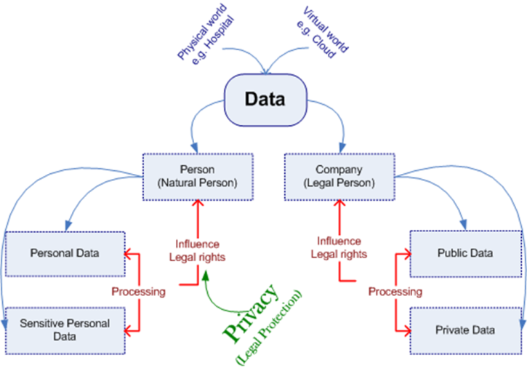
Summary (so far)
Person (Natural Person)
  Personal Data (Privacy)
  Sensitive Personal Data
Company (Legal Person)
  Public Data
  Private Data
How (…data controller, subject, and processor)
What (…personal data and processing)
Where (…member states or third country GOOGLE v. SPAIN)
Why (…subject rights, EU market & constraints on processing)
Right to Sell Data? “my data is my property like my car, can I sell it?”
If data protection is a fundamental right, can it be alienated or waived in exchange for compensation?

Slide 32
Next Topic
Revenue (or Profit)
Legally binding and enforceable contract
Recognized Token of payment

Slide 33
Mny thanks for the attention
umer.wasim@gmail.com
Interdisciplinary Lab for Intelligent and Adaptive Systems (ILIAS)

Slide 34
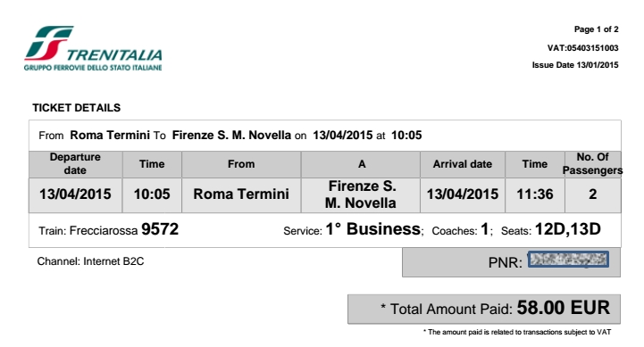
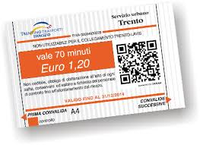
Is this only a ticket?
  Offer is accepted with consideration (some benefits following on both sides)
Contracts formed without the exchange of written (or legally defined form) or even oral, formed simply by a meeting of minds: informal contracts

Slide 35

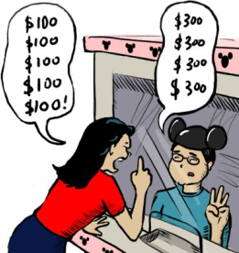
Pharmaceutical Society of Great Britain v. Boots Cash Chemists (Southern) Ltd. (1953)
Boots Introduce Self-service shopping
Against: Breach of Pharmacy and Poisons Act 1933, illegal to sell a listed poison without supervision
Court: is display of goods on self is a standing offer to sell which is accepted by customer on placing good is basket? Or its is simply “invitation to treat” with offer being made by customer and acceptance being affected by cashier ☺
  An invitation to treat is a concept within contract law (...an expression of willingness to negotiate)
Judgment: latter position (you will not get any in pharmacy by saying I accept your offer)
Case is very important in discussing eContracting or Online Contract or Service Level Agreement (SLA)
Is web service on e-commerce giant Amazon website an invitation to treat or standing offer to sell?
Notes:
Amazon: its invitation to treat, offer should come from customer with acceptance following at the later stage in the sales process

Slide 36





How should the contract formation process be structured when one of the parties is a computer?
Remember (contract) meeting of minds but computer is not human (no intend)
Thornton v. Shoe Lane Parking Ltd. (1971)
Role of automated ticket machine
Judgment: The offer is made when proprietor of machine holds it out as being ready to receive the money and acceptance take place when customer puts money in machine slot
The standing offer reflects the intend of the machine operator (mind) and this is then capable of acceptance by customer who indicates her acceptance of terms by putting money in the slot ☺ meeting of minds
So, Amazon operate under the standing offer principle as they use non-human agents to conclude the contract
Is web service on e-commerce giant Amazon website an invitation to treat or standing offer to sell?

Slide 37

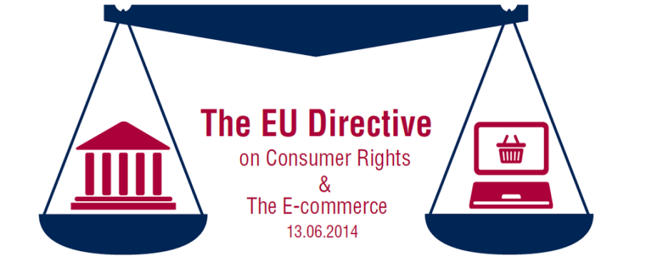
Is an e-commerce website like a shop display (invitation to treat) or like a vending machine (standing offer)?
EU: some states take it as invitation to treat and some as standing offer
Result: adverse affects on cross boarder B2B and B2C transactions, solution?
Notes:
Article 9-11

Slide 38
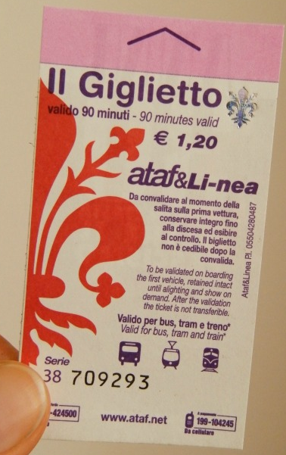


Having established a contact, next is what are terms?
Agreed upon at the time contract is concluded. Terms not brought to attention of counterparty before contract is concluded will not be a part of contract
  Contract established and terms agreed
  Is there any problem after that????
https://youtu.be/HPYz2IzIii0

Slide 39
Summary (so far)
Contracts
  Offer is accepted with consideration
  Informal Contracts (meeting of minds – no legally defined form)
    Self-service shopping (invitation to treat)
    Vending machines (standing offer)
  Online contracts as informal contracts
    e-commerce website is a invitation to treat or standing offer
    EU Directive (e-commerce)
  Terms and Condition
    Valid only if Agreed upon at the time contract is concluded
  Problem: Enforceability for established and agreed contract
    EU Directive (consumer rights)
    More in coming next slides…

Slide 40
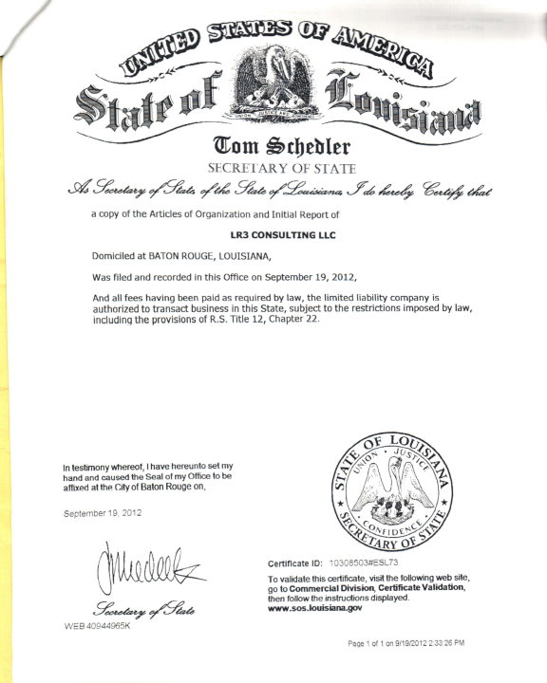

Formal Contracts
Contract in writing and signed, for high value items e.g. property or intellectual property etc.
Is webpage or email can be considered as document (electronic) ‘in writing’?
1996: United Nations Commission on International Trade Law (UNCITRAL) require all UNCITRAL states to formally recognize electric contracts
Art. 5 & 6: Data message
Art. 7: Electronic signature
Art. 11: Electroc contracts
EU: Electronic Signature Directive

Slide 41
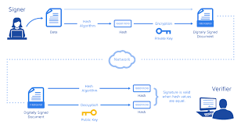

Amazon has a informal contract (invitation to treat) or like a vending machine (standing offer)
Amazon has a formal contract electronically written and electronically signed
Amazon has a something in between: contract is electronically written but not electronically signed
OR
Amazon has a something in between: contract is not electronically written but electronically signed

Slide 42
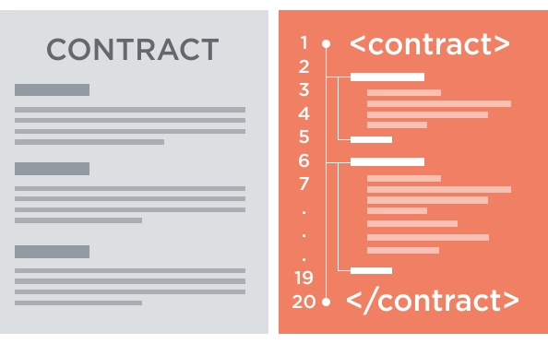
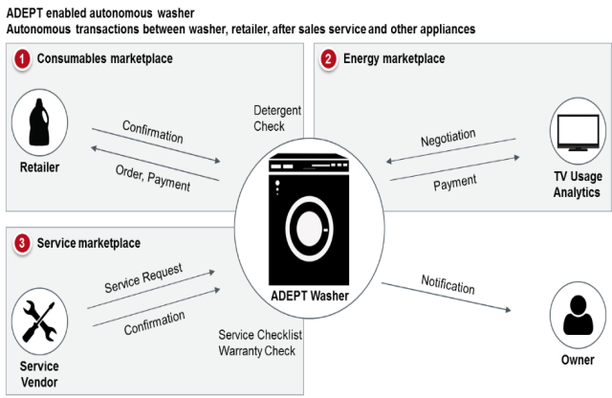

Smart Contracts
IBM & Samsung live demo of ADEPT
  Legally Binding (digitally signed) and Enforceable?
  Especially in the Cloud??????
http://ec.europa.eu/justice/contract/cloud-computing/index_en.htm

Slide 43
Summary - Online Contract
Contracts
  Offer is accepted with consideration
  Informal Contracts (meeting of minds)
  Formal Contracts (written and signed)
Issue in both
  Enforceability (especially in Cloud)
Four possible cases
  Meeting of minds (informal)
  Written and signed (formal)
  Written but may be not considered signed
    Service level agreements (SLA)
  May be considered not written but signed
    Smart Contracts

Slide 44
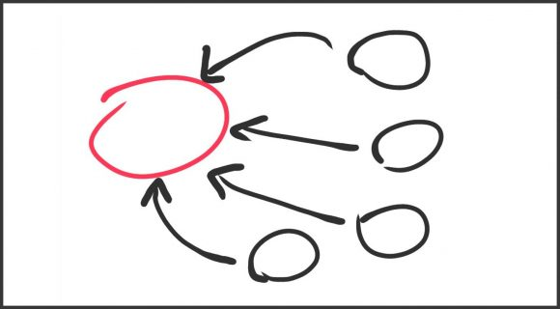


Mother of all Summaries
Legal protection
  Data (competitive advantage)
    IPR
  Data (Personal)
    Data Protection Regulation
  Data in Transaction
    Online contracts
DATA DRIVEN ARCITECHTURES & INNOVATIONS

Slide 45
Mny thanks for the attention
umer.wasim@gmail.com
Interdisciplinary Lab for Intelligent and Adaptive Systems (ILIAS)

