Slide 1
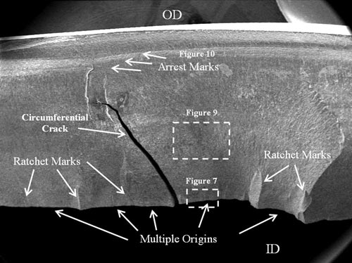
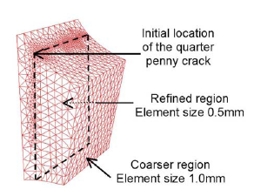
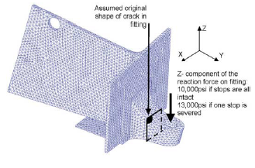
Motivation
Fatigue Fracture Failure of Structure
Initiation: micro defects
Loading : cyclic stress state (temperature, corrosion)
Introduce the numerical methods to simulate crack growth
Numerical methods for crack growth
Volume methods:
FEM, XFEM/GFEM, Meshfree
Boundary methods: BEM
fatigue cracking of nozzle sleeve
http://met-tech.com/
Explain the problems of XFEM based methods in simulating the crack growth
Bordas & Moran, 2006
XFEM+LEVEL SET

Slide 2
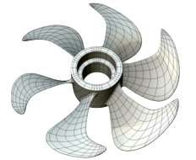
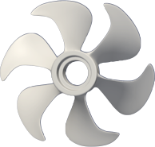


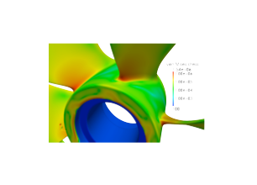
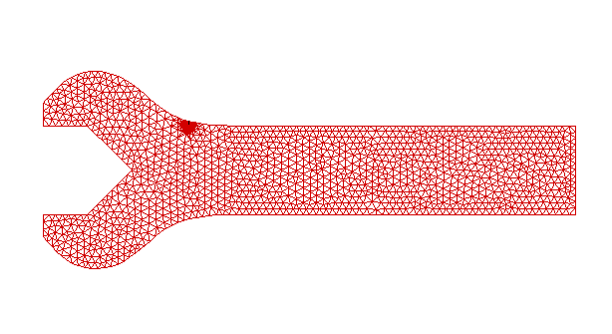
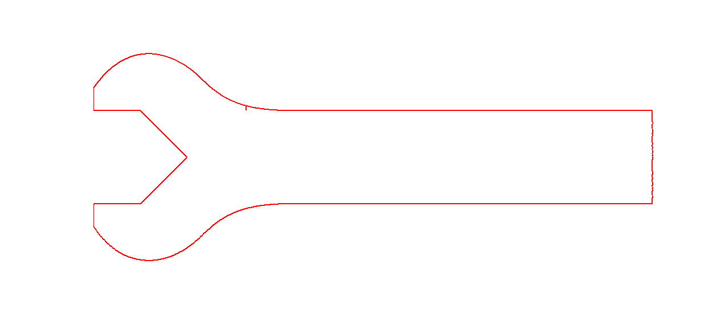
Motivation
Challenges in volume-based methods
Introduce IGABEM to overcome the challenges in FEM based methods , but we should mention the computational cost of BEM, where an acceleration implementation should be done, but this is the problem of BEM, not IGA.
Remeshing (FEM)
Local mesh refinement
mesh
IGA
Efficiency & Accuracy
direct calculation
calculation
stress analysis
crack
XFEM
adaptive refinement
Animation of comparison between an XFEM implementation and IGABEM, if animation cannot by played automatically, please play the .avi video
crack
IGABEM
Direct CAD used

Slide 3
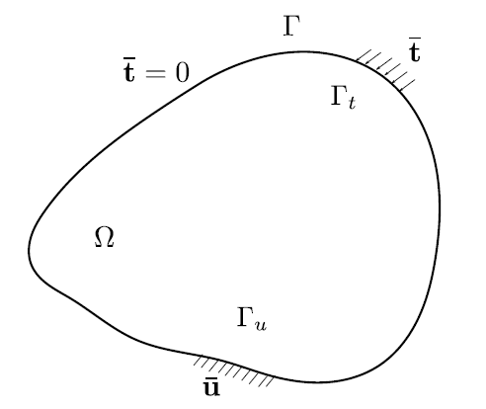
Weighted residual method, collocation
Linear elasticity problem:
Approximation of :
Weighted residual form:
Collocation method:
with shifting property:
Galerkin method (variational principle):

Slide 4
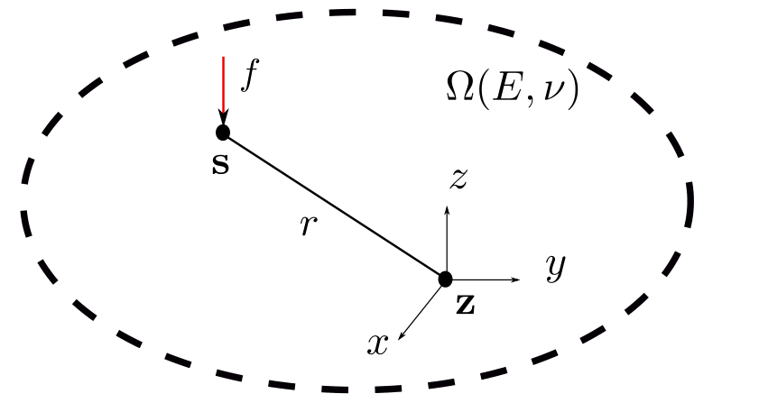
Kelvin fundamental solution
Navier equation:
Kelvin solution is obtained by solving the Naiver equation in the infinite domain. applying the point force on the source point, the displacement and traction at any field point is the fundamental solution of the kelvin problem
Kelvin solution: assuming a unit concentrated force applied on a point in the infinite domain , we seek and for any point
for 3D problem, the expressions are:
Notes:
Kelvin solution is obtained by solving the Naiver equation in the infinite domain. applying the point force on the source point, the displacement and traction at any field point is the fundamental solution of the kelvin problem

Slide 5
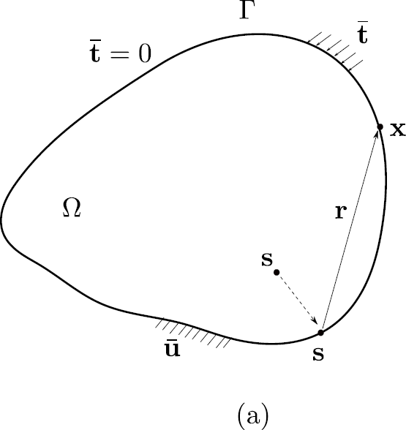
Boundary integral equation: direct method
The somigliana identity is used to obtain the interior displacement as long as the boundary quantities are known
displacement BIE (or strong-singular BIE) is used in the conventional elasticity BEM
the traction BIE (or the hyper-singular BIE) could be used to postprocess the stress. For crack problem, dual equations are used to overcome the singular matrix introduced by overlapped crack surface
Now for a source point inside the domain, we start to evaluate the displacement and traction on the boundary of the domain.
By replacing the aulixiliary state with the Kelvin fundamental solution in Betti’s theorem, we could obtain somigliana identity
Let the source point approach to the boundary and perform the limiting process, we could obtain displacement BIE (or strong-singular BIE)
Then by taking the derivative w.r.t. the source point, we could obtain the traction BIE (or the hyper-singular BIE)
Betti’s theorem
State (1) : auxiliary state, using Kelvin solution
State (2): real state, neglecting body force
Let source point “s” approach to the boundary
Take derivative w.r.t. “s”
Notes:
The somigliana identity is used to obtain the interior displacement as long as the boundary quantities are known
displacement BIE (or strong-singular BIE) is used in the conventional elasticity BEM
the traction BIE (or the hyper-singular BIE) could be used to postprocess the stress. For crack problem, dual equations are used to overcome the singular matrix introduced by overlapped crack surface
Now for a source point inside the domain, we start to evaluate the displacement and traction on the boundary of the domain.
By replacing the aulixiliary state with the Kelvin fundamental solution in Betti’s theorem, we could obtain somigliana identity
Let the source point approach to the boundary and perform the limiting process, we could obtain displacement BIE (or strong-singular BIE)
Then by taking the derivative w.r.t. the source point, we could obtain the traction BIE (or the hyper-singular BIE)

Slide 6
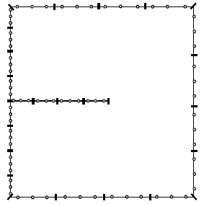
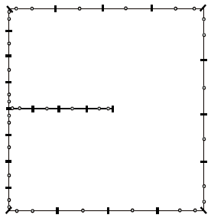

Boundary element discretisation
Discontinuous basis functions are used to simplify the implementation in terms of at least aspects:
Collocation points for discontinuous basis are inside elements (Lagrange) or offset to be inside elements (NURBS).So the C¹ continuity is fulfilled. The calculation of jump term would simply be 0.5.
2) The number of DOFs for displacement is identical to that for traction. So no extra mapping index is used for traction kernel.
However, note that one can use continuous basis for displacement field and discontinuous basis for traction field separately. This will result in GIFT implementation
Lagrange basis
NURBS basis
Collocation: at nodes
Collocation: Greville Abscissae
Discontinuous Lagrange basis functions
Collocation inside elements
Discontinuous NURBS basis functions
Collocation at C⁰ corner offset inside elements
Discontinous Lagange
p=2
NURBS(B-Spline)
p=2
Notes:
Discontinuous basis functions are used to simplify the implementation in terms of at least aspects:
Collocation points for discontinuous basis are inside elements (Lagrange) or offset to be inside elements (NURBS).So the C¹ continuity is fulfilled. The calculation of jump term would simply be 0.5.
2) The number of DOFs for displacement is identical to that for traction. So no extra mapping index is used for traction kernel.
However, note that one can use continuous basis for displacement field and discontinuous basis for traction field separately. This will result in GIFT implementation

Slide 7
Boundary element discretisation
To implement BEM, two loops are primarily involved.
The first one would be the element loop. For a given source point s, we need to loop over the entire boundary to complete the assembly of displacement BIE
The element loop involves the integration of the kernel matrix of Kelvin solution. When the field element (contains field point x,usually the integration point in implementation) is overlapped with the source element (contains source point) , the integration of kernel is singular. Otherwise is regular.
For p=2 element:
Assembling according to the global-local index mapping:
Notes:
To implement BEM, two loops are primarily involved.
The first one would be the element loop. For a given source point s, we need to loop over the entire boundary to complete the assembly of displacement BIE
The element loop involves the integration of the kernel matrix of Kelvin solution. When the field element (contains field point x,usually the integration point in implementation) is overlapped with the source element (contains source point) , the integration of kernel is singular. Otherwise is regular.

Slide 8
The second loop would be the collocation. We need to collocate the source point to elemental nodes (Lagrange) or generated by GA in NURBS. So we call source point as collocation point interchangeably. Then we loop from the first colloc. Pt. to last one, to perform the element loop in last slides. Each colloc. Pt will give one row for the system matrix.
Finally, N *M linear system equations is formed. As stated previously, the N and M are ensured to be identical such that the linear system can be solved directly.
Before solving it, we need to shift all unknown term into left and known to right hand side.
Linear system equations
Collocation point:
N=M
N: number of collocation points
M: number of basis functions
Notes:
The second loop would be the collocation. We need to collocate the source point to elemental nodes (Lagrange) or generated by GA in NURBS. So we call source point as collocation point interchangeably. Then we loop from the first colloc. Pt. to last one, to perform the element loop in last slides. Each colloc. Pt will give one row for the system matrix.
Finally, N *M linear system equations is formed. As stated previously, the N and M are ensured to be identical such that the linear system can be solved directly.
Before solving it, we need to shift all unknown term into left and known to right hand side.

Slide 9
This slide gives the discretised BIEs for crack modeling, i.e., both displacement BIE and traction BIE are used for overlapped crack surfaces. Note that in dual BEM, two jump terms are presented due to the coincide of the source points on ‘upper ‘and ‘lower’ crack faces.
Dual BIEs and discretisation forms
shares the same spatial position and normal as , but uses the parametric coordinate in the mirror element
Notes:
This slide gives the discretised BIEs for crack modeling, i.e., both displacement BIE and traction BIE are used for overlapped crack surfaces. Note that in dual BEM, two jump terms are presented due to the coincide of the source points on ‘upper ‘and ‘lower’ crack faces.

Slide 10
Linear system equations
This slide gives the collocation loop of source point in dual BEM for crack. when source point located on the ‘upper’ crack face, the displacement BIE is applied to form a row of linear system equation. When the source point located on the ‘lower’ crack face, we apply the traction BIE to form a row in the system equation, to avoid the linear dependence caused by using displacement BIE applied to both colloc. pts. that lie on different crack faces but overlapped in spatial position.
Notes:
This slide gives the collocation loop of source point in dual BEM for crack. when source point located on the ‘upper’ crack face, the displacement BIE is applied to form a row of linear system equation. When the source point located on the ‘lower’ crack face, we apply the traction BIE to form a row in the system equation, to avoid the linear dependence caused by using displacement BIE applied to both colloc. pts. that lie on different crack faces but overlapped in spatial position.

Slide 11
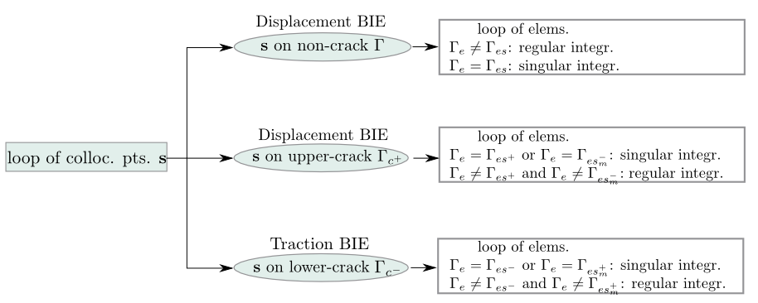
Implementation of dual BEM for crack modeling
This flow chart summaries the process of two loops introduced previously.
Notes:
This flow chart summaries the process of two loops introduced previously.

Slide 12
COD equation for infinite domain
Displacement BIE
The boundary integral equation for crack problem can also be reformulated by setting the boundary quantity as crack opening displacement over a couple of crack surfaces. Let the source point approach one crack surface, for example $S_c=S_{c^+}$, and note that $\mathbf{n}=\mathbf{n^+}=-\mathbf{n^-}$
TractionBIE can be used alone if the COD alone will be used as the unknown for the fatigue crack growth problem. However if the displacement field needs to be known on the crack surfaces, Displacement BIE should also be solved. For a infinite domain ($S_r \to \infty $), assuming that traction-free crack faces are assumed, we could obtain COD equation for infinite domain problem
$\mathbf{t}^{\infty}$ is interpreted as the solution in the `no crack' space
Traction BIE
Notes:
The boundary integral equation for crack problem can also be reformulated by setting the boundary quantity as crack opening displacement over a couple of crack surfaces. Let the source point approach one crack surface, for example $S_c=S_{c^+}$, and note that $\mathbf{n}=\mathbf{n^+}=-\mathbf{n^-}$
TractionBIE can be used alone if the COD alone will be used as the unknown for the fatigue crack growth problem. However if the displacement field needs to be known on the crack surfaces, Displacement BIE should also be solved. For a infinite domain ($S_r \to \infty $), assuming that traction-free crack faces are assumed, we could obtain COD equation for infinite domain problem
$\mathbf{t}^{\infty}$ is interpreted as the solution in the `no crack' space

Slide 13
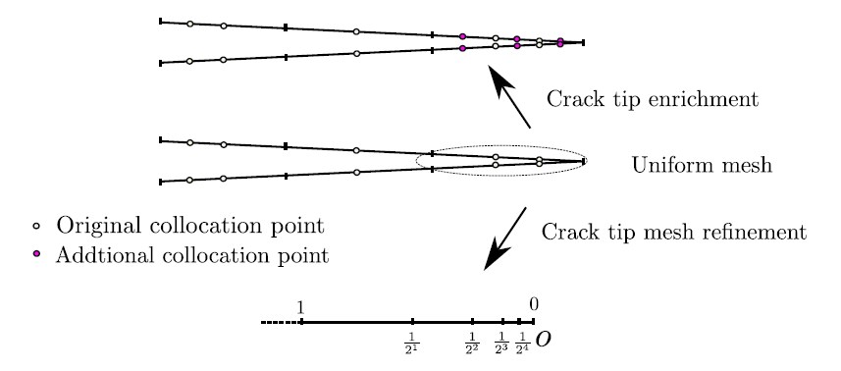
Treatment of crack tip singularity
Partition of unity enrichment (2D)
We will face singular integration in BIE. The method to eliminate the singularity is to use the singularity subtraction method.
1)The integrand is expanded as a series with respect to intrinsic coordinate
2) The explicit singular part in the series is subtracted from the integrand, then remaining part is regular, an Gauss rule is applied for this
3) The subtracted explicit part will be add back and integrated analytically.
Consecutive knot insertion at crack tip (2D) or along crack front (3D)
Notes:
We will face singular integration in BIE. The method to eliminate the singularity is to use the singularity subtraction method.
1)The integrand is expanded as a series with respect to intrinsic coordinate
2) The explicit singular part in the series is subtracted from the integrand, then remaining part is regular, an Gauss rule is applied for this
3) The subtracted explicit part will be add back and integrated analytically.

Slide 14
To deal with the (hyper-)singular integration of kernel matrix in the element loop, we use SST. The basic idea of SST would be expand the kernel into series w.r.t. intrinsic coordinates (such as the polar coordinates in surface element for 3D case). The explicitly represented singular term by intrinsic coordinate \rho is subtracted in the integrand. And will be added back through a semi-analytical way.
(Hyper-)singular integration
Singularity subtraction technique (SST)
Introduce polar coordinate transformation:
Series expansion of the integrand:
Subtract the singular part:
Then add back the semi-analytically treated subtracted part:
Notes:
To deal with the (hyper-)singular integration of kernel matrix in the element loop, we use SST. The basic idea of SST would be expand the kernel into series w.r.t. intrinsic coordinates (such as the polar coordinates in surface element for 3D case). The explicitly represented singular term by intrinsic coordinate \rho is subtracted in the integrand. And will be added back through a semi-analytical way.

Slide 15
(Hyper-)singular integration
in conventional SST in 3D, the quadrature in annular direction turns out to be sensitive on element topology due to:
could be nearly singular when 1) the element is highly distorted; 2) the collocation point is close to element edge.
Conformal transformation
Nearly singular!!
\lambda reflects the element aspect ratio
\psi reflects the element distorted angle
These two coeffs are computed from basis vectors at source point
We propose a transformation T on the parent space that is used to perform SST, to a conformal space. This new space has orthonormal basis vectors. The benefits is to alleviate the near singularity in F_i(\theta)
Introduce coeffs.:
Construct transformation:
Notes:
\lambda reflects the element aspect ratio
\psi reflects the element distorted angle
These two coeffs are computed from basis vectors at source point
in conventional SST in 3D, the quadrature in annular direction turns out to be sensitive on element topology due to:
could be nearly singular when 1) the element is highly distorted; 2) the collocation point is close to element edge.
We propose a transformation T on the parent space that is used to perform SST, to a conformal space. This new space has orthonormal basis vectors. The benefits is to alleviate the near singularity in F_i(\theta)

Slide 16
(Hyper-)singular integration
if $\lambda$ (reflecting the element aspect ratio) and $\text{cos}\psi$ (reflecting the element distortion) deviate from 1, the conformal element will be skewed. This will result in sub-triangles with $\bar\theta$ approaching $\pm\pi/2$ if the field point is close to the edges of the sub-triangles. Thus $\hat\rho(\theta)=h/\text{cos}\bar\theta$ is not calculated accurately.
We use Sigmoidal transformation to alleviate the near singularity in \hat{rho}
Sigmoidal transformation
Nearly singular!!
Notes:
if $\lambda$ (reflecting the element aspect ratio) and $\text{cos}\psi$ (reflecting the element distortion) deviate from 1, the conformal element will be skewed. This will result in sub-triangles with $\bar\theta$ approaching $\pm\pi/2$ if the field point is close to the edges of the sub-triangles. Thus $\hat\rho(\theta)=h/\text{cos}\bar\theta$ is not calculated accurately.
We use Sigmoidal transformation to alleviate the near singularity in \hat{rho}

Slide 17
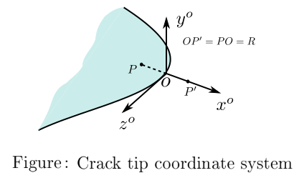
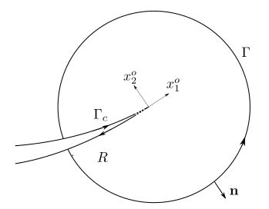

Evaluation of stress intensity factors (SIFs)
Virtual crack closure integrals (VCCI)
M integral
17

Slide 18
Combine with Paris law to calculate the crack advances in fatigue crack growth, we present an algorithm to form new crack increment faces. The procedure is:
Give a set of new positions of sample point on the crack front by Paris law
Generate a new curve by moving the old crack front curve to pass through the new positions of sample points (The algorithm as in slide)
Form crack faces between old curve and new curve
NURBS-represented crack growth algorithm
Fatigue fracture: Paris law
for each sample point
Maximum hoop stress law:
Notes:
Combine with Paris law to calculate the crack advances in fatigue crack growth, we present an algorithm to form new crack increment faces. The procedure is:
Give a set of new positions of sample point on the crack front by Paris law
Generate a new curve by moving the old crack front curve to pass through the new positions of sample points (The algorithm as in slide)
Form crack faces between old curve and new curve

Slide 19
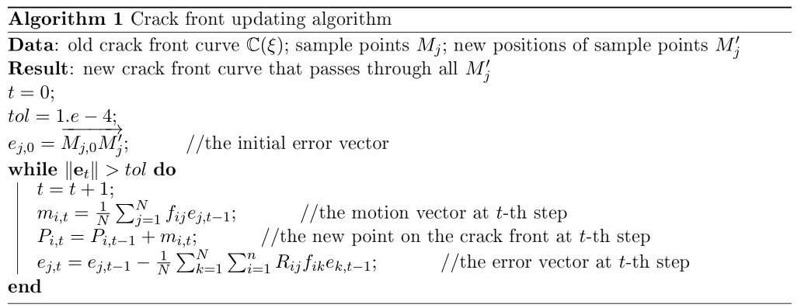
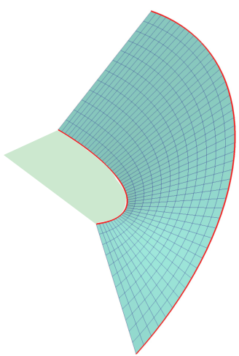
Combine with Paris law to calculate the crack advances in fatigue crack growth, we present an algorithm to form new crack increment faces. The procedure is:
Give a set of new positions of sample point on the crack front by Paris law
Generate a new curve by moving the old crack front curve to pass through the new positions of sample points (The algorithm as in slide)
Form crack faces by lofting between old front and new front
NURBS-represented crack growth algorithm
Notes:
Combine with Paris law to calculate the crack advances in fatigue crack growth, we present an algorithm to form new crack increment faces. The procedure is:
Give a set of new positions of sample point on the crack front by Paris law
Generate a new curve by moving the old crack front curve to pass through the new positions of sample points (The algorithm as in slide)
Form crack faces by lofting between old front and new front

Slide 20
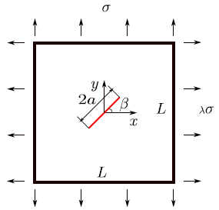

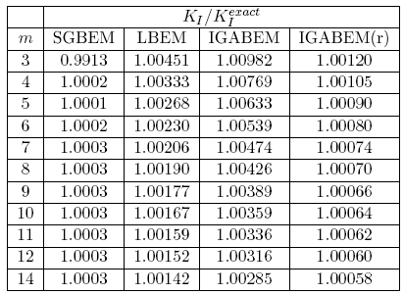
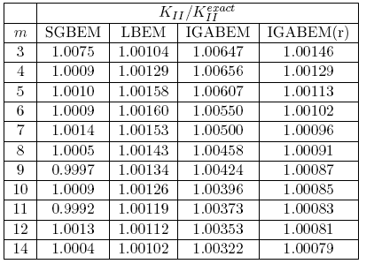
Inclined centre crack (SGBEM, Lagrange BEM, IGABEM)
We show the SIF result of IGABEM and compare with classical methods
IGABEM(r) :Uniform mesh (refined tip element)
LBEM: discontinuous Lagrange BEM
SGBEM: symmetric Galerkin BEM, Sutrahar&Paulino (2004)
m: number of elements in uniform mesh along the crack surface

Slide 21
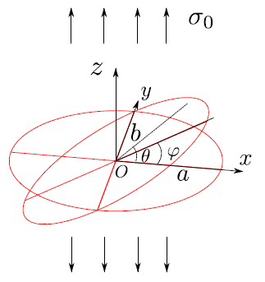
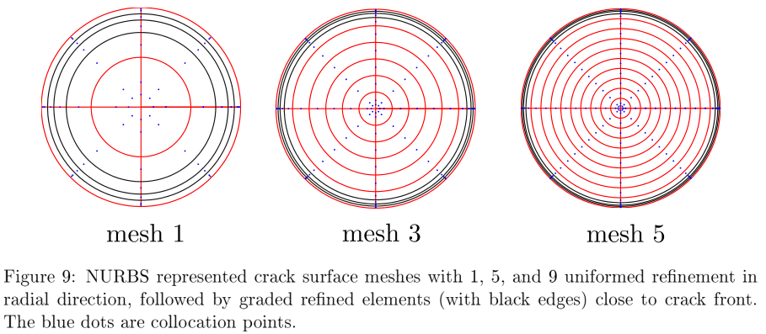
Penny-shaped crack under remote tension (embedded crack)

Slide 22
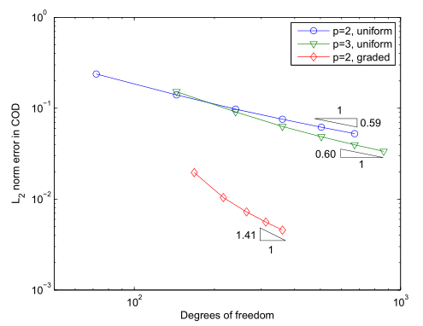
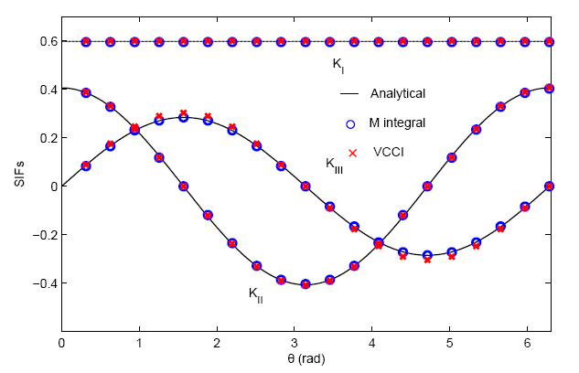

Penny-shaped crack under remote tension
The 3D result of penny crack shows the potential prospect of IGABEM: high accuracy, smoothness of SIF, which is very important to crack propagation
Notes:
The 3D result of penny crack shows the potential prospect of IGABEM: high accuracy, smoothness of SIF, which is very important to crack propagation

Slide 23
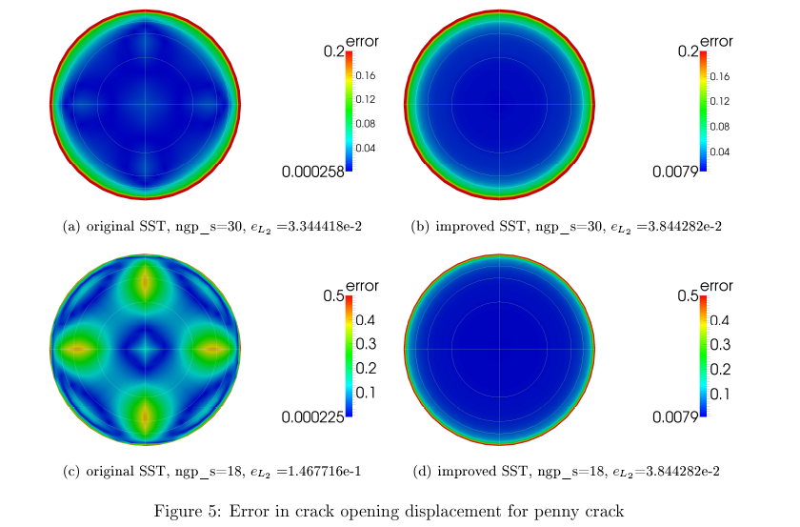
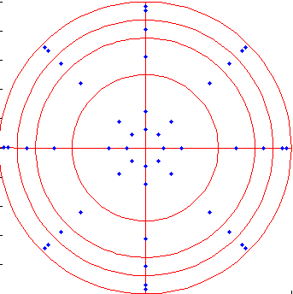
Penny crack under remote tesion (embeded crack)

Slide 24
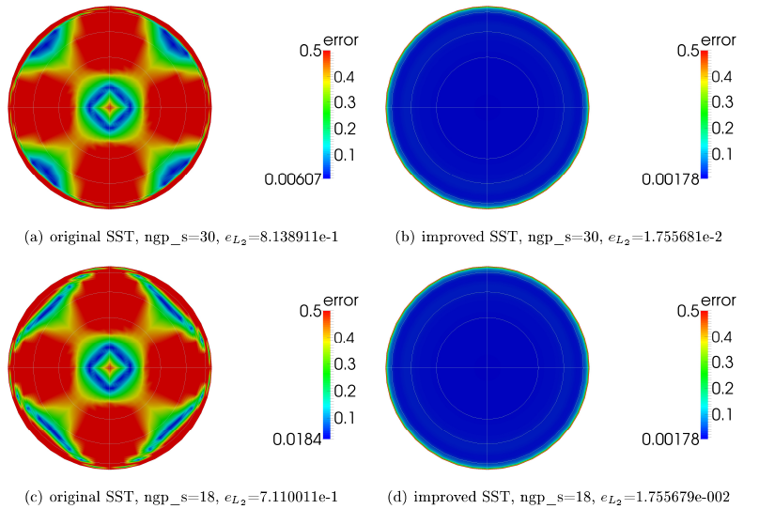
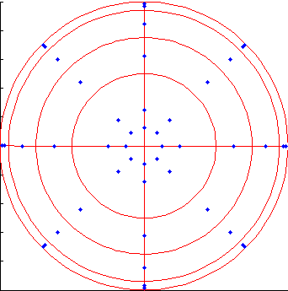
Penny crack under remote tesion (embeded crack)

Slide 25
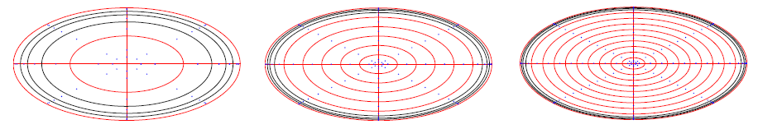
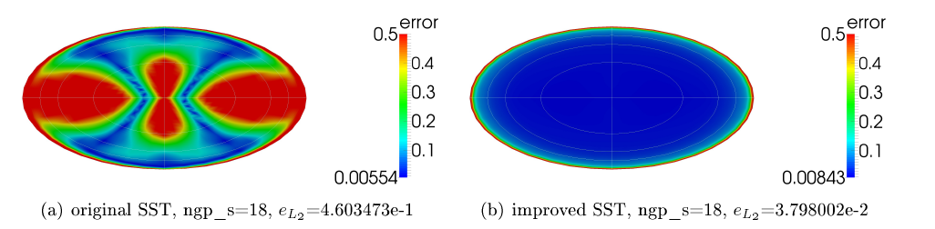
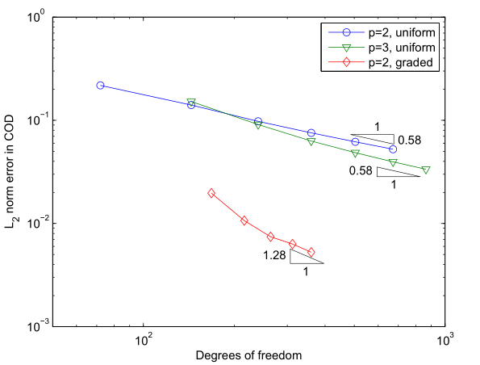
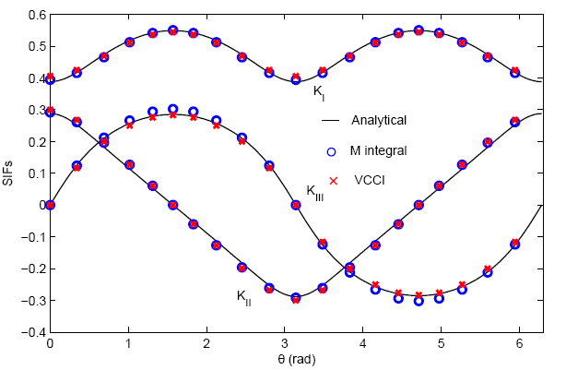

Slide 26
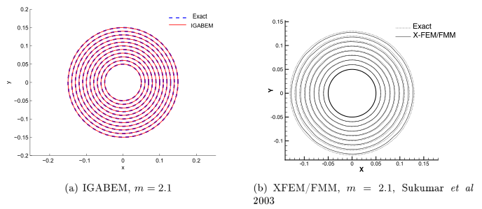
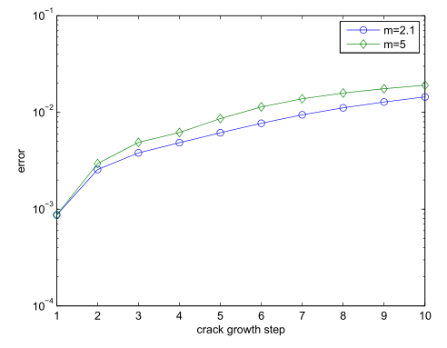
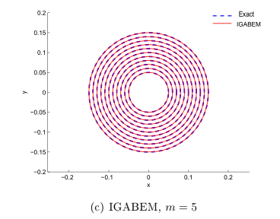
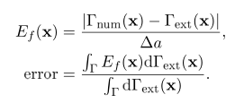
Numerical example of horizontal penny crack growth (first 10 steps)

Slide 27
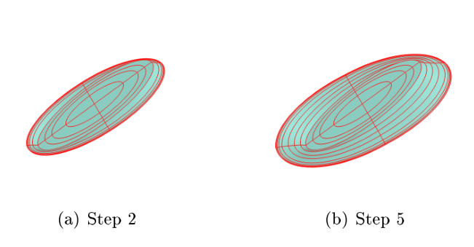
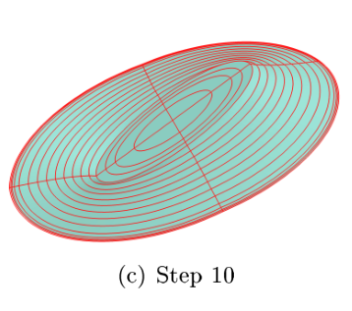
Numerical example of inclined elliptical crack growth (first 10 steps)

Slide 28
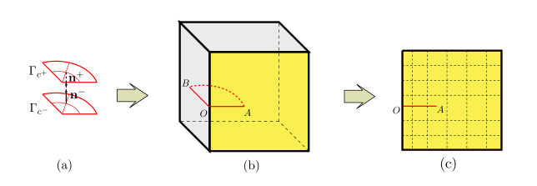
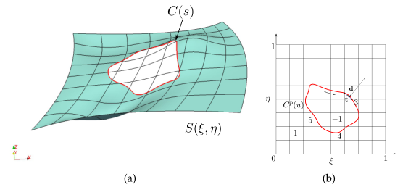
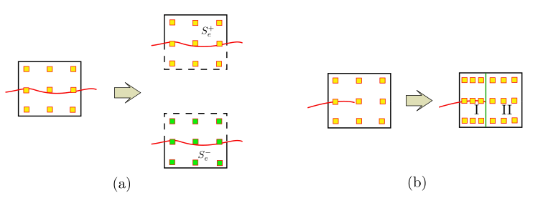
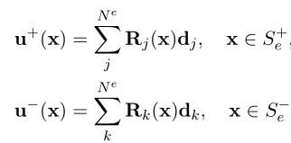
Modeling techniques for surface breaking cracks
For surface breaking cracks, discontinuity is introduced along the body boundary. Crack initiation and propagation is difficult due to highly smoothness in basis functions
Surface discontinuity is introduced
Crack can be considered as trimming curve. Then the problem is converted into trimmed NURBS modeling
Trimmed NURBS technique
Crack → trimming curve
Phantom node method is used to approximate the discontinuous displacement field
Phantom node method
Notes:
For surface breaking cracks, discontinuity is introduced along the body boundary. Crack initiation and propagation is difficult due to highly smoothness in basis functions
Crack can be considered as trimming curve. Then the problem is converted into trimmed NURBS modeling
Phantom node method is used to approximate the discontinuous displacement field

Slide 29
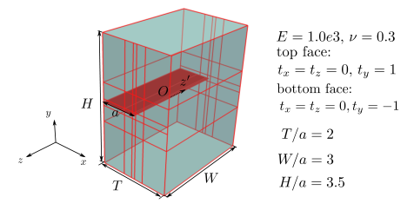
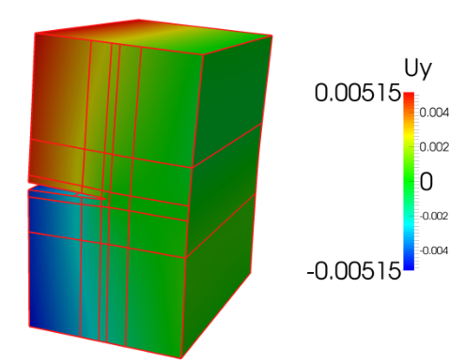
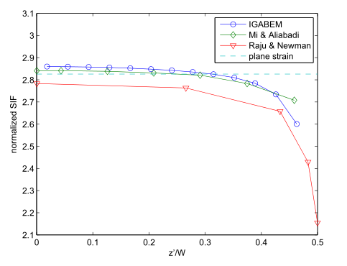
Example of surface breaking cracks: edge crack under uniform tension

Slide 30
References
Peng, X., Atroshchenko, E., Kerfriden, P., & Bordas, S. P. A. (2017). Linear elastic fracture simulation directly from CAD: 2D NURBS-based implementation and role of tip enrichment. International Journal of Fracture, 204(1), 55–78.
Peng, X., Atroshchenko, E., Kerfriden, P., & Bordas, S. P. A. (2017). Isogeometric boundary element methods for three dimensional static fracture and fatigue crack growth. Computer Methods in Applied Mechanics and Engineering, 316, 151–185.
Simpson, R. N., Bordas, S. P. A., Trevelyan, J., & Rabczuk, T. (2012). A two-dimensional Isogeometric Boundary Element Method for elastostatic analysis. Computer Methods in Applied Mechanics and Engineering, 209–212(0), 87–100.
Guiggiani, M., Krishnasamy, G., Rudolphi, T. J., & Rizzo, F. J. (1992). A General Algorithm for the Numerical Solution of Hypersingular Boundary Integral Equations. Journal of Applied Mechanics, 59(3), 604–614.
Rong, J., Wen, L., & Xiao, J. (2014). Efficiency improvement of the polar coordinate transformation for evaluating BEM singular integrals on curved elements. Engineering Analysis With Boundary Elements, 38, 83–93.
Mi, Y., & Aliabadi, M. H. (1992). Dual boundary element method for three-dimensional fracture mechanics analysis. Engineering Analysis with Boundary Elements, 10(2), 161–171.
Becker, A. (1992). The Boundary Element Methods in Engineering. McGraw-Hill Book Company.

