Slide 1






DNS and Semantic Analysis for Phishing Detection
June 22, 2015
Ph.D. defense
Samuel Marchal
Defense committee:
Prof. Ulrich Sorger – chairman Prof. Eric Filiol – reviewer
Prof. Claude Godart – vice-chairman Prof. Eric Totel – reviewer
Prof. Thomas Engel – co-supervisor Dr. Vijay Gurbani – expert
Prof. Olivier Festor – co-supervisor Dr. Radu State – expert

Slide 2








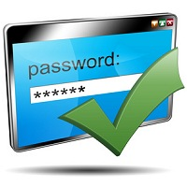

Phishing: a modern swindle
uses social engineering
exploits technical flaws (to impersonate legitimate entities)
DNS and Semantic Analysis for Phishing Detection
1 / 37
Notes:
Crooks who use their power of persuasion to deceive gullible people through with convincing speech and tailored socially engineered messages
Main target were free services or getting money (advance payment, lending of money without warranty, etc.)
Evolution: new means of communication available: electronic communications means
More services available that previously needed more intimate interactions: e-commerce, e-banking, electronic billing, etc.
New tragets: the valuable information handled by these services

Slide 3
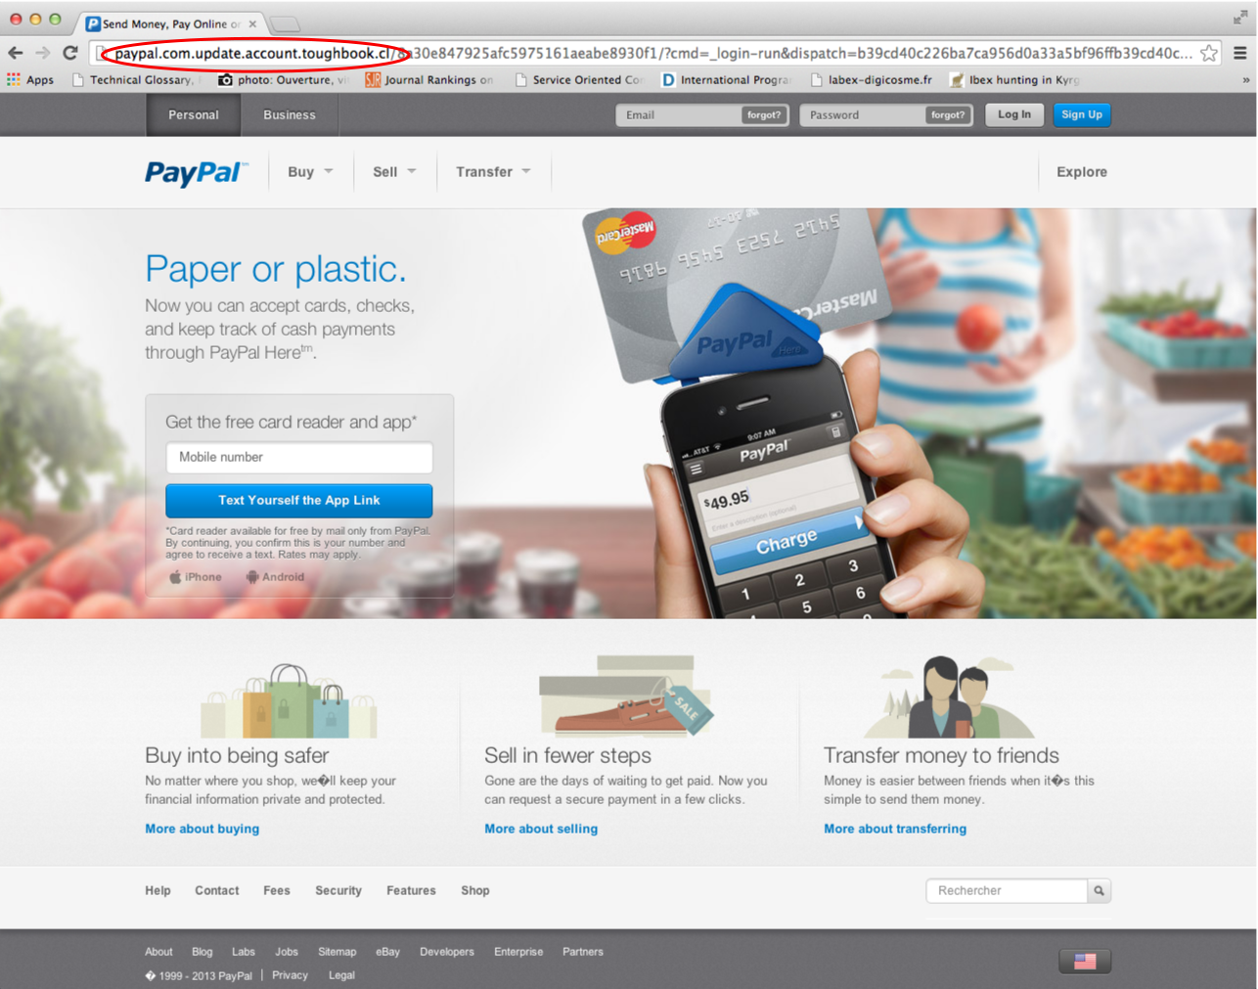
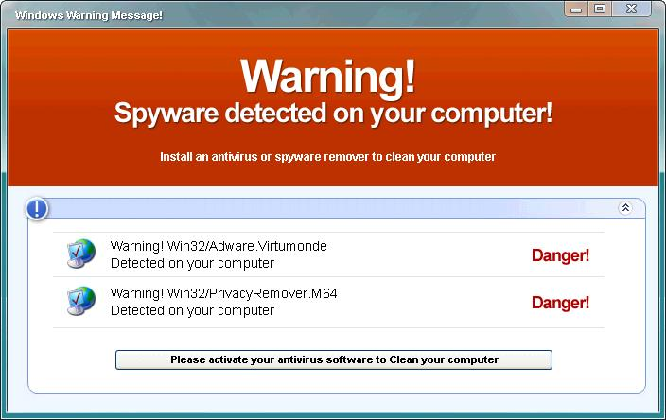
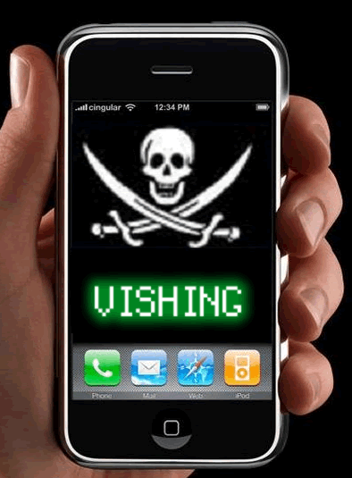
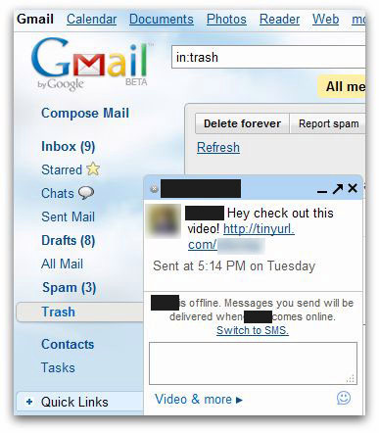
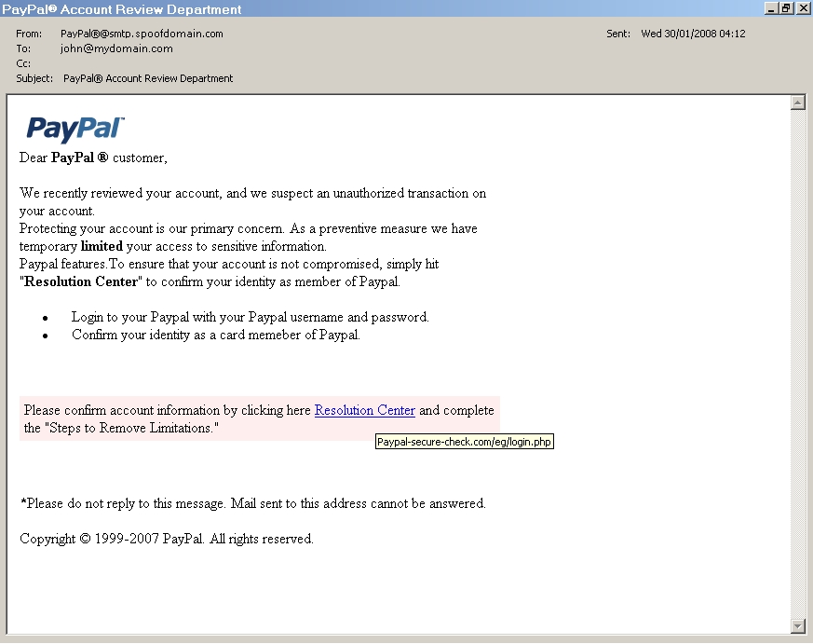
Phishing attacks
Fake websites
Fake antivirus
Phishing email campaigns reported:
60,000 / month
Unique phishing websites detected:
50,000 / month
Unique domain names used:
10,000 / month
(source: APWG – 2Q 2014)
Phone phishing
Instant messages
Spoofed emails
DNS and Semantic Analysis for Phishing Detection
2 / 37
Notes:
Many vectors are used to perform phishing attacks cite some:
However, fake websites and spoofed emails (original vectors) remain the most used

Slide 4
Challenges to fight phishing
Characteristics of phishing attacks:
Target unsavvy users (gullible and with low technical skills)
Use several vectors (websites, emails, instant message, etc.)
Exploit different technical flaws
Have a short lifetime (< 8 hours)
Easy to perform by anyone thanks to ready-to-use kits
Requirements for efficient phishing protection:
Ease of use
Coverage
Speed
Reliability
DNS and Semantic Analysis for Phishing Detection
3 / 37

Slide 5
Current phishing protection methods (1/2)
Reactive blacklisting (e.g. PhishTank):
List of domain names / URLs leading to phishs
Easy to integrate
Based on crowd verification (submission + checking)
Webpage content analysis [CSDM14,MKK08,ZHC07] :
Automated “real time” identification
Visual or semantic analysis of webpage content
Reputation of links included in the webpage
[CSDM14] Teh-Chung Chen, Torin Stepan, Scott Dick, and James Miller. An anti-phishing system employing diffused information. ACM Transactions on Information and System Security, 16(4):16:1–16:31, 2014.
[MKK08] Eric Medvet, Engin Kirda, and Christopher Kruegel. Visual-similarity-based phishing detection. In Proceedings of the 4th International Conference on Security and Privacy in Communication Networks, SecureComm ’08, pages 22:1–22:6. ACM, 2008.
[ZHC07] Yue Zhang, Jason I. Hong, and Lorrie F. Cranor. Cantina: A content-based approach to detecting phishing web sites. In Proceedings of the 16th International Conference on World Wide Web, WWW ’07, pages 639–648. ACM, 2007.
DNS and Semantic Analysis for Phishing Detection
4 / 37

Slide 6
Current phishing protection methods (2/2)
Email content analysis [FST07]:
Automated, machine learning based
Lexical and semantic analysis of email content
Reputation of the sender’s address and links included
URL analysis [LMF11,MSSV09]:
Automated, machine learning based
Study of URL composition: length, labels used, number of level domains, etc.
Reputation of the domain name, host based information, etc.
[FST07] Ian Fette, Norman Sadeh, and Anthony Tomasic. Learning to detect phishing emails. In Proceedings of the 16th International Conference on World Wide Web, WWW ’07, pages 649–656. ACM, 2007.
[LMF11] Anh Le, Athina Markopoulou, and Michalis Faloutsos. PhishDef: URL names say it all. In Proceedings of IEEE Infocom, INFOCOM ’11, pages 191–195. IEEE, 2011.
[MSSV09] Justin Ma, Lawrence K. Saul, Stefan Savage, and Geoffrey M. Voelker. Beyond blacklists: Learning to detect malicious web sites from suspicious urls. In Proceedings of the 15th ACM SIGKDD International Conference on Knowledge Discovery and Data Mining, KDD ’09, pages 1245–1254. ACM, 2009.
DNS and Semantic Analysis for Phishing Detection
5 / 37

Slide 7


Pros & Cons of current protection methods
Methods | Ease of Use | Coverage | Speed | Reliability
Blacklist
Web page
Email
URL analysis
DNS and Semantic Analysis for Phishing Detection
6 / 37

Slide 8
How to improve phishing detection based on
URL analysis ?
Currently used features for phishing URLs identification:
Basic: URL length, labels used, number of level domains, position of labels, etc.
Static: labels do not evolve, etc.
Need to introduce new features able to accurately discriminate phishing from legitimate URLs:
Evolving
Generic
Fast to compute
Use techniques that makes other detection methods reliable:
Crowd verification (blacklist)
Visual similarity analysis (web page)
Semantic content analysis (email + web page)
DNS and Semantic Analysis for Phishing Detection
7 / 37

Slide 9
What is a URL?
http://3ld.2ld.tld/path1/path2?key1=value1&key2=value2
Domain name
Path
Query
Domain name: give a meaningful representation for @IP, usually combination of words reflecting the service provided by the machine
meaningful
Path: directory, files meaningful
Query: keys are variables used for programing meaningful
Analyse the composition and the semantic meaning
of terms embedded in URLs
DNS and Semantic Analysis for Phishing Detection
8 / 37

Slide 10
1. Phishing Presentation and Challenges to Address 2. Phishing Domains Detection Using DNS Features and Semantic Analysis 3. Phishing URLs Rating 4. Phishing Domains Prediction 5. Research Perspectives

Slide 11
1. Phishing Presentation and Challenges to Address 2. Phishing Domains Detection Using DNS Features and Semantic Analysis 3. Phishing URLs Rating 4. Phishing Domains Prediction 5. Research Perspectives

Slide 12
Phishing Domain Names
Phishing DN
Legitimate DN
secure-ppl-update-account.eskyl.ca
signin.ebay.it.gencklp.com
paypal.de-3d-secure.xyz
paypal.com.account.confirmation-idenity.login.iwa-qatar.com
secure-server454-update-account-pay.wtcmontevideo.uy
www.paypal.com
www.ebay.com
www.facebook.com
mail.google.com
www.ing.lu
Phishing domain names use obfuscation techniques:
Longer than legitimate domains: many level domains
Combination of several words to create unregistered domain names
Use a specific vocabulary limited to few semantic fields to deceive the victims
DNS and Semantic Analysis for Phishing Detection
9 / 37

Slide 13
How to identify phishing domain names ?
Compare the semantic composition of an unknown domain name to labelled domain names:
unkown.domain
//
legitimate.domain
=
phishing.domain
sim_leg
sim_phish
:
unkown.domain is a phish
else :
unkown.domain is legitimate
if
<
Issue:
Several domain names are short and do not carry enough information to be evaluated accuratly:
www.ebay.com, www.paypal.com, www.ing.lu
DNS and Semantic Analysis for Phishing Detection
10 / 37

Slide 14
How to expand the semantic information ?
How to expand the semantic information we got about a given domain name ?
unkown.domain
signin.ebay.it.gencklp.com
www.paypal.com
www.ebay.com
mail.google.com
secure-ppl-update-account.eskyl.ca
paypal.de-3d-secure.xyz
//
//
Phishing
DN set
Legitimate
DN set
phishing or legitimate
Problematic:
How to group domain names of common nature ?
How to infer semantic similarity between sets of domain names ?
DNS and Semantic Analysis for Phishing Detection
11 / 37

Slide 15
Domain Names grouping
Phishing attacks leverage techniques to enhance the availability of malicious contents through flux networks
Flux networks are characterized by specific DNS features
Perform DNS monitoring to form group of domain names
IPCount = 4
S_{ip1} = 4.433
youtube.com. 180 IN A 188.93.174.98
180 IN A 188.93.174.114
www.youtube.com. 300 IN A 188.93.174.108
300 IN A 188.93.174.119
youtube.com. 86400 IN NS ns2.google.com
86400 IN NS ns1.google.com
86400 IN NS ns3.google.com
86400 IN NS ns4.google.com
S_{ip2} = 0
TTL = 240
ReqCount = 3
TimeUp = 1
ReqRate = 3
SubDom = 1
ServCount = 4
DNS and Semantic Analysis for Phishing Detection
12 / 37

Slide 16
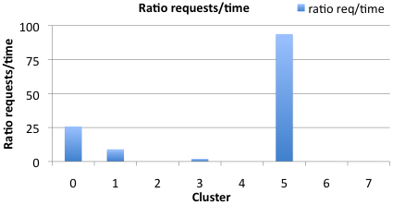
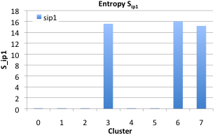
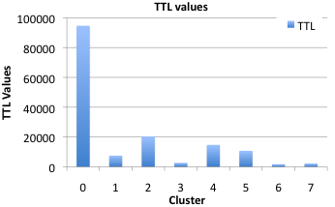
DNS based domain names clustering
Apply K-means clustering on extracted features
Method applied to 2 DNS captures from different networks
8 clusters formed
Ability to group in different clusters:
Popular domain names
CDN domain names
User tracking domain names
Fluxing domain names
DNS and Semantic Analysis for Phishing Detection
13 / 37

Slide 17
Quantifying semantic similarity between domains
Existing techniques to quantify the semantic relatedness between 2 words:
ensure
//
secure
Wordnet [Mil95]: occ_count(ensure,secure) = 6
Normalized Google Distance (NGD) [CV07]
DISCO [Kol08]: sim(ensure,secure) = 0.0943
Based on mutual information computation
Symmetric
Not language specific
Proposition:
Extract words from sets of domain names
Introduce new metrics to compute semantic relatedness between sets of words based on state of the art metrics
[CV07] Rudi L. Cilibrasi and Paul M. B. Vitanyi. The google similarity distance. IEEE Transactions on Knowledge and Data Engineering, 19(3):370–383, 2007.
[Kol08] Peter Kolb. DISCO: A Multilingual Database of Distributionally Similar Words. In Proceedings of KONVENS 2008 – Ergänzungsband: Textressourcen und lexikalis- ches Wissen, pages 37–44, 2008.
[Mil95] George A. Miller. WordNet: A lexical database for english. Commununications of the ACM, 38(11):39–41, 1995.
DNS and Semantic Analysis for Phishing Detection
14 / 37

Slide 18
Phishing domains set identification summary
DNS and Semantic Analysis for Phishing Detection
15 / 37

Slide 19
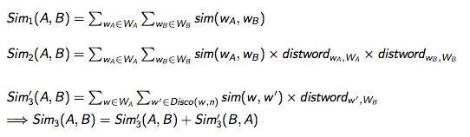
New semantic similarity metrics
Assuming two domain sets A and B and the associated extracted word sets W_{A} and W_{B} with their occurence frequencies distword we introduce 3 metrics to evaluate the semantic relatedness between A and B:
W_{A} = {(malware,0.08),(phish,0.16),(blacklisted,0.08),…}
W_{B} = {(unknown,0.08),(safe,0.08),(test,0.08),…}
distword_{safe,W}
B
DNS and Semantic Analysis for Phishing Detection
16 / 37

Slide 20
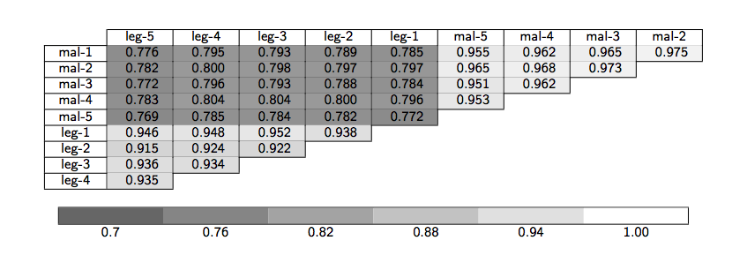
Domain set semantic similarity evaluation
blacklisted
domains
legitimate
domains
13,000
13,000
13,000
13,000
13,000
13,000
13,000
13,000
13,000
13,000
Sim₃(A,B)
leg/mal < 0.8
leg/leg > 0.92
mal/mal > 0.95
DNS and Semantic Analysis for Phishing Detection
17 / 37

Slide 21
First observation:
Domain name semantic analisys:
Relevant to identify phishing domain names….
…. as long as they are grouped in clusters
Shortcomings:
Need to accumulate enough DNS data to get relevant information about a domain name
Delay induced by the composition of initial clusters (real-time afterwards)
Need for reference datasets
How to use semantic analysis to identify
single malicious domains / URLs ?
DNS and Semantic Analysis for Phishing Detection
18 / 37

Slide 22
1. Phishing Presentation and Challenges to Address 2. Phishing Domains Detection Using DNS Features and Semantic Analysis 3. Phishing URLs Rating 4. Phishing Domains Prediction 5. Research Perspectives

Slide 23
Phishing URLs characteristics
www.paypal.creasconsultores.com/www.paypal.com/Resolutioncenter.php
shevkun.org/css/paypal.com/cgi-bin/cmd%3D_login-submit/css/websc.php
us-mg6.mail.yahoo.com.dwarkamaigroup.com/Yahoo.html
emailoans.hostingventure.com.au/bankofamerica.com
nitkowski.pl/components/wellsfargo/questions.php
The registered domain has no relationship with the rest of the URL
Most parts of URLs can be freely defined
Except the registered domain: main level domain + public suffix
http://
4ld.3ld.
mld.ps
/path1/path2?key1=value1&key2=value2
DNS and Semantic Analysis for Phishing Detection
19 / 37

Slide 24
Proposition for phishing URLs detection
Assumptions:
Components of legitimate URLs are all related
Registered domains (mld.ps) of phishing URLs are not related to the remaining of the URL
Analyse relatedness between mld.ps and
the remaining part of a URL : Intra-URL relatedness
DNS and Semantic Analysis for Phishing Detection
20 / 37

Slide 25
URL splitting
URL label extraction:
http://4ld.3ld.mld.ps/path1/path2?key1=value1&key2=value2
“mld” & “mld.ps”
Basic splitting
login.paypal.com/securepayment
RD_{url} = {paypal; paypal.com}
REM_{url} = {login; secure; payment}
DNS and Semantic Analysis for Phishing Detection
21 / 37

Slide 26
Intra-URL relatedness evaluation
How to evaluate the intra-URL relatedness ?
RD_{url} = {paypal; paypal.com}
//
REM_{url} = {login; secure; payment}
Wordnet [Mil95] NGD [CV07] Disco [Kol08]
dictionary based and ”Internet” vocabulary is not necessarily contained in dictionaries
use Search Engine Query Data
(Google Trends & Yahoo Clues)
Web searches reflect the cognitive behaviour of users looking for services on the Internet (what phishers try to identify and to mimic)
See which words are requested together in search engines to infer word relatedness
DNS and Semantic Analysis for Phishing Detection
22 / 37

Slide 27
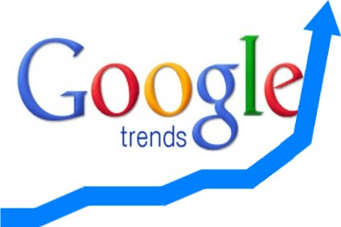

Intra-URL relatedness evaluation
DNS and Semantic Analysis for Phishing Detection
23 / 37

Slide 28
Features set
RD_{url}
REM_{url}
AS_{rd}
REL_{rd}
AS_{rem}
REL_{rem}
Word set relatedness
(Jaccard index)
Words embedded in URL
J_{RR} J_{RA} J_{AA}
J_{AR} J_{ARrd} J_{ARrem}
card_{rem}
Popularity of the registered domain
Popularity of words in URL
mld_{res}
mld.ps_{res}
ranking
ratio_{Arem}
ratio_{Rrem}
DNS and Semantic Analysis for Phishing Detection
24 / 37

Slide 29
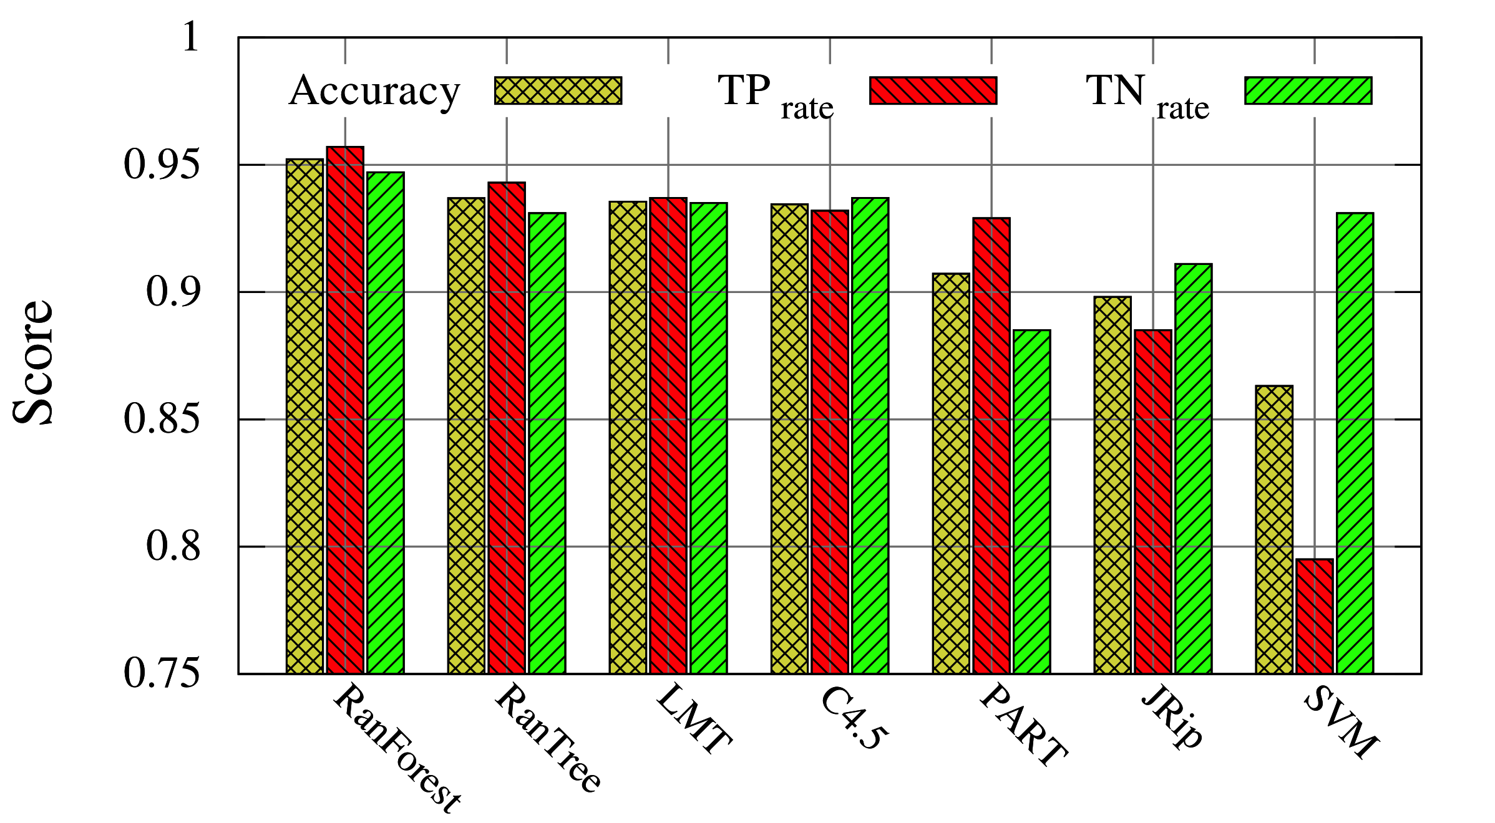
Phishing URLs classification
Machine learning approach:
Test the relevancy of the feature set to identify phishing URLs
7 classifiers tested: Random Forest, C4.5, JRip, SVM, etc.
10-fold cross-validation on 96,016 URLs (legitimate / phishing)
Random Forest:
95.66% accuracy
DNS and Semantic Analysis for Phishing Detection
25 / 37

Slide 30
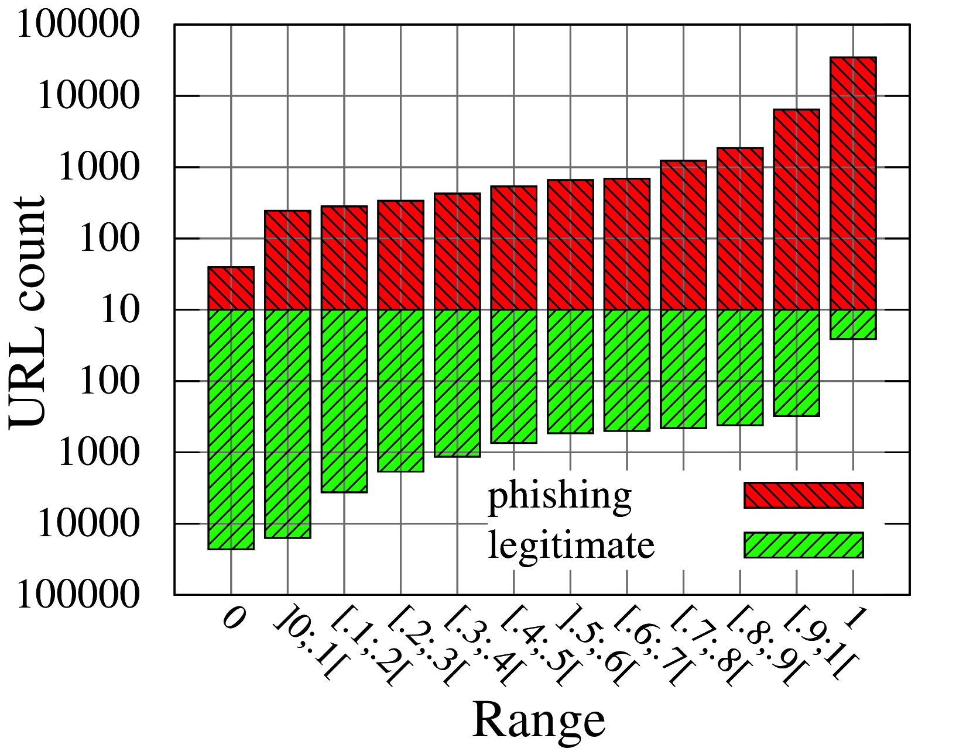
URLs rating
Random Forest based rating system:
Use soft prediction score [0;1] as URL score:
1: phishing URL
0: legitimate URL
0: 22,863 legitimate // 40 phishing
1: 26 legitimate // 34,790 phishing
99.89% correctness on
60.11% of the dataset
[0;0.1] and [0.9;1]
99.22% correctness on
83.97% of the dataset
DNS and Semantic Analysis for Phishing Detection
26 / 37

Slide 31
Conclusive remarks:
Domain names / URLs semantic analysis
Relevant to identify:
Clusters of malicious domains
Individual phishing URLs:
Strong decision: 95.66% accuracy
URL rating: >99% correctness on most URLs
Processing time < 1 sec/URL
Meet: reliability, speed, coverage
Can we step from
phishing identification / reactive methods
to phishing prediction / proactive methods ?
DNS and Semantic Analysis for Phishing Detection
27 / 37

Slide 32
1. Phishing Presentation and Challenges to Address 2. Phishing Domains Detection Using DNS Features and Semantic Analysis 3. Phishing URLs Rating 4. Phishing Domains Prediction 5. Research Perspectives

Slide 33
Phishing domains prediction
How can we know which domain names will be registered and used by phishers ?
Phishing domain names characteristics:
Longer than legitimate domains: many level domains
Combination of several words
Use a specific vocabulary limited to few semantic fields
Allow to identify phishing domain names and URLs
Can these features model the composition of phishing
domain names in order to predict them ?
DNS and Semantic Analysis for Phishing Detection
28 / 37

Slide 34
Natural language model
Key idea: model the composition of domain names used by phishers natural language processing
Extract features from known phishing domain names
Build a composition model using these features
Generate phishing domains before they are registered by phishers
Build a blacklist of potential phishing domain names
to block these as soon as they are used
DNS and Semantic Analysis for Phishing Detection
29 / 37

Slide 35
Features extraction
Phishing domain names
paypal.de-3d-secure.xyz
signin.ebay.it.gencklp.com
secure-ppl-update-account.eskyl.ca
securelogin34ebaymy-securephishing-domain.co.uk
securelogin34ebaymy-securephishing-domain.co.uk
secure
login
34
ebay
my
secure
phishing
domain
distlen = {(8,1)}
distword = {(secure,0.25),(login,0.125),(“34”,0.125) ,(ebay,0.125),…}
distfirstword = {(secure,1)}
distbiwords = {(secure, {(login,0.5),(phishing,0.5}), (login, {(“34”,1)}),…}
DNS and Semantic Analysis for Phishing Detection
30 / 37

Slide 36
Model generation
Markov Chain Model
distlen = {(8,1)}
distword = {(secure,0.25),(login,0.125),(“34”,0.125) ,(ebay,0.125),…}
distfirstword = {(secure,1)}
distbiwords = {(secure, {(login,0.5),(phishing,0.5}), (login, {(“34”,1)}),…}
DNS and Semantic Analysis for Phishing Detection
31 / 37

Slide 37
Semantic extension
Expand the Markov Chain Model
alternative transitions added to each state of the Markov Chain model
n most related word: transition = 0.5 * sim(orig_s,altern_s)
DNS and Semantic Analysis for Phishing Detection
32 / 37

Slide 38
Generation testing
50,000 malicious domain names (3 years):
Learning set: to build the generation model
Testing set: to check if generated domain names were actually use
Predictabilty (1 million generation):
Learning set: the 10% oldest
Testing set: the 90% newest
DNS and Semantic Analysis for Phishing Detection
33 / 37

Slide 39
Conclusion
Phishing domains are predictable:
Their composition can be modelized:
Features extracted from labelled phishing domains
Markov Chain model modelization with semantic extension
Domain names generator
Build a predictive blacklist:
Unregistered domain names + malicious domains
Generated months or years before they are used…
…. still containing legitimate domains
DNS and Semantic Analysis for Phishing Detection
34 / 37

Slide 40
1. Phishing Presentation and Challenges to Address 2. Phishing Domains Detection Using DNS Features and Semantic Analysis 3. Phishing URLs Rating 4. Phishing Domains Prediction 5. Research Perspectives

Slide 41
Research perspectives
Improve proposed techniques:
More refined machine learning techniques (clustering, Markov Models, etc.)
Others semantic analysis techniques (TF-IDF, Latent Semantic Analysis, etc.)
State of the art features
Real world deployment to assess:
Scalability of proposed solutions
Ease of use
Actual efficiency to cope with phishing
Other application of lexical and semantic analysis:
Malware / Fake AV
CCN, NDN
DNS and Semantic Analysis for Phishing Detection
35 / 37

Slide 42
Published work (PhD related)
Samuel Marchal, Jérôme François, Cynthia Wagner, Radu State, Alexandre Dulaunoy, Thomas Engel, and Olivier Festor - DNSSM: A Large Passive DNS Security Monitoring Framework - In Proceedings of the Network Operations and Management Symposium - NOMS ’12, 2012
Samuel Marchal, Jérôme François, Radu State, and Thomas Engel - Semantic Exploration of DNS - In Proceedings of NETWORKING 2012
Samuel Marchal, and Thomas Engel - Large Scale DNS Analysis - In Proceedings of the 6th IFIP International Conference on Autonomous Infrastructure, Management, and Security, and Vulnerability Assessment - AIMS ’12
Samuel Marchal, Jérôme François, Radu State, and Thomas Engel - Proactive Discovery of Phishing Related Domain Names - In Proceedings of Research in Attacks, Intrusions, and Defenses - RAID ’12, 2012
Samuel Marchal, Jérôme François, Radu State, and Thomas Engel - Semantic Based DNS Forensics - In Proceedings of the 4th IEEE International Workshop on Information Forensics and Security - WIFS ’12, 2012
Samuel Marchal, Jérôme François, Radu State, and Thomas Engel - PhishScore: Hacking Phishers’ Minds - In Proceedings of the 10th International Conference on Network and Service Management - CNSM ’14, 2014
Samuel Marchal, Jérôme François, Radu State, and Thomas Engel - PhishStorm: Detecting Phishing with Streaming Analytics - IEEE Transactions on Network and Service Management - TNSM, 2014
DNS and Semantic Analysis for Phishing Detection
36 / 37

Slide 43
Published work (others)
Quentin Jérôme, Samuel Marchal, Radu State, and Thomas Engel – Advanced Detection Tool for PDF Threat - In Proceedings of Data Privacy and Autonomous Spontaneous Security - SETOP ’13, 2013
Samuel Marchal, Xiuyan Jiang, Radu State, and Thomas Engel - A big data architecture for large scale security monitoring - In Proceedings of the IEEE Inter- national Congress on Big Data - BigData Congress ’14, 2014
Samuel Marchal, Anil Mehta, Vijay K. Gurbani, Radu State, Tin Kam Ho, Flavia Sancier-Barbosa - Mitigating mimicry attacks against the Session Initiation Protocol (SIP) – to appear in IEEE Transactions on Network and Service Management - TNSM
DNS and Semantic Analysis for Phishing Detection
37 / 37

Slide 44

Questions
DNS and Semantic Analysis for Phishing Detection

Slide 45
DNS and Semantic Analysis for Phishing Detection
June 22, 2015
Ph.D. defense
Samuel Marchal
Defense committee:
Prof. Ulrich Sorger – chairman Prof. Eric Filiol – reviewer
Prof. Claude Godart – vice-chairman Prof. Eric Totel – reviewer
Prof. Thomas Engel – co-supervisor Dr. Vijay Gurbani – expert
Prof. Olivier Festor – co-supervisor Dr. Radu State – expert

Slide 46
Domain Name splitting
distword = {(my,0.125),(vodafone,0.25),(security,0.125),…}
DNS and Semantic Analysis for Phishing Detection

Slide 47
Experiments and Results
Size of domains sets:
Sim_{i}(A,B) is able to distinguish legitimate from malicious sets of domains:
for large sets (>13,000 domains): ok !!
what is the minimum domain count in one set to evaluate it ?
DNS and Semantic Analysis for Phishing Detection

Slide 48
Experiments and Results
DNS and Semantic Analysis for Phishing Detection

Slide 49
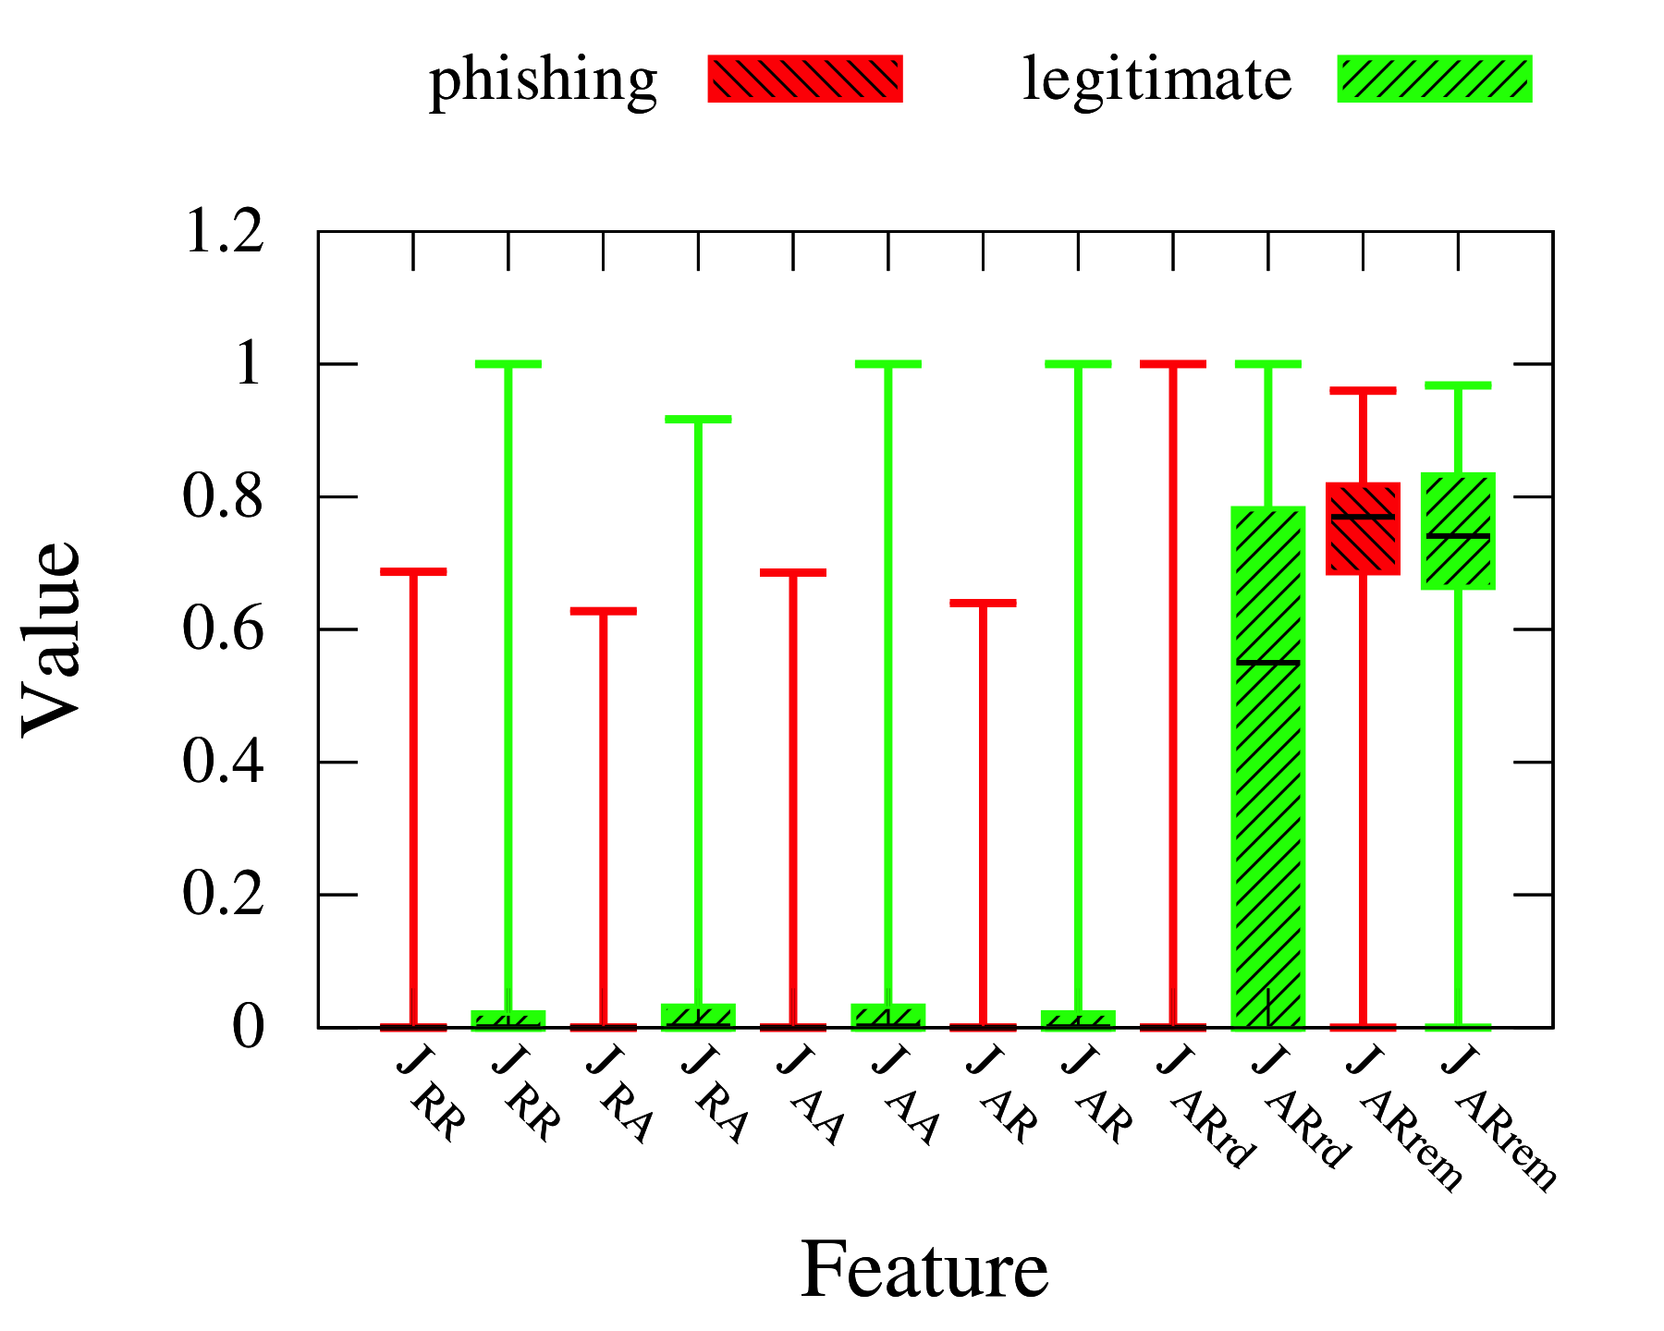
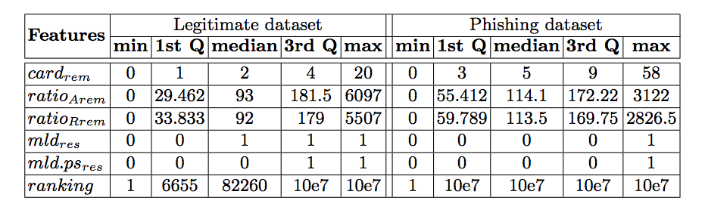
Features analysis
Datasets:
48,009 phishing URLs (source: PhishTank)
48,009 legitimate URLs (source DMOZ)
Features extraction for both datasets
DNS and Semantic Analysis for Phishing Detection

Slide 50
Dataset & model comparison
2 datasets of 50,000 domains each:
malicious domains (MDL, DNS-Black-Hole, PhishTank)
legitimate domains (top Alexa, passive DNS)
Domain length comparison
(malicious /legitimate)
main level domain
length in words
DNS and Semantic Analysis for Phishing Detection

Slide 51
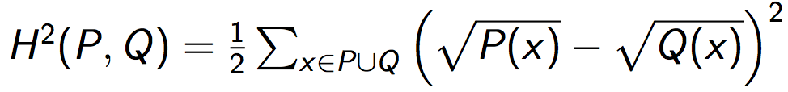
Word distribution comparison
Hellinger distance:
comparison of probabilistic distribution
symetric metric ( H²(P, Q) = H²(Q, P) )
applied to distword (main level domain and public suffix)
malicious and legitimate sets divided in 5 subsets each
Result summary:
Level | mal / mal | leg / leg | mal / leg
Public Suffix | 0.013 | 0.018 | 0.133
Main level domain | 0.44 | 0.49 | 0.56
DNS and Semantic Analysis for Phishing Detection

Slide 52
Offline testing
5 tests of 1 million domains
generation
learning set 30%
(15,000 domains)
testing set 70%
(35,000 domains)
DNS and Semantic Analysis for Phishing Detection

Slide 53
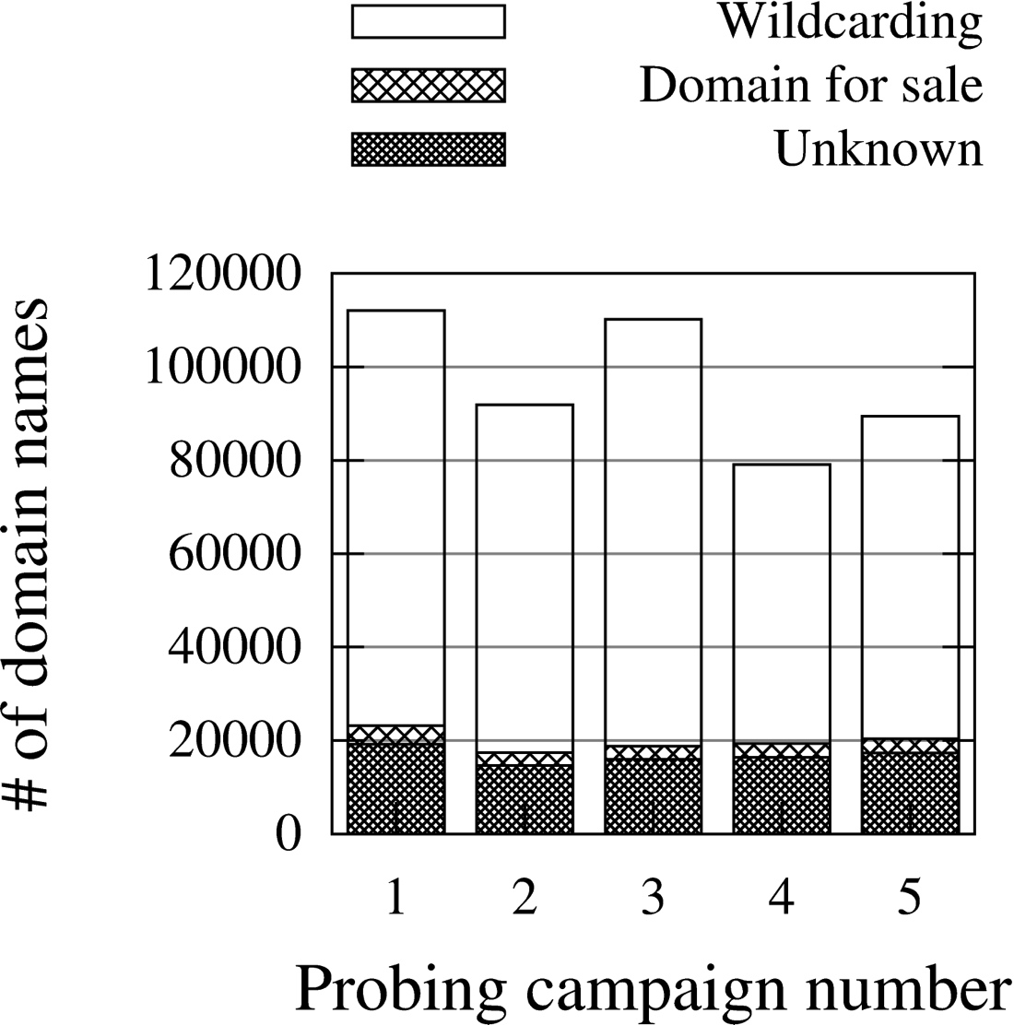
Online generation testing
DNS requests for 1 million generated domain names
≈ 100,000 domains match an @IP:
80,000 wildcarding domains
5,000 domains for sale
15,000 remaining domains:
500 actually malicious
and blacklisted
200 legitimate domains
the rest is unknown…
DNS and Semantic Analysis for Phishing Detection

Slide 54
MC Score
DNS and Semantic Analysis for Phishing Detection

