Slide 1


An isogeometric boundary element method for fracture modeling
Xuan Peng, Cardiff University
Elena Atroshchenko, University of Chile
Stéphane Bordas, University of Luxemburg
May 2015

Slide 2
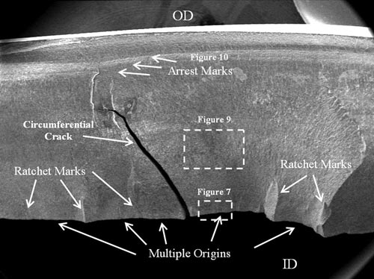
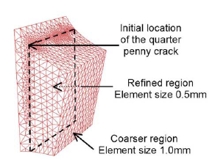
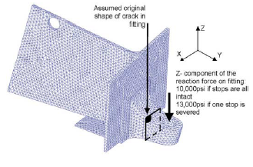
Motivation
2/14
Fatigue Fracture Failure of Structure
Initiation: micro defects
Loading : cyclic stress state (temperature, corrosion)
Introduce the numerical methods to simulate crack growth
Numerical methods for crack growth
Volume methods:
FEM, XFEM/GFEM, Meshfree
Boundary methods: BEM
Fatigue cracking of nozzle sleeve
http://met-tech.com/
Explain the problems of XFEM based methods in simulating the crack growth
Bordas & Moran, 2006
XFEM+LEVEL SET

Slide 3
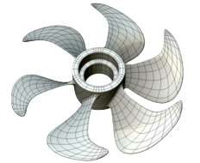



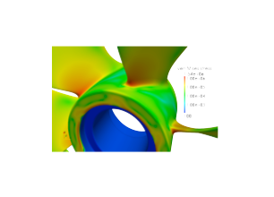
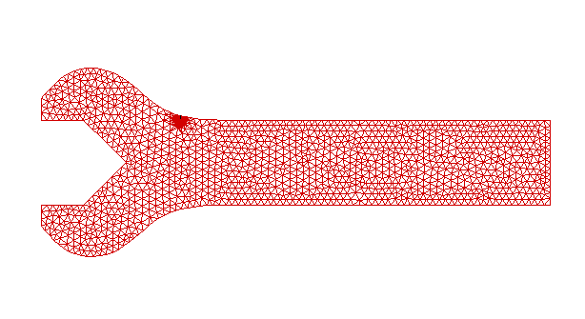
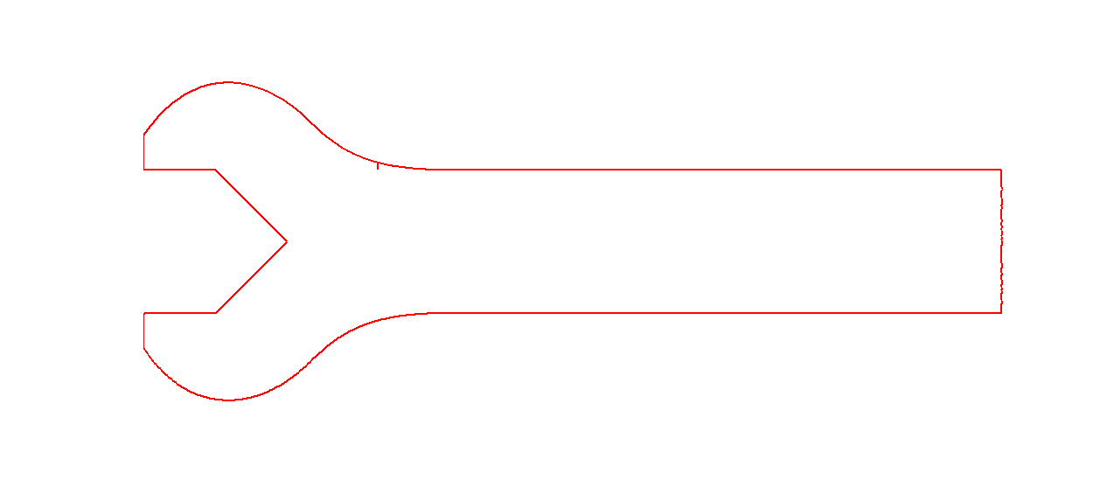
Motivation
3/14
Challenges in volume-based methods
Introduce IGABEM to overcome the challenges in FEM based methods , but we should mention the computational cost of BEM, where an acceleration implementation should be done, but this is the problem of BEM, not IGA.
Remeshing (FEM)
Local mesh refinement
mesh
IGA
Efficiency & Accuracy
direct calculation
calculation
stress analysis
crack
XFEM
adaptive refinement
Animation of comparison between an XFEM implementation and IGABEM, if animation cannot by played automatically, please play the .avi video
crack
IGABEM
Direct CAD used

Slide 4
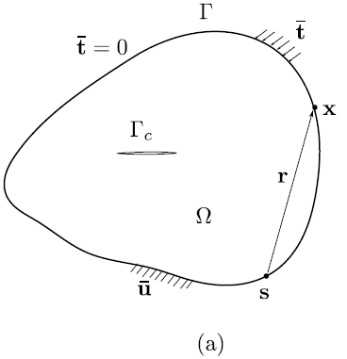
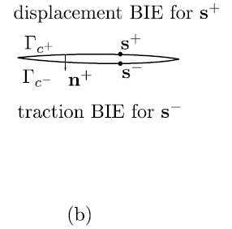
Collocation BEM for crack modeling
4/14
Displacement BIE: non–crack boundary and one crack surface
Dual boundary integral equations are used to overcome the singular system led by using only one BIE
Traction BIE: the other crack surface

Slide 5
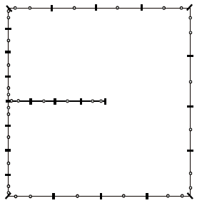

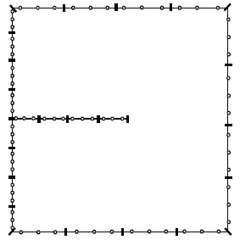
NURBS discretisation and collocation
5/14
Greville Abscissae:
NURBS approximation for displacement and traction, Collcation scheme
NURBS(B-Spline)
p=2
Discretised BIEs
Discontinous Lagange
p=2

Slide 6
Singular integration
6/14
Various order of singularity in the kernels
We will face singular integration in BIE. The method to eliminate the singularity is to use the singularity subtraction method.
1)The integrand is expanded as a series with respect to intrinsic coordinate
2) The explicit singular part in the series is subtracted from the integrand, then remaining part is regular, an Gauss rule is applied for this
3) The subtracted explicit part will be add back and integrated analytically.
Singularity subtraction technique (SST)
regular part

Slide 7
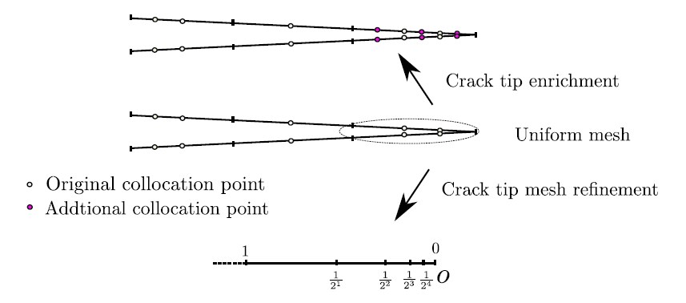
Treatment of crack tip singularity
7/14
Partition of unity enrichment:
We tried two ways to handle the singularity caused by crack tip. One way is PU enrichment, the other is graded mesh refinement for the crack tip
Consecutive knot insertion at crack tip

Slide 8
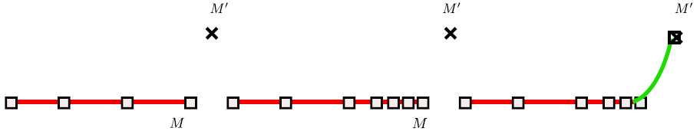
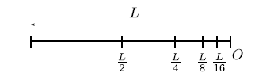
Algorithm for crack propagation
8/14
We adopt the algorithm to activate the crack growth
Specify the new tip point named space constraint which can be obtained by specific fracture criterion
We define a influence function named localized constraint function to describe the deformation of the old crack path, we choose the NURBS basis function as it.
Calculate the moving vector for control points to get new crack path
The method is applicable to 3D case
Space constraint , parametric constraint
Decided by fracture criterion
Localization constraint function
Calculate the moving vector
Applicable to 3D crack growth

Slide 9
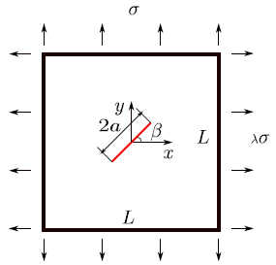

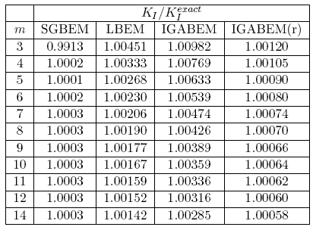
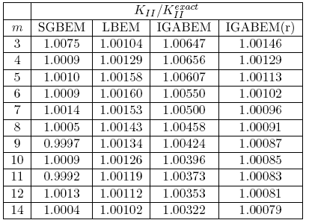
Inclined centre crack (SGBEM, Lagrange BEM, IGABEM)
9/14
We show the SIF result of IGABEM and compare with classical methods
IGABEM(r) :Uniform mesh (refined tip element)
LBEM: discontinuous Lagrange BEM
SGBEM: symmetric Galerkin BEM, Sutrahar&Paulino (2004)
m: number of elements in uniform mesh along the crack surface

Slide 10
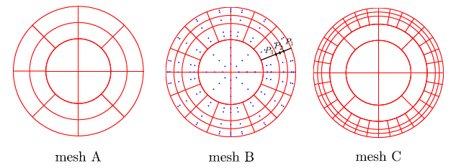
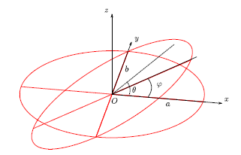
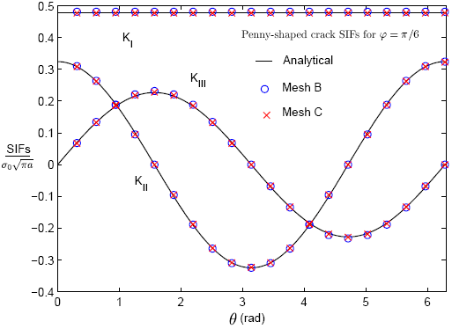
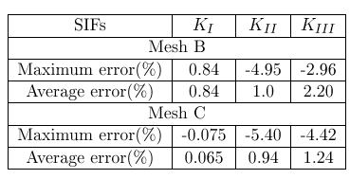
First sight on 3D application
10/14
Penny-shaped crack under remote tension
The 3D result of penny crack shows the potential prospect of IGABEM: high accuracy, smoothness of SIF, which is very important to crack propagation

Slide 11
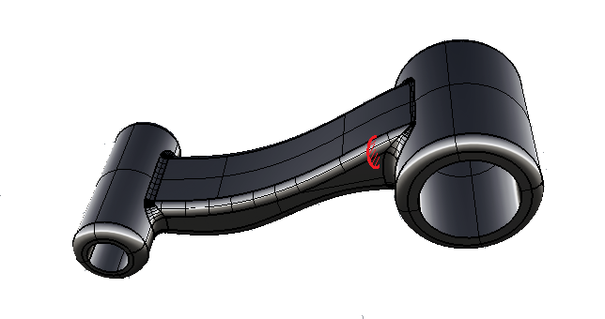
Difficulties in 3D application
11/14
How far we are to non-trivial 3D workpieces
crack
trimmed surface
For a real application in 3D model, we need
Transfer the original CAD, the trimmed NURBS model, into a group of multiple patches using some way . The compatibility is not required between the patches
Crack evolution along the surface needs to be developed
Input from Rhino, ProE, UG,…
untrimmed multiple patches & T-Splines
CAD model
(trimmed NURBS)
Analysis-suitable Splines
Stress analysis
crack evolution description
fracture analysis

Slide 12
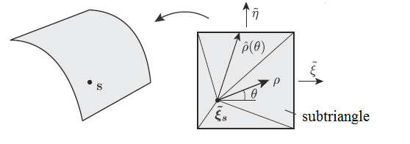
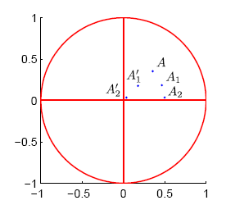
(on going)
Difficulties in 3D application
12/14
Stabilization of singular integral
in conventional SST in 3D, the quadrature in annular direction turns out to be sensitive on element topology
Near singularity in annular direction of the regular part needs to be cancelled ( J. Rong et al, 2014)
could be nearly singular when 1) the element is highly distorted; 2) the collocation point is close to element edge.
Proposed solution:
1)Conformal transformation to get a constant A(\theta)
2) Sigmoidal transformation to cancel the near singularity in \hatrho
Robust evaluation of nearly singular integral
The type of integral
could cause near singularity in the adjacent elements when the collocation point approaches to the edge
Proposed solution for near singular integral in adjacent element: adaptive subdivision and sinh transformation

Slide 13
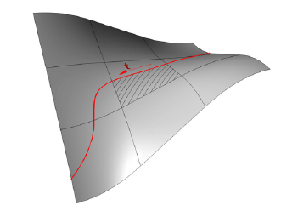
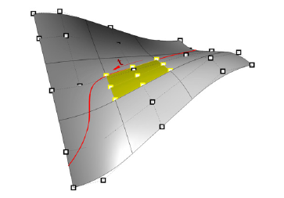
Difficulties in 3D application
13/14
IGABEM for trimmed NURBS
For the geometry difficulty, including the trimmed geometry and the crack-geometry cutting, we first need to
set up the element connectivity for the trimmed NURBS
avoid the big difference in element aspect ratio of trimmed NURBS which will lead to a singular system
find a collocation scheme along with crack cutting
Crack evolution description on the geometry
Proposed solution: reparameterization for trimmed NURBS by R. Schmidt et al, 2012
Any other suggestions are welcomed

Slide 14



14/14
Acknowledgements:
Thanks given to the Framework Programme 7 Initial Training Network Funding under grant number 289361 "Integrating Numerical Simulation and Geometric Design Technology” (FP7: ITN-INSIST) and RealTcut project ERC
thanks for YOUR attention

