Slide 1
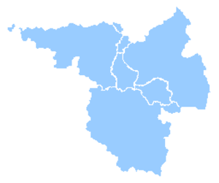
Error controlled adaptive multiscale modelling of fracture for polycrystalline microstructures Stéphane p. a. ßordas (Spaß), Pierre Kerfriden + team University of Luxembourg and Cardiff University
279578 - REALTCUT - Towards real time multiscale simulation of cutting in non-linear materials with applications to surgical simulation and computer guided surgery

Slide 3
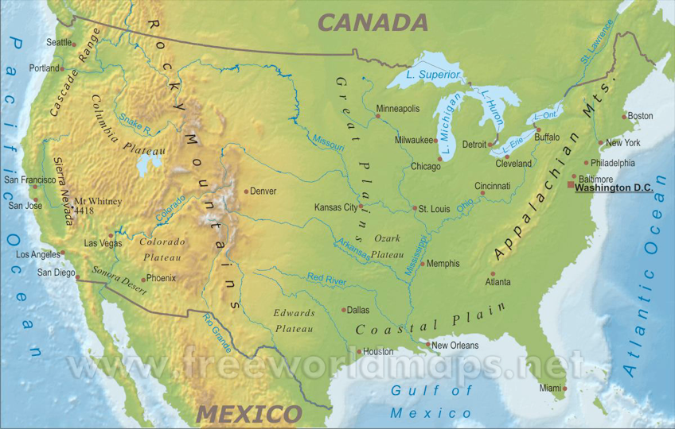
I
M A M
Institute of Mechanics
& Advanced Materials
Chicago, Illinois
1997-2003
MSc Geotechnical Engineering PhD. Damage Tolerance of Aerospace Structures (XFEM) and Biofilm Growth
Advisor: Brian Moran
Now vice-provost for
faculty affairs at KAUST

Slide 4
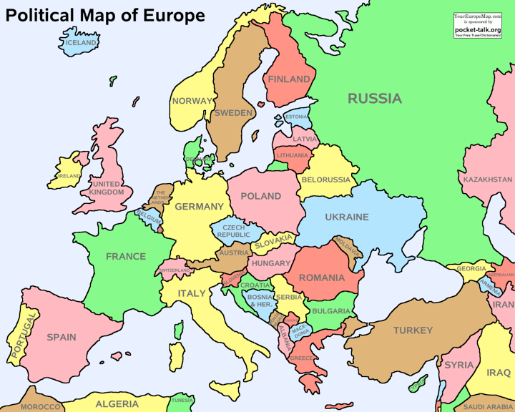
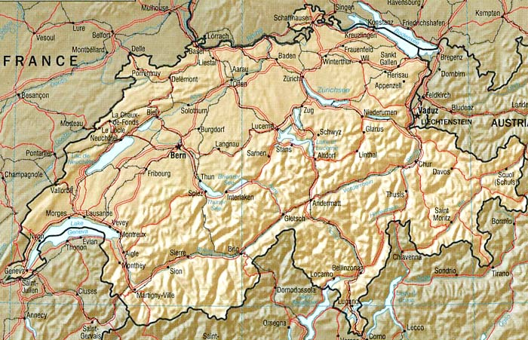
I
M A M
Institute of Mechanics
& Advanced Materials
Post-doc 2003-2006 -
Meshless/XFEM Geomechanics
Lausanne

Slide 5
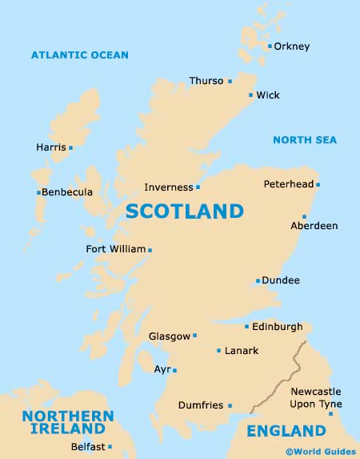
I
M A M
Institute of Mechanics
& Advanced Materials
Lecturer in civil engineering

Slide 6
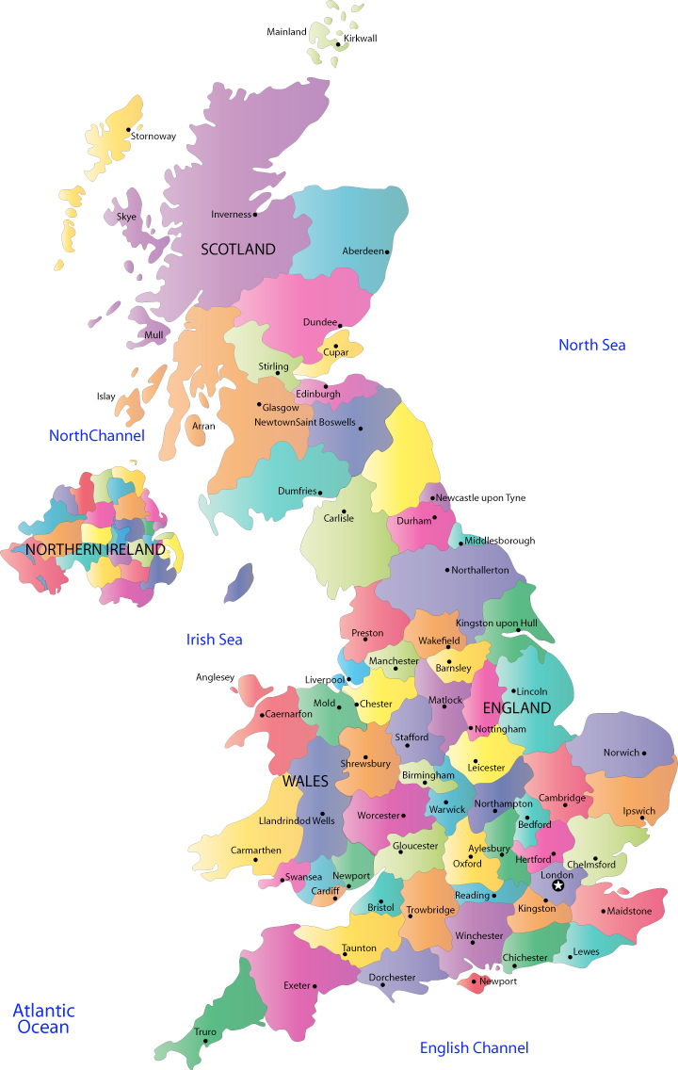
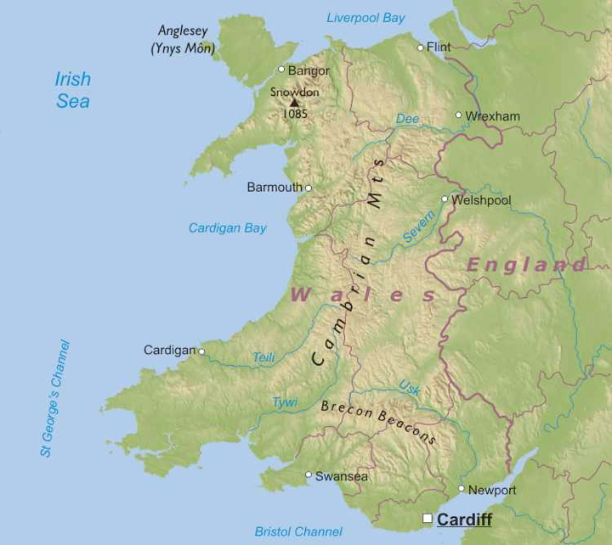
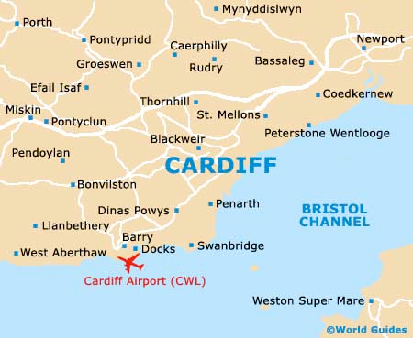
I
M A M
Institute of Mechanics
& Advanced Materials

Slide 7
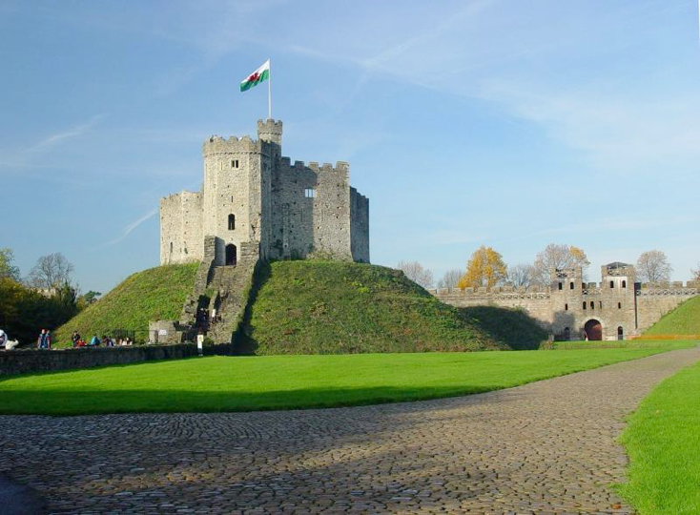
I
M A M
Institute of Mechanics
& Advanced Materials

Slide 8
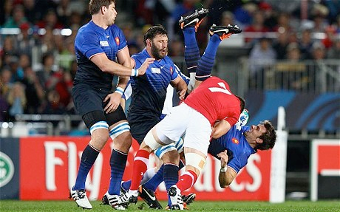
I
M A M
Institute of Mechanics
& Advanced Materials

Slide 9
Space-time trajectory
1975 1997 | 1997 1998 | 1999 2003 | 2003 2006 | 2006 2009 | 2009 present
Paris France | Evanston Illinois, USA | Evanston Illinois, USA | Lausanne Suisse | Glasgow Ecosse | Cardiff, Pays de Galles
1997, ESTP-ENSAM Master “Ecole Spéciale des Travaux Publics, du Bâtiment, et de l’Industrie” | 1998 Northwestern University MSc geotechnical engineering (1/2 bourse) | Déc. 03 Northwestern University PhD, Theoretical and Applied Mechanics | Déc. 03 - Juil.06. post-doc Laboratoire de mécanique des milieux continus (LMC) | lecturer (maître de conférences) | professeur, directeur institute of mechanics & advanced materials
EPSRC first grant
2010 - 2014
RAEng Fellowship
2009
ERC Starting Grant
2012 - 2016
PhD, 2003
FP7 ITN 2012-2015
pas à l’échelle

Slide 10
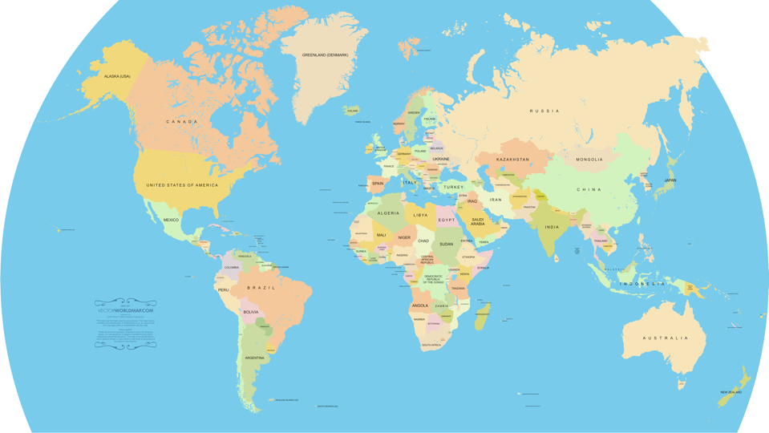
I
M A M
Institute of Mechanics
& Advanced Materials
4
5
6
1
2
3

Slide 11
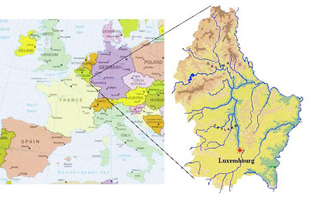
Luxembourg: 2,586.4 km2
Paris region: 12,012 km2

Slide 12
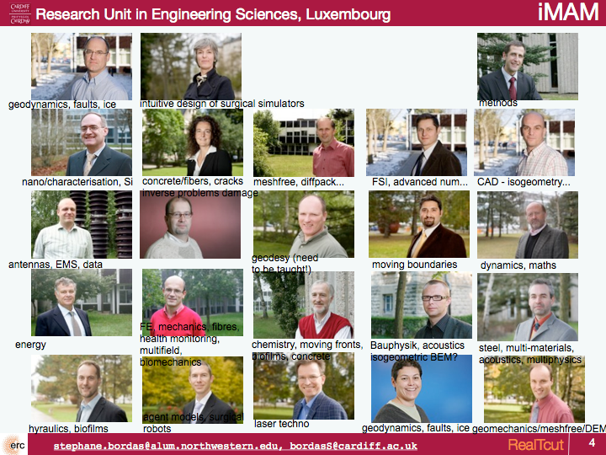

Slide 13
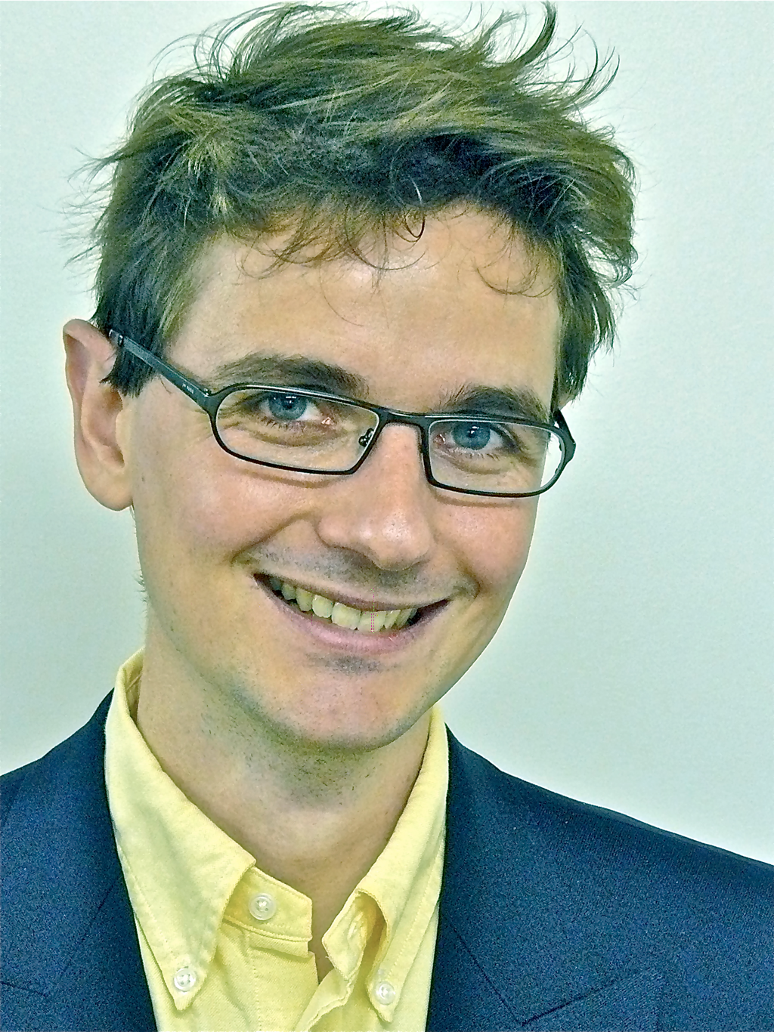
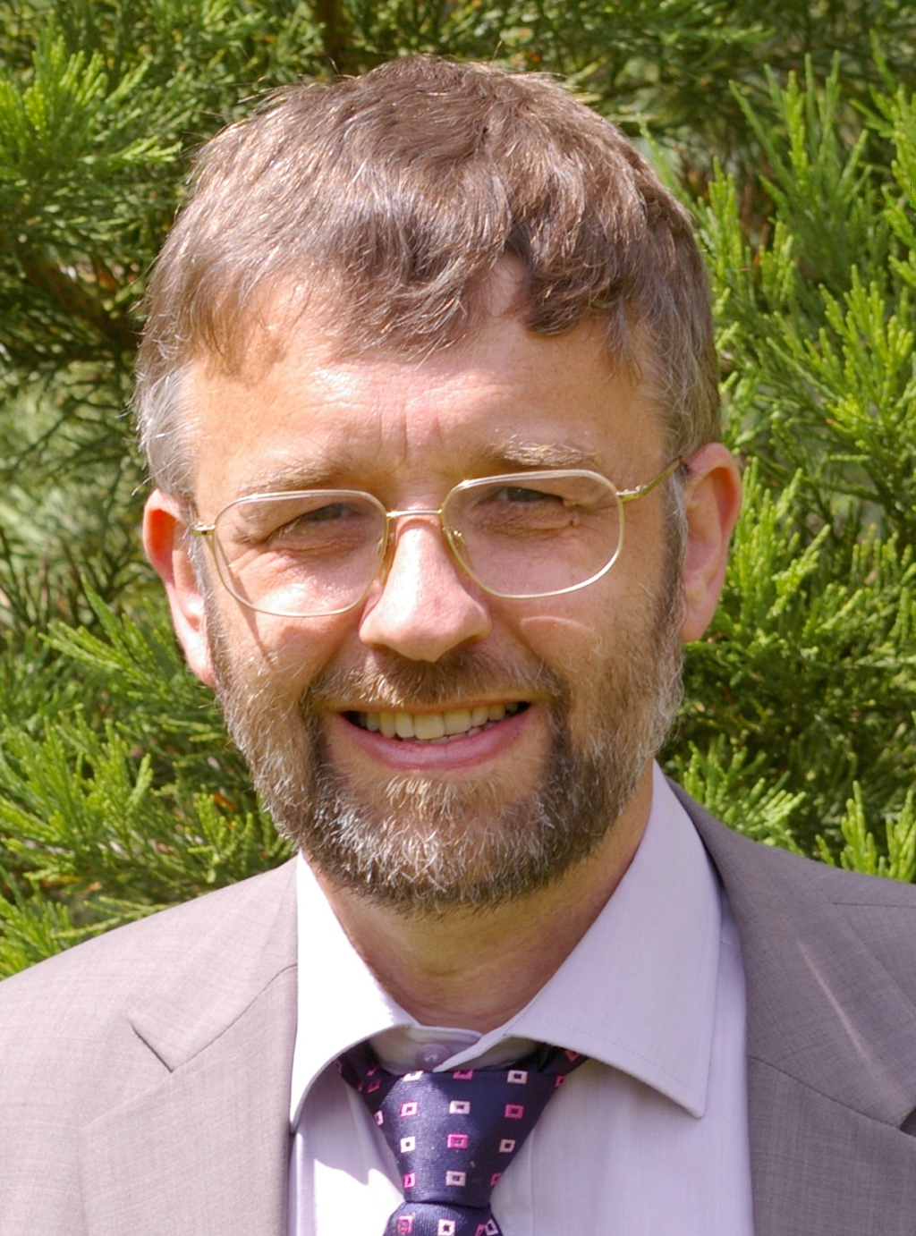
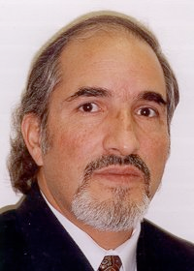
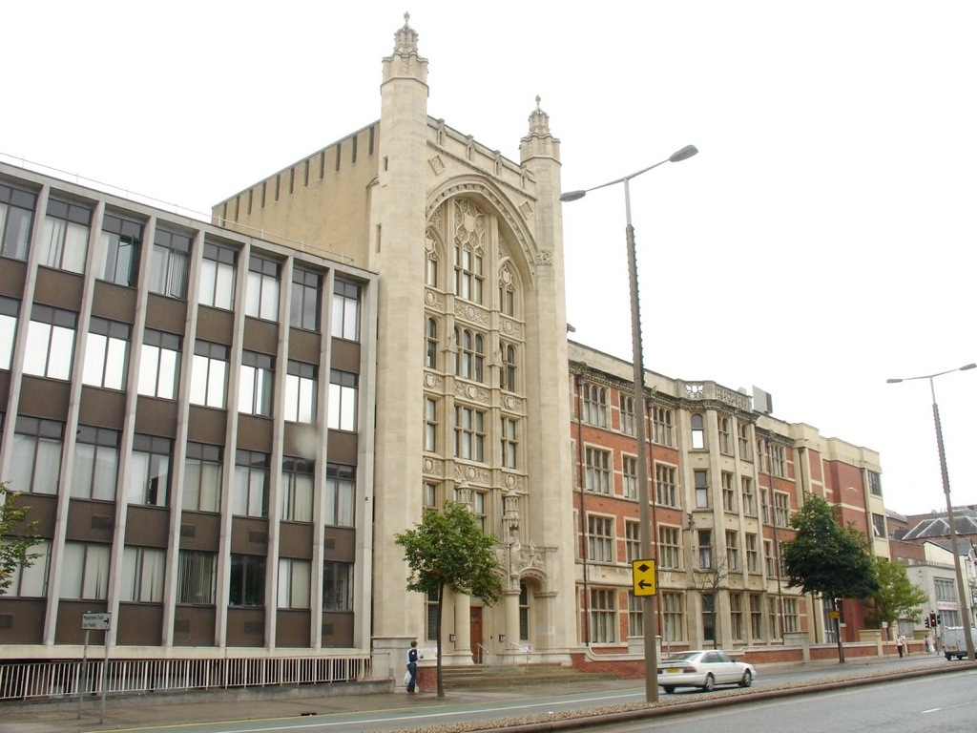
Institute of mechanics and advanced materials
The institute
6 professors, 6 lecturers/senior lecturers
10 post-doc fellows
17 PhD students
~ £1.0M funding annually
Prof. Stéphane Bordas, Director.
Extended FEM/Meshless
Prof. Feodor Borodich
Theoretical/Nano mechanics, contact, adhesion
Prof. Pwt Evans
Contact mechanics, tribology
Dr. Paul Howson
Transcendental eigenvalue problems
Prof. Bhushan Karihaloo
Advanced materials, theoretical mechanics
Prof. David Kennedy
Eigenvalue problems, advanced numerical methods
Dr. Pierre Kerfriden
Multiscale, model order reduction, fracture
Dr. Siva Kulasegaram
Meshless methods
I
M A M
Institute of Mechanics
& Advanced Materials
Theoretical & Computational Mechanics
Tribology & Contact Mechanics
Experiments
Theory
Dr. Lars Beex
Multiscale methods
Prof. Ray Snidle
Contact mechanics, tribology
Dr. Hanxing Zhu
Theoretical mechanics, cellular materials
Computational Mechanics

Slide 14
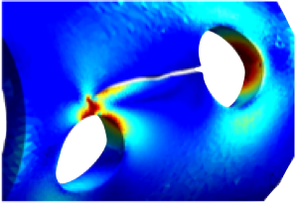
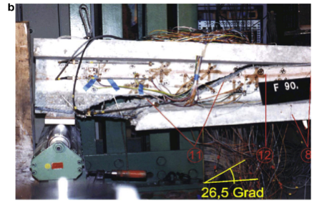
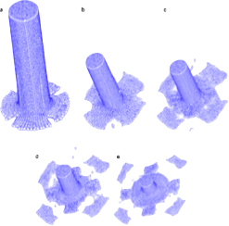
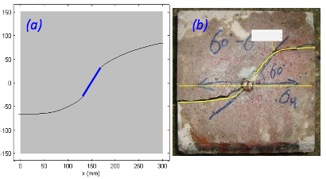
Motivation: fracture of engineering structures and materials
rupture, erreur, non-linéarités
objectifs
contrôle de l’erreur en mécanique linéaire de la rupture avec discrétisations XFEM
fissuration non-linéaire
multi-fissure, grandes transformations
validation expérimentale
réaction alkali-silica - microstructure béton: endommagement/XFEM
méthodes
sans maillage avec et sans enrichissement
évaluation d’erreur a posteriori par “lissage” (recovery) pour XFEM
nouvel algorithme de résolution non-linéaire
output
Math. Comp. Sim., C&S, CMECH, EFM, IJNME, CMAME, parmi les plus cités dans ces journaux
codes libres [sourceforge]
Crack growth without re-meshing
Implicit representation of boundaries and interfaces
Alternative discretization techniques (meshless)
Crack growth without re-meshing
Implicit representation of boundaries and interfaces
Alternative discretization techniques (meshless)
Limerick: unidirectional composites
linear elastic fracture & fatigue
thesis L. Cahill, 2014
num
exp
China/USA: hydraulic fracturing (shale gas)
quasi-static/cohesive
num
dynamics
ductile
dynamics/brittle
exp
14
post-doc Simpson
CMECH
EPSRC project 2011-2012
thesis M. Sheng, USA, China, 2016

Slide 15
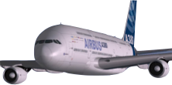
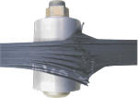
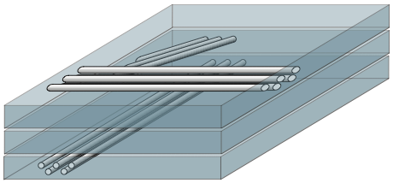
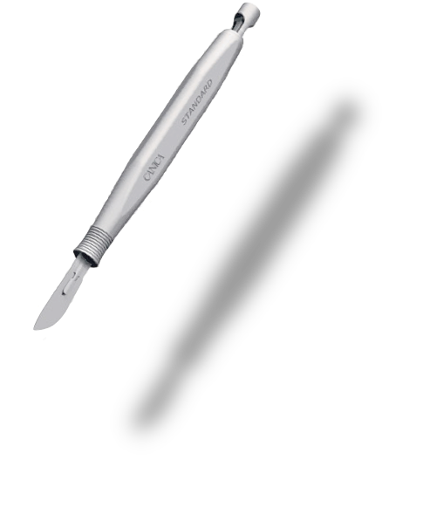
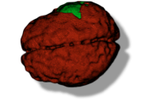
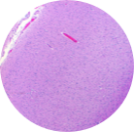
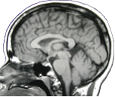
Motivation: multiscale fracture/cutting
Practical early-stage design simulations (interactive)
100 plies
0.125 mm
50 mm
courtesy: EADS
Discretise
[Allix, Kerfriden, Gosselet 2010]
Surgical simulation
Discretise
Reduce the problem size while controlling the error (in QoI) when solving very large (multiscale) mechanics problems

Slide 16
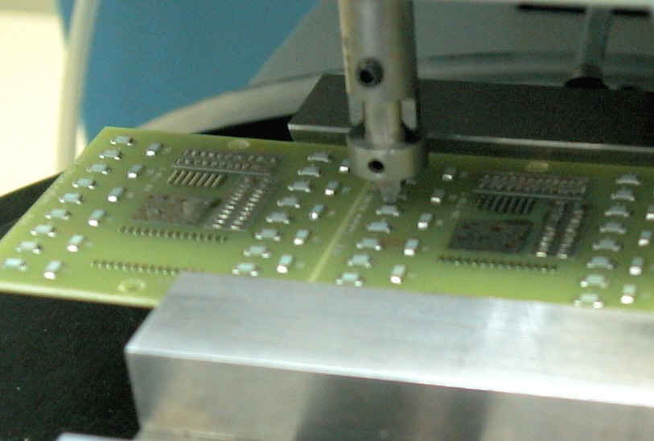
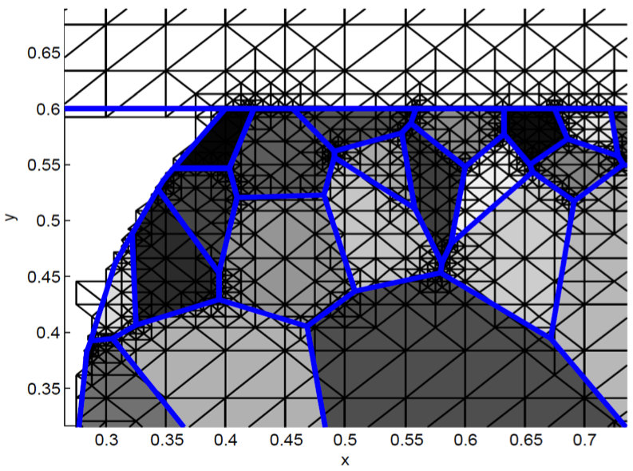
Motivation: multiscale fracture - Example
Solder joint durability (microelectronics), Bosch GmbH

Slide 18
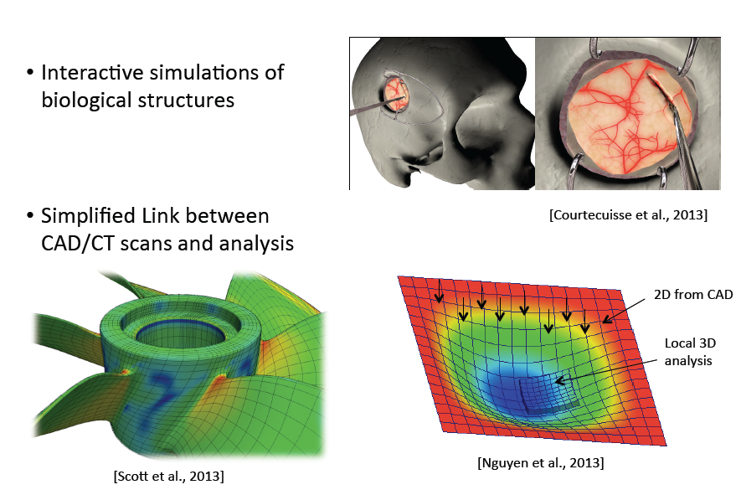

Slide 19
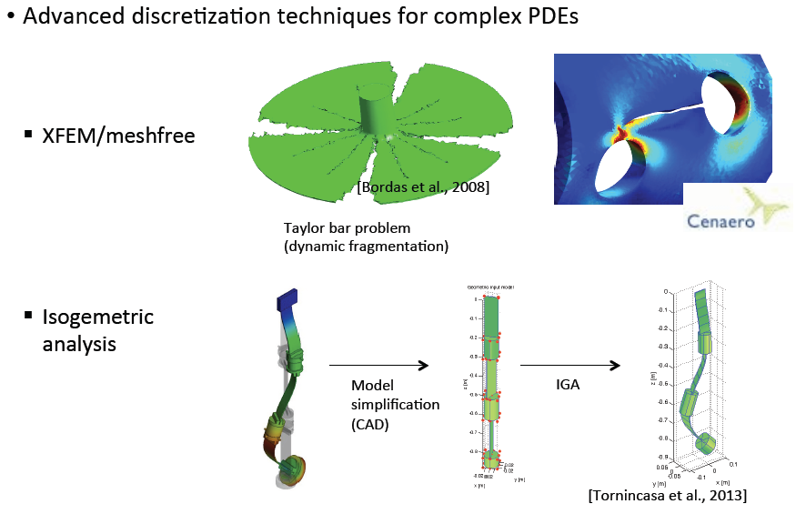

Slide 20
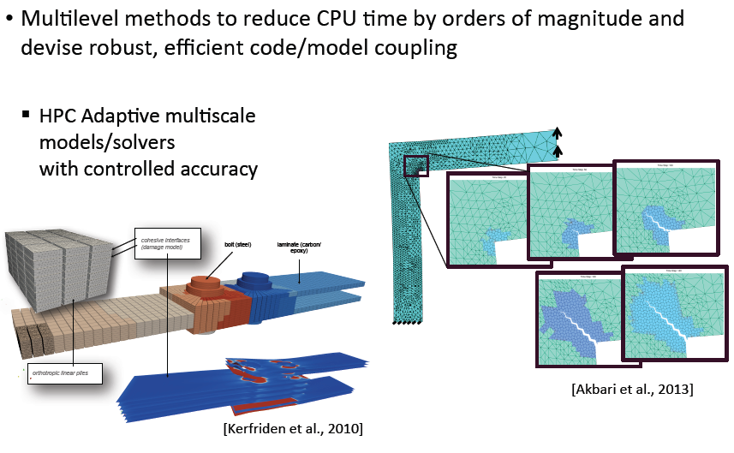

Slide 22
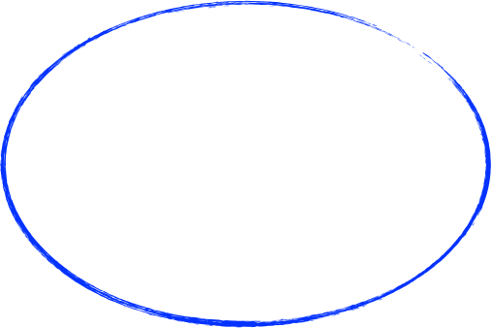
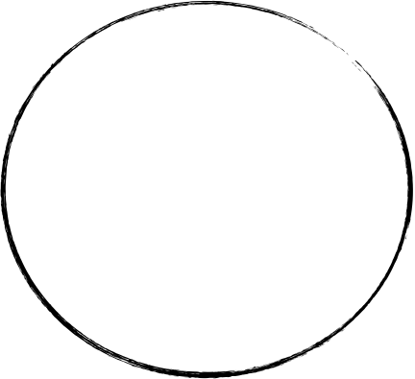
Model reduction
multi-scale & homogenisation
algebraic model reduction (using POD)
Newton-Krylov, “local/global”, domain decomposition
Discretization
partition of unity enrichment
(enriched) meshless methods
level sets
isogeometric analysis
implicit boundaries
Error control
XFEM: goal-oriented error estimates
used by CENAERO (Morfeo XFEM)
meshless methods for fracture
error estimation for reduced models

Slide 23
1) Natarajan, S., Ferriera, A., Bordas, S., Carrera, E., Cinefra, M., & Zenkour, A. (in press). Analysis of functionally graded
material plates using triangular elements with cell-based smoothed discrete shear gap method. Mathematical Problems in
Engineering.
http://hdl.handle.net/10993/14981
Peer reviewed
ORBilu viewed: 21 (2 UL) ; downloaded: 1 — WOS: - — SCOPUS®: -
IF last: 1.383; IF5: 1.216 — EigenF last: 0.0028 — Article Infl. last: 0.2163
2) Nguyen, V., Kerfriden, P., Brino, M., Bordas, S., & Bonisoli, E. (in press). Nitsche’s method for two and three dimensional
NURBS patch coupling. Computational Mechanics.
http://hdl.handle.net/10993/14460
Peer reviewed
ORBilu viewed: 128 (7 UL) ; downloaded: 19 (1 UL) — WOS: - — SCOPUS®: -
IF last: 2.432; IF5: 2.314 — EigenF last: 0.0107 — Article Infl. last: 1.0463
3) Rodrigues, J., Natarajan, S., Ferreira, A., Carrera, E., Cinefra, M., & Bordas, S. (in press). Analysis of composite plates through
cell-based smoothed finite element and 4-noded mixed interpolation of tensorial components techniques. Computers &
Structures.
http://hdl.handle.net/10993/14980
Peer reviewed
ORBilu viewed: 27 (1 UL) ; downloaded: 0 — WOS: - — SCOPUS®: 0
IF last: 1.509; IF5: 2.000 — EigenF last: 0.0134 — Article Infl. last: 0.9159

Slide 24
4) Xu, G., Atroshchenko, E., Ma, W., & Bordas, S. (2014, September 01). Geometry-independent field approximation for splinebased
finite element methods - Generalized Isogeometric Analysis. Computer Methods in Applied Mechanics & Engineering.
http://hdl.handle.net/10993/15781
Peer reviewed
ORBilu viewed: 15 (1 UL) ; downloaded: 30 (2 UL) — WOS: - — SCOPUS®: -
IF 2014: ?; last: 2.617; IF5: 2.738 — EigenF 2014: ?; last: 0.0401 — Article Infl. 2014: ?; last: 1.327
5) Kerfriden, P., Ródenas, J.-J., & Bordas, S. (2014). Certification of projection-based reduced order modelling in computational
homogenisation by the Constitutive Relation Error. International Journal for Numerical Methods in Engineering, 97(6),
395-422.
http://hdl.handle.net/10993/14452
Peer reviewed
ORBilu viewed: 17 (2 UL) ; downloaded: 6 — WOS: 0 — SCOPUS®: 0
IF 2014: ?; last: 2.068; IF5: 2.295 — EigenF 2014: ?; last: 0.0285 — Article Infl. 2014: ?; last: 1.0545
6) Cahill, L. M. A., Natarajan, S., Bordas, S., O’Higgins, R. M., & McCarthy, C. T. (2014). An experimental/numerical investigation
into the main driving force for crack propagation in uni-directional fibre-reinforced composite laminae. Composite
Structures, 107, 119--130.
http://hdl.handle.net/10993/12316
Peer reviewed
ORBilu viewed: 283 (4 UL) ; downloaded: 134 (1 UL) — WOS: 1 — SCOPUS®: 1
7) Courtecuisse, H., Allard, J., Kerfriden, P., Bordas, S., Cotin, S., & Duriez, C. (2014). Real-time simulation of contact and
cutting of heterogeneous soft-tissues. Medical Image Analysis, 18(2), 394-410.
http://hdl.handle.net/10993/15809
Peer reviewed
ORBilu viewed: 112 (4 UL) ; downloaded: 69 (1 UL) — WOS: - — SCOPUS®: 0
IF 2014: ?; last: 4.087; IF5: 4.662 — EigenF: — Article Infl.:
8) Hoang, K. C., Kerfriden, P., & Bordas, S. (2014). An efficient goal-oriented sampling strategy using reduced basis method for
linear elastodynamic problems. Numerical Methods for Partial Differential Equations.
http://hdl.handle.net/10993/15814
Peer reviewed
ORBilu viewed: 7 (2 UL) ; downloaded: 1 — WOS: - — SCOPUS®: -
IF 2014: ?; last: 1.212; IF5: 1.425 — EigenF 2014: ?; last: 0.0051 — Article Infl. 2014: ?; last: 0.6468
9) Natarajan, S., Kerfriden, P., Mahapatra, D. R., & Bordas, S. (2014). Numerical analysis of the inclusion-crack interaction
by the extended finite element method. International Journal for Computational Methods in Engineering Science and
Mechanics.
http://hdl.handle.net/10993/12317
Peer reviewed
ORBilu viewed: 32 (1 UL) ; downloaded: 2 — WOS: - — SCOPUS®: 0
10) Abu Bakar, I. A., Bordas, S., Rabczuk, T., & Kramer, O. (2013). Optimization of Elastic Properties and Weaving Patterns of
Woven Composites. Composite Structures, 100, 575-591.
http://hdl.handle.net/10993/12379
Peer reviewed
ORBilu viewed: 30 (1 UL) ; downloaded: 2 — WOS: 0 — SCOPUS®: -
IF 2013: ?; last: 2.231; IF5: 2.550 — EigenF 2013: ?; last: 0.0182 — Article Infl. 2013: ?; last: 0.6988
11) Natarajan, S., Manickam, G., & Bordas, S. (2013). Supersonic flutter analysis of functionally graded material plates with
cracks. Frontiers in Aerospace Engineering, 2(2), 91--97.
http://hdl.handle.net/10993/12117
Peer reviewed
ORBilu viewed: 15 ; downloaded: 14 — WOS: - — SCOPUS®: -
12) Valizadeh, N., Natarajan, S., González-Estrada, O. A., Rabczuk, T., Bui, T. Q., & Bordas, S. (2013). NURBS-based finite
element analysis of functionally graded plates: Static bending, vibration, buckling and flutter. Composite Structures, 99,
309-326.
http://hdl.handle.net/10993/13772
Peer reviewed
ORBilu viewed: 15 (1 UL) ; downloaded: 8 — WOS: 10 — SCOPUS®: 10
IF 2013: ?; last: 2.231; IF5: 2.550 — EigenF 2013: ?; last: 0.0182 — Article Infl. 2013: ?; last: 0.6988

Slide 25
13) Lian, H., Simpson, R., & Bordas, S. (2013). Stress analysis without meshing: isogeometric boundary element method.
Proceedings of the ICE - Engineering and Computational Mechanics, 166(2), 88–99.
http://hdl.handle.net/10993/12159
Peer reviewed
ORBilu viewed: 377 (9 UL) ; downloaded: 207 (4 UL) — WOS: - — SCOPUS®: 1
14) Simpson, R., Bordas, S., Lian, H., & Travelyan, J. (2013). An isogeometric boundary element method for elastostatic analysis:
2D implementation aspects. Computers & Structures, 118, 2-12.
http://hdl.handle.net/10993/12157
Peer reviewed
ORBilu viewed: 126 (14 UL) ; downloaded: 38 (3 UL) — WOS: 2 — SCOPUS®: 3
IF 2013: ?; last: 1.509; IF5: 2.000 — EigenF 2013: ?; last: 0.0134 — Article Infl. 2013: ?; last: 0.9159
15) Abu Bakar, I. A., Kramer, O., Bordas, S., & Rabczuk, T. (2013). Optimization of elastic properties and weaving patterns of
woven composites. Composite Structures, 100, 575-591.
http://hdl.handle.net/10993/12009
Peer reviewed
ORBilu viewed: 9 ; downloaded: 2 — WOS: 0 — SCOPUS®: 0
IF 2013: ?; last: 2.231; IF5: 2.550 — EigenF: — Article Infl.:
16) Amiri, F., Anitescu, C., Arroyo, M., Bordas, S., & Rabczuk, T. (2013). XLME interpolants, a seamless bridge between XFEM and
enriched meshless methods. Computational Mechanics, 1-13.
http://hdl.handle.net/10993/10965
Peer reviewed
ORBilu viewed: 18 ; downloaded: 36 — WOS: 0 — SCOPUS®: 0
17) González-Estrada, O. A., Nadal, E., Ródenas, J. J., Kerfriden, P., Bordas, S., & Fuenmayor, F. J. (2013). Mesh adaptivity driven
by goal-oriented locally equilibrated superconvergent patch recovery. Computational Mechanics, 1-20.
http://hdl.handle.net/10993/12025
Peer reviewed
ORBilu viewed: 11 ; downloaded: 11 — WOS: - — SCOPUS®: 0
IF 2013: ?; last: 2.432; IF5: 2.314 — EigenF: — Article Infl.:
18) González-Estrada, O. A., Natarajan, S., Ródenas, J. J., Nguyen-Xuan, H., & Bordas, S. (2013). Efficient recovery-based error
estimation for the smoothed finite element method for smooth and singular linear elasticity. Computational Mechanics,
52(1), 37-52.
http://hdl.handle.net/10993/11874
Peer reviewed
ORBilu viewed: 8 (1 UL) ; downloaded: 2 — WOS: 0 — SCOPUS®: 0
IF 2013: ?; last: 2.432; IF5: 2.314 — EigenF: — Article Infl.:
19) Kerfriden, P., Goury, O., Rabczuk, T., & Bordas, S. (2013). A partitioned model order reduction approach to rationalise
computational expenses in nonlinear fracture mechanics. Computer Methods in Applied Mechanics & Engineering, 256,
169-188.
http://hdl.handle.net/10993/10206
Peer reviewed
ORBilu viewed: 51 (5 UL) ; downloaded: 57 (5 UL) — WOS: 4 — SCOPUS®: 6
IF 2013: ?; last: 2.617; IF5: 2.738 — EigenF 2013: ?; last: 0.0401 — Article Infl. 2013: ?; last: 1.327
20) Kerfriden, P., Ródenas, J. J., & Bordas, S. (2013). Certification of projection-based reduced order modelling in computational
homogenisation by the constitutive relation error. International Journal for Numerical Methods in Engineering.
http://hdl.handle.net/10993/10040
Peer reviewed
ORBilu viewed: 15 (2 UL) ; downloaded: 5 — WOS: 0 — SCOPUS®: 0
21) Kerfriden, P., Schmidt, K. M., Rabczuk, T., & Bordas, S. (2013). Statistical extraction of process zones and representative
subspaces in fracture of random composites. International Journal for Multiscale Computational Engineering, 11(3),
253-287.
http://hdl.handle.net/10993/10066
Peer reviewed
ORBilu viewed: 39 (2 UL) ; downloaded: 2 — WOS: - — SCOPUS®: 2

Slide 26
22) Lian, H., Simpson, R. N., & Bordas, S. (2013). Stress analysis without meshing: Isogeometric boundary-element method.
Proceedings of the Institution of Civil Engineers: Engineering and Computational Mechanics, 166(2), 88-99.
http://hdl.handle.net/10993/10039
Peer reviewed
ORBilu viewed: 22 (2 UL) ; downloaded: 27 (1 UL) — WOS: - — SCOPUS®: 1
23) Natarajan, S., Ferreira, A., Bordas, S., Carrera, E., & Cinefra, M. (2013). Analysis of composite plates by a unified
formulation-cell based smoothed finite element method and field consistent elements. Composite Structures, 105, 75-81.
http://hdl.handle.net/10993/11883
Peer reviewed
ORBilu viewed: 23 (1 UL) ; downloaded: 5 (2 UL) — WOS: 0 — SCOPUS®: 1
IF 2013: ?; last: 2.231; IF5: 2.550 — EigenF: — Article Infl.:
24) Nguyen, V., Kerfriden, P., & Bordas, S. (2013). Isogeometric cohesive elements for two and three dimensional composite
delamination analysis. Composites : Part B, Engineering.
http://hdl.handle.net/10993/14468
Peer reviewed
ORBilu viewed: 15 (1 UL) ; downloaded: 24 — WOS: - — SCOPUS®: -
IF 2013: ?; last: 2.143; IF5: 2.646 — EigenF 2013: ?; last: 0.0067 — Article Infl. 2013: ?; last: 0.8284
25) Nguyen-Xuan, H., Liu, G. R., Bordas, S., Natarajan, S., & Rabczuk, T. (2013). An adaptive singular ES-FEM for mechanics
problems with singular field of arbitrary order. Computer Methods in Applied Mechanics & Engineering, 253, 252-273.
http://hdl.handle.net/10993/11882
Peer reviewed
ORBilu viewed: 7 ; downloaded: 2 — WOS: 3 — SCOPUS®: 4
IF 2013: ?; last: 2.617; IF5: 2.738 — EigenF 2013: ?; last: 0.0401 — Article Infl. 2013: ?; last: 1.327
26) Pattabhi, B., Robert, G., Bordas, S., & Timon, R. (2013). An Adaptive Multiscale Method for Quasi-static Crack Growth.
Computational Mechanics.
http://hdl.handle.net/10993/11890
Peer reviewed
ORBilu viewed: 42 (7 UL) ; downloaded: 8 — WOS: - — SCOPUS®: 0
IF 2013: ?; last: 2.432; IF5: 2.314 — EigenF 2013: ?; last: 0.0107 — Article Infl. 2013: ?; last: 1.0463
27) Peng, Q., Crean, J., Dearden, A. K., Huang, C., Wen, X., Bordas, S., & De, S. (2013). Defect engineering of 2D monatomiclayer
materials. Modern Physics Letters B, 27(23).
http://hdl.handle.net/10993/10209
Peer reviewed
ORBilu viewed: 63 (1 UL) ; downloaded: 60 — WOS: 2 — SCOPUS®: 3
28) Rahimabadi, A. A., Natarajan, S., & Bordas, S. (2013). Vibration of functionally graded material plates with cutouts & cracks
in thermal environment. Key Engineering Materials, 560, 157-180.
http://hdl.handle.net/10993/11863
Peer reviewed
ORBilu viewed: 11 (3 UL) ; downloaded: 4 (2 UL) — WOS: - — SCOPUS®: 0
29) Scott, M. A., Simpson, R. N., Evans, J. A., Lipton, S., Bordas, S., Hughes, T. J. R., & Sederberg, T. W. (2013). Isogeometric
boundary element analysis using unstructured T-splines. Computer Methods in Applied Mechanics & Engineering, 254,
197-221.
http://hdl.handle.net/10993/11850
Peer reviewed
ORBilu viewed: 84 (6 UL) ; downloaded: 25 (1 UL) — WOS: 8 — SCOPUS®: 15
IF 2013: ?; last: 2.617; IF5: 2.738 — EigenF 2013: ?; last: 0.0401 — Article Infl. 2013: ?; last: 1.327
30) Simpson, R. N., Bordas, S., Lian, H., & Trevelyan, J. (2013). An isogeometric boundary element method for elastostatic
analysis: 2D implementation aspects. Computers & Structures, 118, 2-12.
http://hdl.handle.net/10993/11852
Peer reviewed
ORBilu viewed: 13 ; downloaded: 5 — WOS: 2 — SCOPUS®: 3
IF 2013: ?; last: 1.509; IF5: 2.000 — EigenF 2013: ?; last: 0.0134 — Article Infl. 2013: ?; last: 0.9159

Slide 27
31) Valizadeh, N., Natarajan, S., Gonzalez-Estrada, O. A., Rabczuk, T., Bui, T. Q., & Bordas, S. (2013). NURBS-based finite
element analysis of functionally graded plates: Static bending, vibration, buckling and flutter. Composite Structures, 99,
309-326.
http://hdl.handle.net/10993/11864
Peer reviewed
ORBilu viewed: 5 ; downloaded: 4 — WOS: 10 — SCOPUS®: 10
32) Wu, S. C. A., Peng, X. B., Zhang, W. H. A., & Bordas, S. (2013). The virtual node polygonal element method for nonlinear
thermal analysis with application to hybrid laser welding. International Journal of Heat & Mass Transfer, 67, 1247-1254.
http://hdl.handle.net/10993/14089
Peer reviewed
ORBilu viewed: 10 ; downloaded: 15 — WOS: 0 — SCOPUS®: 0
IF 2013: ?; last: 2.315; IF5: 2.598 — EigenF 2013: ?; last: 0.0419 — Article Infl. 2013: ?; last: 0.8248
33) Zhao, X., Bordas, S., & Qu, J. (2013). A hybrid smoothed extended finite element/level set method for modeling equilibrium
shapes of nano-inhomogeneities. Computational Mechanics, 1-12.
http://hdl.handle.net/10993/11022
Peer reviewed
ORBilu viewed: 23 (1 UL) ; downloaded: 9 — WOS: 0 — SCOPUS®: 0
IF 2013: ?; last: 2.432; IF5: 2.314 — EigenF: — Article Infl.:
34) Zhao, X., Duddu, R., Bordas, S., & Qu, J. (2013). Effects of elastic strain energy and interfacial stress on the equilibrium
morphology of misfit particles in heterogeneous solids. Journal of the Mechanics & Physics of Solids, 61(6), 1433-1445.
http://hdl.handle.net/10993/11024
Peer reviewed
ORBilu viewed: 15 (2 UL) ; downloaded: 13 — WOS: 0 — SCOPUS®: 0
IF 2013: ?; last: 3.406; IF5: 3.746 — EigenF 2013: ?; last: 0.0201 — Article Infl. 2013: ?; last: 1.7549
35) González-Estrada, O. A., Ródenas, J. J., Bordas, S., Duflot, M., Kerfriden, P., & Giner, E. (2012). On the role of enrichment and
statistical admissibility of recovered fields in a posteriori error estimation for enriched finite element methods. Engineering
Computations, 29(8), 814-841.
http://hdl.handle.net/10993/12026
Peer reviewed
ORBilu viewed: 4 ; downloaded: 3 — WOS: 1 — SCOPUS®: 4
IF 2012: 1.214; last: 1.214; IF5: 1.286 — EigenF 2012: ?; last: 0.0016 — Article Infl. 2012: ?; last: 0.4043
36) González-Estrada, O. A., Ródenas, J. J., Nadal, E., Bordas, S., & Kerfriden, P. (2012). Equilibrated patch recovery for accurate
evaluation of upper error bounds in quantities of interest. ECCOMAS Thematic Conference - ADMOS 2011: International
Conference on Adaptive Modeling and Simulation, An IACM Special Interest Conference, 209-219.
http://hdl.handle.net/10993/12108
Peer reviewed
ORBilu viewed: 12 ; downloaded: 3 — WOS: - — SCOPUS®: 0
37) Kerfriden, P., Passieux, J. C., & Bordas, S. (2012). Local/global model order reduction strategy for the simulation of quasibrittle
fracture. International Journal for Numerical Methods in Engineering, 89(2), 154-179.
http://hdl.handle.net/10993/10207
Peer reviewed
ORBilu viewed: 45 (4 UL) ; downloaded: 21 — WOS: 8 — SCOPUS®: 11
IF 2012: 2.068; last: 2.068; IF5: 2.295 — EigenF: — Article Infl.:
38) Lian, H., Bordas, S., & Sevilla, R. (2012). Recent developments in CAD/analysis integration. Computational Technology
Review, 6, 1-36.
http://hdl.handle.net/10993/12300
Peer reviewed
ORBilu viewed: 50 ; downloaded: 24 — WOS: - — SCOPUS®: -
39) Long, D., Guo, Z., Liu, X., Natarajan, S., & Bordas, S. (2012). A force-based large increment method for 2D continuum solids
and the mesh convergence study. AIP Conference Proceedings, 1504, 377-387.
http://hdl.handle.net/10993/12123
Peer reviewed
ORBilu viewed: 9 ; downloaded: 0 — WOS: 0 — SCOPUS®: 0

Slide 28
40) Nadal, E., González-Estrada, O. A., Ródenas, J. J., Bordas, S., & Fuenmayor, F. J. (2012). Error estimation and error bounding
in energy norm based on a displacement recovery technique. ECCOMAS 2012 - European Congress on Computational
Methods in Applied Sciences and Engineering, e-Book Full Papers, 5042-5057.
http://hdl.handle.net/10993/12235
Peer reviewed
ORBilu viewed: 7 ; downloaded: 5 — WOS: - — SCOPUS®: 0
41) Nadal, E., González-Estrada, O. A., Ródenas, J. J., Bordas, S., Kerfriden, P., & Fuenmayor, F. J. (2012). Error estimation and
error bounding in quantities of interest based on equilibrated recovered displacement fields. ECCOMAS 2012 - European
Congress on Computational Methods in Applied Sciences and Engineering, e-Book Full Papers, 4999-5018.
http://hdl.handle.net/10993/12112
Peer reviewed
ORBilu viewed: 10 ; downloaded: 8 — WOS: - — SCOPUS®: 0
42) Natarajan, S., Chakraborty, S., Thangavel, M., Bordas, S., & Rabczuk, T. (2012). Size-dependent free flexural vibration
behavior of functionally graded nanoplates. Computational Materials Science, 65, 74-80.
http://hdl.handle.net/10993/12114
Peer reviewed
ORBilu viewed: 5 ; downloaded: 0 — WOS: 2 — SCOPUS®: 4
IF 2012: 1.878; last: 1.878; IF5: 1.965 — EigenF: — Article Infl.:
43) Simpson, R. N., Bordas, S., Trevelyan, J., & Rabczuk, T. (2012). A two-dimensional Isogeometric Boundary Element Method
for elastostatic analysis. Computer Methods in Applied Mechanics & Engineering, 209-212, 87-100.
http://hdl.handle.net/10993/13849
Peer reviewed
ORBilu viewed: 6 ; downloaded: 0 — WOS: 18 — SCOPUS®: 22
IF 2012: 2.617; last: 2.617; IF5: 2.738 — EigenF 2012: ?; last: 0.0401 — Article Infl. 2012: ?; last: 1.327
44) Baiz, P. M., Natarajan, S., Bordas, S., Kerfriden, P., & Rabczuk, T. (2011). Linear buckling analysis of cracked plates by SFEM
and XFEM. Journal of Mechanics of Material and Structures, 6(9-10), 1213-1238.
http://hdl.handle.net/10993/12089
Peer reviewed
ORBilu viewed: 4 ; downloaded: 0 — WOS: 8 — SCOPUS®: 9
IF 2011: 0.675; last: 0.460; IF5: 0.668 — EigenF 2011: 0.0033; last: 0.0033 — Article Infl. 2011: 0.4159; last: 0.4159
45) Bordas, S., Natarajan, S., Kerfriden, P., Augarde, C. E., Mahapatra, D. R., Rabczuk, T., & Pont, S. D. (2011). On the
performance of strain smoothing for quadratic and enriched finite element approximations (XFEM/GFEM/PUFEM).
International Journal for Numerical Methods in Engineering, 86(4-5), 637-666.
http://hdl.handle.net/10993/12113
Peer reviewed
ORBilu viewed: 4 ; downloaded: 0 — WOS: 33 — SCOPUS®: 35
IF 2011: 2.009; last: 2.068; IF5: 2.295 — EigenF: — Article Infl.:
46) Kerfriden, P., Gosselet, P., Adhikari, S., & Bordas, S. (2011). Bridging proper orthogonal decomposition methods and
augmented Newton-Krylov algorithms: An adaptive model order reduction for highly nonlinear mechanical problems.
Computer Methods in Applied Mechanics & Engineering, 200(5-8), 850-866.
http://hdl.handle.net/10993/14475
Peer reviewed
ORBilu viewed: 27 (3 UL) ; downloaded: 10 — WOS: 17 — SCOPUS®: 24
IF 2011: 2.651; last: 2.617; IF5: 2.738 — EigenF 2011: 0.0401; last: 0.0401 — Article Infl. 2011: 1.327; last: 1.327
47) Moumnassi, M., Belouettar, S., Béchet, T., Bordas, S., Quoirin, D., & Potier-Ferry, M. (2011). Finite element analysis on
implicitly defined domains: An accurate representation based on arbitrary parametric surfaces. Computer Methods in
Applied Mechanics & Engineering, 200(5-8), 774-796.
http://hdl.handle.net/10993/12915
Peer reviewed
ORBilu viewed: 8 ; downloaded: 0 — WOS: 15 — SCOPUS®: 17
IF 2011: 2.651; last: 2.617; IF5: 2.738 — EigenF 2011: 0.0401; last: 0.0401 — Article Infl. 2011: 1.327; last: 1.327
48) Natarajan, S., Baiz, P. M., Bordas, S., Rabczuk, T., & Kerfriden, P. (2011). Natural frequencies of cracked functionally graded
material plates by the extended finite element method. Composite Structures, 93(11), 3082-3092.
http://hdl.handle.net/10993/11867
Peer reviewed
ORBilu viewed: 3 ; downloaded: 0 — WOS: 18 — SCOPUS®: 17
IF 2011: 2.240; last: -; IF5: - — EigenF: — Article Infl.:

Slide 29
49) Natarajan, S., Baiz, P. M., Ganapathi, M., Kerfriden, P., & Bordas, S. (2011). Linear free flexural vibration of cracked
functionally graded plates in thermal environment. Computers & Structures, 89(15-16), 1535-1546.
http://hdl.handle.net/10993/11865
Peer reviewed
ORBilu viewed: 3 ; downloaded: 0 — WOS: 6 — SCOPUS®: 8
IF 2011: 1.874; last: 1.509; IF5: 2.000 — EigenF 2011: 0.0134; last: 0.0134 — Article Infl. 2011: 0.9159; last: 0.9159
50) Akbari R., A., Bagri, A., Bordas, S., & Rabczuk, T. (2010). Analysis of thermoelastic waves in a two-dimensional functionally
graded materials domain by the Meshless Local Petrov-Galerkin (MLPG) method. Computer Modeling in Engineering &
Sciences, 65(1), 27-74.
http://hdl.handle.net/10993/13773
Peer reviewed
ORBilu viewed: 7 (2 UL) ; downloaded: 0 — WOS: - — SCOPUS®: 7
IF 2010: -; last: 0.849; IF5: 0.955 — EigenF 2010: -; last: 0.0061 — Article Infl. 2010: -; last: 0.4402
51) Bordas, S., & Natarajan, S. (2010). On the approximation in the smoothed finite element method (SFEM) [letter to the
editor]. International Journal for Numerical Methods in Engineering, 81(5), 660-670.
http://hdl.handle.net/10993/11866
Peer reviewed
ORBilu viewed: 7 (3 UL) ; downloaded: 1 (1 UL) — WOS: 18 — SCOPUS®: 19
IF 2010: 1.928; last: -; IF5: - — EigenF: — Article Infl.:
52) Bordas, S., Rabczuk, T., Hung, N.-X., Nguyen, V. P., Natarajan, S., Bog, T., Quan, D. M., & Hiep, N. V. (2010). Strain smoothing
in FEM and XFEM. Computers & Structures, 88(23-24), 1419-1443.
http://hdl.handle.net/10993/12116
Peer reviewed
ORBilu viewed: 11 ; downloaded: 0 — WOS: 80 — SCOPUS®: 80
IF 2010: 1.722; last: 1.509; IF5: 2.000 — EigenF 2010: 0.0154; last: 0.0134 — Article Infl. 2010: 0.9105; last: 0.9159
53) Natarajan, S., Bordas, S., & Mahapatra, D. R. (2010). On numerical integration of discontinuous approximations in partition
of unity finite elements. IUTAM Bookseries, 19, 297-304.
http://hdl.handle.net/10993/12327
Peer reviewed
ORBilu viewed: 13 ; downloaded: 0 — WOS: - — SCOPUS®: 0
54) Natarajan, S., Roy Mahapatra, D., & Bordas, S. (2010). Integrating strong and weak discontinuities without integration
subcells and example applications in an XFEM/GFEM framework. International Journal for Numerical Methods in Engineering,
83(3), 269-294.
http://hdl.handle.net/10993/11873
Peer reviewed
ORBilu viewed: 7 ; downloaded: 0 — WOS: 25 — SCOPUS®: 30
IF 2010: 1.928; last: -; IF5: - — EigenF: — Article Infl.:
55) Rabczuk, T., Zi, G., Bordas, S., & Nguyen-Xuan, H. (2010). A simple and robust three-dimensional cracking-particle method
without enrichment. Computer Methods in Applied Mechanics & Engineering, 199(37-40), 2437-2455.
http://hdl.handle.net/10993/15307
Peer reviewed
ORBilu viewed: 2 ; downloaded: 0 — WOS: 27 — SCOPUS®: 30
IF 2010: 2.085; last: 2.617; IF5: 2.738 — EigenF 2010: 0.0403; last: 0.0401 — Article Infl. 2010: 1.2625; last: 1.327
56) Natarajan, S., Bordas, S., & Roy mahapatra, D. (2009). Numerical integration over arbitrary polygonal domains based on
Schwarz-Christoffel conformal mapping. International Journal for Numerical Methods in Engineering, 80(1), 103-134.
http://hdl.handle.net/10993/12115
Peer reviewed
ORBilu viewed: 8 ; downloaded: 0 — WOS: 35 — SCOPUS®: 43
IF 2009: 2.025; last: 2.068; IF5: 2.295 — EigenF: — Article Infl.:
57) Duflot, M., & Bordas, S. (2008). A posteriori error estimation for extended finite elements by an extended global recovery.
International Journal for Numerical Methods in Engineering, 76(8), 1123-1138.
http://hdl.handle.net/10993/15308
Peer reviewed
ORBilu viewed: 3 ; downloaded: 0 — WOS: 33 — SCOPUS®: 37
IF 2008: 2.229; last: 2.068; IF5: 2.295 — EigenF: — Article Infl.:

Slide 30
58) Natarajan, S., Bordas, S., Minh, Q. D., Nguyen, H. X., Rabczuk, T., Cahill, L., & McCarthy, C. (2008). The smoothed extended
finite element method. Proceedings of the 6th International Conference on Engineering Computational Technology.
http://hdl.handle.net/10993/15333
Peer reviewed
ORBilu viewed: 2 — WOS: 18 — SCOPUS®: 0
59) Nguyen, V. P., Rabczuk, T., Bordas, S., & Duflot, M. (2008). Meshless methods: A review and computer implementation
aspects. Mathematics & Computers in Simulation, 79(3), 763-813.
http://hdl.handle.net/10993/13726
Peer reviewed
ORBilu viewed: 29 (1 UL) ; downloaded: 36 — WOS: 202 — SCOPUS®: 240
IF 2008: 0.930; last: 0.836; IF5: 1.033 — EigenF 2008: 0.0052; last: 0.0068 — Article Infl. 2008: 0.3584; last: 0.4252
60) Bordas, S., Nguyen, P. V., Dunant, C., Guidoum, A., & Nguyen-Dang, H. (2007). An extended finite element library.
International Journal for Numerical Methods in Engineering, 71(6), 703-732.
http://hdl.handle.net/10993/15234
Peer reviewed
ORBilu viewed: 146 (1 UL) ; downloaded: 92 — WOS: 73 — SCOPUS®: 85
IF 2007: 1.612; last: 2.068; IF5: 2.295 — EigenF: — Article Infl.:
61) Bordas, S., & Moran, B. (2006). Enriched finite elements and level sets for damage tolerance assessment of complex
structures. Engineering Fracture Mechanics, 73(9), 1176-1201.
http://hdl.handle.net/10993/14470
Peer reviewed
ORBilu viewed: 6 ; downloaded: 7 — WOS: 68 — SCOPUS®: 77
IF 2006: 1.390

