Slide 1
The Utility of Complex Problems in University Selection
Matthias Stadler & Samuel Greiff

Slide 2
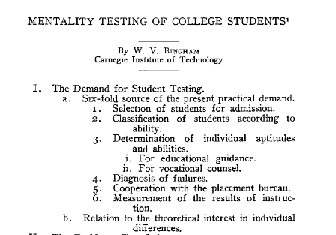
Predicting University Success
(Bingham, 1917)

Slide 3
Established Predictors of University Success
Previous academic achievement (over 90% of all German programs)
  Graduation grade (Abitur, diplôme de fin d’études secondaires, GCSE,…)
  Weighted subject grades
Selection Assessments
  SAT
  GRE
  …
Previous academic achievement and selection assessments account for ≈ 25% of university grades
(e.g. Formazin, Schroeder, Koeller, Wilhelm, & Westmayer, 2011)
Highly correlated with intelligence
(e.g. Frey & Detterman, 2004)

Slide 4
CPS as an additional Predictor of University Success
CPS is closely related to school grades
(e.g. Greiff et al., 2013)
CPS shows incremental validity in predicting school grades over intelligence (Wüstenberg et al., 2012) and working memory capacity (Schweizer et al., 2012)
No published study relates CPS to university success

Slide 5
CPS as an additional Predictor of University Success
Demands at university programs should be more complex than at school
University programs include a higher degree of freedom and strategy
  Choice of lectures
  Planning of exam dates
  …

Slide 6
First Empirical Evidence
Stadler, Becker, Greiff, Spinath (submitted)
Participants:
  78 Participants (59% female)
  Participating in a business program (Master/Diplom)
Measures:
  CPS (FSYS2.0)
  Intelligence (LPS short scale)
  Previous academic achievement (Abitur)
  Objective university success (University GPA)
  Subjective university success (5 item questionnaire)

Slide 7
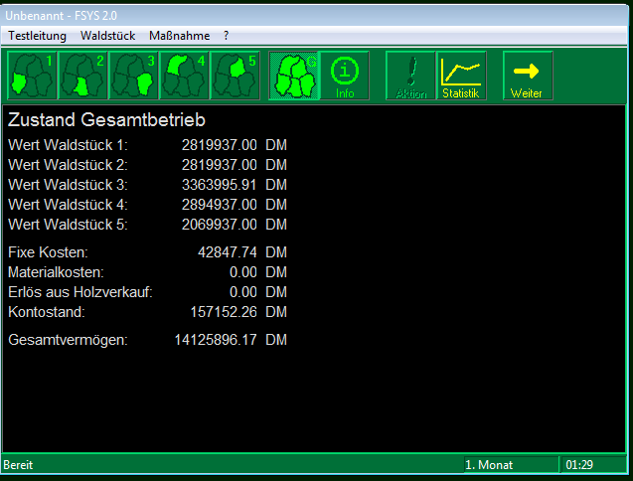
FSYS2.0
(Wagener, 2001)

Slide 8
Results
Results:
  CPS was a significant predictor of University GPA (R²= .14)
  CPS remained a significant predictor (β= .39) of University GPA even after High-School GPA (β= .49) and Intelligence (RW= .12) were controlled for (total R²=.48)
Remaining Questions:
  Can this finding be replicated?
  Can it be generalized to other university programs?
Follow-up study:
  Larger Sample
  Different Programs
  (Natural Sciences, Social sciences, Psychology, Business)

Slide 9
Subjective University Success
5 Statements (e.g. “my grades are in appropriate relation to my effort”)
Agreement on a 5 point Likert scale
Internal consistency: α = .80 (Pilot: .79)
Correlation to GPA: r = .42**

Slide 10
Process Data
“Priority setting” is a subscale of FSYS2.0 that indicates whether a participant reacted to imminent drops in the worth of a forest
“Priority Setting” was the only significant predictor of subjective university success (R²=.25)
Open Questions:
  Can this finding be replicated?
  What psychological construct is indicated by “priority setting”?
Follow-up study:
  Inclusion of self-control as a known predictor of university GPA and possible “missing link”

Slide 11
CPS Tasks are Highly Suited for University Selection
CPS tasks are almost completely language free
CPS tasks are relatively independent of previous knowledge (depending on the CPS measure)
CPS tasks do not need distractors
Item difficulty of CPS tasks can be described very well based on item characteristics
Social validity of CPS tasks has been shown to be high (e.g. Sonnleitner et al., 2013)

Slide 12
Complex Problem Solving (CPS) in University Selection
Summary:
CPS seems to have incremental validity over previous academic achievement and intelligence in predicting university grades
CPS process data can be used to explain non-cognitive aspects of University success
CPS tasks are highly suited for university selection

Slide 13
Discussion
Do you see a major flaw?
Do you see an additional advantage?
Do you have an interesting sample/study to include CPS as a predictor of university success?
Further Questions, Comments, Ideas?

Slide 14
Thank you for your attention!

Slide 15
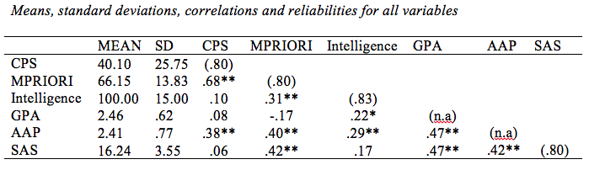
Backup - Correlations

Slide 16
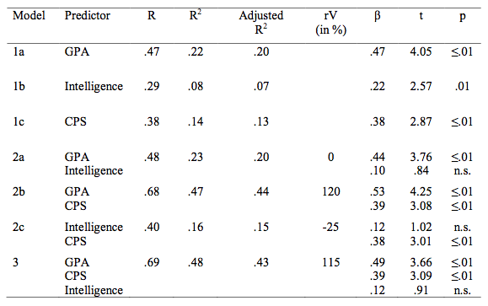
Backup - Regression

