Slide 1
Crack growth analysis by a NURBS-based isogeometric boundary element method
11th World Congress on Computational Mechanics
WCCM XI, Barcenola, Spain
Xuan Peng, Elena Atroshchenko, Robert Simpson,
Sivakumar Kulasegaram, Stéphane Bordas
Cardiff University, UK
July 2014

Slide 2
Outline
1/18
Background and Motivations
Modeling strategy by IGABEM
Dual BEM modeling
Crack tip treatment
Calculation of stress intensity factors
Crack growth algorithm
Numerical examples

Slide 3
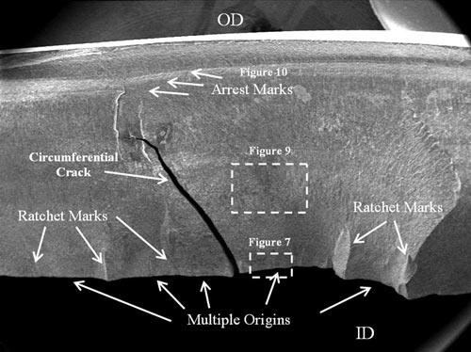
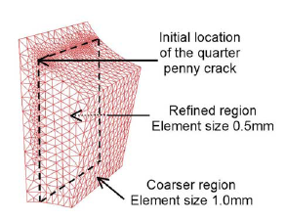
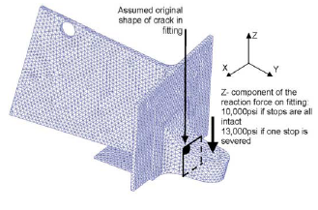
Motivation
2/18
Fatigue Fracture Failure of Structure
Initiation: micro defects
Loading : cyclic stress state (temperature, corrosion)
Numerical methods for crack growth
Volume methods:
FEM, XFEM/GFEM, Meshfree
Boundary methods: BEM
Fatigue cracking of nozzle sleeve
http://met-tech.com/
Bordas & Moran, 2006
XFEM+LEVEL SET

Slide 4
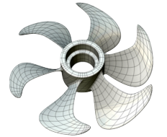
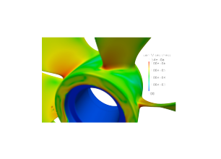
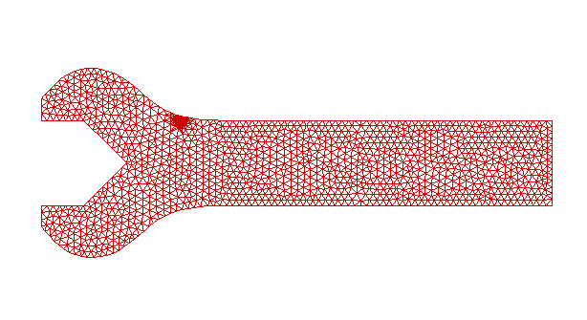
Motivation
3/18
Challenges in volume-based methods
Remeshing (FEM)
Local mesh refinement
mesh
IGA
Efficiency & Accuracy
direct calculation
calculation
stress analysis
crack
XFEM
adaptive refinement
crack
IGABEM
Direct CAD used

Slide 5
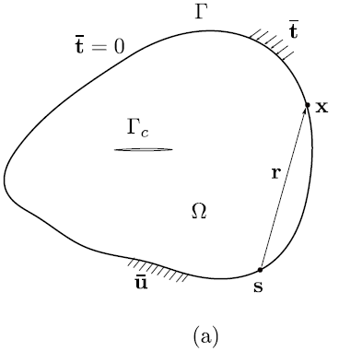
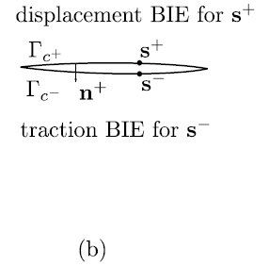
Dual BEM for crack modeling
4/18
Displacement BIE: non–crack boundary and one crack surface
Traction BIE: the other crack surface

Slide 6
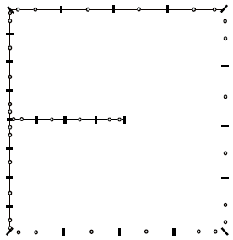
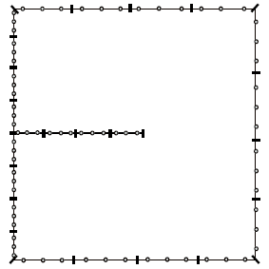
NURBS discretisation and collocation
5/18
Greville Abscissae:
NURBS(B-Spline)
p=2
Discretised BIEs
Discontinous Lagange
p=2

Slide 7
Singular integration
6/18
Singularity subtraction technique:
Rigid body motion:

Slide 8
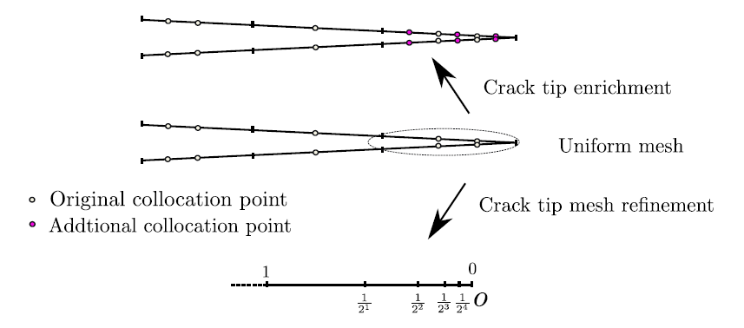
Treatment of crack tip singularity
7/18
Partition of unity enrichment:
Consecutive knot insertion at crack tip :

Slide 9
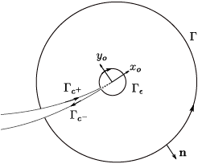
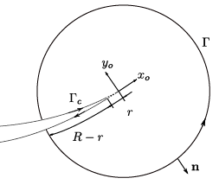
Evaluation of stress intensity factors
8/18
Contour integral based methods:
M integral (involving J₁):
J integral (involving J₁ and J₂):
Singular in evaluating J₂

Slide 10
Algorithm for crack propagation
9/18
Space constraint , parametric constraint
Maximum hoop stress criterion
Localization constraint function
Calculate the moving vector

Slide 11
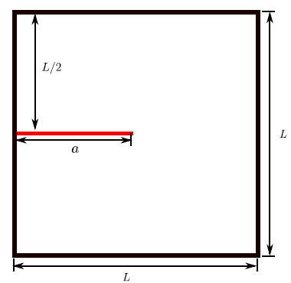
Numerical examples: Edge crack
10/18
NURBS(B-Spline)
p=2
Discontinous Lagange
p=2

Slide 12
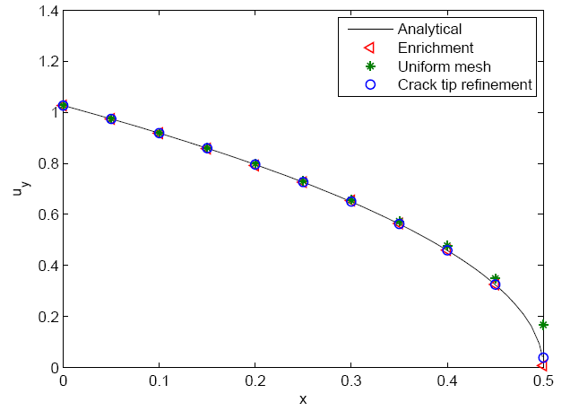
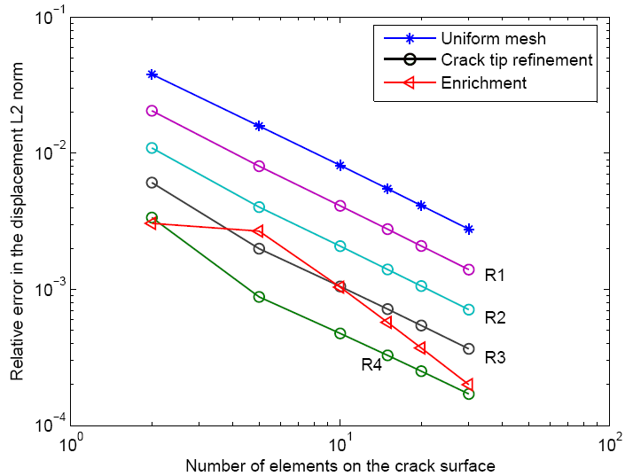
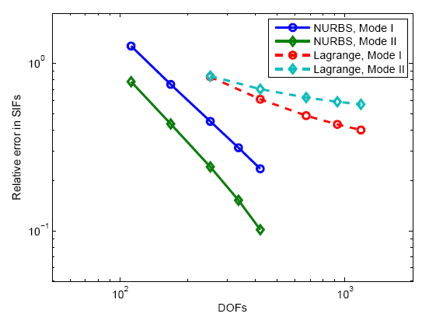
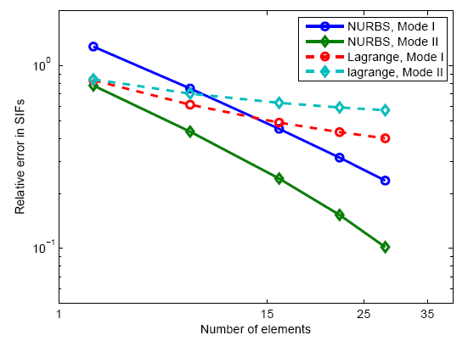
Edge crack
11/18
Crack tip refinement VS enrichment
Crack opening displacement
Error in displacement L2 norm
NURBS VS Langerange: convergence in SIFs, no crack tip treatment

Slide 13
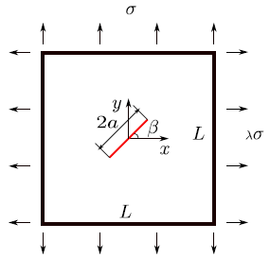
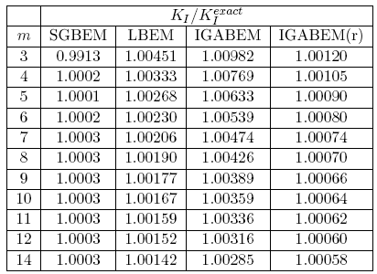
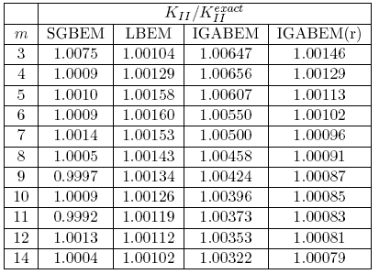
Inclined centre crack (SGBEM, Lagrange BEM, IGABEM)
12/18
IGABEM(r) :Uniform mesh (refined tip element)
LBEM: discontinuous Lagrange BEM
SGBEM: symmetric Galerkin BEM, Sutrahar&Paulino (2004)
m: number of elements in uniform mesh along the crack surface

Slide 14
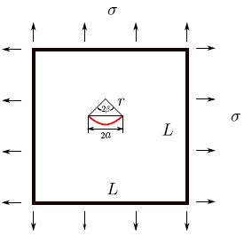
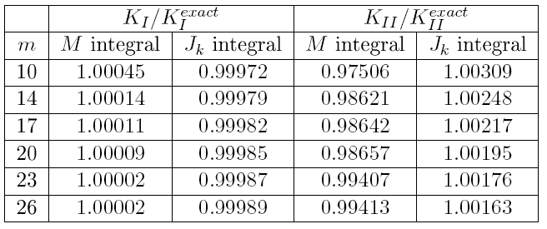
Arc crack (M integral, J integral)
13/18
Uniform mesh + refined tip element
Splitting parameter in J integral:
m: number of elements in uniform mesh along the crack surface

Slide 15
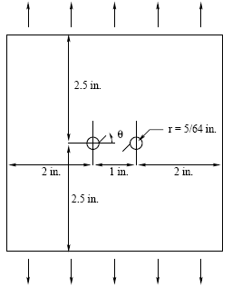
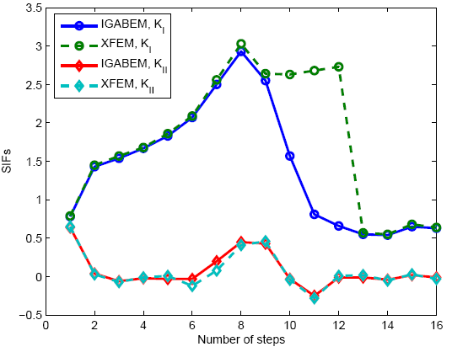
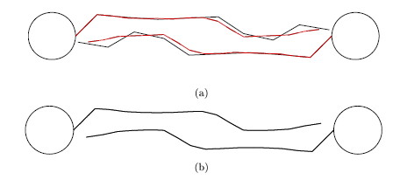
Crack growth from rivet holes
14/18
12 elements for each circle
3 elements for initial cracks with tip refinement

Slide 16
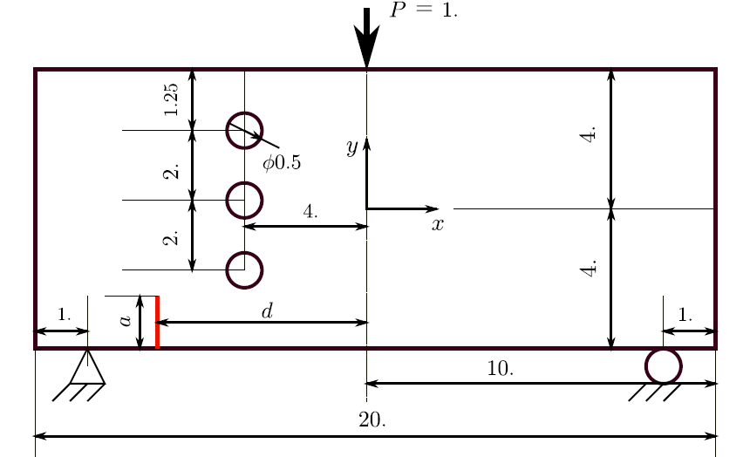
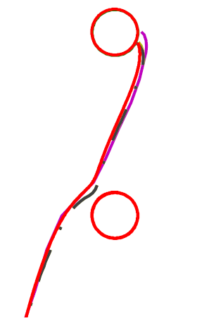
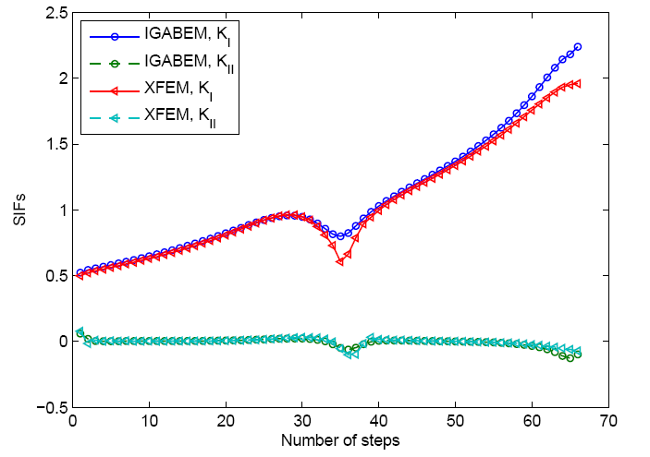
Crack growth through rivet holes
15/18

Slide 17
Conclusions
16/18
Dual equations for IGABEM are used to model crack
The crack tip is treated by graded knot insertion or PU enrichment
J integral and M integral for calculating stress intensity factors
A crack growth algorithm combined with graded knot insertion is realized
Future work
3D implementation on IGABEM for crack growth
Crack-geometry, crack-crack intersection
Crack closure
Cohesive crack modeling

Slide 18
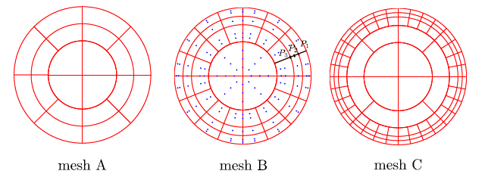
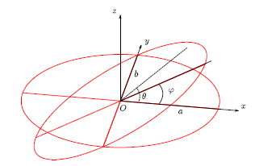
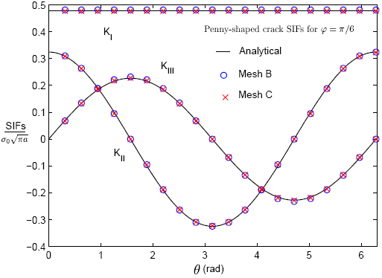
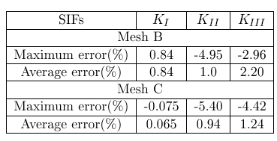
Ongoing work: 3D implementation
17/18
Penny-shaped crack under remote tension

Slide 19
18/18
Acknowledgements:
Thanks given to the Framework Programme 7 Initial Training Network Funding under grant number 289361 "Integrating Numerical Simulation and Geometric Design Technology” (FP7: ITN-INSIST) and RealTcut project ERC
thanks for YOUR attention

