Slide 1
CV
Dipl.-Ing. Mark Michael
2010 - 2014 University of Luxembourg
PhD at the Department of Thermo-/ Fluid Dynamics, FSTC
Degree Thesis
- A Discrete Approach to Describe the Kinematics between Snow and a Tire Tread
2003 - 2009 University of Rostock
Dipl.-Ing. in Mechanical Engineering, Structure and Fluid Mechanics
Degree Thesis
- Determination of the Wake Structure and Surface Forces in the Flow around an Undulating Bluff Body by
means of Direct Numerical Simulation
2008 - 2009 Institute of Fluid Mechanics, Uni. Rostock Project: DFG Priority Programme 1147 Imaging Measurement Methods for Flow Analysis - Experimental investigation of the flow structures of free jet flow striking the slope of a flat plate - Numerical analysis of transient flow topology in the wake of a harbour seal whisker
2007 – 2008 Institute of Machine Dynamics, Uni. Rostock
Project: VibKom – Enhance comfort by improving the prediction of global and local vibrations of ship superstructures
2006 - 2007 Turbocharger Engineering Basic Development at MAN DIESEL SE Numerical vibration analysis, Contact load, Transient thermal loads, Fracture Mechanics of turbines
Notes:
1

Slide 2
Resolution of Different Length Scales by an Efficient Combination of
the Finite and the Discrete Element Method
Mark Michael
Notes:
2

Slide 3
Outline
XDEM
- Multi-physics of Granular Materials
FEM - XDEM Coupling
- Solid Body / Particle Interaction (Tire Performance on Snow)
Mark Michael
3
Notes:
3

Slide 4
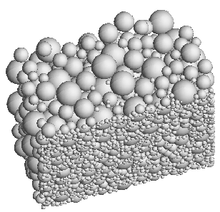
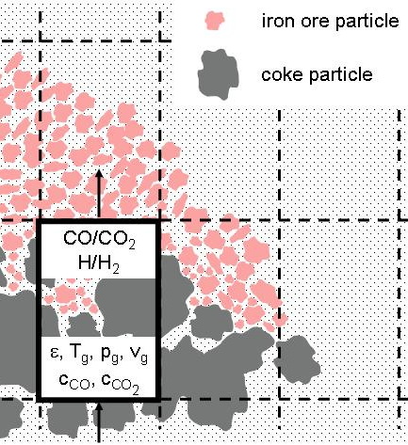
XDEM: eXtended Discrete Element Method
Multi-physics simulation toolbox modelling granular materials and processes:
Particle Motion
- Sand
- Snow
- …
&/or
Chemical Reactions
- Coke
- Iron ore
- Biomass
Mark Michael
4
Notes:
4

Slide 5
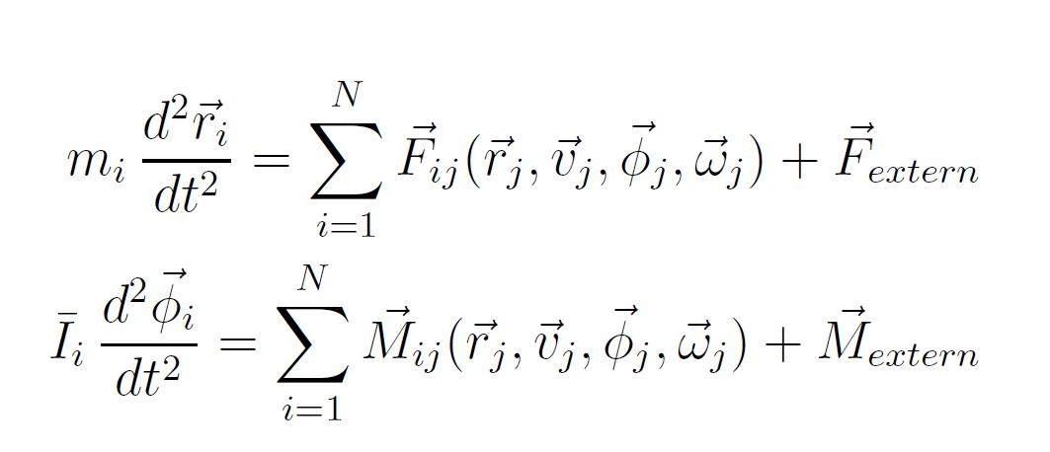
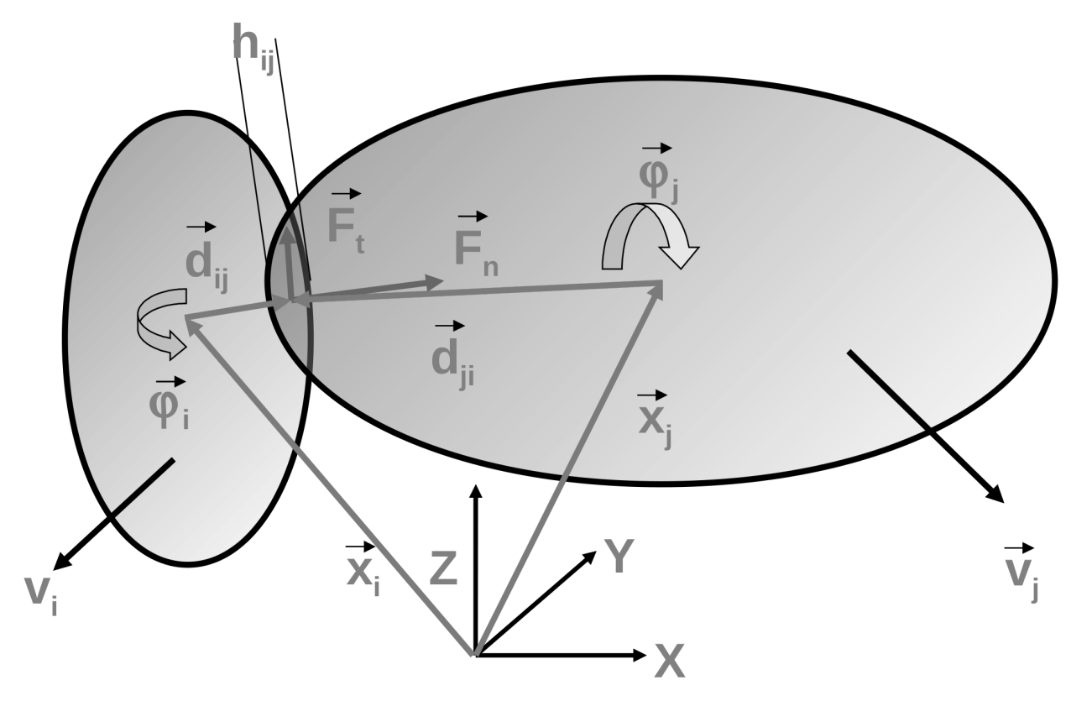
XDEM: Particle Motion ( Classical DEM )
Prediction of force and torque based due impacting particles
Contact law based on overlap and relative velocity
Integration of Newton‘s second law to yield new position and orientation
Mark Michael
5
Notes:
5

Slide 6
XDEM: Particle Conversion / Chemical Reactions
- Prediction of thermal conversion of solid fuels
- Prozesses: heat-up, drying, pyrolysis, devolatilisation, gasification, combustion
- Flexible handling of arbitrary material properties
- Heat and mass transfer to ambient gas
- Inter-particle heat transfer through conduction and radiation
- One-dimensional/transient differential conservation equations
- Intrinsic modelling including porosity, active surface and shrinking
Coke particle
CO₂
CO
r/R
calculation of inner-particle processes
C + CO₂ → 2CO +ΔH_{reac}
k(T) = k₀ * exp(E_{a}/RT)
T_{g}, T_{s}, p_{g}, ε, u_{g}, c_{CO}, c_{CO2}, c_{C}
F. Hoffmann (2012)
Mark Michael
6
Notes:
6

Slide 7
XDEM: eXtended Discrete Element Method
Multi-physics simulation toolbox modelling granular materials and processes:
&
Particle Motion
Particle Conversion
Σ ( Particle Motion + Particle Conversion ) = Entire Process
Mark Michael
7
Notes:
7

Slide 8
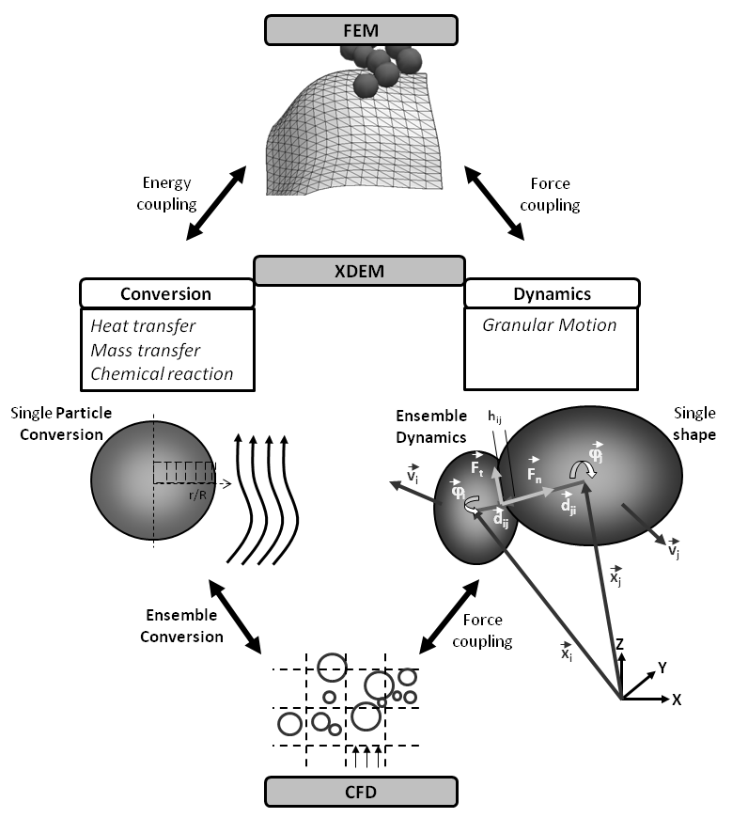
Modules Structure
8
Notes:
8

Slide 9
DEM – FEM Coupling
Mark Michael
9
Notes:
9

Slide 10
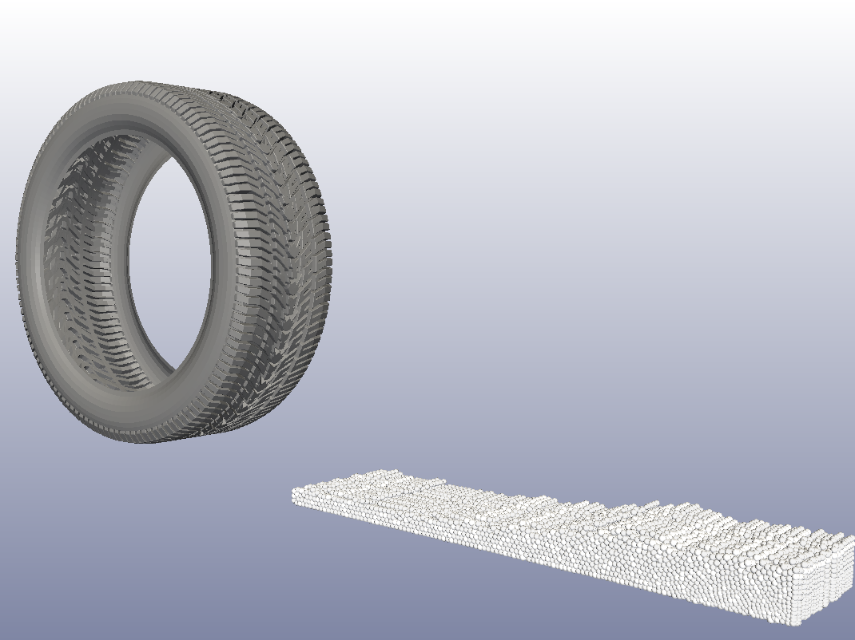
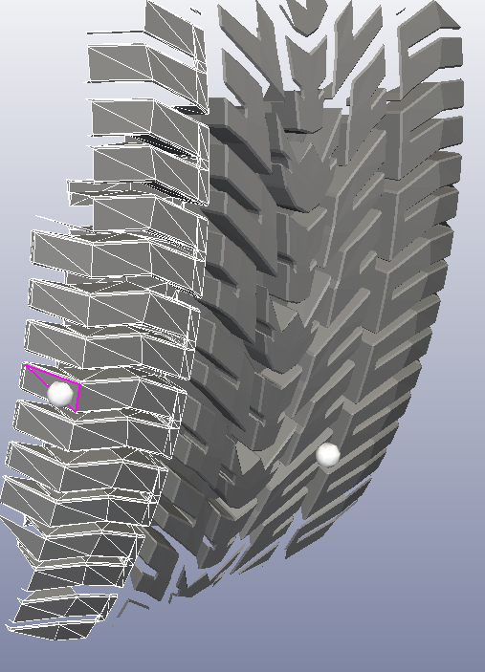
DEM - FEM – Coupling: Technique and Innovation
Finite Element Method
Load and deformation of a tire tread
Coupling DEM - FEM
Transfer of physical quantities between finite element and discrete particle
Discrete Element Method
Processes and motion of snow on grain scale
Mark Michael
10
Notes:
10

Slide 11
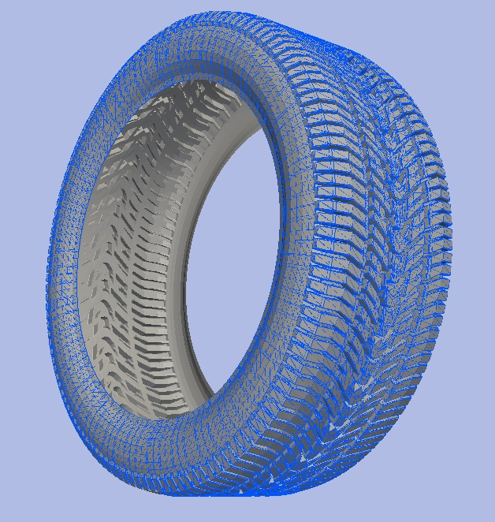
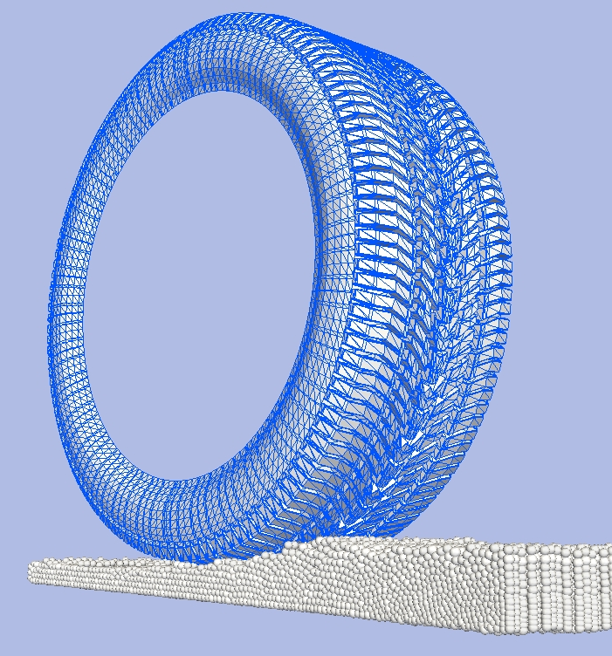
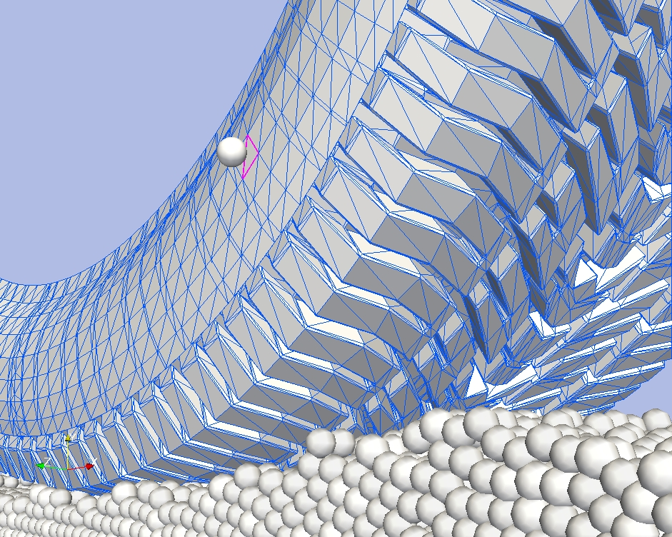
DEM - FEM – Coupling
Surface Elements in FEM = Boundary Elements in DEM
Particle
Intersecting boundary element
Contact detection on DEM side
Mark Michael
11
Notes:
11

Slide 12
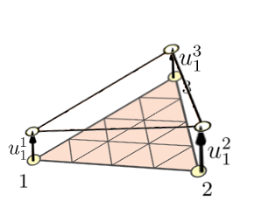
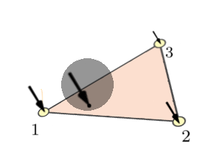
DEM - FEM – Coupling: Procedure
Prediction of displacement at element nodes by means FEM solver
Interpolation of forces by means of FE shape functions
u
Transfer displacement vectors
Transfer of counterpart force
-F
u²
Update of position of boundary shape on DEM side
F_{t}
x²
F_{n}
u¹
-F_{n}
x_{j}
-F_{t}
x¹
Prediction of impact force on boundary on DEM side
Z
Y
X
12
Notes:
12

Slide 13
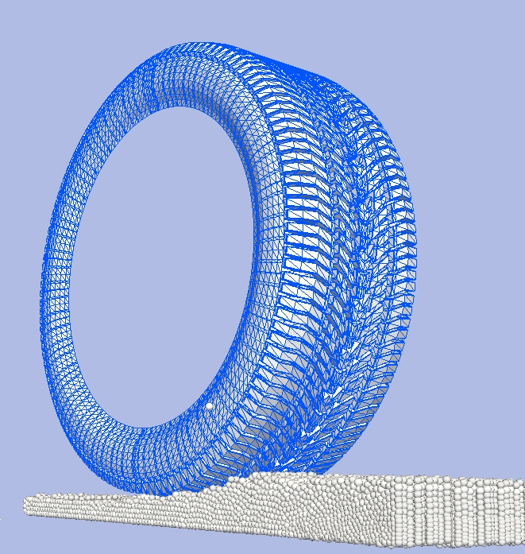
DEM - FEM – Coupling: Contact Detection Algorithm
Detect the intersecting boundary element
Particle of Interest
Mark Michael
13
Notes:
13

Slide 14
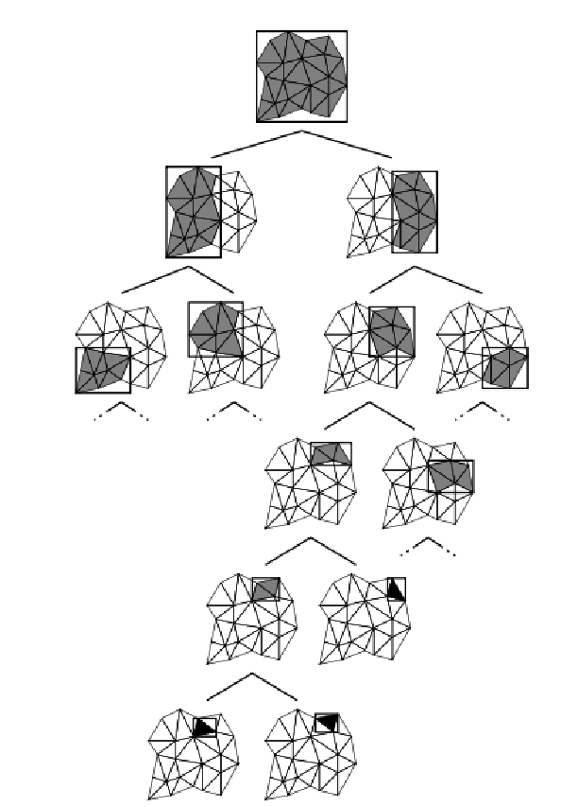
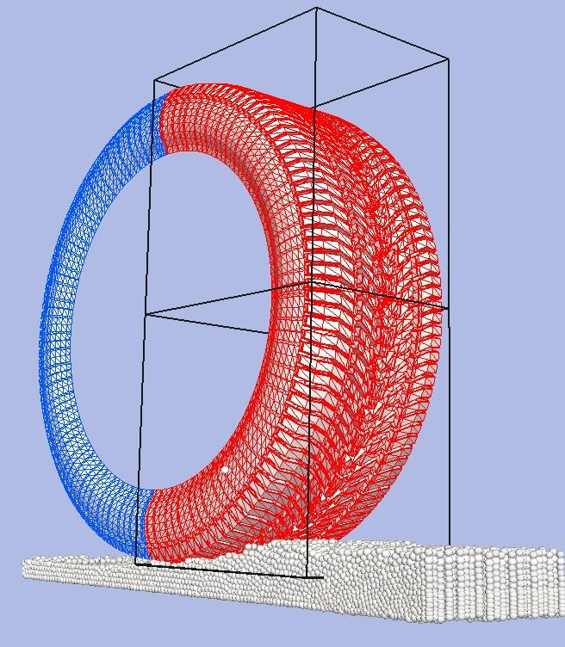
DEM - FEM – Coupling: Contact Detection Algorithm
Detect the intersecting boundary element
Split and predict intersection with child bounding volume
Binary tree storing bounding volumes encapsulating boundary elements
Mark Michael
14
Notes:
14

Slide 15
DEM - FEM – Coupling: Contact Detection Algorithm
Bottom of binary tree
One bounding volume storing one boundary element
Particle
Intersecting boundary element
Binary tree storing bounding volumes encapsulating boundary elements
Mark Michael
15
Notes:
15

Slide 16
DEM - FEM – Coupling
Mark Michael
16
Notes:
16

Slide 17
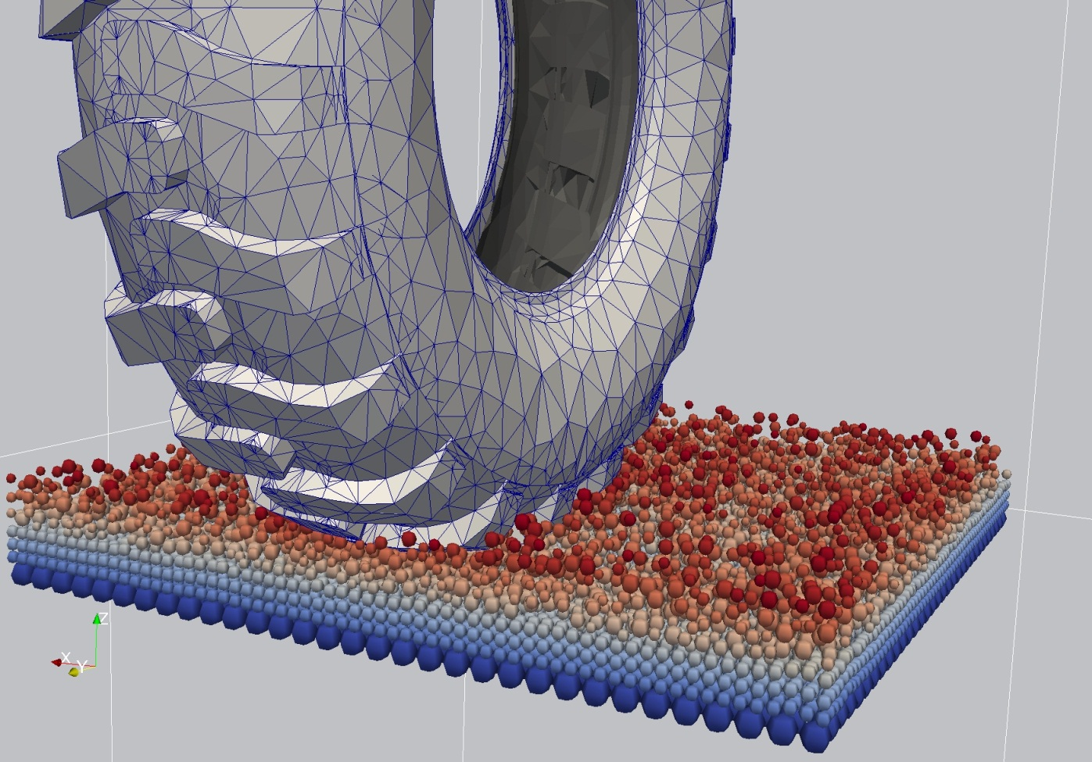
Thank you for your attention
Visit us at:
www.xdem.de
Mark Michael
Notes:
17

