Slide 1
Mark Michael, Dipl.-Ing. www.markmichael.eu
Education
2010 - 2014 University of Luxembourg
PhD at the Department of Thermo-/ Fluid Dynamics, FSTC
Degree Thesis
- A Discrete Approach to Describe the Kinematics between Snow and a Tire Tread
2003 - 2009 University of Rostock
Dipl.-Ing. (MSc) in Mechanical Engineering, Structure and Fluid Mechanics
Degree Thesis
- Determination of the Wake Structure and Surface Forces in the Flow around an Undulating Bluff Body by
means of Direct Numerical Simulation
Employer
2010- 2014 University of Luxembourg
Inutech GmbH Nürnberg, Germany
2012 IRSTEA Grenoble, France
2008 - 2009 Institute of Fluid Mechanics, University of Rostock , Germany
2007 - 2008 Institute of Machine Dynamics, University of Rostock , Germany
2006 - 2007 MAN DIESEL SE, Turbocharger Engineering Development, Augsburg , Germany
Notes:
1

Slide 2


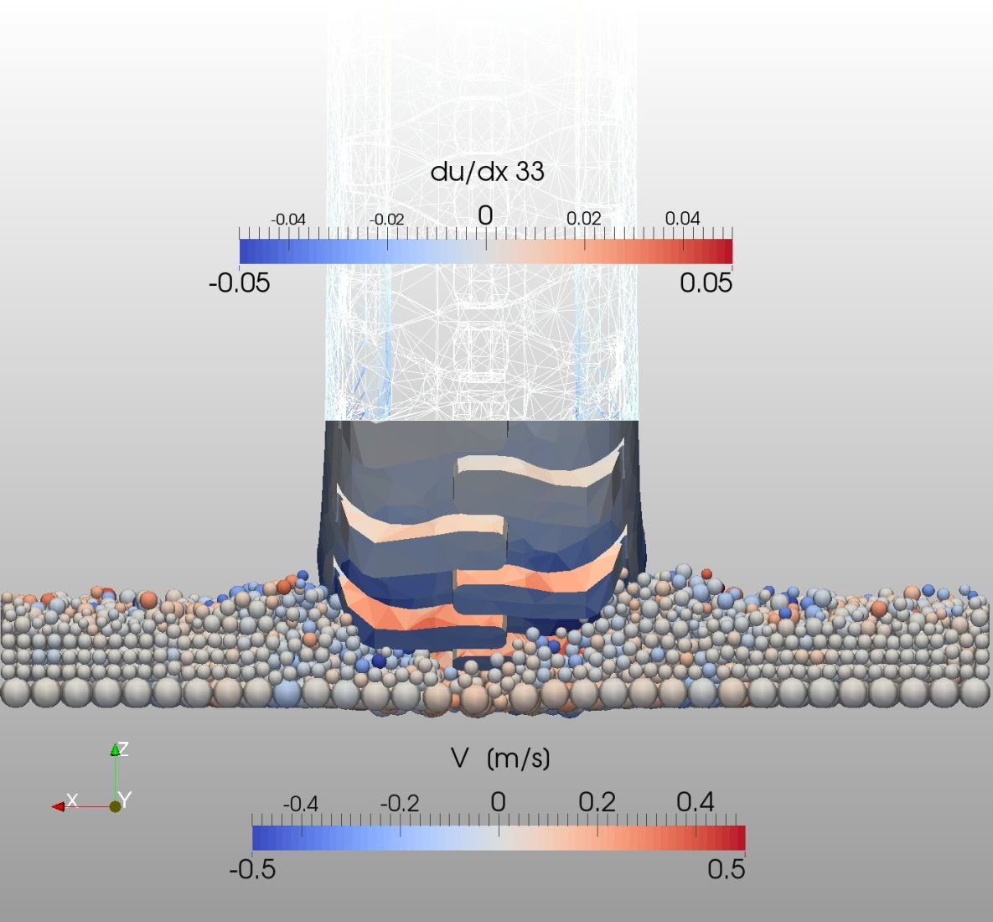
A DISCRETE APPROACH TO DESCRIBE THE KINEMATICS BETWEEN SNOW AND A TIRE TREAD
MARK MICHAEL – XDEM.DE – ERLANGEN 2014
Notes:
2

Slide 3
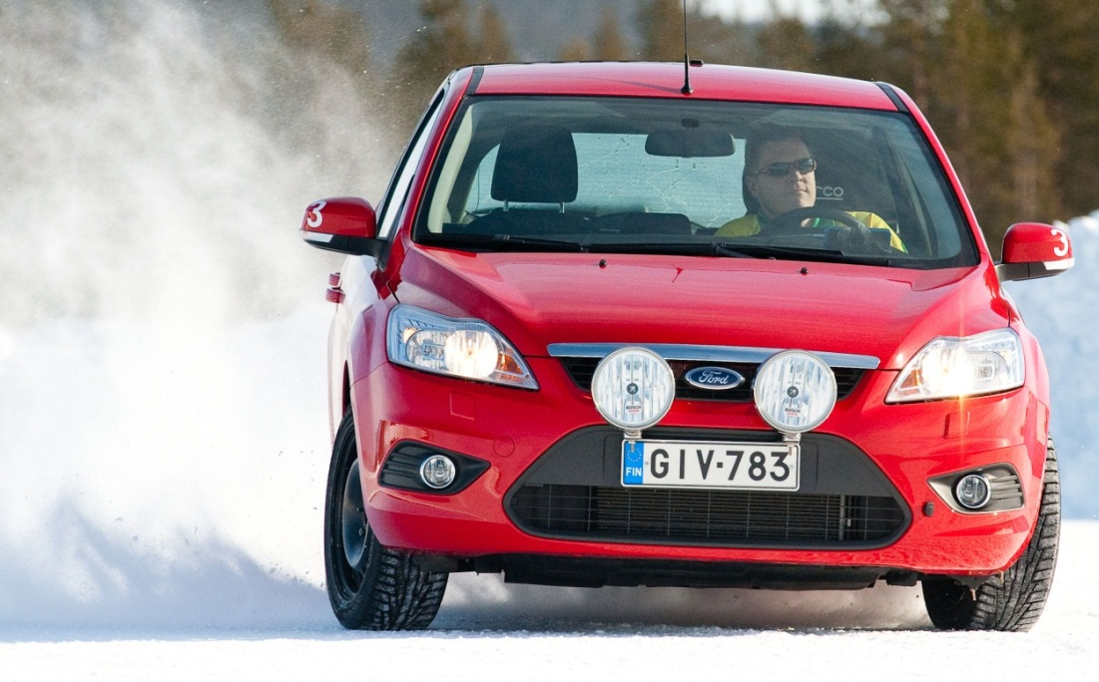
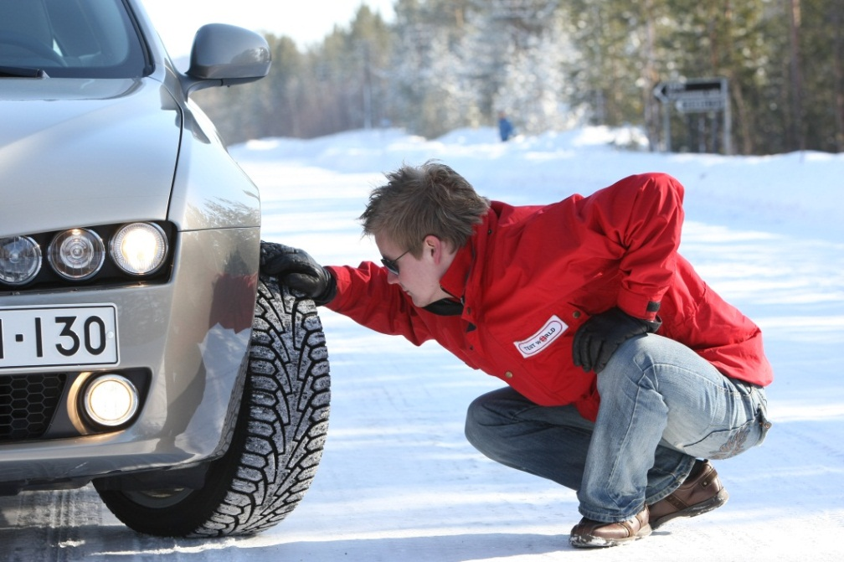
MOTIVATION
A simulation technique that describes the interaction between a tire tread and a snow covered road
Image Source: Test World Oy, Ivalo (Finland) www.testworld.fi
Ranges of Interest
Snow Temperature -30 to 0ºC
Snow Density 200 to 600 kg/m³
Impact Velocity 10⁻³ to 10¹ m/s
Applied Loads 10⁴ to 10⁷ Pa
MARK MICHAEL – XDEM.DE – ERLANGEN 2014
Notes:
3

Slide 4
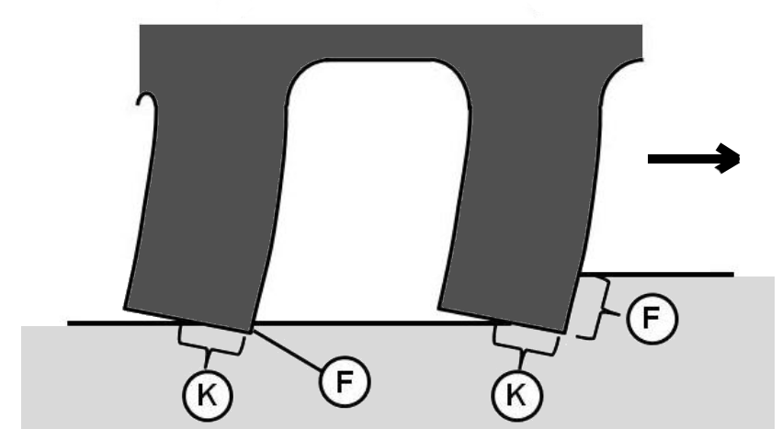
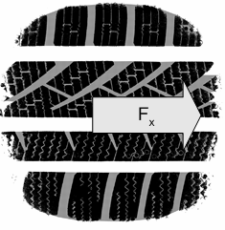
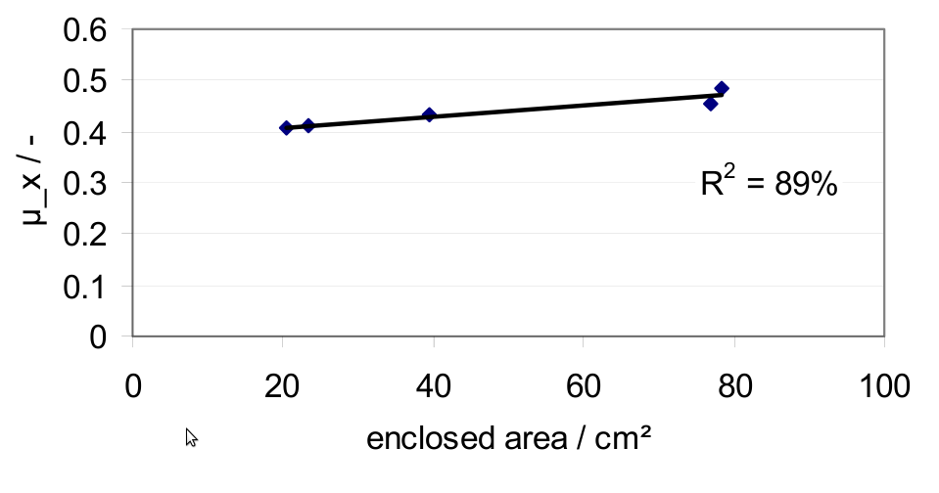
TREAD – SNOW TRACTION MECHANISM
Force Transmission
(K): Form closure
(F): Rubber – snow friction
Interlocking
Compaction of snow inside tread
slots increases shear resistance
Correlation of enclosed area and friction coefficient
Giessler (2007)
MARK MICHAEL – XDEM.DE – ERLANGEN 2014
Notes:
4

Slide 5
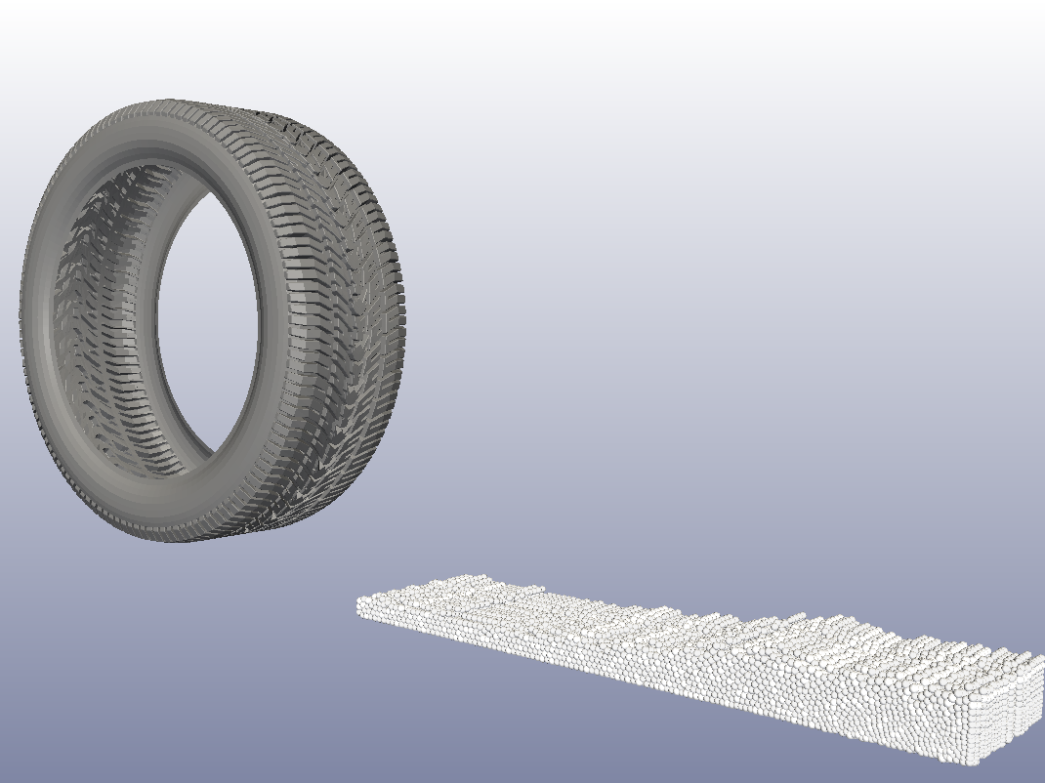
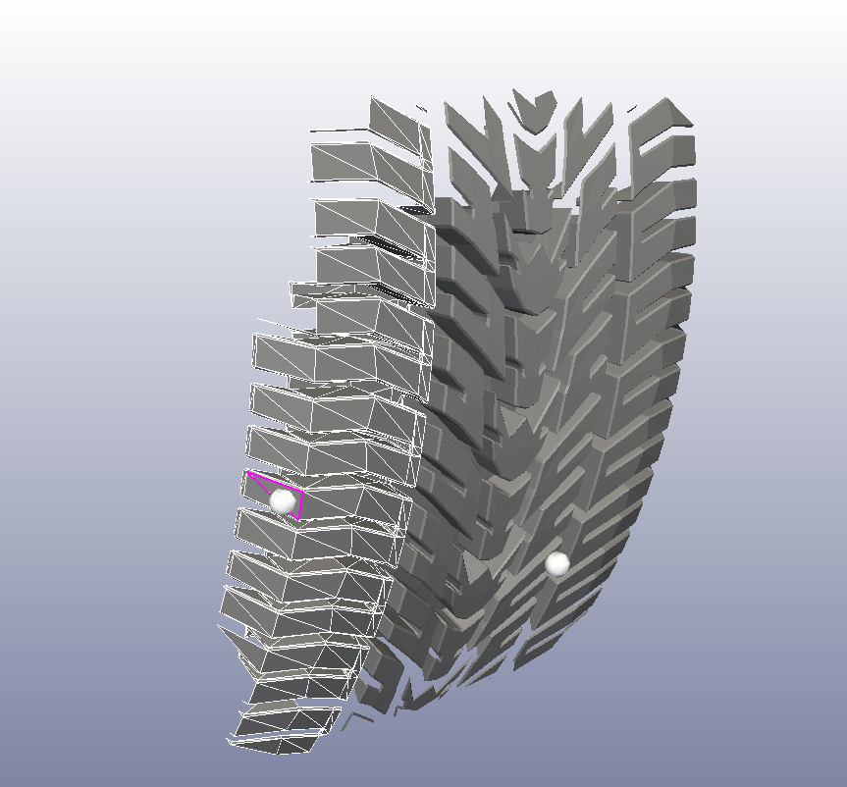
TECHNIQUE AND INNOVATION
Finite Element Method
for Tread Deformation
Interface Coupling of Loads and Deformation
Extended Discrete Element Method
for Grain Motion
MARK MICHAEL – XDEM.DE – ERLANGEN 2014
Notes:
5

Slide 6
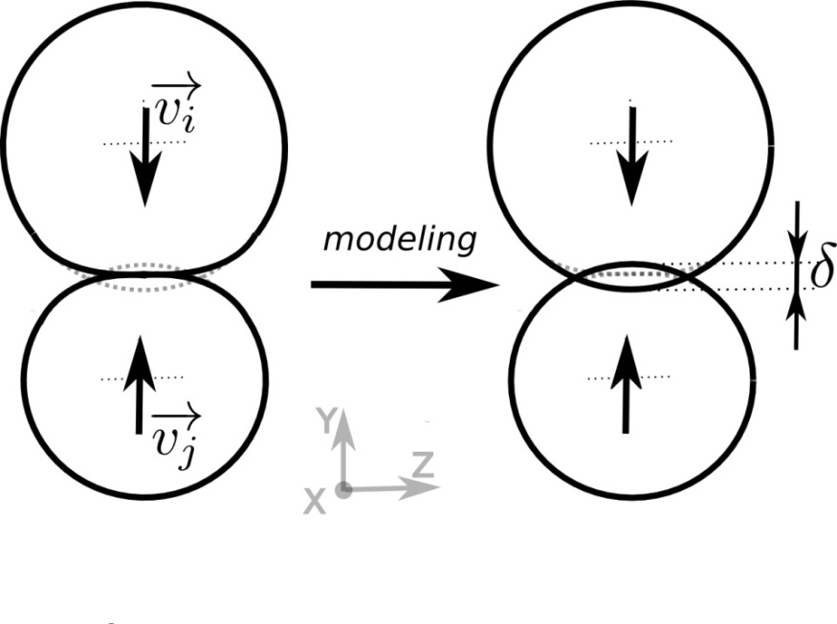
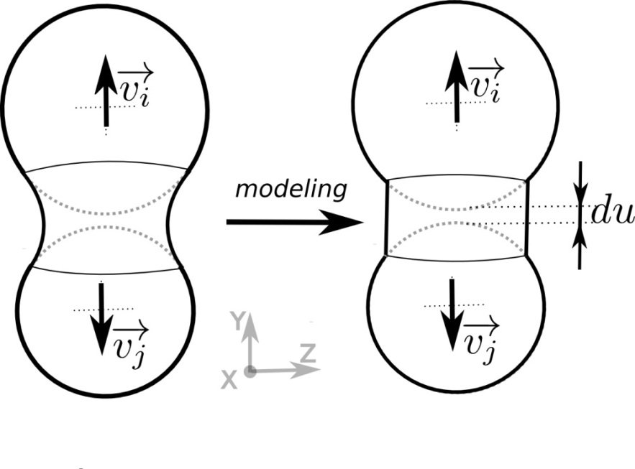
EXTENDED DISCRETE ELEMENT METHOD (XDEM)
Collision
Bonding
MARK MICHAEL – XDEM.DE – ERLANGEN 2014
Notes:
6

Slide 7
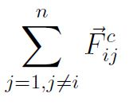
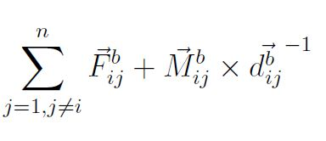
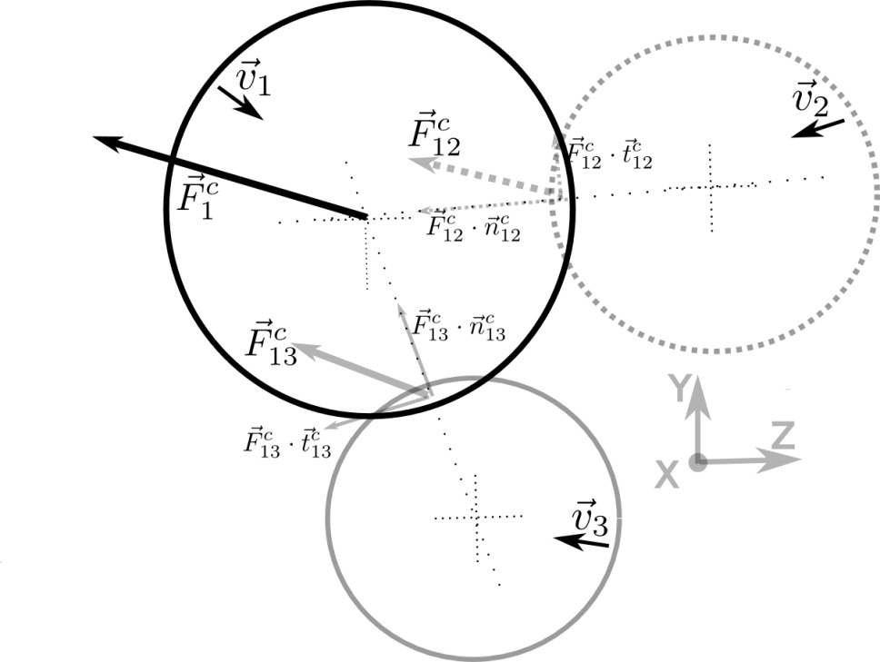
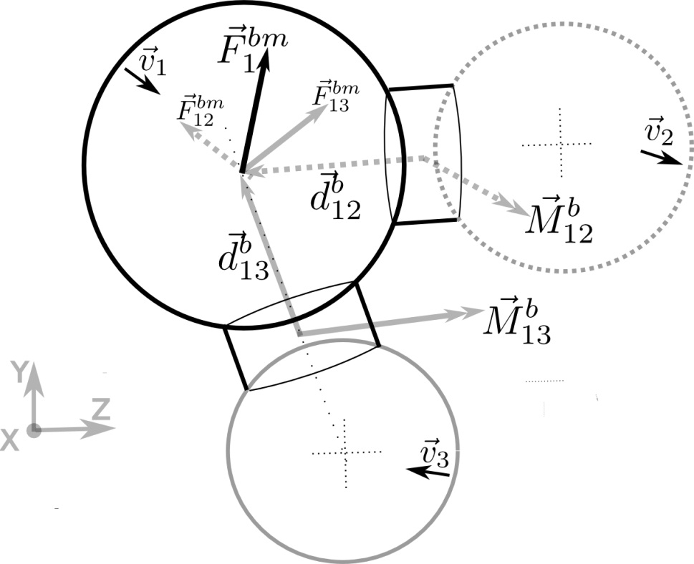
EXTENDED DISCRETE ELEMENT METHOD (XDEM)
MARK MICHAEL – XDEM.DE – ERLANGEN 2014
Notes:
7

Slide 8
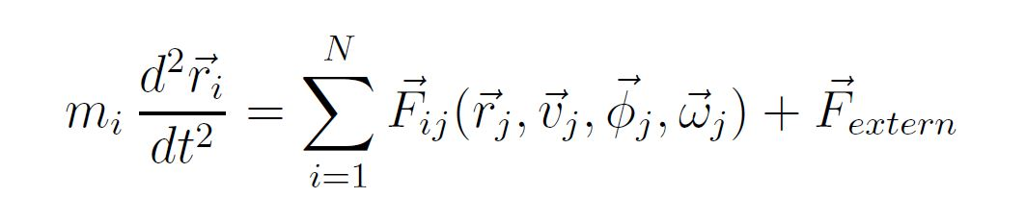
EXTENDED DISCRETE ELEMENT METHOD (XDEM)
Integration of Newton’s second law to yield new position and orientation
V_{t}
V_{t-3}
MARK MICHAEL – XDEM.DE – ERLANGEN 2014
Notes:
8

Slide 9
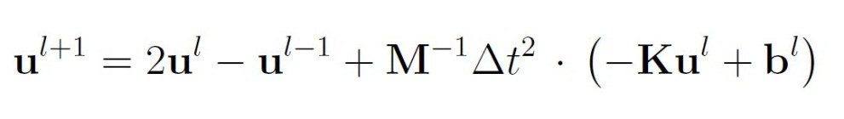
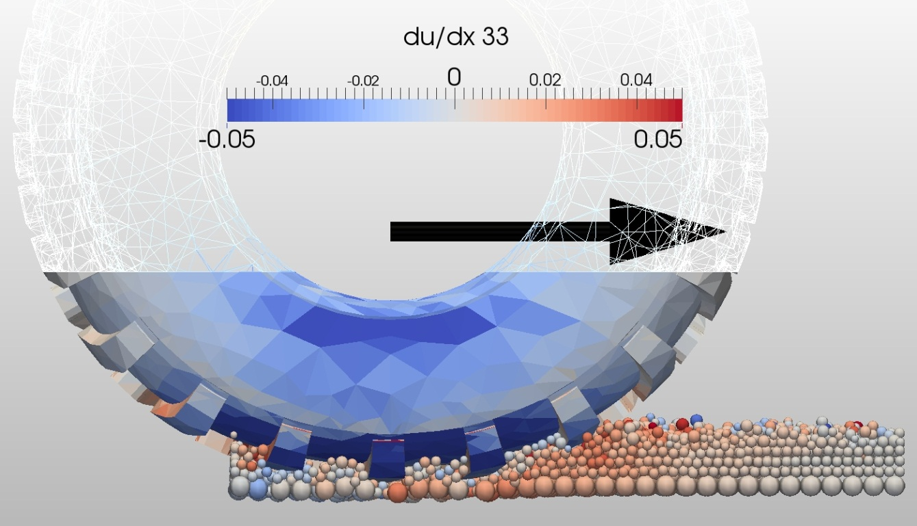
FINITE ELEMENT METHOD (FEM)
Newton’s second law including internal force term and Hook’s linear elastic law
MARK MICHAEL – XDEM.DE – ERLANGEN 2014
Notes:
9

Slide 10
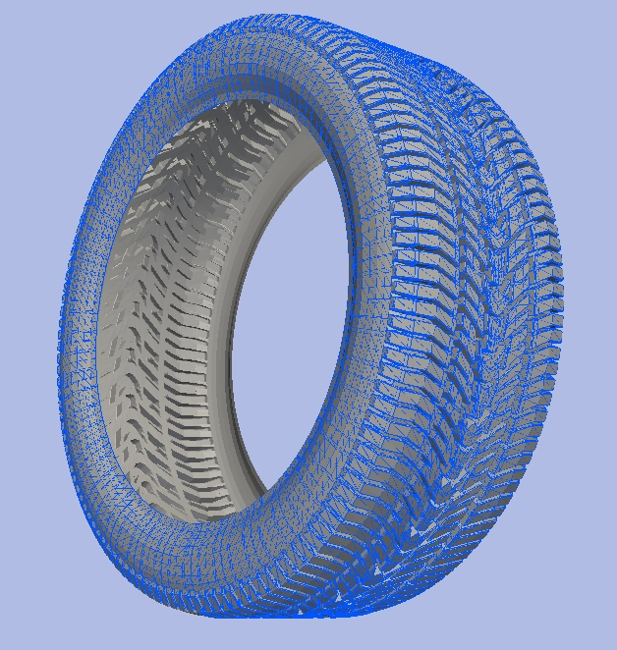
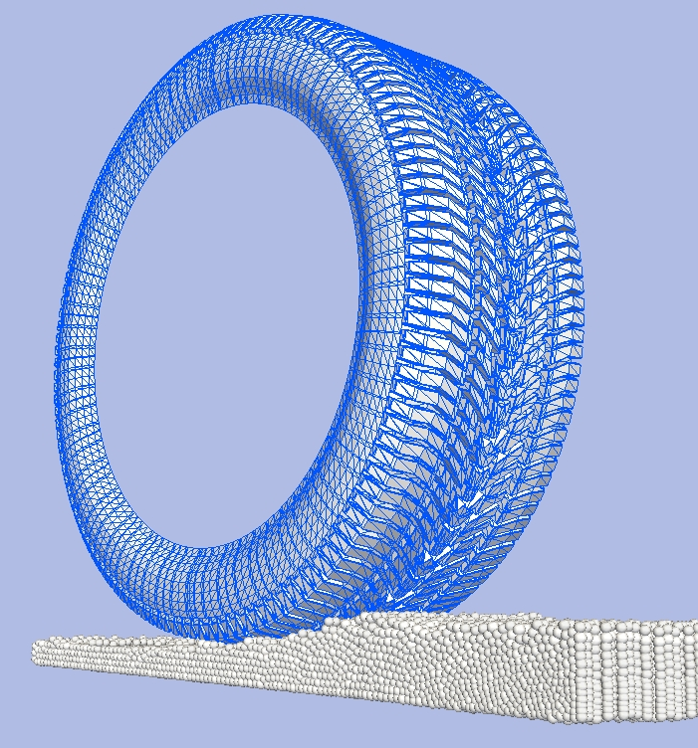
INTERFACE COUPLING
Surface Elements in FEM = Boundary Elements in XDEM
MARK MICHAEL – XDEM.DE – ERLANGEN 2014
Notes:
10

Slide 11
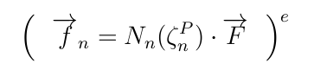
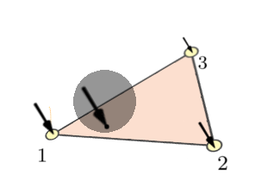
XDEM - FEM COUPLING PROCEDURE
F_{t}
F_{n}
-F_{n}
Interpolation of forces by means of FE shape functions
-F_{t}
-F
Transfer of counterpart force
Prediction of impact force on boundary on XDEM side
MARK MICHAEL – XDEM.DE – ERLANGEN 2014
Notes:
11

Slide 12
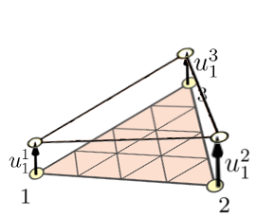
XDEM - FEM COUPLING PROCEDURE
Z
Y
u²
Transfer displacement vectors
Prediction of displacement at element nodes by means FEM solver
u
u¹
x_{j}
Update of position of boundary shape on XDEM side
u³
MARK MICHAEL – XDEM.DE – ERLANGEN 2014
Notes:
12

Slide 13
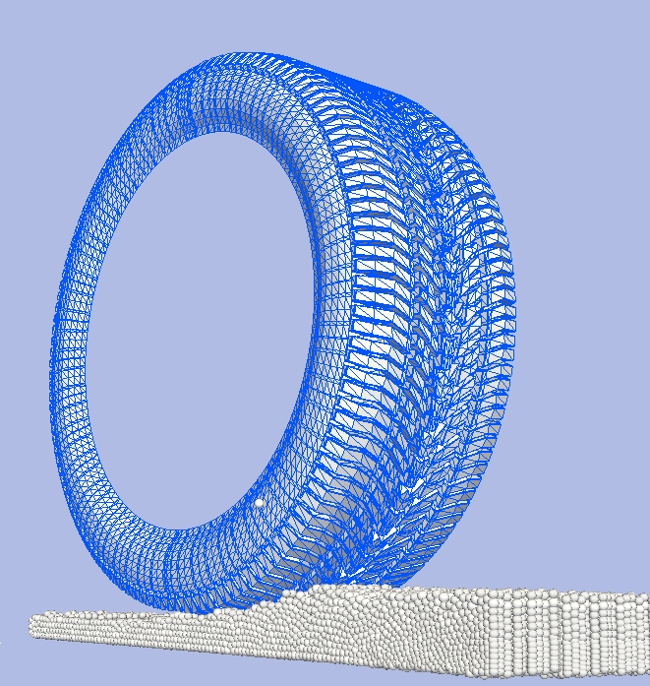
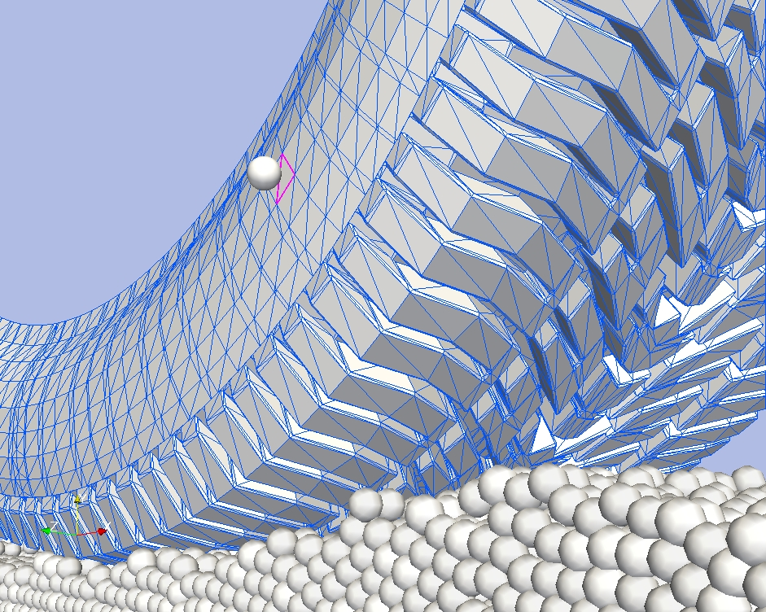
CONTACT DETECTION ALGORITHM
Detection of the intersecting boundary element
Particle
MARK MICHAEL – XDEM.DE – ERLANGEN 2014
Notes:
13

Slide 14
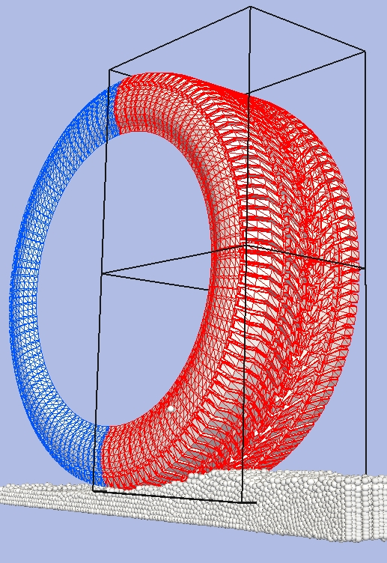
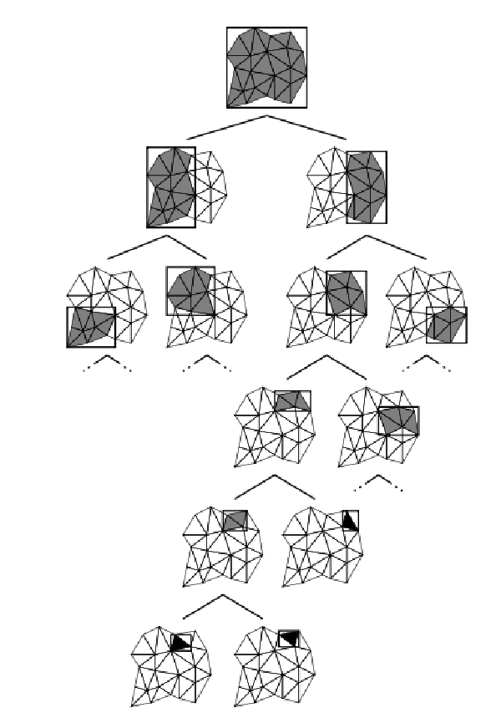
CONTACT DETECTION ALGORITHM
Detection of the intersecting boundary element
Split and predicted intersection with child bounding volume
Binary
tree
Bounding volumes
Particle
Boundary
element
Bottom of binary tree
One volume contains one element
MARK MICHAEL – XDEM.DE – ERLANGEN 2014
Notes:
14

Slide 15
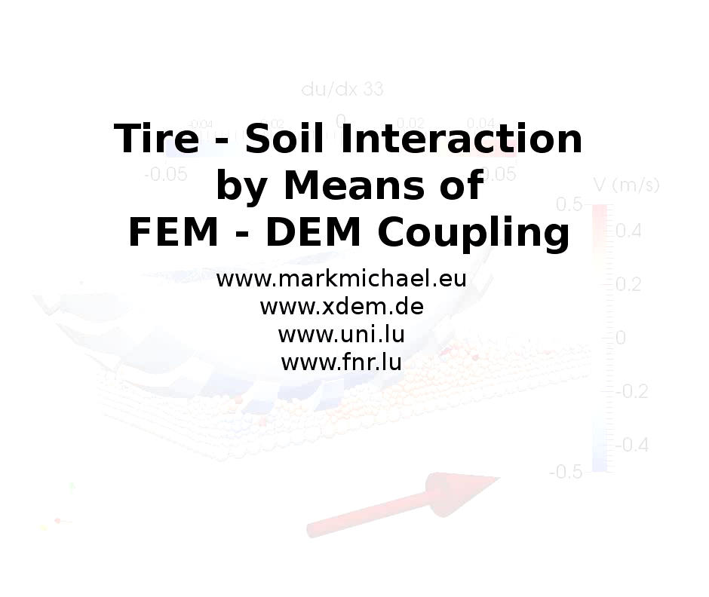
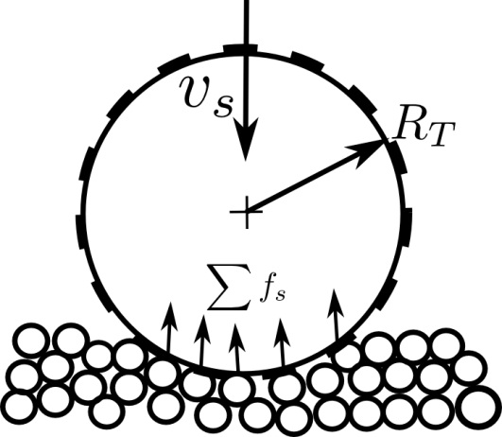
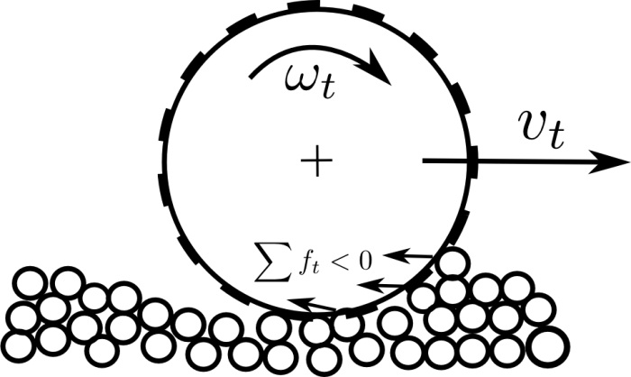
XDEM - FEM COUPLING
Tire – Soil Terrain Interaction
t = 0.2s v = 1 m/s
MARK MICHAEL – XDEM.DE – ERLANGEN 2014
Notes:
15

Slide 16
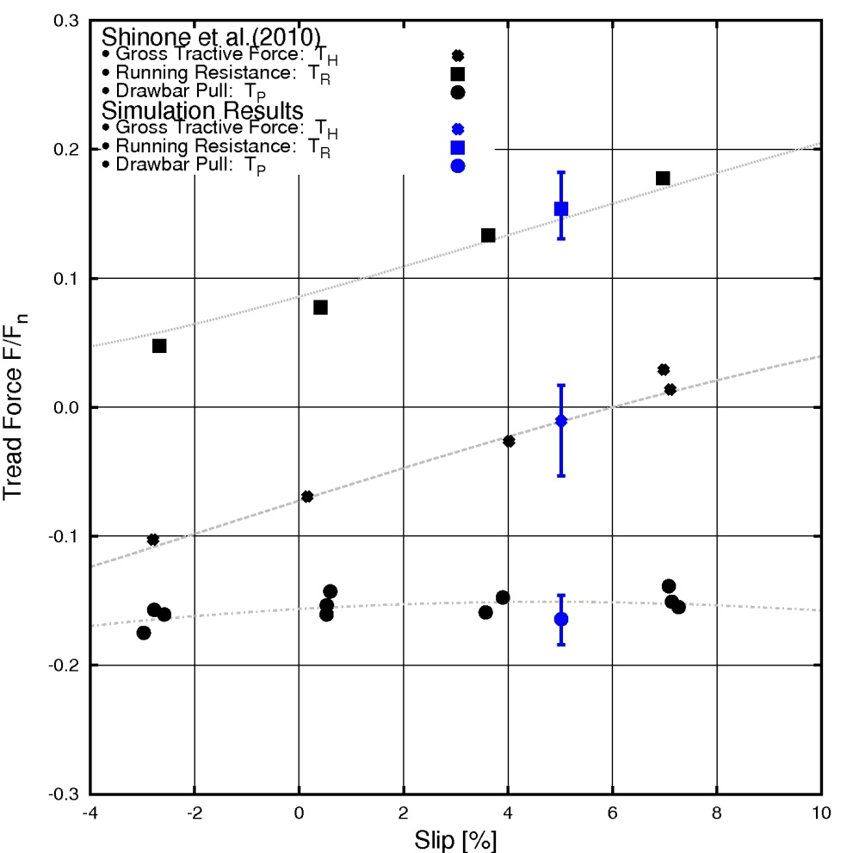
XDEM - FEM COUPLING
Tire – Soil Terrain Interaction
MARK MICHAEL – XDEM.DE – ERLANGEN 2014
Notes:
16

Slide 17
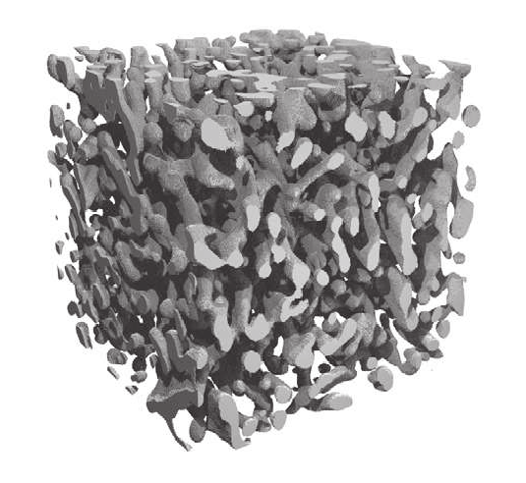
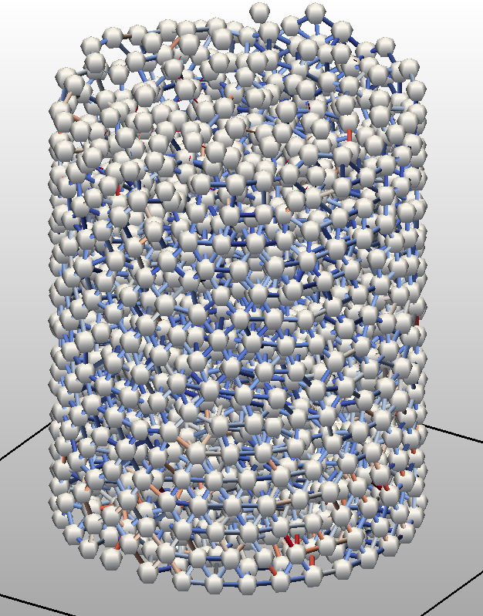
NATURAL TO NUMERICAL SNOW
Ice Matrix of Snow
Numerical Snow Sample
Spherical Grains + Cylindrical Bonds
modeling
X-ray microtomographie scans by Schneebelli (SLF Davos)
MARK MICHAEL – XDEM.DE – ERLANGEN 2014
Notes:
17

Slide 18
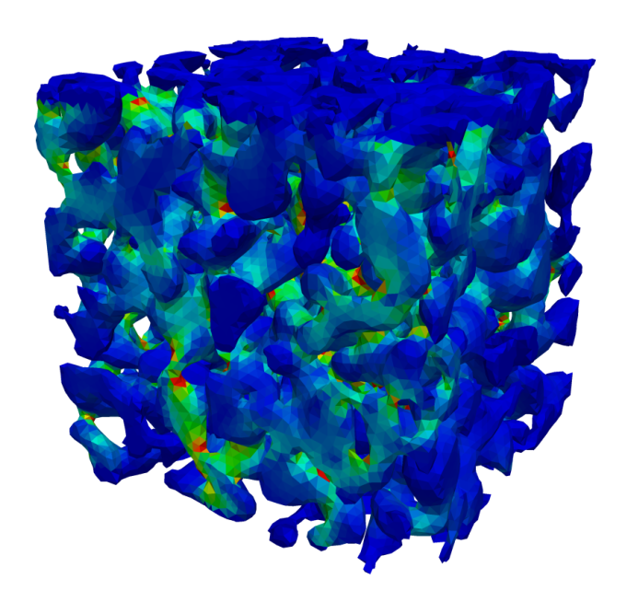
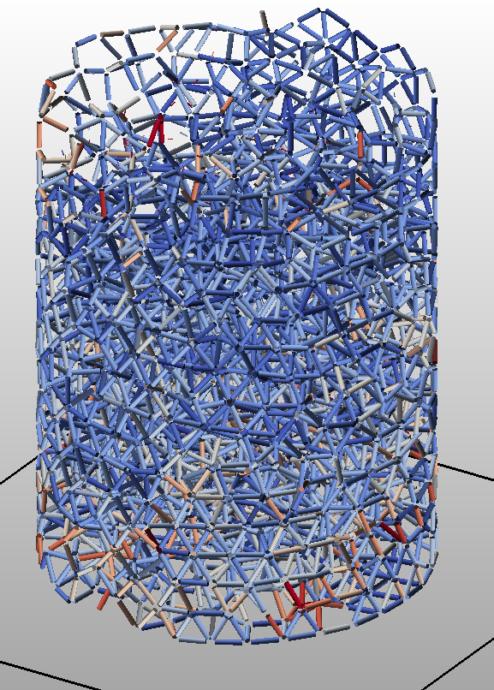
NATURAL TO NUMERICAL SNOW
Ice Matrix of Snow
Stress distriution in finite ice matrix
Numerical Snow Sample
Stress distriution in cylindrical bonds
modeling
FEM by P. Hagenmuller (IRSTEA Grenoble)
MARK MICHAEL – XDEM.DE – ERLANGEN 2014
Notes:
18

Slide 19
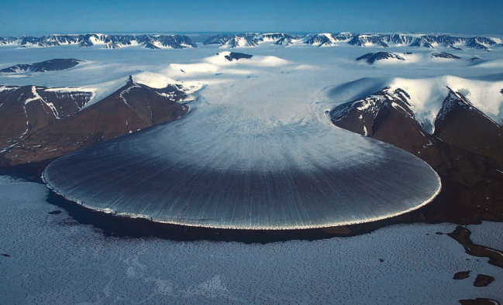

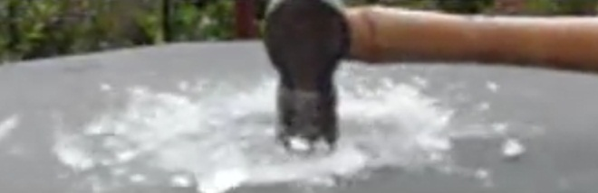
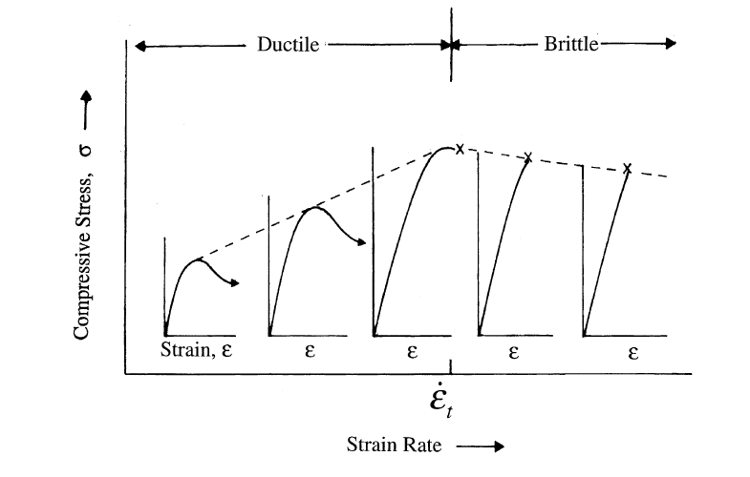
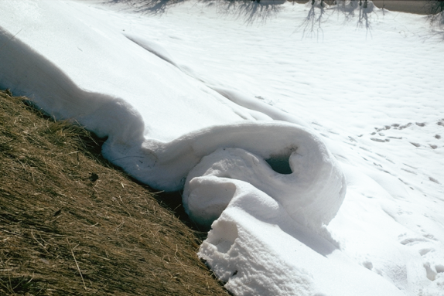
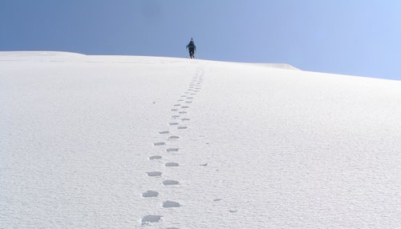
DUCTILE - BRITTLE TRANSITION OF ICE AND SNOW
Ductile Behaviour
Brittle Behaviour
10⁻³ ~ 10⁻⁴s⁻¹
ICE Ih
Schulson (2001)
SNOW
MARK MICHAEL – XDEM.DE – ERLANGEN 2014
Notes:
19

Slide 20
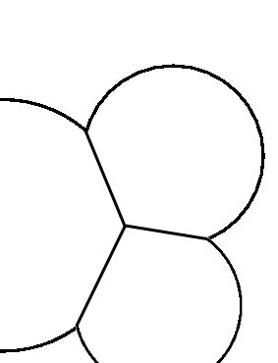

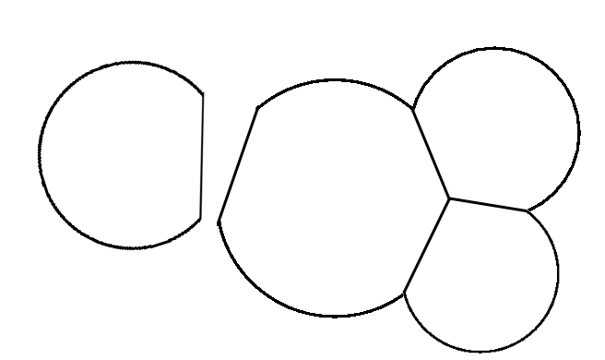
PROCESSES ON GRAIN-SCALE DURING SNOW DEFORMATION
Bonding
- Deformation of ice bonds
- Fracture of ice bonds
Collision
- Repulsive forces due to grain deformation
- Friction between sliding grains
F_{n}
v_{i}
v_{j}
F_{t}
v_{i}
v_{j}
v_{j}
MARK MICHAEL – XDEM.DE – ERLANGEN 2014
Notes:
20

Slide 21
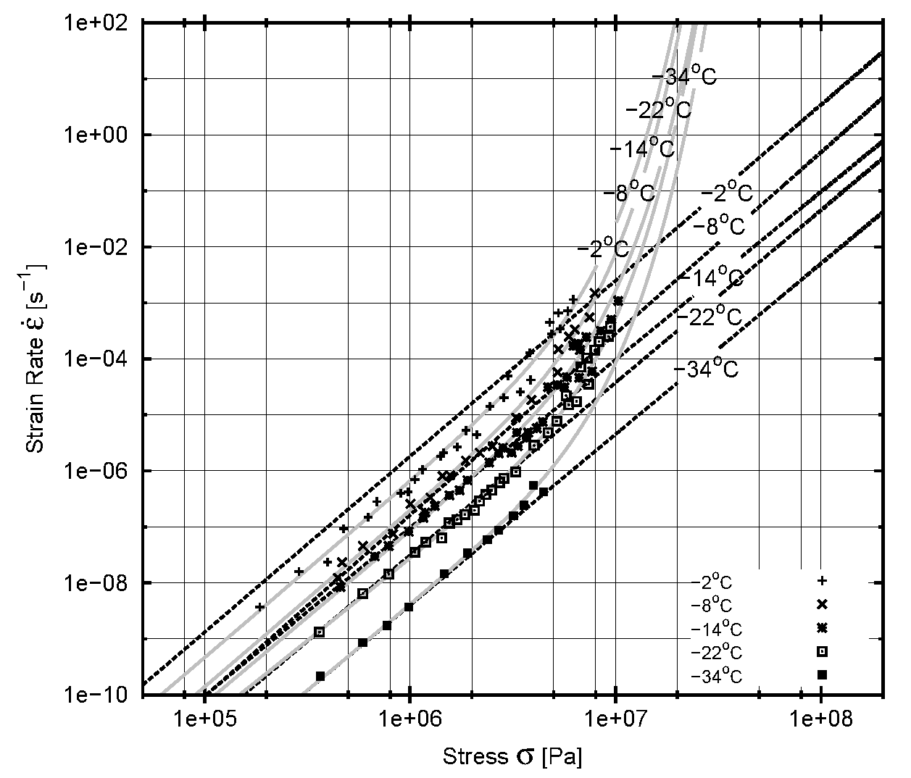
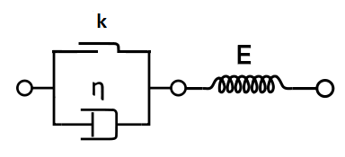

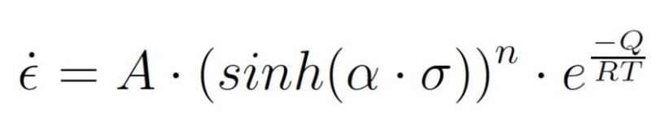
XDEM BONDING MODEL: ELASTIC VISCO-PLASTIC DEFORMATION
Creep Model of Ice by Barnes(1971)
MARK MICHAEL – XDEM.DE – ERLANGEN 2014
Notes:
21

Slide 22
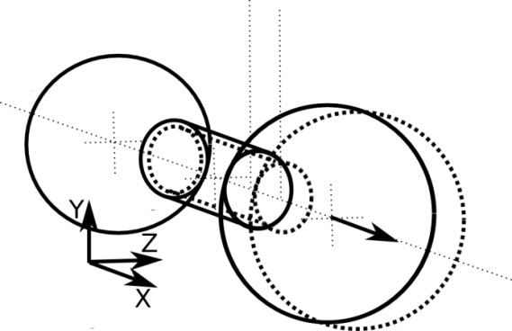
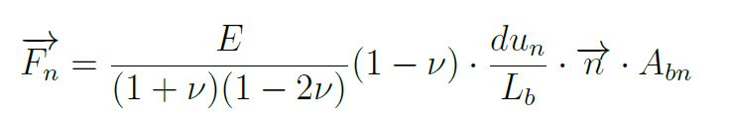
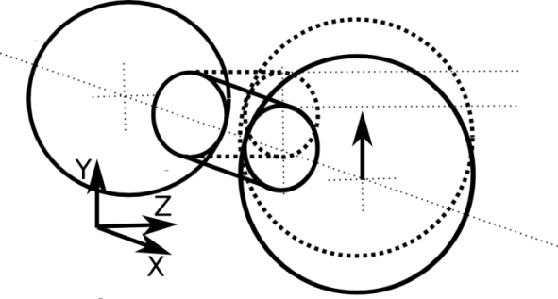
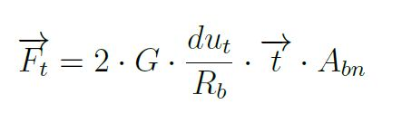
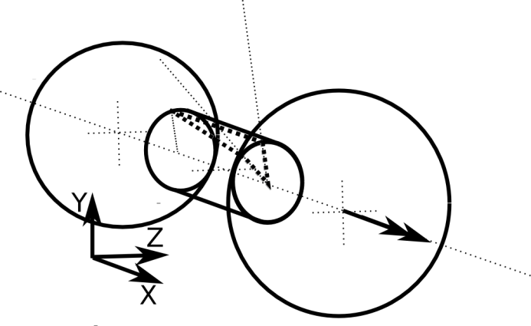
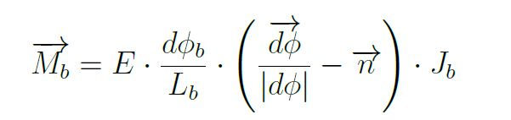


XDEM BONDING MODEL: ELASTIC VISCO-PLASTIC DEFORMATION
Stretch
Shear
Torsion
Bending
MARK MICHAEL – XDEM.DE – ERLANGEN 2014
Notes:
22

Slide 23


XDEM: BOND DEFORMATION AND FRACTURE
5x10⁻⁴s⁻¹
MARK MICHAEL – XDEM.DE – ERLANGEN 2014
Notes:
23

Slide 24



XDEM: BOND GROWTH MODEL
Bond Growth Model derived from Szabo(2007)
Creep Model of Ice by Barnes(1971)
MARK MICHAEL – XDEM.DE – ERLANGEN 2014
Notes:
24

Slide 25


XDEM: ELASTIC VISCO-PLASTIC COLLISION OF GRAINS
Creep Model of Ice by Barnes(1971)
F_{n}
Melting Point
Depression Curve
v_{i}
MARK MICHAEL – XDEM.DE – ERLANGEN 2014
Notes:
25

Slide 26


UNCONFINED COMPRESSION OF SNOW
Ductile Failure
10⁻⁶s⁻¹
Brittle Behaviour
10⁻¹s⁻¹
t = 5.5 h 10% Strain
t = 0.2 s 10% Strain
MARK MICHAEL – XDEM.DE – ERLANGEN 2014
Notes:
26

Slide 27



UNCONFINED COMPRESSION OF SNOW
Ductile Failure
Brittle Behaviour
Kinosita (1967)
MARK MICHAEL – XDEM.DE – ERLANGEN 2014
Notes:
27

Slide 28


UNCONFINED COMPRESSION OF SNOW
Ductile Failure
10⁻⁶s⁻¹
Brittle Behaviour
10⁻²s⁻¹
t = 5.5 h 10% Strain
t = 0.2 s 10% Strain
MARK MICHAEL – XDEM.DE – ERLANGEN 2014
Notes:
28

Slide 29


UNCONFINED COMPRESSION OF SNOW
Ductile Failure
Brittle Behaviour
MARK MICHAEL – XDEM.DE – ERLANGEN 2014
Notes:
29

Slide 30

UNCONFINED COMPRESSION OF SNOW
Snow Strength
vs
Sintering Age
MARK MICHAEL – XDEM.DE – ERLANGEN 2014
Notes:
30

Slide 31
THANK YOU FOR YOUR ATTENTION
Visit us on www.XDEM.de
MARK MICHAEL – XDEM.DE – ERLANGEN 2014
Notes:
31

