Slide 1
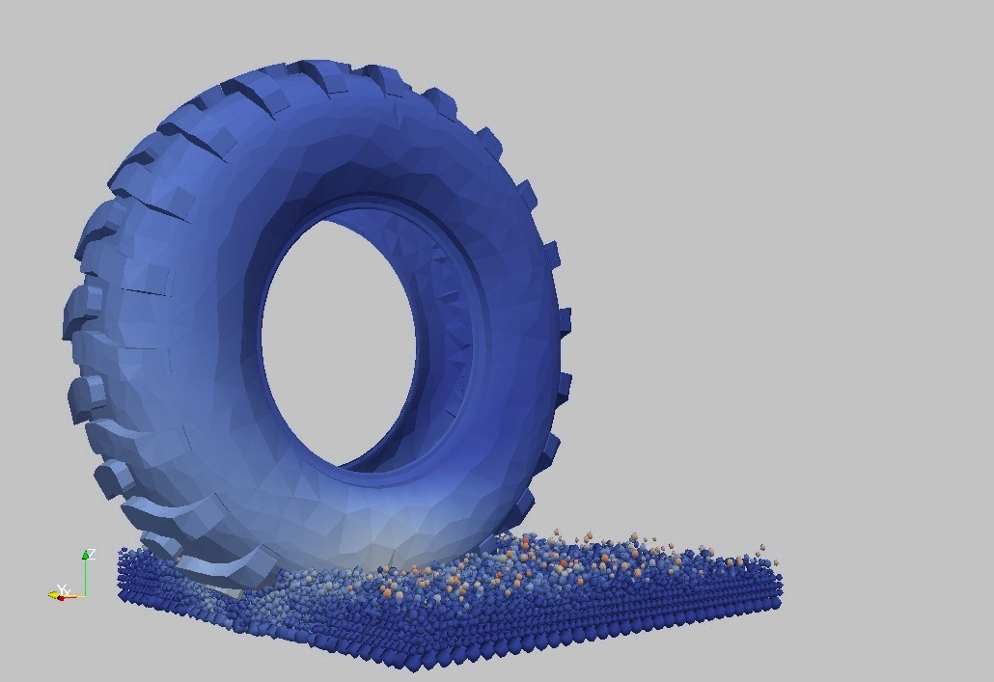
Simulation of the Tractive Performance of Tire Treads on Granular Terrain by Means of Finite and Discrete Element Coupling
Mark Michael - XDEM.de
Tires, Chasis, Road - An Event of the VDI WissensForums 22.10.2013

Slide 2
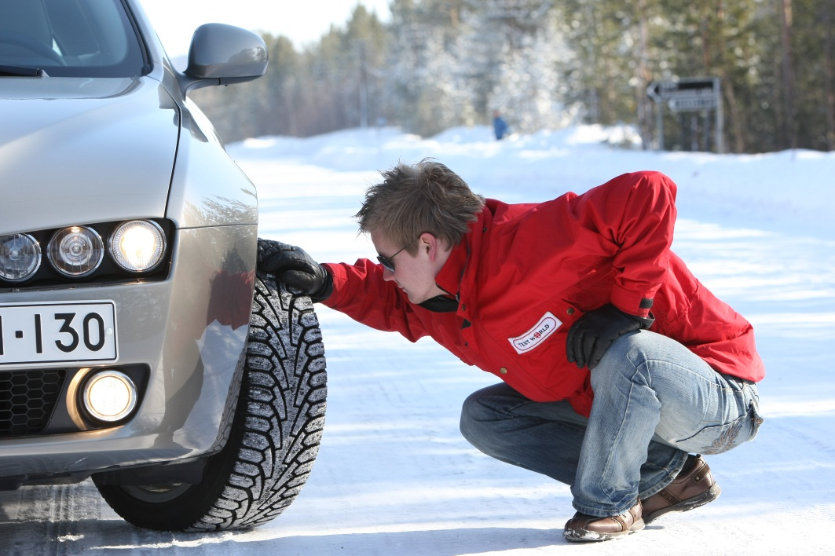
MOTIVATION
A simulation technique that describes the interaction between a tire tread and a snow covered road
Image Source: Test World Oy, Ivalo (Finland) www.testworld.fi
Ranges of Interest
Snow Temperature -30 to 0ºC
Snow Density 200 to 600 kg/m³
Impact Velocity 10⁻³ to 10¹ m/s
Applied Loads 10⁴ to 10⁷ Pa
Mark Michael - XDEM.de
Tires, Chasis, Road - An Event of the VDI WissensForums 22.10.2013

Slide 3
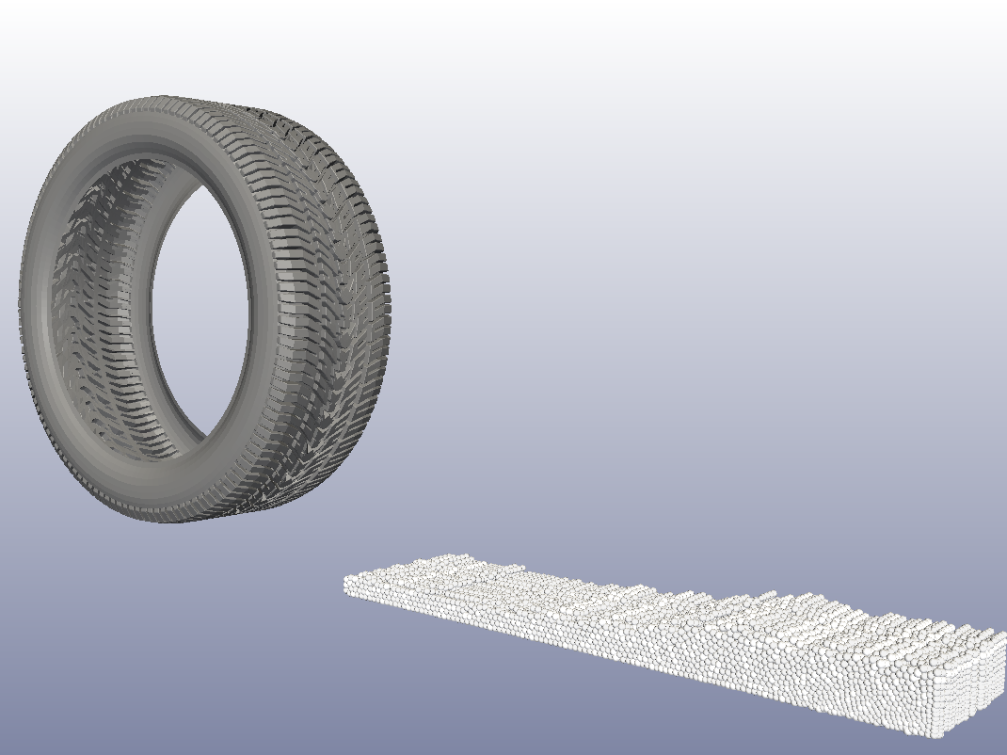
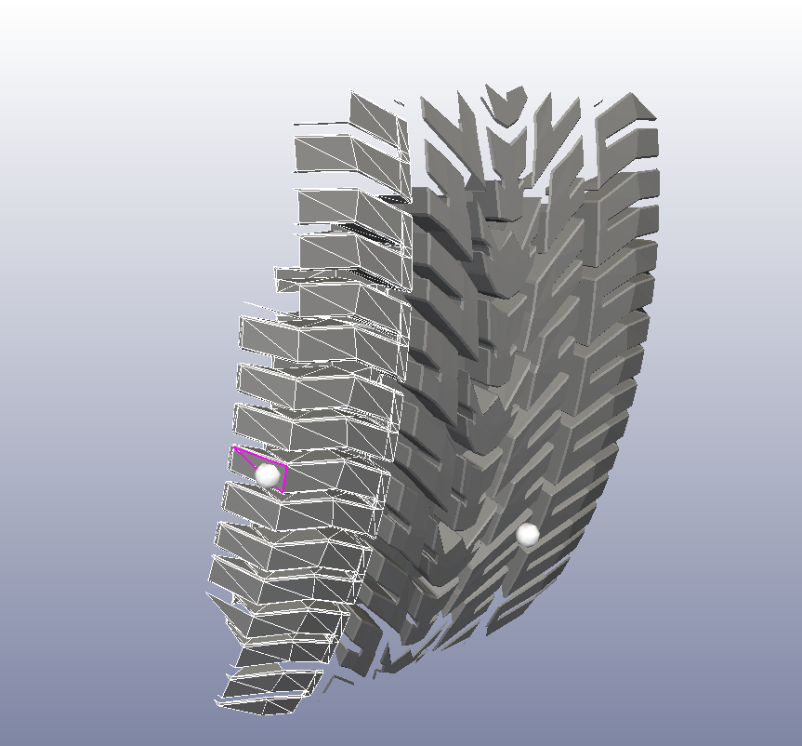
TECHNIQUE AND INNOVATION
Finite Element Method
for Tread Deformation
Interface Coupling of Loads and Deformation
Extended Discrete Element Method for Grain Motion
Mark Michael - XDEM.de
Tires, Chasis, Road - An Event of the VDI WissensForums 22.10.2013

Slide 4
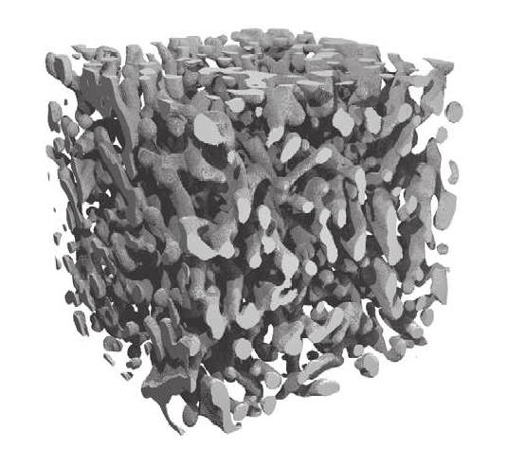
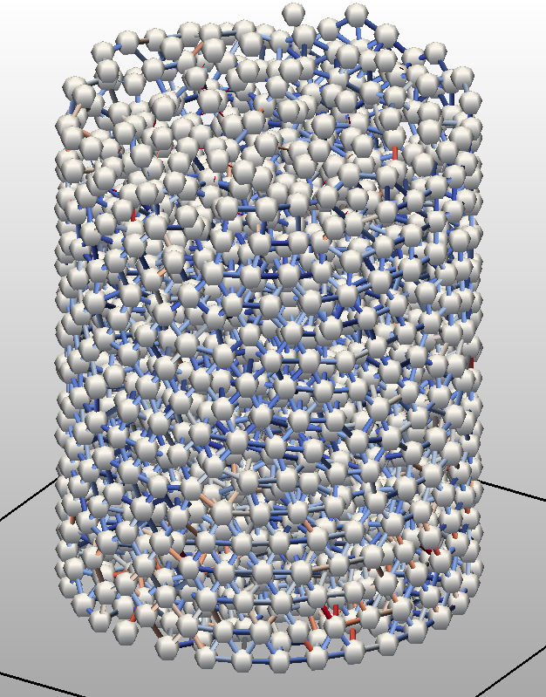
NATURE TO NUMERIC
Ice Matrix of Snow
Numerical Snow Sample
Spherical Grains + Cylindrical Bonds
modeling
X-ray microtomographie scans by Schneebelli (SLF Davos)
Mark Michael - XDEM.de
Tires, Chasis, Road - An Event of the VDI WissensForums 22.10.2013

Slide 5
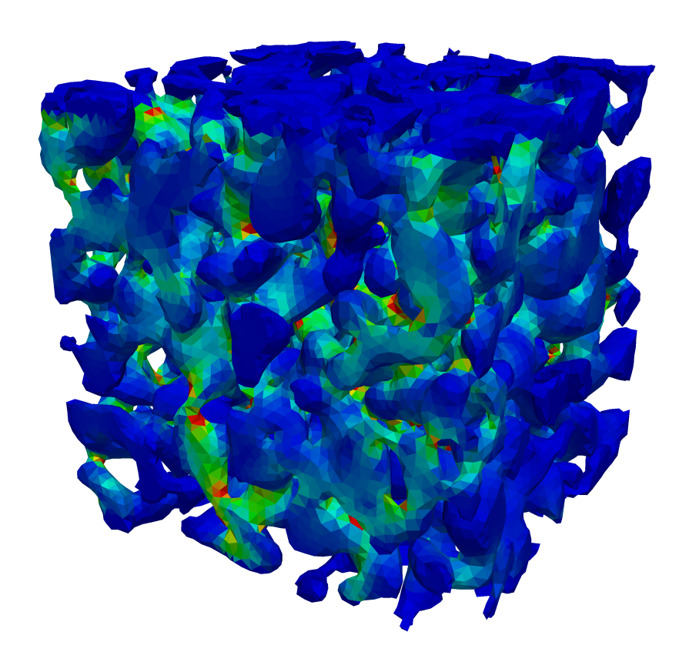
NUMERICAL SNOW
Ice Matrix of Snow
Numerical Snow Sample
Stress distriution in finite ice matrix
Stress distriution in cylindrical bonds
FEM by P. Hagenmuller (IRSTEA Grenoble)
Mark Michael - XDEM.de
Tires, Chasis, Road - An Event of the VDI WissensForums 22.10.2013

Slide 6
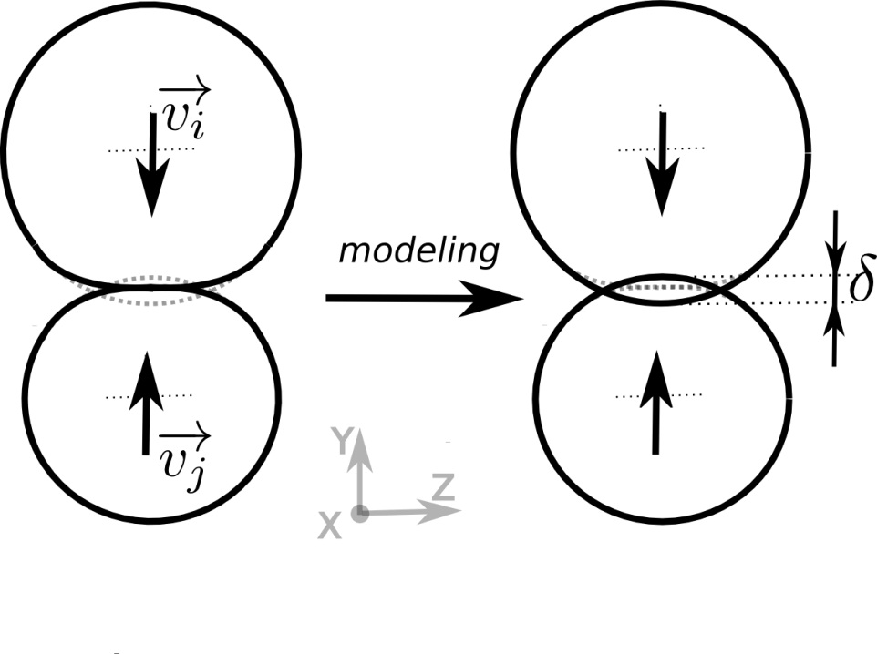
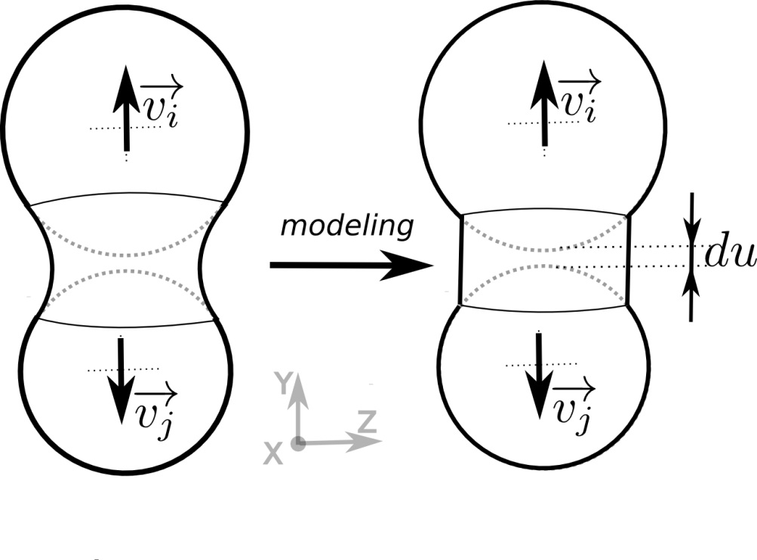
EXTENDED DISCRETE ELEMENT METHOD
Collision
Bonding
Mark Michael - XDEM.de
Tires, Chasis, Road - An Event of the VDI WissensForums 22.10.2013

Slide 7
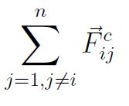
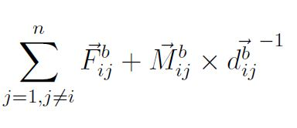
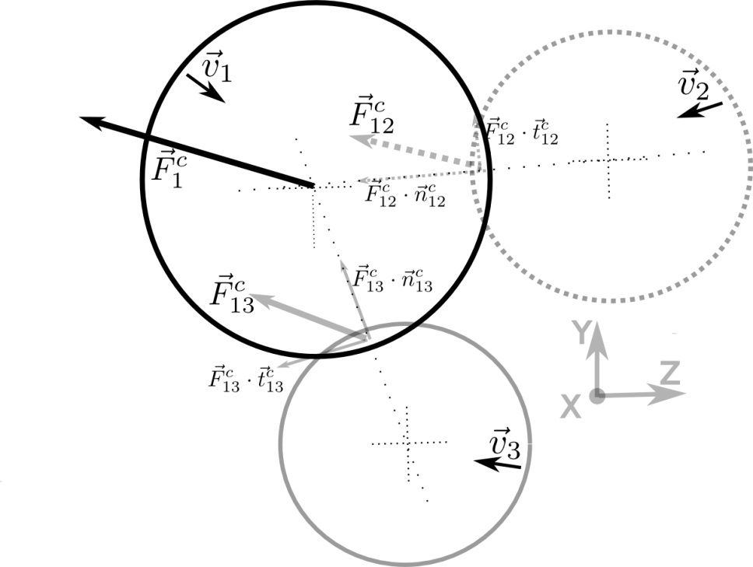
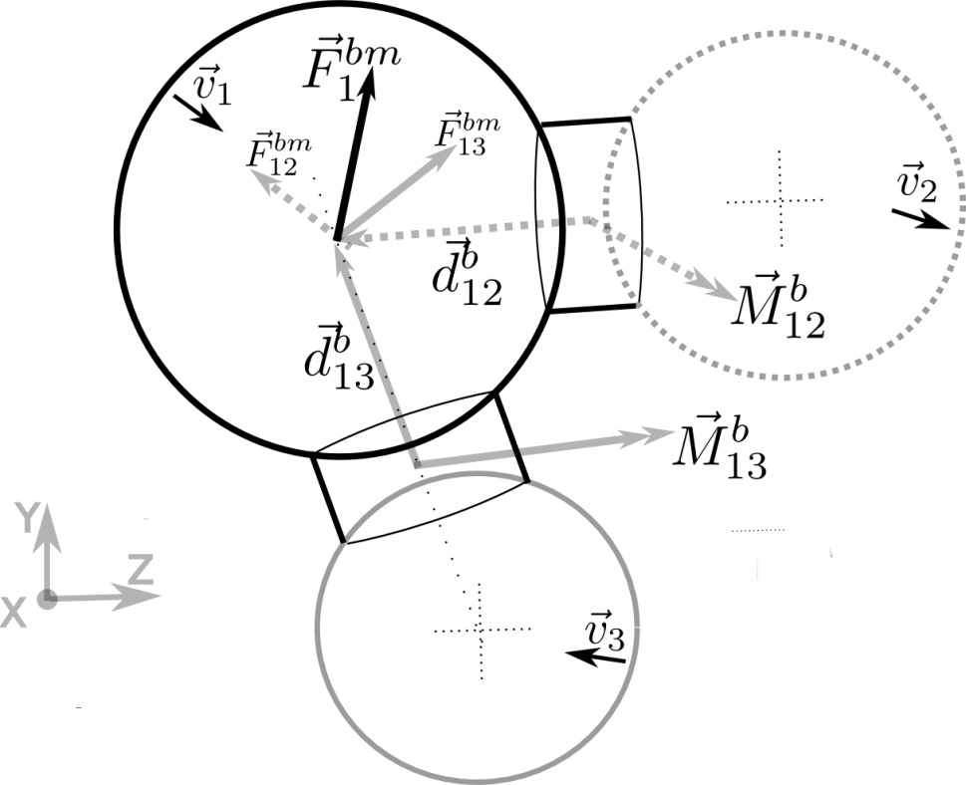
EXTENDED DISCRETE ELEMENT METHOD
Mark Michael - XDEM.de
Tires, Chasis, Road - An Event of the VDI WissensForums 22.10.2013

Slide 8
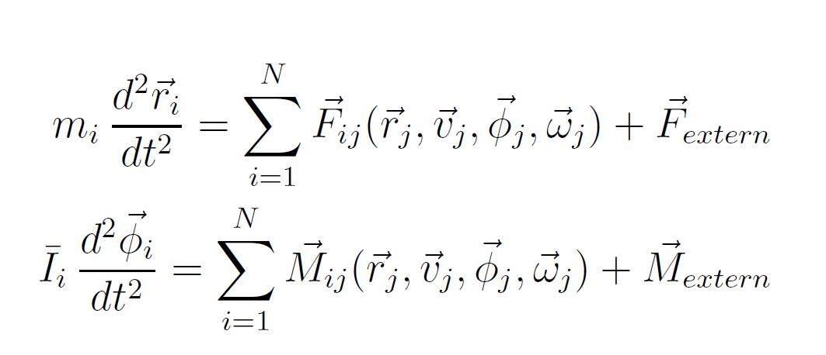
EXTENDED DISCRETE ELEMENT METHOD
Integration of Newton’s second law to yield new position and orientation
V_{t}
V_{t-3}
Mark Michael - XDEM.de
Tires, Chasis, Road - An Event of the VDI WissensForums 22.10.2013

Slide 9
EXTENDED DISCRETE ELEMENT METHOD
Scratch test in snow with metal blades
Mark Michael - XDEM.de
Tires, Chasis, Road - An Event of the VDI WissensForums 22.10.2013

Slide 10
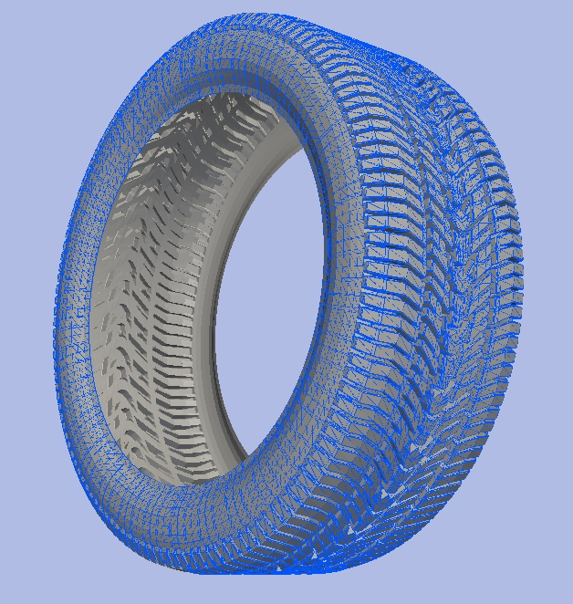
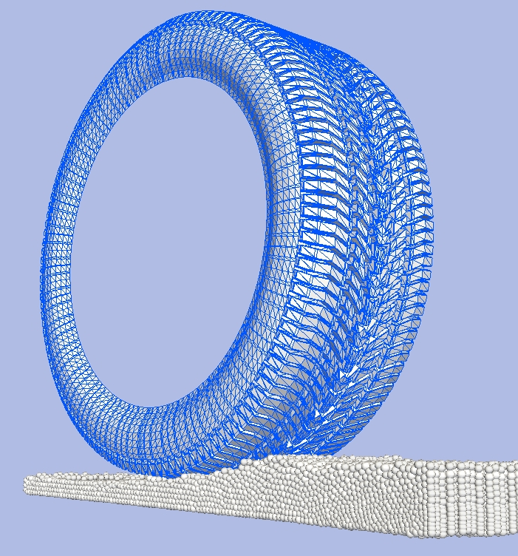
INTERFACE COUPLING
Surface Elements in FEM = Boundary Elements in DEM
Mark Michael - XDEM.de
Tires, Chasis, Road - An Event of the VDI WissensForums 22.10.2013

Slide 11
RIGID TREAD – TERRAIN INTERACTION

Slide 12
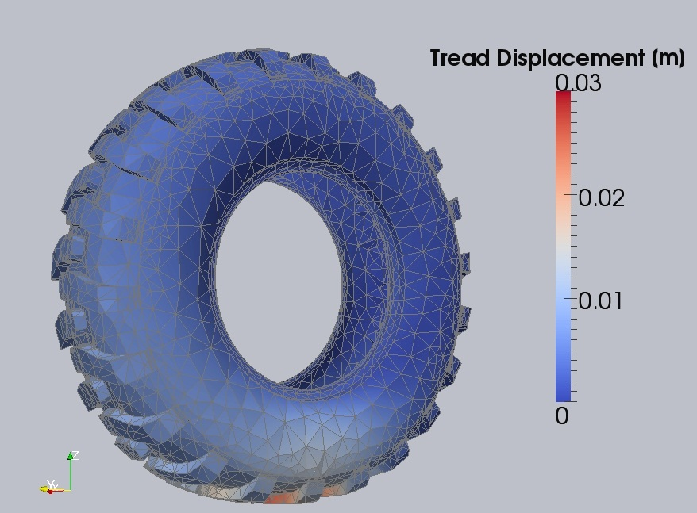
FINITE ELEMENT METHOD
Newton’s second law including internal force term and Hook’s linear elastic law
Mark Michael - XDEM.de
Tires, Chasis, Road - An Event of the VDI WissensForums 22.10.2013

Slide 13
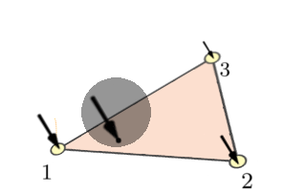
XDEM – FEM COUPLING PROCEDURE
F_{t}
F_{n}
-F_{n}
Interpolation of forces by means of FE shape functions
-F_{t}
-F
Transfer of counterpart force
Prediction of impact force on boundary on DEM side
Mark Michael - XDEM.de
Tires, Chasis, Road - An Event of the VDI WissensForums 22.10.2013

Slide 14
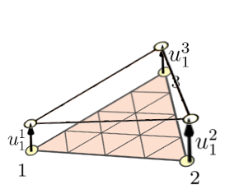
XDEM – FEM COUPLING PROCEDURE
Z
Y
u²
Transfer displacement vectors
Prediction of displacement at element nodes by means FEM solver
u
u¹
x_{j}
Update of position of boundary shape on DEM side
u³
Mark Michael - XDEM.de
Tires, Chasis, Road - An Event of the VDI WissensForums 22.10.2013

Slide 15
XDEM – FEM COUPLING
Spherical and cubical particles impacting elastic membrane
Mark Michael - XDEM.de
Tires, Chasis, Road - An Event of the VDI WissensForums 22.10.2013

Slide 16
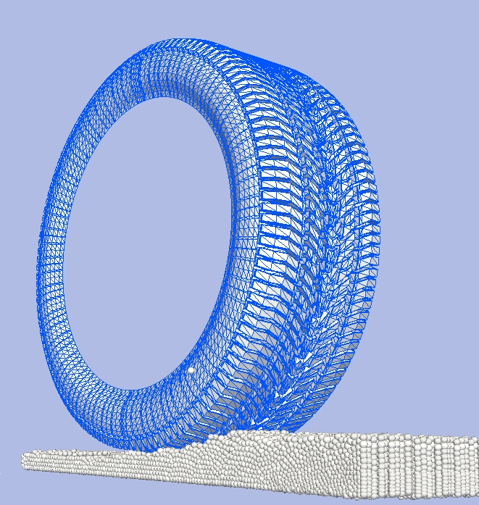
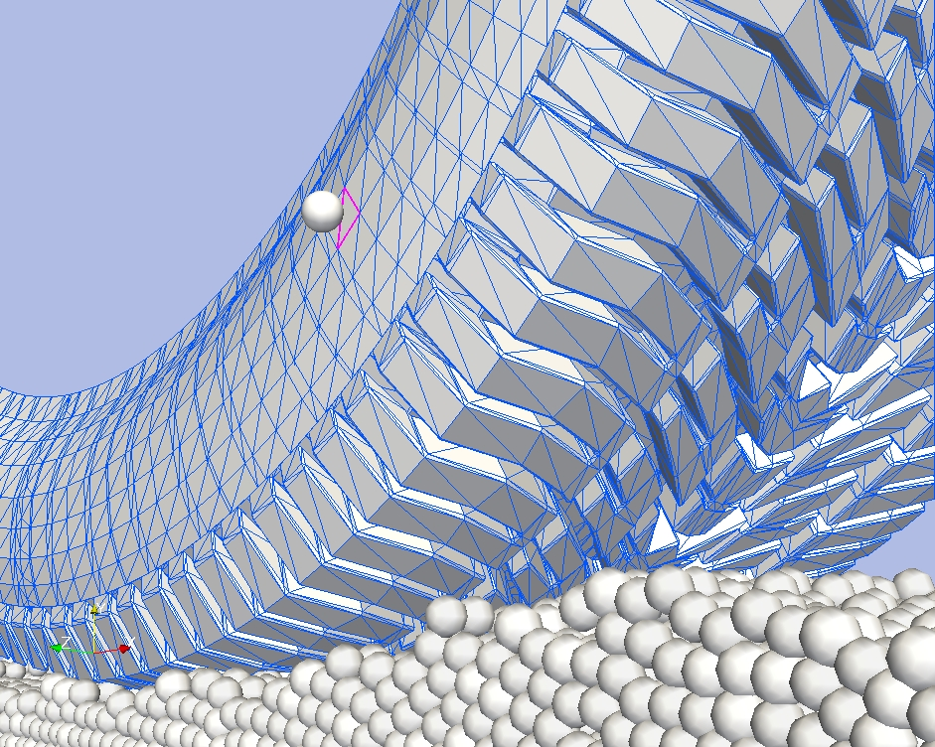
CONTACT DETECTION ALGORITHM
Detection of the intersecting boundary element
Particle
Mark Michael - XDEM.de
Tires, Chasis, Road - An Event of the VDI WissensForums 22.10.2013

Slide 17
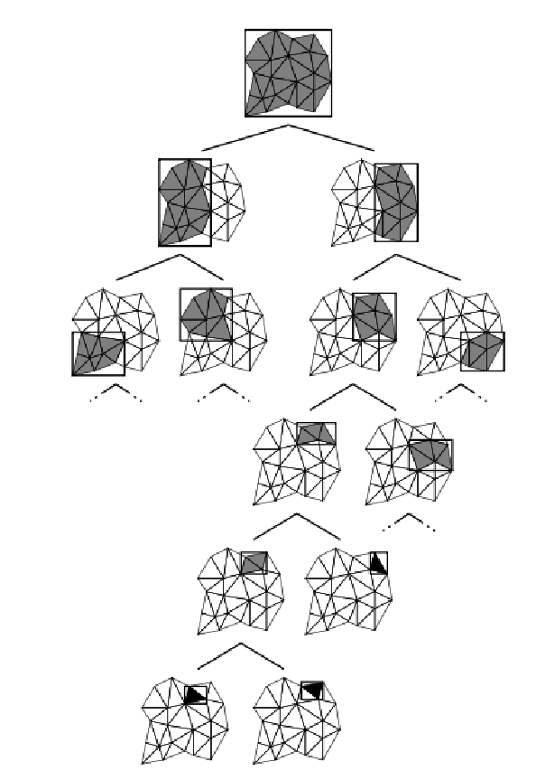
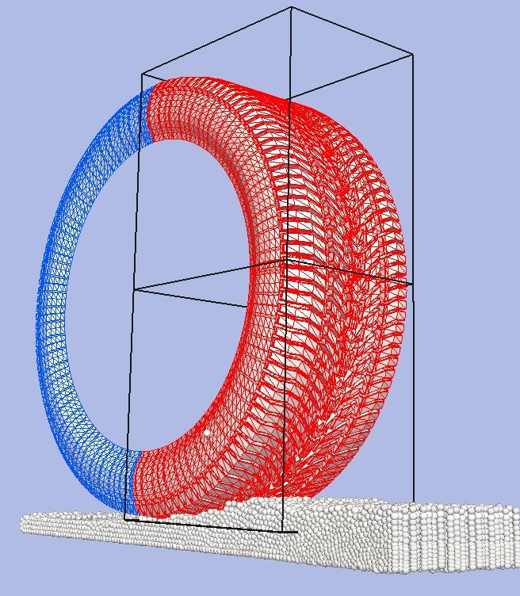
CONTACT DETECTION ALGORITHM
Detection of the intersecting boundary element
Split and predicted intersection with child bounding volume
Binary tree storing of bounding volume
who encapsulate boundary elements
Mark Michael - XDEM.de
Tires, Chasis, Road - An Event of the VDI WissensForums 22.10.2013

Slide 18
CONTACT DETECTION ALGORITHM
Bottom of binary tree
One bounding volume contains one element
Particle
Binary tree storing of bounding volume
who encapsulate boundary elements
Intersecting boundary element
Mark Michael - XDEM.de
Tires, Chasis, Road - An Event of the VDI WissensForums 22.10.2013

Slide 19
XDEM – FEM COUPLING
Tire – Soil Terrain Interaction
Mark Michael - XDEM.de
Tires, Chasis, Road - An Event of the VDI WissensForums 22.10.2013

Slide 20
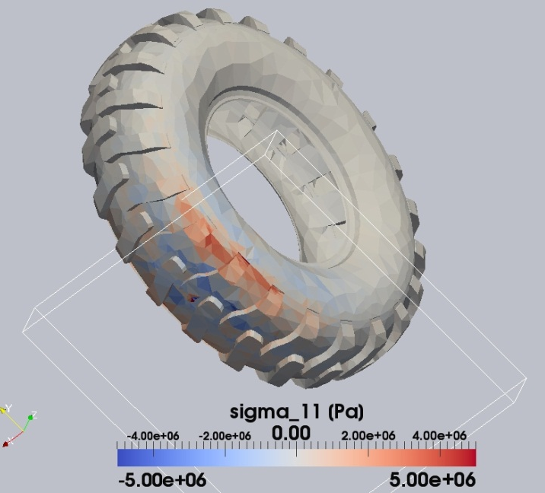
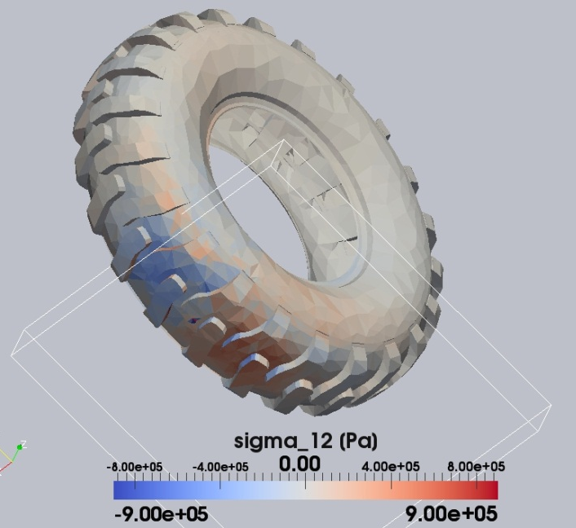
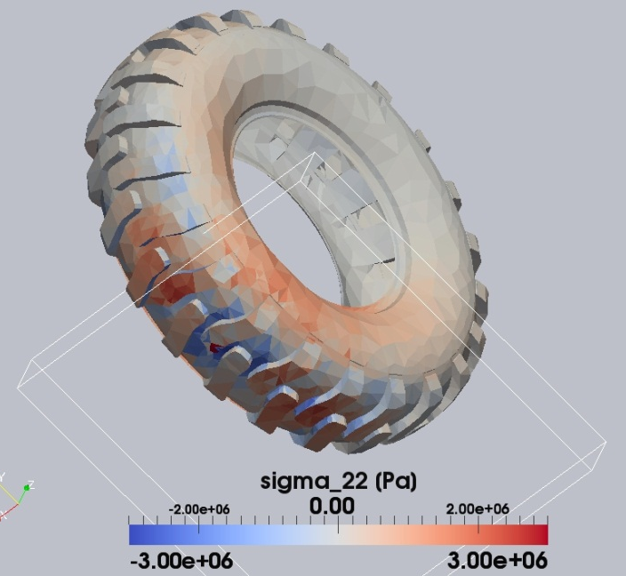
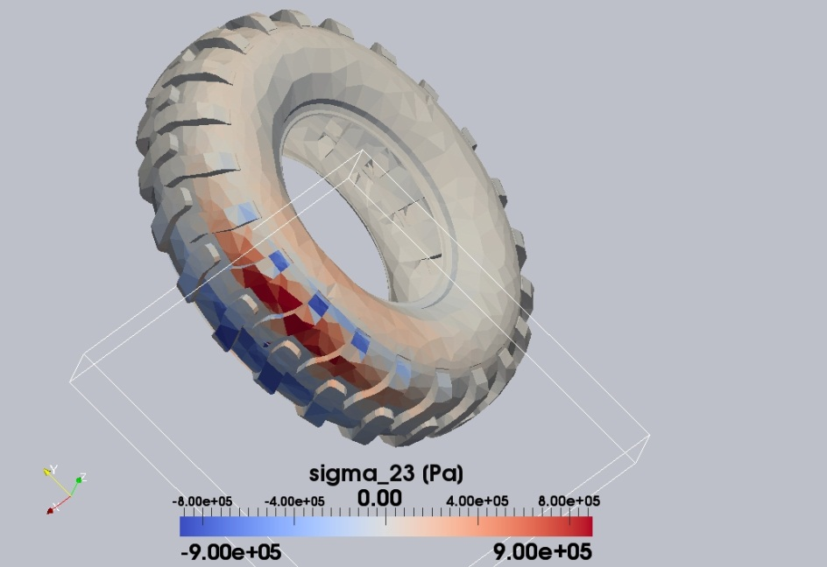
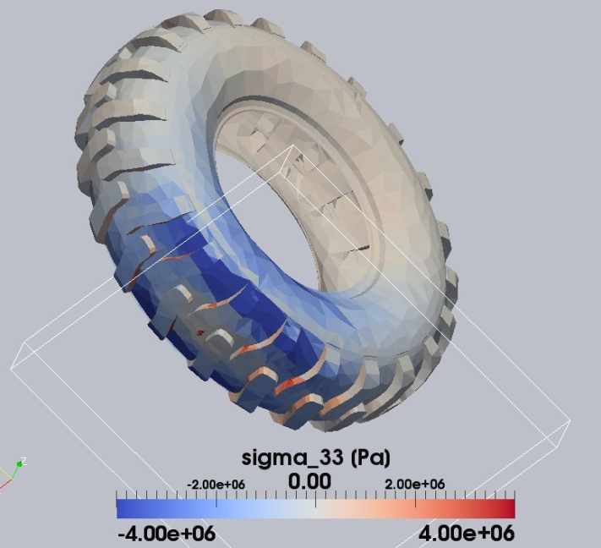
XDEM – FEM COUPLING
Tire – Soil Terrain Interaction: Stress Components
Mark Michael - XDEM.de
Tires, Chasis, Road - An Event of the VDI WissensForums 22.10.2013

Slide 21
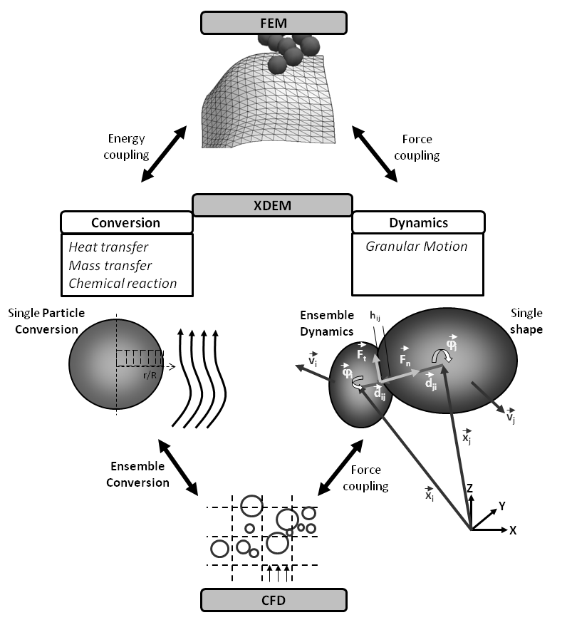
XDEM (eXtended Discrete Element Methode)
Module Structure
Mark Michael - XDEM.de
Tires, Chasis, Road - An Event of the VDI WissensForums 22.10.2013

Slide 22
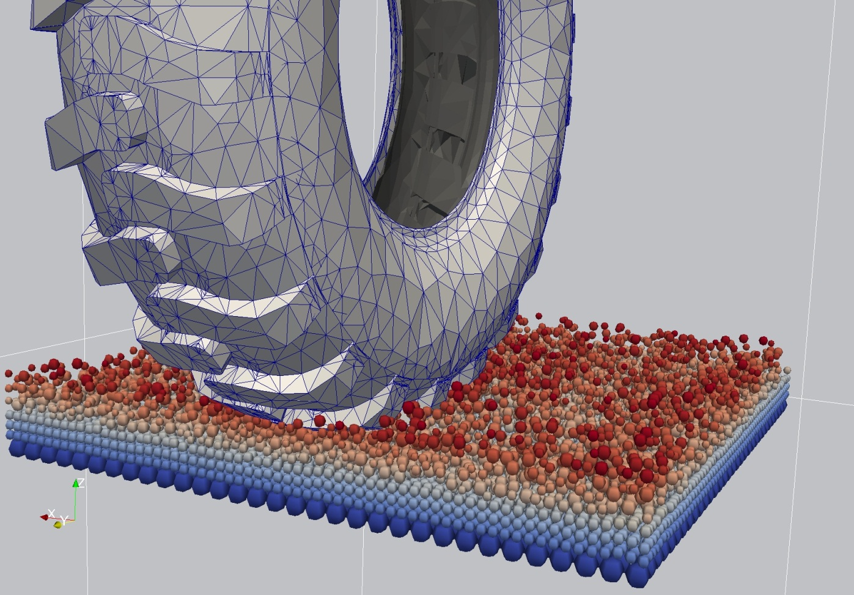
THANK YOU FOR YOUR ATTENTION
Visit us on www.XDEM.de
Mark Michael - XDEM.de
Tires, Chasis, Road - An Event of the VDI WissensForums 22.10.2013

