Slide 1
Meshless Elasticity Model and Contact Mechanics-based Verification Technique
Rifat Aras¹
Yuzhong Shen¹
Michel Audette¹
Stephane Bordas²
¹Department of Modeling, Simulation, and Visualization Engineering, Old Dominion University, Norfolk, VA, United States
²Institute of Mechanics and Advanced Materials, Cardiff University, Wales, UK

Slide 2
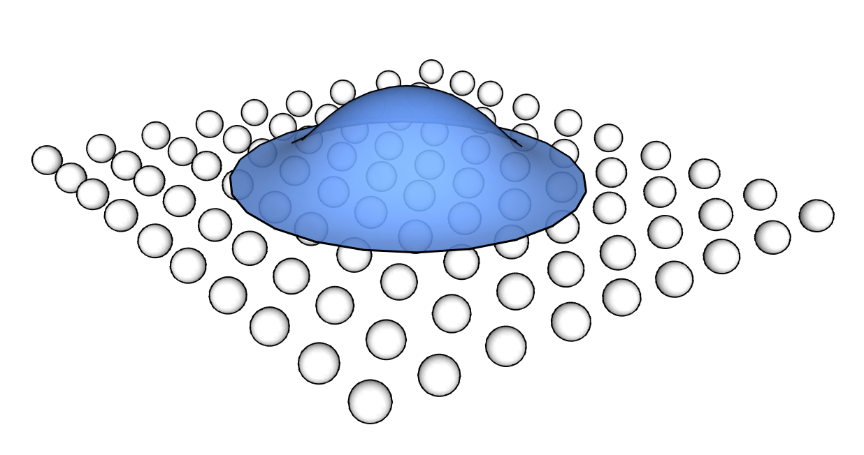
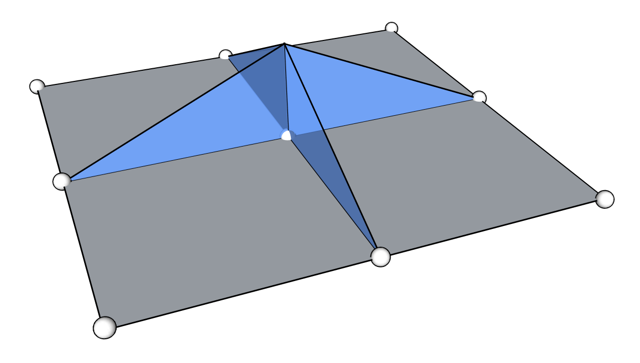
Motivation
Meshless Methods
Represent the continuum as a point cloud with overlapping support regions.
Approximation is built from these points only.
Notes:
Meshless methods are preferable to the mesh-based biomechanics solutions when the problem domain involves extreme deformations or artificial discontinuities. For example, during a surgical simulation with cutting operation, meshless methods eliminate the necessity of remeshing the problem domain due to the fact that they do not require a background mesh to interpolate the continuum variables.
Standard finite element are not well suited for applications that involve strong and weak discontinuities since the shape function of standard finite elements are piecewise polynomials and strong and weak discontinuities can be incorporated only along element edge. A strong discontinuity is a discontinuity in the function itself while a weak discontinuity is a discontinuity in the derivatives of a function. For example, a crack, i.e. a jump in the displacement field, is a strong discontinuity while a material interface, i.e. a jump in the strain field (note that the strain field involves the derivatives of the displacement field) is a weak discontinuity.

Slide 3
Motivation
Advantages of meshless methods
Well suited for problems with large deformations
Well suited for localized problems
Simple implementation of h-adaptivity and p-adaptivity
No need for mesh generation
Drawbacks
Higher computational cost
Difficulties with imposing essential boundary conditions
Notes:
Advantages of Meshless Methods
- Meshfree methods are well suited for problems with large deformations (high velocity impacts, solids under explosive loading, free surface flow)
- Meshfree methods are well suited for localized problems (fracture, fragmentation, cracks, shear bands eventually with high curvature)
- Meshfree shape functions are higher order continuous (no stress jumps at element boundaries, better stress distribution around crack tip, useful for certain constitutive models)
- Non-local interpolation character
- Simple implementation of h-adaptivity and p-adaptivity
- No need for mesh generation
- Better suited for crack problems (no mesh alignment sensitivity, no crack path continuity required)
Drawbacks of Meshless Methods
- Higher computational cost
- Difficulties with imposing essential boundary conditions since the meshless method shape functions are not interpolants.
- Certain meshfree methods are unstable

Slide 4
Motivation
Moving Least Square (MLS) approximation-based meshless collocation method for simulating deformable objects
Verification of the deformable material model through Hertzian theory of non-adhesive elastic contact

Slide 5
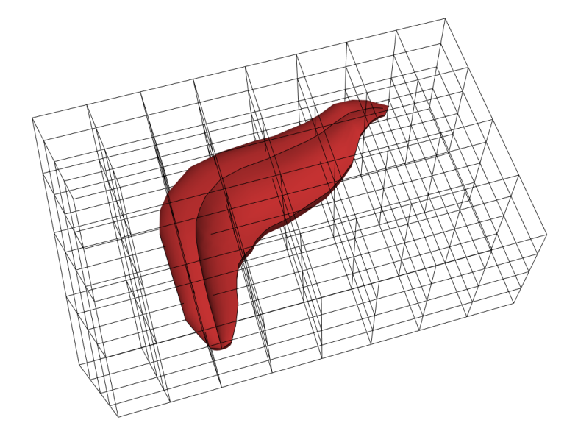
Related Work
Free-form Deformation
Embedding the object of interest into a lattice and deforming the object by deforming the lattice that the object is embedded.
T. W. Sederberg and S. R. Parry, "Free-form deformation of solid geometric
models," ACM Siggraph Computer Graphics, vol. 20, pp. 151-160, 1986.
Notes:
There have been numerous approaches to modeling deformable objects. One early example is the work of Sederberg and Parry that presented a technique for deforming solid geometric models in an intuitive free-form manner. The deformations are based on interpolating trivariate Bernstein polynomials, and can be applied either globally or locally with volume preservation. Free-form deformation is an approximate and simple method for deforming solid objects; however the lack of physical basis is grounds for excluding it as an option for realistic medical simulations.

Slide 6
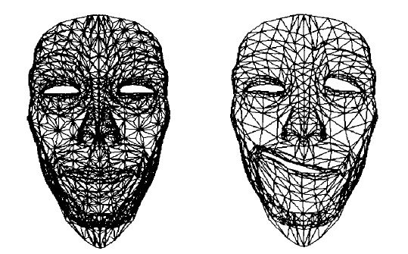
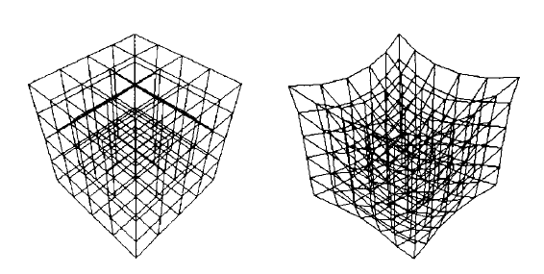
Related Work
Mass-spring Networks
Physically-based tissue model that is represented by a lattice of non-linear spring units.
Volumetric or,
Membrane representation.
K. Waters and D. Terzopoulos, "A physical model of facial tissue and muscle
articulation," in Visualization in Biomedical Computing, 1990, pp. 77-82.
Van Gelder, "Approximate simulation of elastic membranes by triangulated
spring meshes," Journal of graphics tools, vol. 3, pp. 21-42, 1998.
Notes:
Another popular method is mass-spring network models and membrane based approximations that utilize spring meshes. A spring mesh is composed of vertices and edges, in which each edge is realized as a spring that connects vertices pair-wise, and each vertex is idealized as a point mass. Although spring meshes employ physical equations like Hooke’s law, it is difficult to reproduce specific elastic material properties even with very careful distribution of spring stiffness through the mesh and can suffer from poor numerical stability.

Slide 7
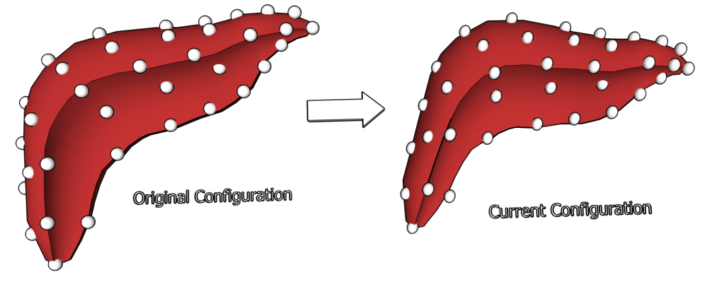
Related Work
Total Lagrangian Explicit Dynamics
Advocates Total Lagrangian formulation vs. Updated Lagrangian formulation.
Employs the explicit time integration scheme rather than the implicit scheme.
Performs computations at the element level eliminating the need of assembling the stiffness matrix of the entire deformable model (possibility of parallel processing?).
K. Miller, et al., "Total Lagrangian explicit dynamics finite element algorithm
for computing soft tissue deformation," Communications in numerical
methods in engineering, vol. 23, pp. 121-134, 2007.
Notes:
A number of recent techniques have addressed the fidelity versus efficiency trade-off. Another important work in the area is the finite element model based on Total Lagrangian Explicit Dynamics (TLED). The difference between the TLED based finite element model and other approaches is using the original reference configuration of the object to calculate the stress and strain tensors during a simulation step. As a result of expressing computations in the reference coordinates, the authors were able to pre-compute spatial derivatives. The pre-computation of the spatial derivatives leads to efficiency in terms of computational resources, while being capable of handling geometric and material nonlinearities.
In this particular work, the central difference based explicit integration was employed rather than the implicit integration scheme. With this choice, they were able to avoid solving the set of non-linear algebraic equations that are required by the implicit integration at each time step. However, the use of explicit integration brings limitation on the time step size. The implementation choice is being justified by stating that the relatively lower stiffness (Young’s modulus) value of the soft tissue relaxes the time step limitation considerably compared to the typical simulations involving more stiff material like steel or concrete.
Extra notes:
Maximum time step allowed for stability is inversely proportional to the square root of Young’s modulus divided by the mass density.
In Updated Lagrangian formulation Cauchy stress and Almansi strain are used. In Total Lagrangian formulation, Second Piola-Kirchoff stress and Green strain are used.
To further increase the efficiency, they use “under-integrated elements” (such as one integration point per a hexahedral element).

Slide 8
Related Work
Meshless Total Lagrangian Explicit Dynamics
Simulation geometry is discretized by meshless nodes (arbitrary distribution) and integration points (regular distribution).
Employs the explicit time integration scheme.
Shape function derivatives are precomputed wrt original configuration for increased efficiency.
Method is verified against ABAQUS through 3 basic experiments: compression, extension, and shear
Horton, et al., "A meshless total Lagrangian explicit dynamics algorithm
for surgical simulation," International Journal for Numerical Methods in
Biomedical Engineering, vol. 26, pp. 977-998, 2010.
Notes:
This work extends the Total Lagrangian Explicit Dynamics algorithm by applying the same precomputation principle to the meshless methods.
The simulation geometry is discretized by meshless nodes at which masses are stored and forces – displacements are computed and integration points at which stresses and strains are calculated. The meshless nodes are arbitrarily distributed through the simulation geometry, whereas the integration points are distributed over a regular grid that does not need to conform to the simulation geometry.
As in the previous TLED method, the local neighboring nodes list and the Moving Least Square (MLS) shape function derivatives are precomputed and used throughout the simulation.
With about 4000 meshless nodes and 6000 integration points, the algorithm runs about 30 times slower than the real-time.

Slide 9
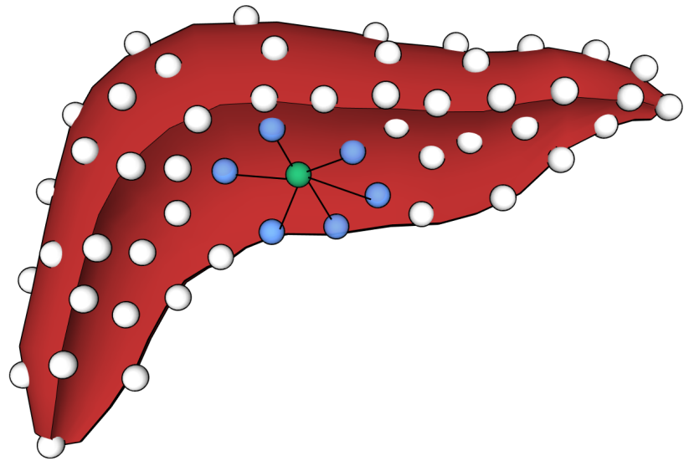
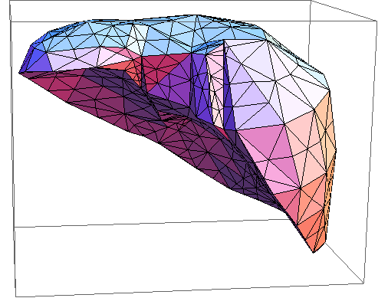
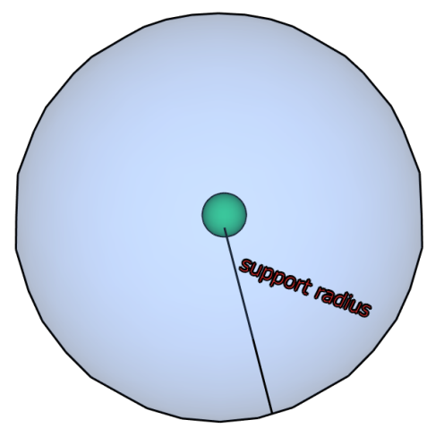
Meshless Collocation Method
Discretization of the Continuum
Node distribution (regular or hierarchical)
Support domains
Node positions from the vertices of tetrahedra
Support radius of each node is obtained from the average distance to the k-nearest neighbors
Notes:
The algorithm supports both regular distribution and hierarchical distribution by pre-tetrahedralization of the complex geometry. In both cases, the support radii of the meshless nodes are computed by finding the average distance to the k-nearest neighbors. To increase the efficiency of the neighborhood search, a kd-tree data structure is utilized.
In this work, we used spherical support domains.

Slide 10



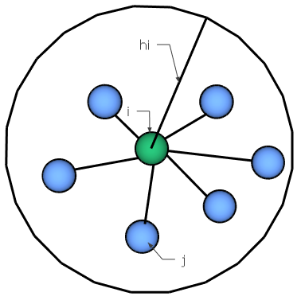

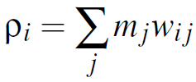
Meshless Collocation Method
Discretization of the Continuum
Weight function
Mass,
volume,
and density
Notes:
Weight (kernel) function in the meshless method context is an important element as it describes the way meshless nodes affect each other and how the material values of the continuum such as the mass, volume and density are distributed among the meshless nodes. In this work we use a polynomial kernel function.
The mass of a meshless node is distributed around it via this weight function. The masses of the meshless nodes are initialized through this given equation. In this equation, rho is the material density value, r_{i} is the average distance to the k-nearest neighbors, and s is a scaling factor parameter chosen by the user so that the average of the assigned densities to the nodes (rho_{i}) is close to the actual density value of the material (rho).

Slide 11
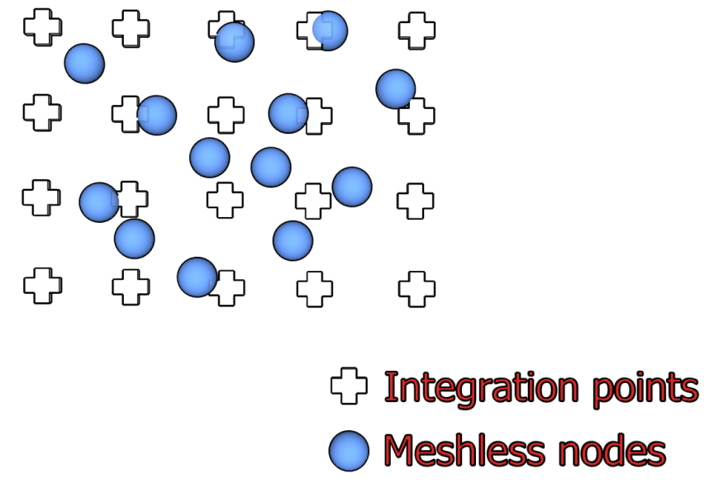
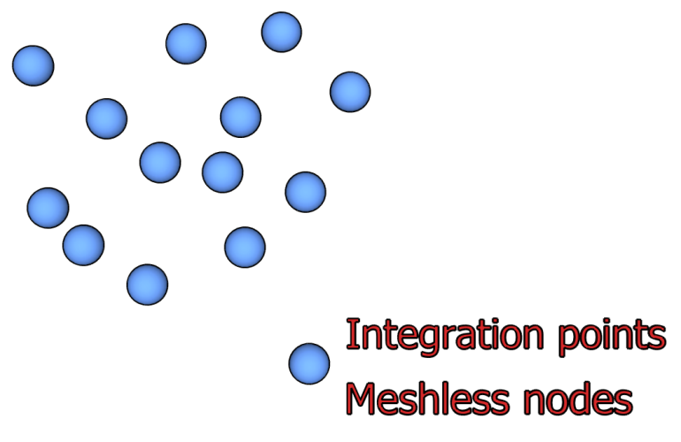
Meshless Collocation Method
Discretization of the Continuum
Nodal integration / Collocation Method
Notes:
Nodal integration is fast and efficient compared to the spatial integration methods that use background meshes and background grids, which use several gauss points per region. The problem with nodal integration is that it suffers from instability which had been addressed by several work.
In this work, we calculate the spatial derivatives of the deformation gradient only at the particle locations similar to the meshless collocation methods. In meshless collocation methods, the equations are satisfied only at the meshless nodes, making these methods truly meshless with higher computational efficiency.
On the left, there is a typical implementation of a meshless method with additional integration points. In these types, stresses and strains are calculated at the integration points whereas forces and displacements are computed at the meshless nodes. On the right hand side is the typical implementation of a collocation-based meshless method with nodal integration. There is no need for additional integration points at the expense of added instability.

Slide 12




Meshless Collocation Method
MLS Approximation with Taylor Series
Moment matrix
Notes:
We need the partial derivatives of the displacement vector field in order to compute the strain, stress, and the internal elastic forces applied to the meshless particles. Moving Least Squares (MLS) approximation is used to compute this gradient.
For a central meshless particle i and its neighbor j, the value of ux at the location of j can be approximated by the first order Taylor expansion as shown above.
We measure the error of approximation as the sum of the squared differences between the approximated values and the known values weighted by the previously defined weight function. When expanded, the error metric takes the following form. Given this form, we want to find the partial derivatives that minimize the error e. Therefore, setting the derivatives of e with respect to the partial derivative terms to zero results in three equations for the three unknowns.
The coefficient of the partial derivative on the left-hand side of the last equation is the 3x3 matrix called the moment matrix (A). A can be inverted and premultiplied with both of the sides of the equation to get the formula for the computation of the partial derivatives.

Slide 13


Meshless Collocation Method
Force Calculation
Strain energy density
Forces applied to the particle i and its neighbors j
Notes:
The elastic body forces that are applied to the individual particles in the meshless collocation method are calculated through the strain energy density, which is a function of the particle displacements. For a particle i with volume vi, the strain energy density becomes as follows.
The forces applied to the particle i and its neighbors j are then the directional derivative of the energy density with respect to particle displacements.

Slide 14
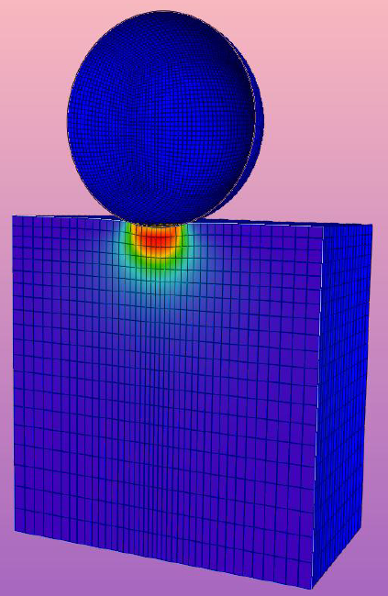

Verification – Contact Mechanics Theory
Hertzian theory of non-adhesive elastic contact
Defines analytical solutions for the interaction of elastic half-spaces.
Assumes:
Small strains,
Much smaller area of contact,
Continuous and frictionless contacts.
Notes:
Hertzian theory of non-adhesive elastic contact defines analytical solutions for the interaction of elastic half-spaces with simple shapes in terms of applied force and object indentation. For example, the amount of indentation of an elastic half-space under a spherical load is given by the above equation, where F is the vertical force applied on the spherical load, R is the radius of the spherical load, d is the indentation amount, and E* is the combined Young’s modulus of the two materials.
The Hertzian theory assumes (1) small strains within the elastic material, (2) much smaller area of contact compared to the areas of the objects in contact, and (3) continuous and frictionless contact surfaces.

Slide 15

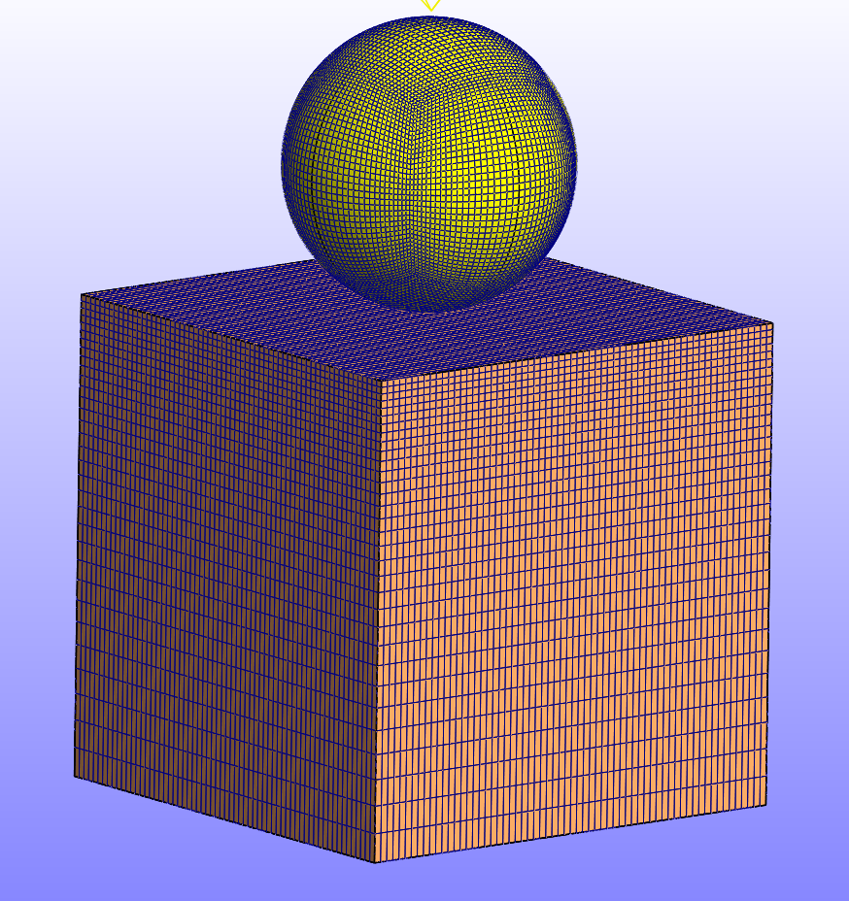
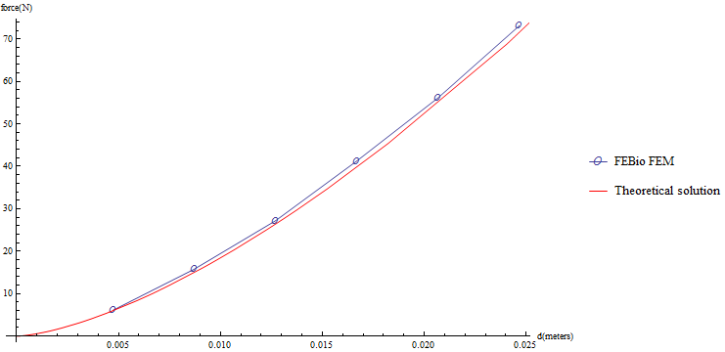
FEBio Experiments
Open-source software suite focusing on biomechanics.
Simulation of 10 time steps of 0.1 s each took over 4 minutes.
Notes:
FEBio is an open-source software suite that is primarily targeted towards biomechanics and biophysics problems with a specific focus on nonlinear large deformation problems in biosolid mechanics. FEBio provides several models and options to represent the non-adhesive Hertzian contact theory. In our experiments, we selected the facet-to-facet sliding algorithm that is based on Laursen’s contact formulation. In this algorithm, the contact constraints are enforced through lagrange multipliers.
The simulation scene for the experiments was recreated in FEBio for the deformable block and the rigid spherical indenter.
The simulation took over 4 minutes for 10 time steps. The node at the middle of the top of the deformable block was tracked for the vertical displacement and the vertical component of the contact force and the obtained load-displacement curve was compared to the theoretical solution. As can be seen from the force – indentation curve obtained through the FEBio application, the results are in very good agreement with the theoretical solution, therefore verifying the usefulness of the Hertzian contact theory as a verification method.

Slide 16
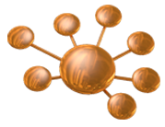
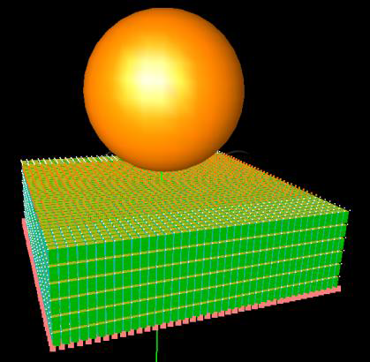
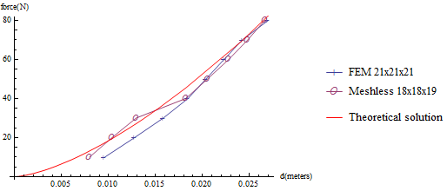
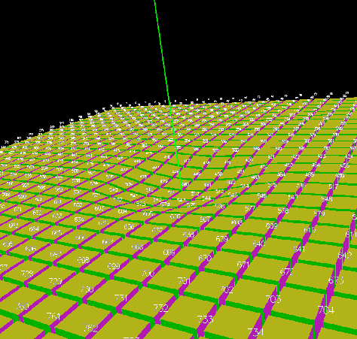
SOFA Experiments
Open-source library focusing on interactive medical simulations.
Notes:
SOFA is an open-source object-oriented software library that is targeted towards interactive medical simulations.
The contact mechanics experiment was setup as a SOFA scene. In order to assess the ground-truth performance of the contact handling in SOFA, the rectangular deformable block was represented with the hexahedral finite element model in addition to the described meshless collocation method. For a given sphere radius, simulations were performed for varying force values (F) applied to the spherical load. With the applied force, the rigid sphere comes into contact with the block and deforms it. The vertical velocity of the sphere is monitored and the indentation of the material (d) is measured when the sphere comes to rest. This F-d pair is recorded and compared to the theoretical solution for both the hexahedral FEM and meshless method cases.
As can be seen from the force – indentation curves, the two results for the SOFA FEM and meshless method implementation show good agreement with the theoretical solution.

Slide 17
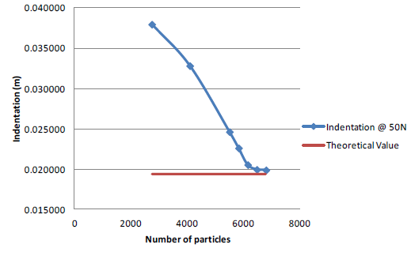
SOFA Experiments
Notes:
We also performed a mesh convergence study for the meshless collocation method by investigating the convergence of the indentation amount to the theoretical value for a fixed amount of force. After around 6000 particles, the indentation value converges to the theoretical indentation value.

Slide 18
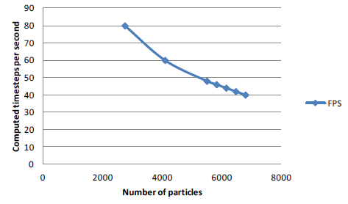
Performance Comparison
Notes:
We compared the SOFA FEM implementation and the meshless collocation method with close accuracy in terms of the required computation times. For our meshless collocation method with nodal integration, we use an explicit time integration scheme with timestep of 0.001s without a stability problem. The calculations are performed within the SOFA application on a single Intel Core i5 cpu running at 2.67 GHz with 16 GB of RAM under Windows 7 operating system. The calculation speed of the numerical algorithm is governed by the number of meshless particles and the number of neighbors assigned to each particle.The SOFA FEM implementation with timestep 0.01s, took 195ms of calculations per timestep, whereas the meshless method with timestep 0.001s, consumed 20.11ms for calculations per timestep. Therefore, the meshless collocation implementation in SOFA (along with other SOFA related operations such as collision detection…etc.) is roughly 25 times slower than the real-time operation, which is slightly better than the 30 times slower performance reported by the Meshless TLED algorithm (with older hardware of course).

Slide 19
What is next?
Meshless collocation methods are appealing even though they suffer from stability issues.
The effect of the distribution of the meshless nodes in such methods is yet to be understood.
The effect of the nodal support radius selection is also an open research question to be investigated.

