Slide 1
Problem statement: parametrized weak form
Exact parametrized elastodynamic problem
Initial conditions:
Boundary conditions:
Space-time quantity of interest:

Slide 2
Problem statement…
Bi/linear forms
Bilinear forms are continuous and coercive.
Assume affine parameter dependence of the bi/linear forms

Slide 3
Finite element discretization
Trapezoidal scheme
“Method of Lines”: spatial discretize (FE) + temporal discretize (Newmark)
Discretize the time span into
Solve following elliptic systems
FE quantity of interest:

Slide 4
RB approximation: Galerkin projection
Introduce ; and nested Lagrangian RB spaces
Galerkin projection:
Solve the following elliptic systems
RB quantity of interest:

Slide 5
Approaches to build goal-oriented basis functions?
Dual Weighted Residual (DWR) method
Solve additionally an adjoint problem
Remove the snapshots cause small error – keep the ones cause large error
Build optimal goal-oriented basis functions based on all POD snapshots
Use adjoint technique to build optimally basis functions based on all POD snapshots
We want to build optimally goal-oriented basis functions without computing/storing all the snapshots?
[Meyer et al. 2003] [Grepl et al. 2005] [Bangerth et al. 2001] [Bangerth et al. 2010]
[Bui et al. 2007] [Willcox et al. 2005]
RB + Greedy sampling strategy
[Rozza, Huynh, Patera 2008]

Slide 6
Standard POD-Greedy algorithm
[Haasdonk et al. 2008] [Hoang et al. 2013]
1) Where: given a set of snapshots the POD space is defined as:
or, written as:
2) Projection error:
3) Residual
Set
Set
While
end.
(k)

Slide 7
Goal-oriented vs. standard POD-Greedy algorithm
Set
Set
While
end.
Set
Set
While
end.
CV process
Asymptotic output error estimation
(k)
(k)

Slide 8
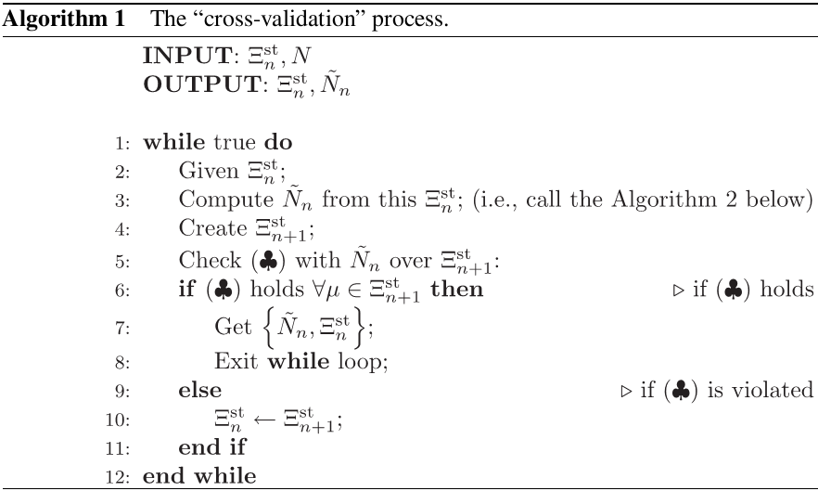
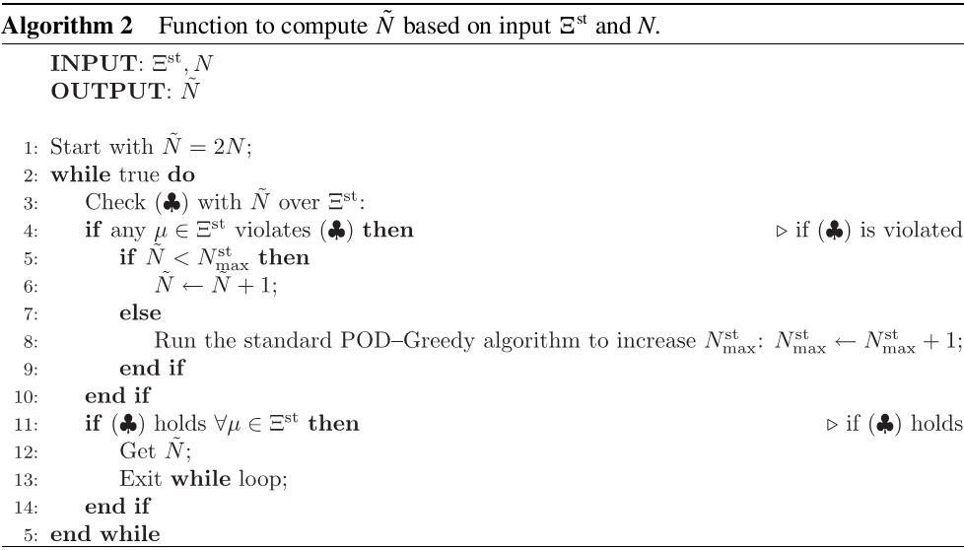
Cross-validation process

Slide 9
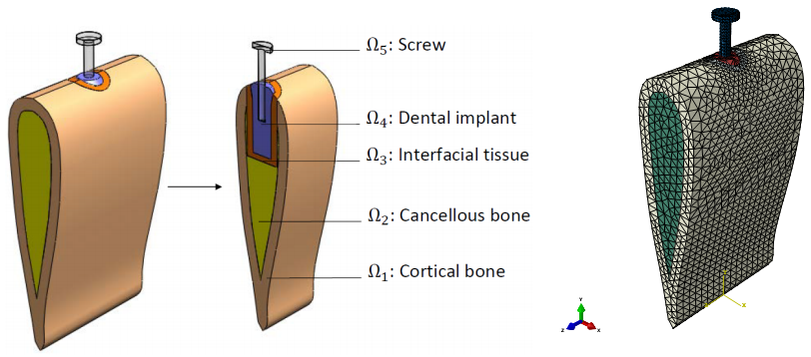
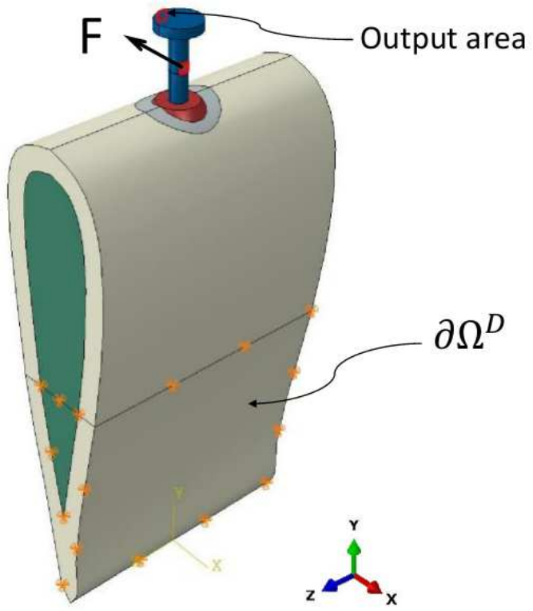
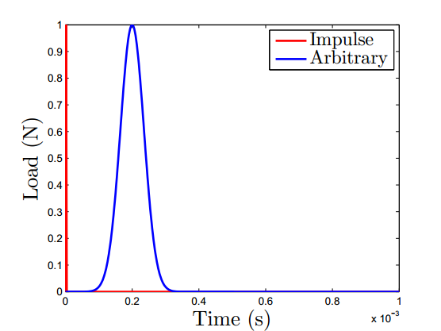
Numerical example: 3D dental implant model

Slide 10
3D Dental implant model problem…
Material properties
Explicit bi/linear forms:

Slide 11
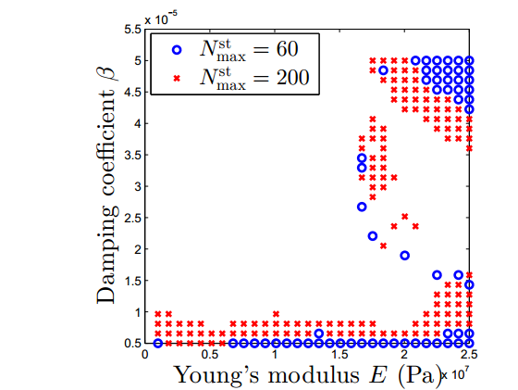
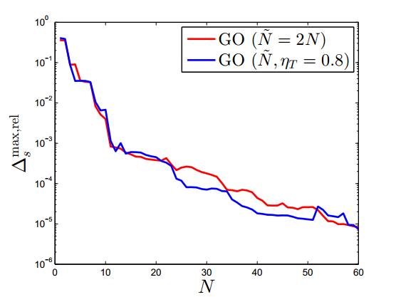
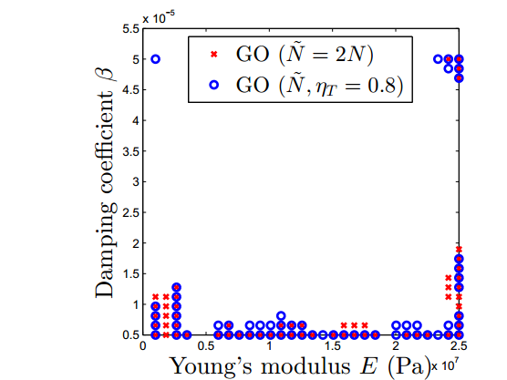
Numerical results…
Standard POD-Greedy algorithm
GO POD-Greedy algorithm

Slide 12
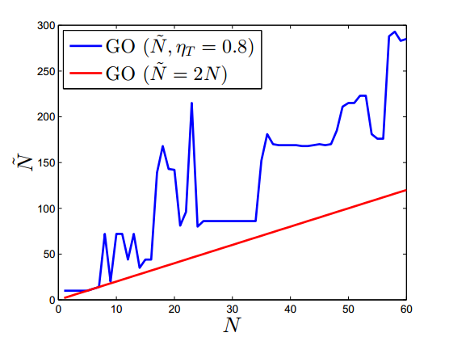
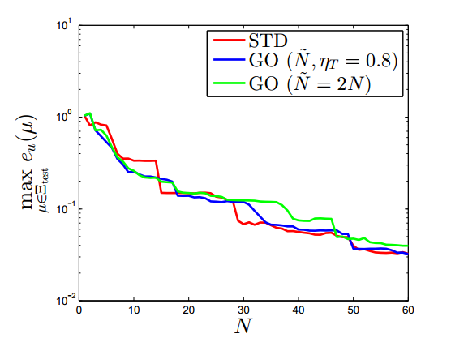
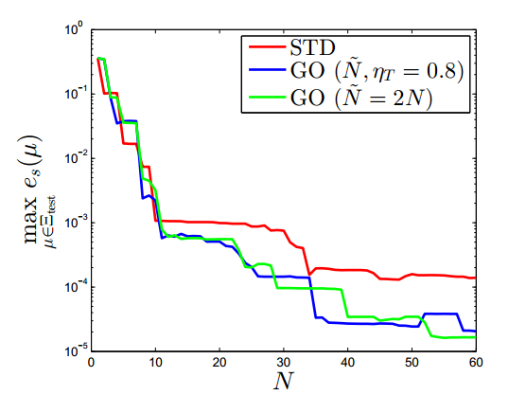
Numerical results…
Cross-validation (CV) process
All true errors of solution and QoI

Slide 13
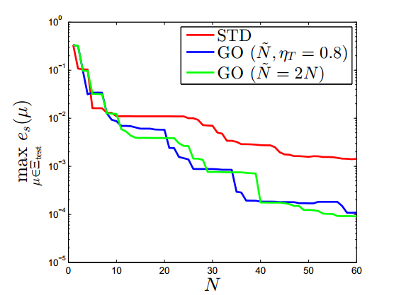
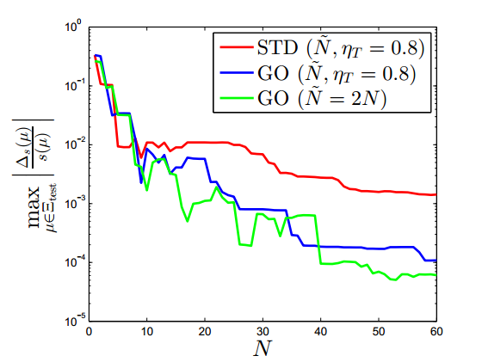
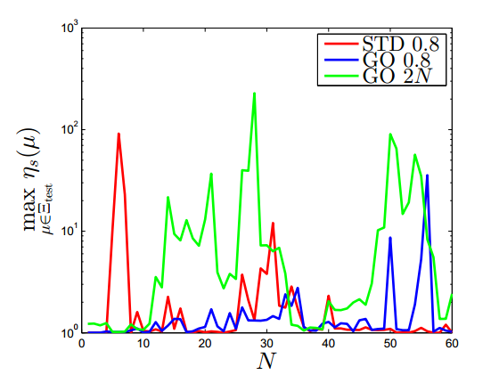
Numerical results: QoI
True errors vs Error approx. for case 1 Gauss load
Max and min effectivities for case 1 Gauss load

Slide 14
Numerical results…
Computational time (online stage)
All calculations were performed on a desktop Intel(R) Core(TM) i7-3930K CPU @3.20GHz 3.20GHz, RAM 32GB , 64-bit Operating System.

Slide 15
References
Wang, S., Liu, G. R., Hoang, K. C., & Guo, Y. (2010). Identifiable range of osseointegration of dental implants through resonance frequency analysis.Medical engineering & physics, 32(10), 1094-1106.
Hoang, K. C., Khoo, B. C., Liu, G. R., Nguyen, N. C., & Patera, A. T. (2013). Rapid identification of material properties of the interface tissue in dental implant systems using reduced basis method. Inverse Problems in Science and Engineering, 21(8), 1310-1334.
Hoang, K. C., Kerfriden, P., Khoo, B. C., & Bordas, S. P. A. (2015). An efficient goal‐oriented sampling strategy using reduced basis method for parametrized elastodynamic problems. Numerical Methods for Partial Differential Equations,31(2), 575-608.
Hoang, K. C., Kerfriden, P., & Bordas, S. (2015). A fast, certified and "tuning-free" two-field reduced basis method for the metamodelling of parametrised elasticity problems. Computer Methods in Applied Mechanics and Engineering, accepted.
Hoang, K. C., Fu, Y., & Song, J. H. (2015). An hp-Proper Orthogonal Decomposition-Moving Least Squares approach for molecular dynamics simulation. Computer Methods in Applied Mechanics and Engineering, accepted.

Slide 16
THANK YOU
FOR YOUR ATTENTION

