Slide 1



Hydrological mass changes inferred from high-low satellite-to-satellite tracking data
Tonie van Dam, Matthias Weigelt
Mohammad J. Tourian
Nico Sneeuw
Adrian Jäggi
Lars Prange

Slide 2
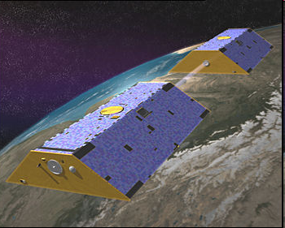
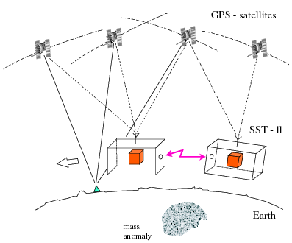
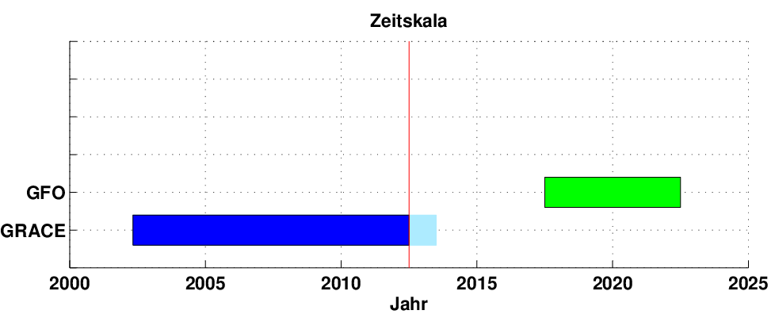
GRACE und GRACE Follow-On (GFO)
Low-low
K-Band (Laser)
GPS
Accelerometer
© CSR Texas
~ 4-5 year data gap (?)
year

Slide 3
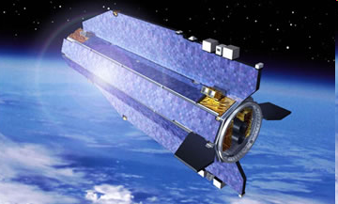
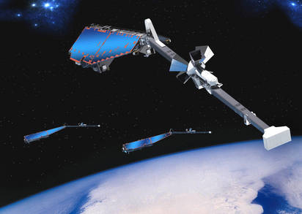
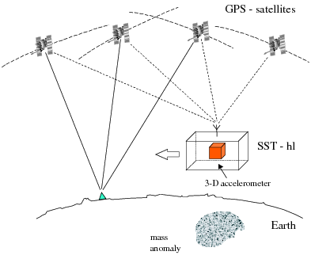
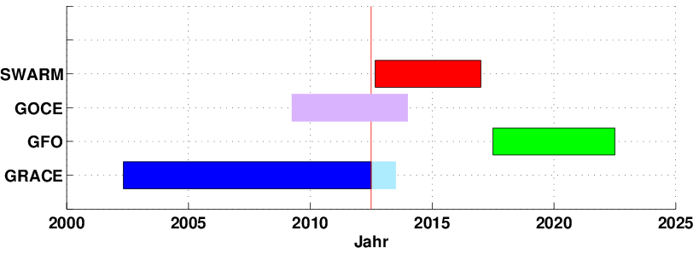
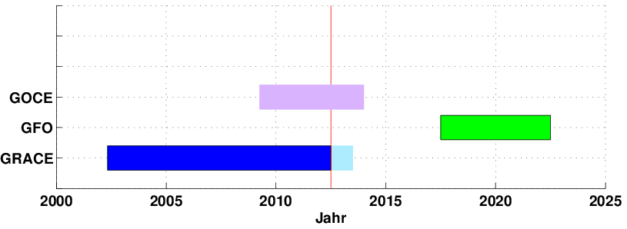
Other gravity field missions
High-low
SWARM
GOCE
© ESA
© EADS Astrium
year
GOCE

Slide 4
CHAMP

Slide 5
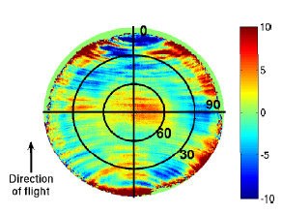
CHAMP reprocessing
GPS positions:
10 s sampling
empirical absolute antenna phase center model
Approach:
acceleration approach
no accelerometer data used
no regularization and no a priori model / information
Prange 2010
Postprocessing with a Kalman filter:
Time series K_{lm}
Trend + mean annual signal
Prediction model
Kalman filtering (Davis et al. 2012)
Process noise
Filtered time series

Slide 6
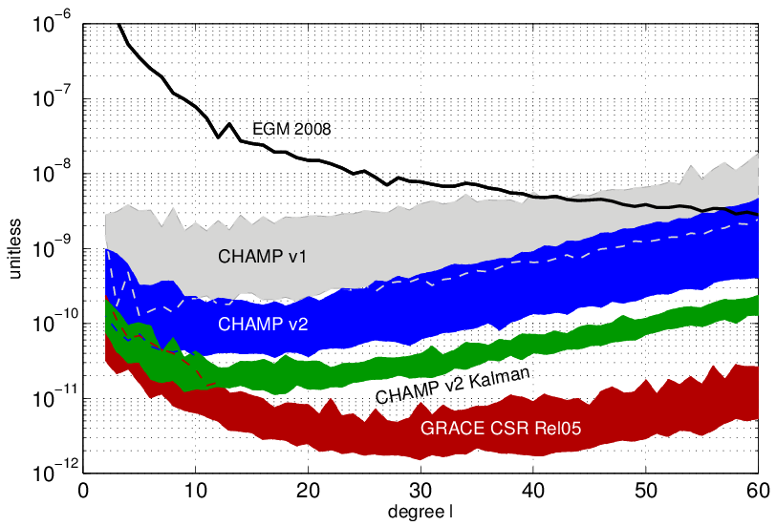
Filtered monthly gravity field solution

Slide 7
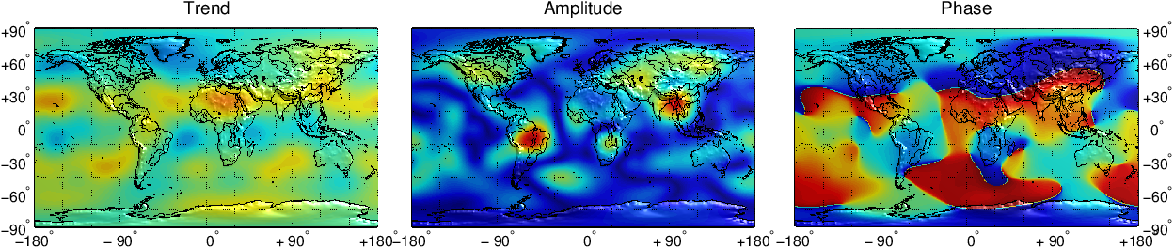
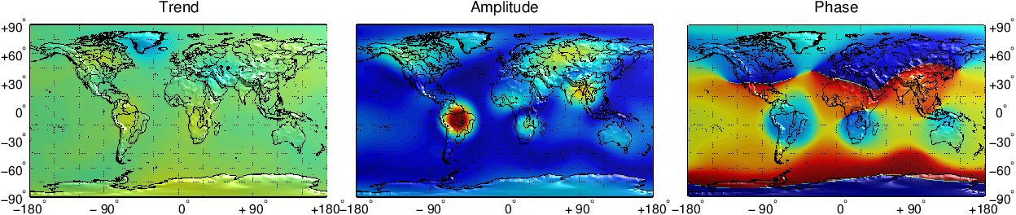
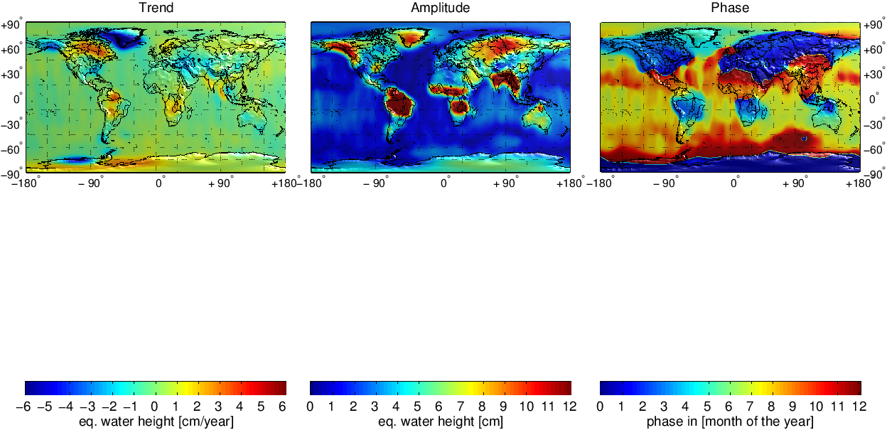
CHAMP vs. GRACE
1400km
CHAMP:
GRACE:

Slide 8
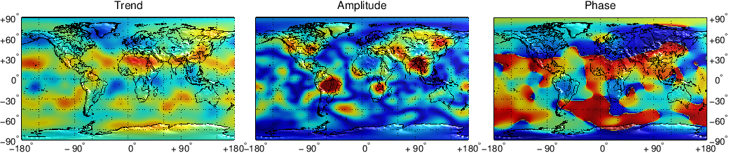
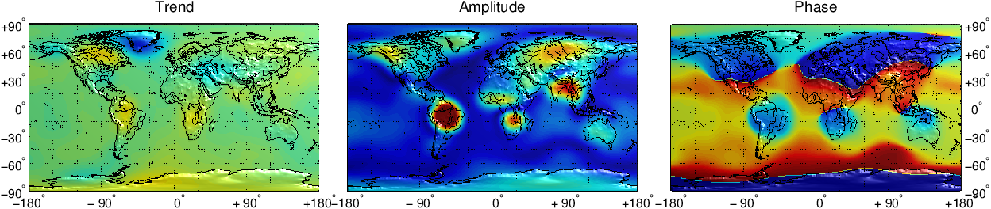
CHAMP vs. GRACE
1400km
1000km
CHAMP:
CHAMP:
GRACE:
GRACE:

Slide 9
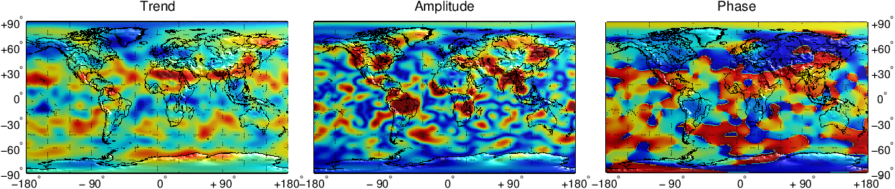
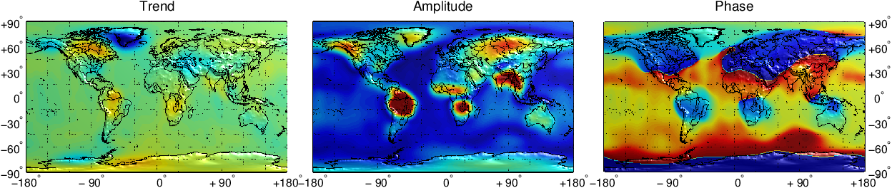
CHAMP vs. GRACE
1400km
1000km
750km
CHAMP:
CHAMP:
CHAMP:
GRACE:
GRACE:
GRACE:

Slide 10
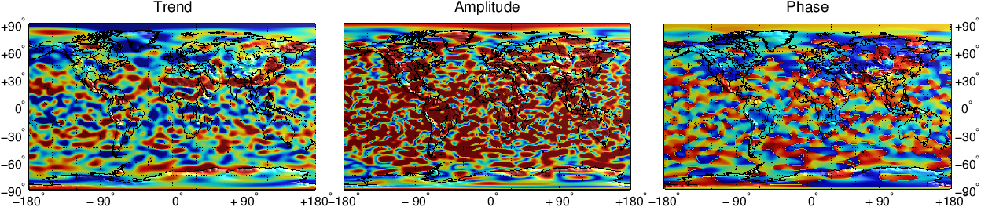
CHAMP vs. GRACE
500km
1400km
1000km
750km
CHAMP:
CHAMP:
CHAMP:
CHAMP:
GRACE:
GRACE:
GRACE:
GRACE:

Slide 11
CHAMP vs. GRACE
500km
1400km
1000km
750km
750km
CHAMP:
CHAMP:
CHAMP:
CHAMP:
CHAMP:
GRACE:
GRACE:
GRACE:
GRACE:
GRACE:

Slide 12
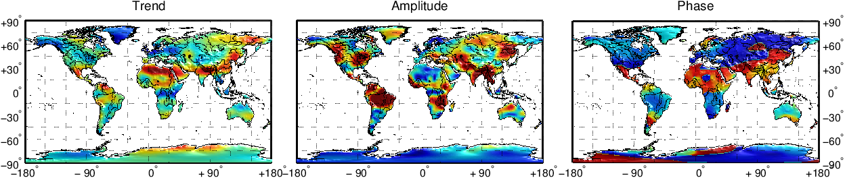
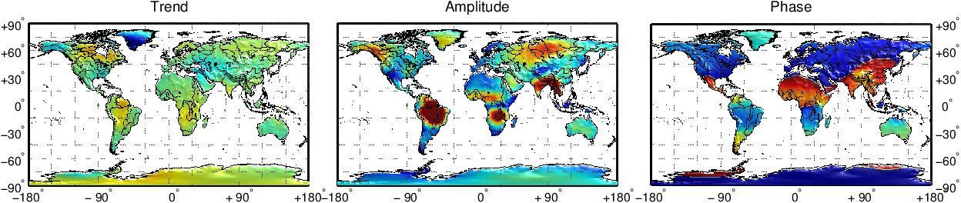
CHAMP vs. GRACE
500km
750km
1400km
1000km
750km
750km
CHAMP:
CHAMP:
CHAMP:
CHAMP:
CHAMP:
CHAMP:
GRACE:
GRACE:
GRACE:
GRACE:
GRACE:
GRACE:

Slide 13
Evaluation with Hydro-Meteorology

Slide 14
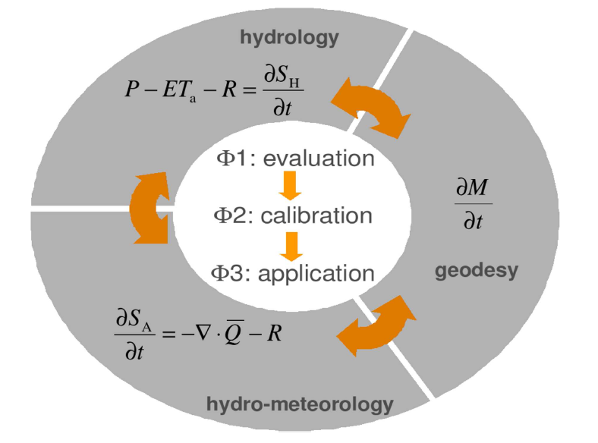
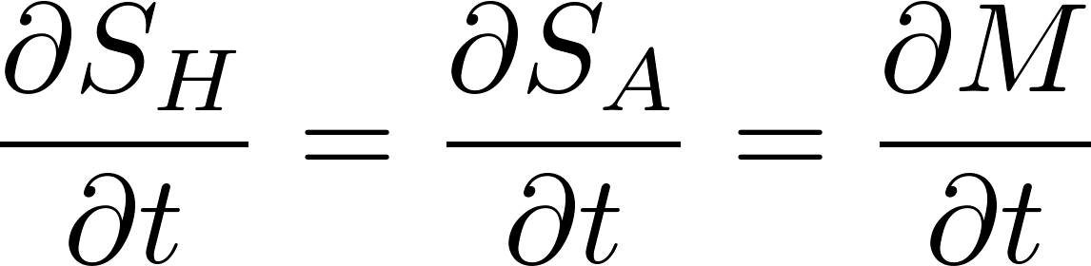

Mass change as a hydrological observable
P | = | precipitation
ET_{a} | = | evapo-transpiration
R | = | runoff
Balance
CHAMP
GRACE
= divergence of vertically integrated moisture flux

Slide 15
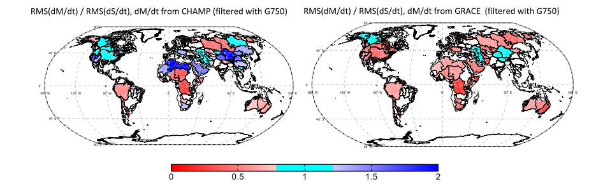
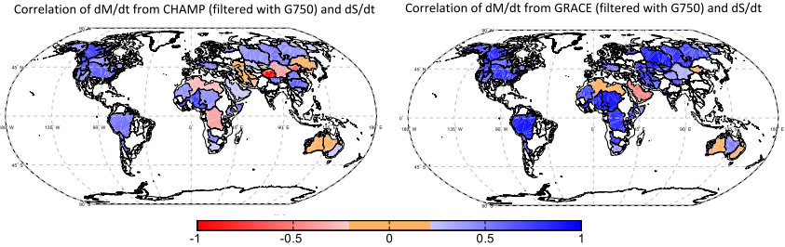
Mass estimate & correlation – 750km

Slide 16
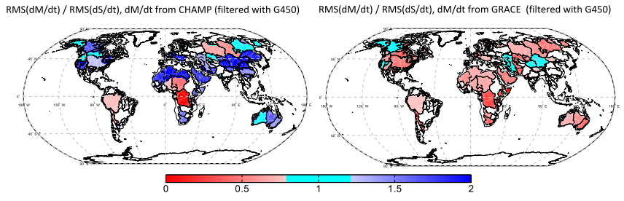

Mass estimate & correlation – 450km

Slide 17
Mass estimate & correlation – 450km
“Optimal” filter radius is catchment and signal dependent (see Tourian 2013)

Slide 18
Evaluation with GPS

Slide 19
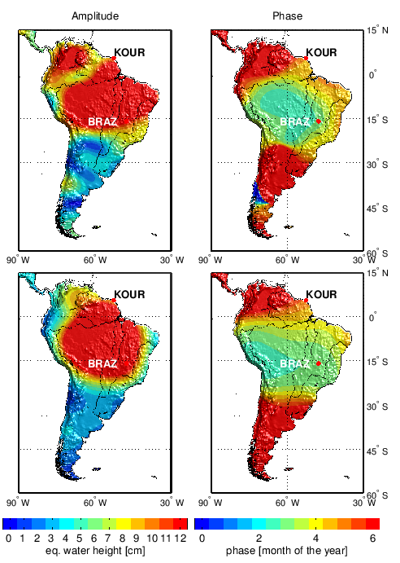
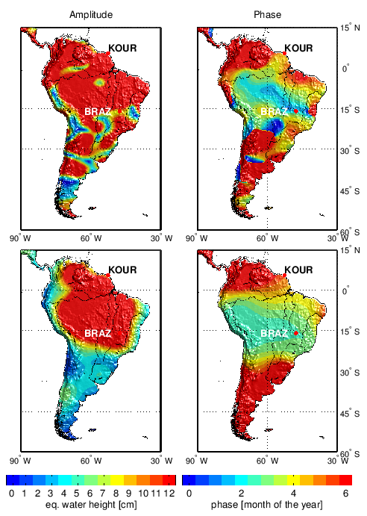
Loading analysis - Amazon
750 km
450 km
CHAMP
GRACE

Slide 20
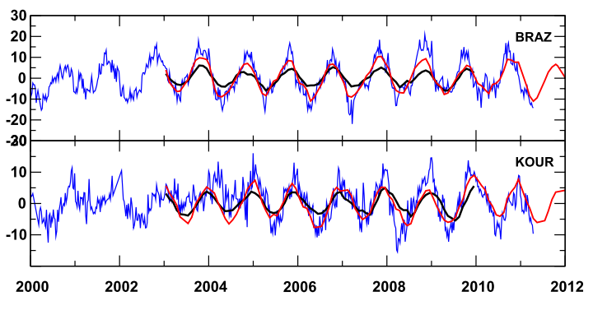
Loading analysis - Amazon
750 km
450 km
Surface displacement - 450 km
GPS
CHAMP
CHAMP
GRACE
[mm]
GRACE
year

Slide 21
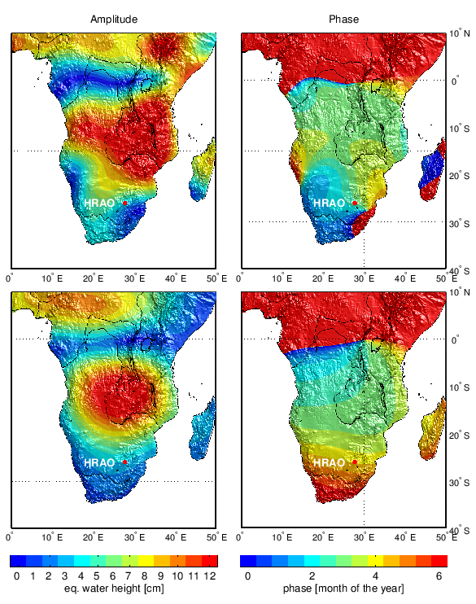
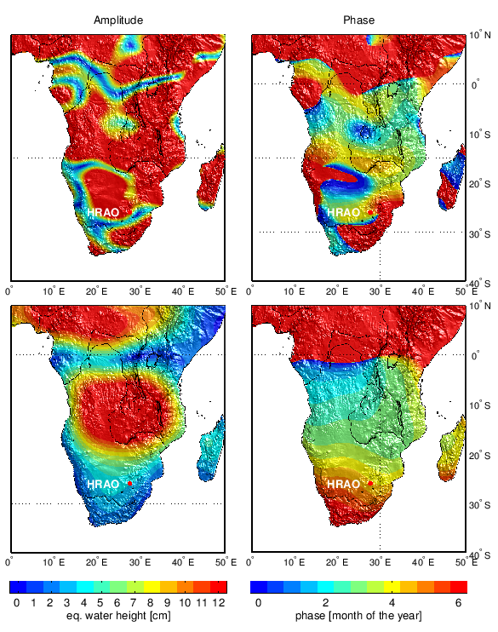
Loading analysis – South Africa
750 km
450 km
CHAMP
GRACE

Slide 22
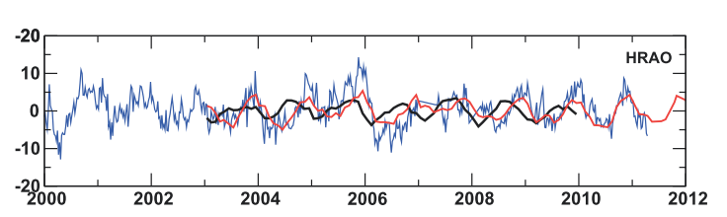
Loading analysis – South Africa
750 km
450 km
Surface displacement - 450 km
CHAMP
GPS
CHAMP
[mm]
GRACE
year
GRACE

Slide 23
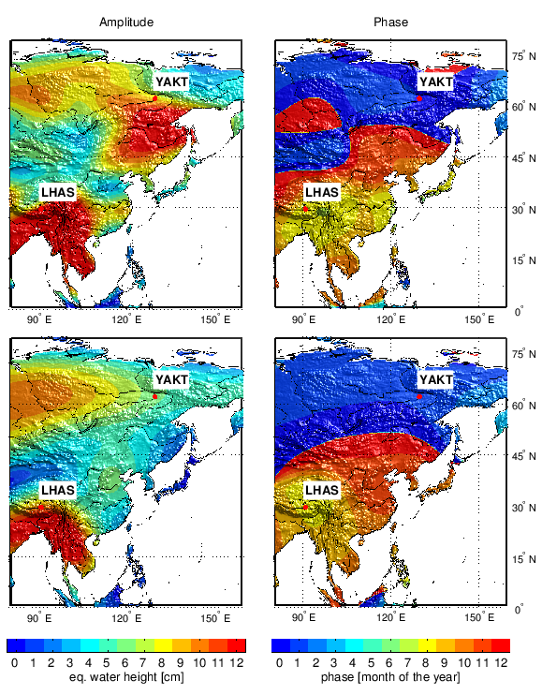
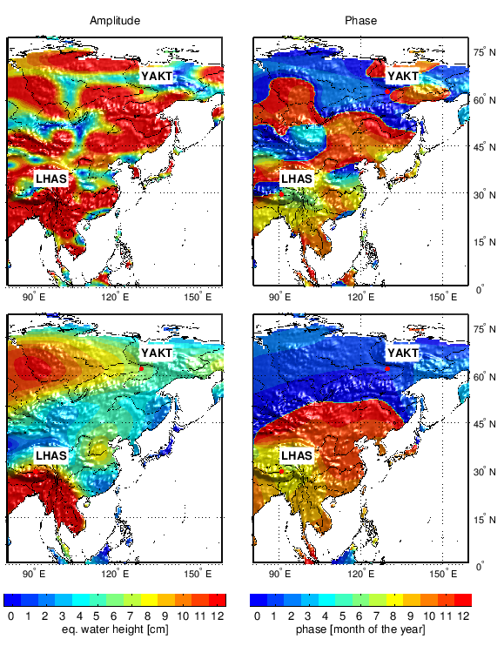
Loading analysis – East Asia
750 km
450 km
CHAMP
GRACE

Slide 24
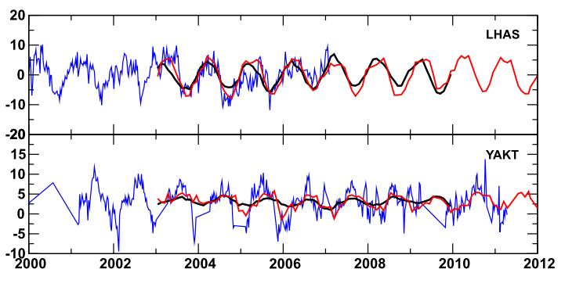
Loading analysis – East Asia
750 km
450 km
Surface displacement - 450 km
GPS
CHAMP
CHAMP
GRACE
[mm]
GRACE
year

Slide 25
Summary

Slide 26
Summary
Time variable gravity field from high-low SST
Long wavelength features
Refinement in the processing possible/necessary
Spatial error pattern needs to be understood
Filter dependency on catchment and application
Processing might include a beneficial smoothing!
Remarkable agreement with hydro-meteorology and GPS
SWARM? GOCE?

Slide 27
Summary

Slide 28
Backup

Slide 29
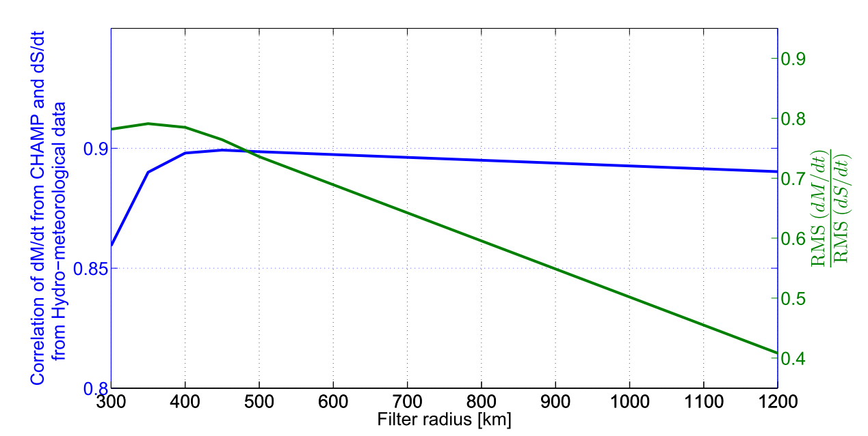
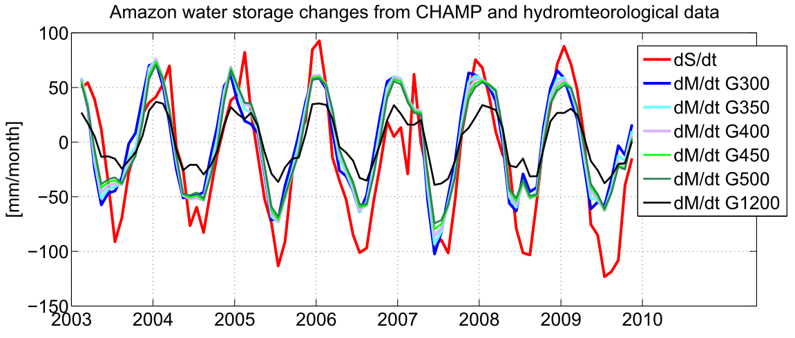
Filter size for Amazon basin

