Slide 1
Smooth nodal stress in the XFEM for crack propagation simulations
X. Peng, S. P. A. Bordas, S. Natarajan
Institute of Mechanics and Advanced materials, Cardiff University, UK
1
June 2013

Slide 2

Outline
Extended double-interpolation finite element method (XDFEM)
Motivation
Some problems in XFEM
Features of XDFEM
Formulation of DFEM and its enrichment form
Results and conclusions

Slide 3
Motivation
Some problems in XFEM
Numerical integration for enriched elements
Lower order continuity and poor precision at crack front
Blending elements and sub-optimal convergence
Ill-conditioning

Slide 4
Motivation
Basic features of XDFEM
More accurate than standard FEM using the same simplex mesh (the same DOFs)
Higher order basis without introducing extra DOFs
Smooth nodal stress, do not need post-processing
Increased bandwidth

Slide 5
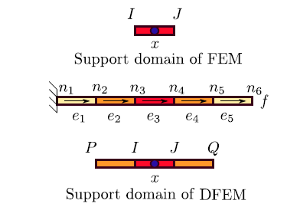

Double-interpolation finite element method (DFEM)
The construction of DFEM in 1D
Discretization
The first stage of interpolation: traditional FEM
Provide at each node
The second stage of interpolation: reproducing from previous result
are Hermitian basis functions

Slide 6
Double-interpolation finite element method (DFEM)
Calculation of average nodal derivatives
For node I, the support elements are:
In element 2, we use linear Lagrange interpolation:
Weight function of :
Element length

Slide 7
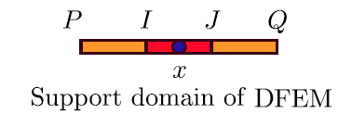
Double-interpolation finite element method (DFEM)
The can be further rewritten as:
Substituting and into the second stage of interpolation leads to:

Slide 8
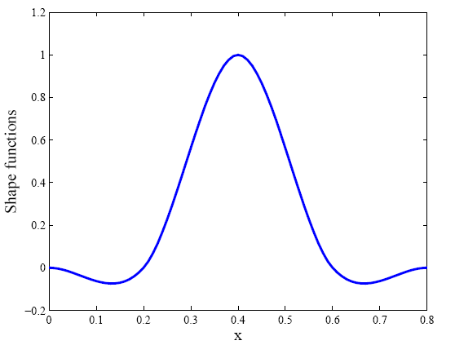
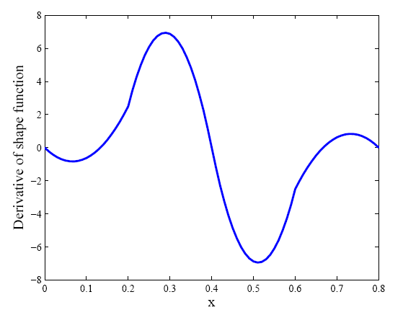
Shape function of DFEM 1D
Derivative of Shape function

Slide 9
Double-interpolation finite element method (DFEM)
We perform the same procedure for 2D triangular element:
First stage of interpolation (traditional FEM):
Second stage of interpolation :
are the basis functions with regard to

Slide 10
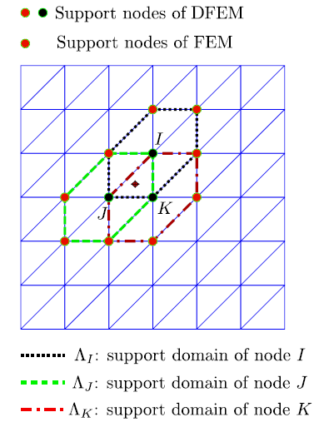
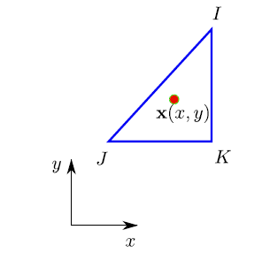
Double-interpolation finite element method (DFEM)
Calculation of Nodal derivatives:

Slide 11
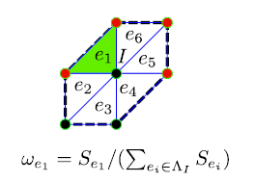
Double-interpolation finite element method (DFEM)
Calculation of weights:
The weight of triangle i in support domain of I is:

Slide 12
Double-interpolation finite element method (DFEM)
The basis functions are given as(node I):
are functions w.r.t. , for example:
Area of triangle

Slide 13
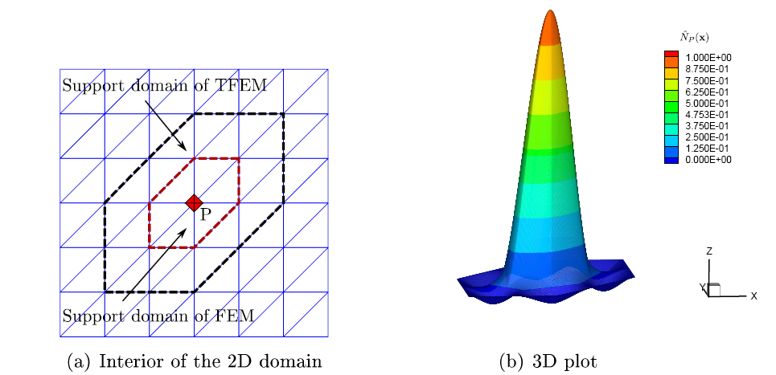
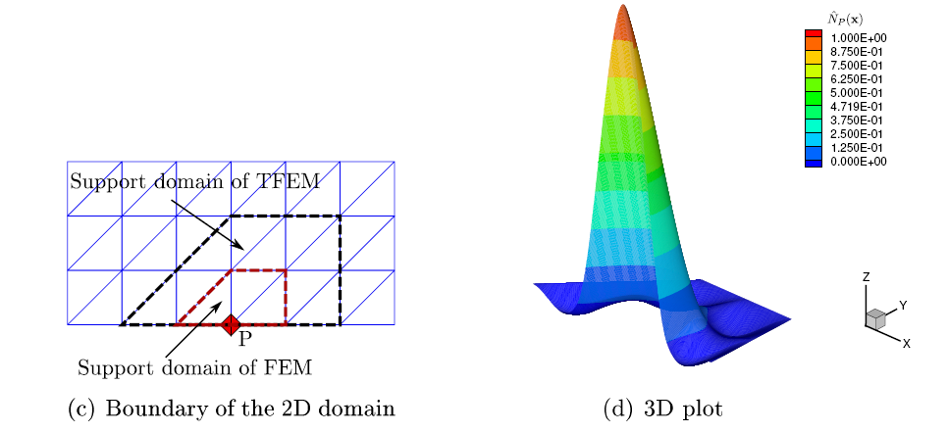
Double-interpolation finite element method (DFEM)
The plot of shape function:

Slide 14
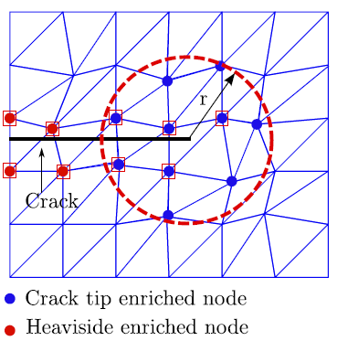
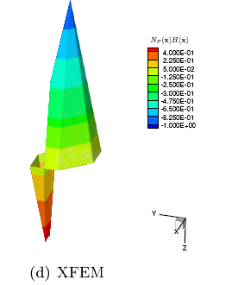
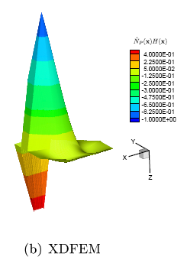

The enriched DFEM for crack simulation
DFEM shape function

Slide 15
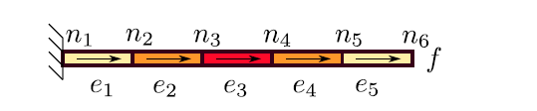
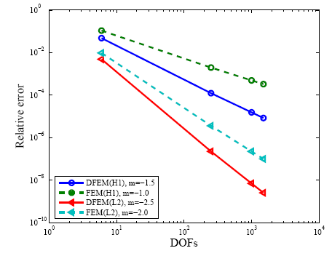
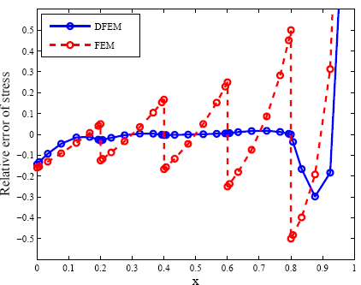
Numerical example of 1D bar
Problem definition:
Analytical solutions:
E: Young’s Modulus
A: Area of cross section
L:Length
Displacement(L2) and energy(H1) norm
Relative error of stress distribution

Slide 16
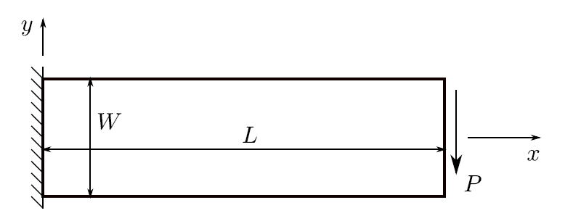
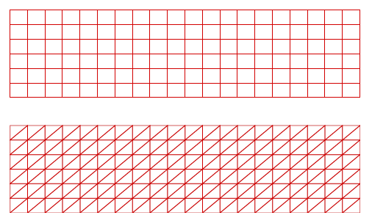
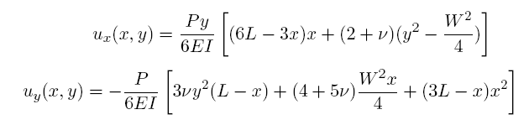
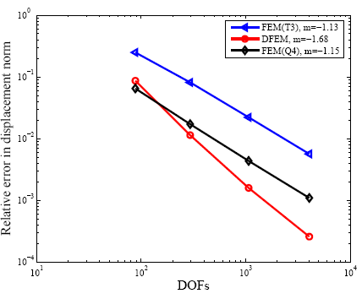
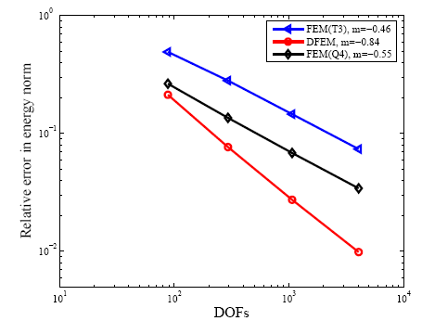
Numerical example of Cantilever beam
Analytical solutions:

Slide 17
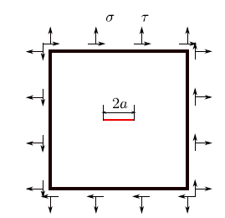
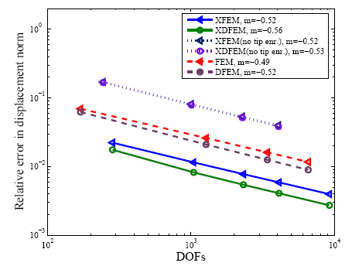
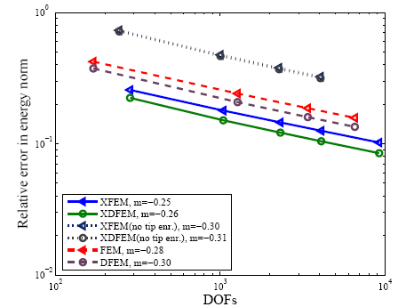
Numerical example of Mode I crack
Mode-I crack results:
explicit crack (FEM);
only Heaviside enrichment;
full enrichment

Slide 18
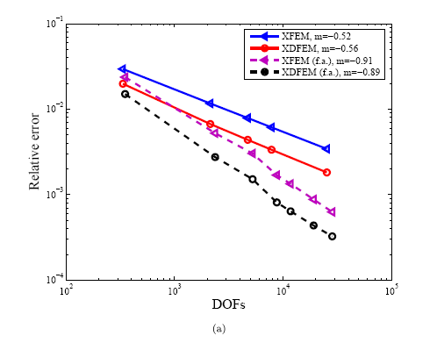
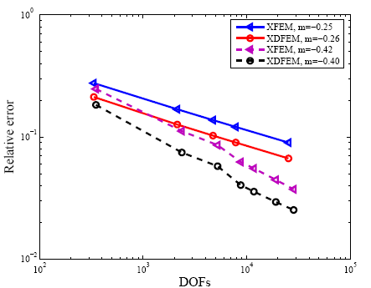
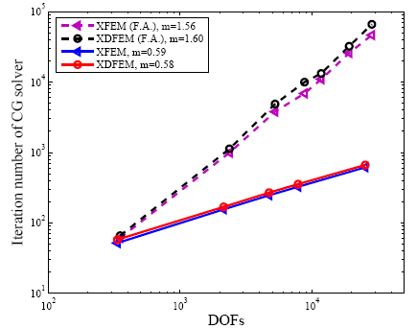
Effect of geometrical enrichment

Slide 19
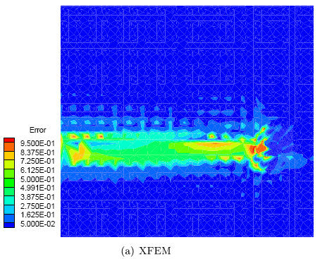
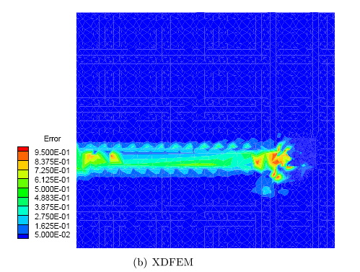
Local error of equivalent stress

Slide 20
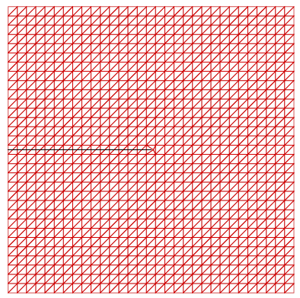
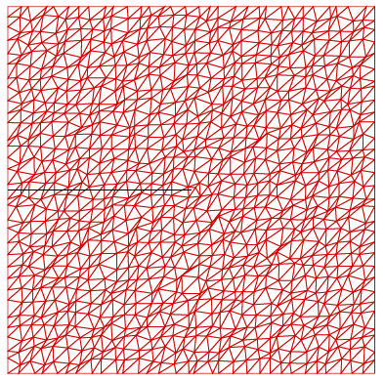
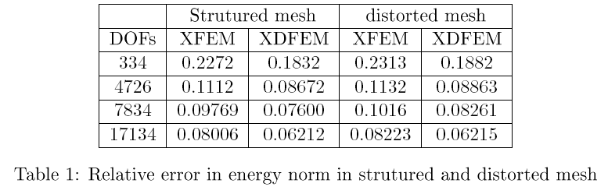

Slide 21
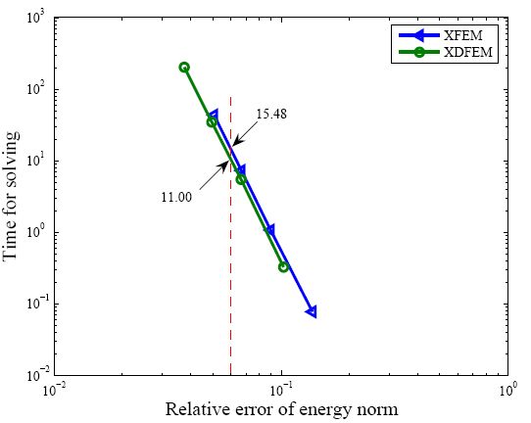
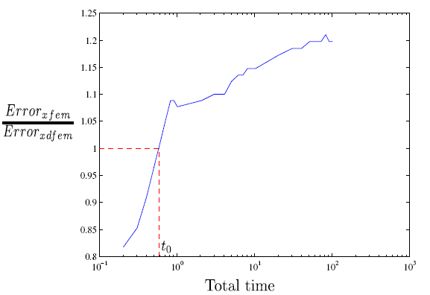
Computational cost

Slide 22
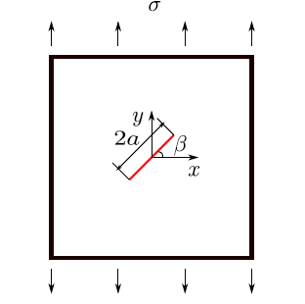
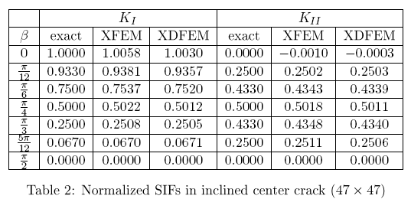
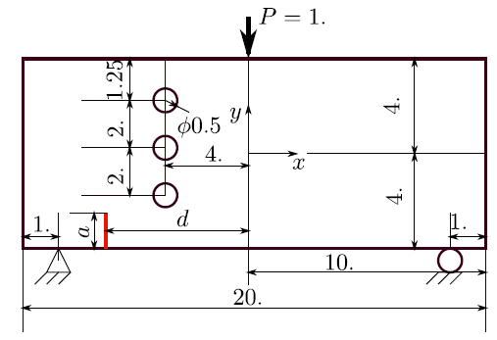


Slide 23
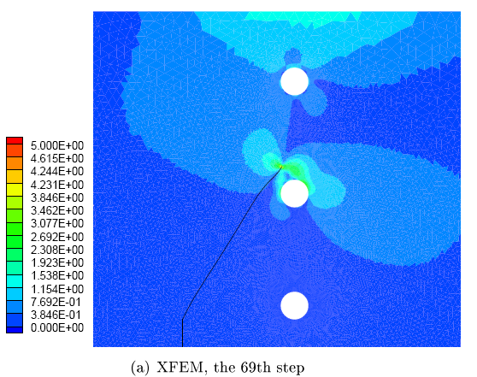
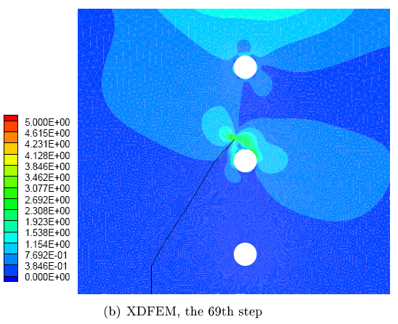

Slide 24
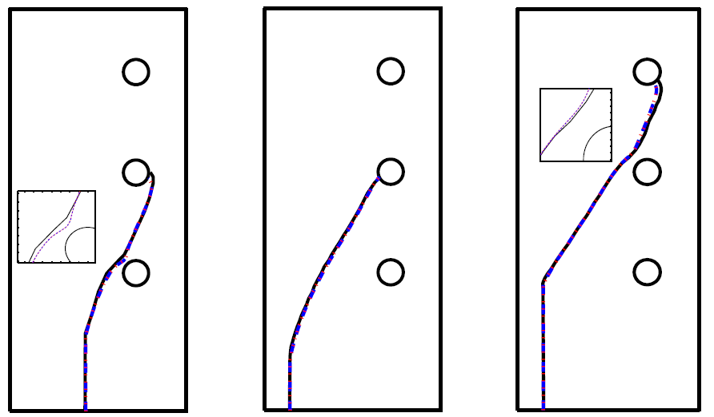




Slide 25
Reference
Moës, N., Dolbow, J., & Belytschko, T. (1999). A finite element method for crack growth without remeshing. IJNME, 46(1), 131–150.
Melenk, J. M., & Babuška, I. (1996). The partition of unity finite element method: Basic theory and applications. CMAME, 139(1-4), 289–314.
Laborde, P., Pommier, J., Renard, Y., & Salaün, M. (2005). High-order extended finite element method for cracked domains. IJNME, 64(3), 354–381.
Wu, S. C., Zhang, W. H., Peng, X., & Miao, B. R. (2012). A twice-interpolation finite element method (TFEM) for crack propagation problems. IJCM, 09(04), 1250055.
Peng, X., Kulasegaram, S., Bordas, S. P.A., Wu, S. C. (2013). An extended finite element method with smooth nodal stress. http://arxiv.org/abs/1306.0536

